Slide 1
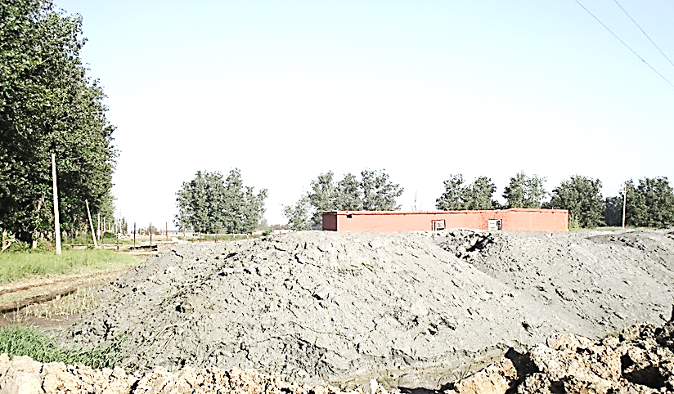
PRESENTATION ON USE of FLYASH in CONSTRUCTION
By
Gopal Varshney C.E., CPWD
CPWD Day

Slide 2
Certain Facts Reg Fly ash
Annual Generation(2020) - 226.13 MT
Anticipated generation (2030) – 900 MT
Utilization - 187.81 MT (83%)
Area occupied (2020)- 65000 Acre
Major Areas of Utilization in construction industry:
Cement – 25%
Bricks & Tiles – 9.46%
Road / Embankment/ Ash Dyke – 19.08%
Reclaiming low lying area – 15.5%

Slide 3
Certain Facts Reg Fly ash
Cost per 50 kg bag- Rs. 85/ Rs240 of OPC
Thermal power plant (Coal + Lignite) account for 54.7 % of total power generation
GST on fly ash product - 5%
Mobile app for availability of fly ash – ASHTRACK

Slide 4
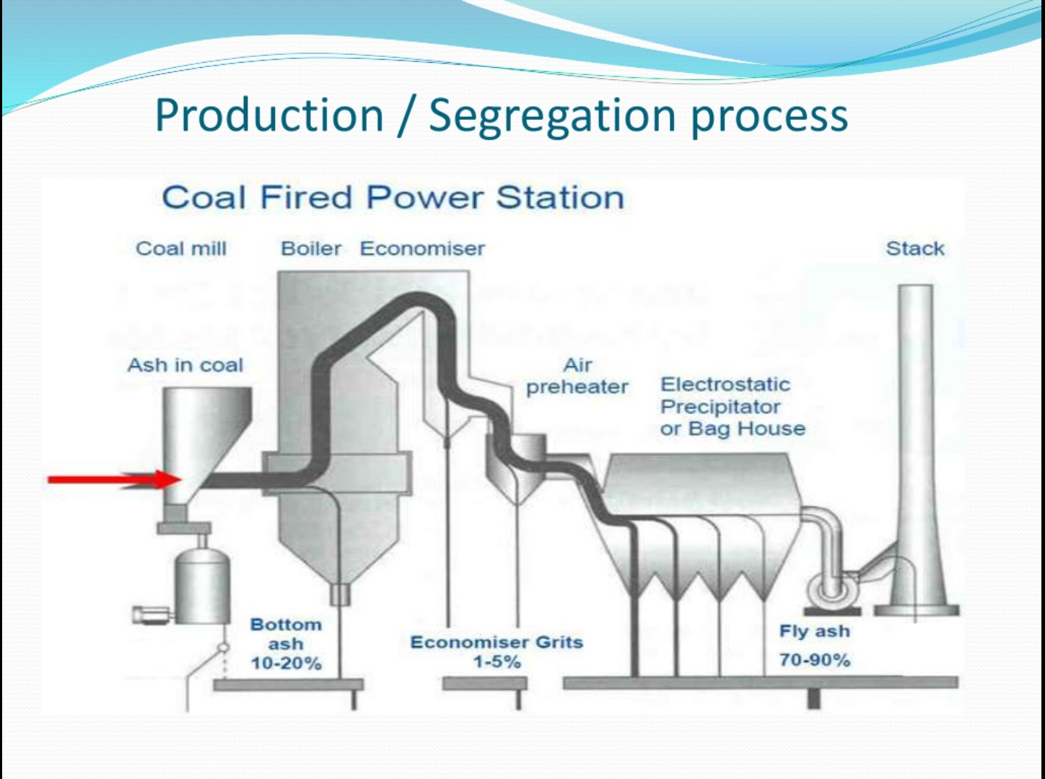
Production process

Slide 5
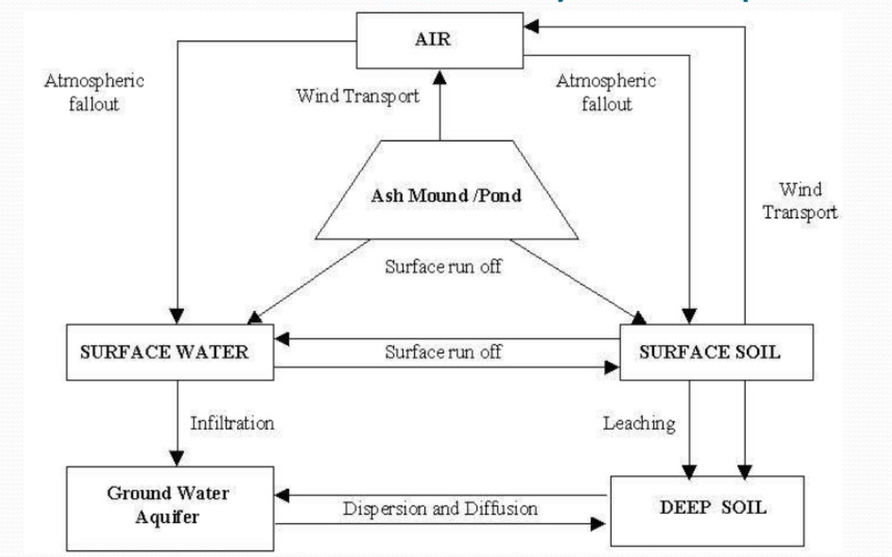
Pollution cycle of fly ash

Slide 6
Environmental consideration of disposal
Fly ash can casus all three environmental risks
Air : Direct emission of toxic chemicals from power plant and wind blown ash dust from mounds
Water : Wet system of disposal from power plant directly into near by surface water system
Ground : Long storage of ash can contaminate under line soil and under ground water

Slide 7
Constituents of fly ash
Silica – Si O₂
Lime – Ca O
Iron – Fe2 O₃
Alumina – Al2 O₃
And certain toxic chemicals

Slide 8
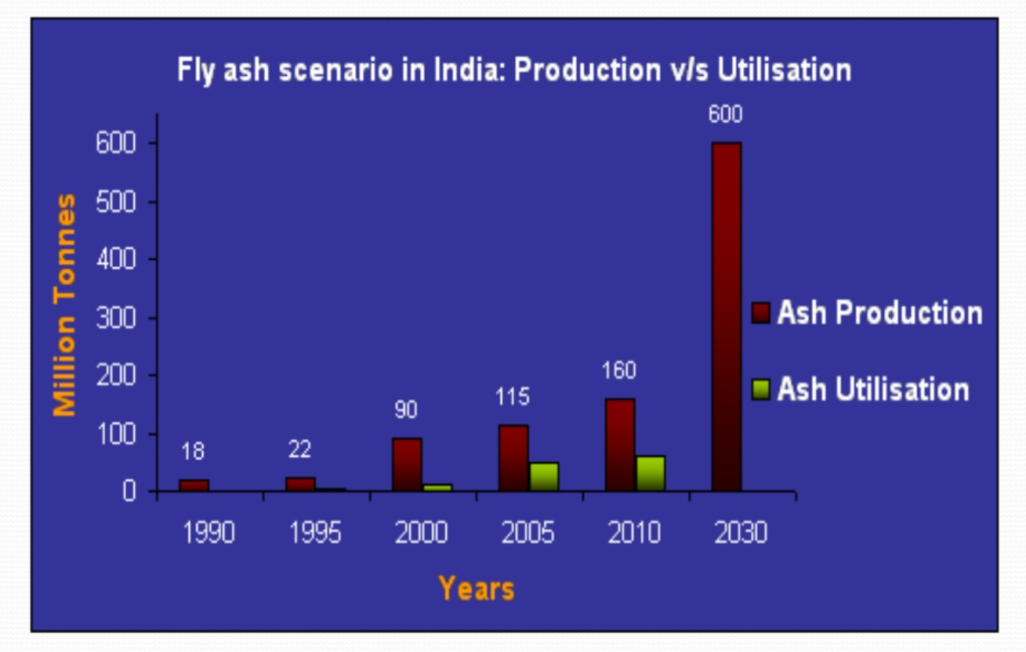
Production v/s Utilization

Slide 9
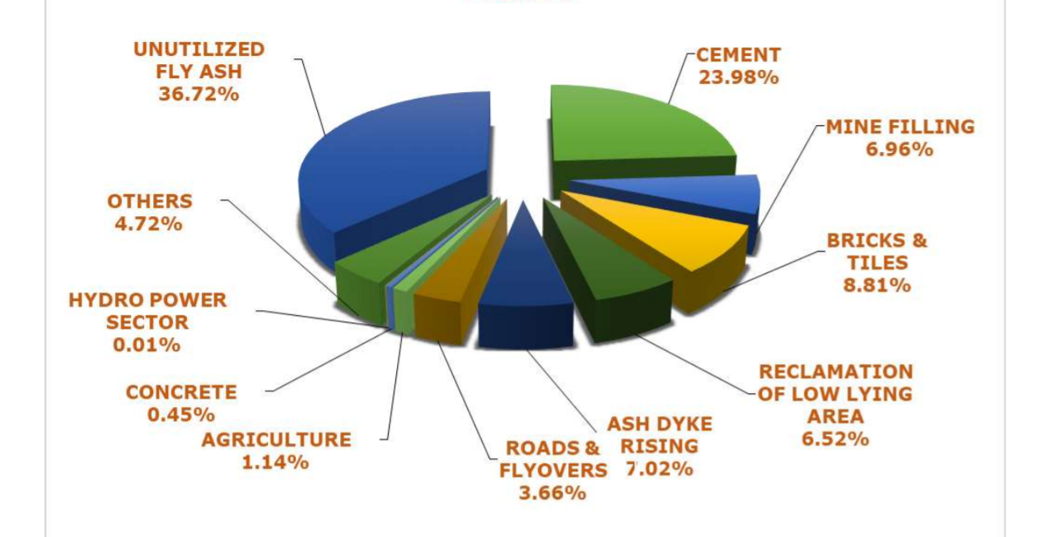
Major Modes of Fly Ash Utilization

Slide 10
Percentage of fly ash used in:
PPC 35 %
Concrete Mix 35 %
Bricks 25 %
AAC block 65%

Slide 11
Fly ash notification- A timeline
1991
Utilized 100% ash in 9 years (by 2009)
Mandatory use by construction agency within 50 km
2003
Radius increased from 50 km to 100 km
2009
Timeline revised for 100% utilization by 2014

Slide 12
Fly ash notification- A timeline
2016
Radius increased from 100 to 300 km
Cost to be borne by thermal plant within 100 km
Equal share from 100 km to 300 km
Timeline extended to 2017
2020 (Draft)
Focus on pollutants rather than construction agencies
100% utilization within next 3 years
In case of none compliance provide fly ash free of cost to construction agency within 300 km and fine of Rs. 1000 per ton

Slide 13
Use of Fly Ash in construction industry
Filling in Road embankment
Filling in plinths of buildings
Fly-ash/FALG bricks
AAC block
PPC
Concrete Mixes
Concrete blocks
Paver blocks
In Base Course in Roads

Slide 14
Advantages of Fly ash
Environment friendly
Highly economical
Fine particles leads to less permeability
More resistance to acid and sulphate attack
Less Shrinkage
Good workability, durability and finish
Less generation of heat of hydration

Slide 15
Disadvantage of Fly Ash
Poor control can lead to
Bad quality
Strength
Increase in permeability
Slower strength gain
(So more advantages than disadvantages)

Slide 16
Fly Ash/Pond Ash
FLY ASH
Fine particles carried along with gases collected by using electrostatic precipitator
Has pozzolanic / silicious properties
Used in replacing cement
POND ASH
Collected in furnace bottom
Embankment filling

Slide 17
Case study – IIT Ropar
Project sanctioned in 2014 for Rs. 1200 crores with plinth area of 232000 sqm
Fly ash bricks, AAC Block, PPC and filling in road embankment

Slide 18
Case study – IIT Ropar
Provision not kept in plinth filling due to fear of sulphate attack on concrete
But huge quantity required due to plinth level of 2 meters, forced reconsideration
Good earth rate – Rs. 400 per cum whereas fly ash for free was available in Ropar Thermal Plant 10 km away from site
The quality of fly ash got tested
The sulphate content found less then the required as per IRC:SP:58-2001

Slide 19
Case study – IIT Ropar
S. no. | Parameters | Range as per IRC 58 | Results of sample
1 | Specific Gravity | 1.90-2.55 | 2.26
2 | Plasticity | Non-plastic | Non-plastic
3 | Maximum Dry Density (gm/cc) | 0.9-1.6 | 1.11
4 | Optimum Moisture Content (%) | 38.0-18.0 | 32.80
5 | Cohesion (kN/sqm) | Negligible | Nil
6 | Angle of Internal Friction (degree) | 30 – 40 | 34.9
7 | Coefficient of Consolidation (cm/ sec) | 1.75x10-5-2.01x10-5 | 1.24x10-4
8 | Compression index | 0.05-0.4 | 0.064

Slide 20
Case study – IIT Ropar
S. no. | Parameters | Range as per IRC 58 | Results of sample
9 | Permeability (cm/sec) | 8x10-6-7x10-4 | 5.14x10-5
10 | Particle size distribution (% of materials)
 | Clay size fraction | 1-10 | 4.8
 | Silt size fraction | 8-85 | 78.4
 | Sand size fraction | 7-90 | 16.8
 | Gravel size fraction | 0-10 | 0
11 | Coefficient of Uniformity | 3.1-10.7 | 7.74
12 | Soluble Sulphate content (gm/litre) | 1.9 | 0.02

Slide 21
Case study – IIT Ropar
Columns casted till bottom of the plinth beam
Filling with pond ash
Three layers of compacted 15 cm depth of pond ash (Dry density 95 %)
Intermediatory layer of 15 cm earth (Soil density 98%)
Top and side layer of 30 cm earth

Slide 22
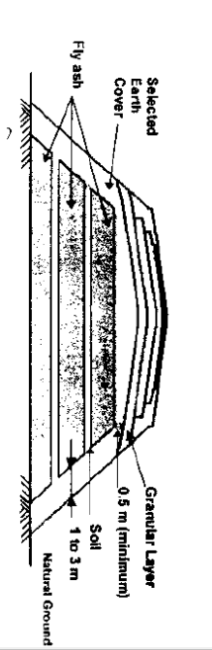
Case study – IIT Ropar

Slide 23
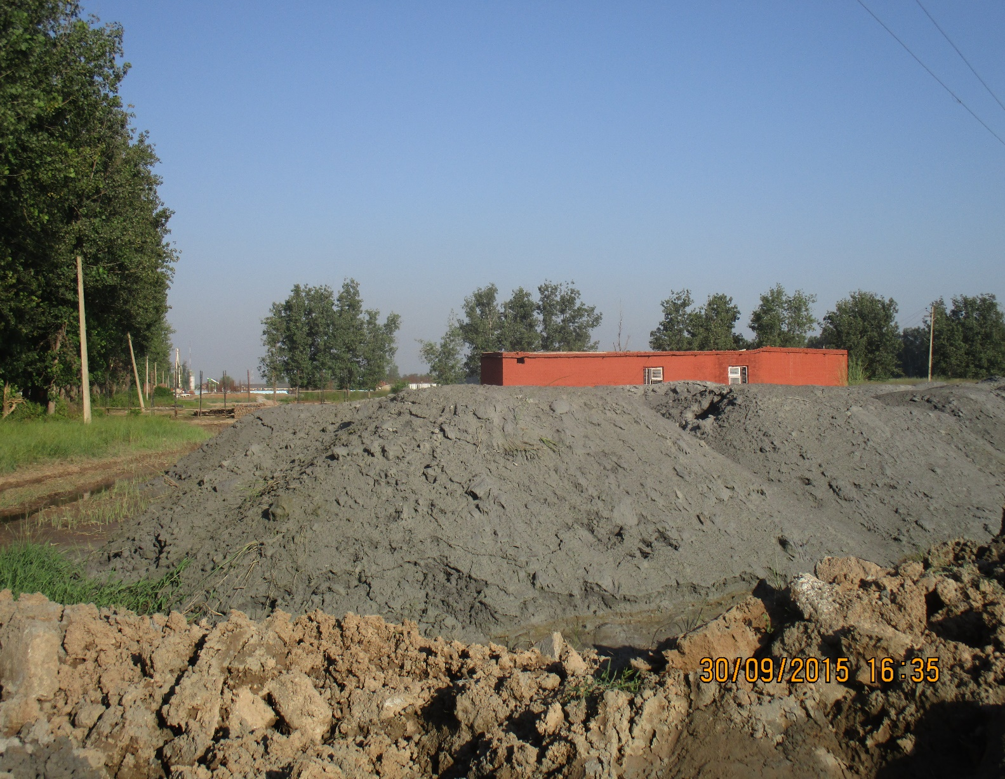
Case study – IIT Ropar
Stacking of pond ash at site

Slide 24
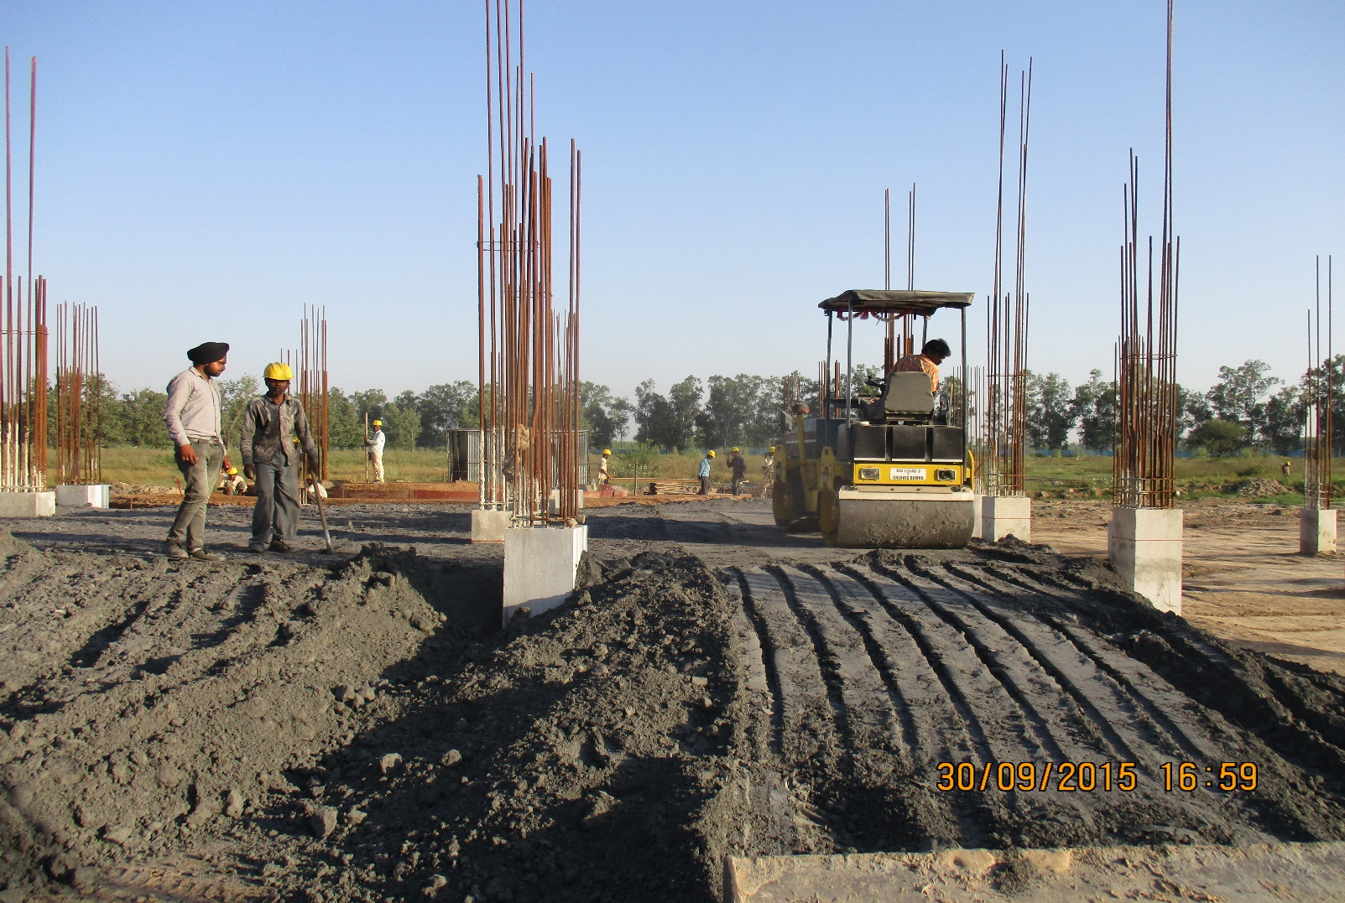
Case study – IIT Ropar
Compaction of layers by roller

Slide 25
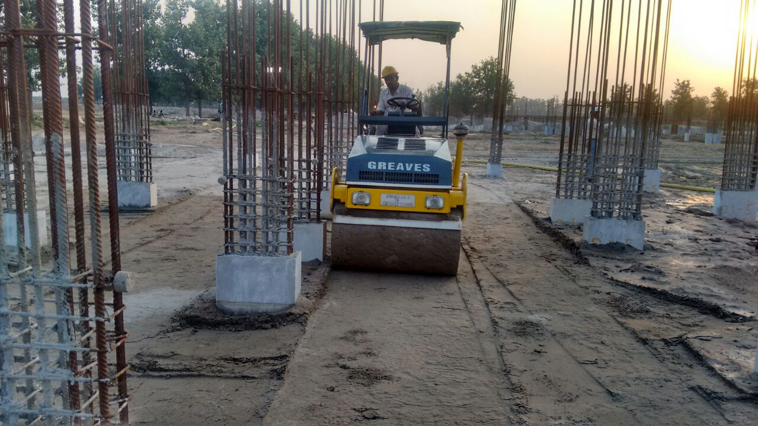
Case study – IIT Ropar
Compaction of layers by roller

Slide 26
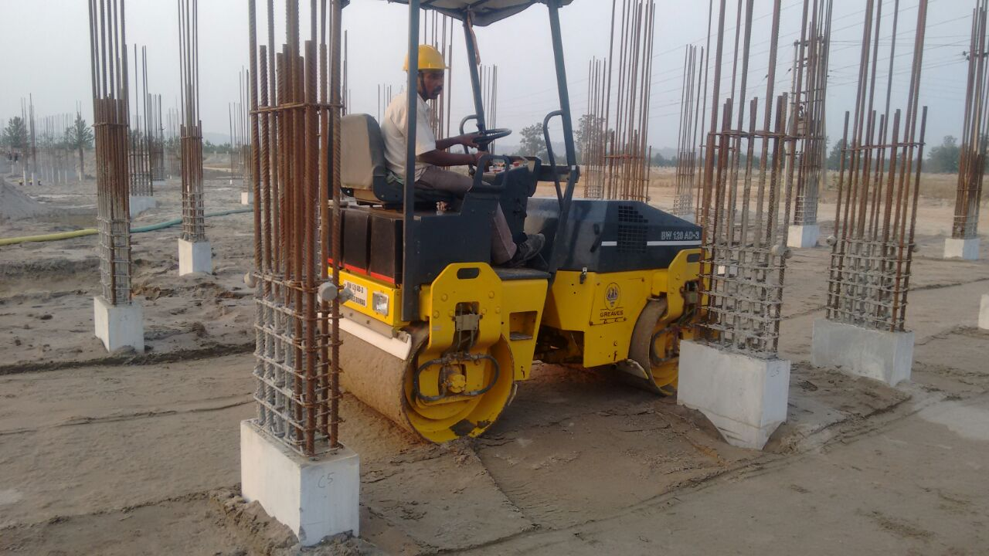
Case study – IIT Ropar
Compaction of layers by roller

Slide 27
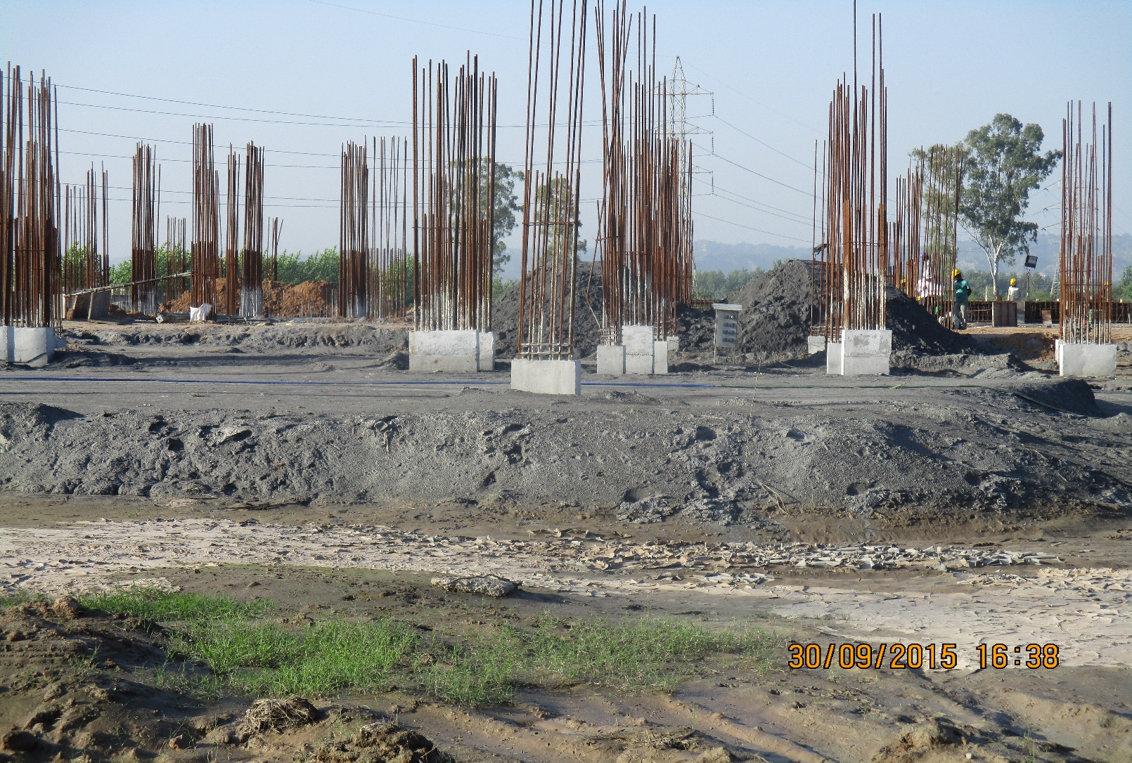
Case study – IIT Ropar
Compacted layers

Slide 28
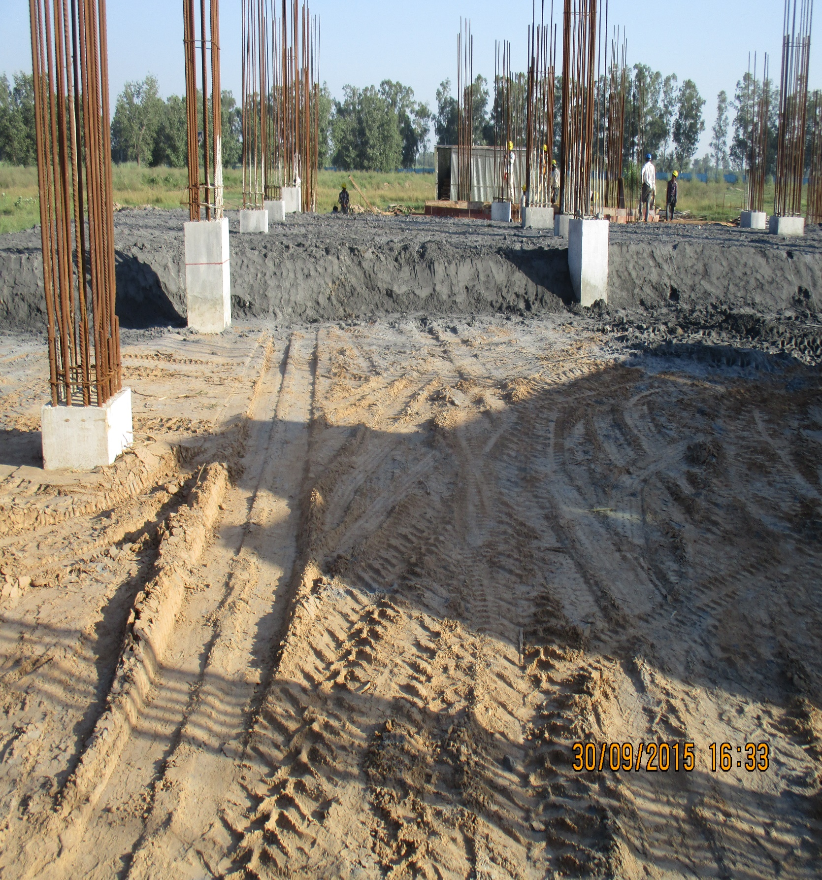
Case study – IIT Ropar
Filling of earth and pond ash in layers

Slide 29
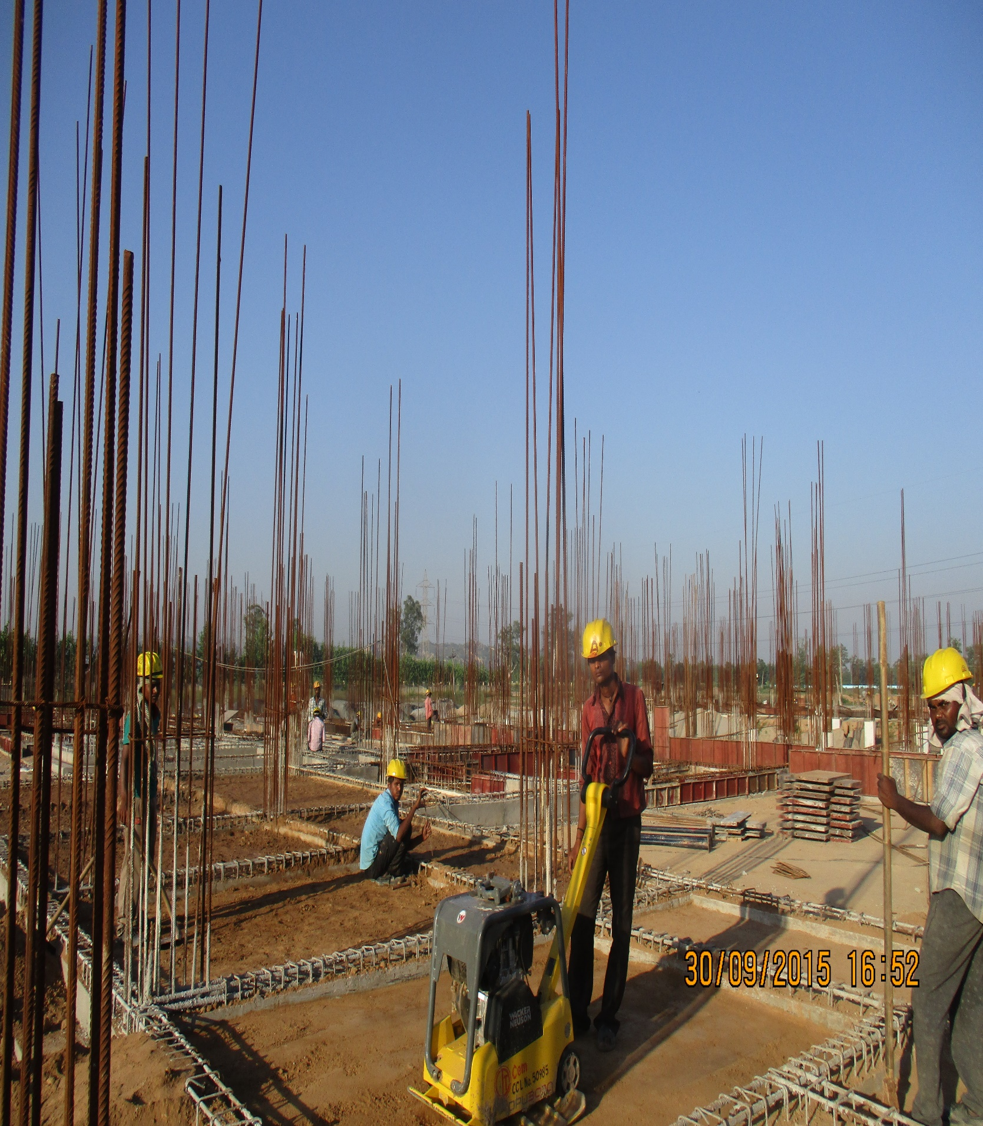
Case study – IIT Ropar
Compaction within plinth with earth compactor

Slide 30
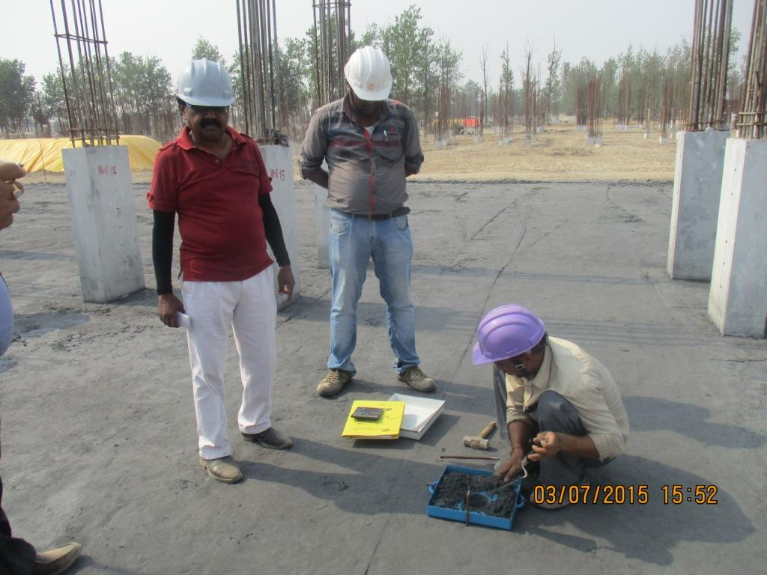
Checking density of fly ash

Slide 31
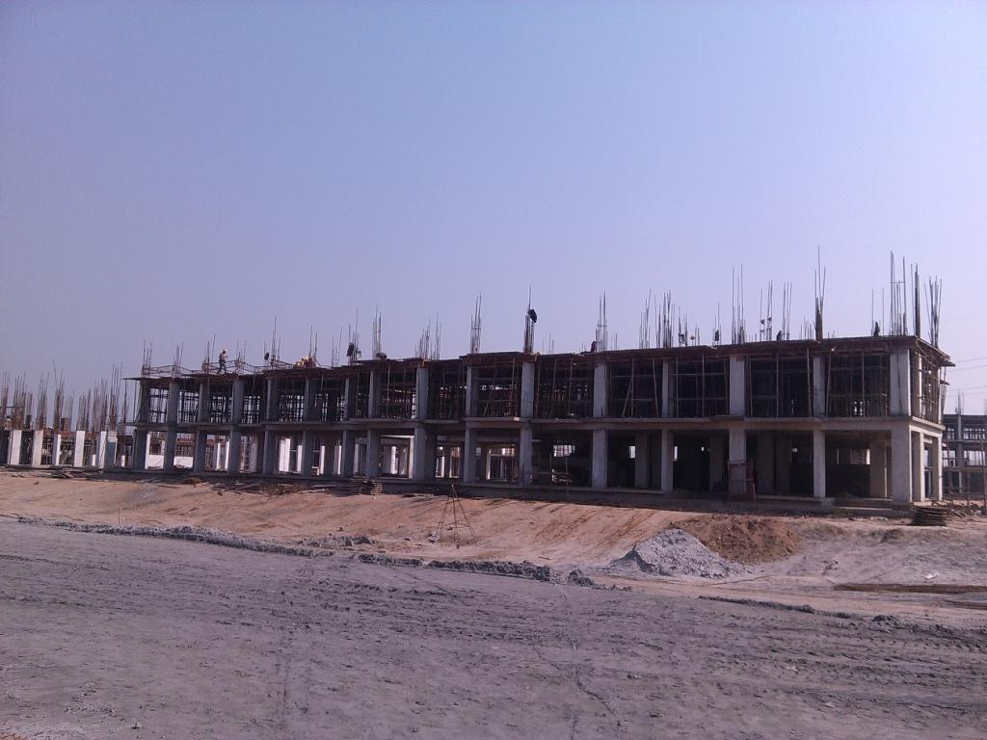
Filling in plinth

Slide 32
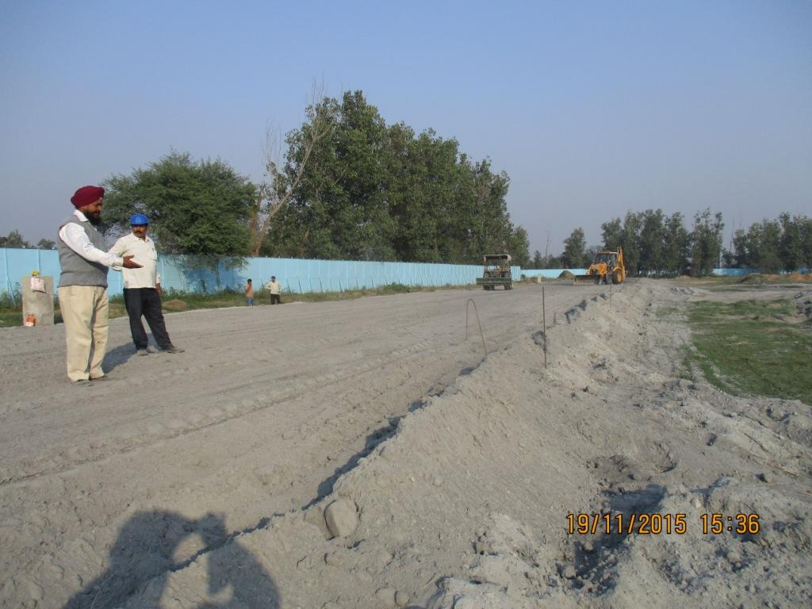
Fly ash in embankment

Slide 33
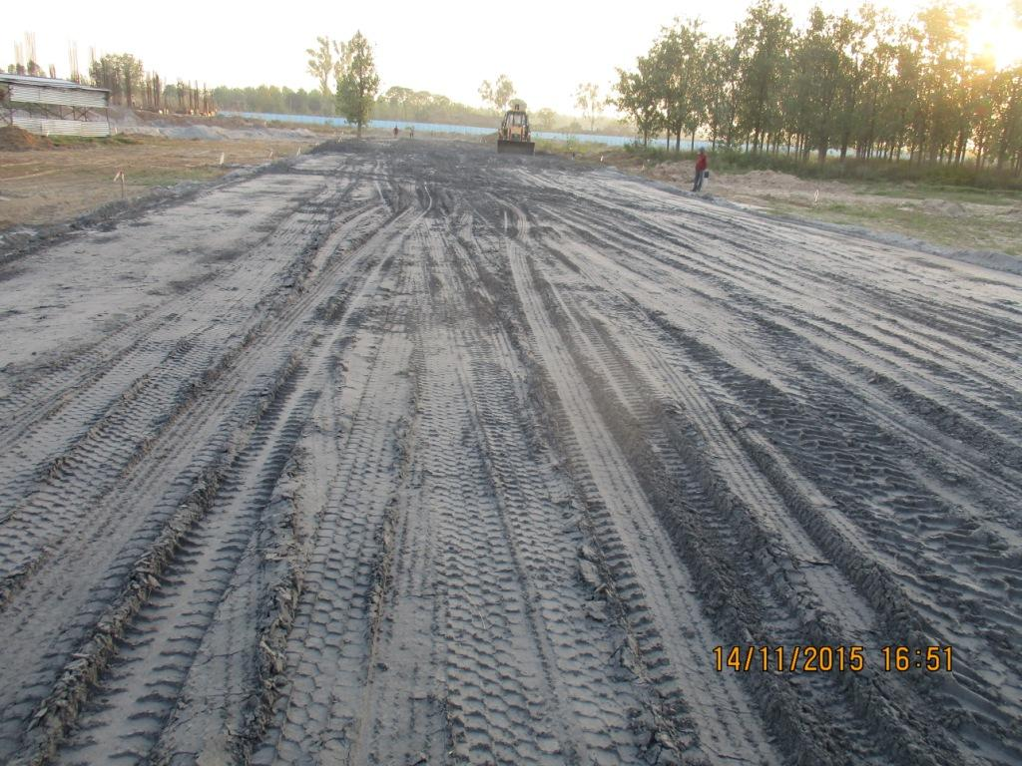
Fly ash in embankment

Slide 34
Use in CAPFIMS till now
Fly ash brick – 2,071 MT
AAC block – 2,227 MT
Fly in concrete mix 25,196 MT
PPC – 3,586 MT

Slide 35
References for usage of fly ash in construction
Road embankment – IRC SP:58-2001
C/o rural roads – IRC SP:20-2003
For use in cement mortar / concrete – IS:3812-2003
Fly ash bricks – IS:12894, IS:16720, IS:13757
For use in base course in roads - IRC:60

Slide 36
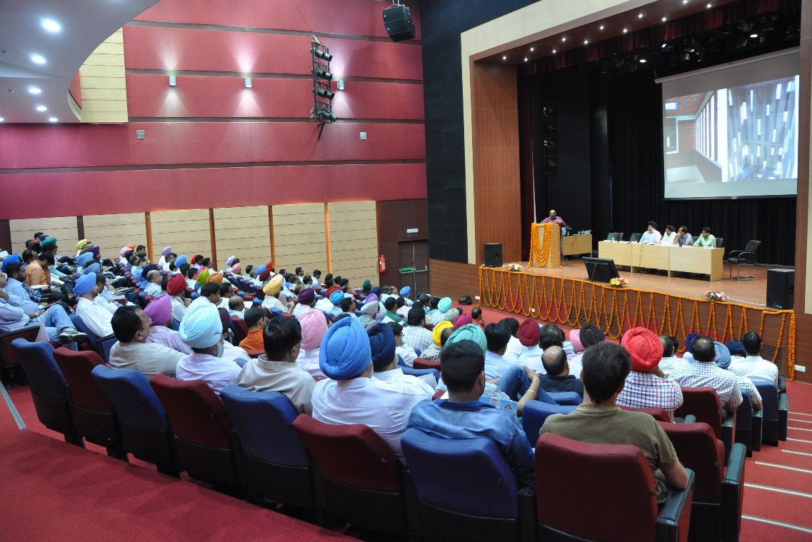
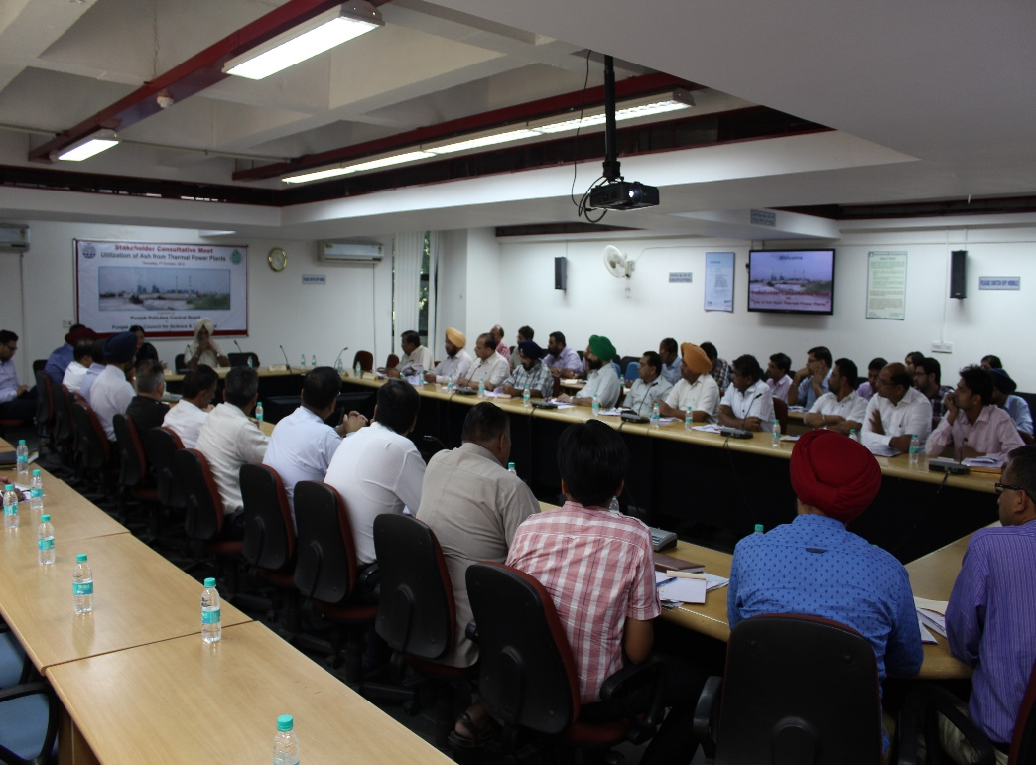
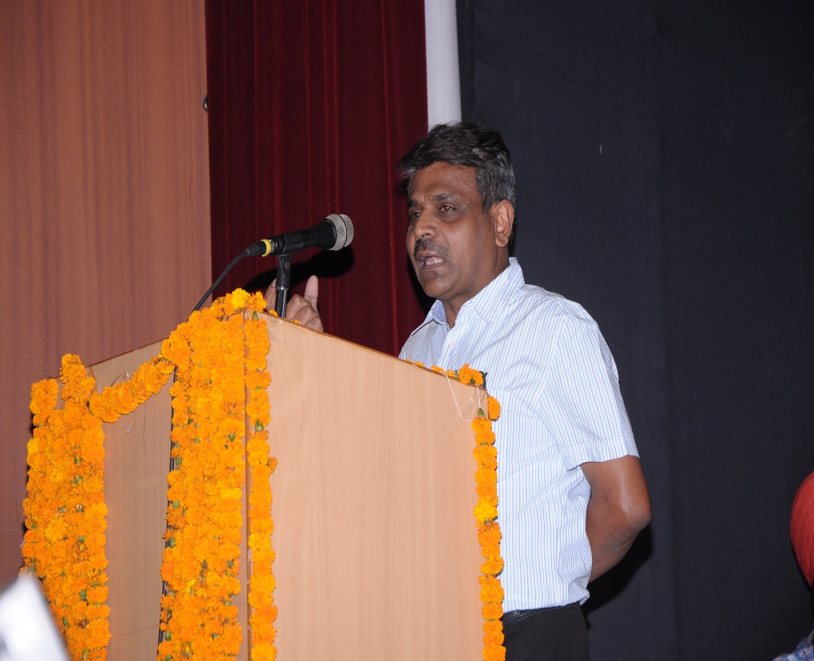
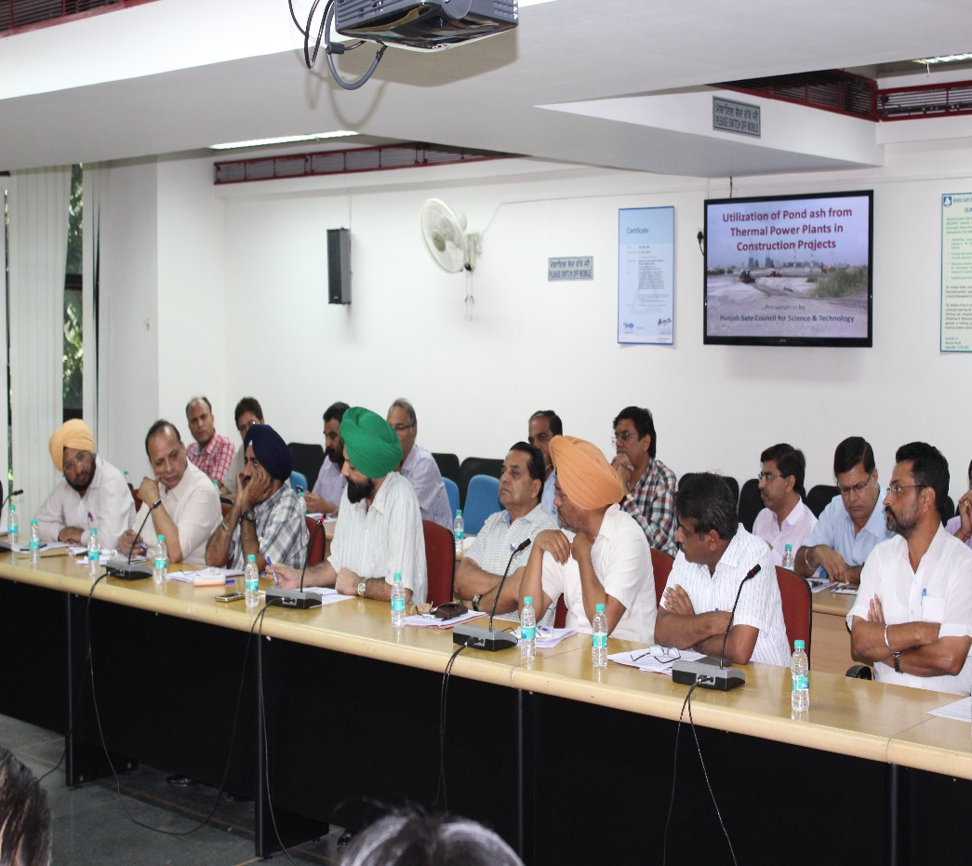

Slide 37
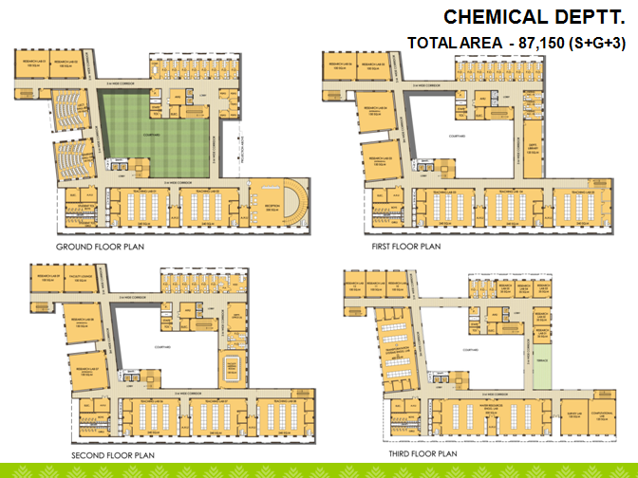

THANK YOU

