Slide 1


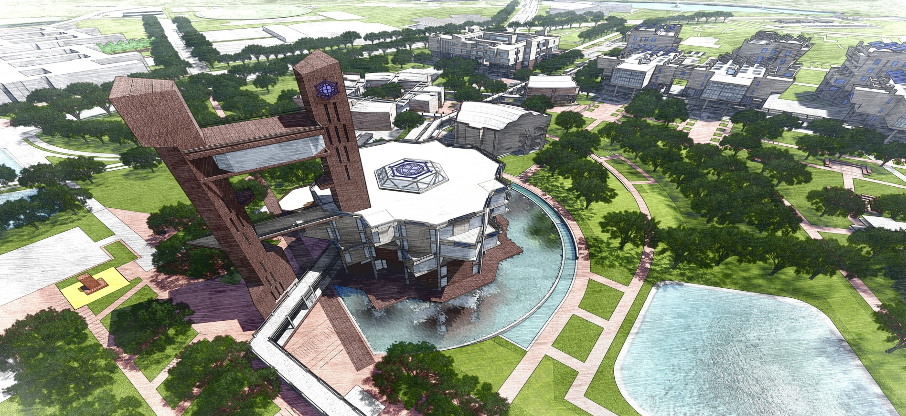
INNOVATIVE TECHNOLOGY AT IIT BHILAI PROJECT
PERMANENT CAMPUS OF IIT BHILAI AT KUTELABHATA, DURG, CHHATTISGARH.PHASE-1 (STAGE-1)
DATE :- 12/7/2021 SE cum PD BHILAI under PROJECT REGION MUMBAI, MUMBAI(M.H.)

Slide 2
PROJECT BRIEF
1 | Client | Director, IIT Bhilai, MHRD
2 | Sanctioned Amount And Date | Rs 758.00 Crore dated 07/03/2020.
3 | Consultants | M/s Kanvinde Rai & Chowdhury- Master Plan and Academic Zone (DP1) . M/s Aadharshila Designs Pvt. Ltd. – Hostel Zone (DP2) M/s Akshaya Jain & Associates – Residential Zone (DP3)
4 | Third Party Quality Control Agency | Wapcos Ltd, PSU under Ministry Of Jal Shakti
5 | Executing Agency | Larsen & Toubro Ltd.
6 | Tendered Amount | Rs. 719.83 Crore
7 | Stipulated Date of Start | 08.07.2020
8 | Stipulated Date of Completion | 07.07.2022
9 | Target Date of Completion | 07.10.2022
10 | Physical Progress upto 30.06.2021 | 31 % achieved against 44.20% planned

Slide 3
SCOPE OF WORK
S. No. |  | Building | No. of floors | Plinth area (sqm)
1. |  | Boundary Wall | -- | 7.36 Km
2. | Academic Buildings (DP1) | Engineering Department (2 Blocks) | G+5 | 17800
 |  | Science Department (2 Blocks) | G+3 | 10700
3.
4. |  | Central Instrumentation Facility | G+2 | 2950
5. |  | CPF | G+2 | 5915
6. |  | 60 & 135 capacity Lecture Hall | G+1 | 3820
 |  | 300 capacity Leture Hall | G+1 | 905
7.
8. |  | 500 capacity Leture Hall | G+1 | 1590
9. |  | Library and Data Centre & Observatory | G+4 & G+10 | 6650
 |  | External Engineering Services (Ancillary Buildings) | -- | 5265
10.
 |  | Access Corridor (1170 m) | G+1 | 4350
11.

Slide 4
S. No. |  | Building | No. of floors | Plinth Area (sqm)
1. | Residential (DP3) | Beta type residential (40 unit) | G+10 | 6779
2. |  | Gama type residential (40 unit) | G+10 | 8769
3. |  | Delta type residential (40 unit) | G+10 | 13465
4. |  | Director’s Residence | G | 646
5. |  | Visitors hostel (20(SS) + 6 (DS)) | G+3 | 3029
6. |  | Health Centre | G+2 | 2105
7. |  | Shopping Centre | G+1 | 2036
8. |  | Faculty /Institute Club | G | 690
9. | Hostel Buildings (DP2) | Boys hostel 1 (480 bed) | G+3 | 12262
10. |  | Boys hostel 2 (480 bed) | G+3 | 12652
11. |  | Girls hostel 1 (380 bed) | G+3 | 9051
12. |  | Married Student’s Housing (96 ) | G+3 | 6097
13. |  | Mess Block | G+1 | 5218
 |  |  | TOTAL | 1,42,744

Slide 5
EXTERNAL ENGINEERING SERVICE
A. CIVIL 1. Ancillary Buildings Water treatment plant including pump room and underground tank (14,40,000 litres) Underground tank (7,40,000 litres) & pump room, academic area Main receiving sub station (MRSS) Electric sub -station & plant room, Academic area Electric sub stations, for Residential & Hostel area. 900 KLD Sewage Treatment Plant including pump room based on MBBR technology. Meter room, Security Complex, Watch Towers & Security Cabins Telephone exchange building | E & M SERVICES Internal electrical installation HVAC Lifts Fire Fighting Automatic Fire Alarm System Substation & HT/LT distribution DG Set Solar Water Heating System Street and Area Lighting Aerators for Artificial Pond
2. Public Health Engineering Services Roads & Culverts Master Plan, landscape & Ponds.

Slide 6
INNOVATIVE TECHNOLOGY IMPLEMENTED AT IIT BHILAI PROJECT
1 | Drawing Document Management System
2 | Construction Images Documentation system
3 | Use of Building Information Modeling (BIM)

Slide 7
1. DRAWING DOCUMENT MANAGEMENT SYSTEM
This web platform developed by IIT Bhilai and implemented in this project.
Mainly designed for keeping the record of drawings/document prepared and submitted by various consultants in this project.
In this window, user can upload file by using below steps – users will select the followings as per their uploading rights:
Consultant- DP1, DP2, DP3
Design Stage- Concept Drg, Tender Drawings, GFC, As Built Drawing
Building Name- Lecture Hall, Library etc.
As soon as any Drawing/Document uploaded on this portal, emails sent to each of the stakeholders for information.
Drawings/Documents can be uploaded in pdf, .docx , .ppt, .rar, AutoCad, Naviswork, Excel etc.
All Drawings uploaded during Tendering on this portal and Bidders Downloaded it while quoting their price.
Revisions in Drawings and Version control record can be Maintained for any future reference.

Slide 8
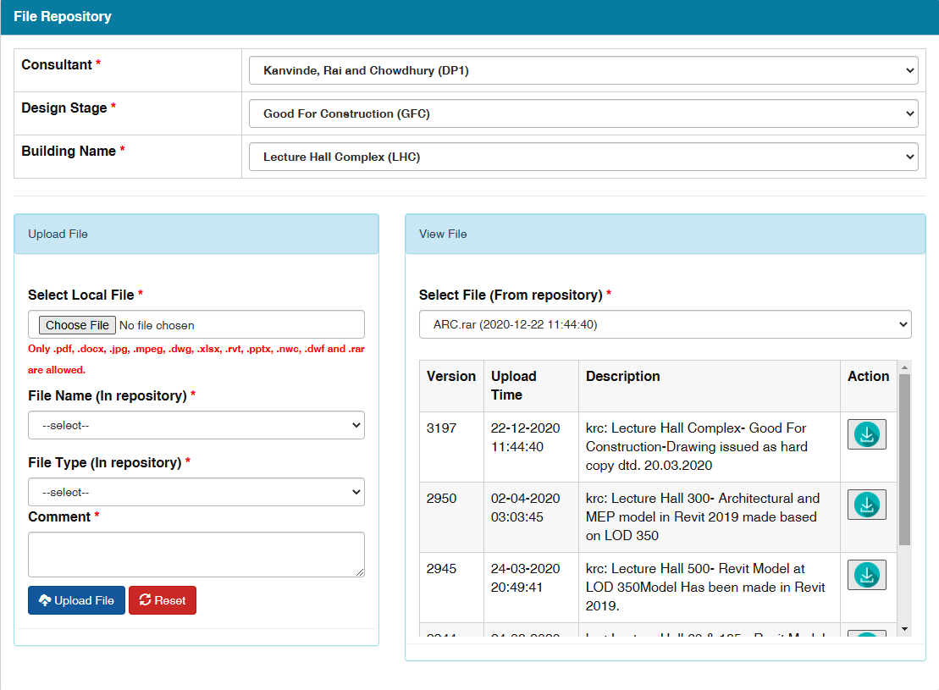
1. DRAWING DOCUMENT MANAGEMENT SYSTEM

Slide 9
This web platform developed by IIT Bhilai and implemented in this project.
Photos are uploaded on this portal on daily basis by the agency showing progress, important events, Training at site etc.
All Third party Quality control issues raised over this platform and rectification done are also uploaded.
As soon as photos are uploaded an automatic email sent to all the stakeholders.
Stakeholders Can see any uploaded photographs from one date to another Date.
An effective tool in Progress Monitoring and Quality Control of work.
2. CAMPUS CONSTRUCTION IMAGE
MANAGEMENT

Slide 10
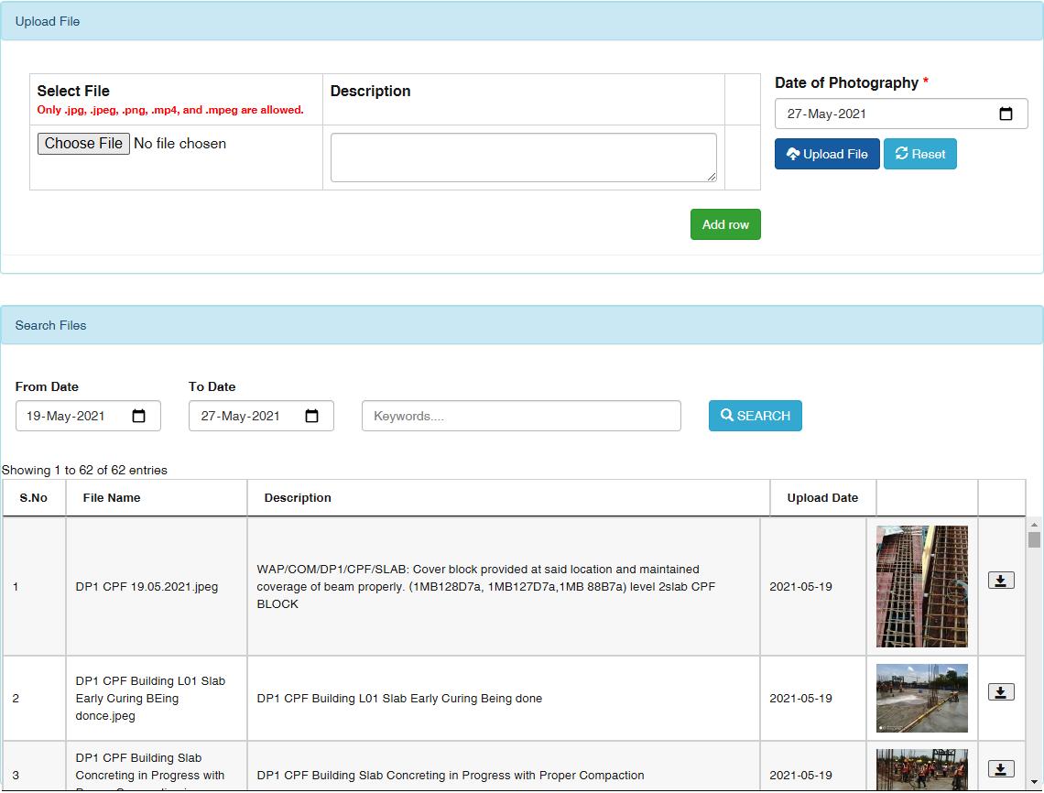
2. CAMPUS CONSTRUCTION IMAGE MANAGEMENT

Slide 11
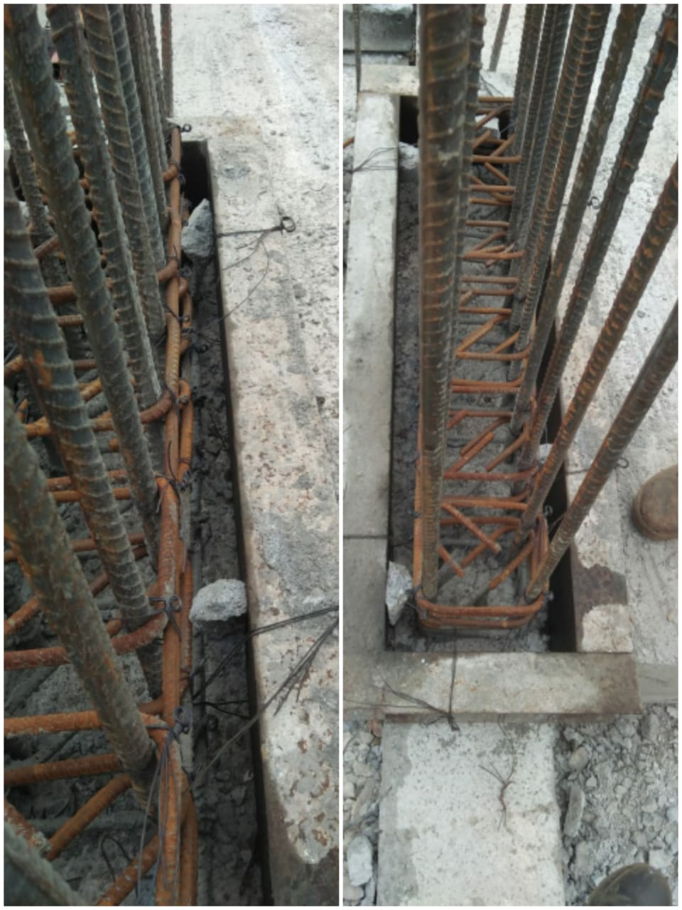
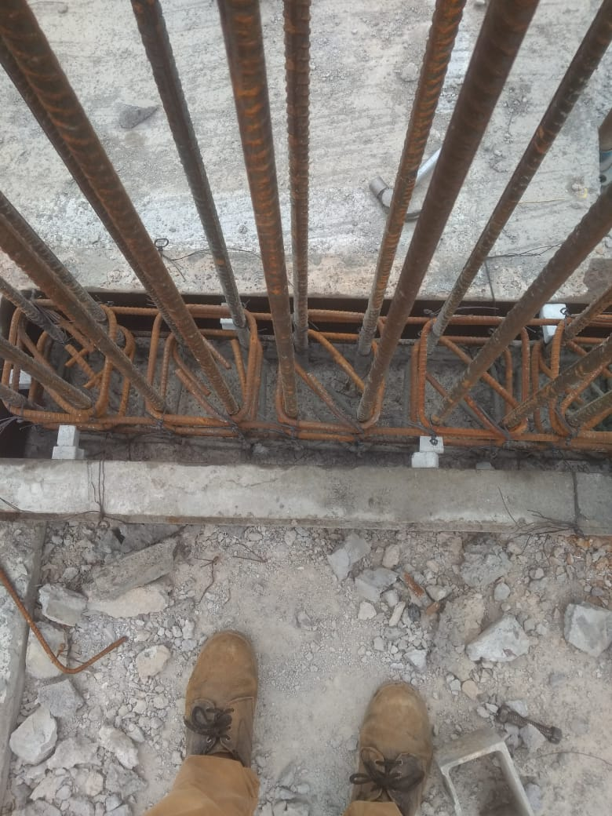
TPQA (Wapcos) issues Raised and Resolved uploaded on CCIM
Improper Cover blocks used
Rectified – Proper cover blocks used

Slide 12
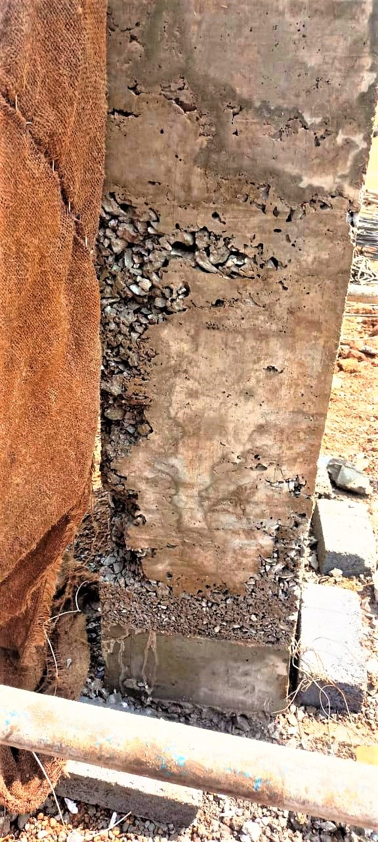
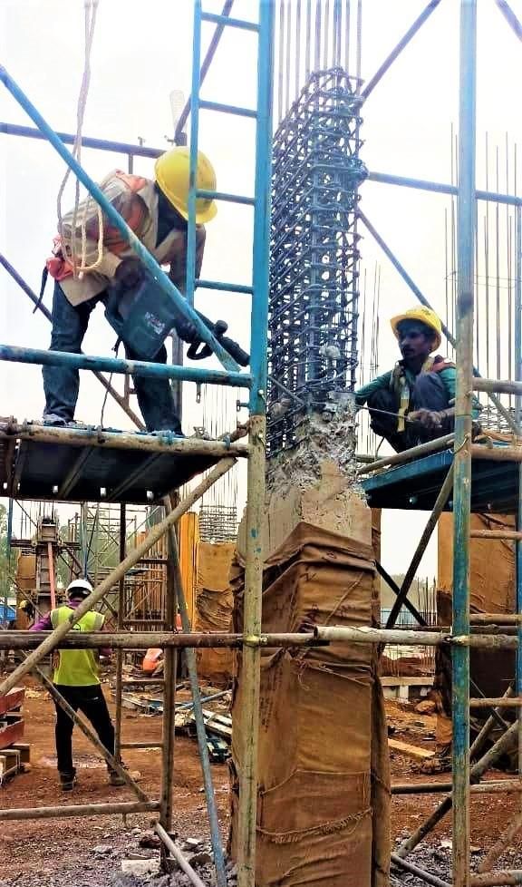
MAJOR HONEYCOMB OCCURRED IN COLUMN
Major honeycomb occurred in column
Column dismantled.

Slide 13
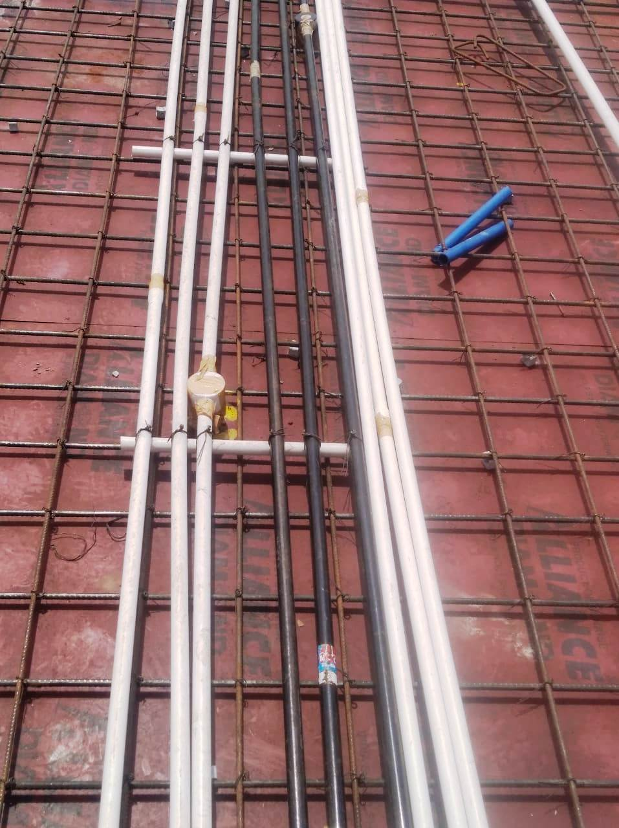
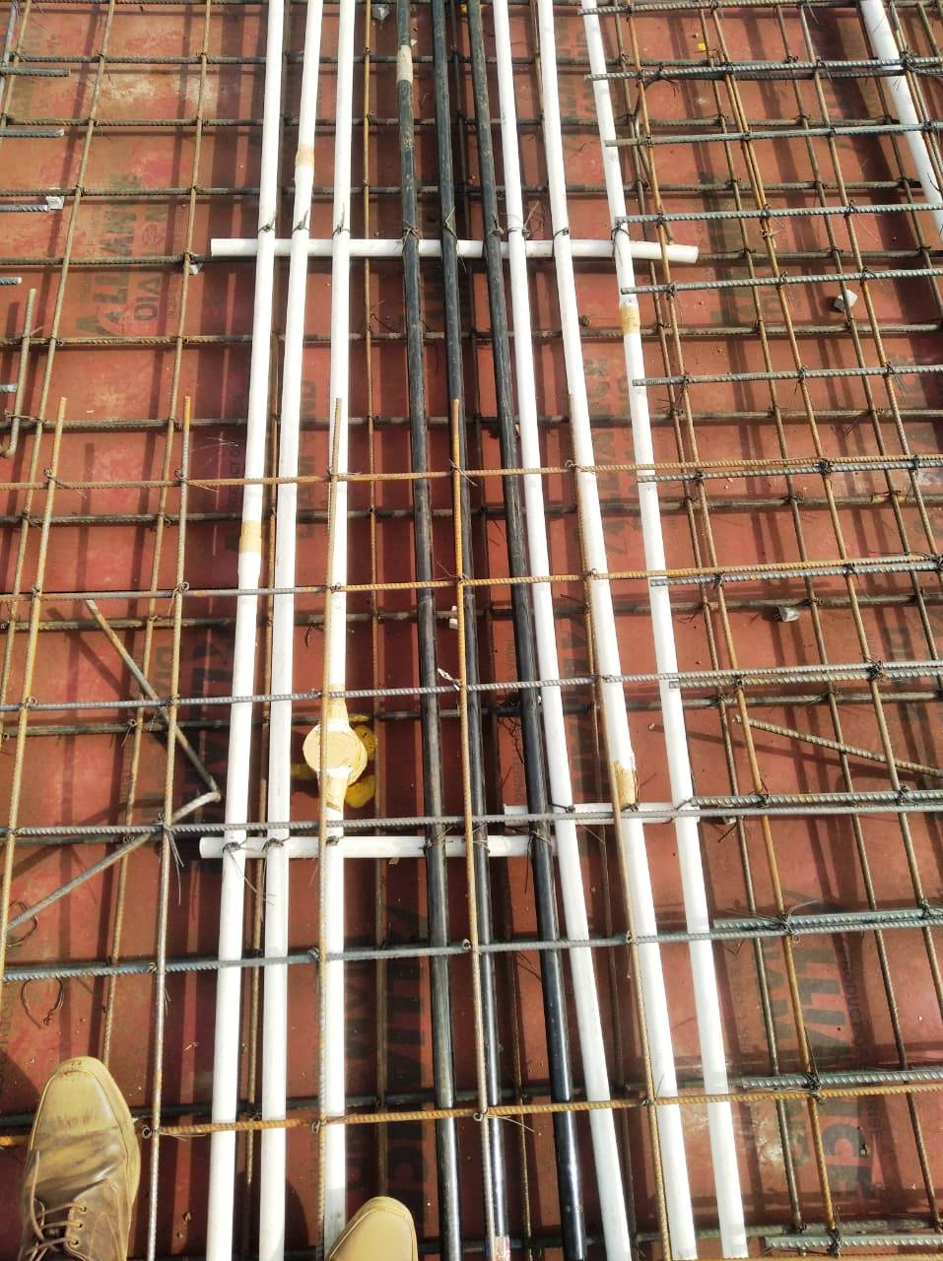
CONDUIT SPACING
CONDUIT SPACING NOT MAINTAINED
CONDUIT SPACING RECTIFIED

Slide 14
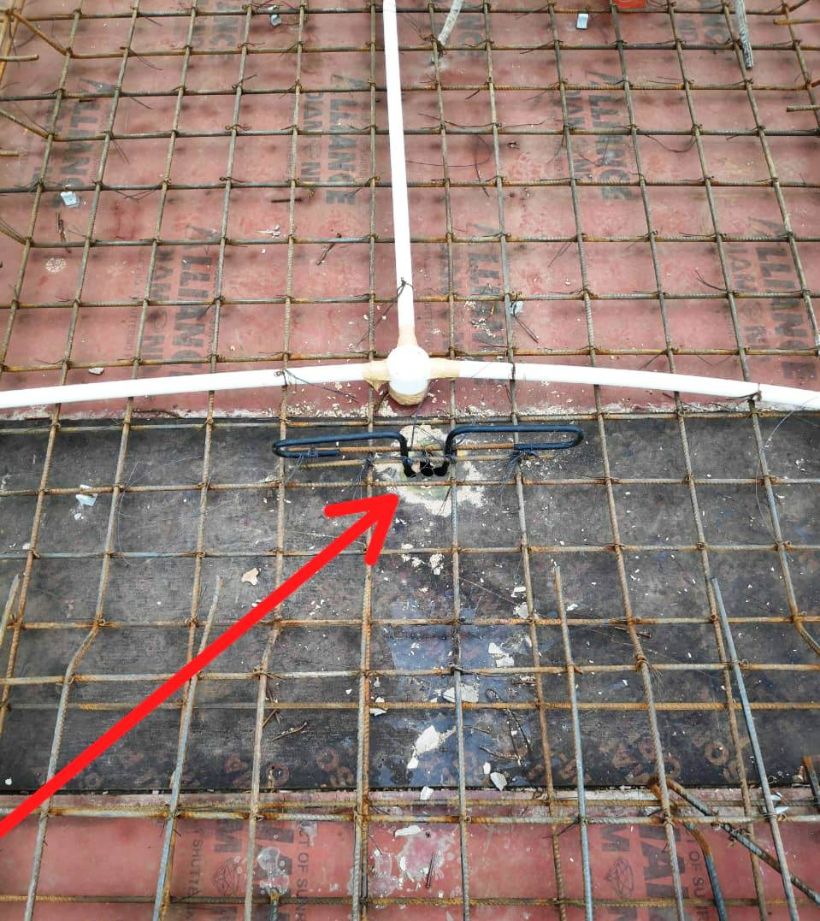
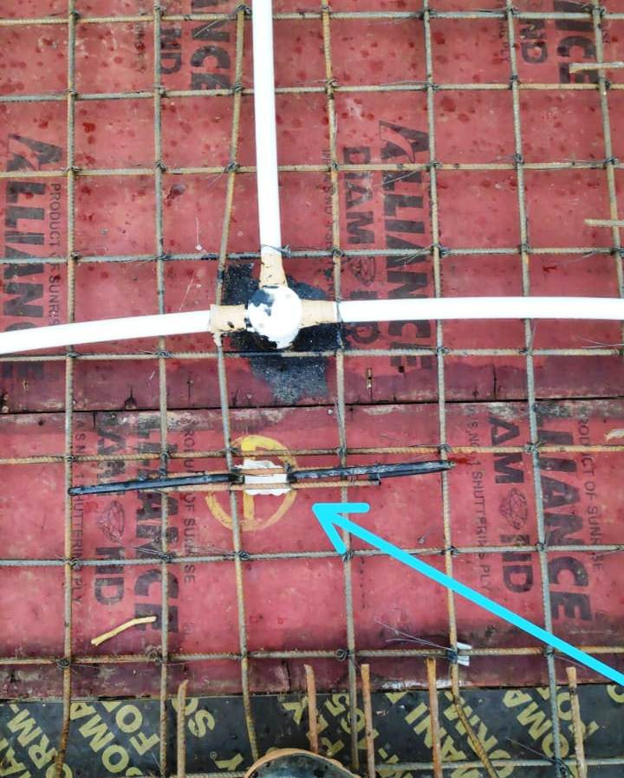
FAN HOOK
HOLE HAS NOT BEEN CLOSED, DUE TO WHITCH THE CONCRETE SLURRY WILL LEAK
COMPLETELY FILL WITH FOAM SHEET

Slide 15
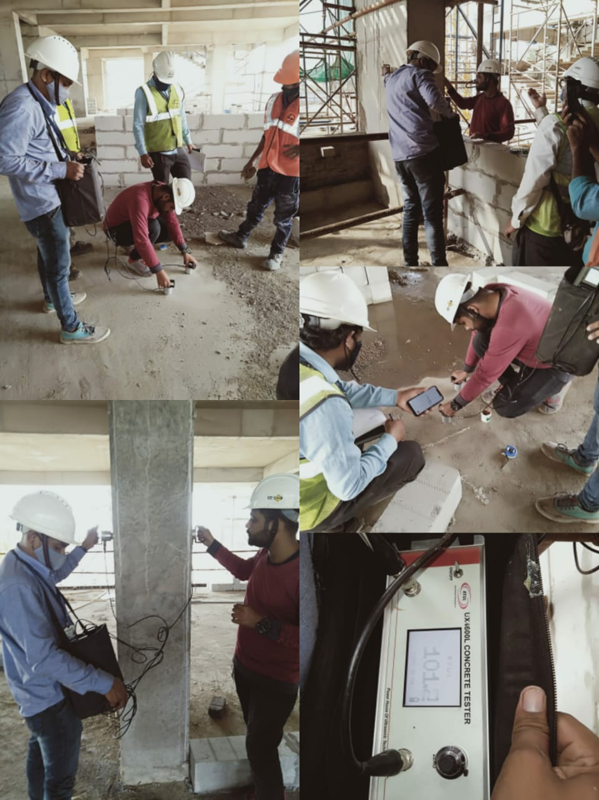
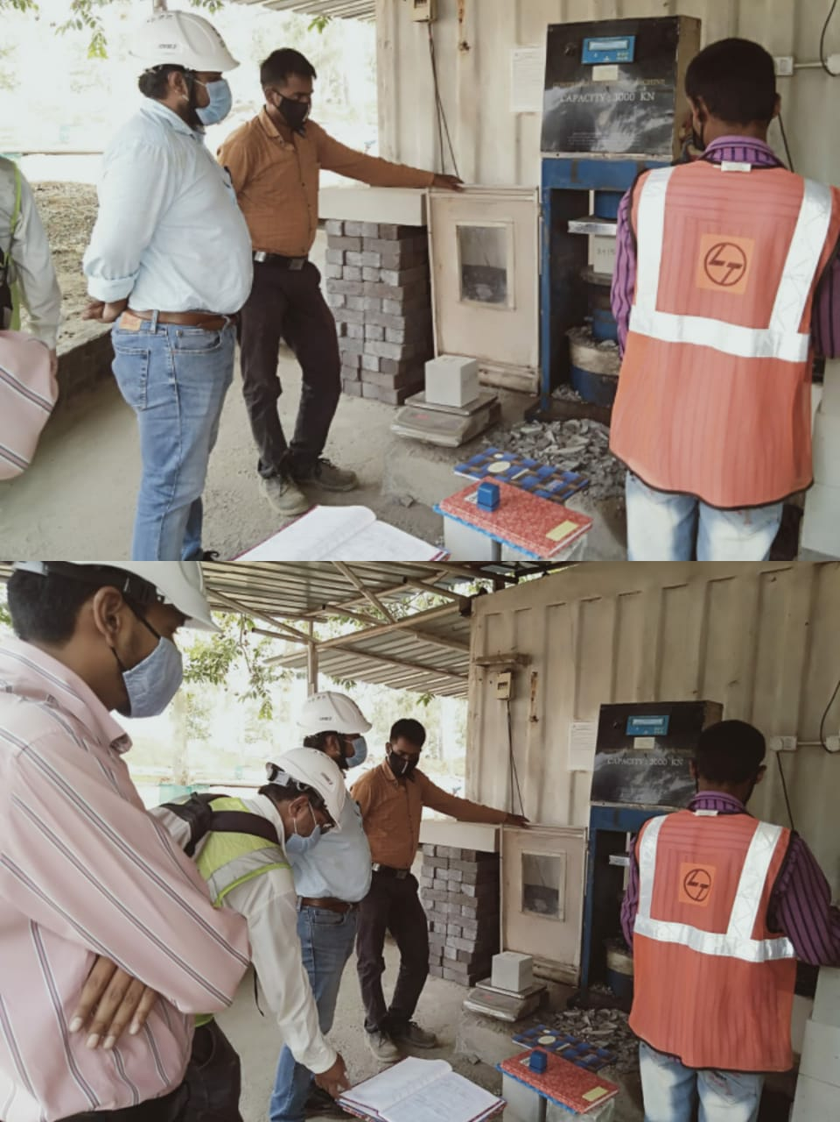
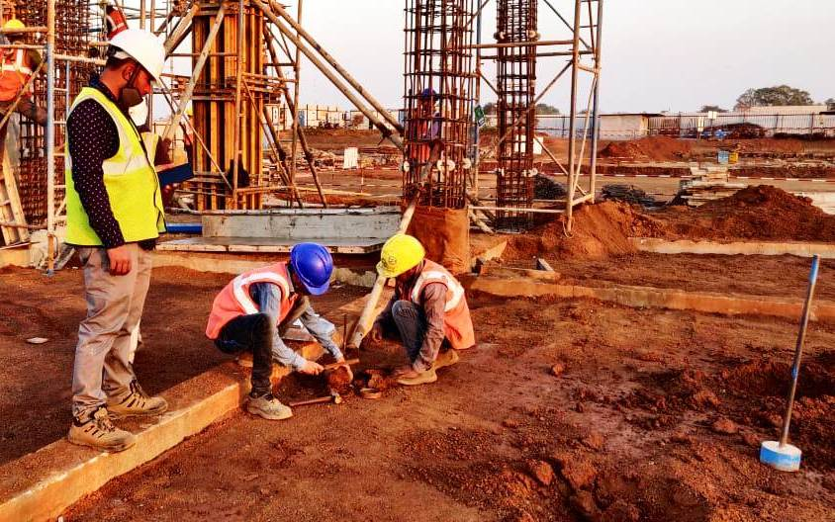
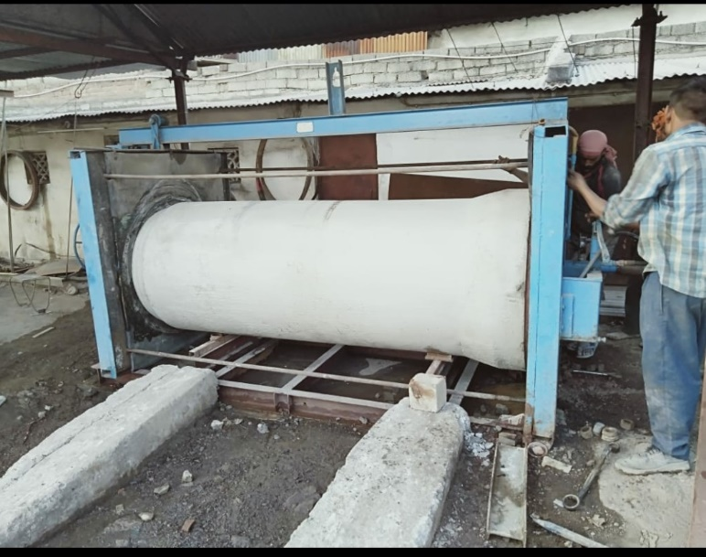
Testing Witnessed by TPQA at Site Laboratory
Testing of Soil compaction
UPV Test
RCC pipe Inspection
Compressive strength of concrete

Slide 16
3.
BUILDING INFORMATION MODELING (BIM) AT IIT BHILAI PROJECT

Slide 17
BENEFITS OF BIM MODELLING
Early identification of potential issues among Architectural, Structural and Various MEP services through RFI
Clear Visualization of Issues and resolution meetings with client, consultants and L&T teams
BIM 360 Document Management within various stakeholders.
Quantity Take off from the models
Time Management and Progress Monitoring
Development of Shop drawings from the model itself
Development of Completion Drawings after resolution of all Issues and as per actual construction.

Slide 18
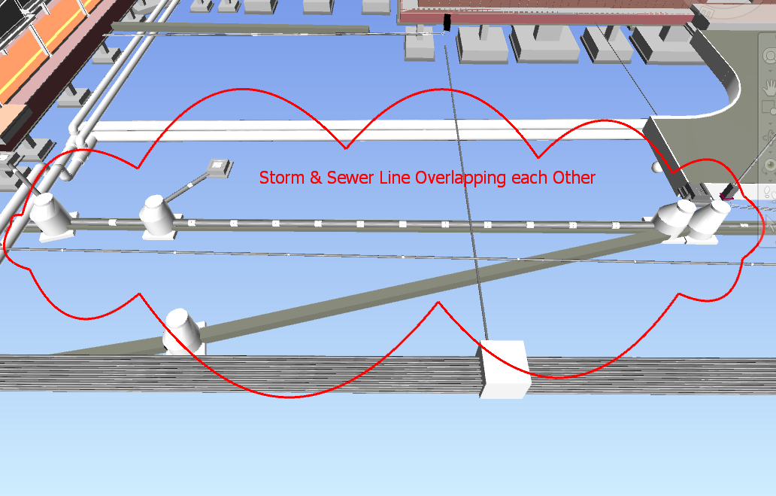
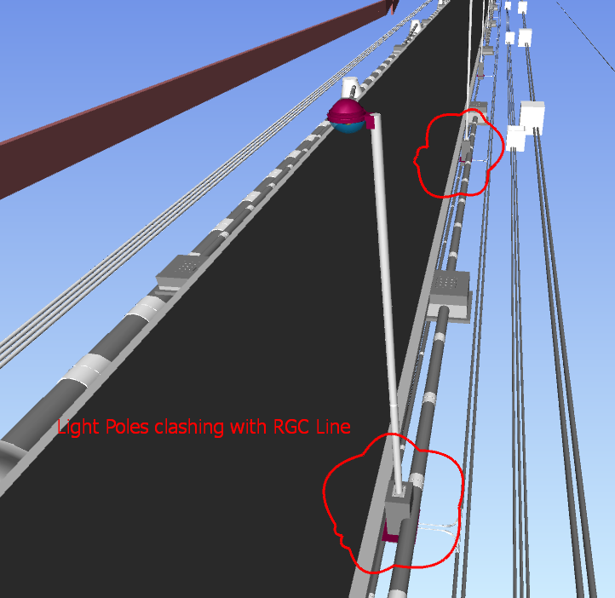
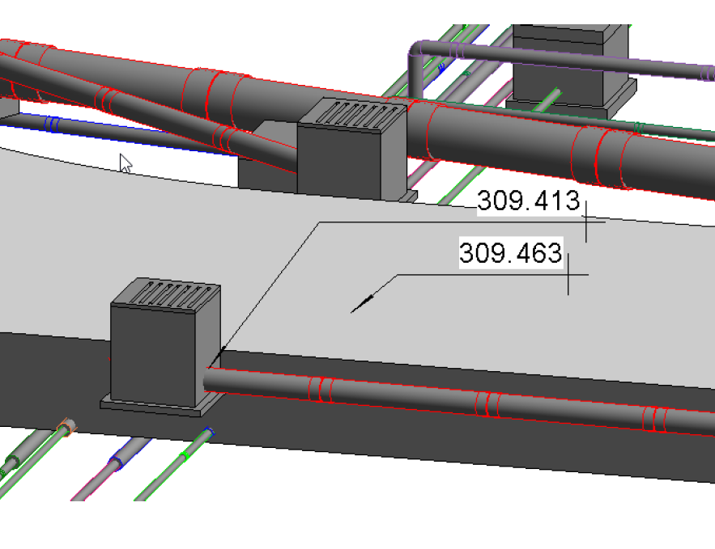
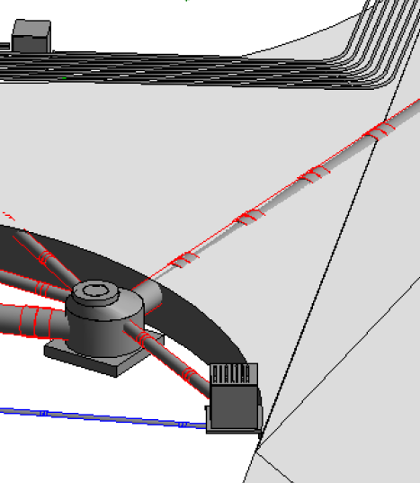
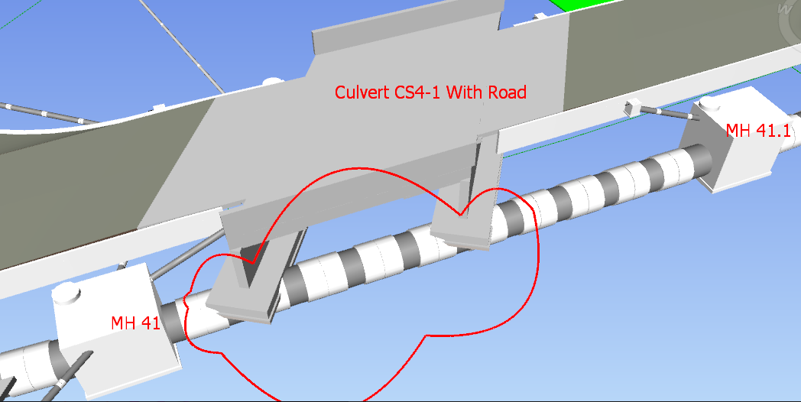
IDENTIFIED CLASHES IN EXTERNAL SERVICES
1. Light pole clash with RGC line.
2. Storm water pipe and chambers have elevations greater than Road.
Storm water pipe crossing through Road.
Culvert CS4-1 with Road
5. Storm and Sewer line overlapping each other.
5
1
2
3
4

Slide 19
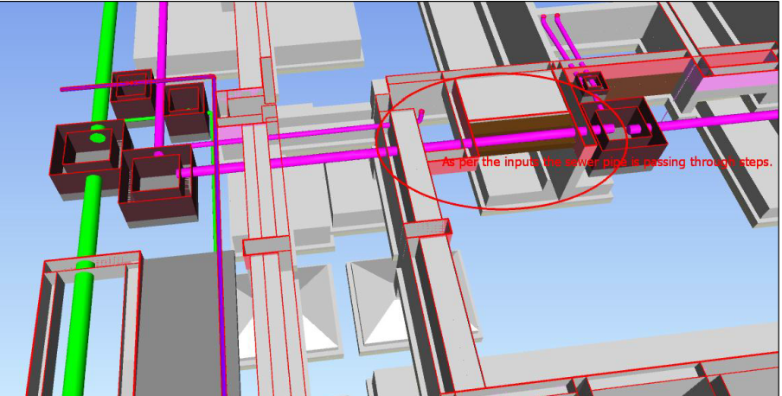
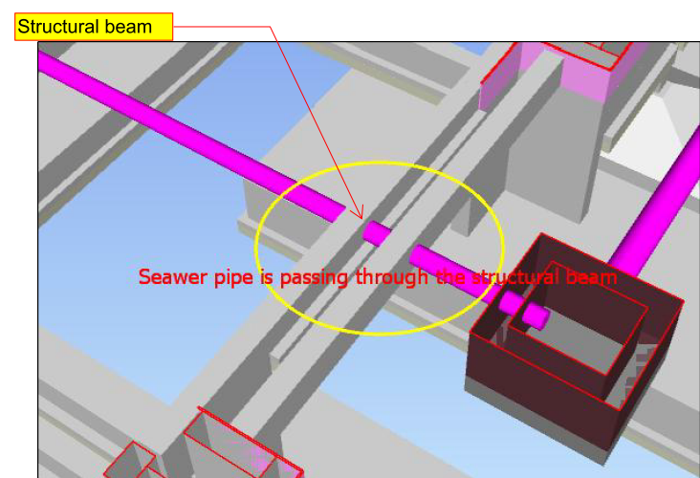
SEWER PIPE CLASH THROUGH STEPS OF ENTRANCE/ STRUCTURAL BEAM

Slide 20
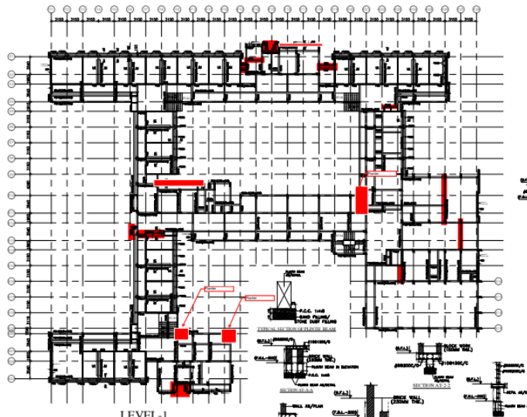
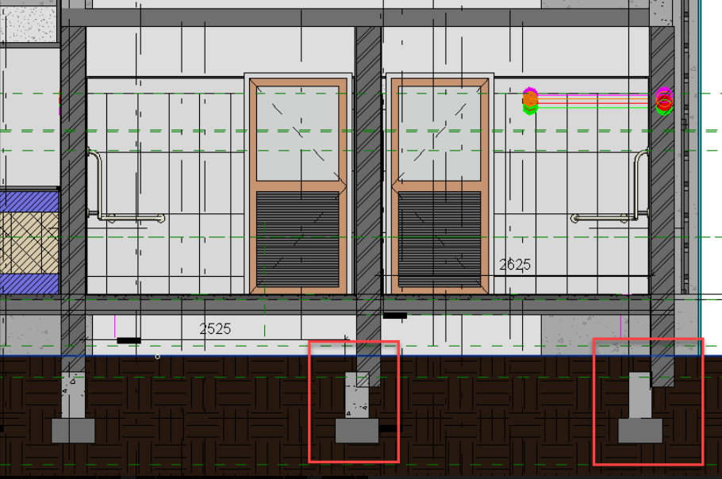
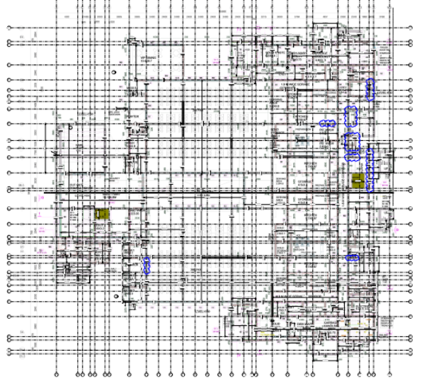
IDENTIFICATION OF CONSTRUCTABILITY ISSUES
Plinth beams as per Structural Drawing are not aligned which Level-1 Arch wall
Marked Location

Slide 21
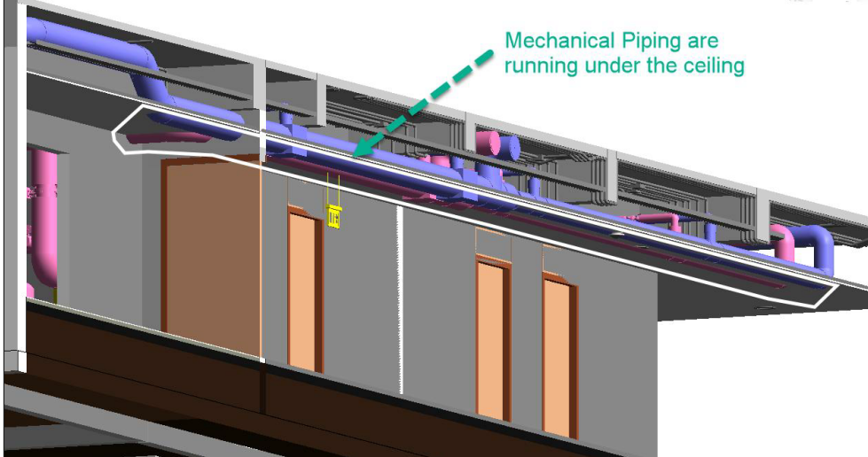
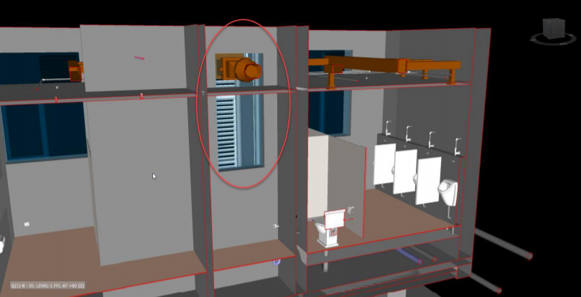
IDENTIFIED CLASHES IN BUILDINGS
Pipe running below the False ceiling Level
AC Duct Clashing with Louver

Slide 22

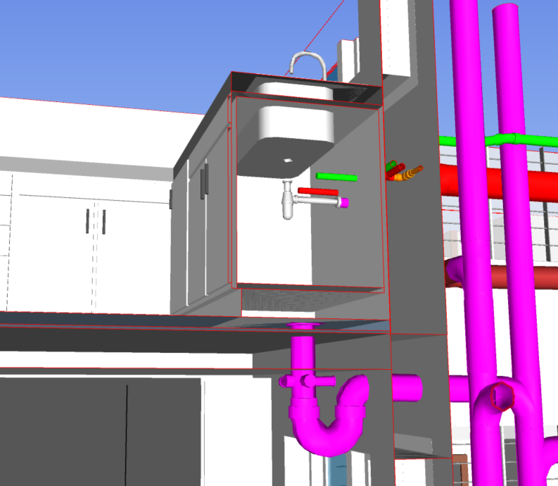
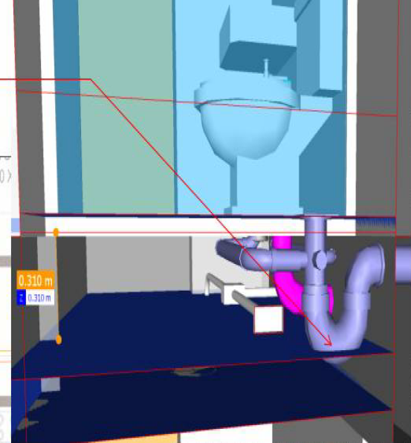
IDENTIFIED CLASHES IN BUILDINGS
AVAILABLE SUNKEN AREA IS ONLY 300 MM, P TRAP COULD NOT BE ADJUSTED, MINIMUM 350 MM REQUIRED.

Slide 23
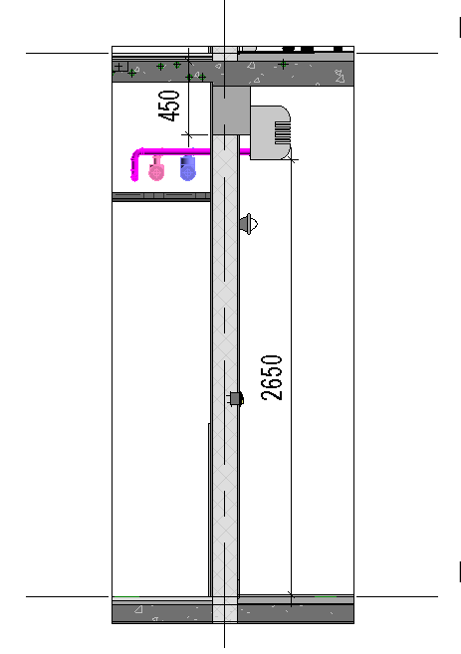
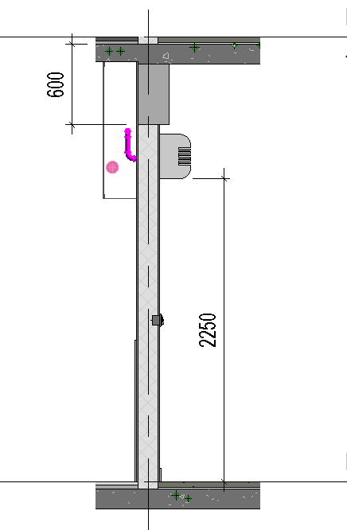
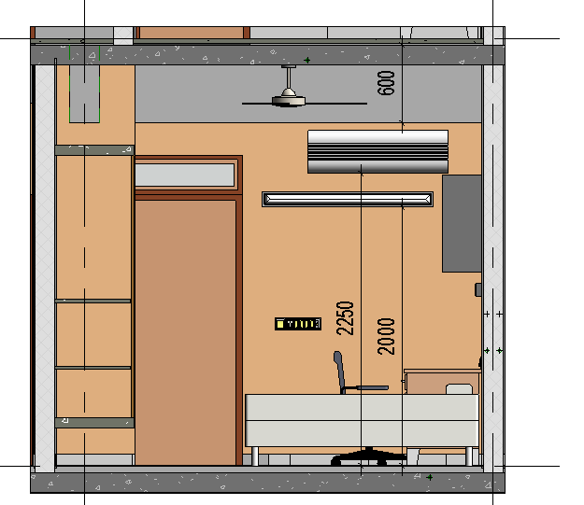
IDENTIFICATION OF CONSTRUCTABILITY ISSUES
Beam Depth – 450mm / 600 mm & Width 230 mm
Blockwork – 150mm
If Indoor unit is shifted downward then issue with drain pipe of AC unit and light Fixture
Consultant’s comment – To increase blockwork from 150 mm to 230mm.
Variation in Volume (Cum) = 214.831 cum
Total Hostel Rooms Effected – 329 nos.
BH1 BUILDING |  | Level 01 | Level 02 | Level 03 | Level 04 | Total
 | Beam Depth 450 | 1 Rooms | 9 Rooms | 1 Room | 1 Room | 12
 | Beam Depth 600 | N/A | 4 Rooms | 51 Rooms | 53 Rooms | 108
BH2 BUILDING |  | Level 01 | Level 02 | Level 03 | Level 04 | Total
 | Beam Depth 450 | N/A | N/A | N/A | N/A | N/A
 | Beam Depth 600 | N/A | 4 Rooms | 62 Rooms | 57 Rooms | 123
GH1 BUILDING |  | Level 01 | Level 02 | Level 03 | Level 04 | Total
 | Beam Depth 450 | N/A | 2 Rooms | 7 Rooms | 7 Rooms | 16
 | Beam Depth 600 | N/A | 6 Rooms | 32 Rooms | 32 Rooms | 70

Slide 24
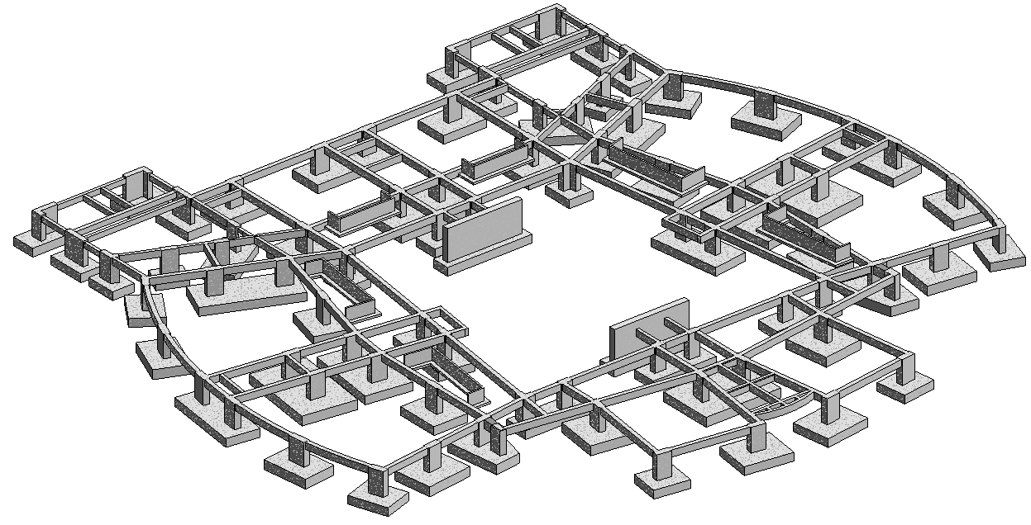
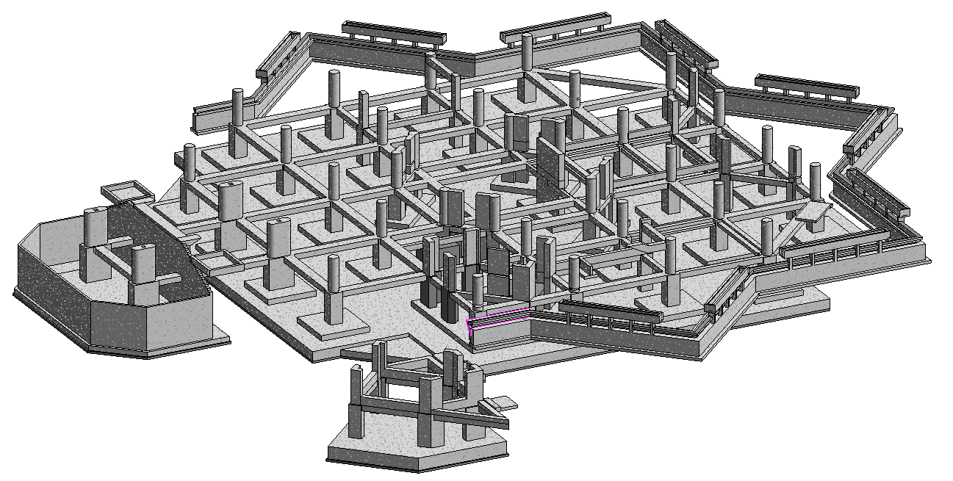
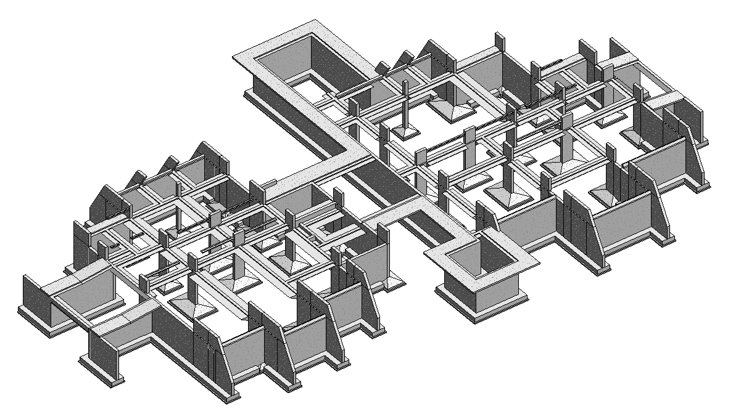
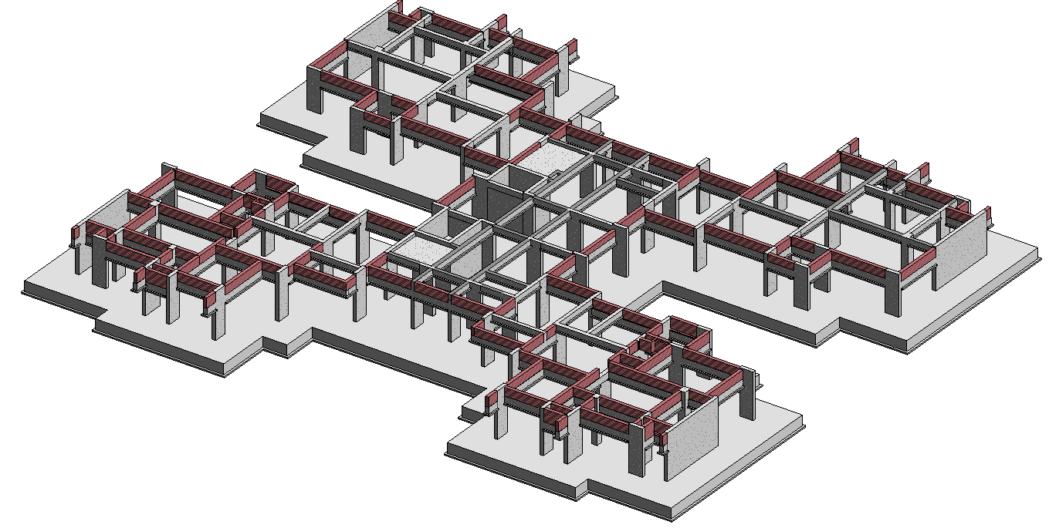
Structural Quantity Take Off From BIM Models
LH1
LDC
INC
BETA

Slide 25
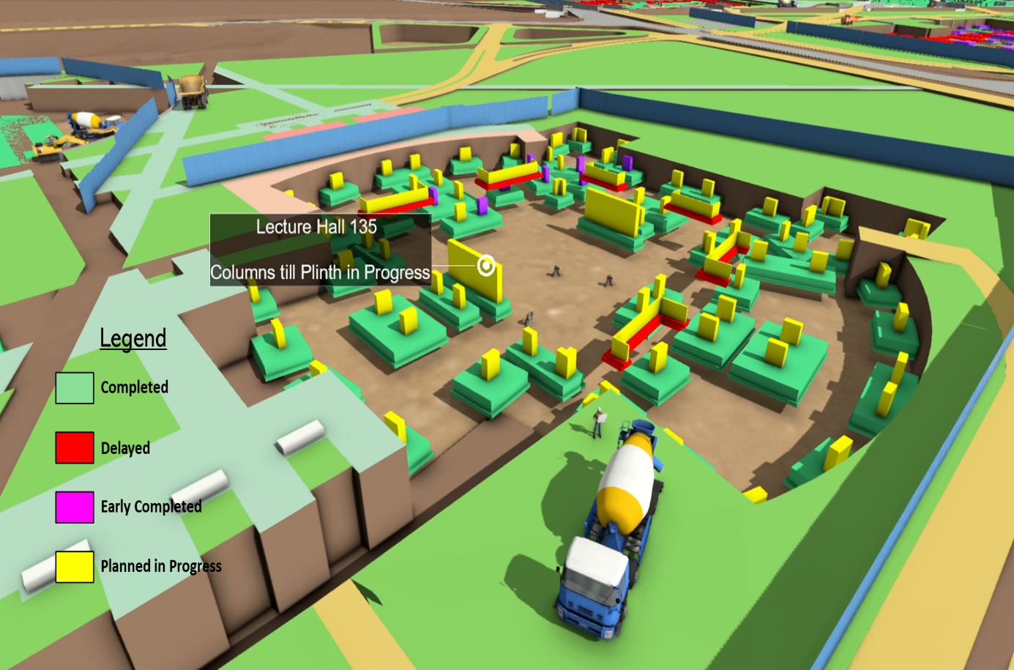
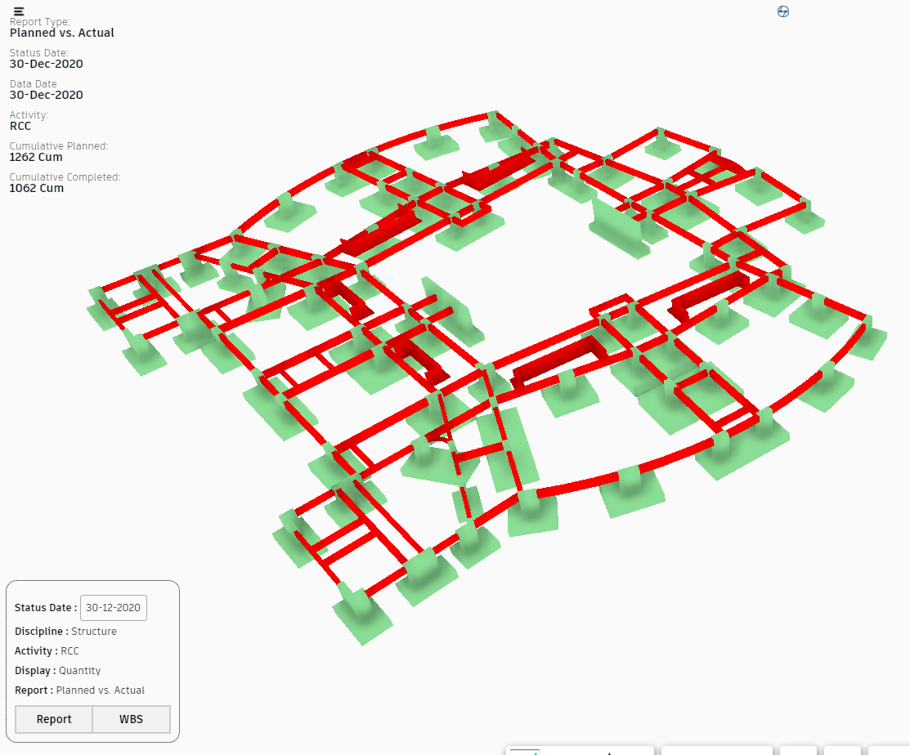
PROGRESS MONITORING
https://apps.bnfic.tech/vip/
BIM models can be linked with Primevera software to monitor the Progress. At any particular date, the items Planned up to that day, completed, delayed and early completed can be visualized.

Slide 26
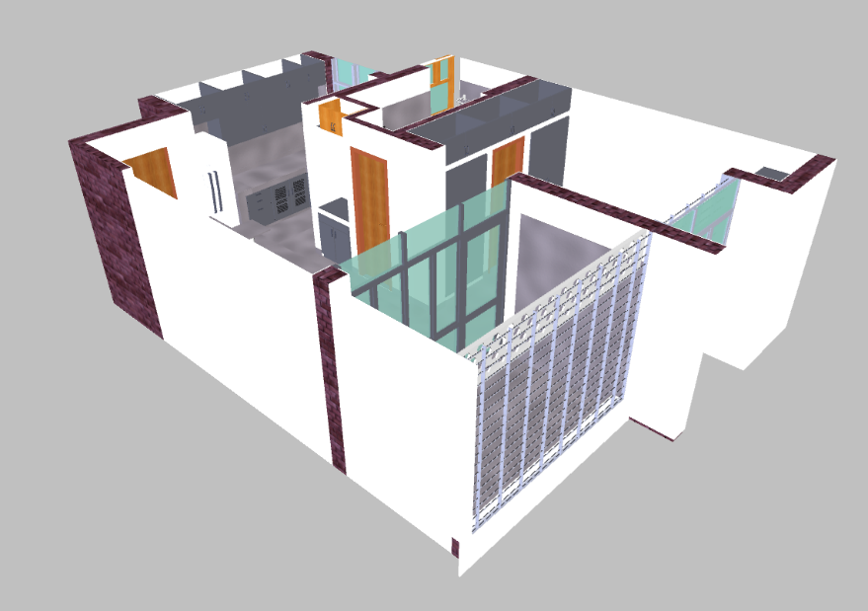
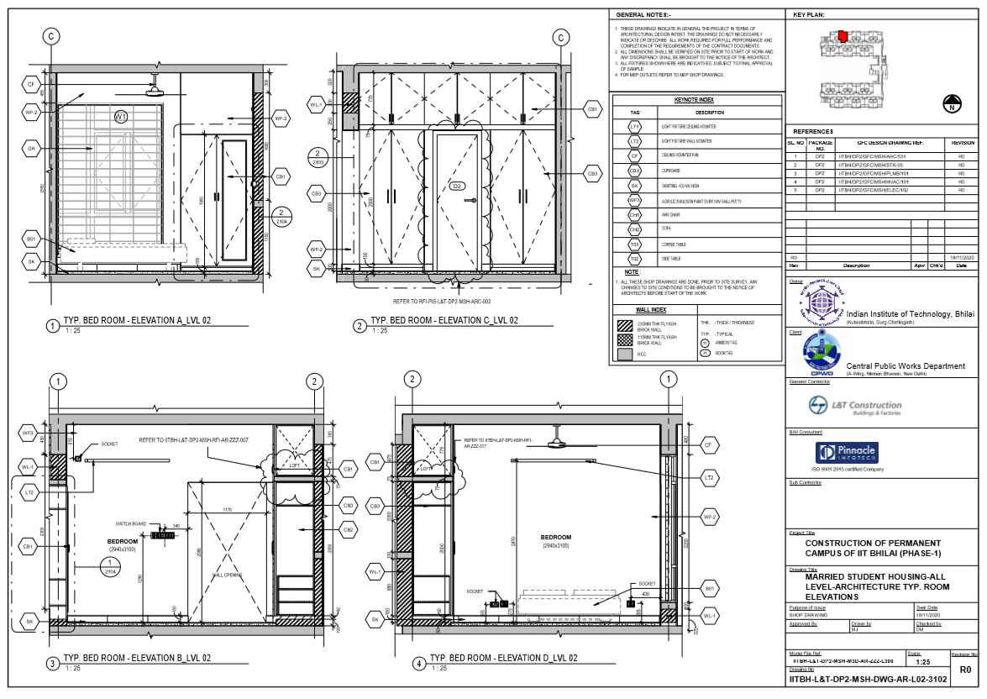
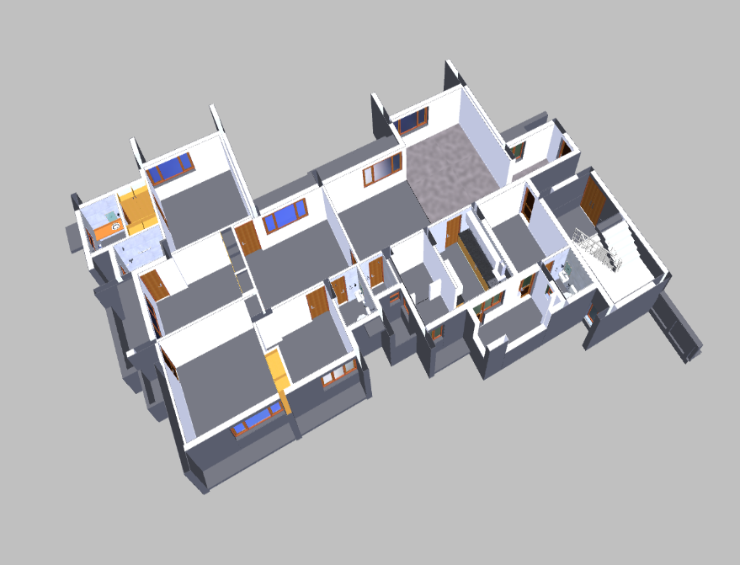
DEVELOPMENT OF SHOP DRAWING GENERATION FROM BIM MODEL
MSH Model
Delta
Shop drawings generated from the Model can be reviewed by all the Stakeholders.

Slide 27
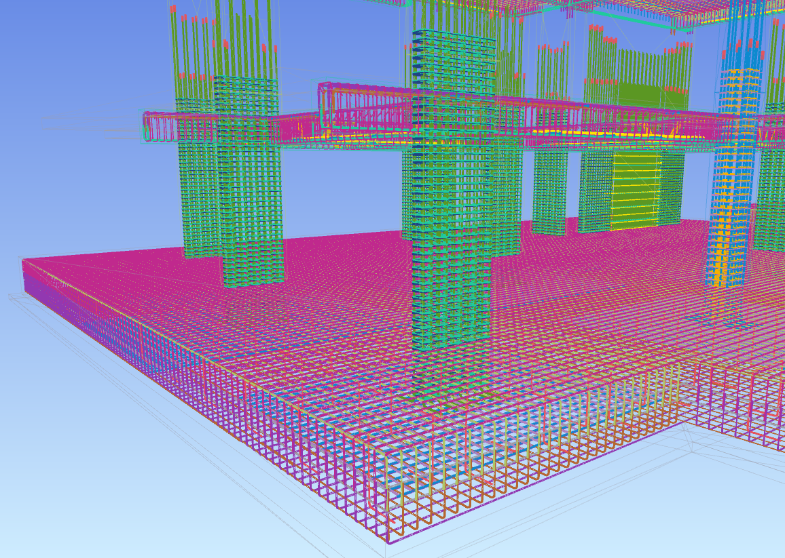
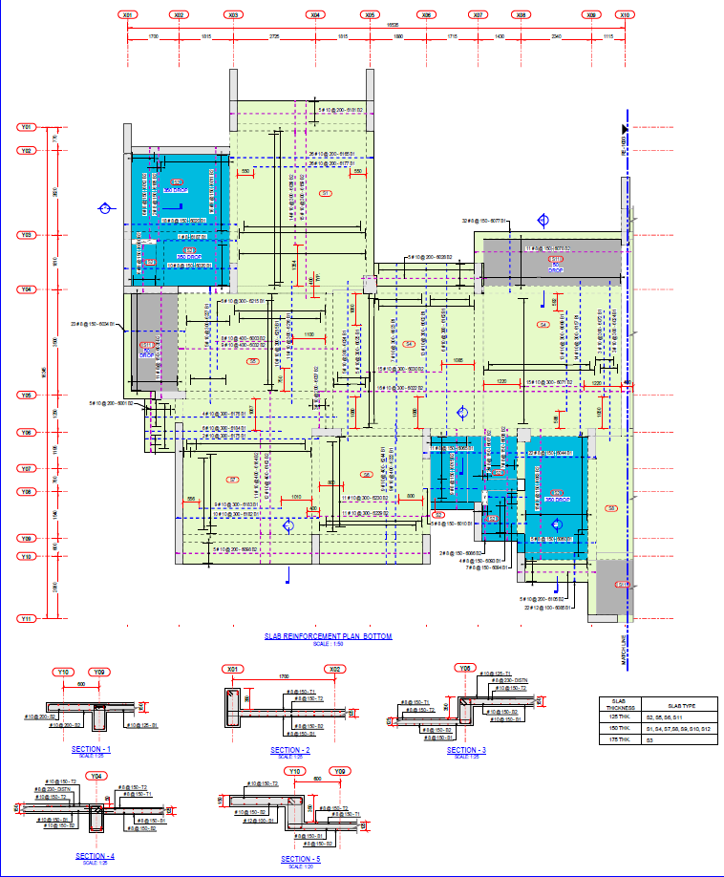
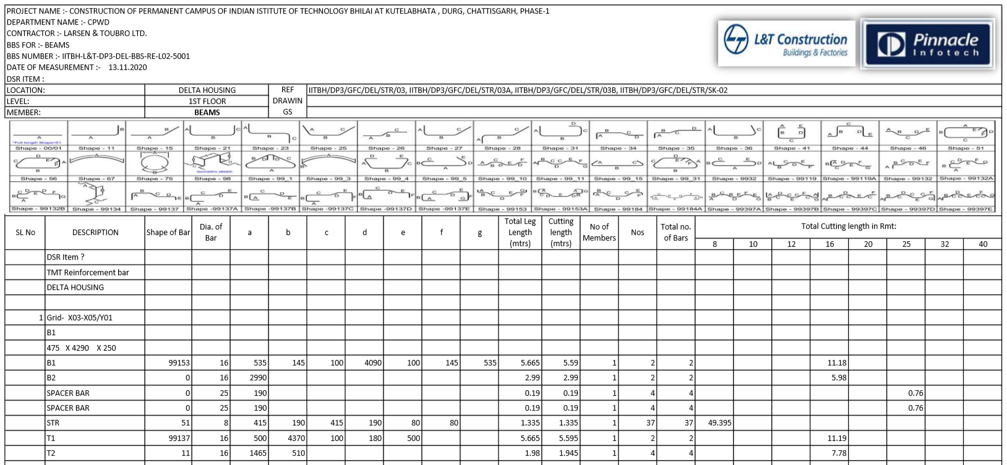
BBS GENERATION AND SHOP DRAWING FROM REINFORCEMENT MODEL
Delta Rebar Model

Slide 28
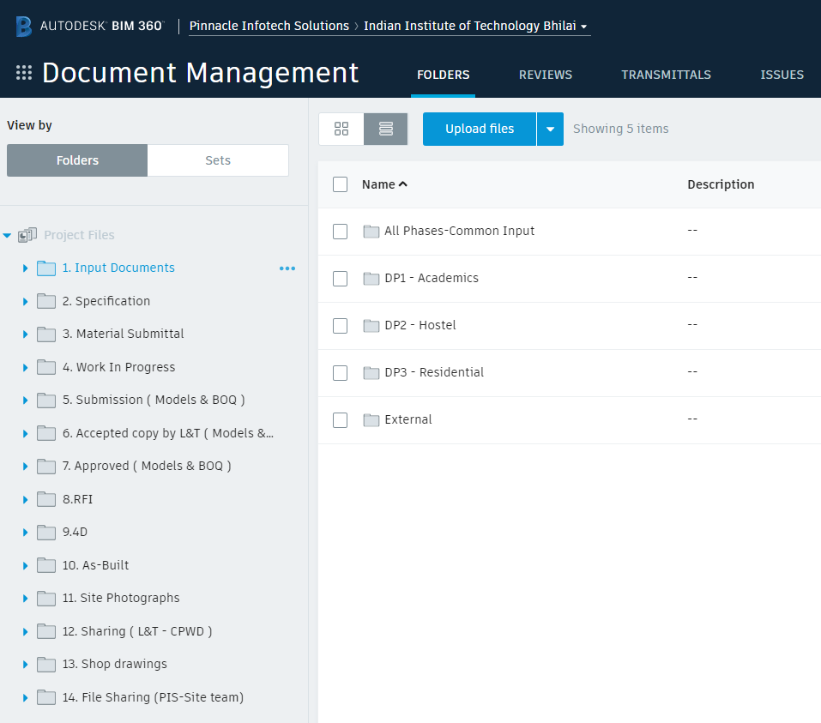
COMMON DATA ENVIRONMENT (BIM 360) FOR DOCUMENT MANAGEMENT
Cloud-based Document Management System with well-defined data access, data security, and workflows Setup on BIM 360.
Creation of Document, Review by Various Stakeholders, Approval etc all can be done on single platform online.

Slide 29
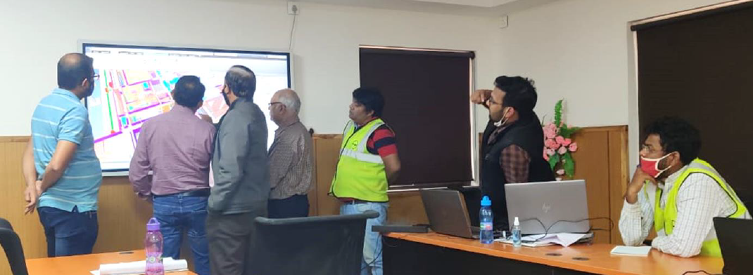
INFORMED DECISION MAKING AND REVIEW MEETINGS THROUGH ‘BIM’
Review of BIM models by all stake holders – Client, Consultant, L&T, Sub-contractor

Slide 30
Thank You

