Slide 1

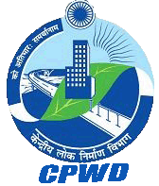



Government of India Ministry of Housing & Urban Affairs Central Public Works Department For Excellence In Public Works
Digital Transformation on Public Project Delivery Using Common Data Environment and Building Information Modeling
- Experience from IIT Palakkad Phase 1A (Package 1)
Er. C.S. Abineesh
Executive Engineer,
Palakkad Project Zone
Central Public Works Department,
IIT Palakkad Main Campus,
Kanjikode west,Palakkad-678623, Kerala.
pkdeeiippd@cpwd.gov.in
Dr. V. Senthilkumar
Vice Chairman, Engineering Works Department,
Assistant Professor, Civil Engineering Department,
IIT Palakkad
senthil@iitpkd.ac.in
Digital Transformation in Public Project Delivery Using CDE and BIM

Slide 2
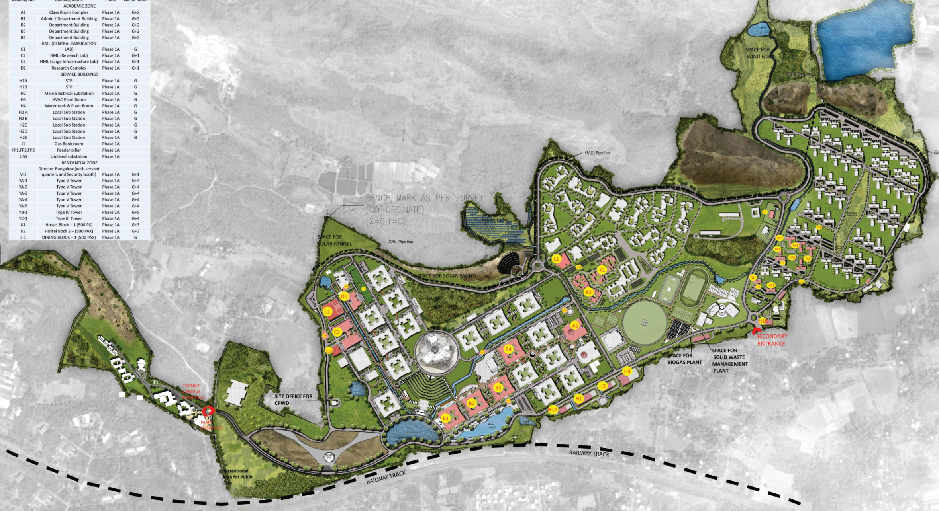
Project Description
Development of Permanent Campus Phase 1A at Kanjikode, Palakkad, Kerala
Project Value: Duration: 27 Months Start Date:
EPC Mode 3
Mandated BIM LOD 400 as a Requirement
Client Office
2 Architectural Firms
CPWD as PMC
TPQA
Multiple Sub Contractors
More than 100 vendors Firms
25 Building Spaces of an Average of G+3
More than 3000 Design Drawings and Specifications
Digital Transformation in Public Project Delivery Using CDE and BIM

Slide 3
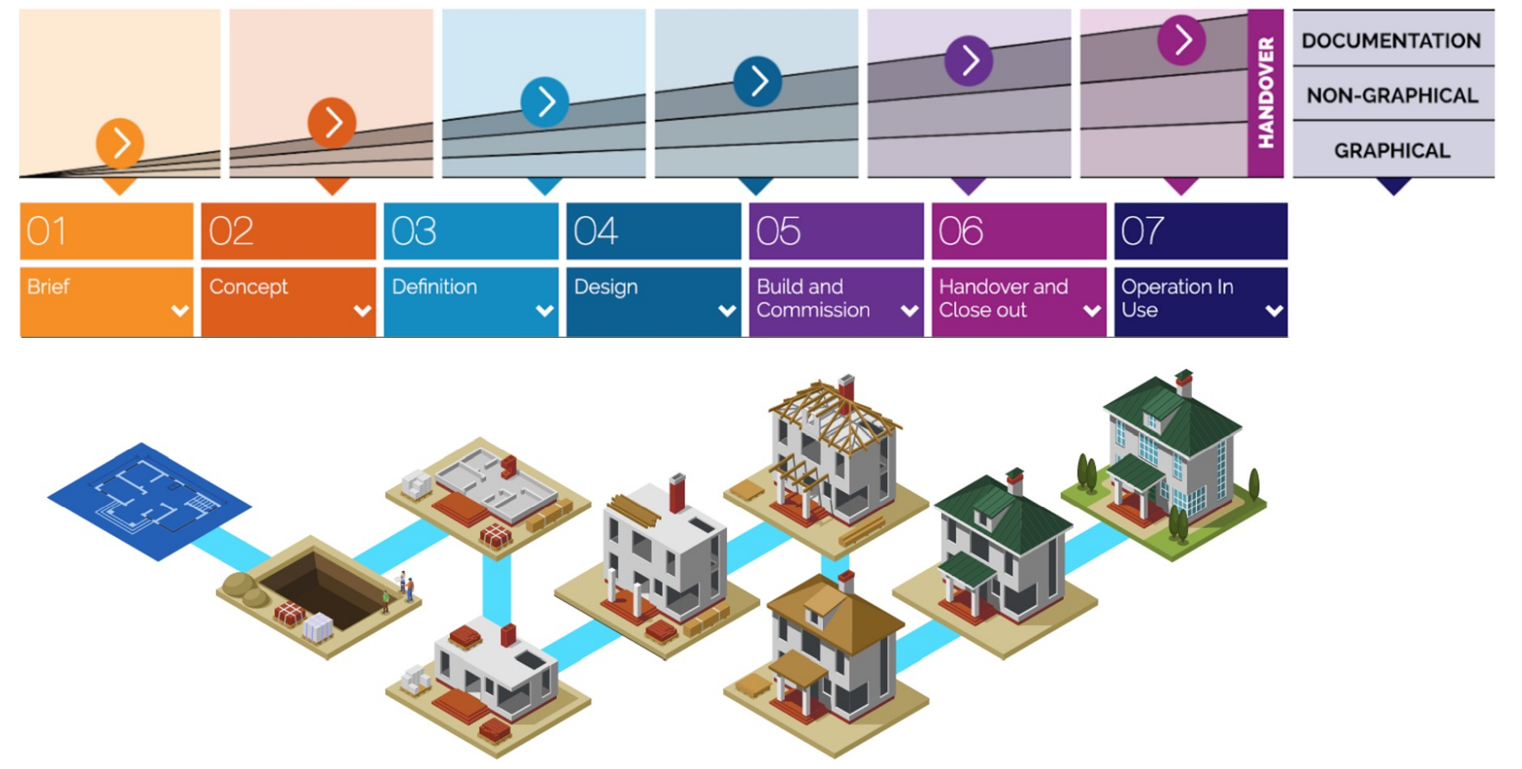
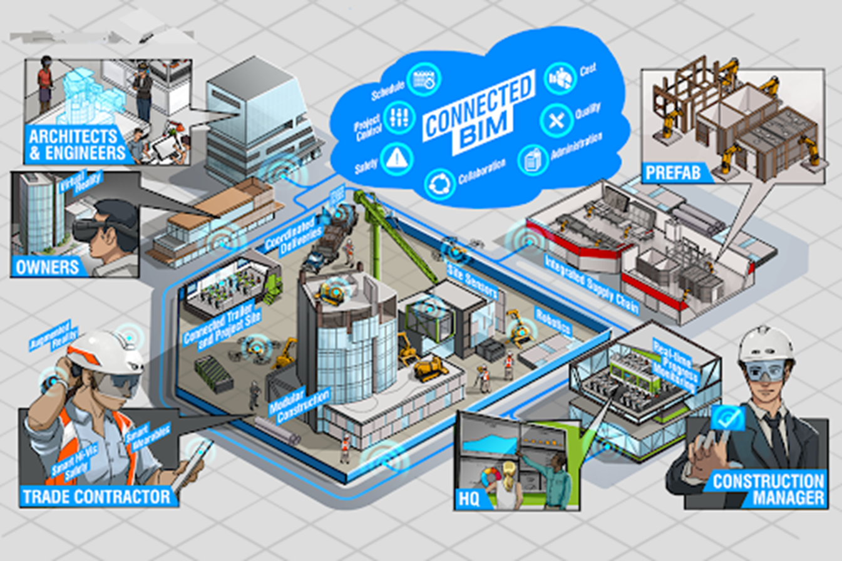
Need for the Common Data Environment and Building Information Model
Digital Transformation in Public Project Delivery Using CDE and BIM

Slide 4
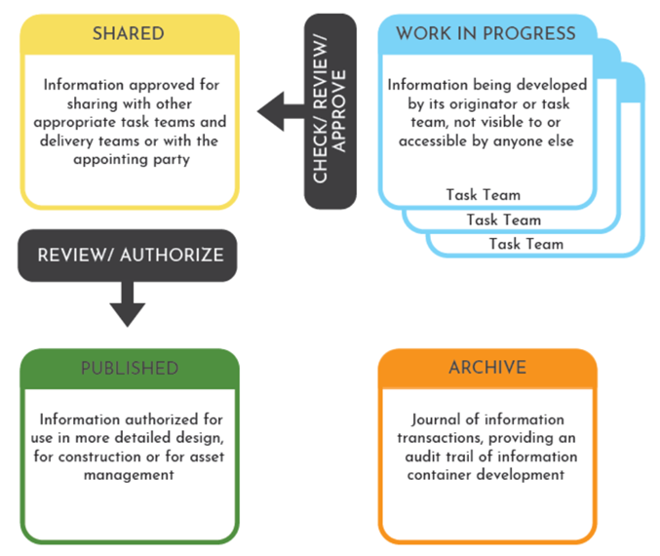
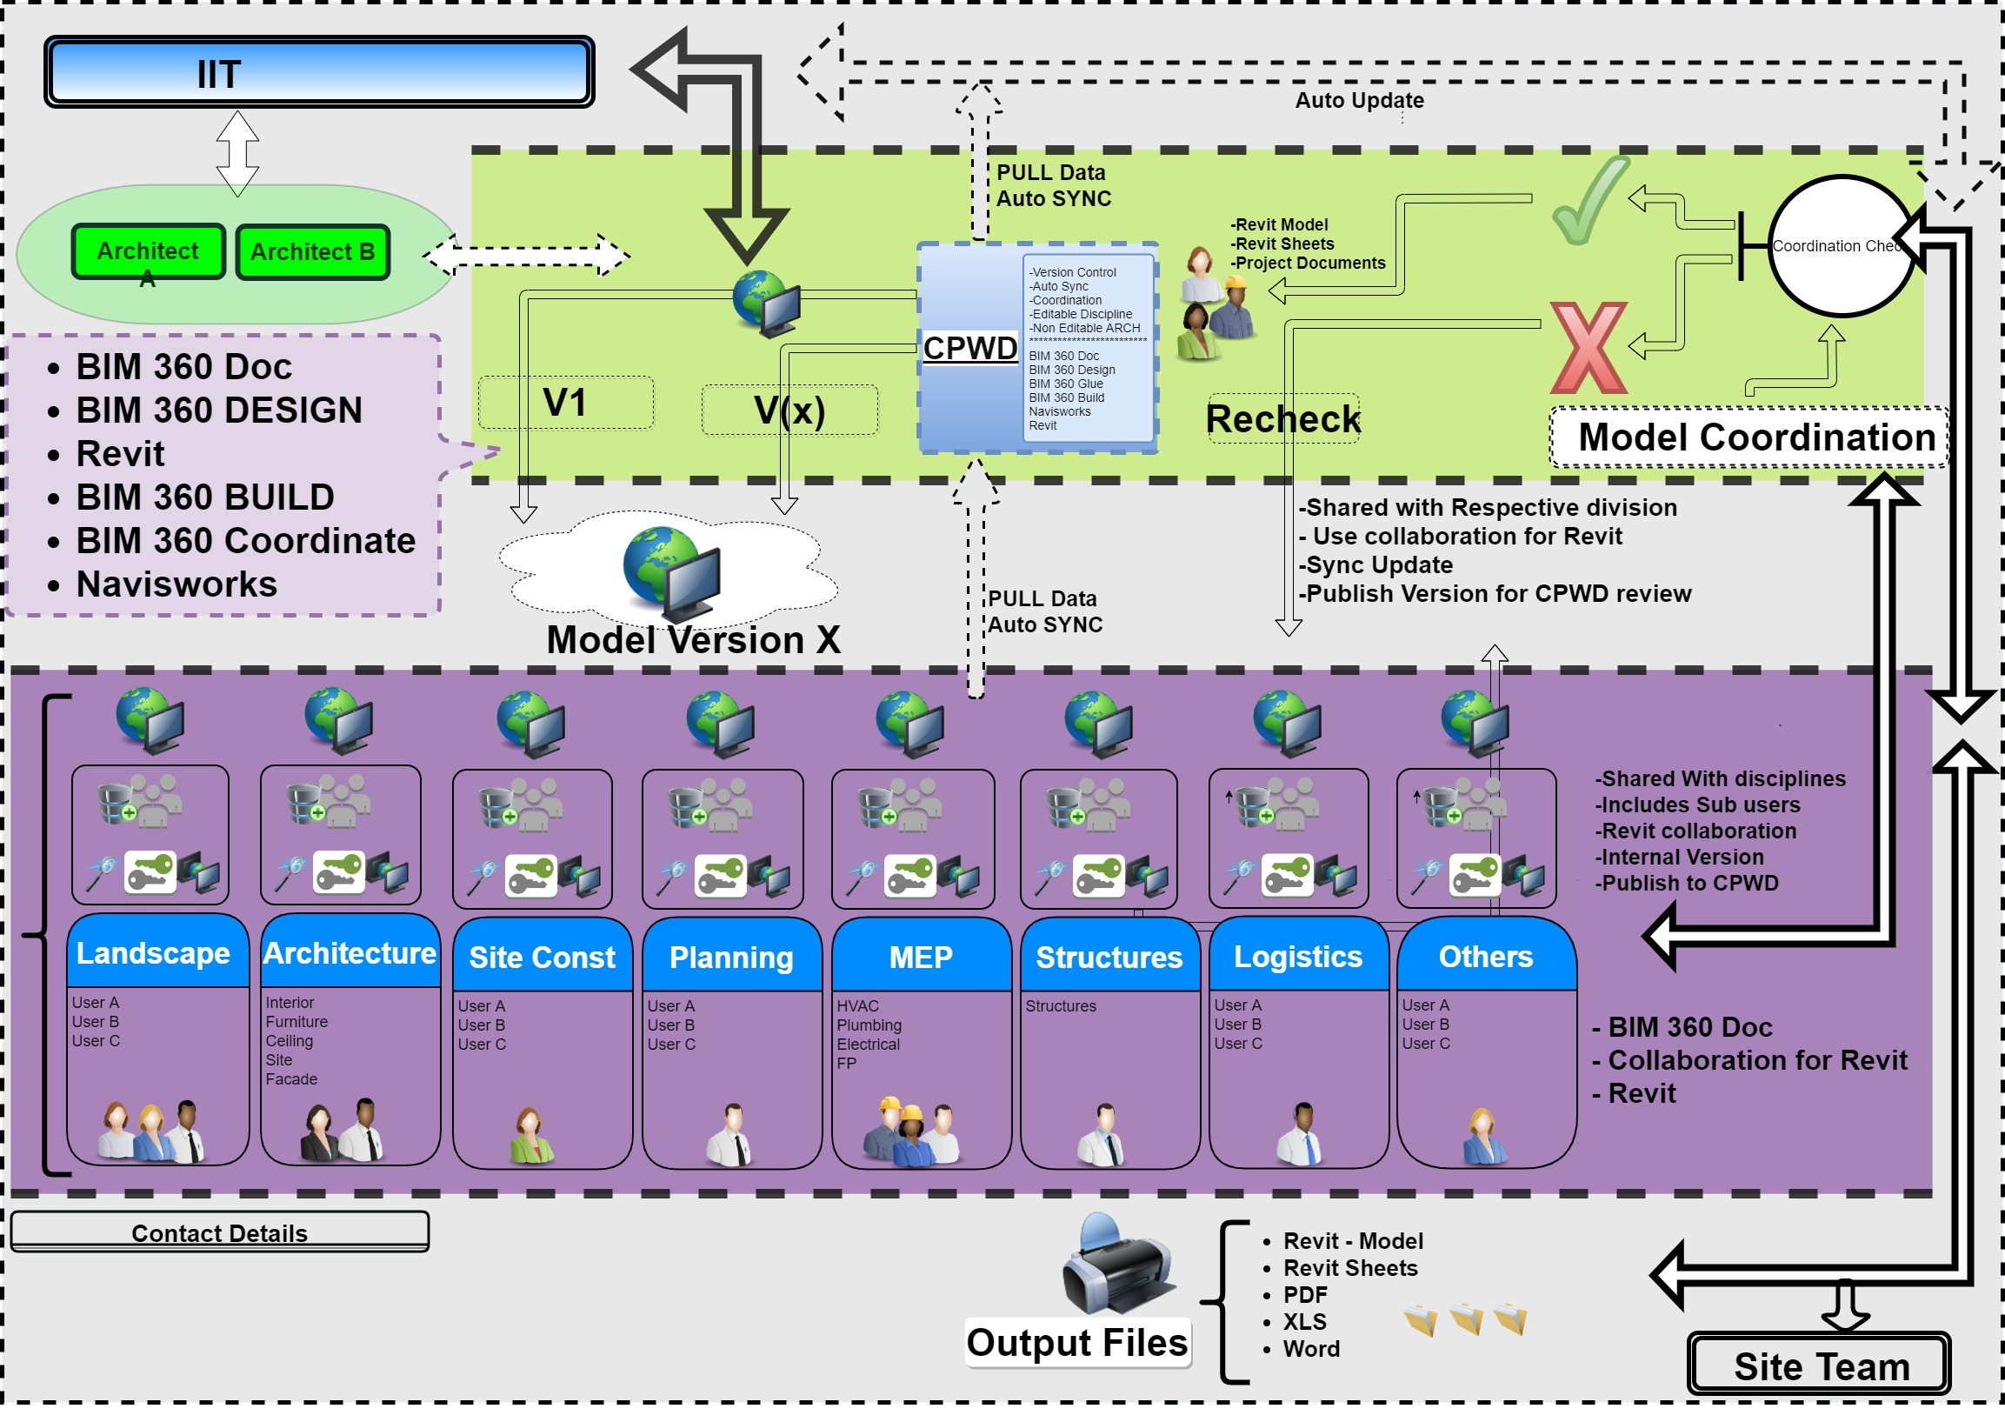
Design of the CDE at IITPKD Project
•Include licenses to access the CDE for all individuals sharing information.
•Provide a secure login system (at user level, to track activity for audit purposes).
Digital Transformation in Public Project Delivery Using CDE and BIM

Slide 5
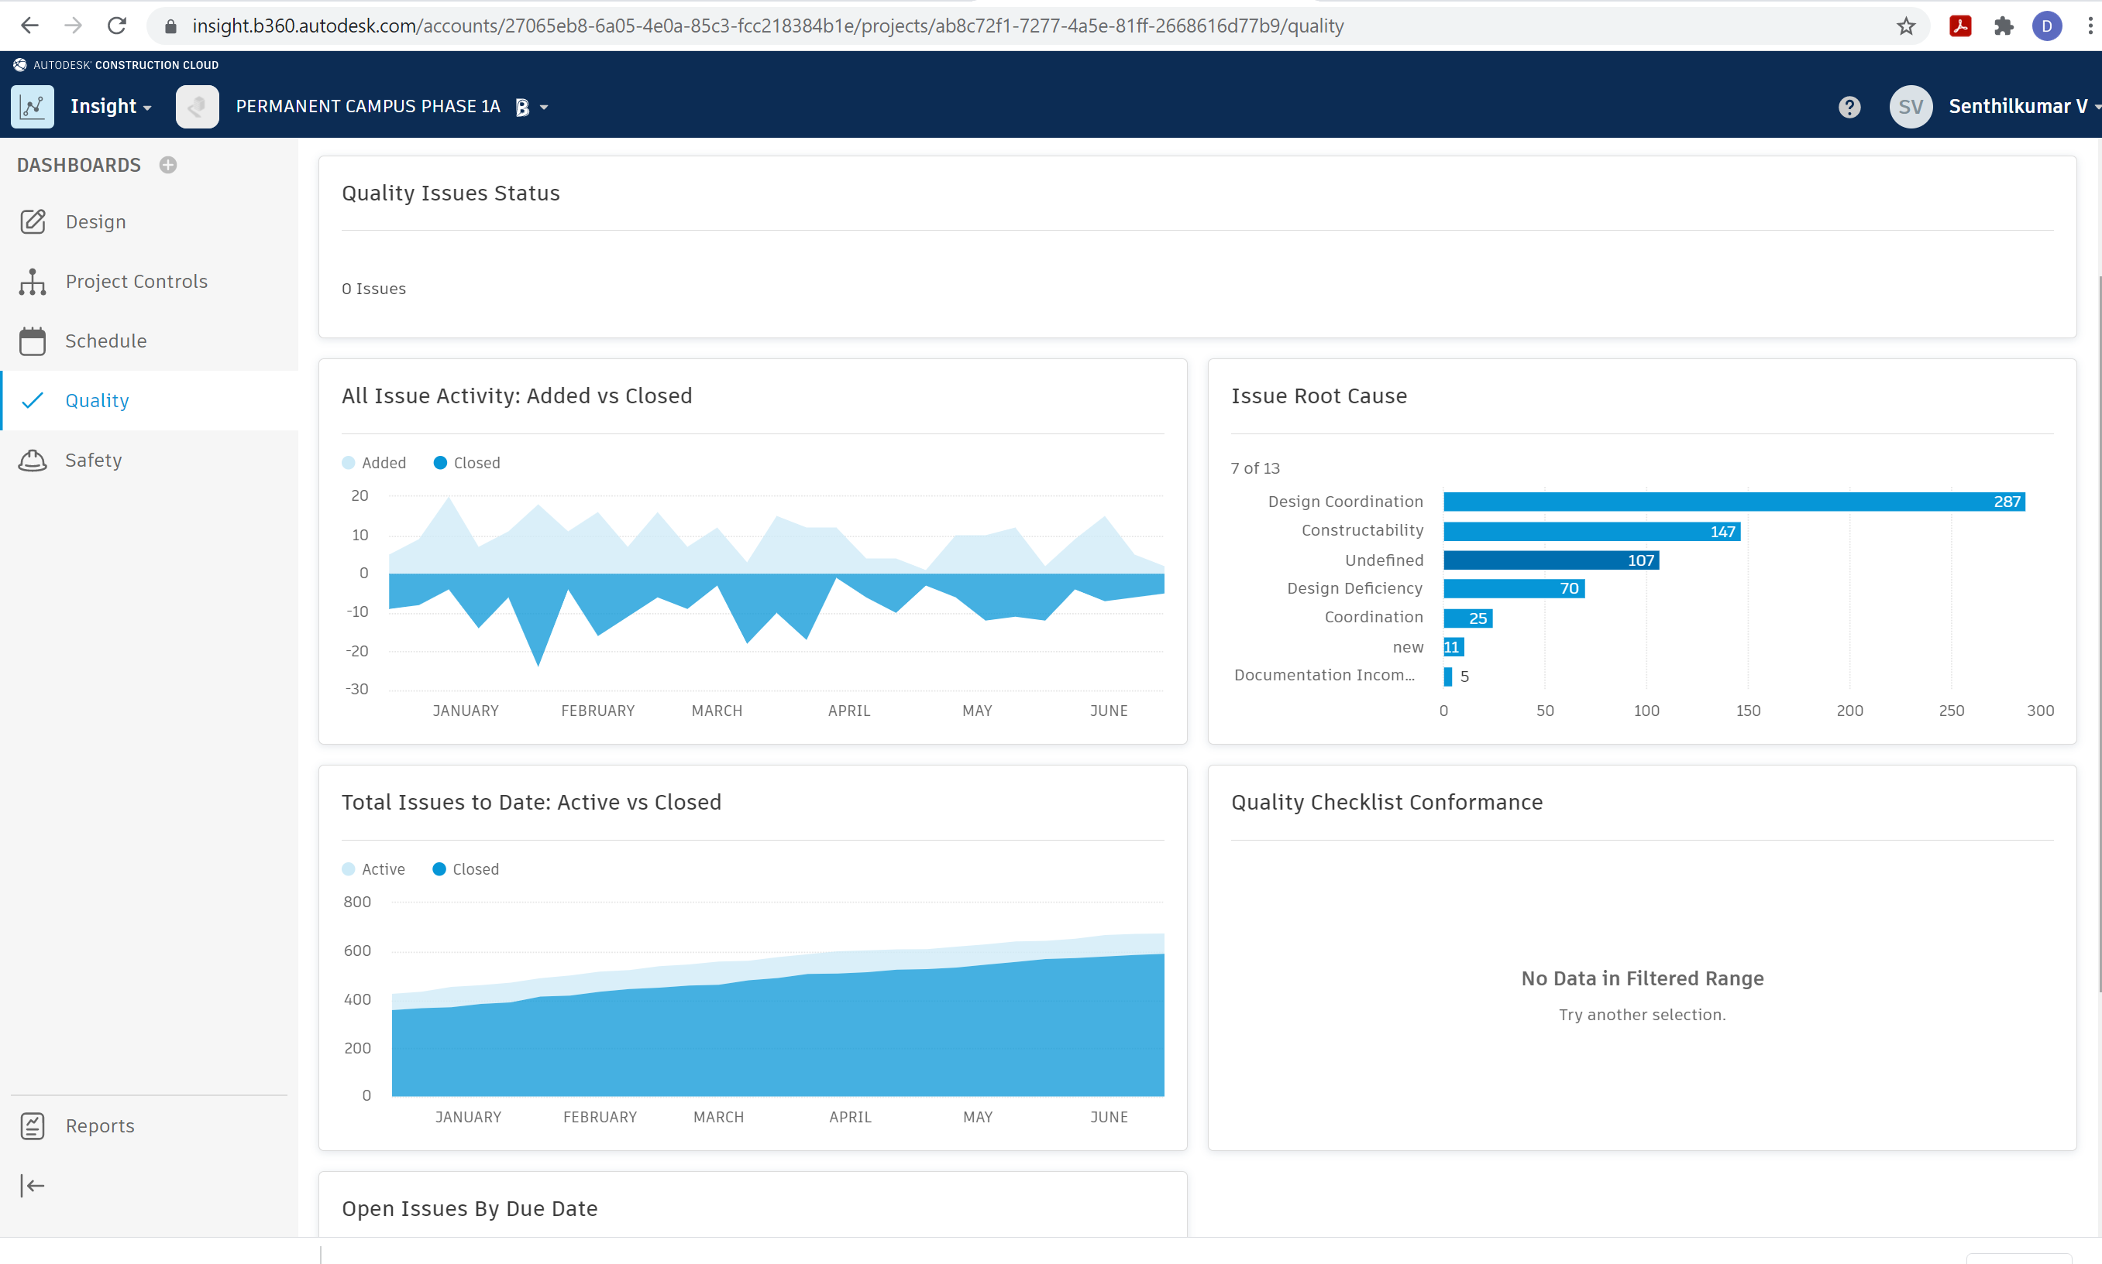
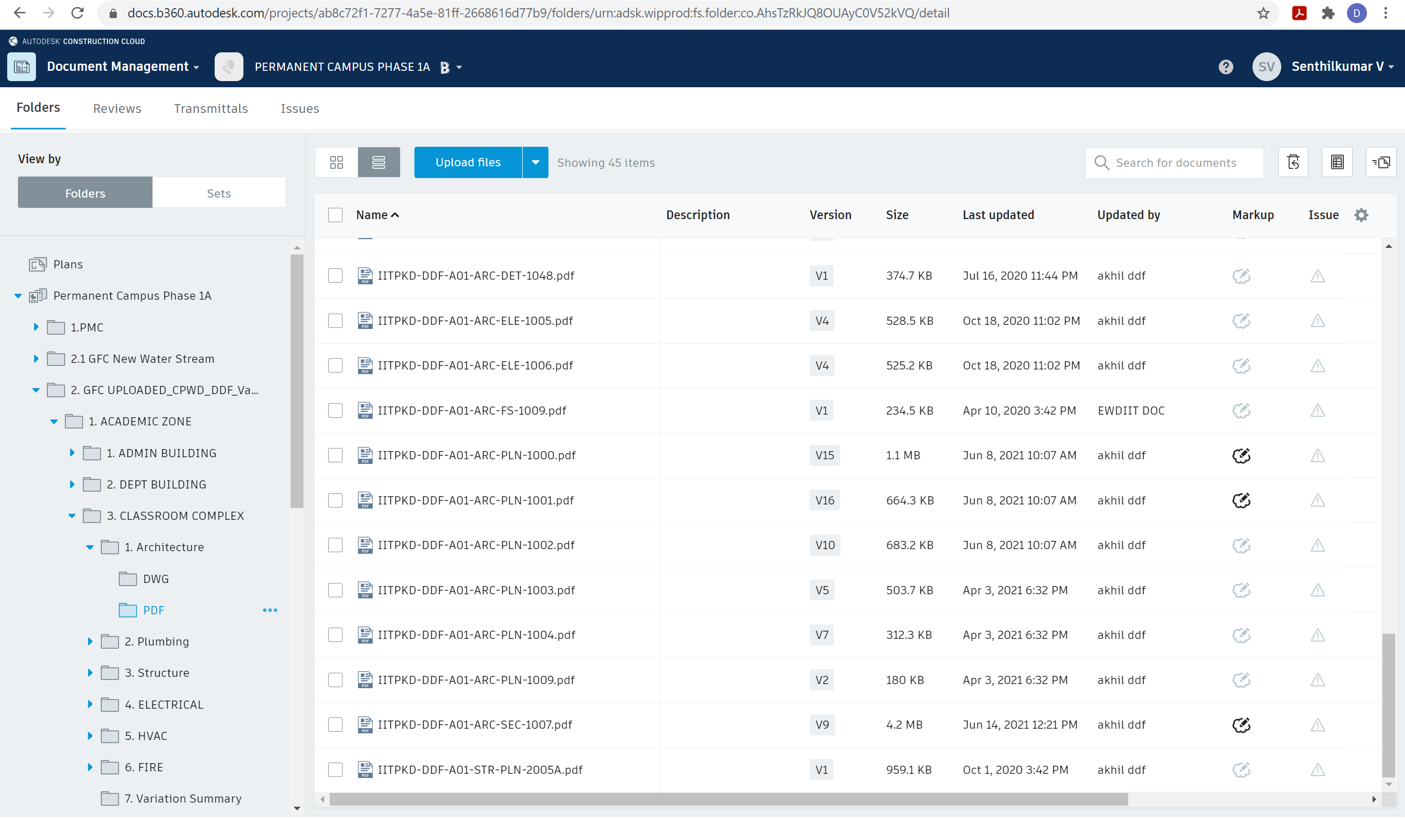
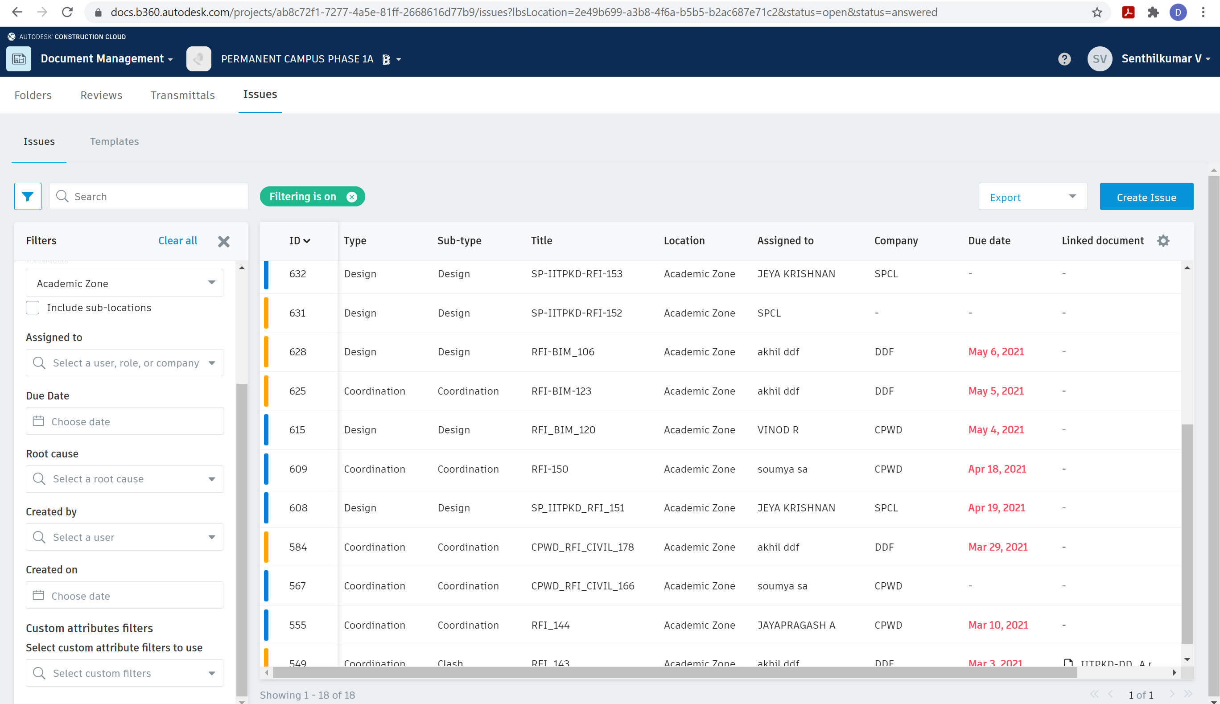
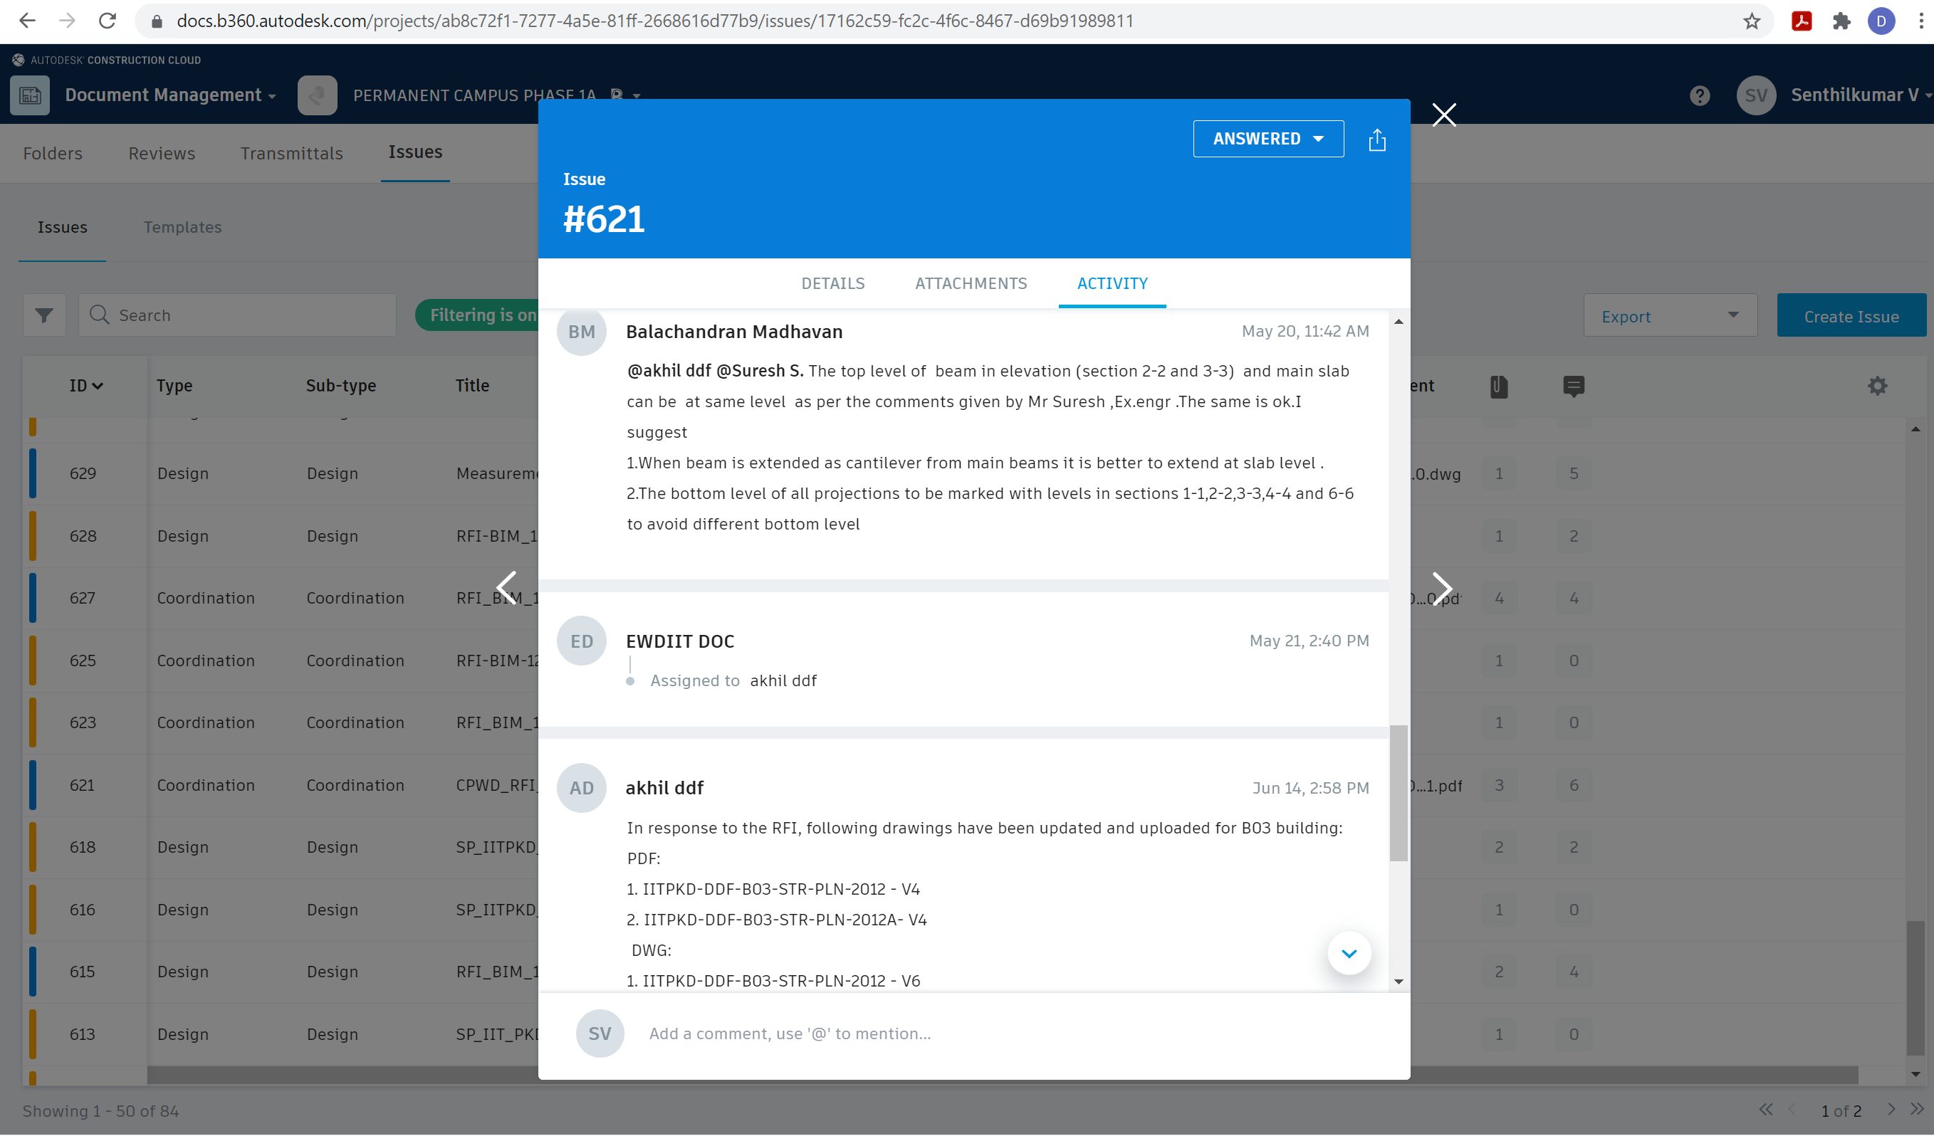
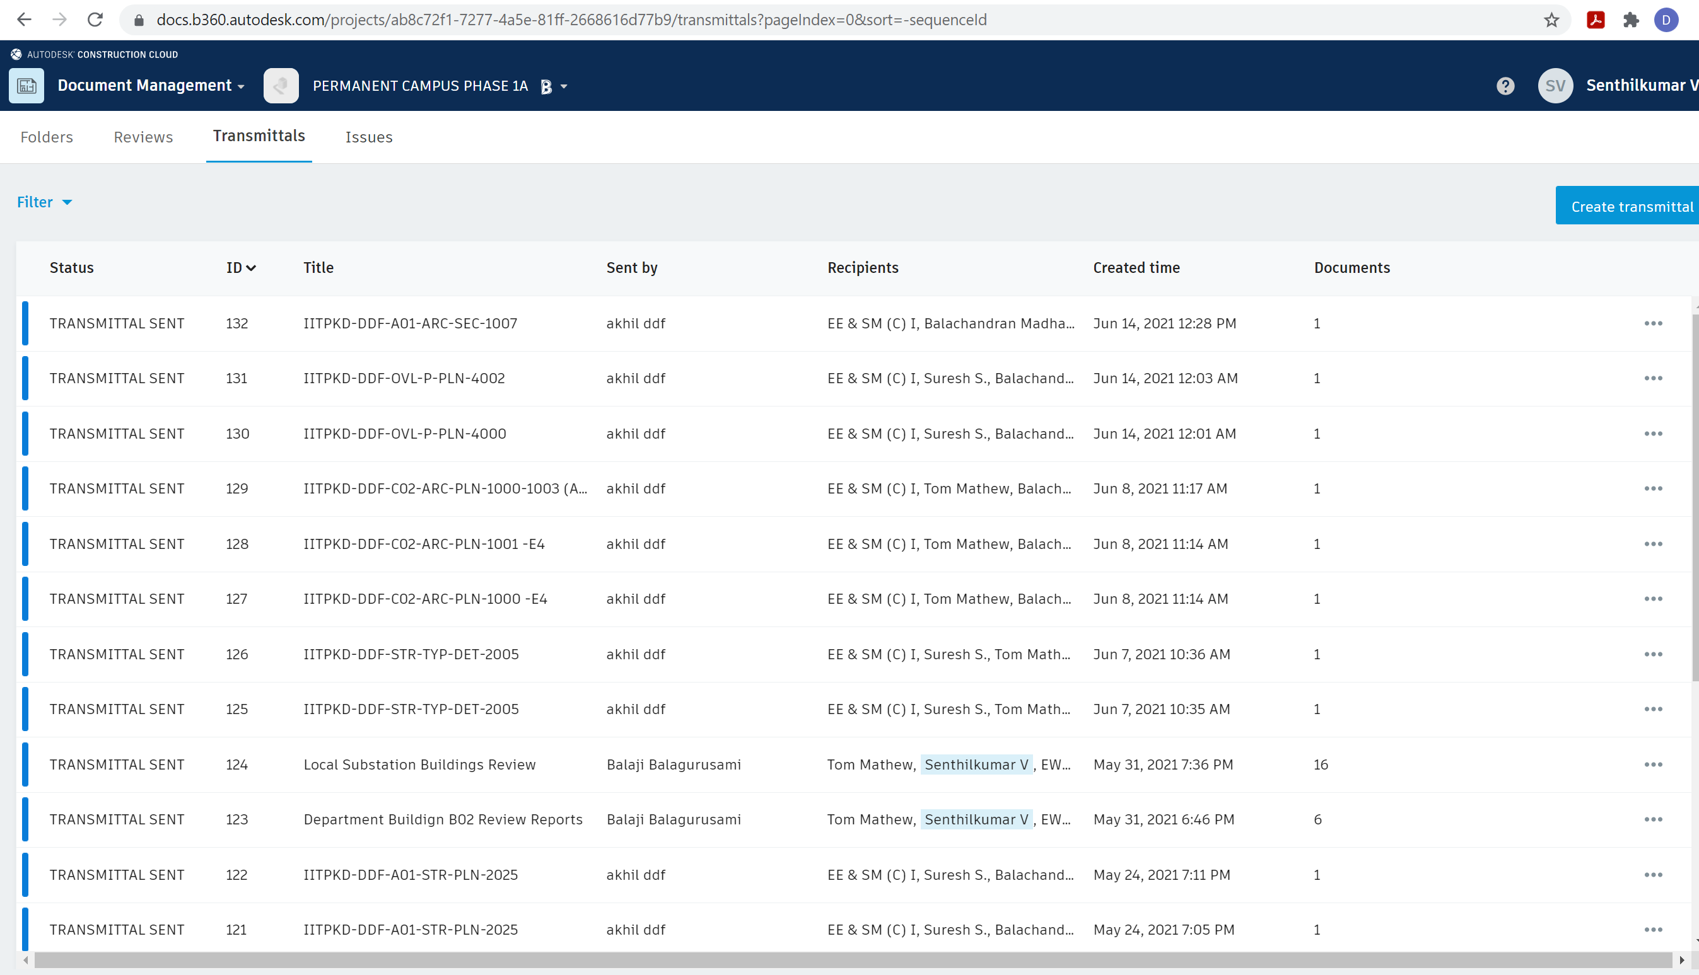
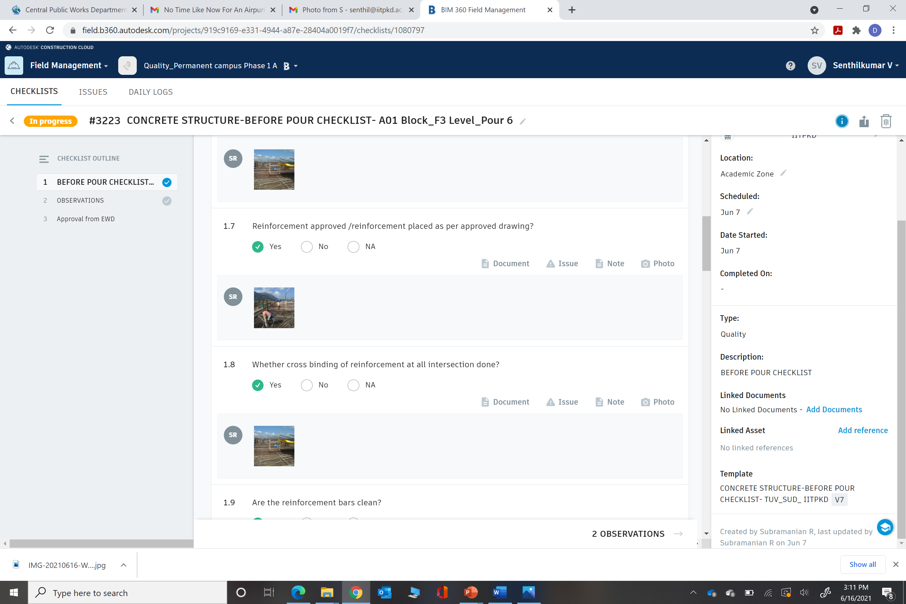
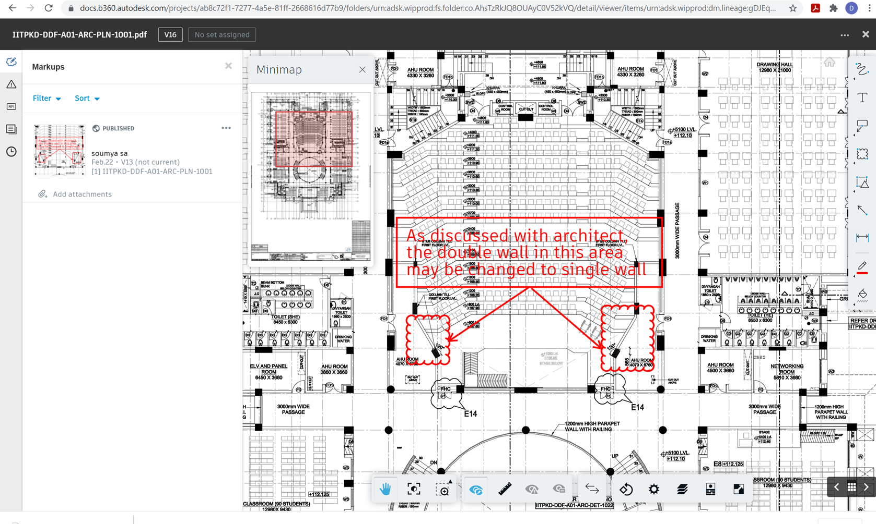
Benefits Realized using Common Data Environment Model
Automated Version Control
Markups for Easy Communication
Issue/ RFI History
Automated Change Management/ Drawing Comparisons
File Sharing/ Authoring
Automated Transmittal and Submittal records
Agenda for the Coordination Meeting
Remote Access and Discussion during Covid
Better Quality Management
Limitless Model Accessibility
Provide overall insights to the project's performance
Around 675 issues with multiple iterations of information is resolved
Around 9000 design revisions are managed with a maximum of 15 revisions in one design document.
Interventions through predictive analytics based on issue types issue resolution time and company
Digital Transformation in Public Project Delivery Using CDE and BIM

Slide 6
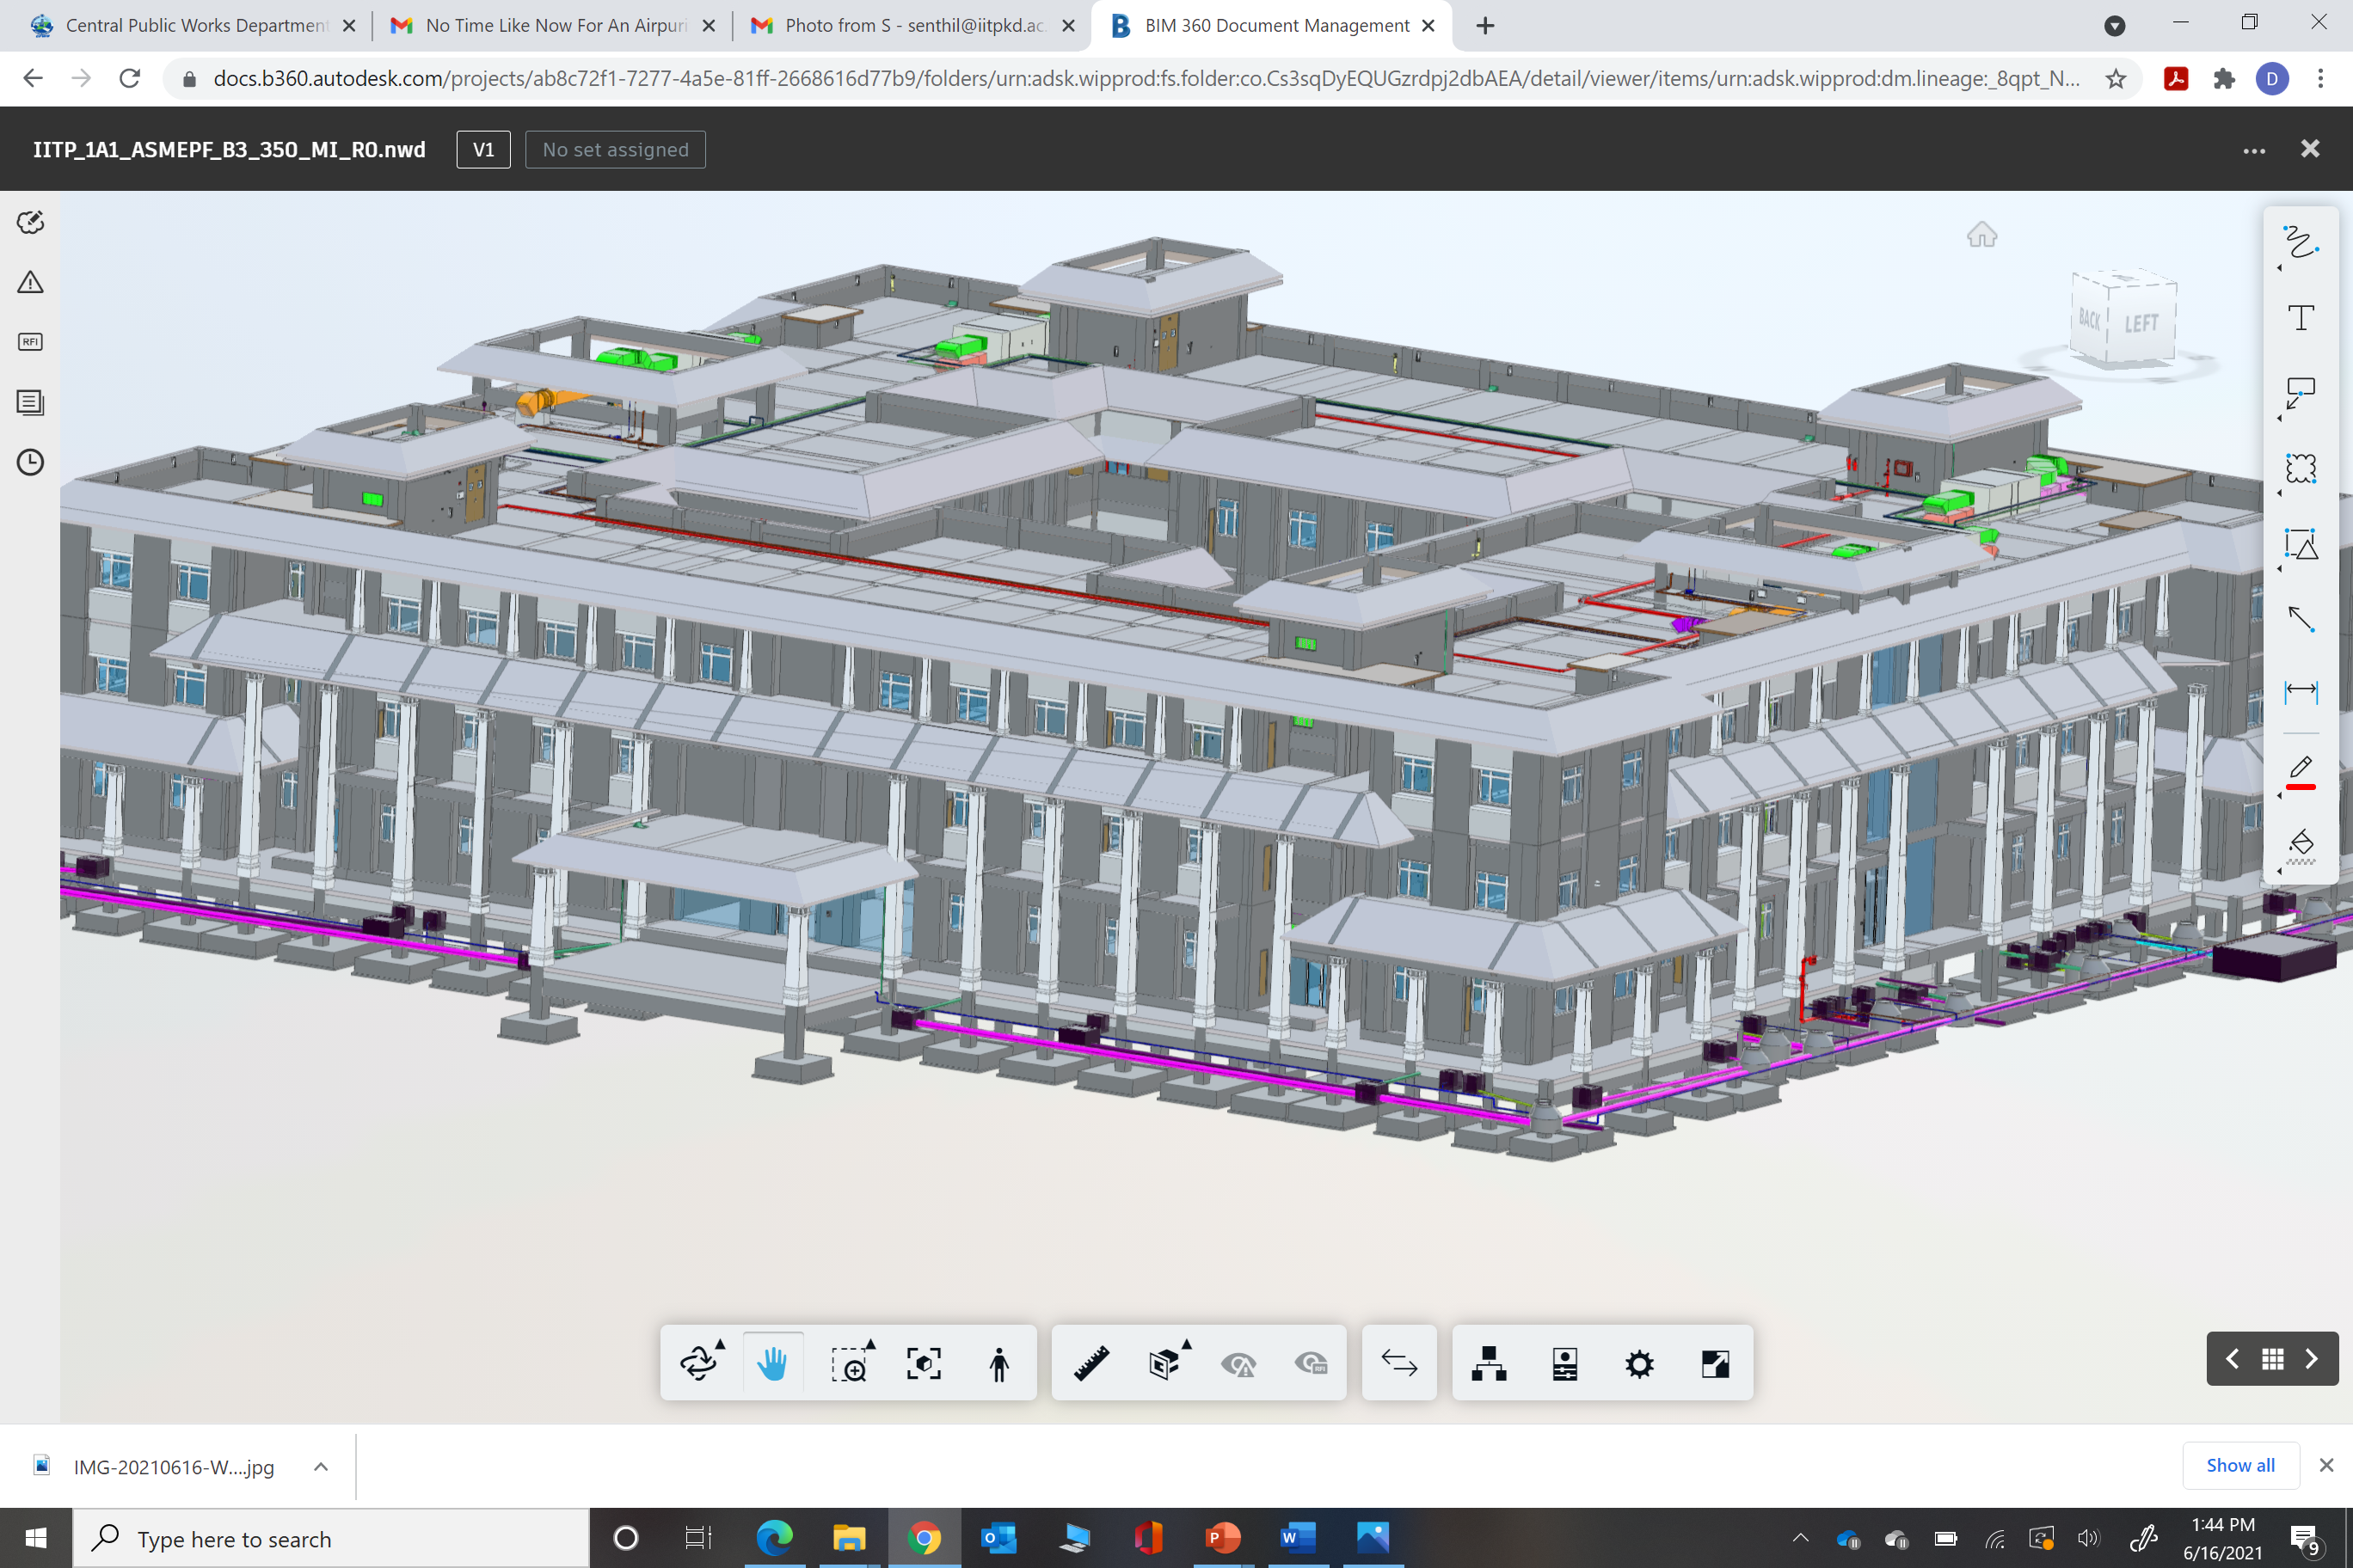
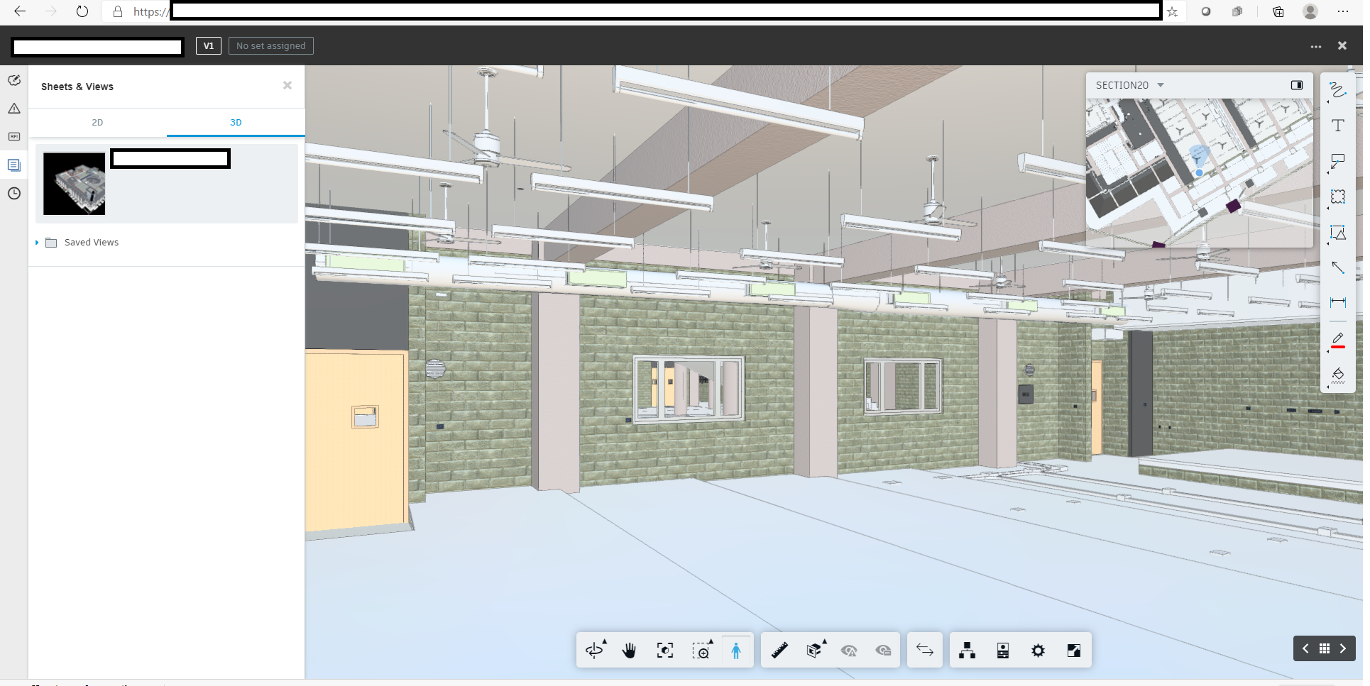
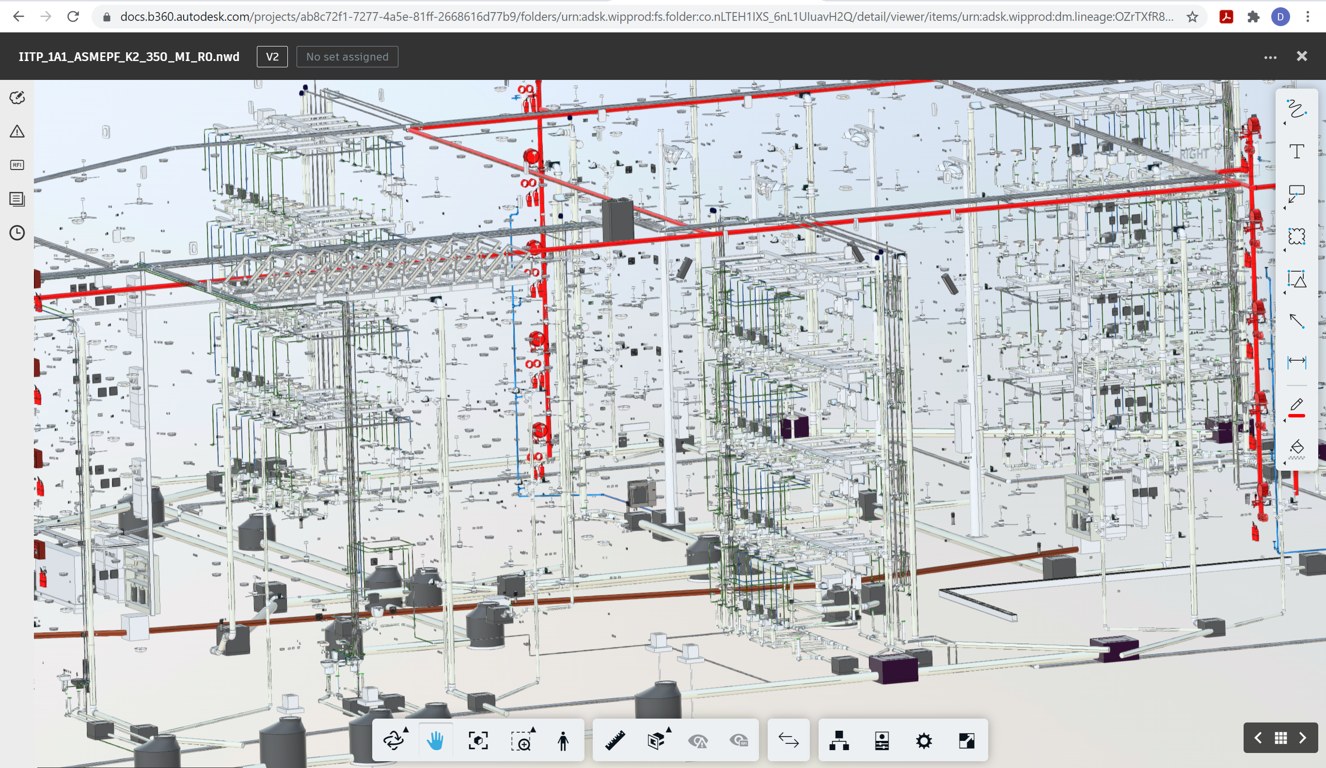
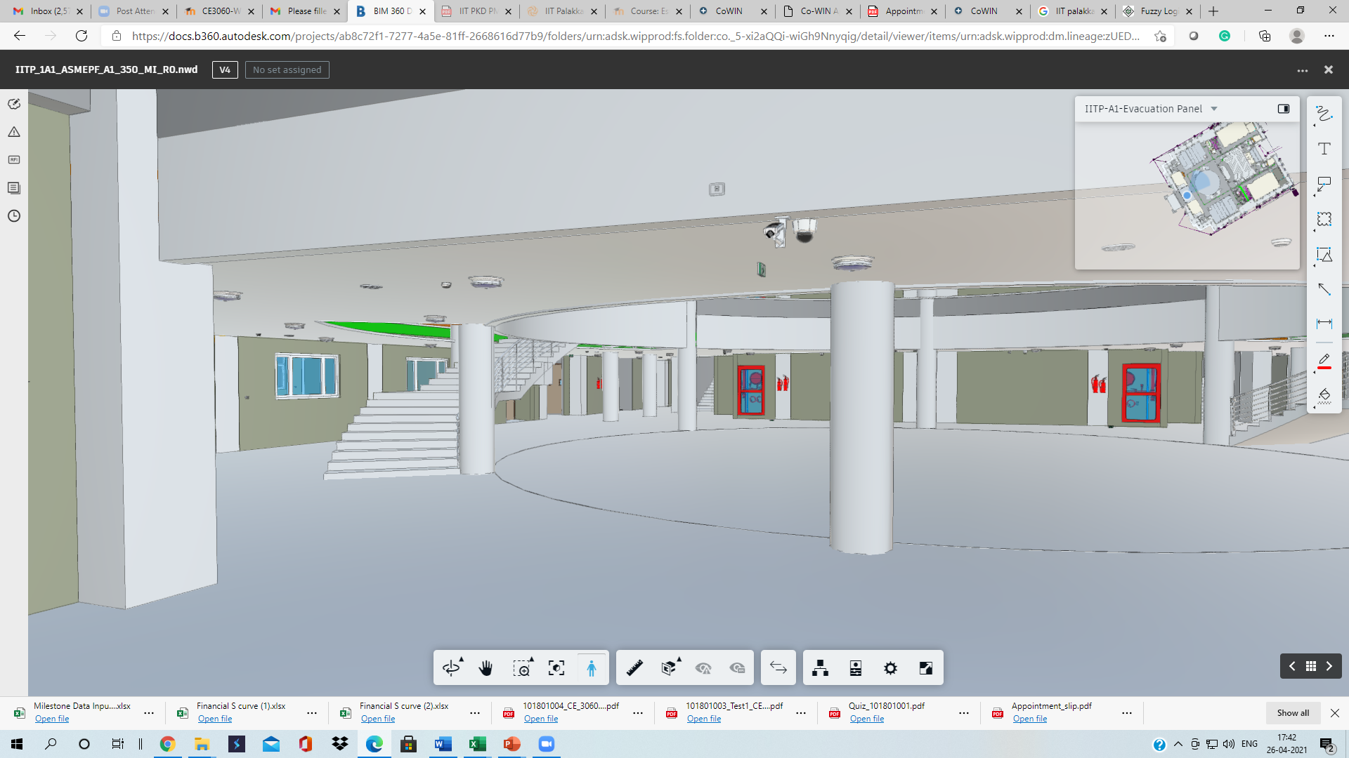
Benefits Realized using BIM
Easy Resolution of RFI’s
Less Lead Time to Issues/RFI’s Resolution
Informed Decision Making
Proactive Services Coordination
Proactive Clash Detection
Model/ Drawing Accuracy and Quality Checking Project Planning
Site Inspection
Digital Transformation in Public Project Delivery Using CDE and BIM

Slide 7
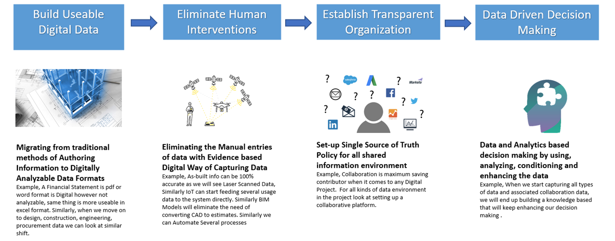
Expected Advantages on the Digital Transformation
Digital Transformation in Public Project Delivery Using CDE and BIM

Slide 8
Challenges Encountered in CDE and BIM Implementation and Support Expected
Lack of Guidelines and Enabling SOP’s
Team Workflow Alignment
Resistance to Change
Lack of Awareness and Skill Sets among the Team Members
Non-Availability of Standards on Digital Transformation(BIM/ CDE Implementation)
Complete Project Stakeholders Buy in and Support
Standardization in BIM Implementation (BIS Standards/ Guidelines) such as Standard BIM Execution Plan, Organization, Employer and Project Information Requirement
BIM Friendly SOP’s
Digital Data Management Guidelines
Training and Awareness
Mandated Implementation
Support for Implementation Use Cases and Research & Development
Digital Transformation in Public Project Delivery Using CDE and BIM

Slide 9
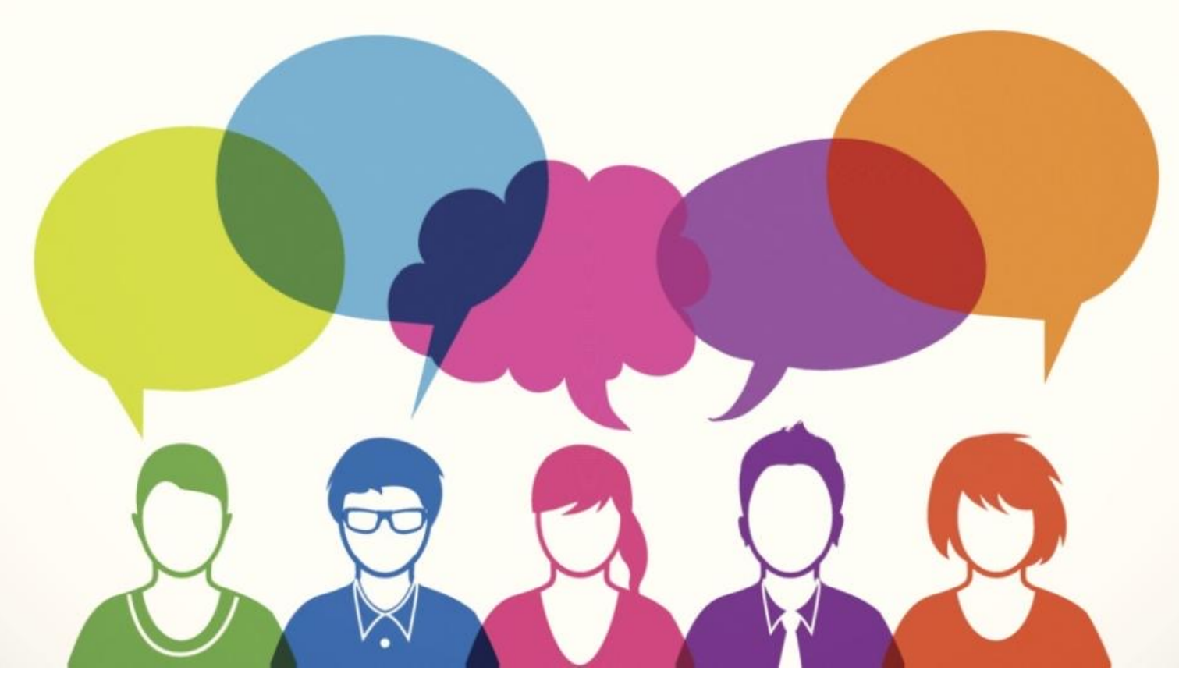
Thank You and Questions
Digital Transformation in Public Project Delivery Using CDE and BIM

