Slide 1


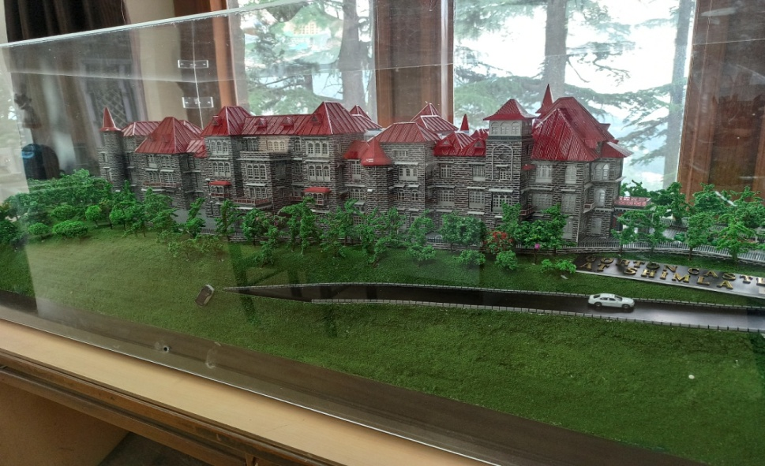
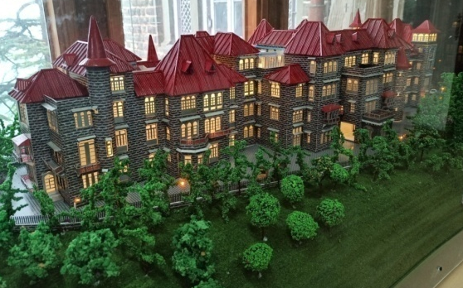
Central Public Works Department Shimla
Welcome
Technical Session on CPWD Day
Gorton Castle Building, Shimla (HP)

Slide 2
CASE STUDY
OF
REPAIR, RESTORATION & RETROFITTING
OF FIRE DAMAGED
"GORTON CASTLE BUILDING"

Slide 3
HISTORICAL
BACKGROUND

Slide 4
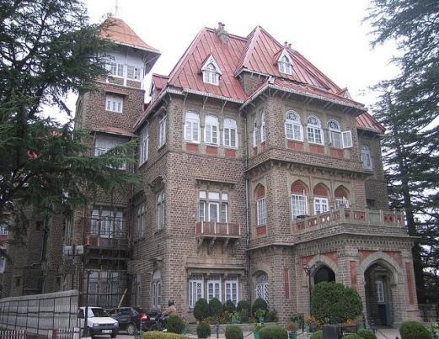
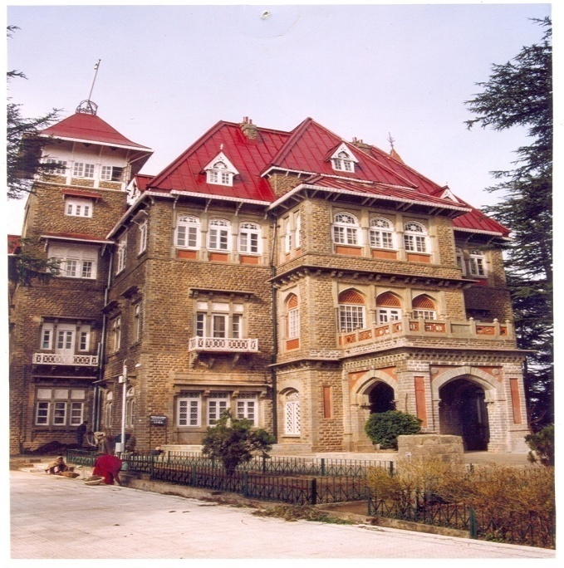
The site of ‘Gorton Castle’ Shimla originally belonged to Mr. Gorton, I.C.S. during the year 1840. Then it felled into the hands of a Banker, Sir James Walker, for making it a hospital, in 1890. However, the proposal was later rejected due to non-suitability of site.
The Imperial Government of India then purchased the site in 1900 to build the office of Civil Secretariat at a cost of 1.20 lakh.
The original design of current building was conceptualized by Sir Swinton Jacob in 1900 and it was built under supervision of Major H.F. Chesney, R.E. The construction works commenced during November, 1901 and completed during May, 1904 and this building was named as “Government of India Civil Secretariat”.

Slide 5
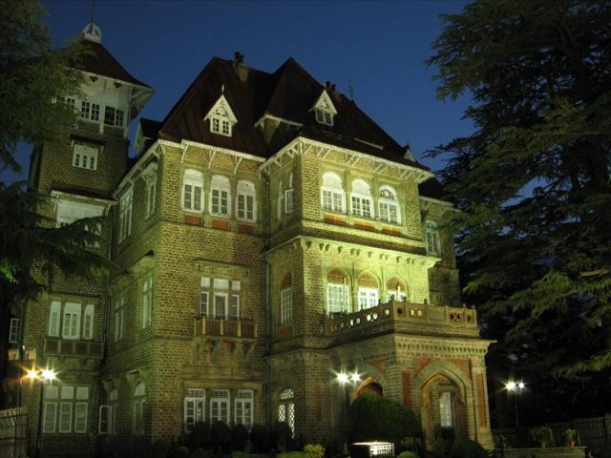
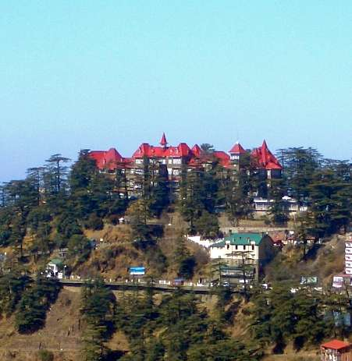
The building was got constructed for a cost of Rs. 11 lakhs.
The structure of this building is three to four storeyed structures with load bearing stone masonry walls in lime-surkhi mortar of varying thickness (width reducing from 90cm at Ground Floor to 45cm at Top Floor) with GI Sheet in Nainital pattern, artistic roof with provision of various features such as spires, canopies, flag-post, attic floors, jack arch ceiling, etc.
Presently, Gorton Castle Building houses the office of Pr. Accountant General (A&E) and Pr. Accountant General (Audit) of Himachal Pradesh.

Slide 6
FIRE INCIDENCE

Slide 7
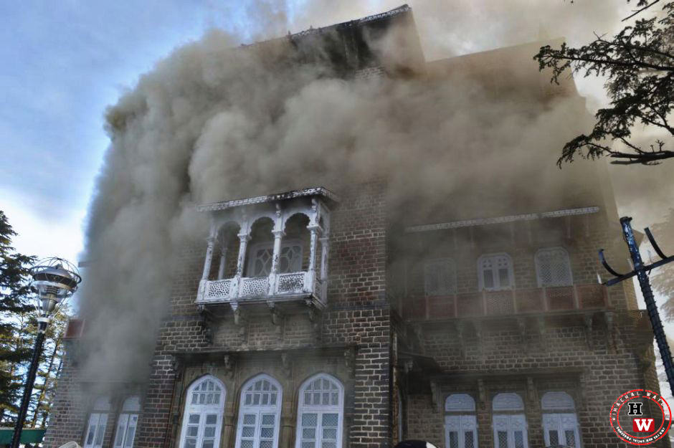
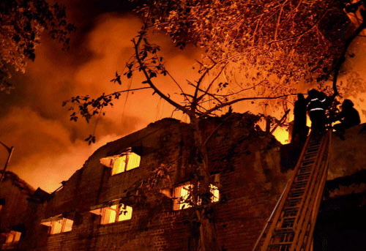
In the night of 27th-28th January, 2014, a major fire broke. Due to this unfortunate incidence, top two floors of Gorton Castle Building gutted into fire causing massive damage to the top two floors of building including structural damages. CPWD took the challenge of repair, restoration & retrofitting of fire damaged Gorton Castle building.
A comprehensive inspection and study of the building was made by the Senior Scientists of CBRI and CPWD officials.
As per recommendations of CBRI, retrofitting of this building was taken in two phases. The repair, restoration & retrofitting of this building for phase-I is already completed and handed over.

Slide 8
MAJOR ACTIVITIES:
GROUND FLOOR
AND
FIRST FLOOR

Slide 9
STRENGTHENING:
USING
BOND STONES

Slide 10
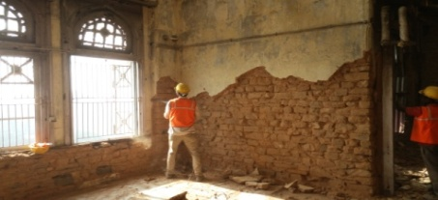
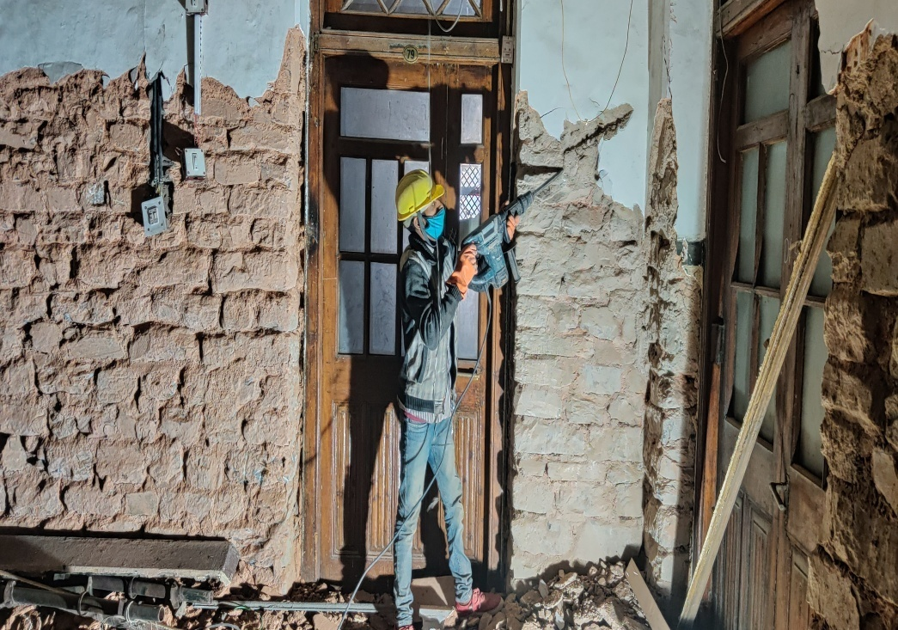
DISMANTLING OF
EXISTING LIME
PLASTER USING
PNEUMATIC
HAMMER

Slide 11
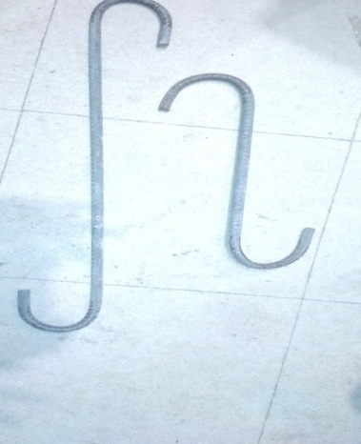
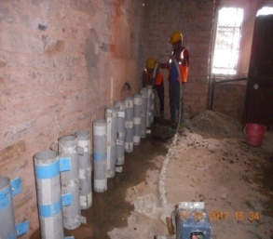
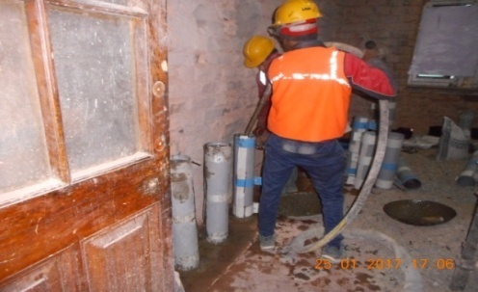
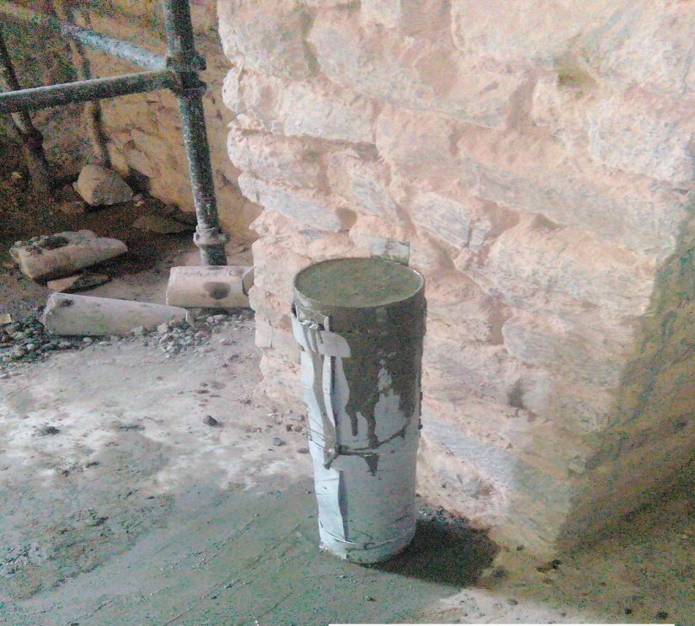
PRE-CASTING OF
BOND (THROUGH)
STONES (135MM
DIA) IN M25
DESIGN MIX
CONCRETE
HAVING 10MM
DIA TMT BAR AT
CENTRE

Slide 12
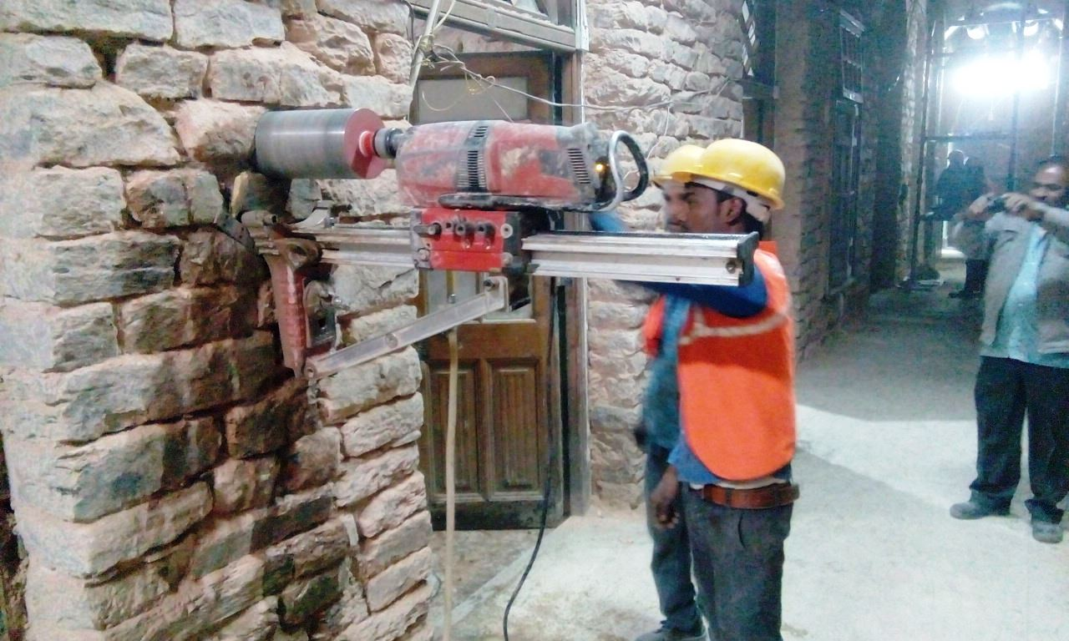
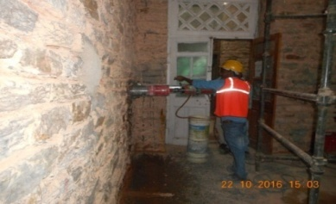
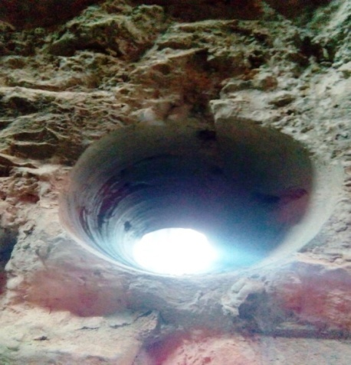

CORE
CUTTING
(150MM DIA)
IN STONE
MASONRY
WALLS

Slide 13
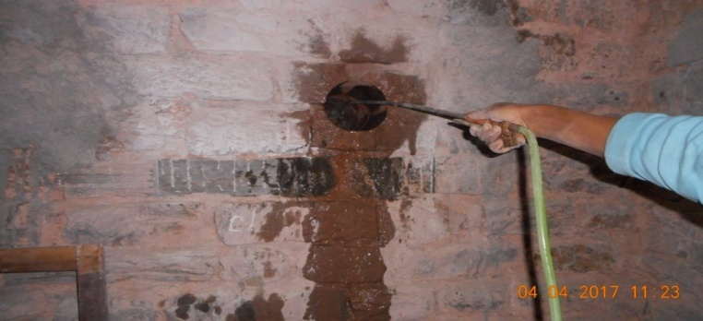
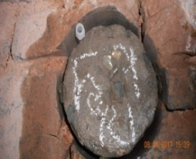
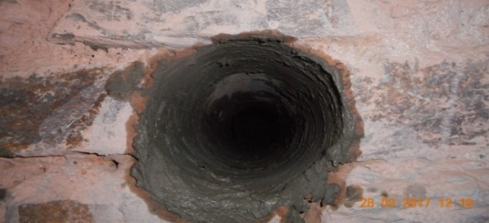
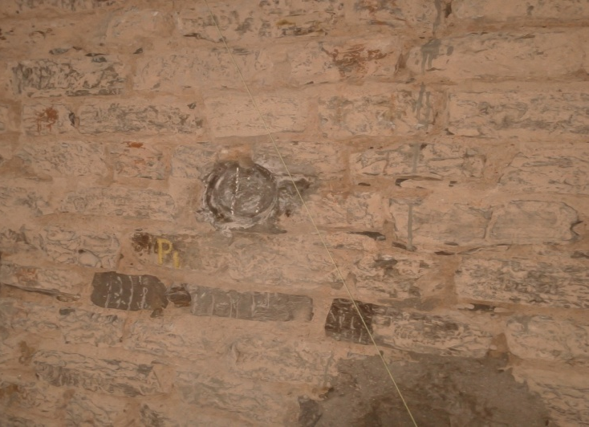
INSERTION
AND PLACEMENT
OF BOND
STONES AT
SPACING OF
1.5 MTRS
CENTER TO
CENTER BOTH
HORIZONTALLY
AND
VERTICALLY

Slide 14
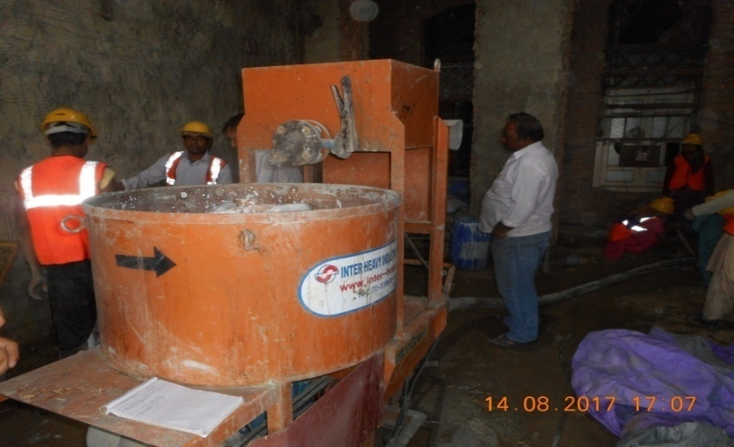
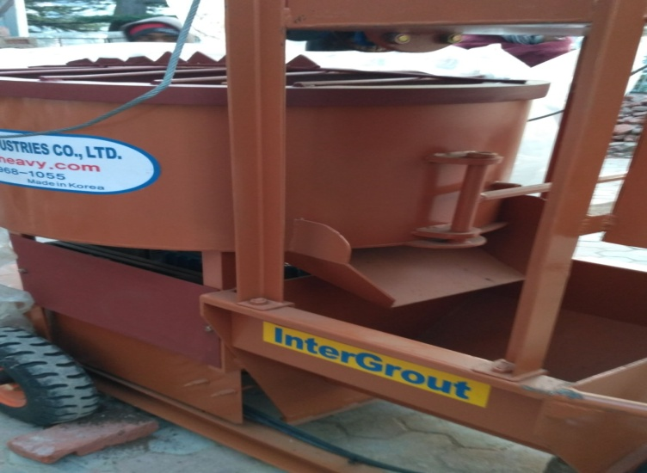
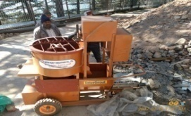
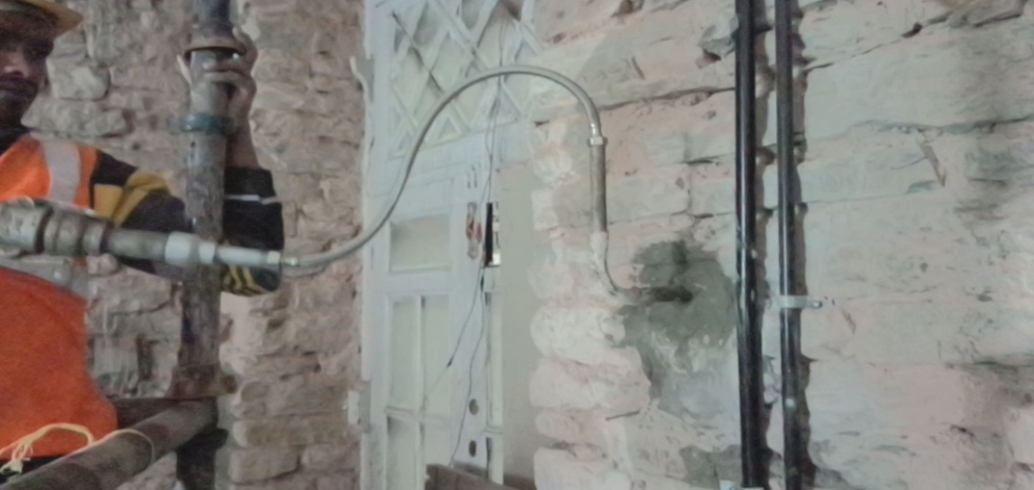
PRESSURE GROUTING
OF PERIPHERAL GAP
AROUND BOND
STONE USING
LIME-CEMENT-SAND
GROUT (1 LIME:
1 CEMENT: 1 QUARTZ
SAND) ADMIXED
WITH CEBEX
100 (PLASTICIZED
EXPANDING GROUT)

Slide 15
STRENGTHENING:
USING
PRESSURE
GROUTING

Slide 16
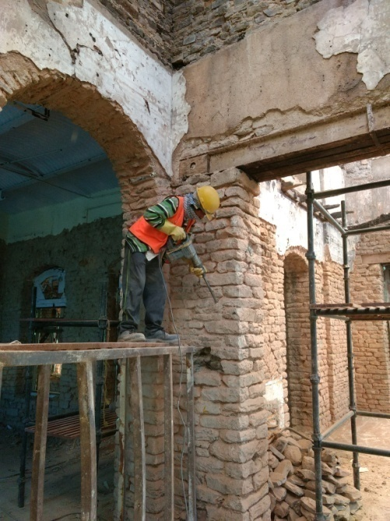
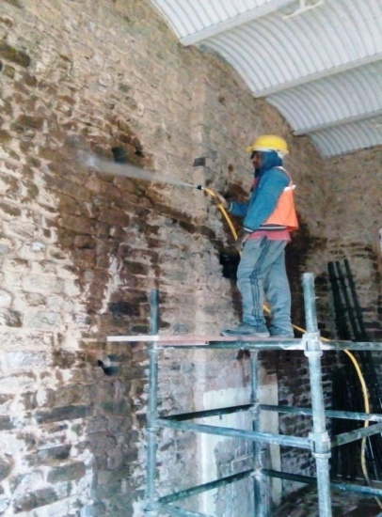
RAKING OF
JOINTS AND
CLEANING OF
STONE
MASONRY
WALLS USING
WATER
PRESSURE JET

Slide 17
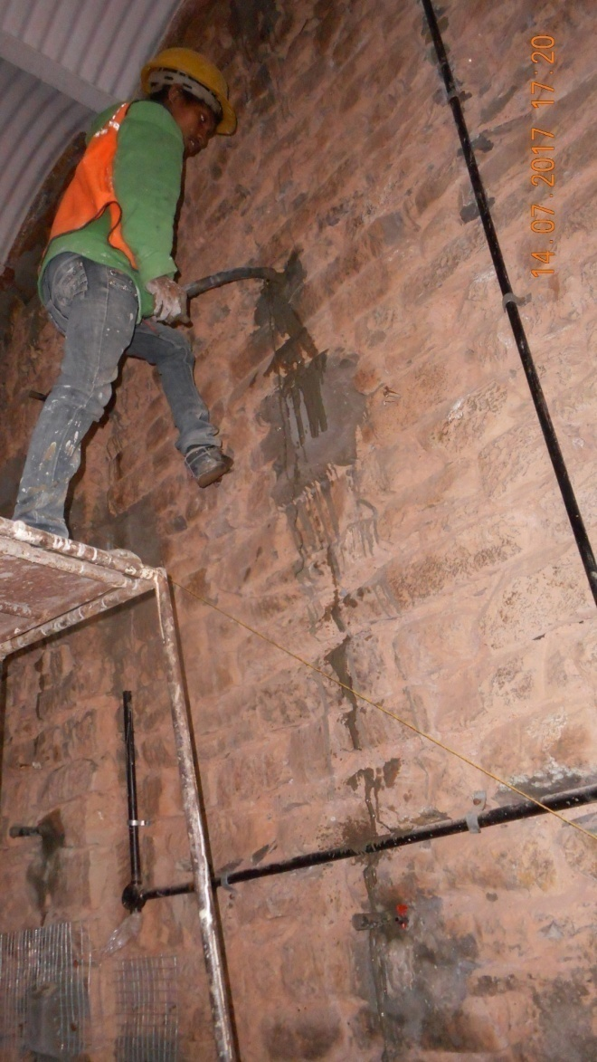
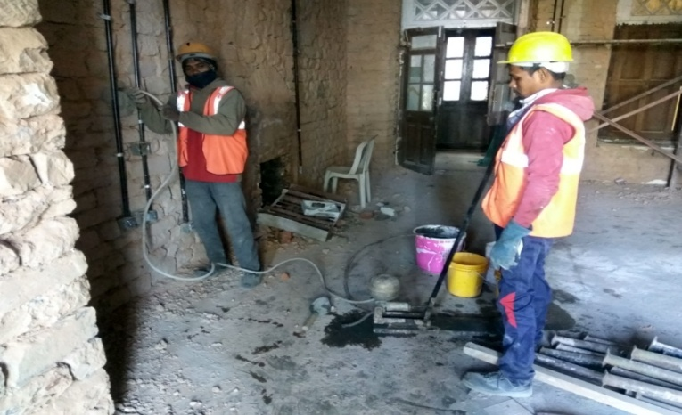
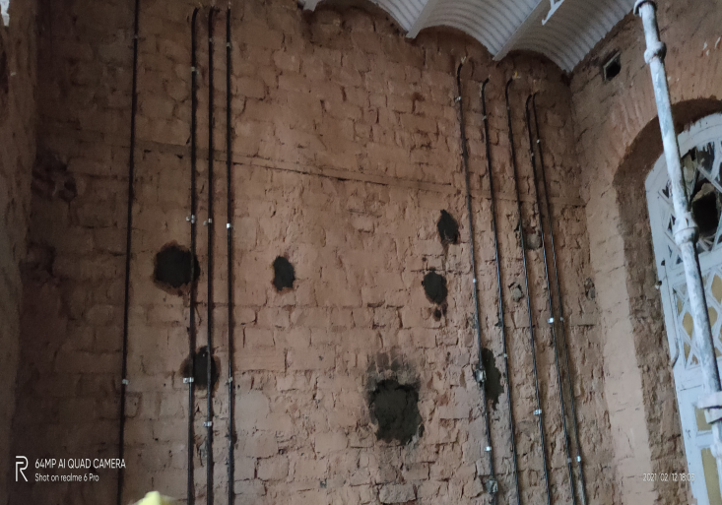
PRESSURE GROUTING
USING LIME-
CEMENT-SAND
GROUT
AT LOCATIONS OF
LOOSE MORTAR
JOINTS/ HOLLOW
JOINTS/ CRACKED
STONES

Slide 18
STRENGTHENING:
USING
EPOXY COATED
CORNERS BARS

Slide 19
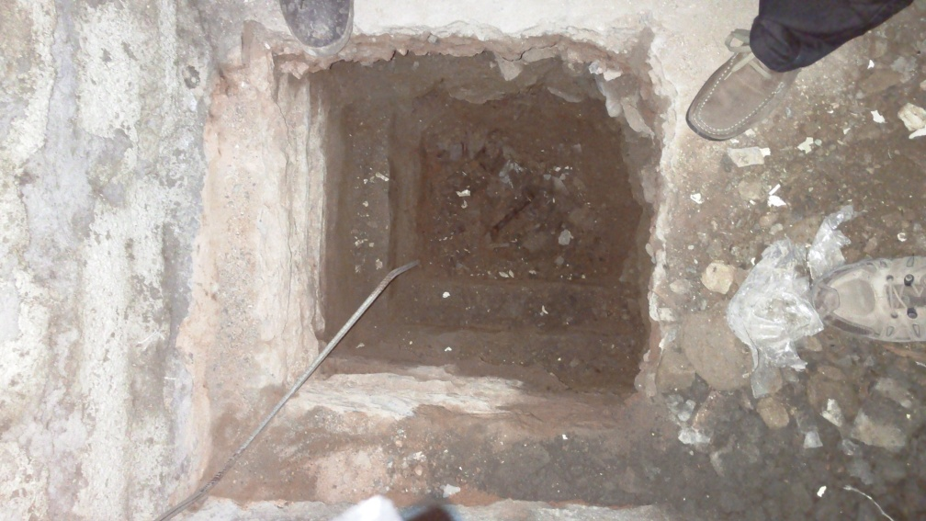
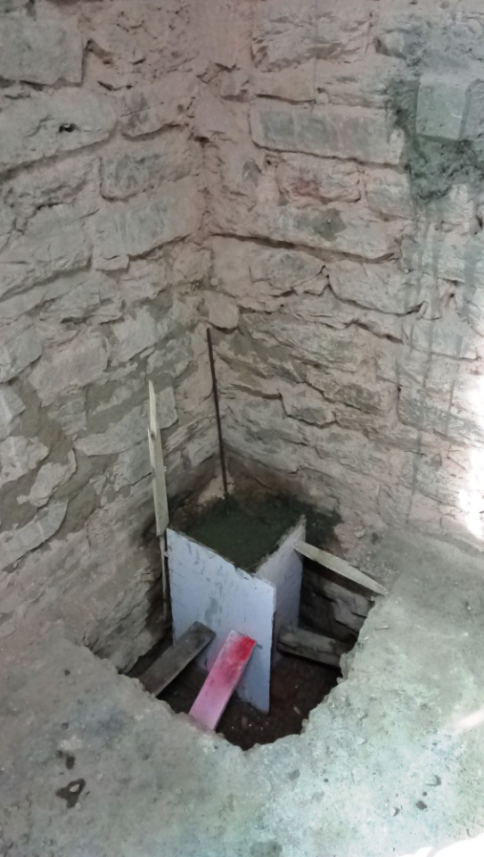
MAKING PEDESTAL
OF SIZE 600 X 600
X 600 MM IN
M25 DESIGN
MIX CONCRETE
BELOW GROUND
FLOOR LEVEL

Slide 20
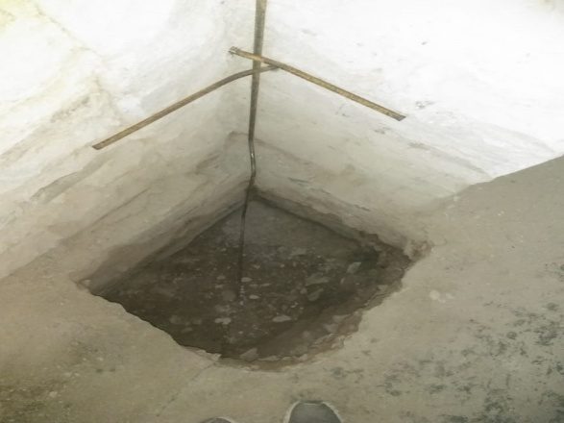
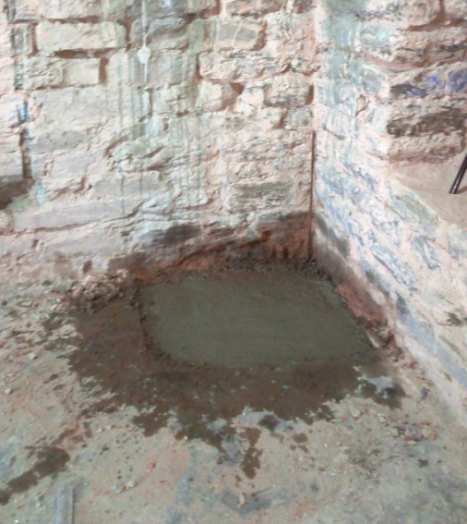
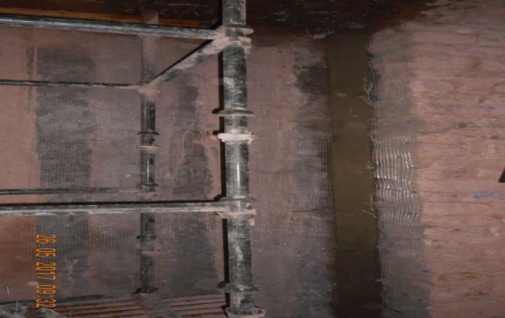
ERECTION
EPOXY
(NITOZINC
PRIMER)
COATED 12 MM
DIAMETER TMT
STEEL BARS

Slide 21
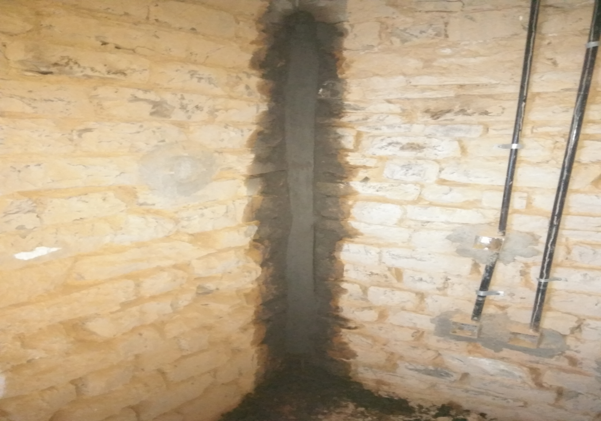
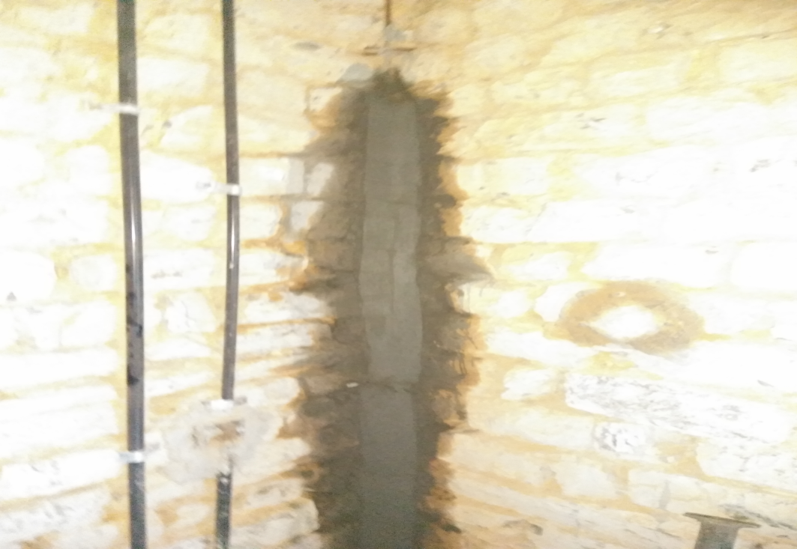
MAKING
CHAMPHERED
CORNERS OF
75 X 75 MM
USING MICRO-
CONCRETE

Slide 22
STRENGTHENING:
USING
GALVANISED
WELDED
WIRE MESH

Slide 23
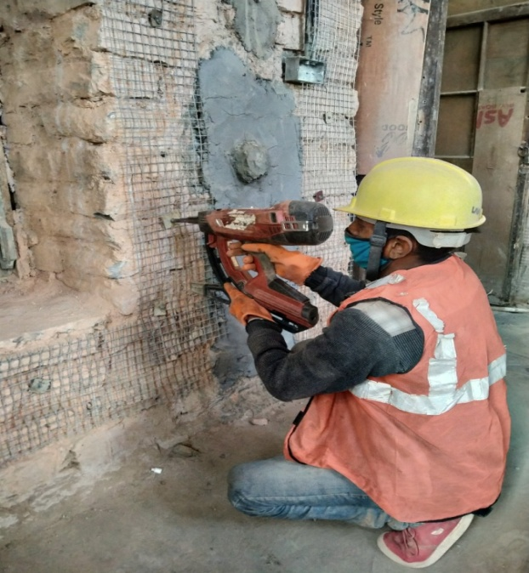
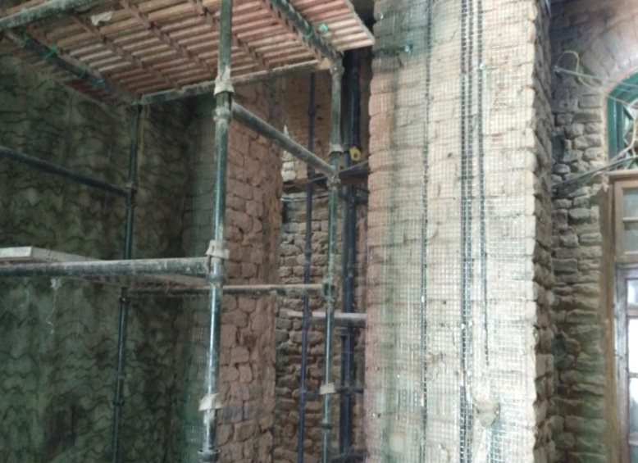
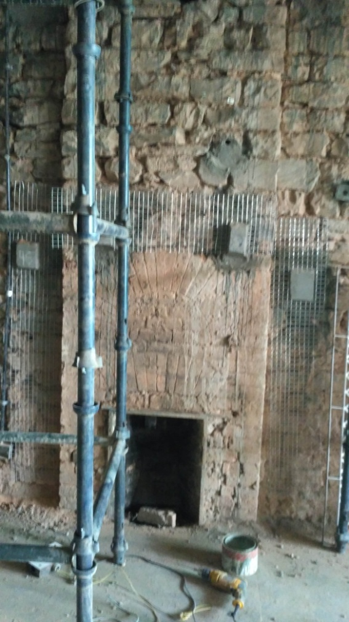
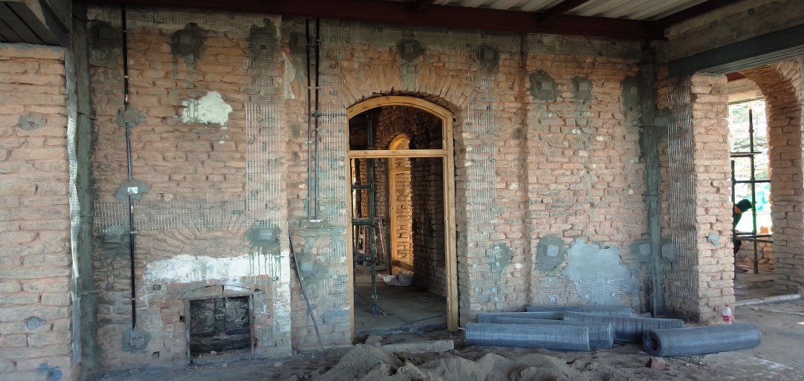
PNEUMATIC NAILING
OF 300 MM
WIDE GALVANIZED
WELDED WIRE
MESH AROUND
DOOR/ WINDOW
OPENINGS AND
AT SILL & LINTEL
LEVELS

Slide 24
STRENGTHENING:
USING FERRO
CEMENT PLASTER

Slide 25
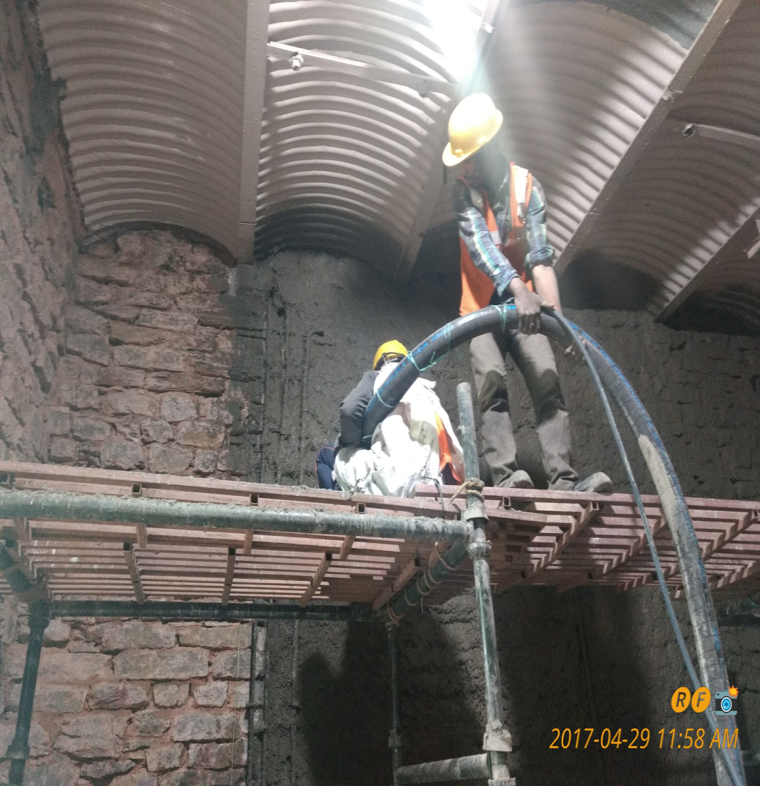
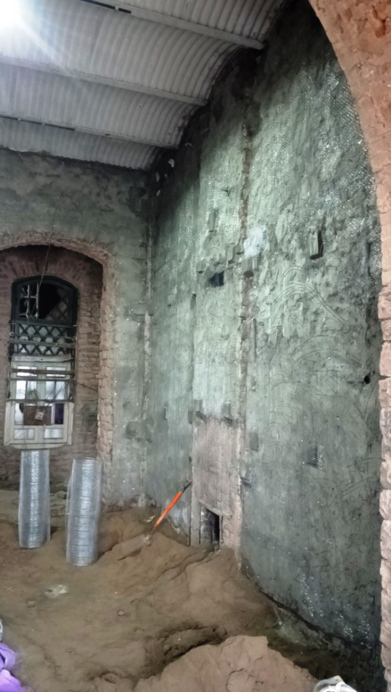
LEVELING COURSE
OF CEMENT PLASTER
OF VARYING THICKNESS
TO BRIDGE UNEVEN
PROTRUSIONS OF STONES
IN CEMENT MORTAR
(1 CEMENT: 3 COARSE SAND)
ADMIXED WITH CONPLAST
WL (INTEGRAL
WATERPROOFING AGENT)
AND SBR LATEX (MORTAR
AND SCREED MODIFIER
CUM BONDING AID) AND
APPLICATION OF LAYER
OF NITOBOND AR (BONDING
AGENT BETWEEN OLD
AND NEW LAYERS)

Slide 26
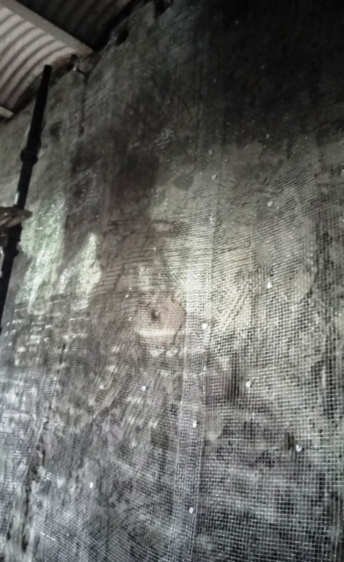
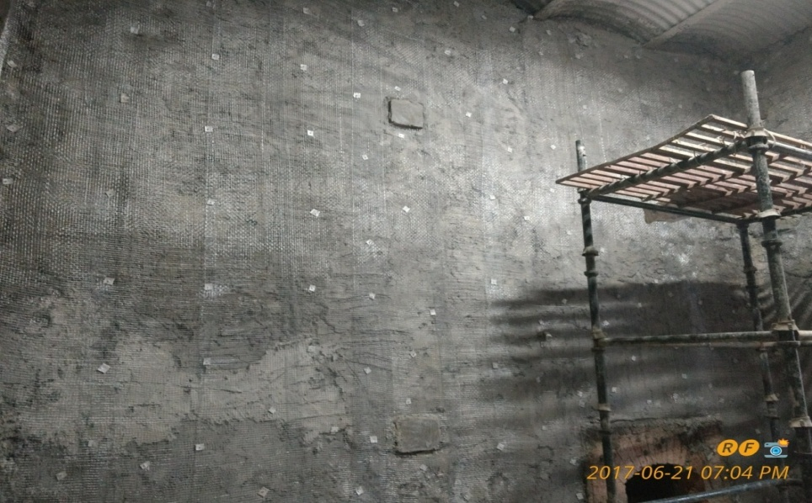
PNEUMATIC
NAILING OF
GALVANIZED
WOVEN WIRE
MESH ON THE
SURFACE OF
LEVELING COURSE

Slide 27

20 MM THICK FERRO-
CEMENT LINING
OVER LEVELING COURSE
ON STONE MASONRY
WALLS IN CEMENT
MORTAR IN TWO
LAYERS OF 10 MM
THICKNESS EACH WITH
GALVANIZED WOVEN
WIRE MESH BETWEEN
LAYERS OVER LEVELING
COURSE

Slide 28
SESMIC RETROFITTING:
USING
HELICAL BARS

Slide 29
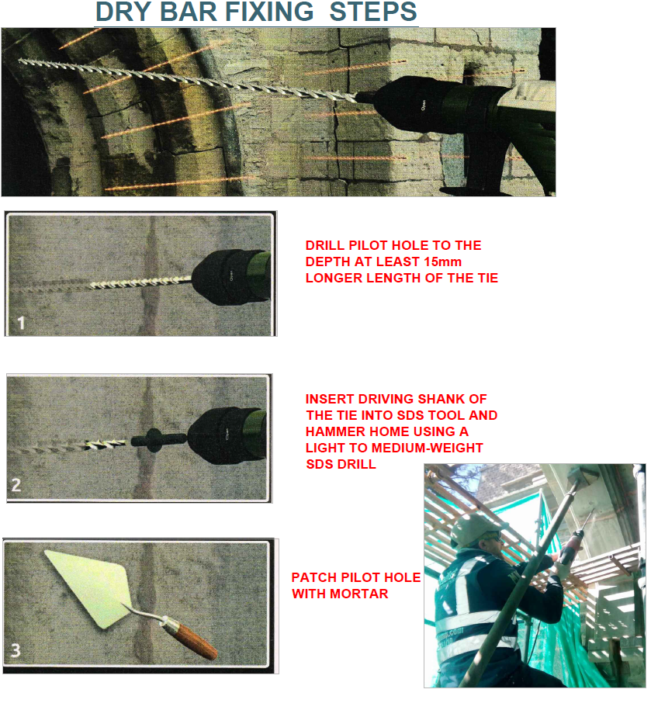
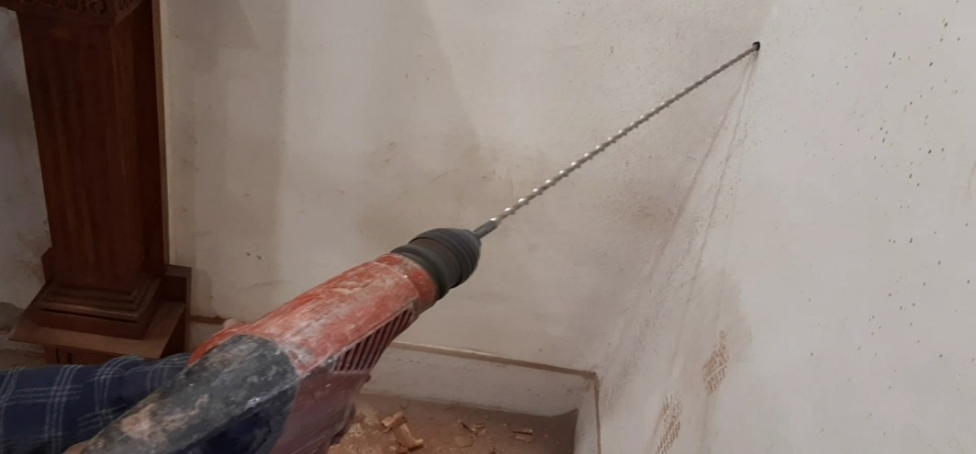
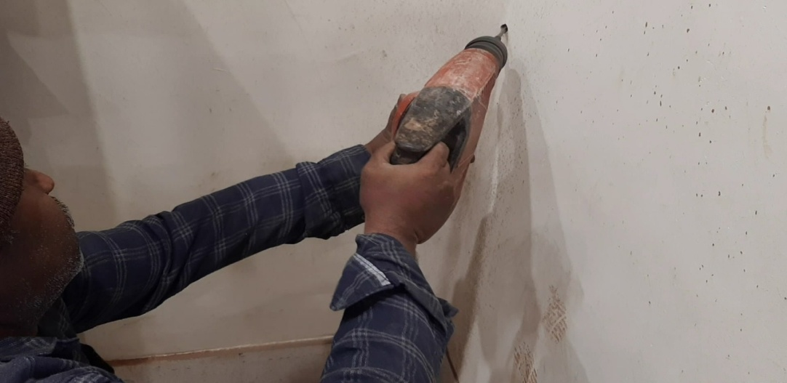
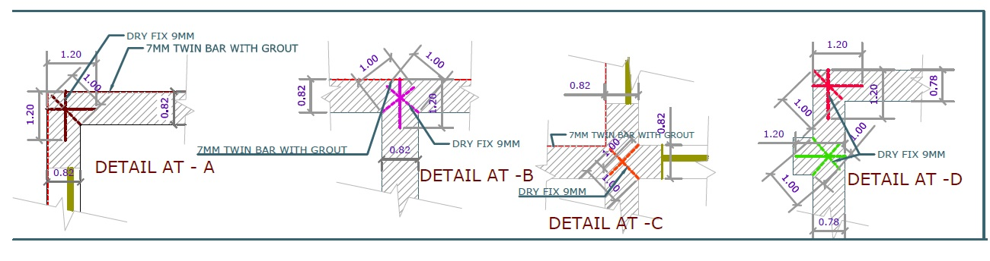
DRY STITCHING
OF STONE
MASONRY
JOINTS USING
7 MM DIA
STAINLESS
STEEL HELICAL
BARS AT SILL
LEVEL AND
LINTEL LEVEL

Slide 30
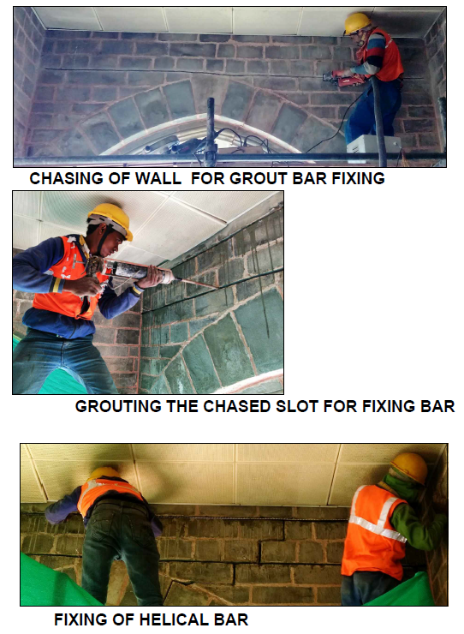


WET STITCHING
USING 9 MM
DIA STAINLESS
STEEL HELICAL
BARS AND FILLING
THE GROOVE
WITH THIXOTROPIC
GROUT

Slide 31
RE-CONSTRUCTION:
SECOND FLOOR
AND
THIRD FLOOR

Slide 32



DISMANTLING
OF EXTREMELY
BURNT SECOND
AND THIRD
FLOOR

Slide 33


NEW STONE
MASONRY WALLS
IN CEMENT-LIME
MORTAR (1 CEMENT :
1 LIME : 3 COARSE
SAND) MATCHING
WITH SHADE
OF PARENT
STONE

Slide 34



RE-CONSTRUCTION
OF FIRE PLACES
FOR FIRE CHIMNEY
IN BRICK MASONRY
AND FACIA
DECORATIVE
WOOD WORK IN TEAK
WOOD

Slide 35




PROVISION OF MS
BELTING ARRANGEMENT
OF EPOXY COATED
MS FLAT INSIDE STONE
MASONRY WALL AT
LINTEL LEVEL (SECOND
AND THIRD FLOOR)
IN ORDER TO TIE
THE STRUCTURE
AND PROVIDE DUCTILE
STRENGTH TO STRUCTURE
AGAINST SEISMIC
FORCES

Slide 36


CASTING OF
150 MM THICK
RCC BANDS
IN M25
DESIGN MIX
CONCRETE
ABOVE LINTEL
LEVEL

Slide 37




DECK SHEET ROOFING
SUPPORTED ON MS
GIRDERS AND
PROVISION OF
MS SHEAR STUDS
WITH NOMINAL
STEEL BAR (8MM DIA
@ 250 MM C/C)
IN M25 CONCRETE

Slide 38


PRE-ENGINEERED
TUBULAR TRUSSES
AND PURLINS
COATED
WITH PRIMER,
FIRE RETARDANT
PAINT AND
ENAMEL
PAINT

Slide 39


PINE WOOD PLANKS
(COATED WITH
FIRE RETARDANT
PAINT & BITUMAN
PAINT) & APP
WATERPROOFING
MEMBRANE (3 MM
THICK AND
5 LAYERED)

Slide 40


POLYNUM
SHEETS
(4 MM THICK)
AS MOISTURE/
VAPOUR
BARRIER
OVER APP
SHEETS

Slide 41


PLACEMENT
OF POSTAL
RED 0.8MM
THICK CRC
SHEETS IN
NAINITAL
PATTERN

Slide 42


CLEANING OF
EXTERNAL FACADE
USING ANTIFUNGAL
WASH TREATMENT
CHEMICALS, POINTING
THE JOINTS OF
STONE MASONRY
AND APPLYING
CHEMICAL FOR
RESTORATION
OF STONE AND
WATER REPELLENT

Slide 43
INTERNAL
FINISHING
WORKS

Slide 44




ORNAMENTAL
TEAK WOOD
WITH MELAMINE
POLISH

Slide 45



ORNAMENTAL
DOOR FITTINGS:
BRASS HANDLES
AND TOWER
BOLTS IN
DOORS AND
WINDOWS

Slide 46


ORNAMENTAL
PRECAST CAST
IRON SPIRAL
STAIRCASES

Slide 47


ORNAMENTAL
ELECTRICAL
FITTINGS:
GOLDPLATED
ELECTRICAL
SWITCHES &
SOCKETS

Slide 48


DHAJJI WALL INTERNAL
PARTITIONS:
STONE PIECES/ STONE CHIPS
MASONRY WALL IN MUD –
PHASKA MORTAR REINFORCED
WITH PINE WOOD BATTEN AND
FRAMES TO PROVIDE THERMAL
I NSULATION AND ECONOMISE
THE COST OF CONSTRUCTION

Slide 49


CAST IRON
RECTANGULAR
DRAINAGE
PIPES WITH FUNNEL
AT TOP

Slide 50
PHOTOGRAPHS:
BEFORE AND AFTER
EXECUTION OF WORK

Slide 51




ROOMS - BEFORE
ROOMS - AFTER

Slide 52




CORRIDOR - BEFORE
CORRIDOR - AFTER

Slide 53

Devendra Prakash
Superintending Engineer
Shimla Circle, CPWD,
Shimla, Himachal Pradesh

