Slide 1

CPWD DAY PRESENTATION ON
INFRASTUCTURE DEVELOPMENT
A CHALLENGE IN
RANN OF KACHCHH
( STATE OF GUJRAT )
By
B. P. Singh, CE(BFZ)
12.07.2021

Slide 2

Welcome to Kuchchh
Background
Rann of Kachchh at a glance
Ground Conditions
Observations
Physical and Chemical Properties of Soil & Bore Water
Methodology
System design & material selections
Work in progress
Conclusion

Slide 3


Slide 4
Background
Border Fencing Zone of CPWD is involved in developing infrastructure works in state of hilly terrain of Uttarakhand, riverine belt of Punjab, desert land of Rajasthan and Rann of Kachchh in Gujarat. Each state is known for its uniqueness in terms of climatic conditions, environmental severity, soil condition and other construction associated problems. Here, the focus has been kept on deliberating the problems related with the Rann of Kachchh area only . CPWD is having its presence since way back in the year 1990 in this area.
C/o Road
Border Road (22+7 Km)
Link Road (32Km)
Maintenance of border road and link road (486 Km)
Strengthening of link road and border road (65 Km)
New Fence (22+88 Km)
Replacement of Existing damaged Fence (66 Km)
Border Out Post (23+5)
Cont..

Slide 5

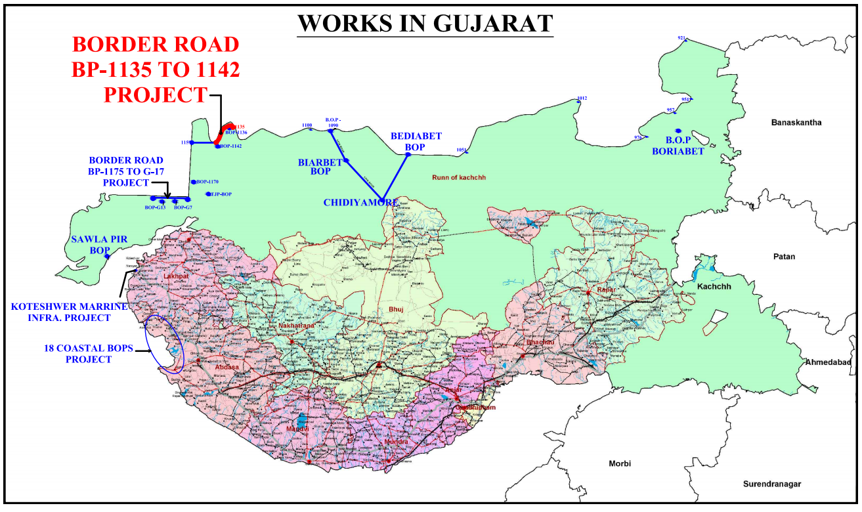
Cont..

Slide 6
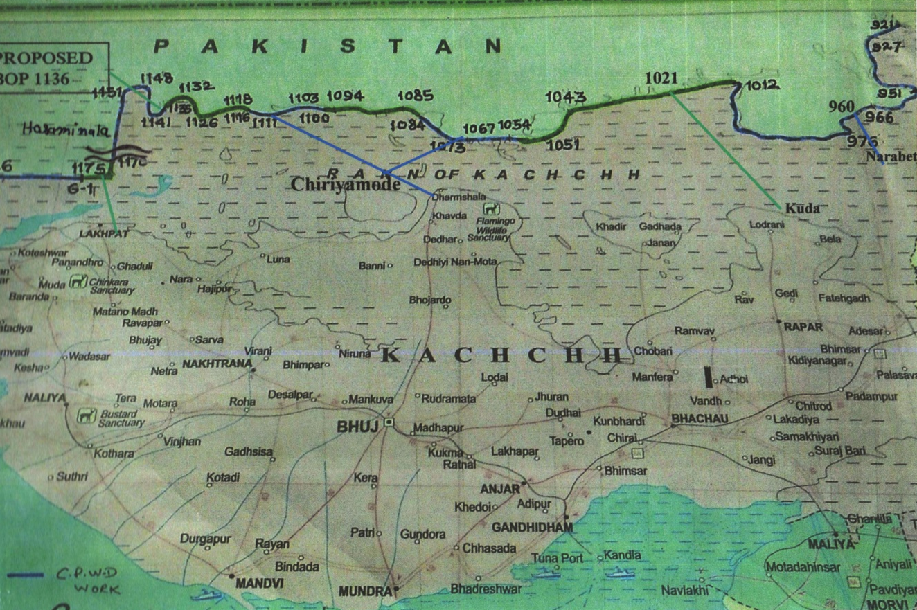

Slide 7
Runn of Kachchh at a Glance
Katchchh | Ancient land with history since antiquity times and deriving its name from geographical characteristics and topographical features resembling a Tortoise ‘kachchh’
Latitude | 22 ⁰ 44’11”- 24 ⁰ 41’25” N
Longitude | 68 ⁰ 09’46”-71 ⁰ 54’47” E
Coast line | 406 Km
Temperature | 0-50 ⁰ C
Rainfall | Annual average 382 mm. Total annual rainfall varies from 2 mm to maximum of 840 mm. Even though rainfall is scanty sometimes heavy rain 100 mm to 250 mm in a day are recorded. Short rainy season, frequent failure of monsoon, high rate of evaporation (2400 mm annual) Freak cyclone storm with high local winds
Cont..

Slide 8
Climate | It falls within great tropical desert belt stretching from Sahara to Thar. Summer sun is vertical and intensively hot. Winters are comparatively cool and particularly following failure of monsoon rains, the dry land becomes extremely cold. No vegetation cover but High radiation.
Wind | Strong prevailing winds. During cool months it blows N-E. Basic Wind speed as much high as 50 m/s
Topography | Flat, sea water ingress and regress due to tidal variations land area remains marshy. The depth of tidal water varies from 1.8 m to 2.1 m
Seismicity | Seismologically very active (Zone-V)

Slide 9
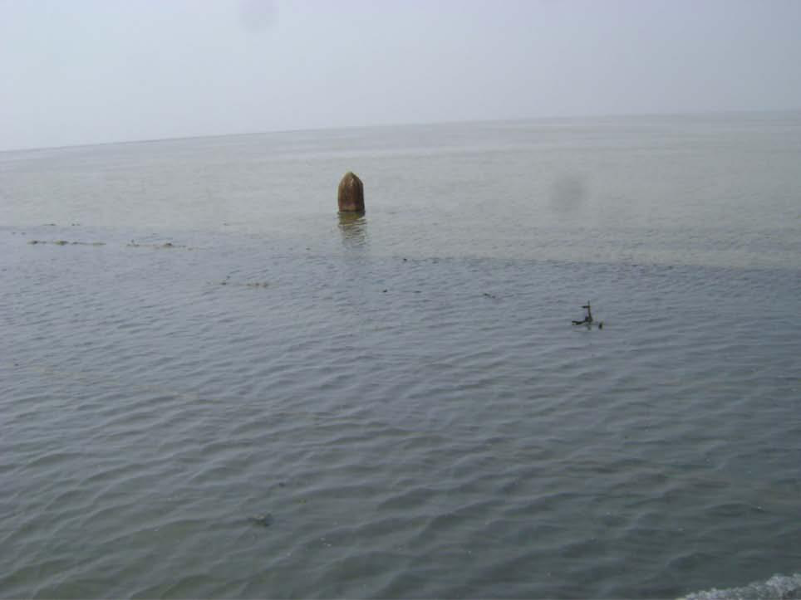
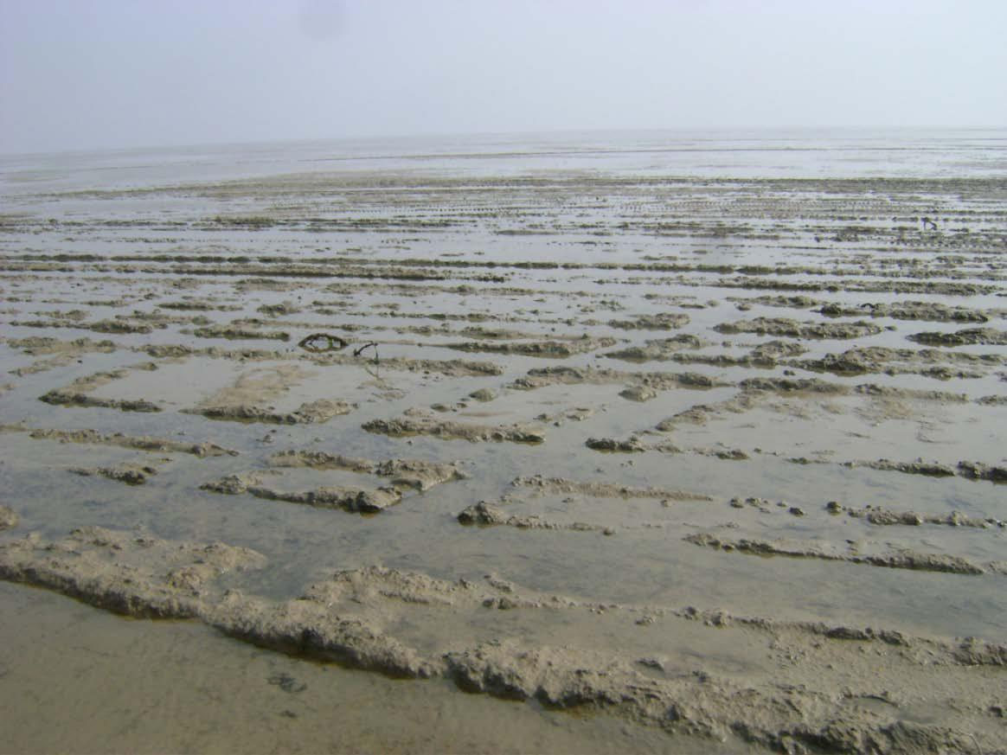
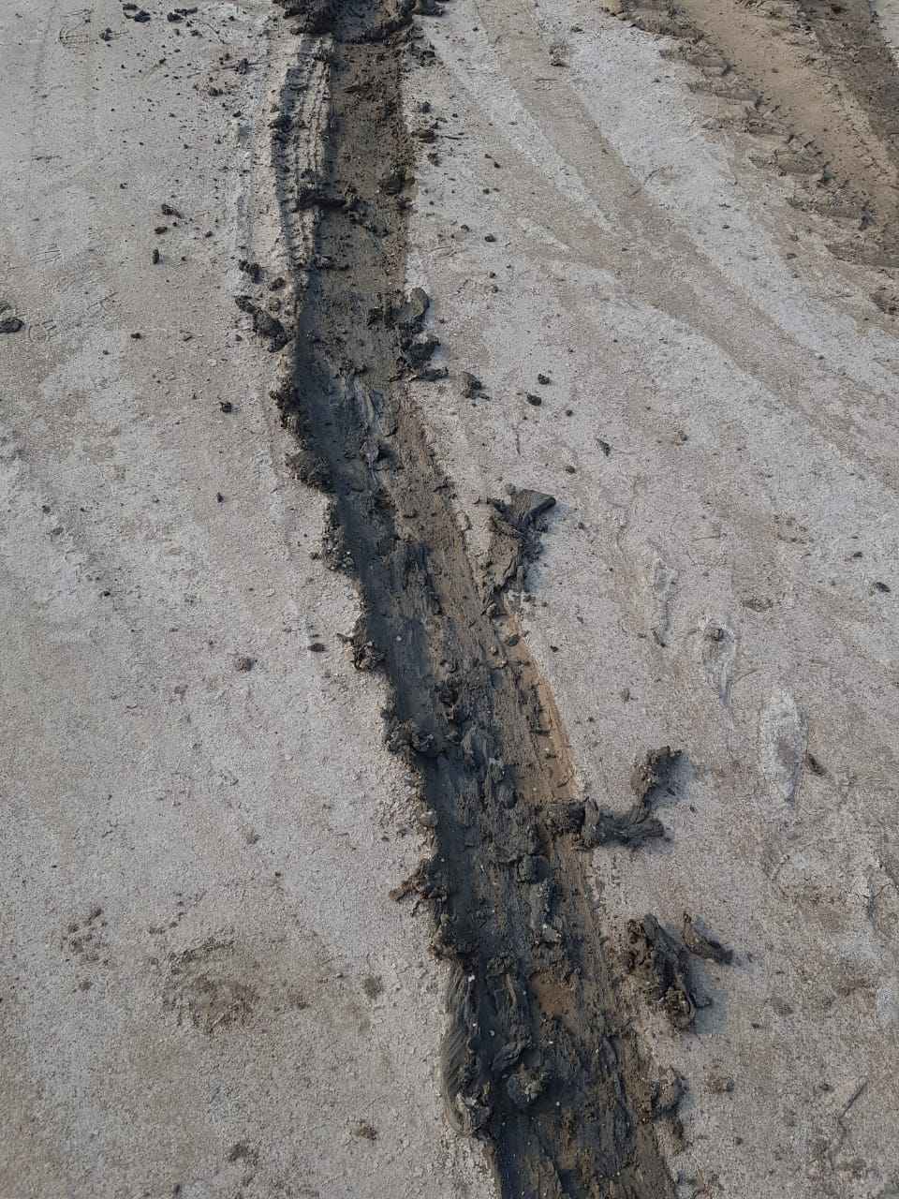
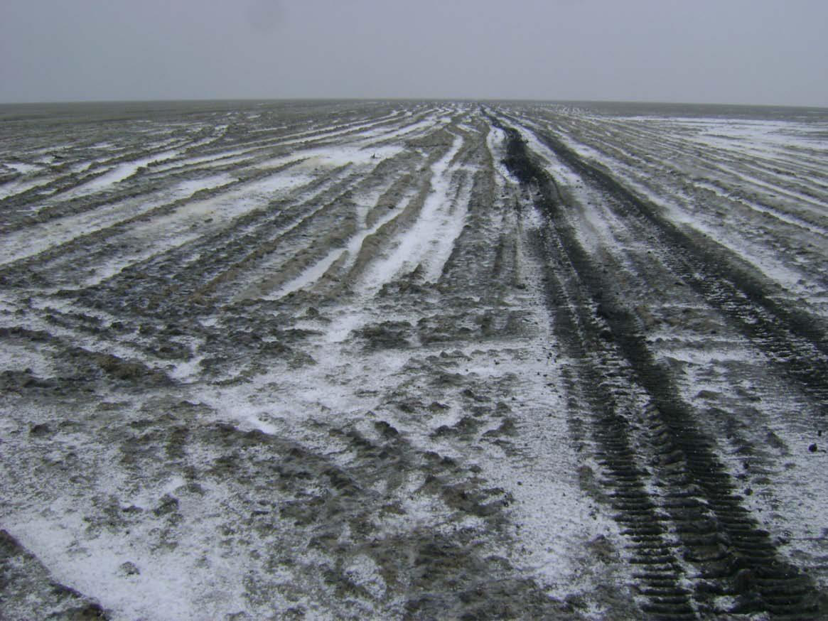
May to July
August to September
October to November
December to April
BP 1175 to G17 pillar
Cont..

Slide 10
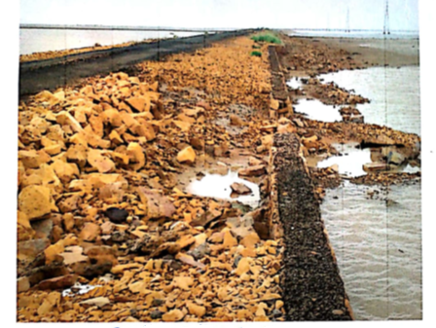
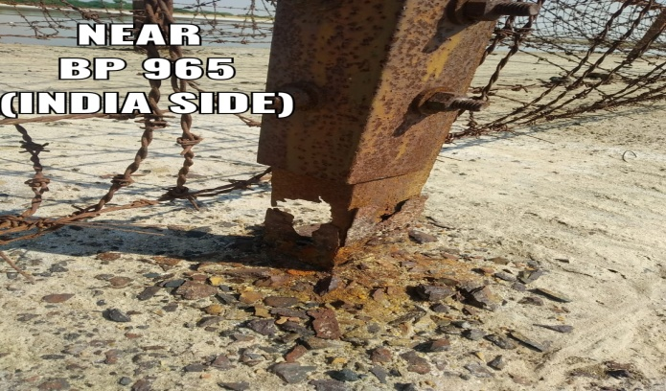
Damage in existing link road
Overtopping of border road
Corrosion in fence
Damage in building
Cont..

Slide 11
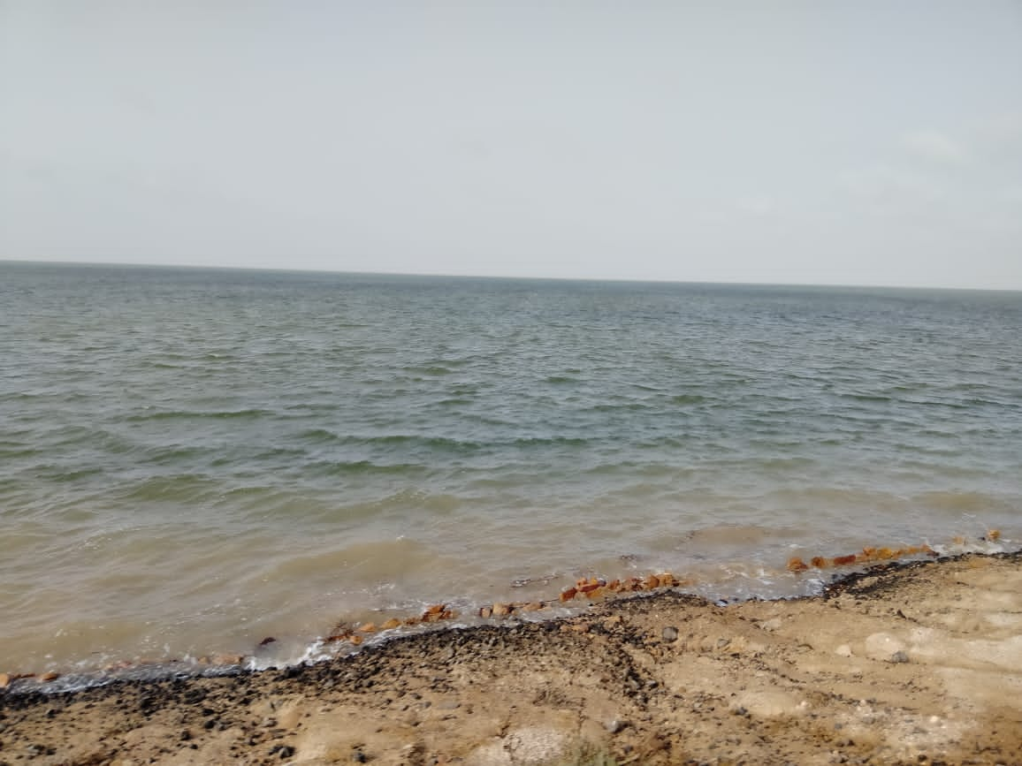
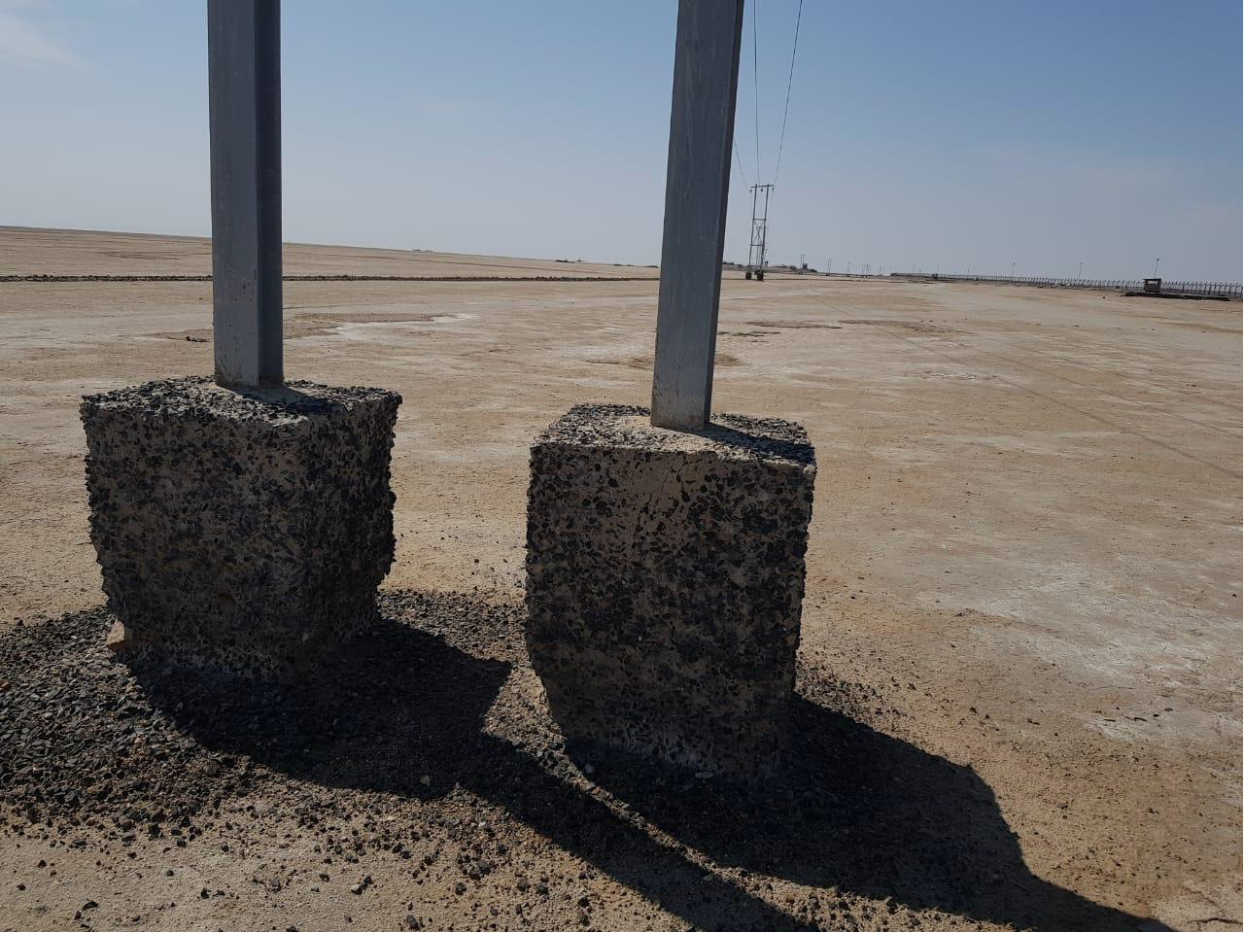
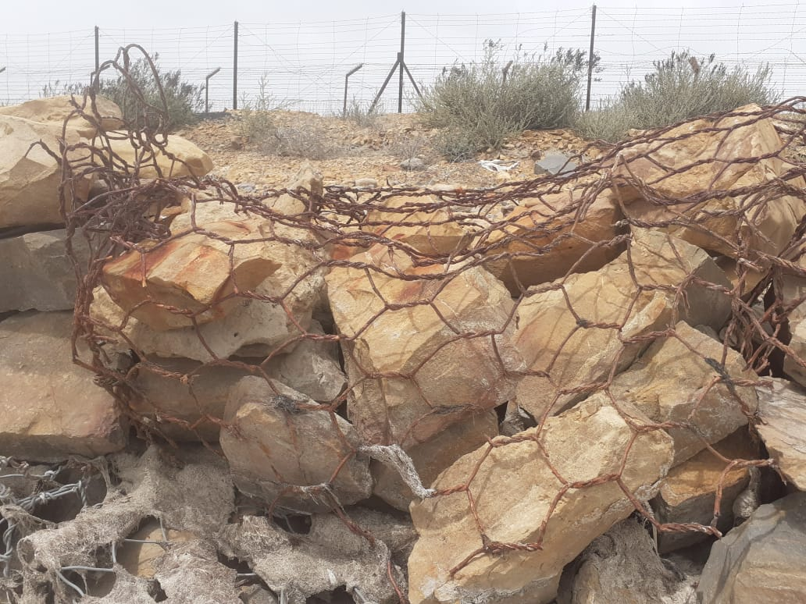
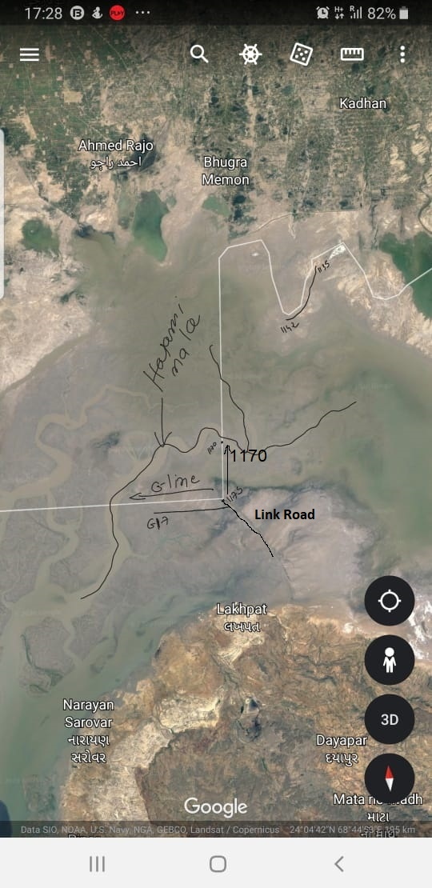
Tidal water wave action
Concrete Loosing Strength
Damage in hand made Gabion
Fringing of Border near Harami Nala

Slide 12
Observations
Poor drainage | Inadequate cross drainage structure
Soil erosion | No confinement of Soil, high content of Silt & Clay (16 – 26%). High speed wind, nil vegetation & tidal wave action.
Low bearing capacity of soil | SPT N Value 2 - 13
Excessive corrosion | Presence of high salt content (Sulphate & Chloride) in soil, water & air.
Water logging/marshy land | Embankment under capillary fringing zone, less percolation of water resulting ponding of water for longer period.
Overtopping of road by storm & tidal water | Embankment top below HFL, Two way movement of water
Harsh weather conditions | Climate like desert, intensively hot (>50⁰C) & high rate of evaporation, Unavailability of skilled labour & difficult Accessibility

Slide 13
Methodology
Durable structural system to resist erosion and corrosion
Stable against degradation
Safety against global and local failure
Sustainability use of local available materials
Economy
Modular for ease in construction and future maintenance
Speedy construction

Slide 14
System Design | Selection of materials
1. Erosion control Flexible, Permeable, Modular & Monolithic structure capable of quick energy dissipation from flowing water, self adjusting and drain freely (Gabion structures) | Machine made PVC Coated over heavily coating (260 g/m²) of Galfan wire (Zn 90% + Al 10%) DT Mesh 10 X 12 durability against salt spray test of 3000 Hrs. Use of local available hard stone of appropriate size & weight, hardness, flexural strength and LA abrasion value Non-woven thermally bounded and needle punched bio-non degradable Geotextile of appropriate permittivity (0.2­ /sec) & AOS (0.25 mm) PVC Coated Gabion mattress filled with local available aggregate stone in embankment slope.
2. Ground improvement technique Geotextile in combination with Geogrid & GSB at bottom and stone soling | Bi-Axial Geogrid (38 X 38) integrally formed and using punched and drawn procedure highly resistance to ultra-violet light and is stabilized by 2% carbon black. Ultimate tensile strength in both the directions more than 40 kN/m. Remains unaffected by biological degradation and is highly resistant to acids, alkalis and salts that are typically found in soils Made from extruded high modulus polypropylene
Cont…

Slide 15
Structural system | Selection of materials
3. Embankment construction Total height 3.5 – 3.8 m depending upon HFL. Geotextile as separator layer between filled soil & capillary cut-off sand layer at HFL + 0.3 m | Fill material - Local Rann soil wrapped with Geotextile all around. Slope suitably treated with revett mattresses 230 mm thick filled with graded aggregate rip-rap. Sand drainage layer Gabion retaining wall on both the side of embankment
4. Cross drainage structures 2-3 bays Box Culvert size 2.5 X 2.5 m @ 250 m C/C. U/S and D/S equally treated for protection against scour. | Factory controlled Precast RCC Box Culvert with richer mix M-40, W/C 0.30 of each segment length of 1.5 m jointed with plug & socket arrangement. RCPT Value 600 coulomb, water permeability 10 mm. OPC Cement with limiting C3A Content 5.65% Use of low carbon HCR Steel as reinforcement Application of two coats of water repellent polymer based acrylic paint
Cont..

Slide 16
Structural system | Selection of materials
5. Fence Anti cut, anti clime and anti rust single line modular fence to resist the Very high aggressive environment (C-5) Ground contact of fence eliminated by the use of precast RCC beam between foundation block and fence. | Factory made GI Coated 3-5-8 fence made with 4 mm dia heavy coated PM + TPC (400 micron) over welded mesh and CHS Post dia 76.1 mm SS 316 Grade in concertina coil and fitting and fixtures. Precast CC foundation block with the arrangement of receiving CHS Post and RCC Beam fixed with non shrink cement grout. Foundation block top kept 150 mm above ground level.
6. Building work | HCR Steel as reinforcement, richer mix Factory made precast RCC drain Use of RO Water

Slide 17
Direction of movement of Rain & Tidal Water
The soil profile of finer particle size and presence of salts inhibit percolation of water and therefore, water stagnates for the longer time period on the surface.
Relatively flat terrain has undefined water channel systems and movement of surface water is mainly governed by the strong wind systems. Due to high speed winds waves resembling sea waves are created in these otherwise stagnated water.
In monsoon seasons, due to tidal ingress of marine water and flood water from north coming from Pakistan side and from east and south directions creates flooding situations overtopping the road sections

Slide 18
Sub Soil Engineering Properties
Subsoil properties |  | Location
 |  | BP 1135 – BP 1154 | BP 1175 – G17
SPT N – Value at 1.5 m depth |  | 4 – 13 | 2 – 7
In-situ Moisture Content (%) |  | 22.10 | 30.5
Salt Content (%) |  | 13.81 | 16.91
Liquid Limit (%) |  | 33 | 36
Plastic Limit (%) |  | NP | 19
Plasticity Index (%) |  | NP | 17
Grain size Analysis | Gravel (%) | 0 | 0
 | Sand (%) | 80 | 71
 | Clay (%) | 16 | 29
Ground water table |  | 0.85 – 4.0 | 0.45 - 1.50
High Flood Level |  | 1.80 – 2.00 | 2.00 – 2.10
Cont..

Slide 19
Chemical analysis
A - Soil
BP | Depth (m) | pH | Chlorides (%) | Sulphate (g/l)
1135-1142 | 3.0 | 7.87 | 0.45 | 2.9
 | 6.0 | 8.11 | 0.78 | 2.4
1175-G17 | 1.5 | 8.03 | 0.65 | 5.6
 | 3.0 | 8.07 | 0.88 | 5.2
B – Bore water
BP | pH ( >6.00) | Chlorides (as Cl) Max allowed 500 mg/l | Sulphate as (SO3) Max allowed 400 mg/l
1135 - 1142 | 7.12 | 10000 | 3010
1175 – G17 | 7.55 | 16650 | 4650

Slide 20
Stone
Locally available hard stone is being used having water absorption less than 2.5% by mass of stone
Transverse strength not less than 70 N/mm2
Wear loss less than 2 mm on the average and 2.5 mm for any individual specimen as per IS 1123
Durability as specified IS 1123
Abrasion Value <30

Slide 21
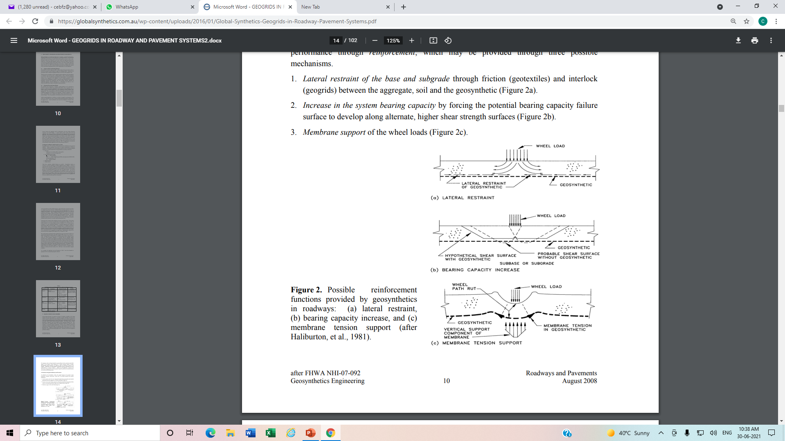
Geogrid & Geotextile soil improvement mechanism
Lateral restraint of the base and subgrade through friction (geotextiles) and interlock (geogrids) between the aggregate, soil and the geosynthetic.
Increase in the system bearing capacity by forcing the potential bearing capacity failure surface to develop along alternate, higher shear strength surfaces.
Membrane support of the wheel loads.

Slide 22
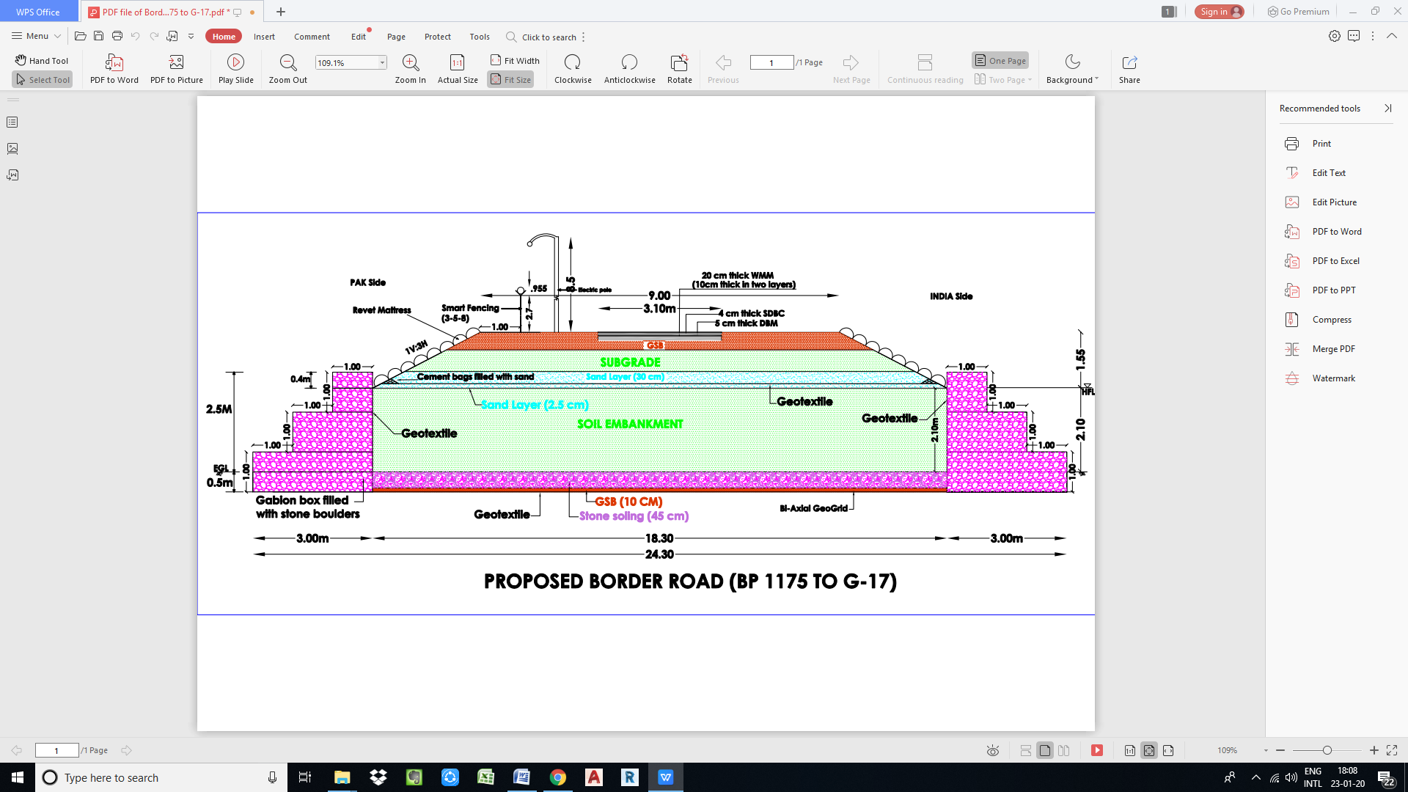
Location | Height of embankment
1135 - 1149 | 3.5m
1149 - 1154 | 3.7m
1175 - G10 | 3.5m
G10 - G17 | 3.8m
Typical road section

Slide 23
Cont…

Slide 25
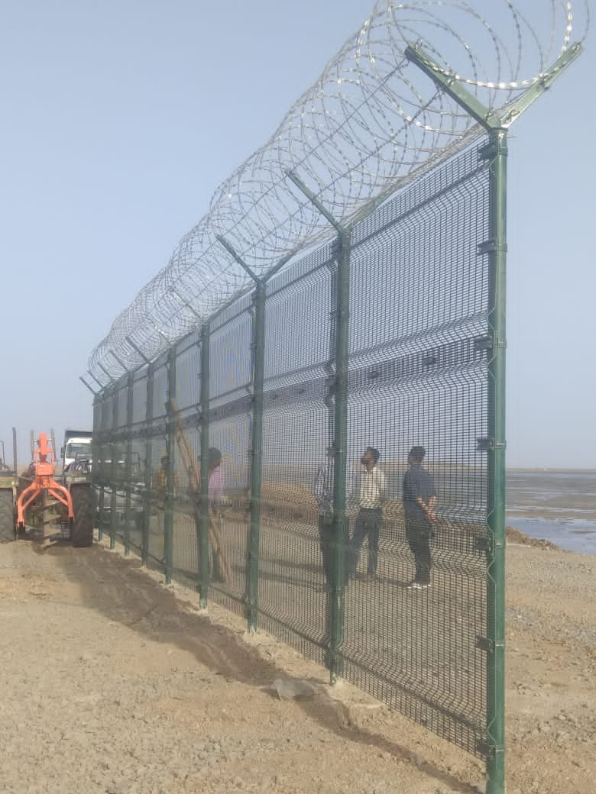
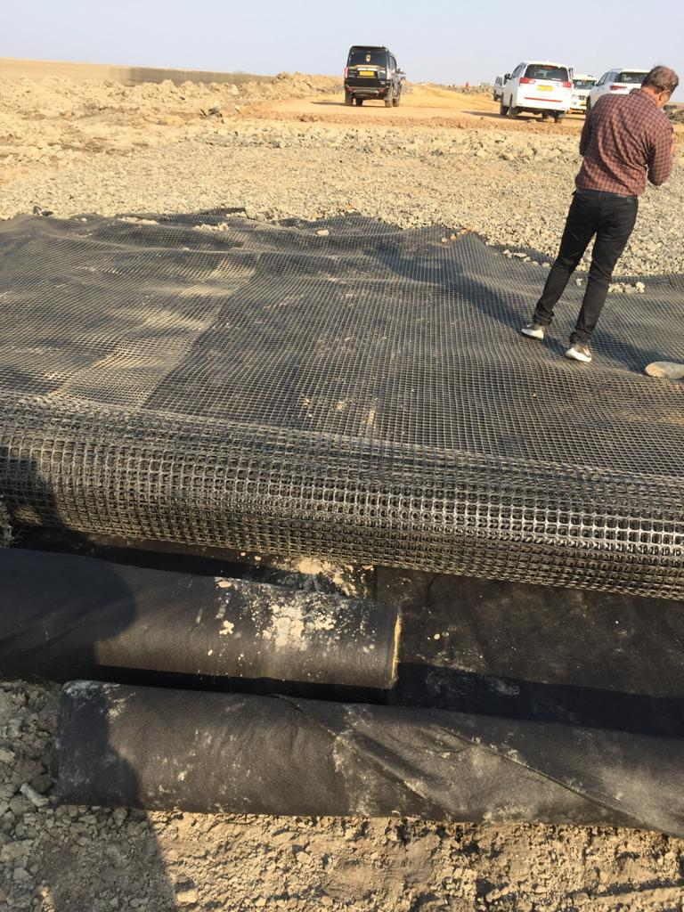
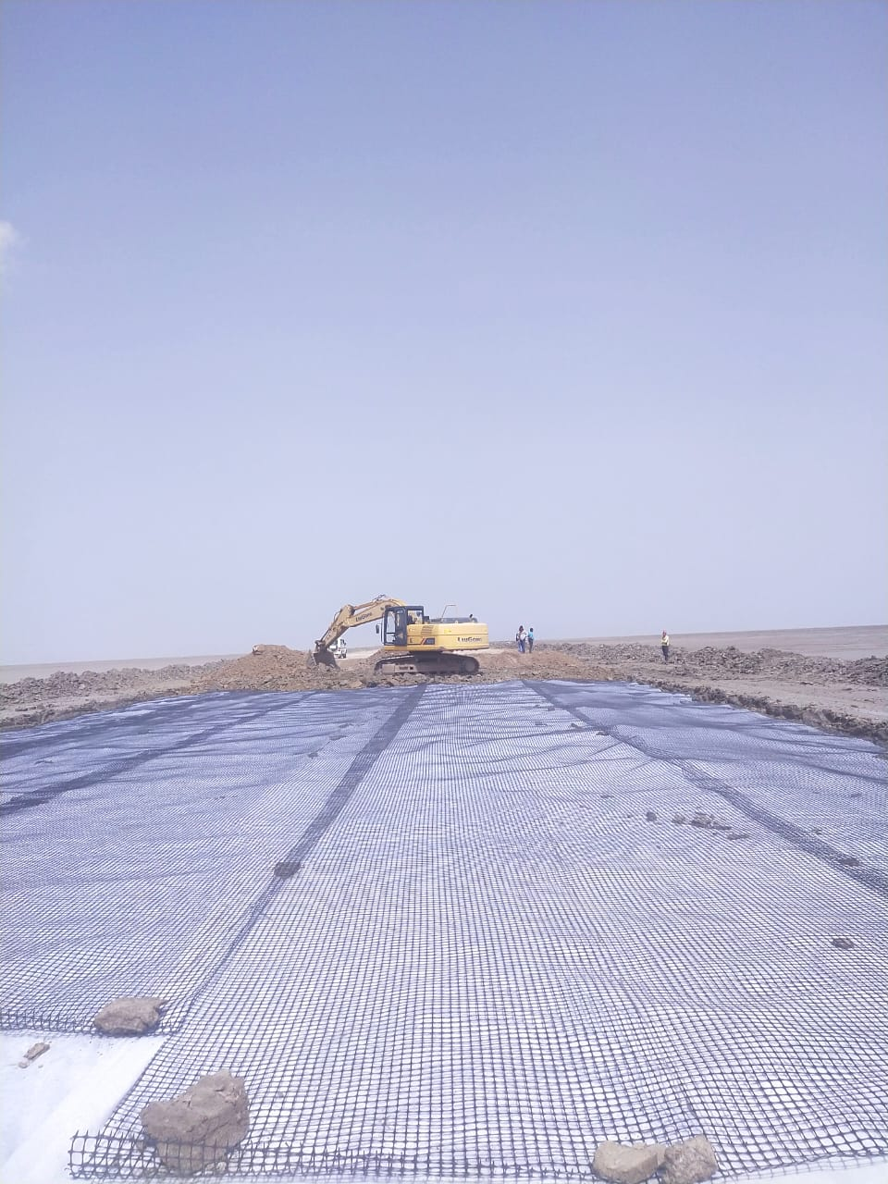
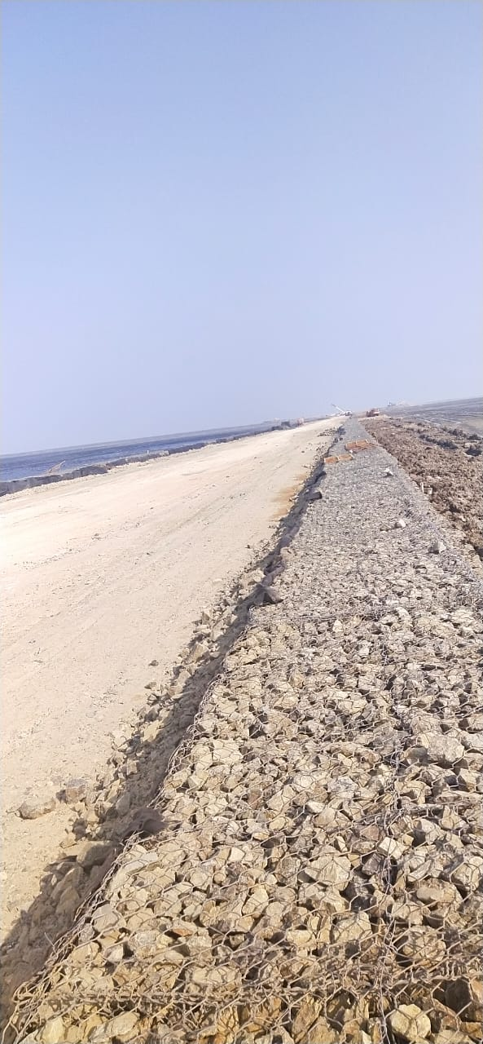
Cont..

Slide 26
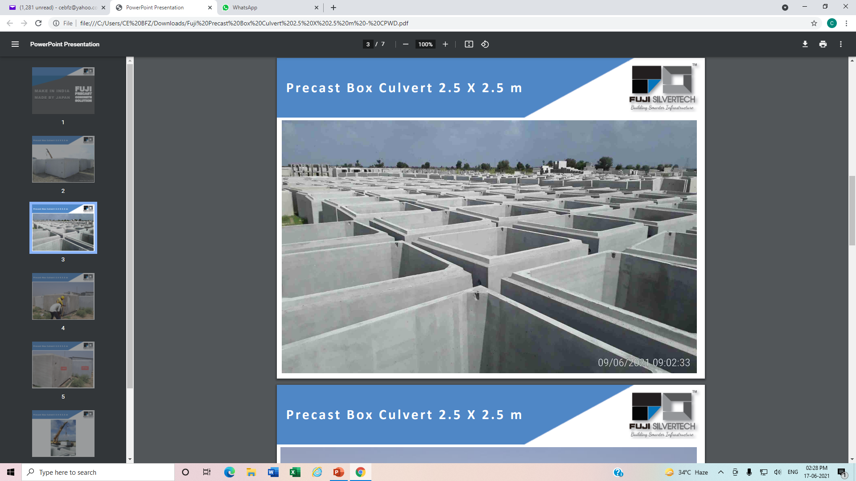
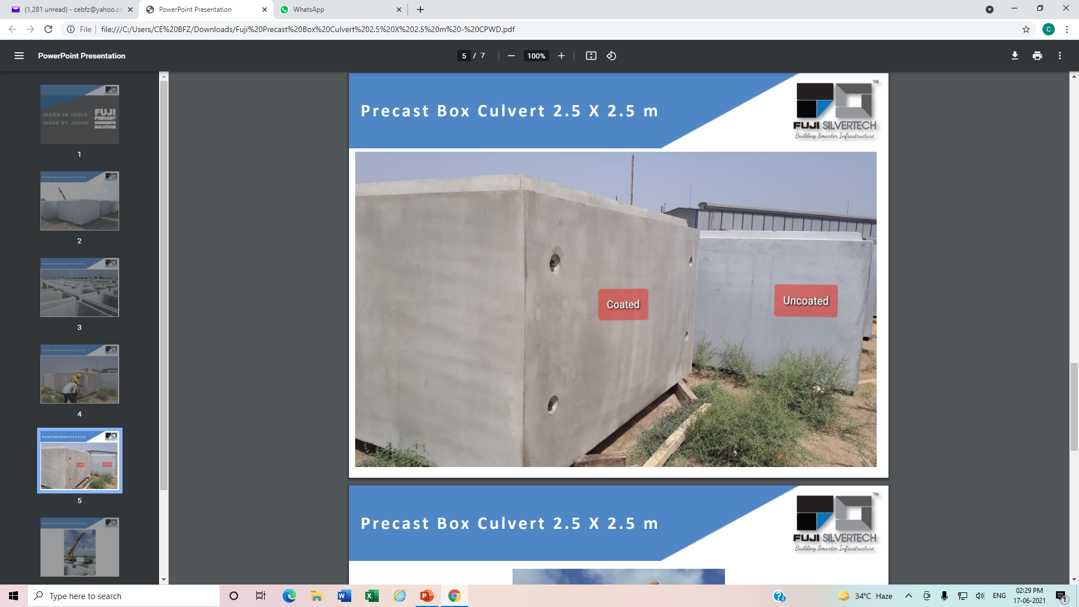
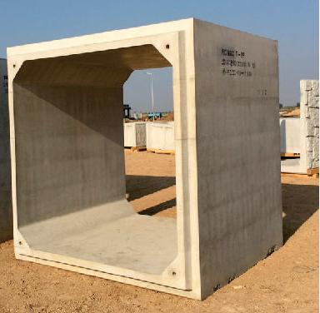
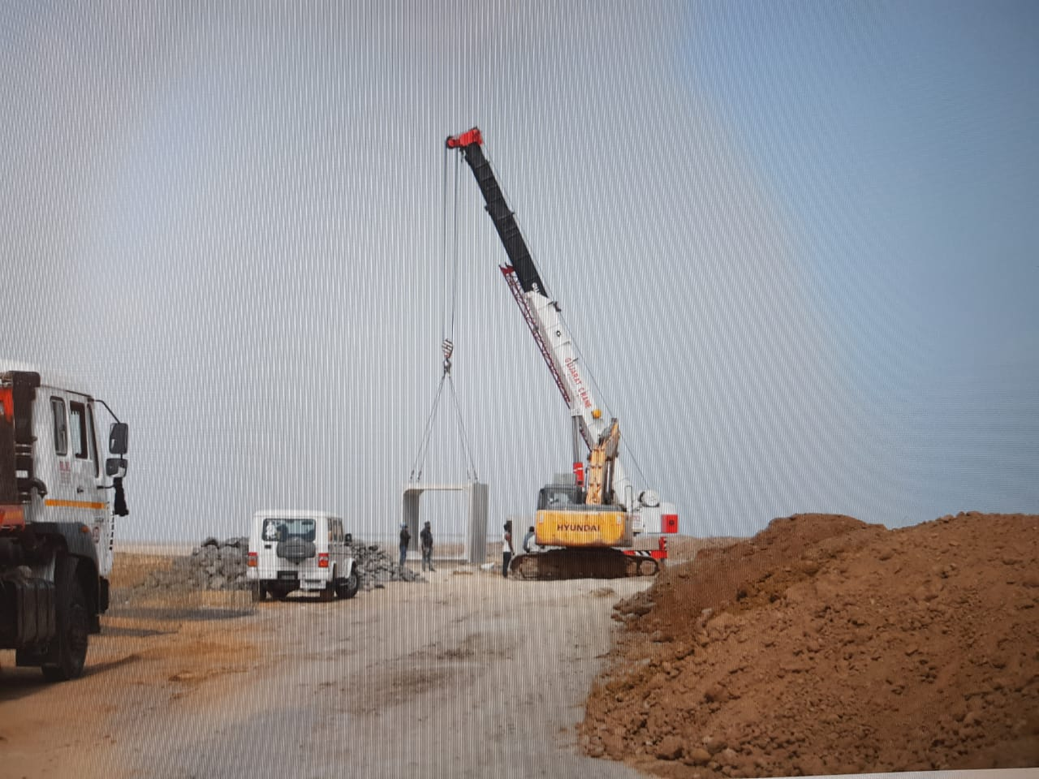
Cont..

Slide 27
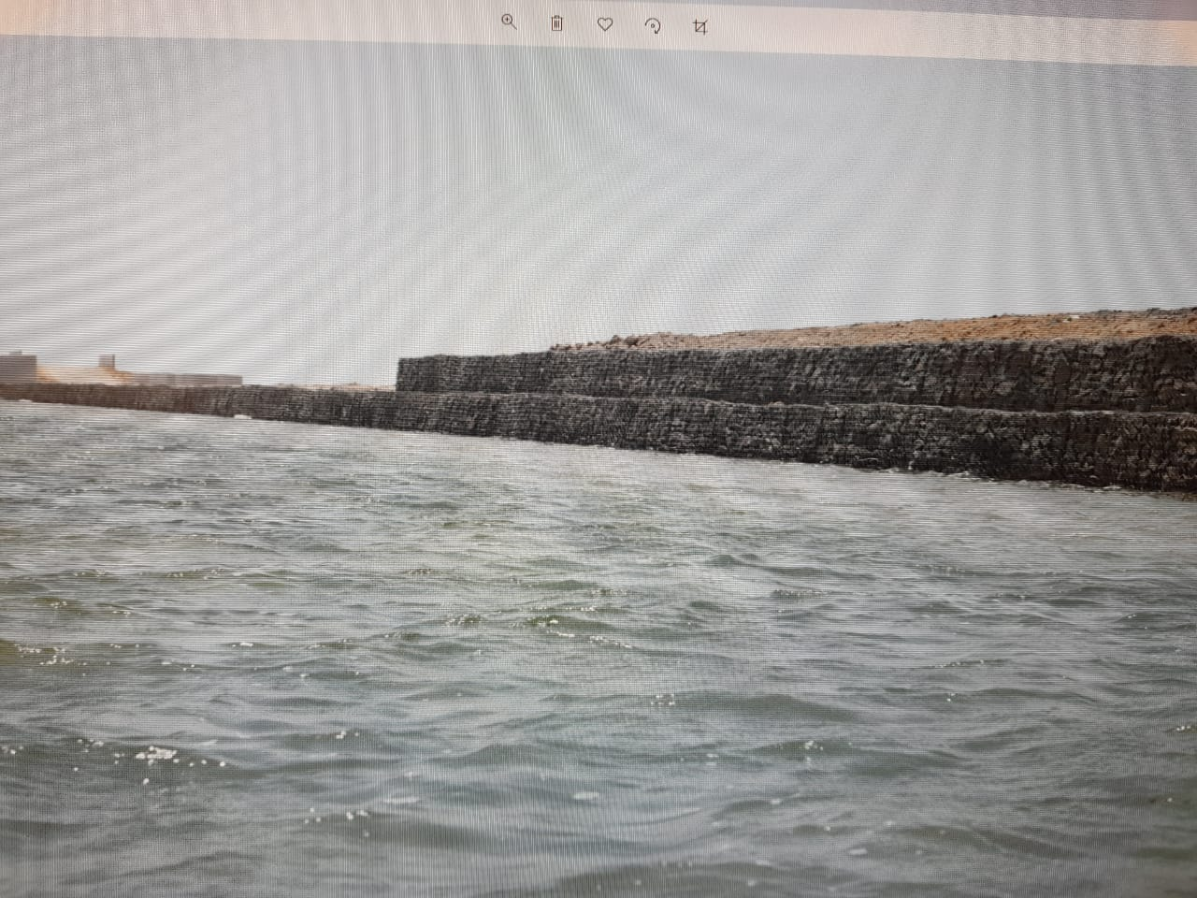
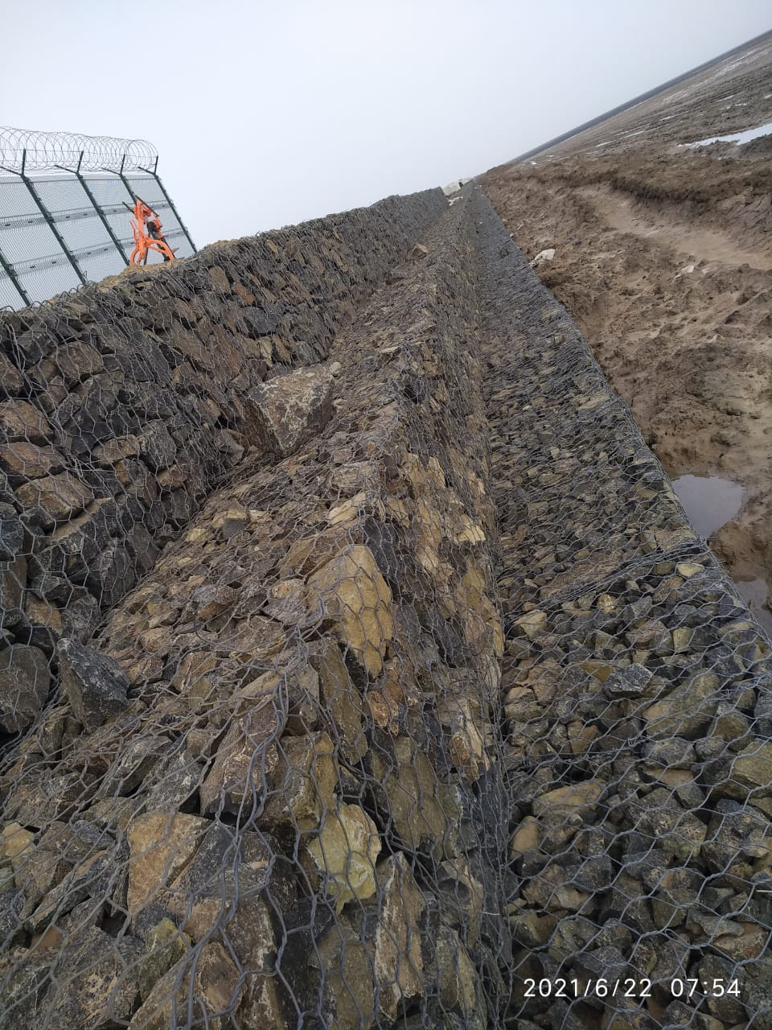
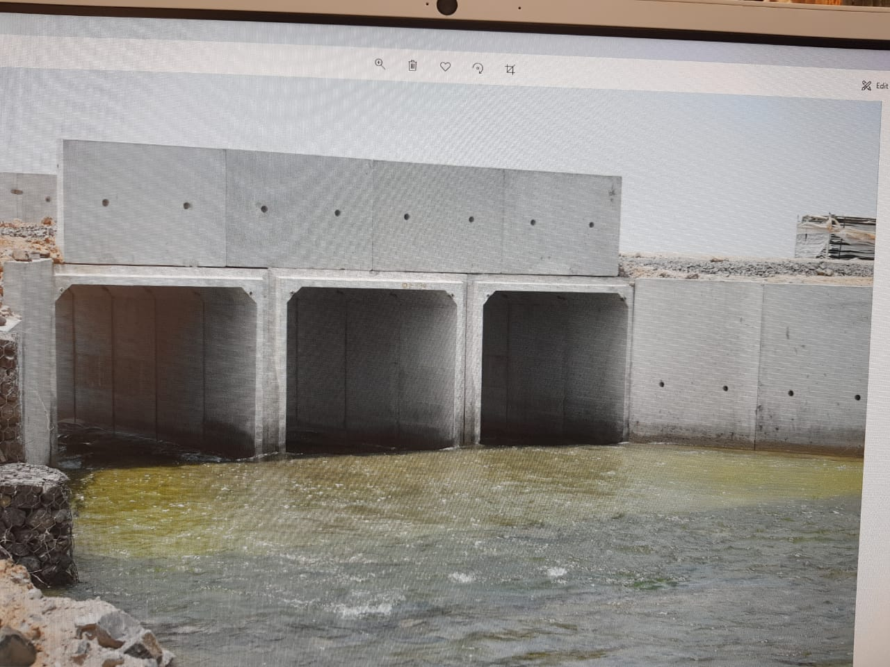
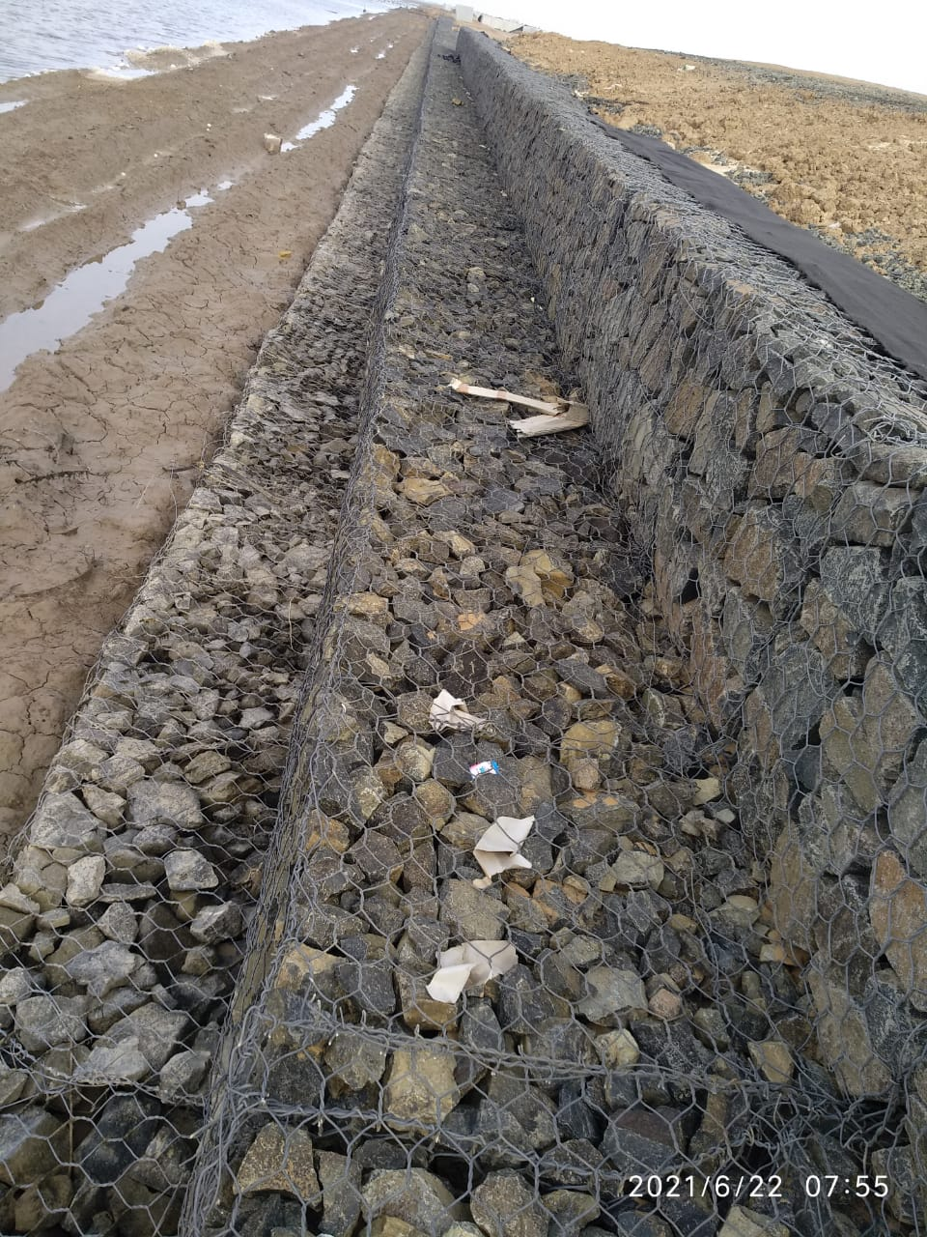
Cont..

Slide 28
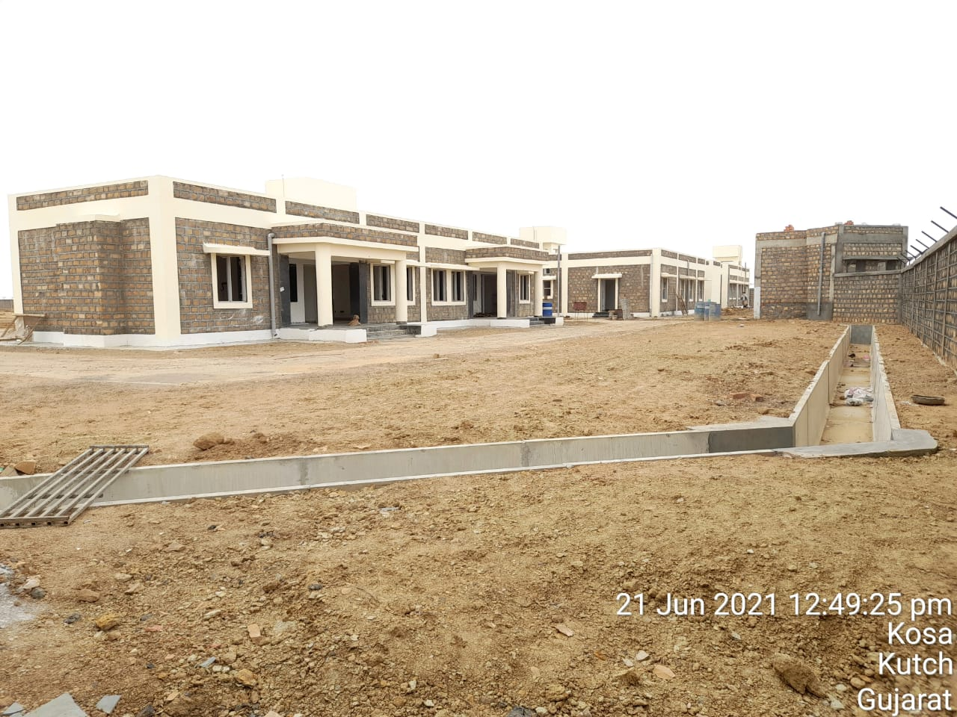
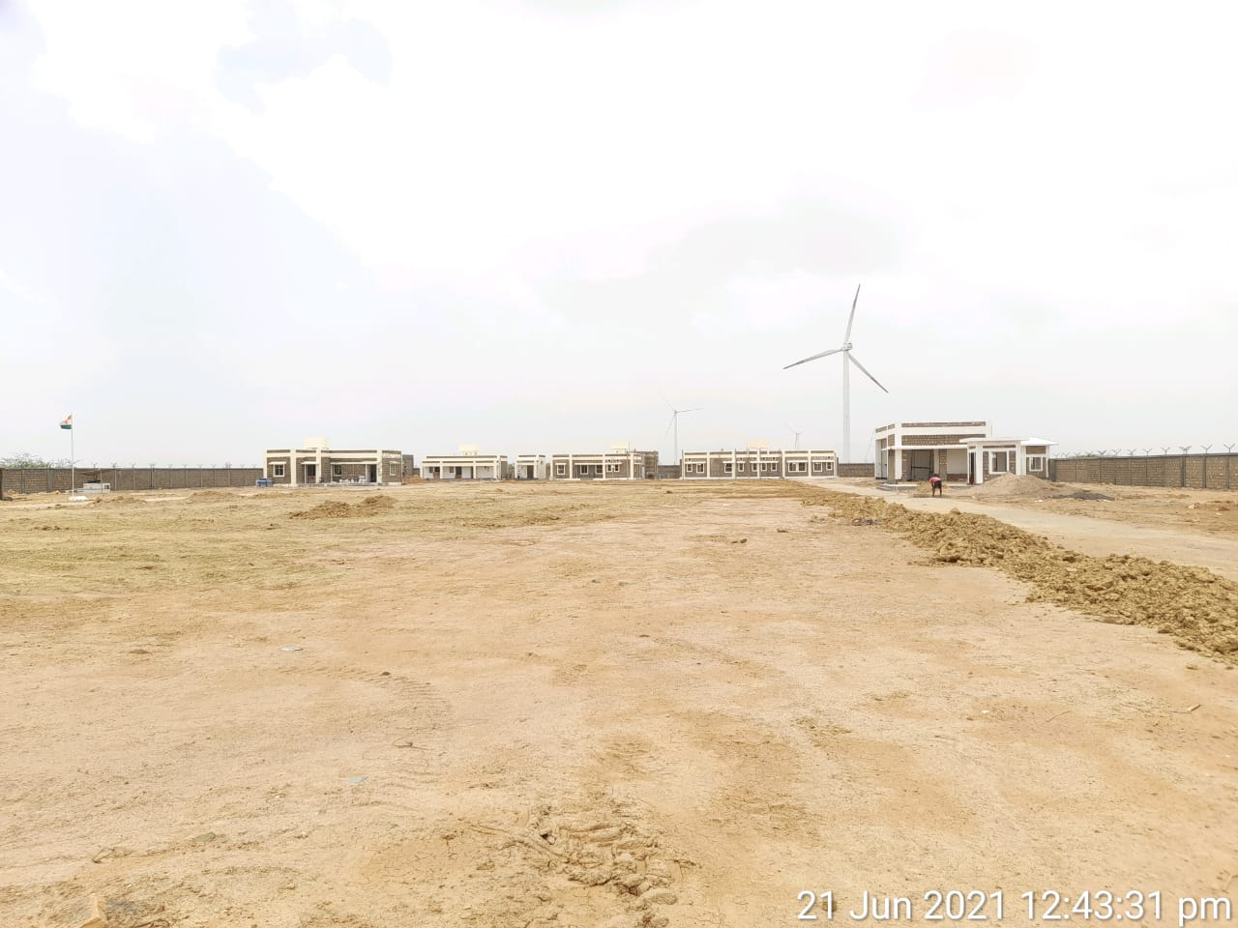
Cont..

Slide 29
Conclusion
The challenges posed by the Environmental severity can be dealt by treating the every element of a structure suitably.
The adverse effect of Sulphates and Chlorides in the soil and water has been effectively countered by the use of dense and durable concrete by controlling the vital parameters of water permeability and RCPT test.
By the use of new technology and materials available, the soil capacity has been improved.
Soil erosion and tidal wave action of water have also been dealt suitably by use of Gabions, Geogrid and Geotextile.
Present industry trend and practice is helpful in finding the feasible solutions.
Codal recommendation needs to be carefully studied before field implementation. Sometimes only indications are given in the code to tackle a specific problem which requires further study.
Use of New Technology and as much as possible local available material has been helpful in reducing the carbon foot print.

Slide 30
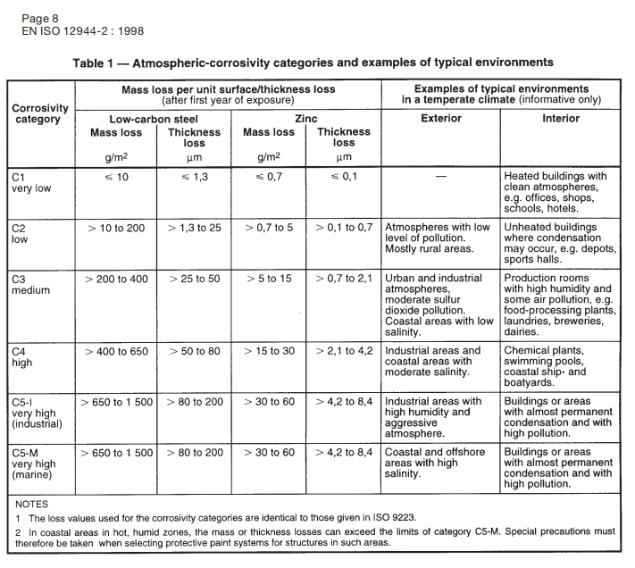

Slide 31
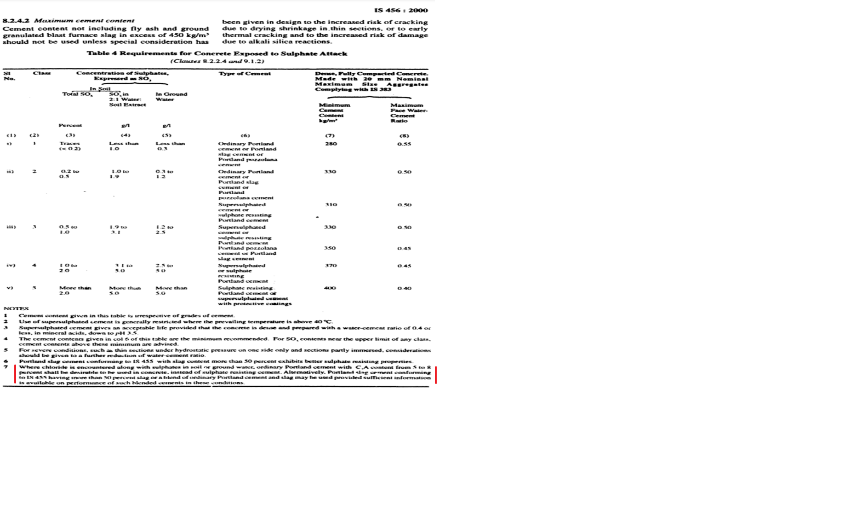

Slide 32
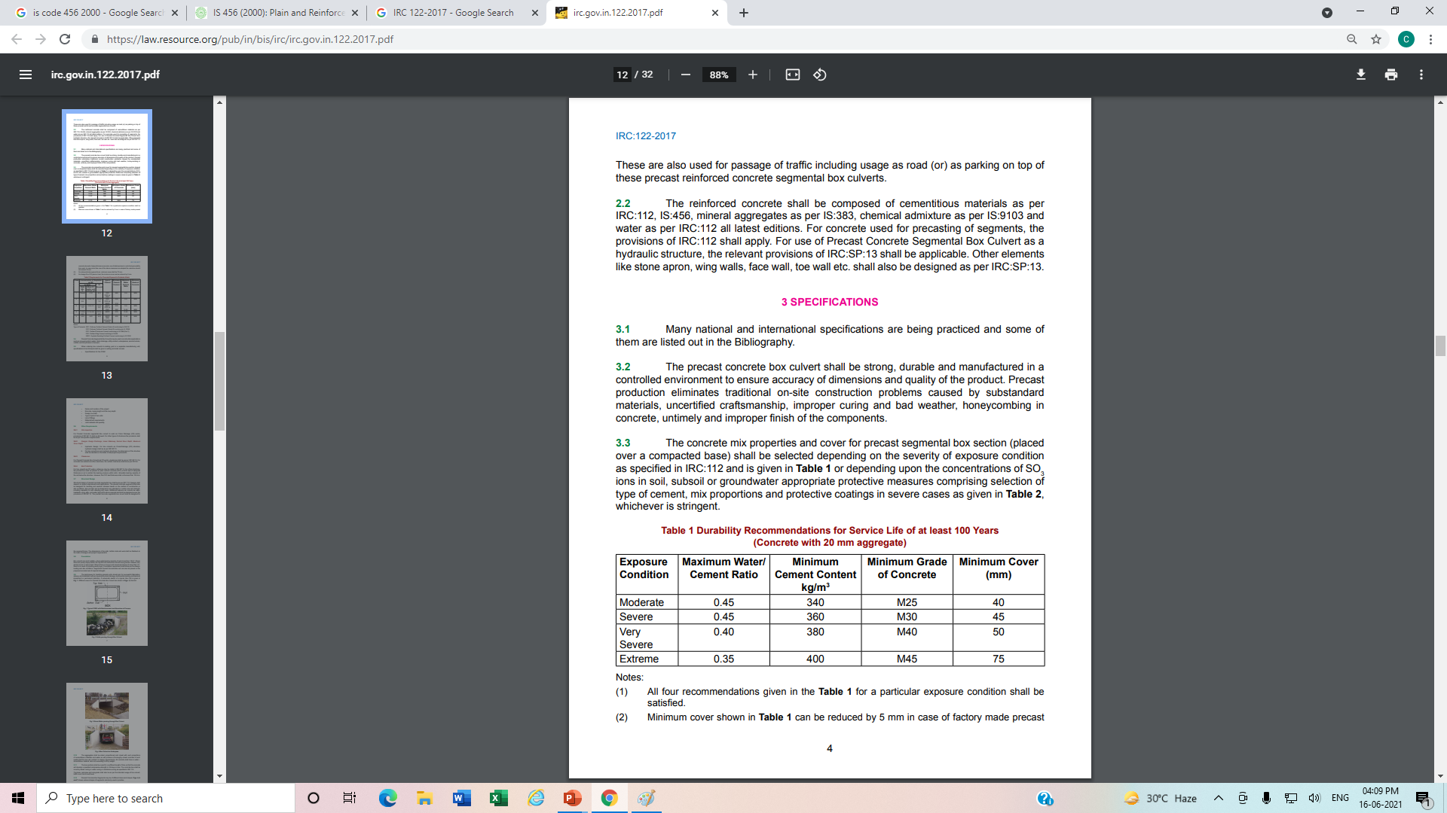
Cont...

Slide 33
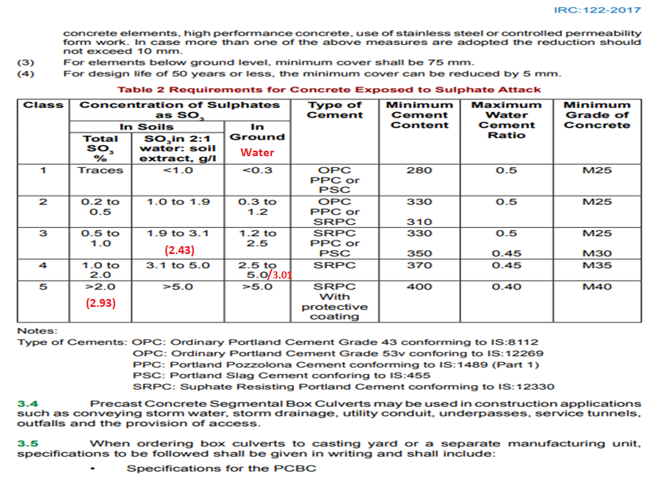

Slide 34
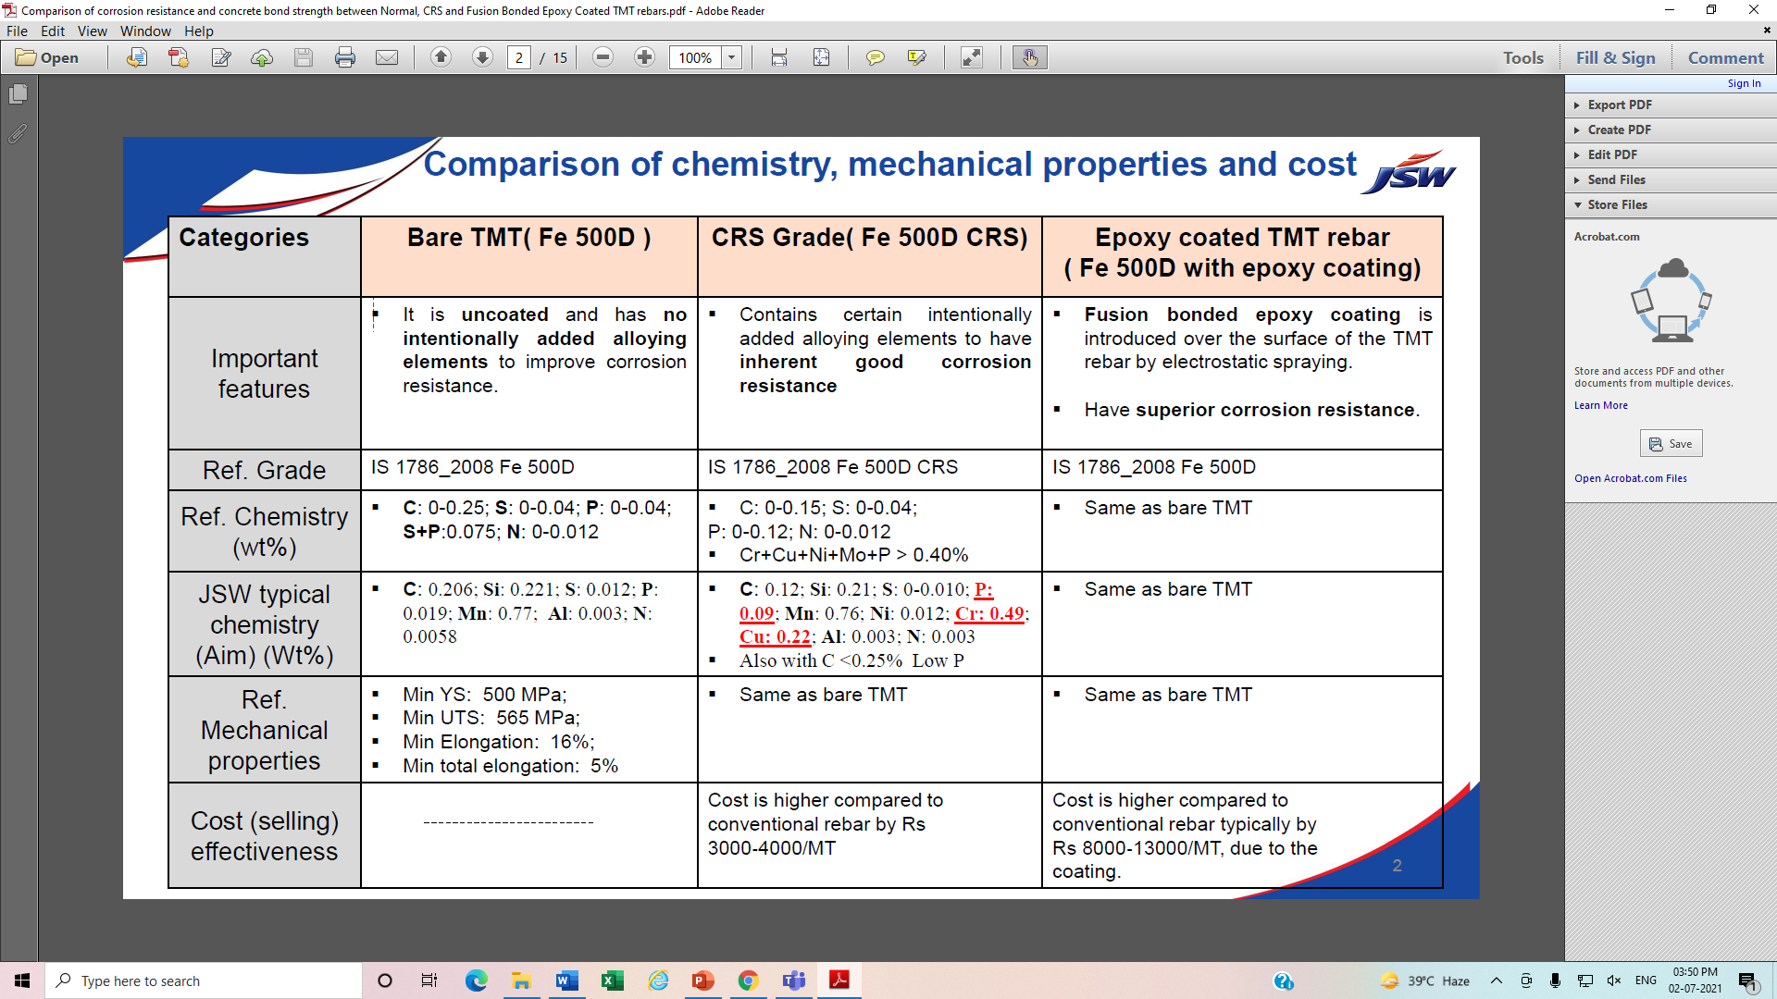

Slide 35
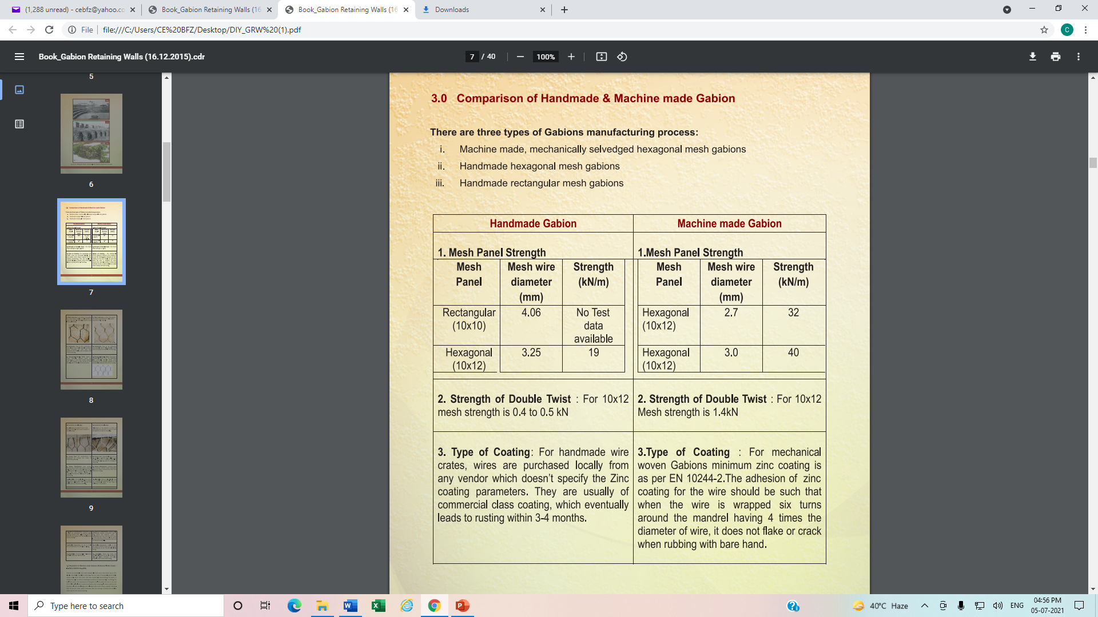

Slide 36
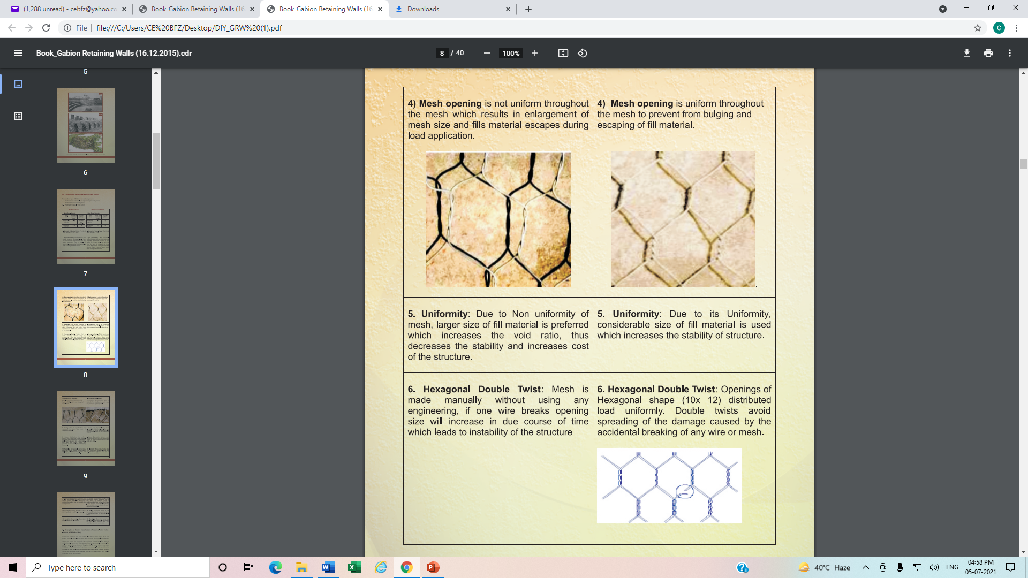

Slide 37
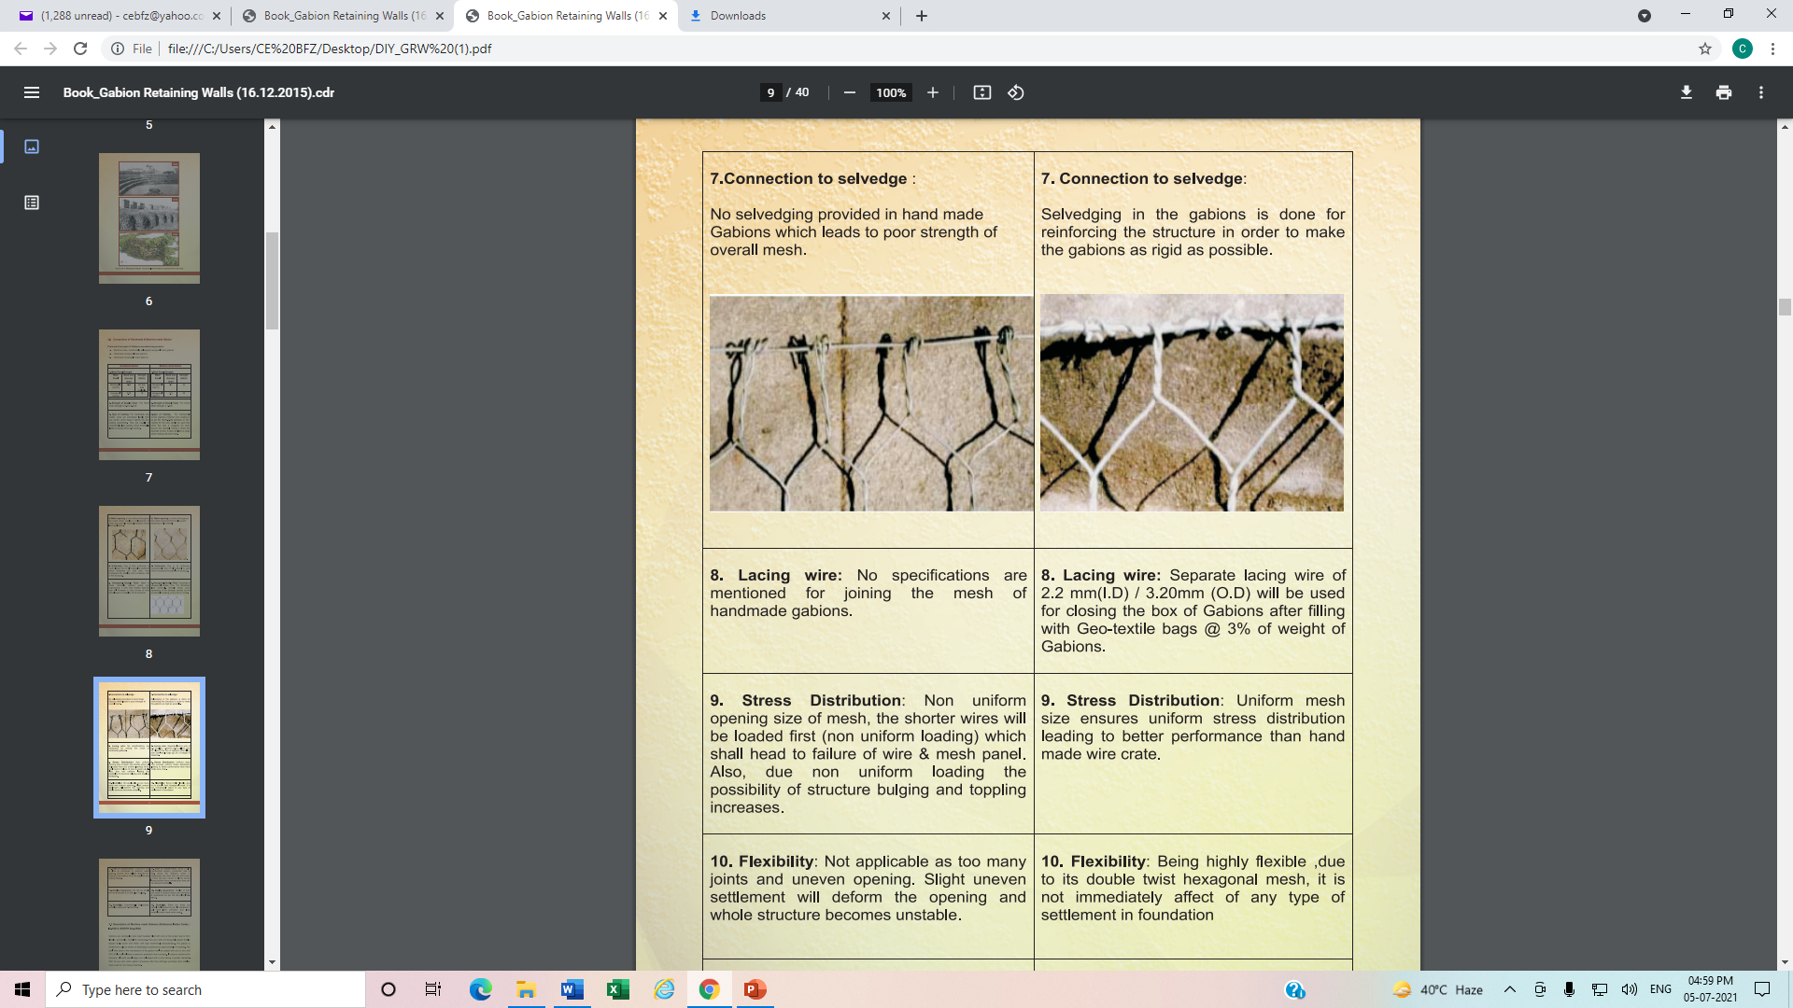

Slide 38
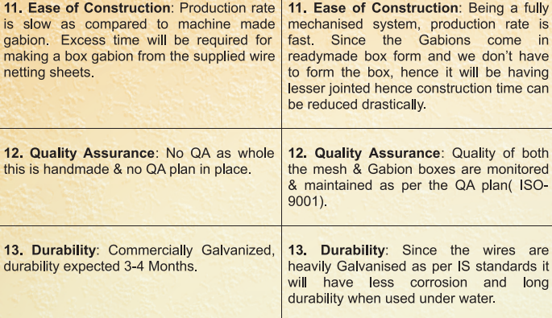

Slide 39
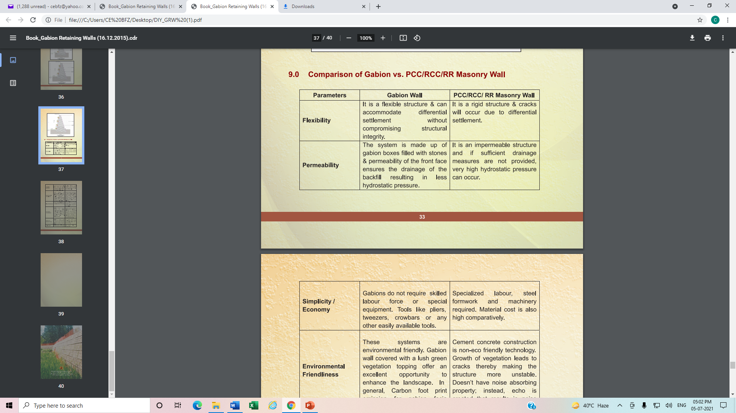
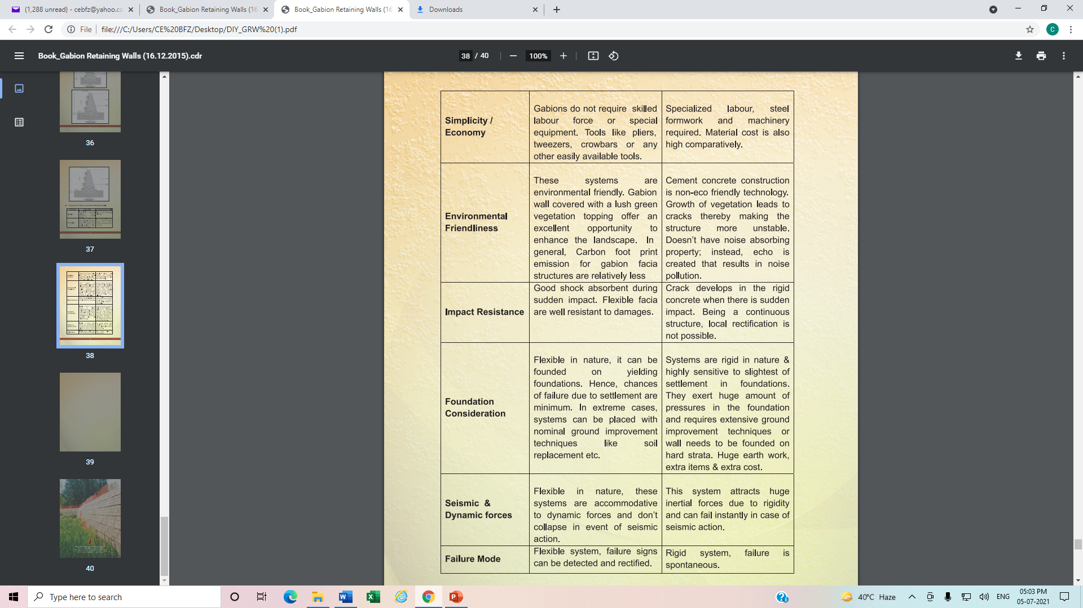
Cont…

Slide 41
IRC:116 (2018)
Cont…

Slide 42
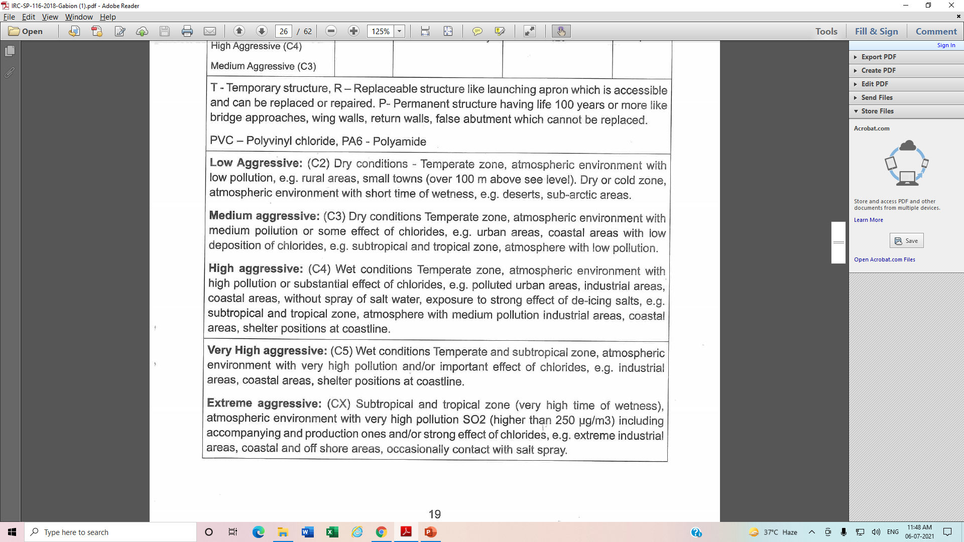
Cont…

Slide 45
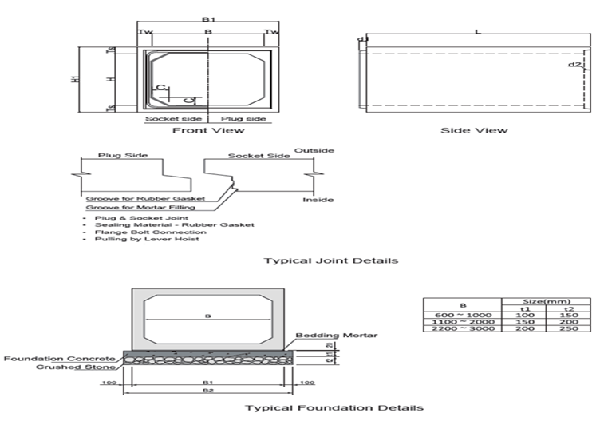
B X H | B | B1 | H | H1 | L | Ts | Tw | C | d1 | D2 | Ref. Wt. (Kg)
2500 X 2500 | 2500 | 2900 | 2500 | 2940 | 1500 | 220 | 200 | 200 | 80 | 80 | 8840

