Slide 1

Revisiting the Built Environment in Post Covid Era
C. K. Varma, ADG(Region Chennai)
&
K. Lingeswaran CA(Region Chennai)
Notes:
We all have undergone a very traumatic year and a half in which we have lost so many friends and relatives. This has jolted all of us from within. During this period of great crisis, I have thought of revisiting our built environment and apply the learning during covid period to construction sector. Namaskar and very warm wishes for the CPWD day to one and all. I am C.K.Varma, ADG Region Chennai. Together with my Chief Architect Mr. K.Lingeswaran, I will sail you through few slides which will govern our future habitat.

Slide 2
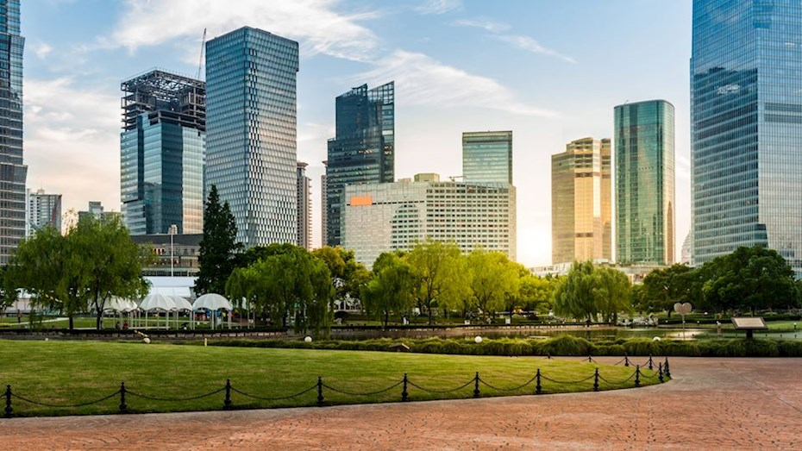
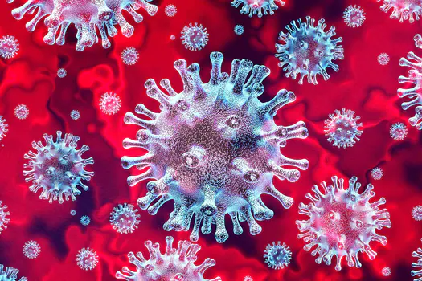
The virus isn’t simply a health crisis; it is also a design problem.
Notes:
The Corona virus did not merely exposed the gaps in our health care system, but also left question marks about how we build our habitat. A matter of serious design thinking on the part of builders of the Nation i.e. CPWD the premier construction arm of Government of India.

Slide 3
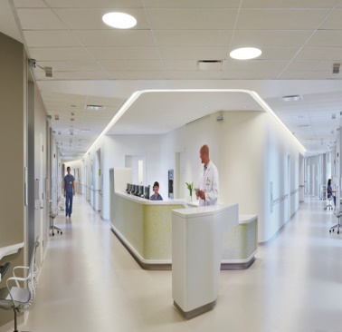
The second wave has triggered many changes we are now looking towards our living and working spaces.
Notes:
The built environment should necessarily include more open spaces, touchless services, sanitisation sprinklers, automatic doors with thermal imaging , social distancing norms, separate entry and exit points , proper shielding between people etc.

Slide 4

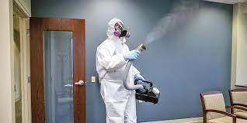
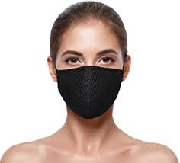

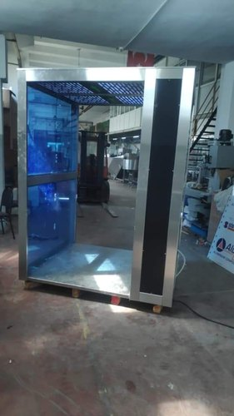
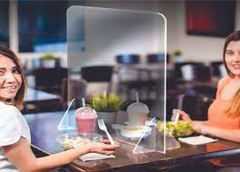
If social distancing, frequent sanitisation and covering face with mask are the neo norms of the society, then these norms should also be in-built in our living spaces where we work or rest or socialise.
This can be achieved by making flexible changes in our built spaces as depicted below:
Social distance through furniture layout
Sanitisation Chamber
Transparent shield
Notes:
Translation of basic Covid protocols into building norms.

Slide 5
Architectural Controls
Notes:
A few suggestions on building design side

Slide 6
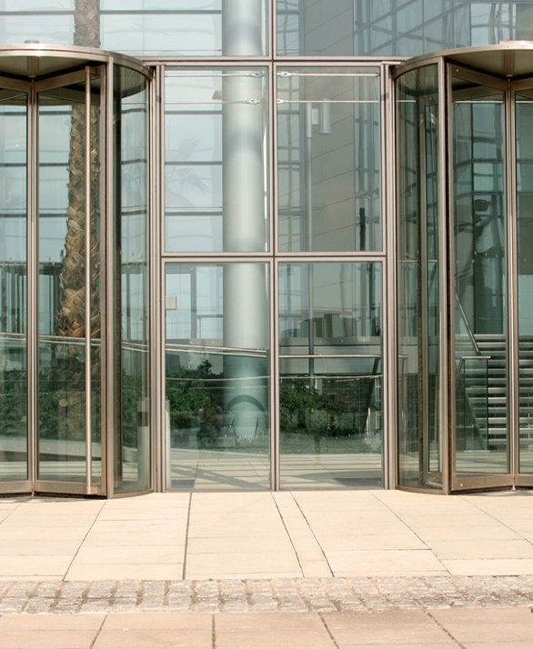
Separate entry and exit Gates
Notes:
Separate entry and exit will prevent mixing of people entering the building and leaving the building physically thus maintaining social distance.

Slide 7
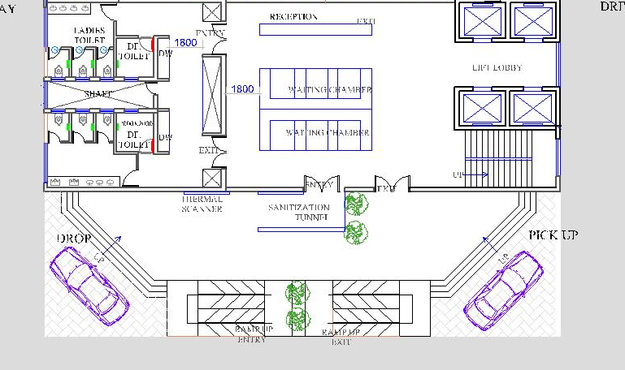
Wall near to entry with built in Thermal scanner
&
Space provisions for Sanitisation chamber at the entrance
THERMAL
SCANNER
SANITATION
CHAMBER
ENTRY
EXIT
DROP POINT
PICK UP
DIFFERENT RAMPS FOR
DIFFERENTLLY ABLED
Notes:
Our Chennai team has developed a typical building layout which incorporates thermal scanner built-in in the wall at the entrance, sanitization chamber, separate entry and exit points

Slide 8
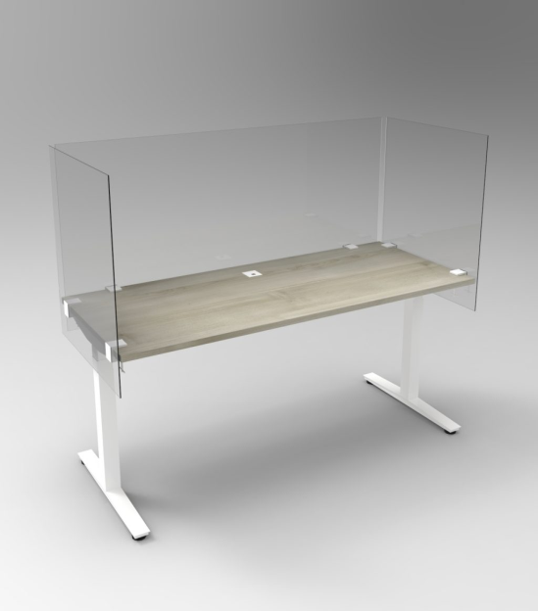
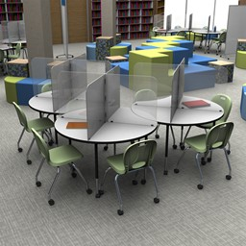
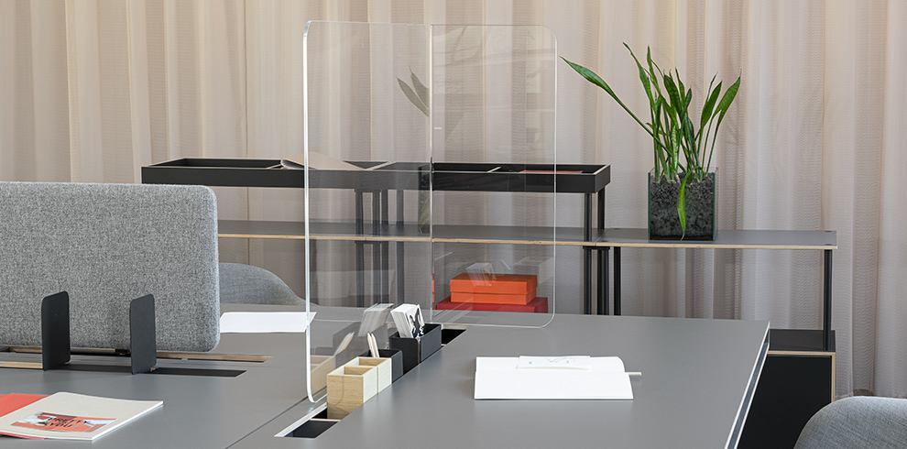
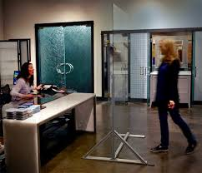
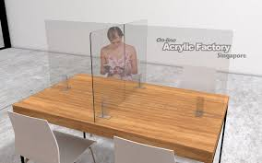
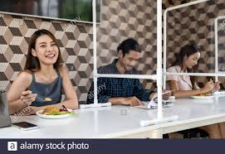
Furniture Layout to avoid direct facing and shielding.
Notes:
By carefully redesigning the interiors with staggered layout and with shielded furniture, close contact with another person in the vicinity can be prevented.

Slide 9
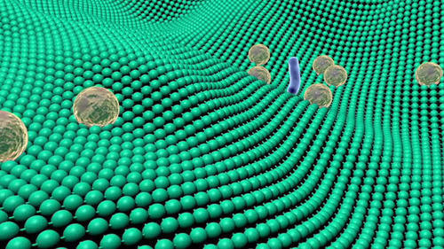
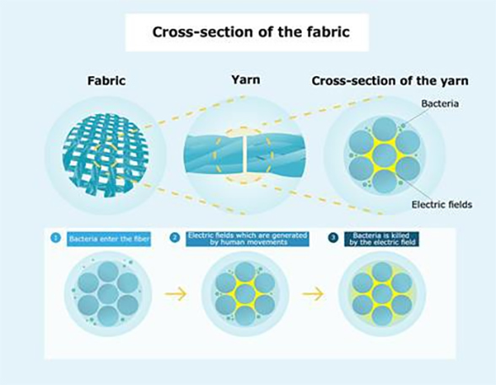
Special types of Interior Fabrics for avoiding sitting of pathogens
Notes:
Future should consist of such types of fabrics as shown for draping, wall covering and carpet etc.

Slide 10
Post Covid Building Materials
Easy to clean building materials with non-porous surfaces and Antimicrobial Technology
Wall treatment using microbicide wall paint
Floor treatment – Granite and other natural stone countertop surfaces allow for moisture, food particles, and microbial spores to accumulate so should be avoided. The flooring materials include bamboo and cork which comprise natural, anti-fungal agents that prevent growth of bacteria and other microorganisms.
Notes:
Building materials will have to be carefully chosen to have these properties.

Slide 11

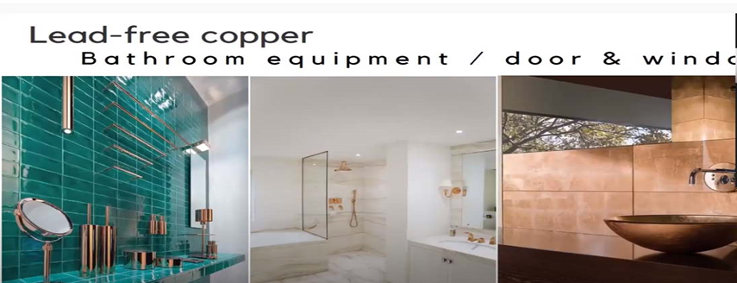
Lead free Copper will be the new material trend for Kitchen & Bathroom fixtures
Notes:
Virus has least probability to stick to copper which is also lead free.

Slide 12
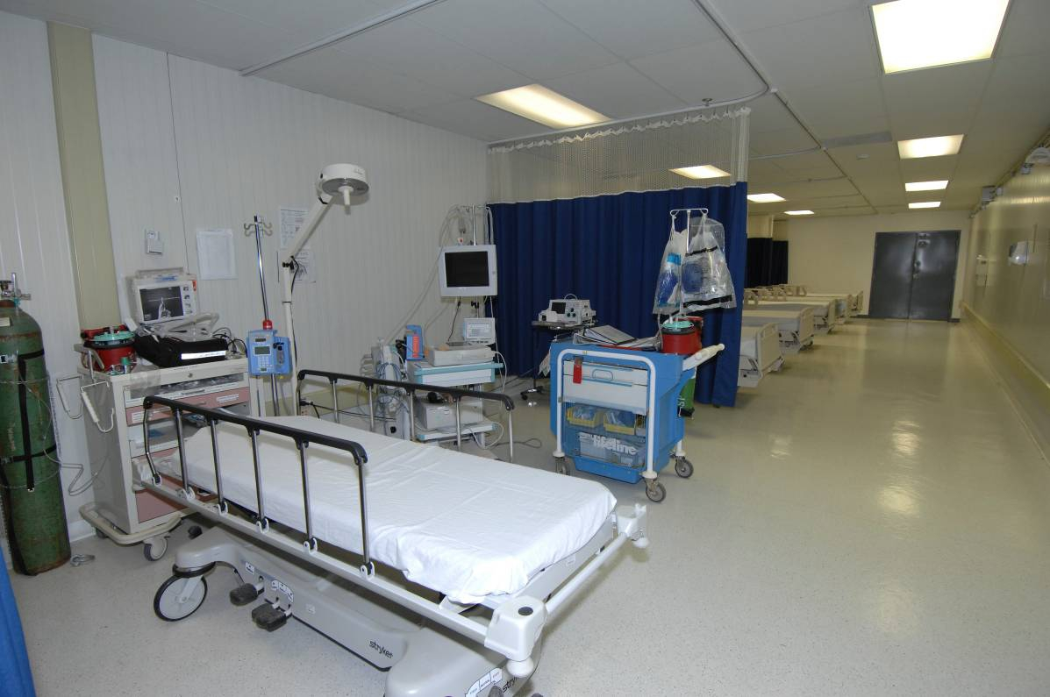
From design perspective, a normal patient room should be more flexible to increase capacity or be easily converted into an ICU.
One bed space converted into ICU by required Add- Ons
Notes:
Health care design need an upgrade too. “The biggest thing to come to light during this period is the inability for hospitals to accommodate the large number of sick people.

Slide 13

Work From Home is the new trend
Notes:
A space with enough daylight, ventilation, electrical gadgets and comfortable sitting will be the new norm in dwelling units.

Slide 14
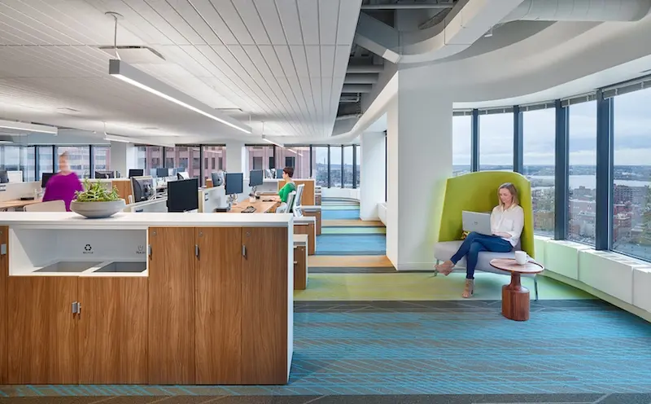
Concerns about future viruses might require more open spaces for enabling people to spread out.
Notes:
More open spaces within the built environment will be helpful to people within to maintain social distance.

Slide 15
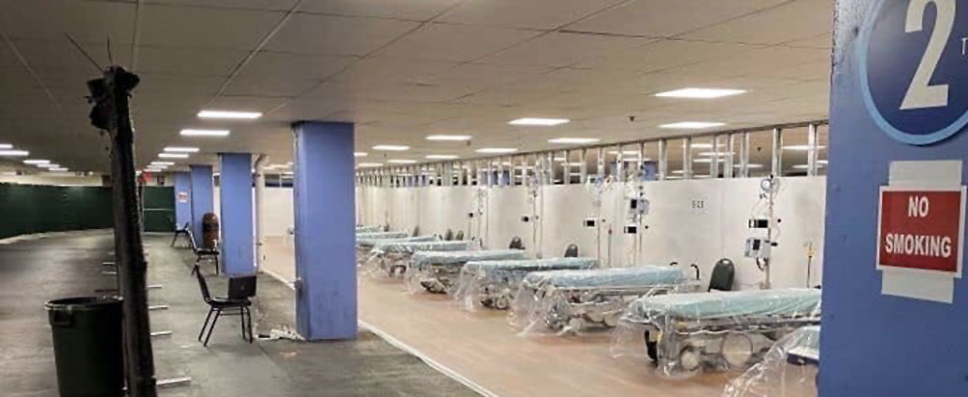
Even Parking spaces need to have the flexibility to turn into critical care units / quarantine spaces.
Notes:
Large parking spaces in every public utility building can turn into covid hospital as the need arises.

Slide 16
Engineering Controls
Notes:
Now a few suggestions on engineering side

Slide 17
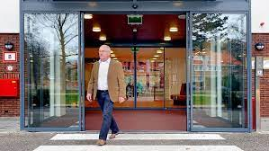
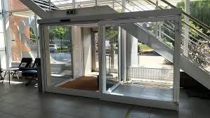
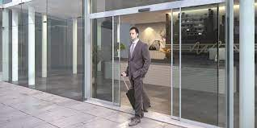
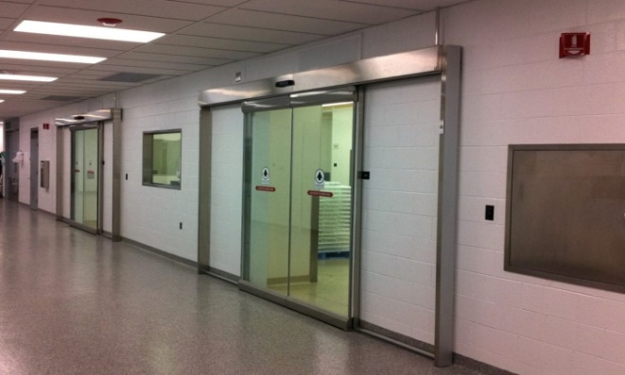
Doors can be automatic to avoid any surface touching
Notes:
Automation can facilitate touchless entry and exit into the built spaces giving more freedom from pathogens.

Slide 18
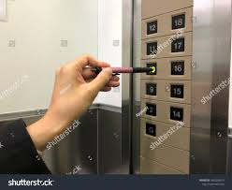
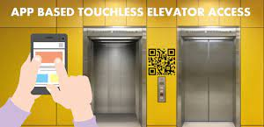
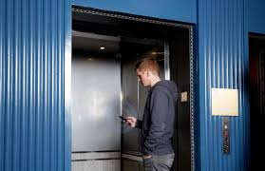
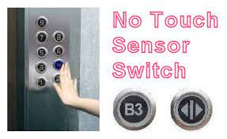
Touchless/App Based Elevators
Notes:
Elevators had been a much debated facility in multi-storey buildings. Using pen or key is not a good choice. Instead App based destination control or no touch sensor switch can be a better option.

Slide 19
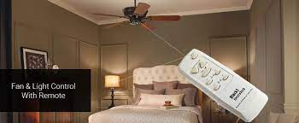
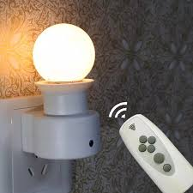
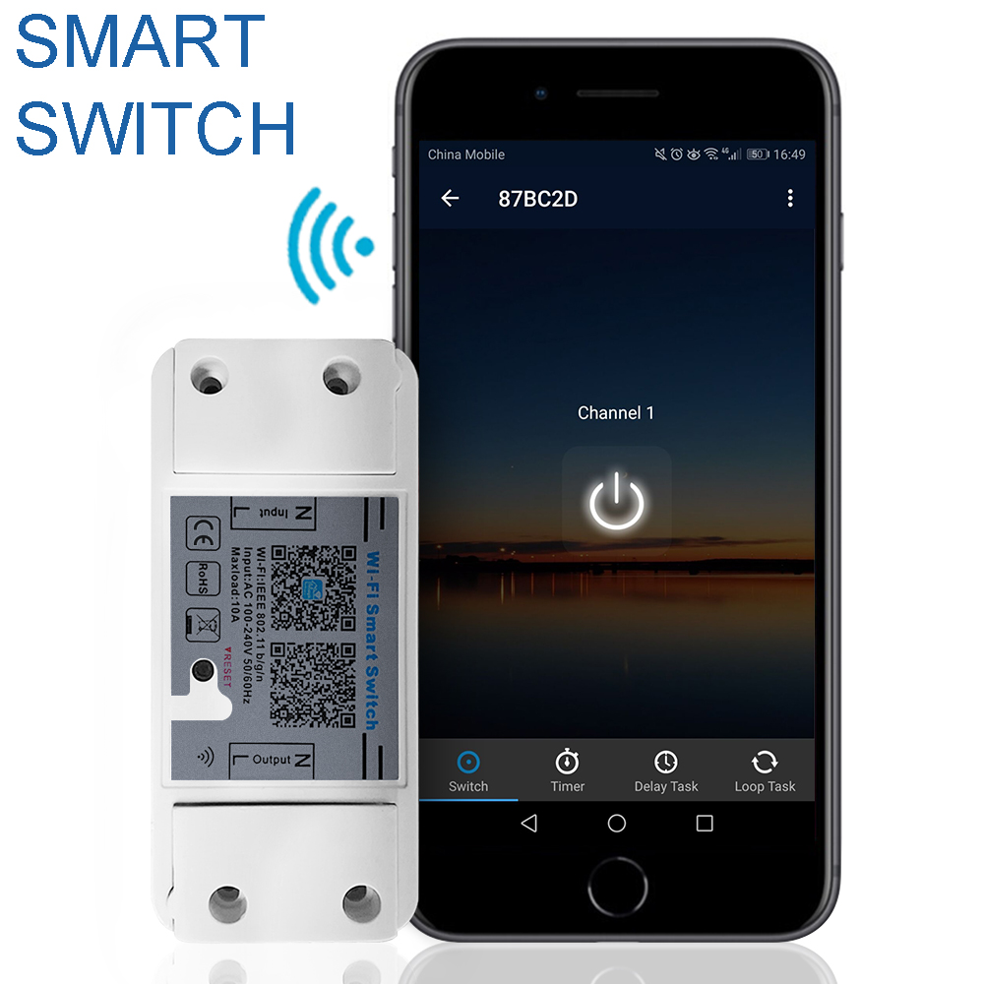
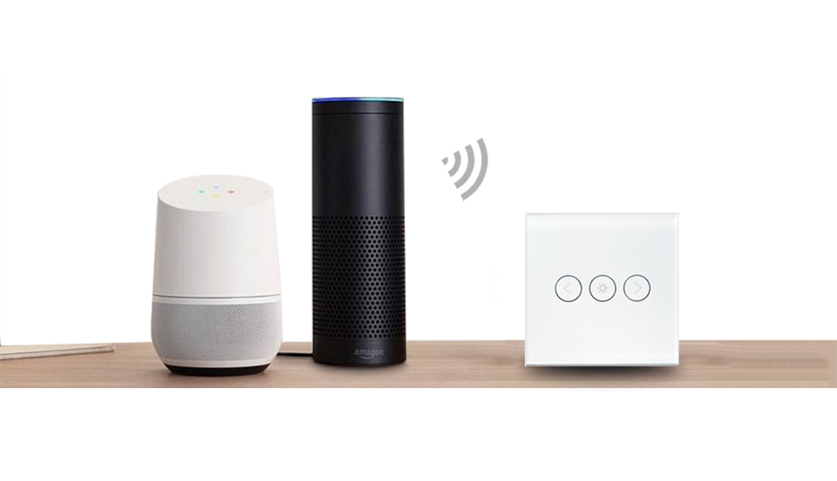
Remote/voice operated switches for room lights & Fan
Notes:
Why use fingers to touch switches . Instead lights and fans can be operated through either a remote or voice activated device.

Slide 20
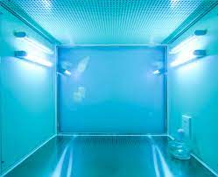

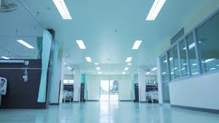

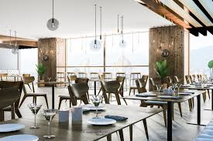
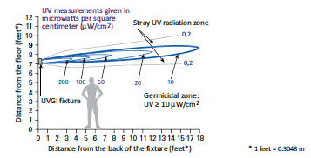
UV Lights should be used for sanitisation in offices and homes.
Notes:
At least one UV Light should be installed in every space to provide disinfection of usable surfaces.

Slide 21
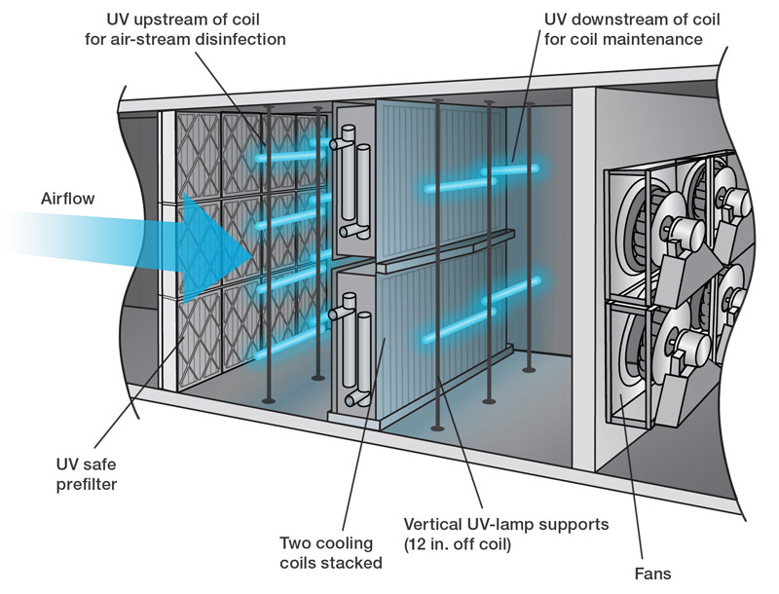
UVGI (Ultraviolet germicidal irradiation) system in Air conditioning can sanitise the air in the AHU itself
Notes:
Air flow when gets sanitised through Ultra violet rays will provide people safe air with requisite comfort .

Slide 22
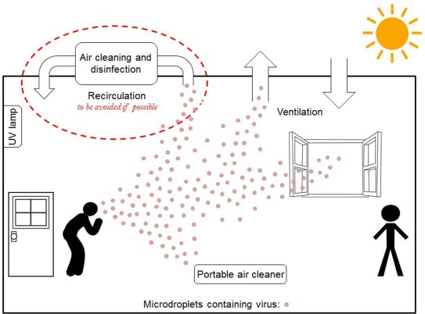
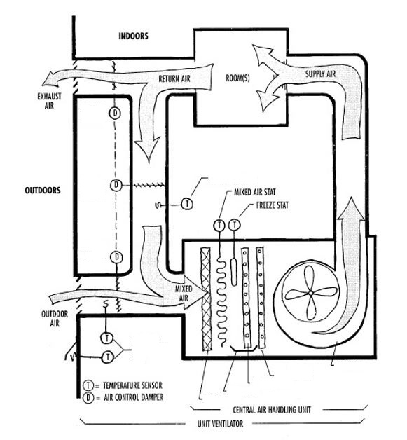
The need for fresh air and more air changes in the closed spaces has obligated us to look to our present system of comfort with air conditioning and air circulatory system.
to be stopped
To be stopped
Notes:
Mixing of return air should be totally eliminated. 100% Fresh air intake and exhaust should be the new norms in HVAC Design to avoid any infection through air draft.

Slide 23
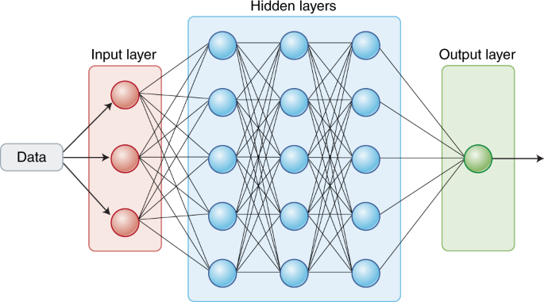
Use of AI (Artificial Intelligence) in density Management within built space
Notes:
Density Management within built space will be controlled by suitable Algorithm based on Artificial Intelligence.

Slide 24
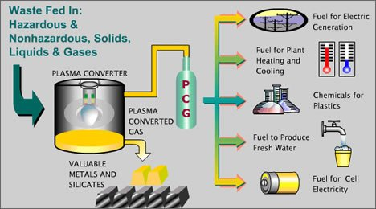
Waste Converters
Notes:
More waste, more convertors to follow zero waste policy. Plasma convertor will be the ultimate to convert entire waste into useful products.

Slide 25
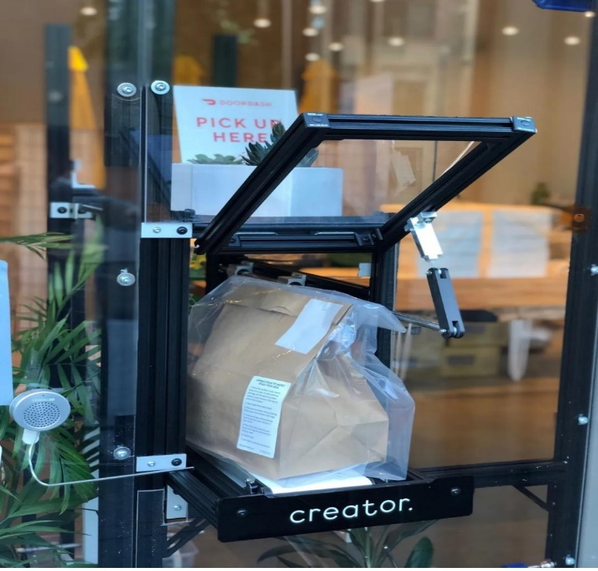
Food transfer window
Notes:
Its applicability will be felt more in housing societies as well as office gates.

Slide 26
Motto of building design
Putting wellness
at its heart by Passive and active interventions!
Notes:
The Philosophy to be adopted now

Slide 27


Stay Safe
Stay Healthy
&
Stay Negative
while
being Positive
Notes:
Please like share and prescribe these suggestions if you are convinced.

