Slide 1
Emerging Medical Technologies in
Healthcare Infrastructure
PRESENTATION BY:
Ar. MONIKA GUPTA
(Healthcare Architect)
Senior Associate at M/s Sikka Associates, New Delhi
12th July 2021

Slide 2
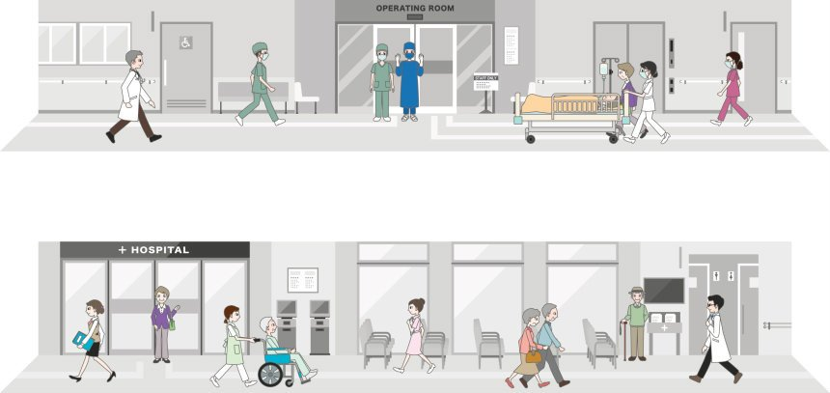


It's Important to understand that a hospital is the most unique commercial building.
Minute details of the building could be life saving factors for millions of people.
FF (FOUR FLOWS) - patient Flow, staff Flow, material Flow & services Flow - is the most impacting factor of any hospital design.
It's important to plan everything right, but extremely critical to plan RIGHT those services which impact the full cycle of FF.

Slide 3
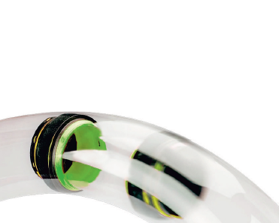
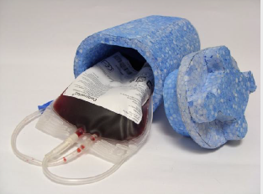
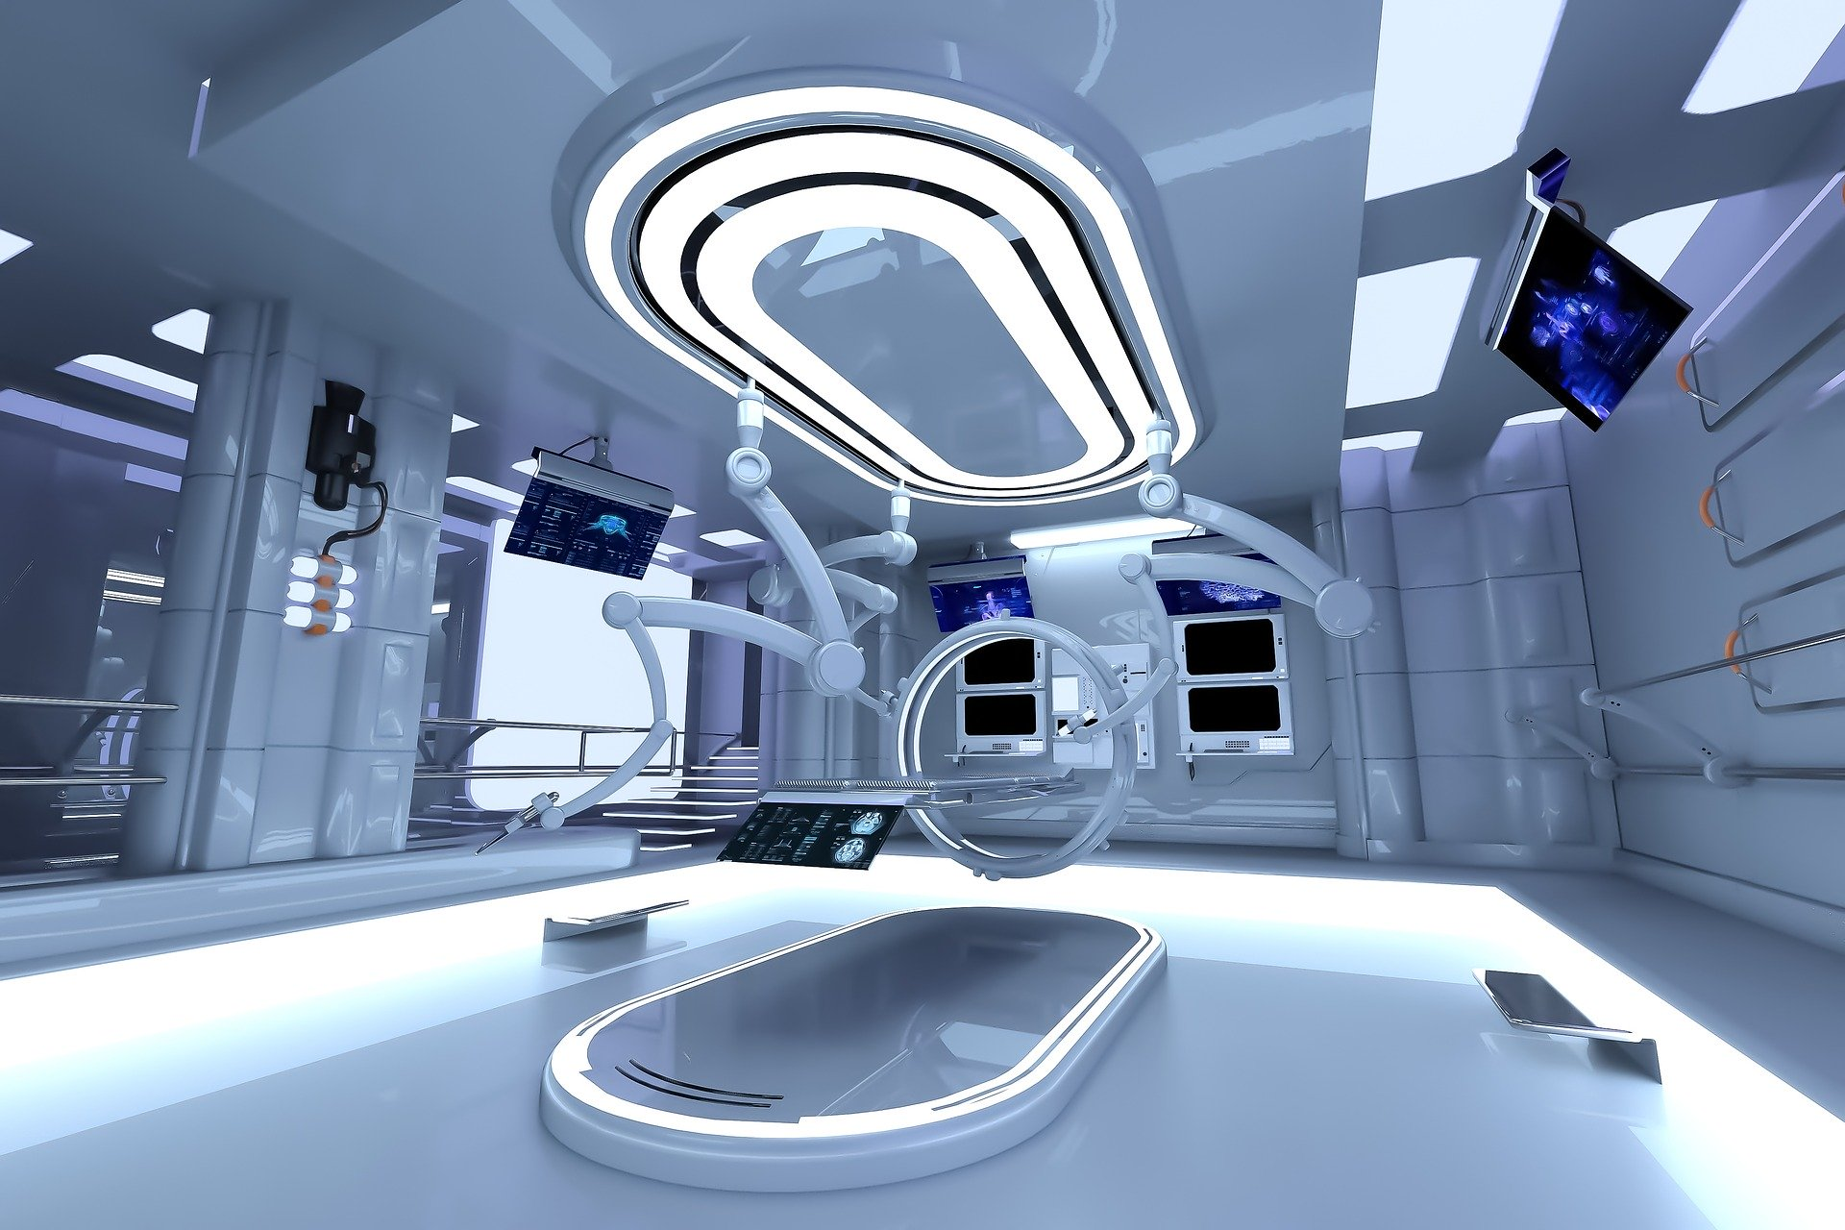
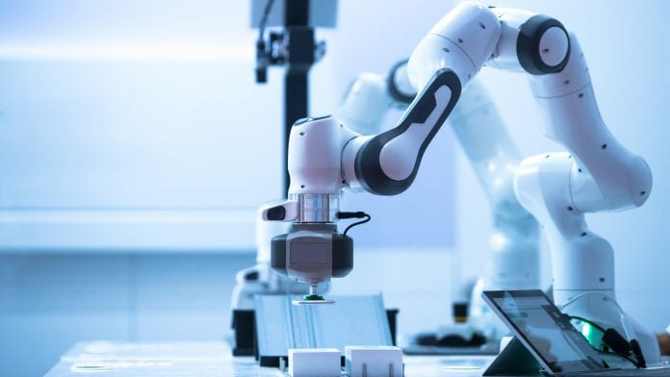
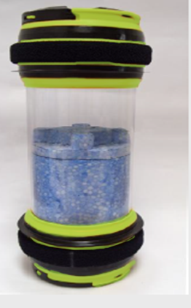
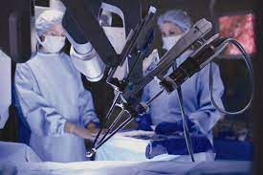

To succeed with FF, it's important that technology be adopted for important areas of a hospital. This is not only the need of the hour but also something we owe to the humanity at large.

Slide 4
Pneumatic Waste-Laundry Collection System (PWLCS)
01

Slide 5
Pneumatic Waste-Laundry Collection System (PWLCS)
PWLCS is an ideal way to transfer soiled linen and solid waste (of any kind) from the source to a centralized collection inside or outside the building pneumatically (suction) through pipes. This central collection point can be at any distance.
A network of tubes (500mm) runs throughout the building both vertically and horizontally and also in public areas of the facility.
Multiple buildings can be easily connected with this system reducing operation time and increasing efficiency and hygiene.

Slide 6
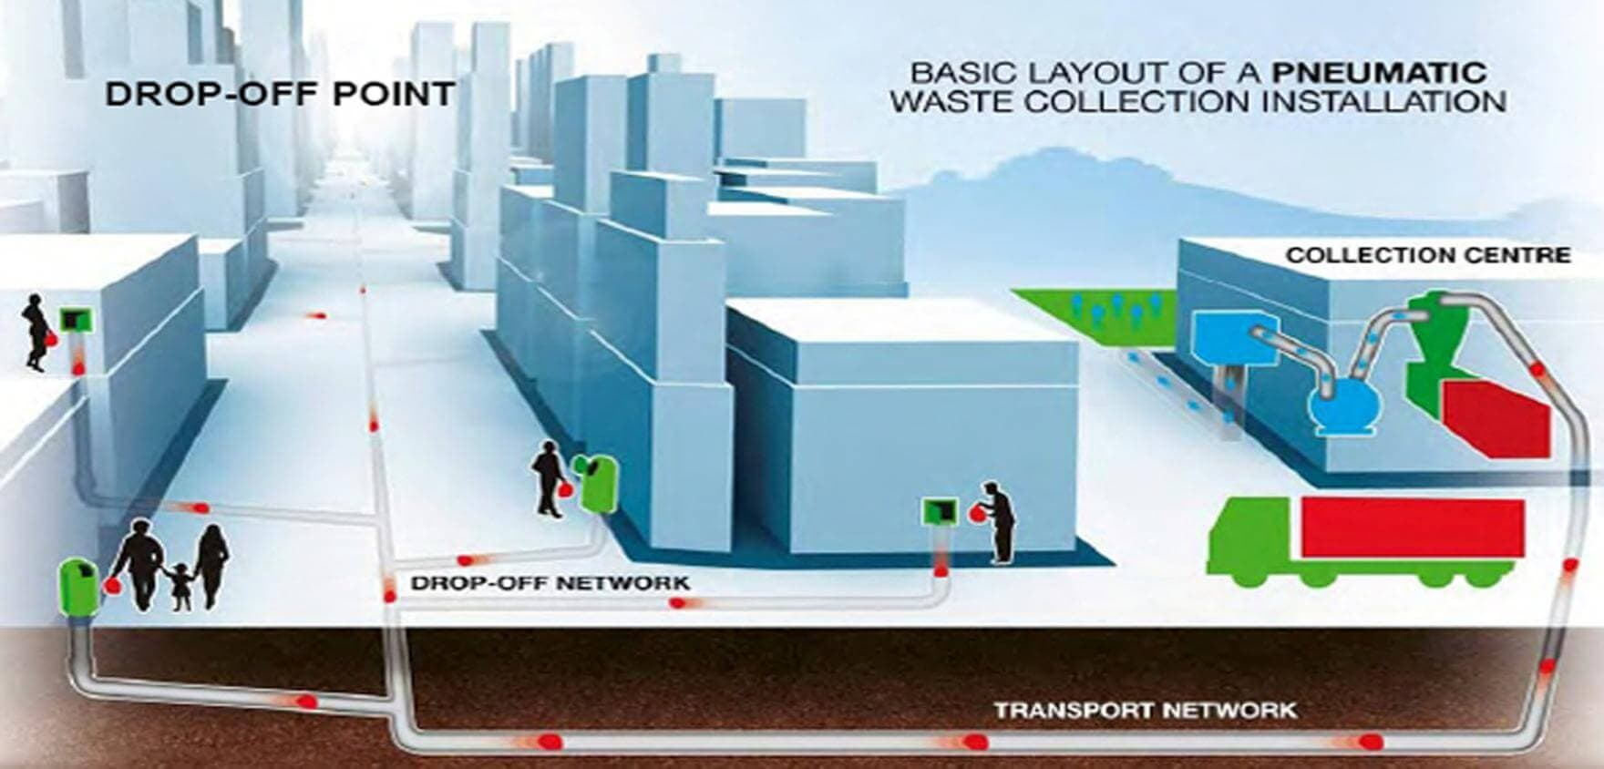
Basic Layout of Pneumatic Waste Collection System

Slide 7
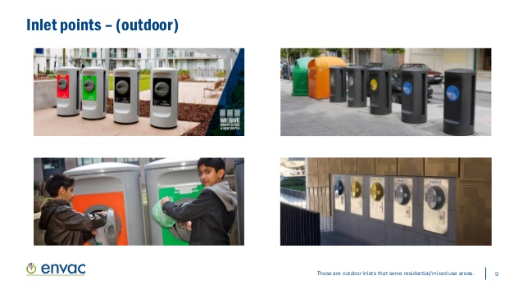
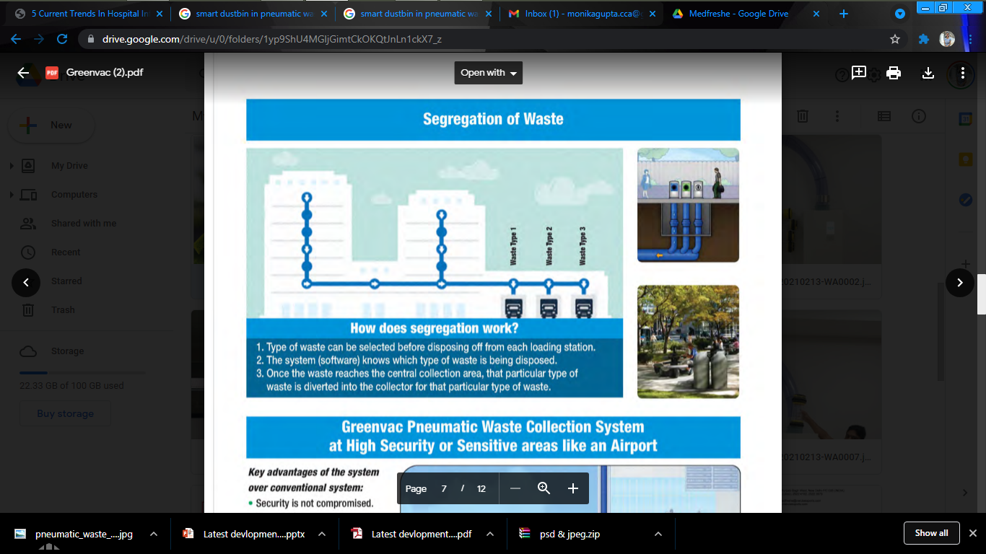
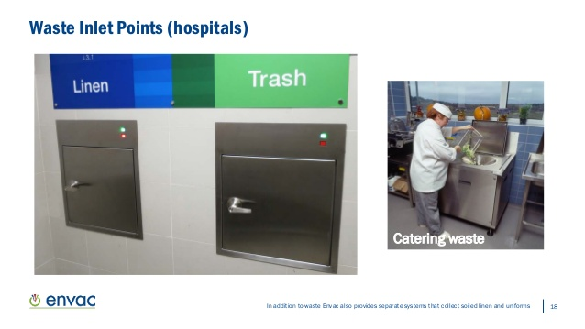
Segregation of Waste
Benefits of PWLCS are:
Hygienic
Reduced carbon footprint
No odour
No rodents, insects, flies due to waste
Aesthetic
Limited exposure to waste
Minimizes human contact
Green and Smart Concept
Eliminates cross contamination, etc.
One collection point in entire facility
Waste Inlet Points - Outside
Type of waste can be selected before disposing off from each loading station
The system (software) knows which type of waste is disposed in which tube
Once the waste reaches the central collection area, the particular type of waste is diverted into the collector for that particular type of waste.
Waste Inlet Points - Hospital

Slide 8
Pneumatic Tube System (PTS)
02

Slide 9
Pneumatic Tube System (PTS)
Small tube is spread out across multiple floors of a hospital and the connected with multiple stations. Each station can send or receive material (samples, blood bags, medicines, documents, cash, etc) from each other via a carrier (container).
Travel speed of material: 3-7 meters/second

Slide 10
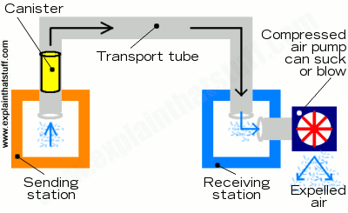
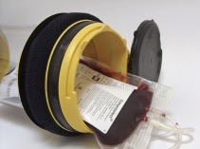
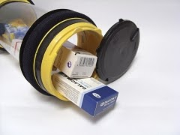
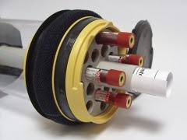
Simple PTTS Cycle:
Pneumatic Tube System in Healthcare:
• Sending blood samples to laboratory
• Blood samples/bags to blood bank
• Pathology specimens
• medicine from pharmacy
• Medical reports
• Small surgical and medical equipments

Slide 11
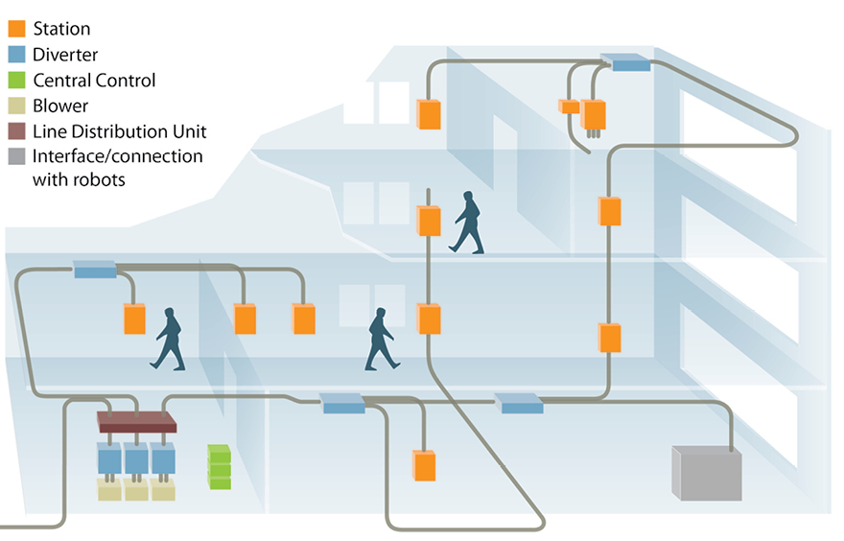
Components:
Blower –It generates the air that moves the PTS carriers via pressure or vacuum suction.
Carrier – A Reusable plastic containers that contains lab specimens, pharmaceuticals, blood products, etc. sent through a pneumatic tube system.
Control Centre – The software that controls the communication.
Station – The user interface which includes an interactive touch screen system for the sending or receiving of the carrier.
Diverter – A route switching device used at branching points within a tube network to allow a carrier to move from one path to another.
Tubing –110mm or 160mm size. In healthcare facilities, PVC and Stainless-Steel systems are preferred above Galvanized Iron.

Slide 12
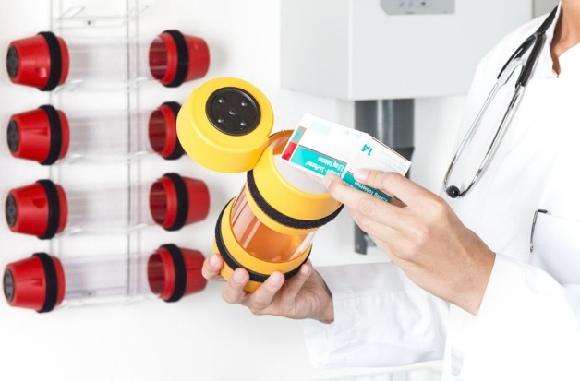
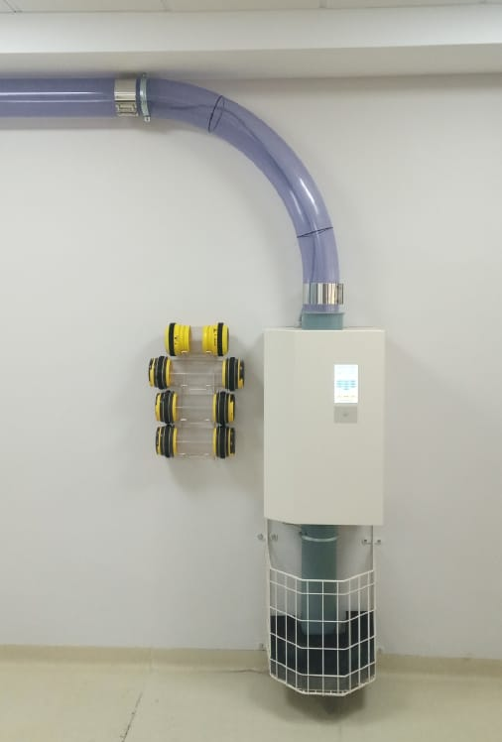
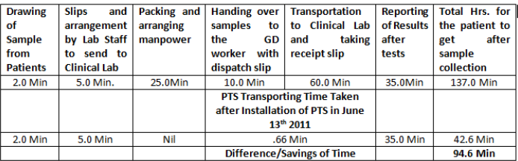
Benefits of Pneumatic Tube System:
Time Efficient Solution
Prevent cross-contamination and germ spreading.
Centralized lab solution.
Fully automated
Reduced bottle necks
16-18 kg material @ speed of 8 meters/sec
Loading Station
Typical Scenario of time taken by PTS
The above table shows a saving of manpower and time of 94.6 minutes for the total completion of process of sample transportation and results being put online – at Kasturba Hospital, Manipal

Slide 13
Nurse Call System (NCS)
03

Slide 14
Nurse Call System (NCS)
The Basic NCS is designed to help patients in the Hospital, in emergency situations, by calling for help and to call for additional help.
NCS must be an independent system and possess its own electrical supply and communication network.
The NCS Design Engineering must be easy to maintain,
Must have sufficient resilience to meet the varying loads that hospital’s experience.

Slide 15
Advanced Nurse Call System
The fundamental operation of a NCS is to provide audible and visual notification at the Nurse Station to seek help.
Lavatory emergency, staff emergency, code blue, and room auxiliary calls as available in advanced NCS. Advanced NCSs are provided as per Hospital policy. However, BIS NEC 2011 requires all Hospitals to provide a hard wired, Basic NCS.
The Call cancellation or resetting shall be possible only at the call originating station.
All NCSs are designed to provide “follow-the-light” concept for Call service Compliance

Slide 16
Short overview of minimum requirements (DIN VDE 0834)
Every bed must have a call release assigned to it, which can be easily reached by bedridden patients.
Call buttons are always red.
Outside every room it is essential to provide a corridor indicator lamp, which indicates the call (red) and the presence (green) as a minimum.
Rooms, which cannot be looked into from the installation location of the presence recognition, such as bathrooms, must be provided with a separate call cancellation.
MOUNTING HEIGHTS OF DEVICES
Operational Devices, with or without indicator lamps (e.g. call or cancel push button consoles) | 700 mm to 1500 mm from finished floor level
Operational devices with text displays (e.g. terminals with call display units) | 1500 mm to 1700 mm from finished floor level
Non-operational Indicator lamps and large text displays | 1500 mm to 2500 mm from finished floor level
Call switches in bathrooms must be fitted a minimum of 200 mm above the highest possible position of the shower head or any other faucet in the room. | The pull cord should end 100 – 200 mm from the floor, so that persons lying on the floor can reach the pull cord.

Slide 17
Automated Storage & Retrieval System (ASRS)
04

Slide 18
Automated storage & Retrieval System (ASRS)
Key features of ASRS are:
Optimum utilization of available space and a safe and quick storage and retrieval mechanism.
ASRS are computer and –robot-aided systems that can retrieve items or stone them in specific locations
It allows more storage space due to high-density to high-density storage & narrower aisles.
It is characterized by multiple speed options, multiple heights, and a small footprint.
Solution for Healthcare Industry:
These automated storage systems are used in Hospital- MRD, Clean laundry, food stores, documents, CSSD

Slide 19
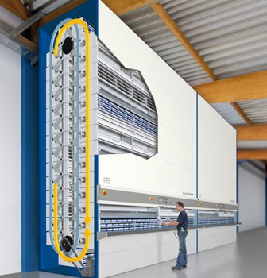
Understanding the structure of AS/RS:
Storage Structure: Fabricated Steel rack framework to support the load
Storage/ Retrieval Machine: Capable of both horizontal and vertical movement
Storage Modules: Unit load containers customized to the size available for storage
Pick up & Deposit Stations P/D Stations: End number of such stations can be customized as per end user requirement

Slide 20
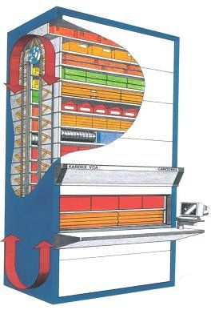
Advantages of ASRS are:
Space Saving: Upto 60% footprint
Higher Storage density: Increases by nearly 80% in the same area as that of Conventional racking.
Safety: Neat & clean arrangement
Reduced human effort
Easy to locate the material: A list of stored material is available on an acrylic sheet holder on one side of the rack.
Individual locking racks
Both Clockwise & Anticlockwise movement
Slim Storage

Slide 21
Hospital Information System (HIS)
05

Slide 22

Hospital Information System (HIS)
Practice of acquiring, analysing & protecting digital and traditional medical information vital in providing quality patient care.
It generates as well as maintains Electronic Medical Records (EMR) and makes it available across the hospital

Slide 23
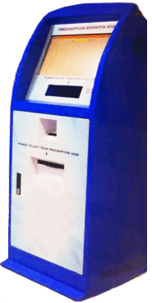
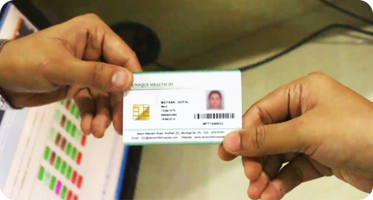
Smart Solutions for Hospitals:
HEALTHCARE KIOSK
SMART ID CARDS
Increased patient satisfaction by lowering waiting times and providing higher levels of convenience and privacy.
Using the kiosk, patients can self-register themselves and can also book appointments etc.
Healthcare kiosk also facilitates automated application processing, positive patient experience, reduced staffing costs, and better visitor management, amongst the rest.
Issuing of e-Health Smart Card to the patient at the time of registration / admission, feeds the Personal + Clinical details (Blood Group, Allergies, Current Health Problems, Current Medications, Vision/Implants, etc.), Insurance Details, Emergency Contact Information with mobile numbers, etc.

Slide 24


Smart Solutions for Hospitals:
MOBILE APPS FOR DOCTORS & PATIENTS
PATIENT PORTAL
Timely alerts and notifications promote accurate and reliable communication and interaction between the patients and the doctors, and ensure that there is no delay in availing treatment and assistance.
It provides access to doctors and authorized users of the institution to view the patient and drug interaction information and the medication knowledge bases.
The Patient Portal grants rights to patients to log in to the system using their unique log in credentials in order to book appointments, view doctors’ schedules, and access and download their medical reports and documents, in just a few clicks, from the comfort of their home.

Slide 25

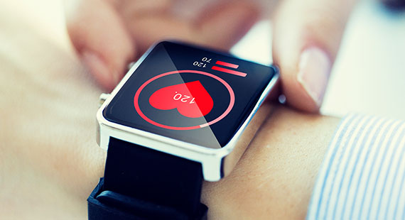
Smart Solutions for Hospitals:
DASHBOARDS
WEARABLE GADGETS
The healthcare industry is fast embracing innovation and wearable devices and technologies are making their mark to a major extent.
Connected wearable medical devices empower providers to offer an enhanced standard of care to the patients while improving efficiency and cutting down operational costs
Dashboards display a list of associated patients and include useful summary-level information about each.
Users receive detailed information by easily navigating to specific tabs within the patient chart.
The Emergency Department (ED) Patient Dashboard integrates directly with Orders modules to provide high-level ED status information in the form of wait times and area counts.

Slide 26
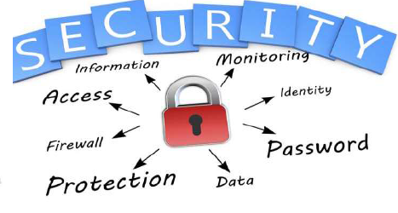
Components of Information System:
Computer Hardware
Computer Software
Telecommunications
Database and data warehouses
Human resource and procedures
Benefits of HIS and Smart Hospital:
Organized & Coordinated Treatment Process
Improved Patient Safety
Betterment in Patient Care
Hassle-free Process of Performance Analysis
Transfiguration in Clinical Procedures
Circumvention of Medical Errors
Instant & Seamless Accessibility to Patients’ Details
Minimized Operational Expense
Saving of Time
Improved Patient Satisfaction

Slide 27
Thank You

