Slide 1
BIO SAFETY LEVELS
INSIGHT INTO FACILITY REQUIREMENTS AND DESIGN

Slide 2
TOPICS COVERED
1 . What is Biosafety, its need , levels, general practices
2 . Checklist of factors and features for Bio safety Labs
3 . Technical Standards for Engineering controls of a BSL3 Lab
4 . Certification and Validation

Slide 3
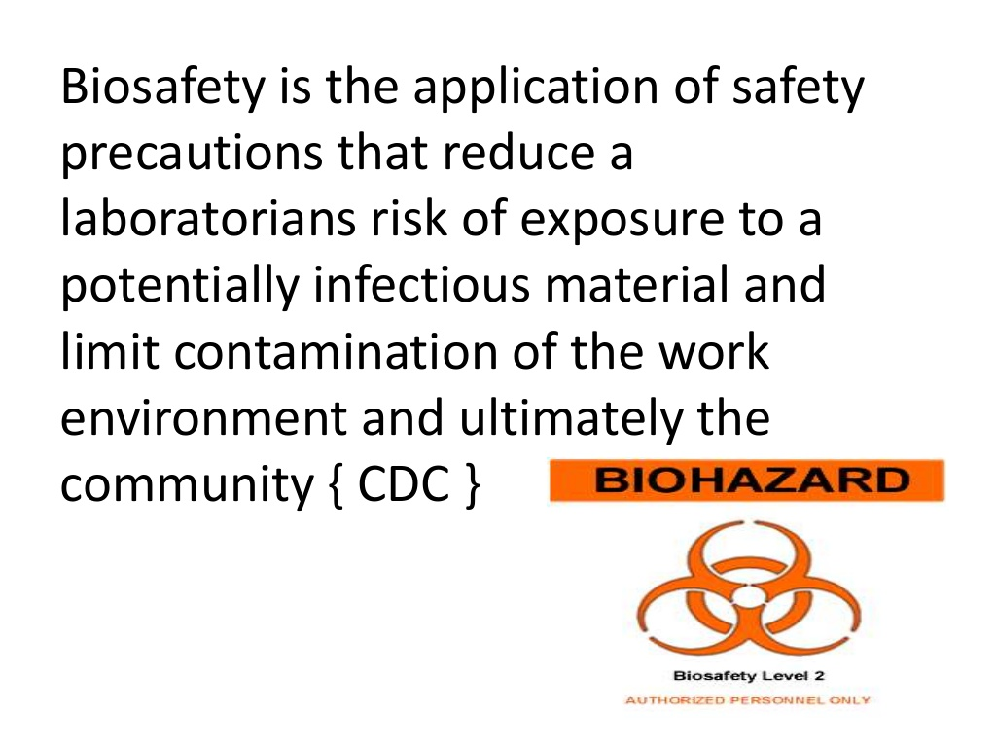
BIOSAFETY

Slide 4
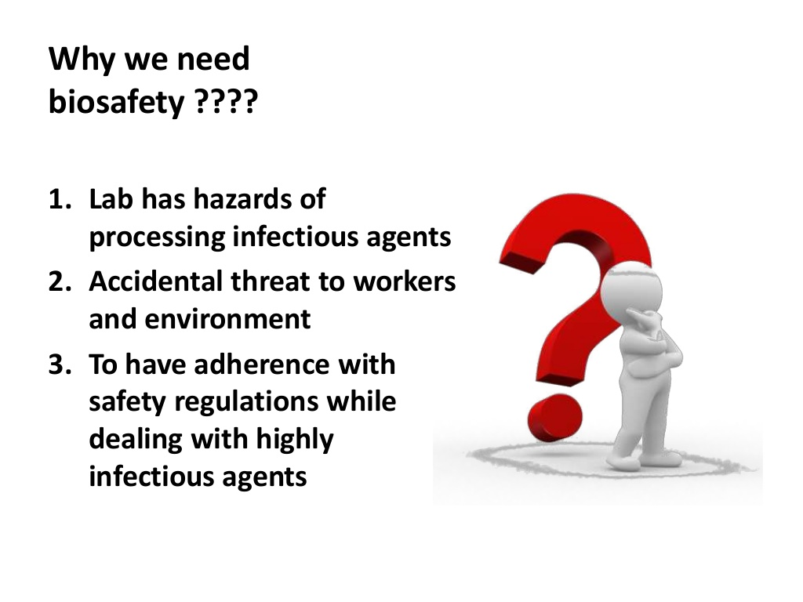

Slide 5
Risk Group (RG) classification
Risk Group | Description
RG 1 | A microorganism that is unlikely to cause human/ animal/plant disease.
RG 2 | A microorganism that can cause disease in human /animal/ plant but the laboratory exposures may or may not cause serious infection to individual and risk(s) of spread of infection is limited.
RG 3 | A microorganism that usually causes serious/lethal human/ animal/ plant disease but does not ordinarily spread from one infected individual to another.
RG 4 | A microorganism that usually causes serious/lethal human/ animal/ plant disease and that can be readily transmitted from one individual to another, directly or indirectly.

Slide 6
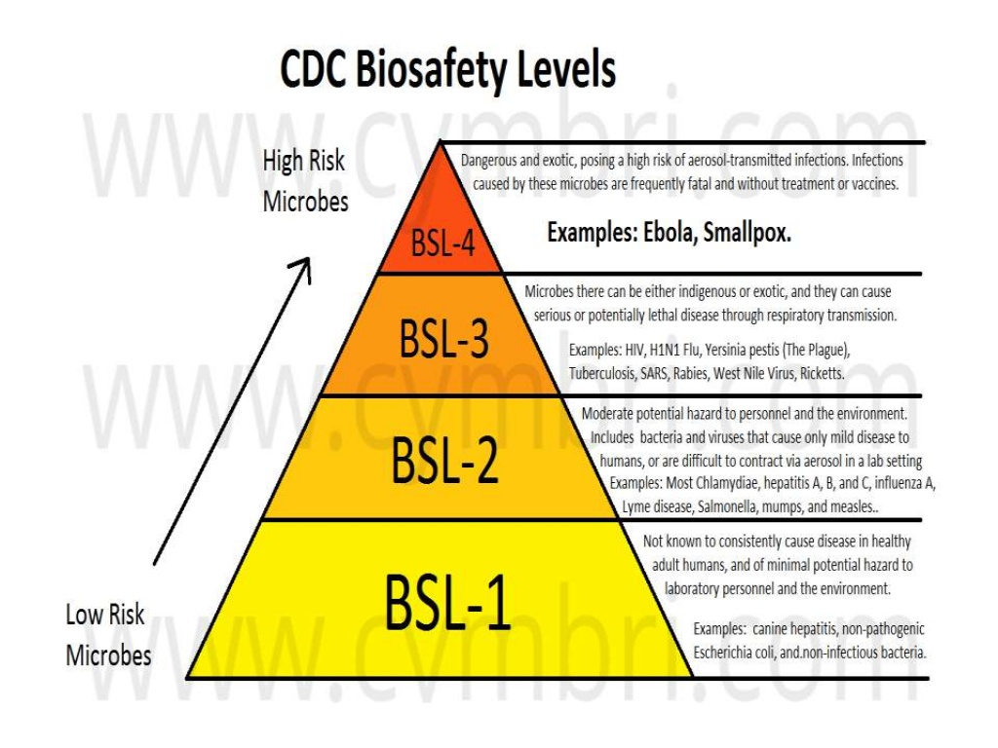

Slide 7
BIOSAFETY LEVEL1
A Biosafety Level 1 (BSL-1) lab is suitable for work involving well-characterized agents not known to consistently cause disease in healthy adults and that are of minimal potential hazard to laboratory personnel and the environment. This laboratory is not necessarily separated from the general traffic patterns in the building. Work is generally conducted on open bench tops using standard microbiological practices. Special containment equipment and facility design are neither required nor generally used.
Eg. Non Pathogenic strain of E-coli

Slide 8
STANDARD PRACTICES- BSL1
Frequent hand washing
Door that can be kept locked while working
Limits to access of the lab space while working
No eating or drinking or storage of food in the lab space
Care to limit splashes and creation of aerosols
Decontamination of surfaces after every use.

Slide 9
BIOSAFETY LEVEL 2
A Biosafety Level 2 (BSL-2) lab is similar to BSL-1 and is “suitable for work involving agents of moderate potential hazard to personnel and the environment. It differs from BSL-1 in that access to the laboratory is limited when work is being conducted and all procedures in which infectious aerosols or splashes may be created are conducted in biological safety cabinets or other physical containment equipment”.
Generally associated with Human disease.

Slide 10
STANDARD PRACTICES- BSL 2
PRIMARY BARRIERS
Biosafety cabinets or physical containment devices are used.
PPE used as needed.
SECONDARY BARRIERS
Providing lockable doors for facilities that house restricted agents
Locating new laboratories away from Public areas.
Eyewash station
Furniture to be covered with nonfabric material that can be decontaminated

Slide 11
The Biosafety Level 3
The Biosafety Level 3 (BSL-3) lab is “applicable to clinical, diagnostic, teaching, research, or production facilities in which work is done with indigenous or exotic agents with a potential for respiratory transmission, and which may cause serious or potentially lethal disease as a result of exposure by inhalation route. All laboratory manipulations should be performed in biological safety cabinets or other enclosed equipment, such as gas-tight aerosol generation chamber”.
Generally associated with potentially lethal diseases routed through Inhalation.

Slide 12
STANDARD PRACTICES- BSL 3
All practices of BSL2 : primary and secondary
In addition:
Special Engineering and design features. Lab air is exhausted to the outdoors
Ventilation is balanced to provide directional airflow into the room.
Restricted access
Self closing doors with automatic locking

Slide 13
The Biosafety Level 4
The Biosafety level-4 (BSL-4) lab is “applicable for the work with dangerous and exotic agents that pose a high individual risk of life-threatening disease, which may be transmitted via the aerosol route and for which there is no available vaccine or therapy.” The laboratory worker’s complete isolation from aerosolized infectious materials is accomplished primarily by working in a Class III BSC or in a full-body, air-supplied and positive-pressure personnel suit.
Associated with highest biosafety from dangerous and exotic viruses or agents with unknown risk of transmission.
Eg. Ebola, small pox, Marburg viruses

Slide 14
GENERAL PRACTICES- BSL 4
Safety equipment (Primary barriers)
All procedures conducted in Class III Biosafety cabinets OR
Class II BSC combined with full body, air supplied, positive pressure personal suit
Facilities (Secondary barriers)
Separate building or Isolated zone
Dedicated supply and Exhaust and decontamination systems

Slide 15
BSL4 CONTAINMENT SYSTEM TYPES
A. Cabinet room
a. The cabinet room housing Class III biological safety cabinet must be separated from outside environment by two air lock entry doors. Handling of Risk Group 4 microorganisms must be performed in this room and nothing must be taken out of the room. All required instruments for study must be placed inside the cabinet room.
b. Cabinet room must be attached with outer and inner changing rooms fitted with shower.
c. An arrangement of interlocked autoclave or fumigation chamber must be kept to transfer materials inside the cabinet room.

Slide 16
B. Suit laboratory
a. A protective suit laboratory is designed and maintained to provide personnel protection equivalent to that provided by Class III biological safety cabinets and must be attached with changing and decontamination rooms.
b. It must be attached with outer and inner changing rooms fitted with shower.
c. Entry into the suit laboratory is through an airlock fitted with airtight doors.
d. Exit through a chemical shower facility to decontaminate the surface of the positive pressure suit. In the event of an emergency exit or failure of the chemical shower system, a method for decontaminating positive pressure suits, such as a gravity fed supply of chemical disinfectant, is needed.
e. An appropriate warning system for personnel working in the suit laboratory must be provided for use in the event of mechanical system or air failure.
f. Decontamination room, fitted with decontamination shower system must also be attached with suit laboratory.

Slide 17
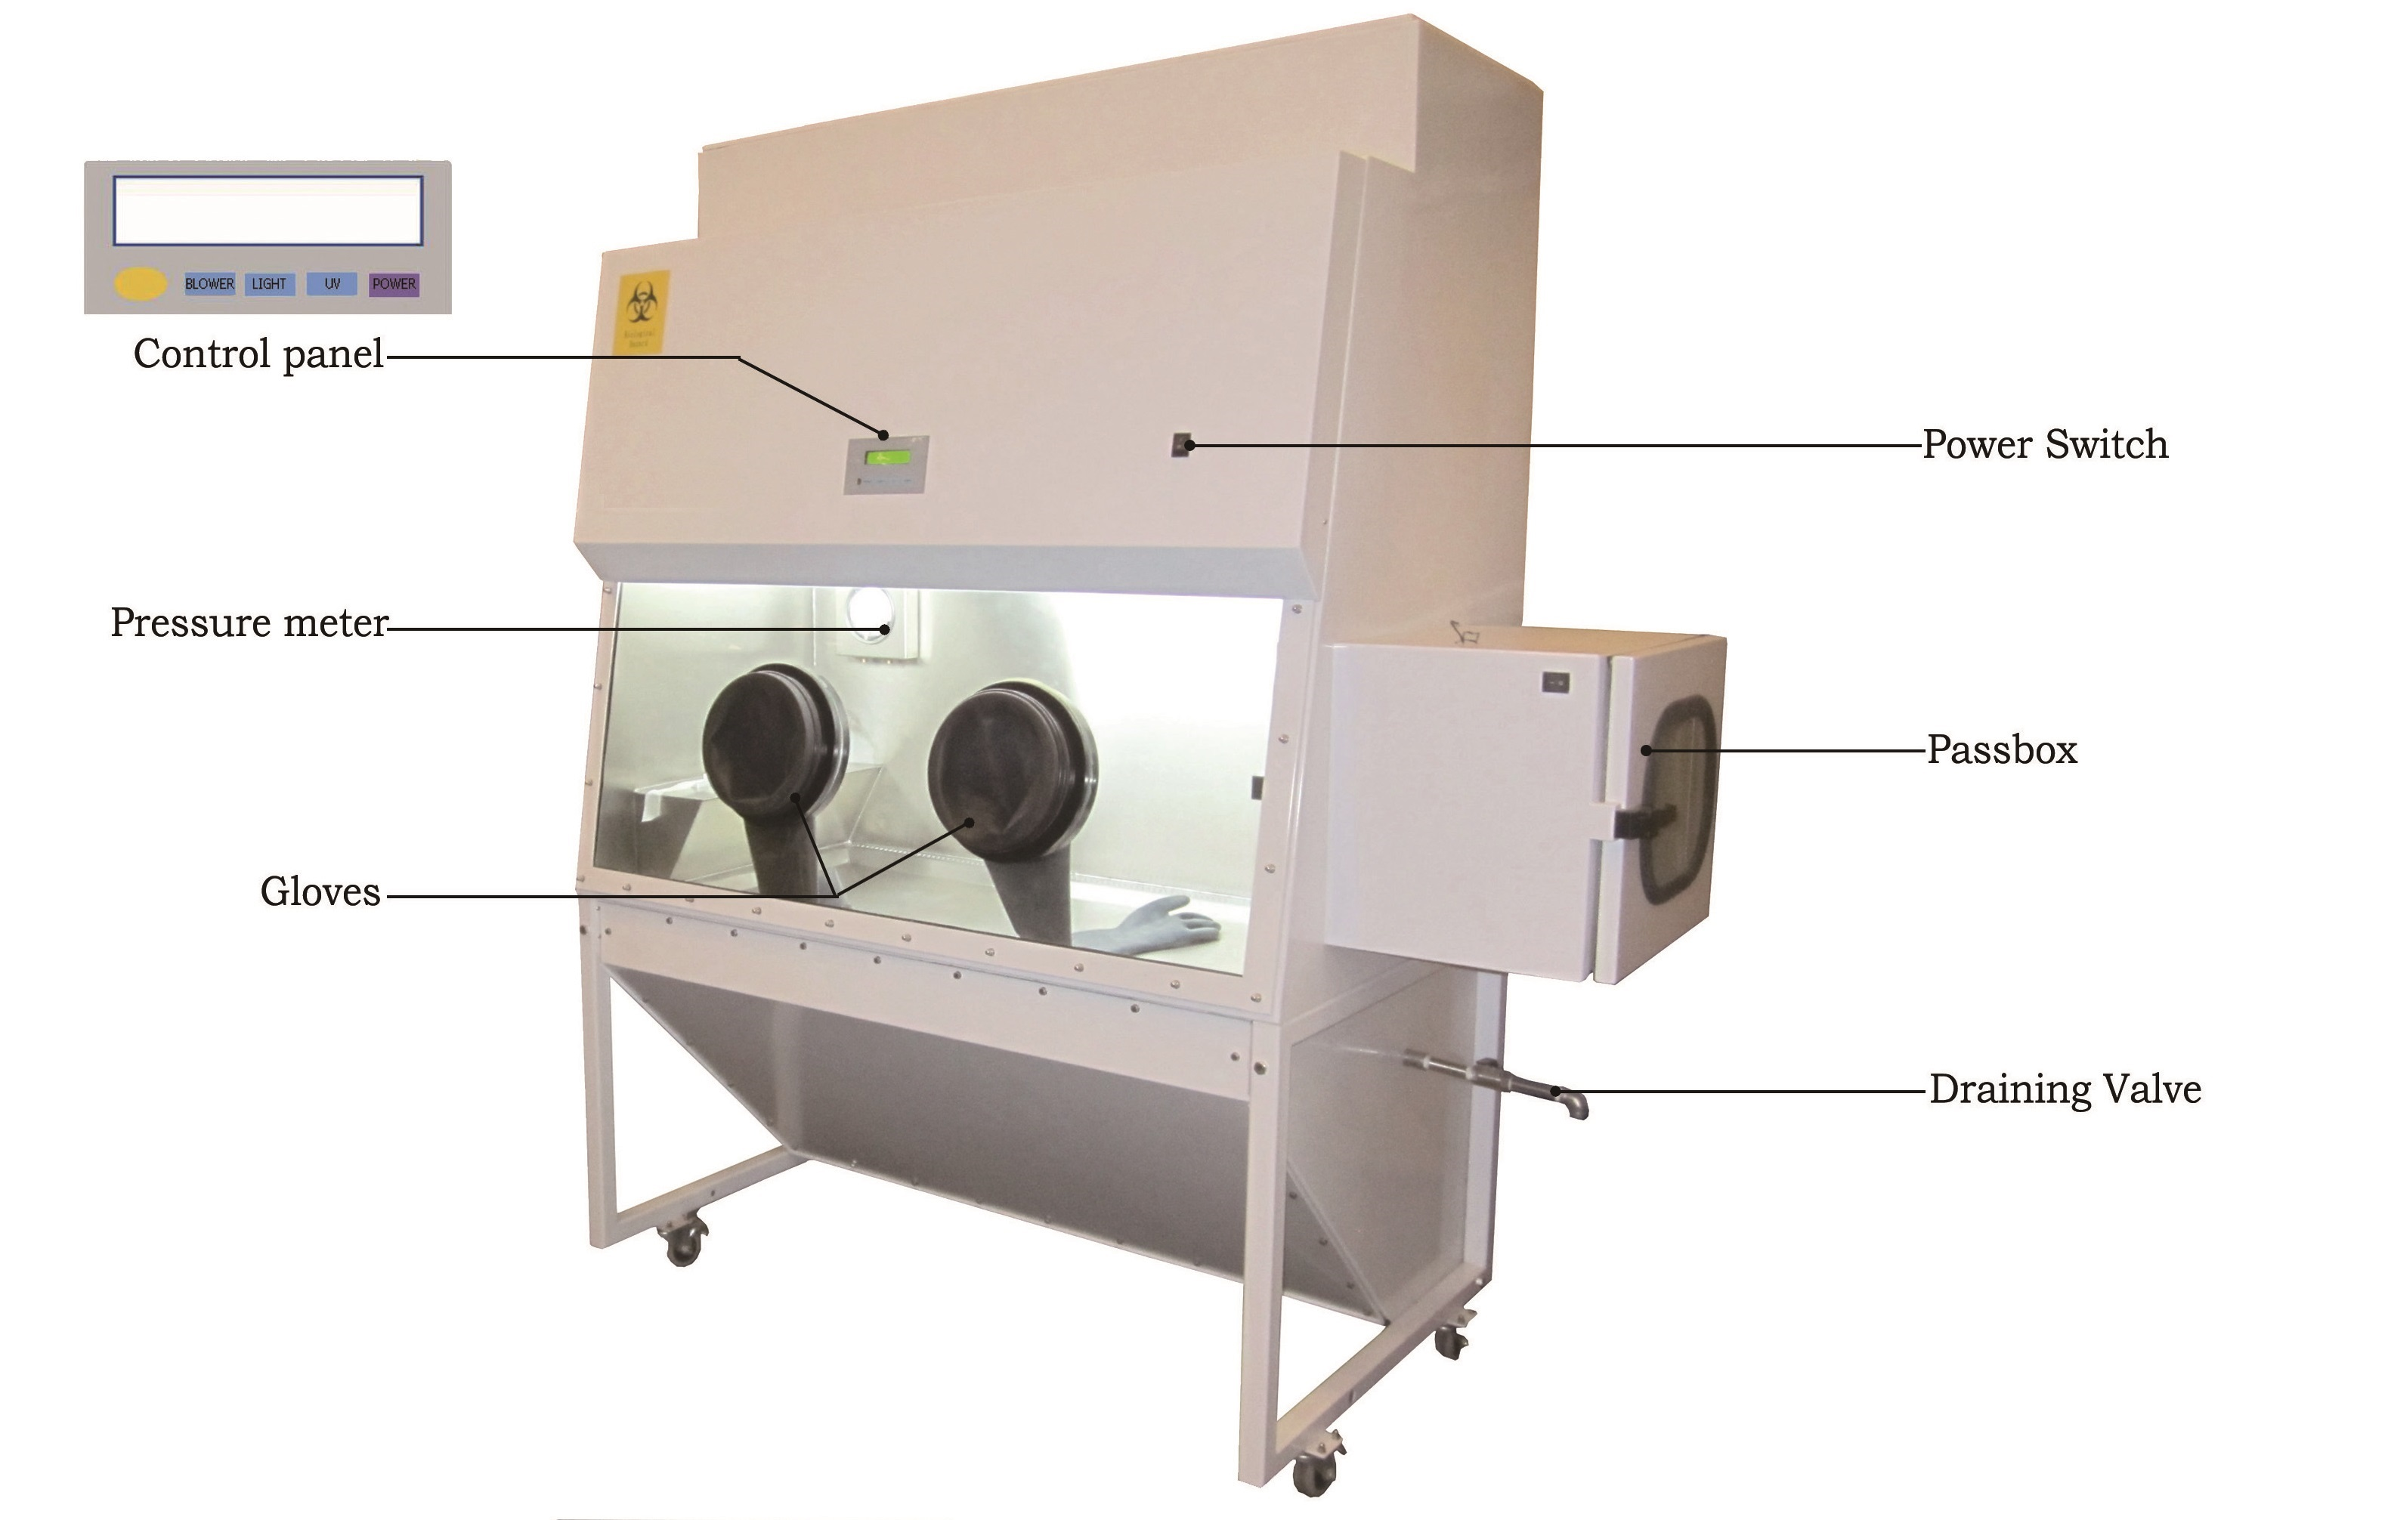
CLASS III CABINET

Slide 18
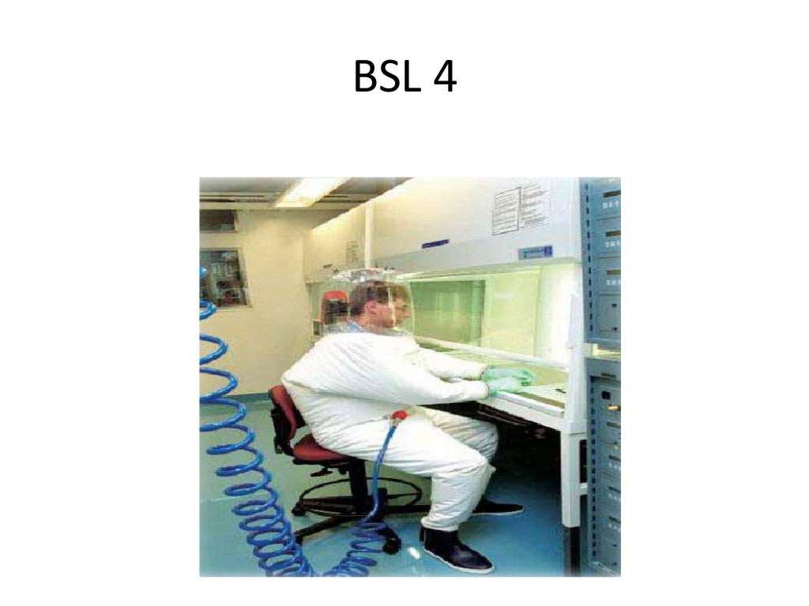
PRESSURISED SUIT PROTECTION

Slide 19
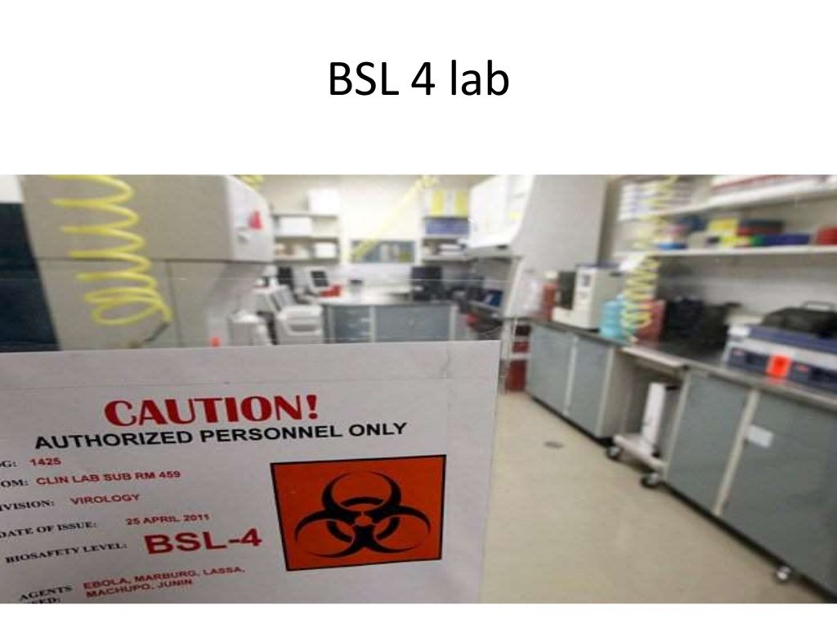

Slide 20
Changing Room

Slide 21
Decontaminating shower

Slide 22
Scouring the air-HEPA filter and filtration inspection verification

Slide 23

The Indian Acts/Regulation/Guidelines pertaining to BSL
Manufacture, Use/Import/Export and Storage of Hazardous Microorganisms/Genetically Engineered Organisms or Cells, Rules, 1989 under the Environment (Protection) Act, 1986.
The Regulation & Guidelines for Recombinant DNA research and Biocontainment, 2017.
Guidelines for the Establishment of Containment Facilities: Bio safety Level 2 (BSL-2) & 3 (BSL-3) and certification of BSL-3 facility, 2020.

Slide 24
Competent Authorities under Rules 1989
Competent Authorities | Role
Recombinant DNA Advisory Committee (RDAC) | Advisory
Institutional Biosafety Committee (IBSC) | Regulatory/ Approval
Review Committee on Genetic Manipulation (RCGM)
Genetic Engineering Appraisal Committee (GEAC)
State Biotechnology Coordination Committee (SBCC) | Monitoring
District Level Committee (DLC)

Slide 25
Comparison of Area and Cost Factors for Biosafety Level Laboratories
 | BSL-1 | BSL-2 | BSL-3 | BSL-3 | BSL-4 | BSL-4
 |  |  | Standard | Enhanced | Cabinet | Suit
Net Area (NSF) | 1,000 | 1,000 | 1,100 | 1,400 | 1,700 | 2,400
Gross Area (GSF) | 1,538 | 1,667 | 2,200 | 2,979 | 4,474 | 7,273
NSF / GSF Ratio | 0.65 | 0.60 | 0.50 | 0.47 | 0.38 | 0.33
Relative Cost Factor | 1 | 1.25 | 2 | 2.5 | 4 | 6

Slide 26
A Checklist of Factors and Features for Biosafety Level Laboratories
 | Infectious Agent | BSL-1 | BSL-2 | BSL-3 | Cabinet BSL-4 | Suit Bsl-4
Hazard | Not harmful to humans or environment, work possible on open bench work possible on open bench | Y
 | Moderate hazard to people, environment vaccine and treatment known; |  | Y
 | Potential for aerosol transmission |  |  | Y
 | Serious or lethal hazard to people; vaccine and treatment known |  |  | Y
 | Serious, lethal, or unknown hazard to people; no vaccine or treatment available |  |  |  | Y | Y

Slide 27
Electric | Emergency power generation system |  |  | Y | Y | Y
Plumbing | Liquid effluent kill-tank |  |  | O | Y | Y
Fire Protection | Class A FP system and wet sprinklers Safety Equipment | Y | Y | Y | Y | Y
Sterilizer | Autoclave available in bldg |  | Y
 | Autoclave, 1-door in suite |  |  | Y
 | Autoclave, 2-door in suite |  |  |  | Y | Y
 | Dunk tank for item transfers out of containment lab |  |  | O | O | O
Certified BSC | Biosafety Cabinet II Type A | O | Y | Y
 | Biosafety Cabinet II Type B |  |  | Y |  | Y
 | Biosafety Cabinet III |  |  |  | Y
Splash | Emergency deluge shower | Y | Y | Y

Slide 28
Protection | Emergency eyewash fountain | Y | Y | Y | Y
Personal | Handwash sink | Y | Y | Y | Y
Hygiene | Laboratory coat |  | Y | Y | Y
 | Personal protective equipment |  | Y | Y | Y
 | Positive pressure-air sealed full-body suit |  |  |  |  | Y
Life safety | Self-contained breathing air |  |  |  | Y | Y
Sharps | Needles/sharp containers | Y | Y | Y | Y | Y
Material Transfer | Pass-through box with interlocking doors facility features |  | O | Y
Doors | Automatic door closer | O | Y | Y | Y | Y
 | Door locks | O | Y
 | Door locks with access control system | O | O | Y | Y | Y
Surfaces | Cleanable floors | Y
 | Cleanable floors, ceilings, walls | O | Y | Y | Y | Y
 | Cleanable lab furniture | O | Y | Y | Y | Y

Slide 29
 | Cleanable work countertops | Y | Y | Y | Y | Y
 | All penetrations in lab sealed |  |  | Y
 | All penetrations in lab sealed gastight |  |  |  | Y | Y
 | Water-resistant floors | Y | Y
 | Water-resistant floors and walls |  |  | Y | Y | Y
 | Water-resistant work counters | O | Y | Y | Y | Y
Air-Lock | Provide air-lock(s) |  |  | Y | Y | Y
 | Provide airlock with gowning |  |  | Y
Anteroom | Provide anteroom with gowning and/or changing |  |  | O | Y | Y
 | Provide anteroom for gowning and shower-into lab |  |  |  | Y | Y
 | Provide anteroom for clothes change and shower-out lab |  |  |  | Y | Y
 | Provide anteroom for suit decontamination shower-out lab |  |  |  |  | Y

Slide 30
Equip Decon | Provide a gastight room for equipment and furniture gaseous sterilization |  |  | O | Y | Y
Windows | Exterior windows | O | O | O | N | N
 | Exterior windows - operable with insect screens | Y | Y | N | N | N
 | Interior windows view into lab Ventilation Features | O | O | O | Y | Y
Airflow | Airflows into lab, negative pressure | O | Y | Y | Y | Y
Exhaust | Natural ventilation possible | O | O | N | N | N
 | Mechanical exhaust | O | Y | Y | Y | Y
 | Mechanical exhaust with HEPA filters |  |  | Y
 | Mechanical exhaust independent of general building exhaust with 2 HEPAs in series |  |  | O | Y | Y
 | In-place filter-testing facilities |  |  | O | Y | Y
 | Vacuum line require HEPA filter |  |  | Y | Y | Y

Slide 31
Symbol key
Supply Air | Natural ventilation possible | O | O | N | N | N
 | HVAC supply required |  | Y | Y | Y | Y
 | HVAC supply independent of general building supply |  |  | Y
 | HVAC supply independent of general building supply with HEPA filters |  |  |  | Y | Y
 | HVAC supply automatic shutdown interlocked with exhaust |  |  | Y | Y | Y
 | Supply backflow prevention with dampers |  |  | Y | Y | Y
 | Breathing air system- protected, separate |  |  |  | O | Y

Slide 32
TECHNICAL STANDARDS FOR THE ENGINEERING CONTROLS FOR BSL-3 LABORATORY

Slide 33
FACILITY FEATURES FOR BSL3 LABS GENERAL ISSUES
1. Personnel Entry/Exit in lab through Clothing Change & Shower Rooms: Shower doors located between the clean and dirty change room should not to be opened simultaneously. These doors should be interlocked electronically and/or mechanically. Additionally visual and audible alarms are recommended. There should be manual override facility to interlocking in case of emergency. Facility should preferably have separate entry/ exit for Ladies and Gents wherever appropriate.
2. Materials, Supplies & Equipment should enter/ leave through Double Door Autoclave, fumigation chamber / Airlock with inter locked doors. Doors should be interlocked electronically and /or mechanically. Additionally, visual and audible alarms are recommended.
3. Work Conducted in Primary Containment Equipment: Work should be conducted in a Biosafety cabinet. The BSC may be selected based on protection assessment, work assessment, Chemical vapour generation assessment. In general, BSC Class II type B1 or B2 is recommended.

Slide 34
4. Hand Washing station: Should be placed near the laboratory exit. Provision for sensor-based or foot / elbow operated eye wash station should also be there.
5. Laboratory and animal room wastes from the containment area to be decontaminated or sterilized before disposal. A Double door barrier autoclave with interlocking of doors and other controls. Waste material is loaded in the autoclave from the facility and removed from outside the facility after autoclave selected cycle is completed.
6. Lab clothing: Lab clothing should be decontaminated by autoclaving before washing.
7. Animal cages: may be autoclaved or thoroughly decontaminated by cleaning with hot water at 82ºC.
8. Appropriate cautionary signs: Appropriate hazard sign should be pasted for BSL-3 on the main entrance door of the laboratory.
9. The facility should be located in a separate building or isolated zone within a building, as per “Box in Box” principle, i.e., more containment area is surrounded by less containment area.

Slide 35
10.Pass through cabinets /dunk tanks for transfer of biological materials. Door interlocking with override facility. Dunk tank, as feasible, based on risk assessment.
11. Steam Glassware sterilizer: Single door/ double door based on requirement.
Ethylene Oxide barrier autoclave: should be used for materials which cannot be steam autoclaved.
12. Liquid Effluent (Bio-Waste) Treatment should be conducted at -50 Pa or more based on risk assessment and box in box principle.
13. Personnel change room is recommended for laboratory work.
14. Shower: the availability of shower within facility at the exit is recommended for a BSL-3 laboratory work but mandatory for high risk work. Drain water from such shower cannot & should not be disposed of in municipal waste without treatment. It must be ensured that such bath water flows down to designated drain for treatment and must not remain stagnant on floor. As per risk assessment permit for work on comparatively lower risk work, air shower maybe considered as a substitute to water shower.

Slide 36
15. Lab contiguous with shower: These showers are in addition to shower at the exit of the facility and are required in animal houses and high risk areas. Drain water from such shower must be treated in effluent treatment system before disposing in municipal waste.
16. Work surfaces: bench tops impervious to water, resistant to acids, alkalis, organic solvents and moderate heat and should be monolithic.
17. Interior surfaces of walls, floors and ceilings: monolithic, resistant to liquids and chemicals, all penetrations to be sealed. All floor drains should have adequate water seal traps filled with chemical disinfectant (chemical would need frequent topping up). Epoxy resin is recommended for flooring. Epoxy, PU, low-lustre acrylic or latex enamel paint is recommended for walls. Wall and floor junction should be coved to walls and sealed.
18. All Windows should be fixed type and sealed windows should be made with unbreakable double glass.

Slide 37
21. Vacuum outlets (if provided) should be protected by HEPA filters & liquid disinfectant in traps. HEPA filters (with efficiency of 99.97% or better) must be validated annually or replaced annually. 22. Other liquid & gas services protected by backflow preventers, as per services required in lab. 23. Sewer and other vent lines protected by HEPA filters. HEPA filters must be validated annually. 24. Ventilation Facility: individual supply & exhaust air systems. Air tight leak proof duct (Tested for leakages): Required Single Pass / once through system (No Recirculation): Required Directional Air Flow: Required Pressure Gradient: Required Supply/ exhaust fans interlocking: supply fan to start only after exhaust fan is switched on

Slide 38
25. Ventilation Containment Equipment: Class III BSC: Required for high risk pathogens. Supply air through HEPA filters and exhaust through double HEPA filters in series in addition to pre- filters. Class II BSC: HEPA supply and exhaust should be validated annually. 25. Direct Digital Control(DDC) and Building Automation System (BAS) are required Leak tightness testing & validation of critical components of the biological containment system prior to final acceptance of the completed work is required, as per national guidelines. 26. Duct work should be tested by soap bubble test or pressure decay method.

Slide 39
ARCHITECTURAL CONSIDERATIONS
Laboratory Layout
1. The designing of a biocontainment laboratory must consider laboratory personnel, material, pathogen flow routes; activities to be carried out; facilities including laboratory equipment required in containment laboratory. The engineering services required for the laboratory equipment and for working of the laboratory need to be identified so that provision can be kept for the services while designing the lab
2. BSL-3 laboratory design should be rodent and insects free.
3. Adequate means of outlets shall be provided from laboratories without breaching containment or leading to cross contamination. Air locks shall be provided at transitional points between the spaces of different biocontainment levels through which personnel and / or material must pass.
4. The entry/exit should be through cloth change and additionally, through shower room while exit. The need and number of showers shall be as per the laboratory SOP and requirement.

Slide 40
5. For equipment and other material which cannot be autoclaved, the facility should have Air-Lock with gaseous decontamination system and inter locking of doors so that only one door opens at a time. Once a dirty side door is opened, the clean side door should open only after decontamination cycle is completed. If formaldehyde is used for gaseous decontamination then it should be neutralised by ammonia. SOP must be developed by the Laboratory In-charge. 6. Facility must have an emergency exit in case of fire or other emergency and must have an override facility with interlocking of all exit doors. Facility specific SOP may be developed for exit from the facility, in case of emergency. Maintenance of emergency exit door may be done at regular intervals as developed for preventive maintenance. Emergency door should remain closed and its key should be kept in a glass box nearby. 7. The emergency door must only be opened in the event of an emergency or at the time of mock drill. SOPs with frequency at least once in a year, should be developed by the Laboratory In-charge. 8. For large facilities, if wash rooms are required, then effluent from the wash room should also be decontaminated before disposing off in the municipal sewer system. Washroom drains must have a minimum 125mm trap and it should be ensured that trap is always filled with water for sealing and sewer line should have HEPA filter (99.97% or better efficiency) air vent.

Slide 41
Room Envelope and Interior Finish
1. The design should include construction materials and finishes that are compatible with respective research activities and decontamination methods. Floor should be made of epoxy material and seamless, impervious, abrasion resistant, non-slip when wet, cleanable. The floor should be able to withstand disinfectants and be washable with 82 C hot-water containing detergents and the decontamination liquids under hose pressure. Walls of the labs must be constructed with non- porous materials with industrial grade epoxy paint. 2. Doors, frames, casework and bench tops should be non-absorptive; the use of organic materials should be avoided. Surfaces to be scratch, stain, moisture, chemical and heat resistant in accordance with laboratory function. Surfaces to provide impact resistance in accordance with laboratory function. Surfaces to be continuous and compatible with adjacent and overlapping materials (i.e. to maintain adhesion and a continuous perimeter); wall and floor welded seams are acceptable in BSL-3 laboratories.

Slide 42
Continuity of seal to be maintained between the floor and wall (a continuous cove floor finishes up the wall is recommended). Interior coatings should be gas and chemical resistant in accordance with laboratory function (should be able to withstand chemical disinfection, fumigation). Interior coatings should be cleanable. Bench tops should not have open seams.Bench tops should contain spillage of materials (e.g. with marine edges and drip stops). Benches, doors, drawers, door handles, etc .should have rounded rims and corners. Backsplashes, if installed, should be tight placed along with wall and sealed at wall-bench junction. Reagent shelving should be equipped with lip edges. Cabinet doors must be self-closing and lockable. Drawers should be of one-piece construction and equipped with catches.

Slide 43
Heating Ventilation and Air-Conditioning (HVAC) For the purpose of isolation purpose, separate air handling systems should be installed in non-containment and containment zones. Further, AHUs should be installed in each isolation zone, wherever isolation is required within the containment area. Each air-handling unit serving a containment area shall supply 100% fresh air. Wherever feasible and economical, heat recovery may be done from lab exhaust air. Direction of air flow should be from less contaminated area to more contaminated area. Air flow within containment area should be from entrance to rear area. All laboratory rooms must be provided with a visual monitoring device that indicates directional inward air-flow. There should be 6-8 air-changes per hour for offices, 10-12 air-changes for laboratory. HVAC system should have provision for less air change during no occupancy to conserve energy.

Slide 44
Differential pressure of minimum 15 Pascals should be maintained between separate functional spaces to ensure more negative pressure in those areas which are at higher risk of contamination. The BSL-3 facility is recommended to be maintained at differential negative pressure of 15, 30, 45 Pa. All negative pressure in the containment area should be measured with reference to common single atmospheric set point. HVAC system must be capable of sensing and responding to unusual outside pressure conditions (like a storm) and maintaining negative pressure in the containment area during all weather conditions. For the ease of maintenance, active components of HVAC system must be kept outside containment area with provision for sufficient space for maintenance of components. The capacity of exhaust system must be approximately 15% more than the supply air system. Variable speed drive on the exhaust fan is recommended to facilitate room pressure control adjustments. HVAC system must be controlled by electronic control system or BAS.

Slide 45
Air duct for supply and exhaust should be air tight up to zero leakage dampers. Isolation valves should be provided in HEPA Filter housing to avoid any leakage of contaminated air and for provision of gaseous decontamination of laboratory, in case of breakdown of AHU. Duct should be tested for any leakage before commissioning of laboratory by soap bubble test or pressure decay test at + 1000 Pascal pressure. Ducting should be of SS-304 material to avoid rusting of duct work. Structural stability to withstand 1.25 times maximum design pressure under supply and exhaust fan failure conditions (no wall distortion or damage should occur). The exhaust air from all the containment equipment and containment area shall be filtered through HEPA/ULPA filters before discharging outside. Efficiency of HEPA/ULPA filters should be better than 99.97%. HEPA/ULPA filter housing shall have provision of Isolation valves in both upstream and downstream side for decontamination of HEPA/ULPA filters during maintenance. HEPA filter housing should have pressure differential meter to know the status for any choking of filters.

Slide 46
Pre-filters shall be installed in upstream side of HEPA filters to increase the life of HEPA filters in both supply air and exhaust air. Exhaust pre filters can also be installed within the containment area where they can be changed easily. Used pre-filters should be decontaminated before removal from the containment area. HEPA Filter housing should have in-situ leak testing facility to assure integrity and damage in installation of HEPA filter and leakage testing of HEPA filter sealing with its housing. Supply and exhaust HEPA filters housings should be located as close as possible to the containment space to reduce the containment duct length. HEPA filter housing should have provision for physical isolation using zero leakage bio seal dampers. Housing should also have provision of port for injecting chemical for decontamination of HEPA filters before their removal for replacement. For existing facilities which do not have above provision, they should develop SOP for safe maintenance and HEPA filter replacement. Bag-In- Bag-Out (BIBO) HEPA filters may be preferred or HEPA filter housings may be kept under negative pressure.

Slide 47
HEPA filters may be designed for approximately 50% of its rated capacity so that there is sufficient margin for dust loading as capacity of filter reduces with the choking of HEPA filters. Exhaust should be discharged at a safe distance from the supply air, minimum distance between supply and exhaust should be 7m. Exhaust air should be discharged in such a direction that it has minimum impact of storm/ wind direction. Air from the containment space is to be discharged preferably from the roof and in vertically upward direction at a velocity greater than 3000 fpm (900 meter per minute)with cowl hood or at 135 degree inclination to prevent rain water entry. In areas with higher contamination, double HEPA filter in series are recommended. HEPA filters may be required to be installed in parallel depending upon the quantity of air to be filtered based on containment area.

Slide 48
Outside air intake should be such that rain should not wet or clog the supply air filters. Air intake may be protected with 6 mm or 12 mm bird screen. As a general principle, design must ensure that failure of electrical, mechanical or power source will not shut down critical biocontainment system. Therefore sufficient redundancy should be kept based on risk analysis based on criticality and cost factor. Redundant fan, pumps should be considered in supply and exhaust air ventilation systems. To prevent overheating of interior rooms, N+1 number of chillers should be considered (N being the number of best size chillers).

Slide 49
MECHANICAL
1. Air compressor, if required for pneumatic controls and for compressed air supply in the BSL-3, should be oil- and moisture- free, and installed outside the containment area. Sound level should be less than 60 DB and must be installed on vibration isolators. Air compressor must have moisture separator with automatic moisture drain valve.
2. Analysis may be done to have a centralized steam generator (oil fired boiler) or electric boiler, or stand-alone electric steam generators depending on requirement. Steam is required for autoclave, liquid waste decontamination and hot water generator for central heating/ personnel showers etc.
3. BSL-3 facility must have DG generator for 100% load requirement with AMF panel. Fuel storage capacity should be designed keeping in view local load shedding and continuous run of generator for long time due to electric supply break down. DG set should be housed in environment friendly enclosure and must meet CPCB norms. Noise level should be less than 60 DB. Standby generator is recommended. However, its cost and risk analysis may be done at the design stage.

Slide 50
SERVICES
1.Service pipes shall be installed with slopping lines. Back flow preventers may be used to isolate branch water lines. For cleaning purpose and to avoid contamination, piping should be mounted at some gap from the wall. Compressed air for instrument control and other requirements should be oil and moisture free, and must have small inline HEPA filters and back flow preventers. 2.Each floor drain should have minimum 125 mm deep trap, which should be directly connected to the liquid waste decontamination system. It must have cleanout plugs within the containment zone. Liquid waste pipe should be acid and chemical resistant, and leak proof. Drain pipe should be easily cleanable and preferably 150 mm in size. 3. A foot, elbow or automatic operated hand washing station should be provided near the exit of each functional space. Sink should be acid and chemical resistant, preferably of SS or epoxy coated resins.

Slide 51
ELECTRICALS
1. Separate power and lighting panels should be provided for containment and non-containment spaces. All main distribution panels should be located outside containment space for ease of maintenance. 2. All the inside and outside opening of the conduit, running from non- containment area to containment area and across different containment areas having differential negative pressure, should be sealed to prevent circulation of air. 3. Sealing should be done at accessible space for inspection and maintenance. 4. All lights should be energy efficient, as per Energy Conservation Building Code(ECBC). Lighting should be in the range of 300 - 500 lux in the laboratory and 700-800 lux in cleaning cycle area. 5. A standby generator with AMF panel capable to bear 100% load of the facility should be available in case of power failure.

Slide 52
6. All signage, emergency lights, BAS, communication network, exhaust system to maintain negative pressure and other critical equipment should be provided with on line UPS with minimum half an hour backup. There should be a standby UPS of 100% capacity of designed capacity UPS. The capacity of UPS shall be designed on the basis of emergency load of the facility. 7. Electrical load should be divided equally on each phase. 8. There should be a centralized voltage regulator to supply +/- 10 % of rated electric supply. Voltage regulator shall be kept outside the facility. 9. Equipment which need servo voltage (+/- 2%) supply may be identified well in advance and central servo stabilizer may be kept outside the facility. 10. Separate cable with 100% capacity of load should be kept as stand-by and shall be used in case of any fault in the main cable to reduce down time. 11. Electrical load may be properly calculated during the design stage, by keeping in mind, any future addition of equipment(s).

Slide 53
12. Wiring for interlocking of double door entry, air locks, pass boxes, double door autoclaves should be well planned so that both the doors cannot be opened simultaneously. 13. The electrical system must have sufficient circuits and power to support decontamination need of the facility. 14. Earthing with copper earth plate 600 mm X 600 mm, 3 mm thick along with masonry enclosure and cover plate having 2.7 meter long watering pipe fitted with funnel for watering. Earthing should be separate for neutral and other for earthing as per Indian Electricity Rules. There should be separate similar earthing for electric supply and each generator. Voltage difference between neutral and earth should be less than 5V.

Slide 54
COMMUNICATION NETWORKS
1. The laboratory should be equipped with communication network between containment area and outside support area. 2. Fax, LAN network should be provided for electronic transfer of information and data within the containment laboratory as well as from containment laboratory area to outside area. Electronic transfer of information and data should be encouraged, while avoiding paper transfer. However, in case paper has to be taken out from containment area to non-containment area, it must be de-contaminated through autoclave/ fumigation chamber/Air-lock. 3. It is recommended to install CCTV in containment area to monitor the laboratory working from outside the containment area.

Slide 55
CONTAINMENT PERIMETERS
1. A double door barrier autoclave with bio seal should be located on containment barrier. Body of autoclave should be located outside of containment for ease of maintenance. Outside room (Clean side) of autoclave should be well ventilated. 2. Autoclave condensate drains should be directly connected to drain piping system and should be decontaminated along with liquid effluent in Effluent Treatment Plant (ETP). Barrier autoclave and pass boxes should be equipped with interlocking door (electrically and /or mechanically) and visual or audible alarm to prevent opening of both doors simultaneously. 3. Autoclave should be PLC controlled and should record complete cycle real time data like temperature, steam pressure, type of cycle etc. A record for all autoclave cycles should be maintained. 4. Clean side door of barrier autoclave/ fumigation air lock should open only after completion of the decontamination cycle.

Slide 56
5. For materials that cannot be autoclaved (e.g. heat sensitive equipment, samples, films etc.), other proven technologies for material decontamination (e.g. chemical, gaseous) should be provided at the barrier. SOPs to be developed by the Laboratory In-charge. 6. Dunk tank and double door pass box with gaseous decontamination with interlocking of doors should be available at the barrier of the facility. 7. All penetrations should be sealed with non-shrinkable sealant and tested for leakage at the time of testing and commissioning. 8. Containment side of barrier autoclave, Necropsy room (Post mortem room) and effluent treatment room are highly contaminated areas. Hence, negative pressure of these areas should be accordingly kept at more negative value.

Slide 57
DECONTAMINATION
For personnel, change of laboratory clothing in change room and shower is recommended. Air exit should occur only after HEPA filtration. Liquid waste is decontaminated by steam liquid effluent treatment or by dosing chemical disinfectant. Entry to effluent treatment system should be through cloth change room and shower room and staff must take shower before exit from the effluent treatment system. Effluent treatment system should be at negative pressure. The value of negative pressure may be set after doing risk analysis and keeping in view of negative pressure of its surrounding areas. Solid wastes should be taken out of the facility through steam autoclave. Equipment which cannot be autoclaved should be taken out after gaseous decontamination

Slide 58
TESTING, COMMISSIONING AND VALIDATION
For Certification, the new facilities shall be tested, validated and commissioned.
Testing
Testing of equipment/ Critical components should be initially performed by the construction contractor in the presence of a team involved and test results are properly documented. The following equipment and systems must be tested during the construction:
Leak testing of supply and exhaust duct work (Duct of SS-304 recommended).
Factory testing of HEPA filters, HEPA filter Housings, Isolation valves, Air tight gates and other critical components.
Field testing of HEPA filters and HEPA filter housings after installation at site.
Leak testing of containment spaces (Recommended for and high-risk
pathogens).

Slide 59
Differential pressures and/ or directional air flows between adjacent areas as per design parameters.
Field testing of Biological safety cabinets.
Functioning of all critical parameters should be repeated and demonstrated to authorized person/ team or project management consultant for the facility, in presence of the Laboratory In-charge and Biosafety Officer. Final testing and commissioning should take place in presence of committee / project team that may include third party. All performance parameters and adjustments / replacements if any carried out during testing should be documented for future reference.

Slide 60
Commissioning:
Commissioning is the verification of physical construction with the design parameters/ predetermined performance criteria and it is one part of overall validation process. This requires verification and documentation of critical containment components, equipment start up, adjustments of parameters, control system calibration, balancing and performance testing.
Commissioning procedure for the laboratory should be well designed and implemented to verify the safe aspects of facility operation. Commissioning of facility shall include all critical elements such as airflow patterns, negative pressures in different zones of the facility, biosafety cabinets, temperature profiles in autoclaves, procedures for decontamination and sterilization, verification of light lux level, operation of HVAC systems, measurement of chilled water pumps capacity, air quantities at outlet diffusers / grilles, air compressor capacity, air curtains, steam boiler, clean room garment storage cabinet, floor traps, drains, dunk tanks, checking of ceiling panels, pass box, shower cabinets/ air shower, water outlets, air leak in ducts as well as plenums, doors and view panels along with functioning of all the alarm systems.

Slide 61
Commissioning………contd
Additionally, commissioning of all the basic requirements as per the approved layouts, including electrical connections, emergency electric supply, UPS, local area network (LAN) connections, servers, water connections, sewage connection, hardware fitting, telephones and intercoms. Functioning of the BMS with all the desired parameters, fine setting of access control and all the inventories etc.

Slide 62
VALIDATION
Validation represents successful completion of commissioning and acceptance of operational protocols that meet the required design parameters, as per “Regulations and Guidelines on Biosafety of Recombinant DNA Research & Biocontainment , 2017”. Performance based tests to be conducted at the time of validation are provided at Annexure III. It is also a verification of all approvals from statutory bodies like Fire safety, Municipal corporation, Pollution control board, Electrical Inspector, Natural climatic safety and Boiler Inspection Authority, as applicable

Slide 63
The validation process should also verify that following protocols have been developed in the facility:
Staff training has been reinforced.
SOPs for working in the facility have been developed.
Mock drill has been conducted.
A document describing the mandate and features of the laboratory has been developed.
Facility and Operation Manuals explaining biosafety aspects as well as maintenance of engineering systems has been prepared.
A Technical Manual should also be developed for the facility.

Slide 64
CERTIFICATION
For Certification, an inter-ministerial committee to be constituted. Committee shall include representatives/nominees of DBT, ICAR, DST, MOEF&CC, ICMR and Experts including Engineers. The engineer must have experience of installation, testing, commissioning and maintenance of BSL-3 facility. The committee shall examine the documentation submitted by the Laboratory In- charge. The committee may also consider visiting the facilities before certification.
The committee to review the documents having validation done by an ISO/IEC 17025/Bureau of Indian Standards/Quality Council of India certified Third party organization.
The Certificate shall be issued for three years.
Documentation for Testing, Commissioning and Validation of the facility certifying compliance with due guidelines shall be preserved for future reference

Slide 65
REVALIDATION
Revalidation of certain containment components should be performed in normal routine without affecting the working of containment facility. Nature and frequency depends on no. of factors. For example, following components can be revalidated without affecting the working of facility. These need to be revalidated, on annual basis:
Revalidation of directional flow.
Revalidation of No. of air changes etc.
Detection of any visual leak in room perimeter.
Leakage through entry/ exit doors, Pass box, Air-Lock doors etc.
Re-calibration of sensitive controllers and gauges.
Monitoring of the efficacy of autoclaves (quarterly internally)
Monitoring the working of effluent decontamination system. Monitoring resistance across HEPA filters through pressure differential meters installed across HEPA filters will indicate the necessity &frequency of replacing HEPA filters.

Slide 66
Biological safety cabinets need to be revalidated at least annually. Additionally after relocation of the cabinet, after electrical or mechanical maintenance and after HEPA filters are replaced.
Other containment equipment like IVC must be tested at least annually for HEPA filter integrity testing.
Integrity testing of supply and exhaust HEPA filter housing and scanning of HEPA filters must be done annually. HEPA filters must be decontaminated prior to testing.
Liquid effluent decontamination system and BAS must be tested annually.
Revalidation of critical components like integrity of room perimeter & duct work is necessary every time any major structural repair or modification in the structure or new installation of any critical equipment has been done.
All the testing and revalidation must be done by qualified, competent, ISO/IEC 17025/Bureau of Indian Standards/Quality Council of India certified third party organization.

Slide 67
BSL-4 project
BSL-4 project or facility can operate correctly and in safe condition if we have :
A good design , engineering, construction and validation of the installation.
A trained personnel and good procedure system.
A good maintenance team which ensure the well state of the installation.

Slide 68
General considerations regarding BSL-4 laboratory-from the outside
BSL-4 design features include the following:
All seams, joints and doors are sealed to make the building airtight. You can not open a window. Air does not flow in or out under the doors.
Air is pumped in and out of the building through a filtration system that catches the tiniest microscopic particles, including bacteria and viruses.
All air ducts are welded stainless steel and tested to be airtight.
Inside many BSL-4 facilities, laboratories are surrounded by buffer corridors that help protect the labs in the event of bombing attack from outside.
Features such airlocks, fumigation chambers , disinfectant “ dunk tanks” and waste water treatment systems ensure that absolutely everything that leaves a BSL-4 laboratory is decontaminated.

Slide 69
A security checkpoint at the entry to the site
A secured perimeter around the building
A buffer between the building and parking areas, drop-off zones
On-site 24-hour surveillance
An additional vehicle checkpoint for lab employees, visitors
A secured entryway, including security guards, surveillance cameras, an intercom system and card access readers
A delivery vehicle inspection area
The building also contain numerous safety and security measures throughout

Slide 70
General considerations regarding BSL-4 laboratory-interior security
Once pass outside security, BSL-4 lab workers must pass an interior security station
Security measures will include combinations of the following
Extensive background checks prior to employment for everyone who works in the building
Guards who check everyone’s identification and credentials
Special identification cards that are scanned to provide an electronic record of who goes in and out, and when
Identifications devices such as retinal or fingerprint scanners.

Slide 71
Inside the lab
Entries and exits have double-door airlocks
Work surface are regularly decontaminated
Researchers are vaccinated against the pathogen they are studying
All solid and liquid waste is decontaminated by heat sterilization, gaseous sterilization or liquid disinfectant

Slide 72
THANK YOU

