Slide 1
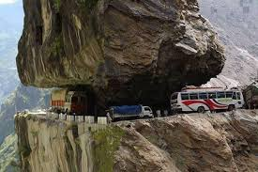
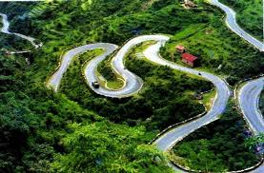
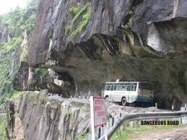
Intercontinental Consultants and Technocrats Pvt. Ltd.
PRESENTATION ON
DESIGN OF HILL ROAD ALIGNMENT
“Innovative, Creative & Technologically Sustainable Infrastructure Solutions”

Slide 2
Contents
Hill Road Definition
Design Issues in Hill Roads
Special Consideration in Hill Road Design
Route Selection
Engineering Data for Design
Geometric Design Standards
Design of Hair-pin Bends
Climbing Lane
Other Geometric Design Aspects
Case Study of NH-21 (Kiratpur Nerchowk Alignment)

Slide 3
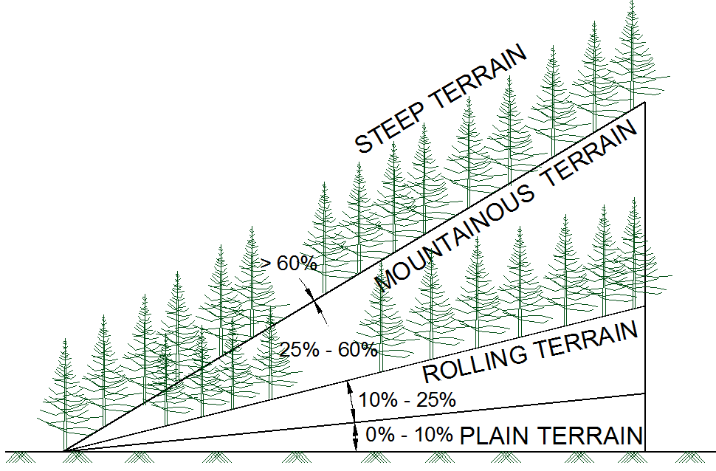
Hill Road Definition
Hill road is defined as the one which passes through a terrain with a cross slope of 25% or more.
IRC:SP:73-2015 and IRC:SP:84-2014 have merged the Mountainous and Steep Terrain having Cross Slope more than 25%.

Slide 4
Design Issues in Hill Roads
Design and Construction of Hill roads are more complex than in plain terrain due to factors summarized below:
Highly broken relief with vastly differing elevations and steep slopes, deep gorges etc. which increases road length.
The geological condition varies from place to place.
Variation in hydro-geological conditions.
Variation in the climatic condition such as the change in temperature due to altitude difference, pressure variation, precipitation increases at greater height etc.
High-speed runoff due to the presence of steep cross slopes.
Filling may overload the weak soil underneath which may trigger new slides.
Need of design of hairpin bends to attain heights.
Need to save Commercial and Residential establishments close to the road.
Need to save the ecology of the hills.

Slide 5
Special Consideration in Hill Road Design
Alignment of Hill Roads
The designer should attempt to choose a short, easy, economical and safe comforting route.
General considerations
When designing hill roads the route is located along valleys, hill sides and if required over mountain passes.
Due to complex topography, the length of the route is more.
In locating the alignment special consideration should be made in respect to the variations in:
Temperature
Rainfall
Atmospheric pressure and winds
Geological conditions
Resettlement and Rehabilitation considerations
Environment Considerations

Slide 6
Special Consideration in Hill Road Design
Temperature
Air temperature in the hills is lower than in the valley. The temperature drop being approximately 0.5° per 100 m of rising.
On slopes facing south and southwest snow disappears rapidly and rain water evaporates quickly while on slopes facing north and northeast rain water or snow may remain for the longer time.
Unequal warming of slopes, sharp temperature variations and erosion by water are the causes of slope failure facing south and southwest.
Rainfall
Rainfall generally increases with increase in height from sea level.
The maximum rainfall is in the zone of intensive cloud formation at 1500-2500 m above sea level. Generally, the increase of rainfall for every 100 m of elevation averages 40 to 60 mm.
In summer very heavy storms/cloud burst may occur in the hills and about 15 to 25% of the annual rainfall may occur in a single rainfall. The effects of these types of rainfall are serious and should be considered in design.
Atmospheric pressure and winds
Atmospheric pressure decreases with increase in elevation.
At high altitudes, the wind velocities may reach up to 25-30 m/s and depth of frost penetration is also 1.5 to 2 m.
Intensive weathering of rocks because of sharp temperature variations.

Slide 7
Special Consideration in Hill Road Design
Geological conditions
The inclination of folds may vary from horizontal to vertical stratification of rock. These folds often have faults. Limestone or sandstone folds may be interleaved with layers of clay which when wetted may cause fracturing along their surface. This may result in shear or slip fold.
The degree of stability of hill slopes depends on types of rock, degree of strata inclination or dip, occurrence of clay seams, the hardness of the rocks and presence of ground water.
When locating the route an engineer must study the details of geological conditions of that area and follow stable hill slopes where no ground water, landslides, and unstable folds occur.
Resettlement and Rehabilitation
Due to limited availability of flat areas and connectivity issues, most of the residential and commercial activity happens very close to the road leading to large scale R&R and becomes a challenge in alignment design.
Environment
Hills are ecologically sensitive areas relatively untouched by human activity. The alignment design must attempt to minimize tree cutting and large scale earth filling/cutting to minimize damage.

Slide 8
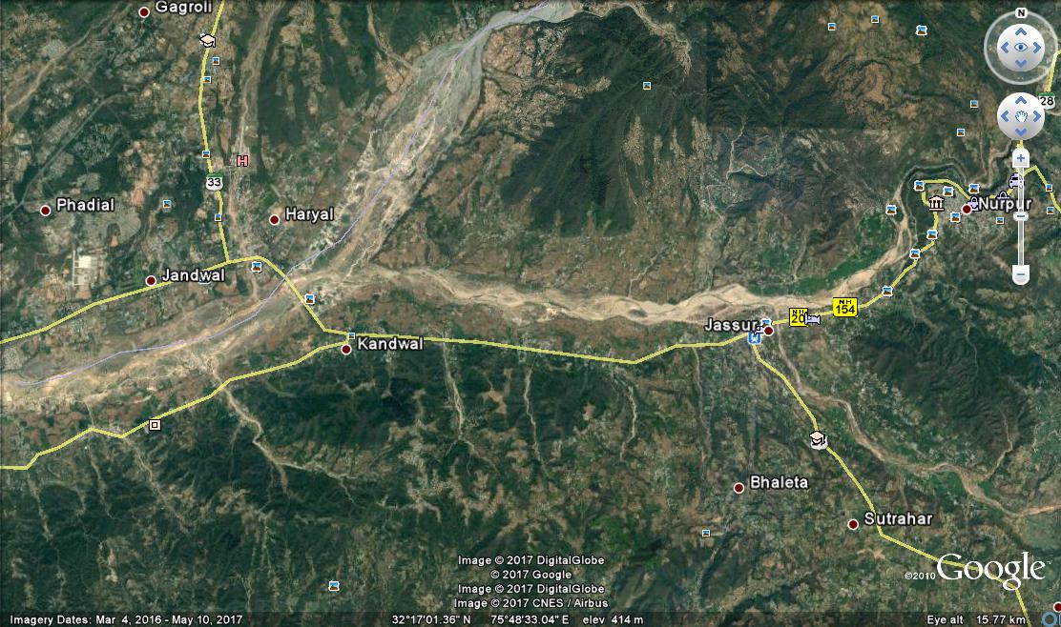
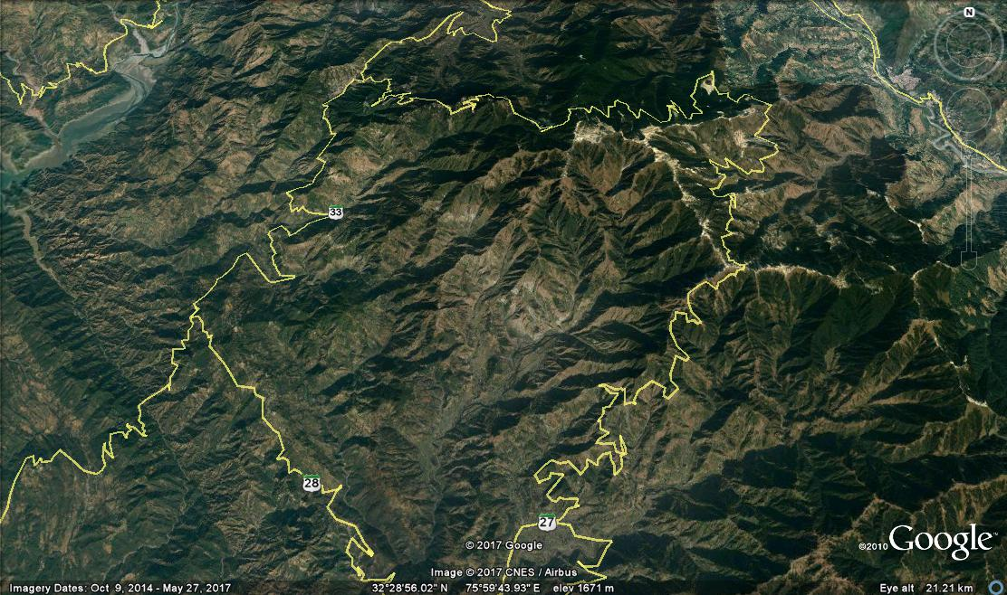
Route Selection
Hill road alignment may follow alignment at Valley bottom or on a ridge depending on the feasibility of the road. The first is called River route and the second is called Ridge route.
River route
Most frequent case of hill alignment as there is a great advantage of running a road at a gentle gradient.
Runs through lesser horizontal curvature.
Requirements for the construction of bridges over tributaries.
Construction of special retaining structures and protection walls on hill side for safe guarding the road against avalanches in high altitude areas.
Benefit of low construction cost and operation cost.
Ridge route
Characterized by the very steep gradient.
Large number of sharp curves occurs on the road with hair pin bends.
Extensive earthwork is required.
The requirement for the construction of special structures.
High construction and operation cost.
Road along River Route
Road along Ridge Route

Slide 9
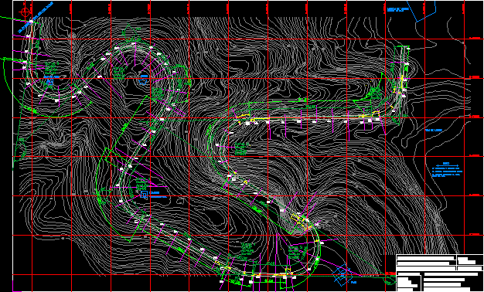
Engineering Data for Design
The design data includes:
The terrain classification all along the alignment - to be established through topographic data/ Contours of the area using Satellite Imagery.
All features like river course, streams, cross-drainage structures (for existing alignment), flooding areas, high flood levels, landslide areas, snow/avalanche prone areas etc.
River Morphology and Regime data.
Chainage wise inventory of the side slope material type i.e. soil with classification and properties, rock type and its structural geology of the area.
Hydrological data for all stream and river crossings.
Available material and resources that can be used in the road construction.
Geometric standards.
Contour Data for Design

Slide 10
Geometric Design Standards
The various Design Standards being followed in the India for the design of Hill Road are:
IRC:SP:48-1998 Hill Road Manual.
IRC:52-2001 Recommendations About the Alignment Survey and Geometric Design of Hill Roads.
IRC:SP:91-2010 Guidelines for Road Tunnels.
IRC:SP:73-2015 Manual of Specifications and Standards for Two Laning of Highways with Paved Shoulder.
IRC:SP:84-2014 Manual of Specifications and Standards for Four Laning of Highways through Public Private Partnership.

Slide 11
Geometric Design Standards
Hill Road Capacity
Type of Road | Design Service Volume in PCU per day
 | As per IRC:SP:48-1998 and IRC:52- 2001 |  | As per IRC:SP:73-2015 & IRC:SP:84-2014
 | For Low Curvature (0-200 degrees per km) | For High Curvature (above 0-200 degrees per km) | Level of Service ‘B’ | Level of Service ‘C’
Single lane | 1,600 | 1,400 | - | -
Intermediate lane | 5,200 | 4,500 | - | -
Two Lane | 7,000 | 5,000 | 9,000 | -
Four Lane | - | - | 20,000 | 30,000

Slide 12
Geometric Design Standards
Design Speed:
The design speed for various categories of hill roads are given below:
Road Classification | As per IRC:SP:48-1998 and IRC:52- 2001 |  |  |  | As per IRC:SP:73-2015 & IRC:SP:84-2014
 | Mountainous Terrain |  | Steep Terrain |  | Mountainous and Steep Terrain
 | Ruling | Minimum | Ruling | Minimum | Ruling | Minimum
National and State Highways | 50 | 40 | 40 | 30 | 60 | 40
Major District Roads | 40 | 30 | 30 | 20 | - | -
Other District Roads | 30 | 25 | 25 | 20 | - | -
Village Roads | 25 | 20 | 25 | 20 | - | -

Slide 13
Geometric Design Standards
Sight Distance:
Visibility is an important requirement for safety on roads.
It is necessary that sight distance of sufficient length is available to permit drivers enough time and distance to stop their vehicles to avoid accidents.
Design Speed (Km/h) | As per IRC:SP:48-1998 and IRC:52- 2001 |  | As per IRC:SP:73-2015 & IRC:SP:84-2014
 | Mountainous and Steep Terrain
 | Stopping Sight Distance (m) | Intermediate Sight Distance (m) | Safe Stopping Sight Distance (m) | Desirable Minimum Sight Distance (m)
20 | 20 | 40 | - | -
25 | 25 | 50 | - | -
30 | 30 | 60 | - | -
35 | 40 | 80 | - | -
40 | 45 | 90 | 45 | 90
50 | 60 | 120 | 60 | 120
60 | - | - | 90 | 180

Slide 14
Geometric Design Standards
Minimum Radius of Horizontal curves
Classification | As per IRC:SP:48-1998 and IRC:52- 2001 |  |  |  |  |  |  |  | As per IRC:SP:73-2015 & IRC:SP:84-2014
 | Mountainous terrain |  |  |  | Steep terrain |  |  |  | Mountainous and Steep
 | Area not affected by snow |  | Snow Bound Areas |  | Area not affected by snow |  | Snow Bound Areas
 | Ruling Minimum | Absolute Minimum | Ruling Minimum | Absolute Minimum | Ruling Minimum | Absolute Minimum | Ruling Minimum | Absolute Minimum | Desirable Minimum Radius | Absolute Minimum Radius
National Highway and State Highways | 80 | 50 | 90 | 60 | 50 | 30 | 60 | 33 | 150 | 75
Major District Roads | 50 | 30 | 60 | 33 | 30 | 14 | 33 | 15 | - | -
Other District Roads | 30 | 20 | 33 | 23 | 20 | 14 | 23 | 15 | - | -
Village Roads | 20 | 14 | 23 | 15 | 20 | 14 | 23 | 15 | - | -

Slide 15
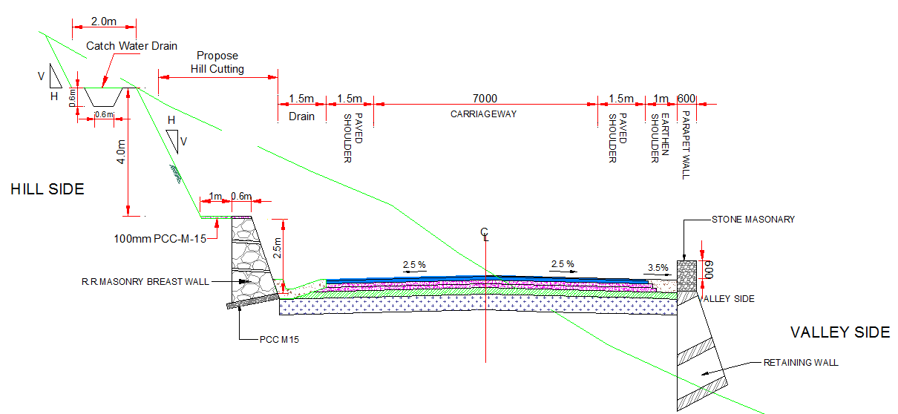
Geometric Design Standards
Typical Cross-sections – 2 lane carriageway (as per IRC:SP:73-2015)
As per IRC:SP:48-1998 and IRC:52- 2001
Road Classification | Carriageway Width (m) | Shoulder Width (m)
National and State Highways
i) Single lane | 3.75 | 2 x 1.25
ii) Double Lane | 7.00 | 2 x 0.9
Major District Roads and Other District Roads | 3.75 | 2 x 0.5
Village Roads | 3.00 | 2 x 0.5

Slide 16
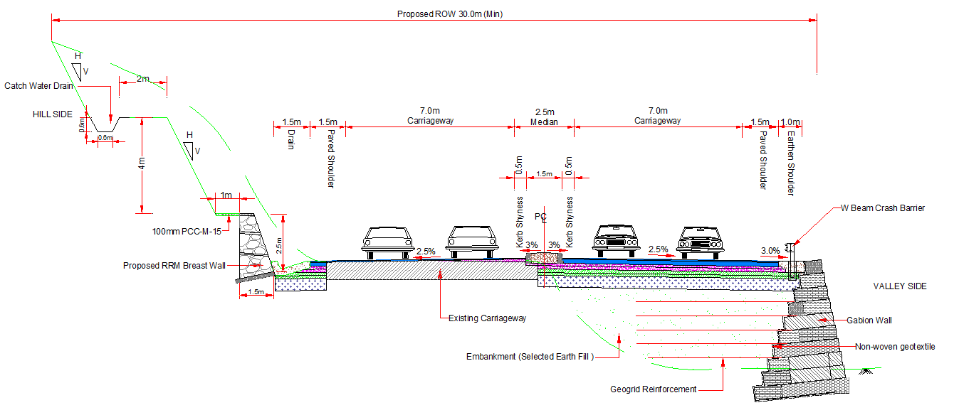
Geometric Design Standards
Typical Cross-sections – 4 Lane Carriageway Widening Towards Valley Side (as per IRC:SP:84-2014)

Slide 17
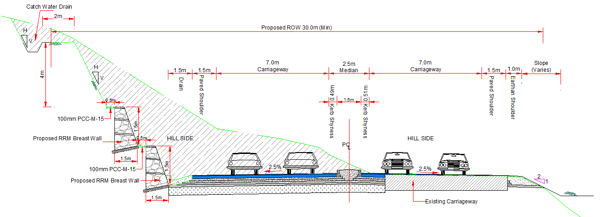
Geometric Design Standards
Typical Cross-sections – 4 Lane Carriageway Widening Towards Hill Side (as per IRC:SP:84-2014)

Slide 18
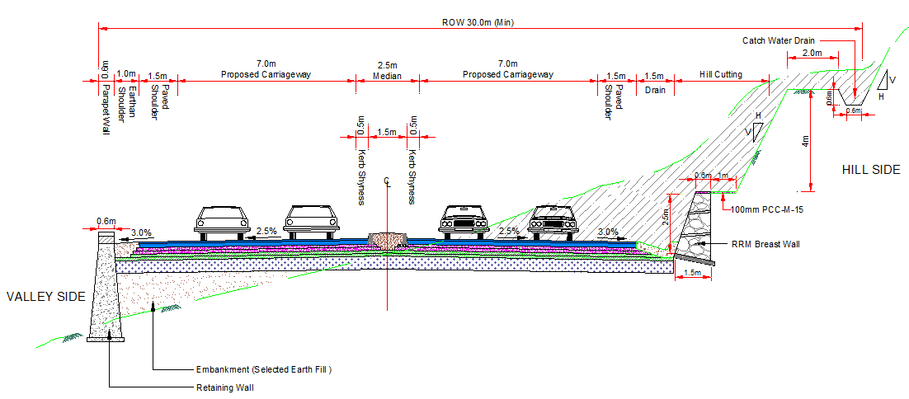
Geometric Design Standards
Typical Cross-sections – 4 Lane Carriageway Widening on Both Side (as per IRC:SP:84-2014)

Slide 19
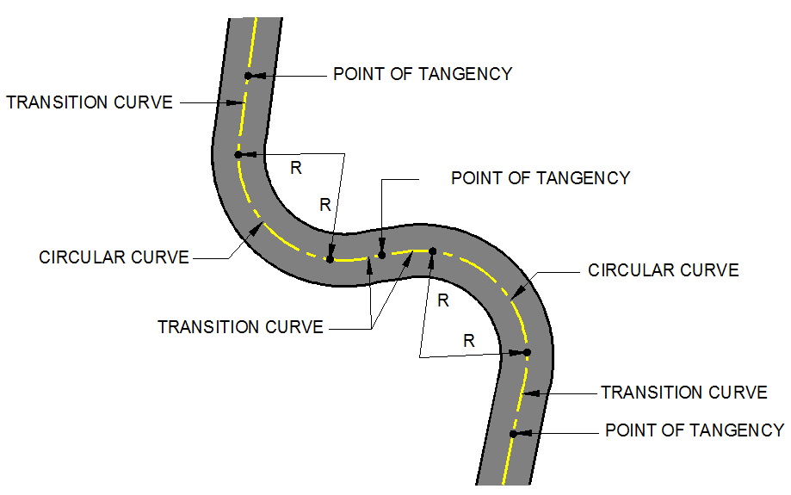
Geometric Design Standards
Reverse curves are needed in difficult terrain.
It should be ensured that there is sufficient length between the two curves for introduction of requisite transition curves.

Slide 20
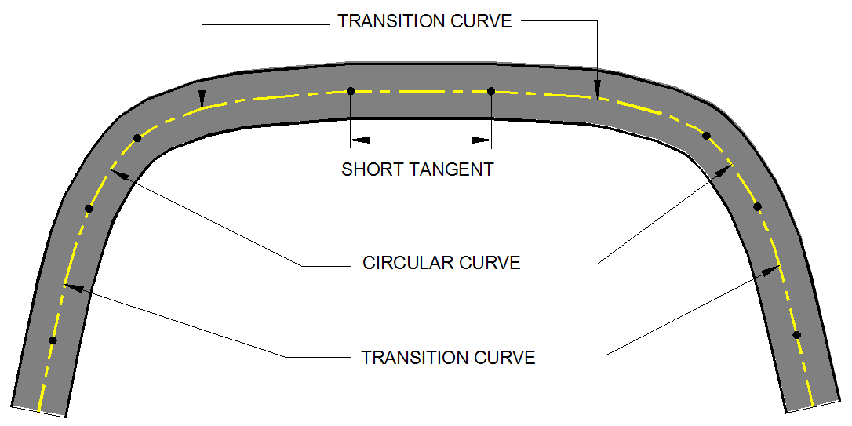
Geometric Design Standards
Curves in same direction separated by short tangents, known as broken – back curves.
Should be avoided, as far as possible, in the interest of aesthetics and safety and replaced by a single curve.
If this is not feasible, a tangent length corresponding to 10 seconds travel time must at least be ensured between the two curves.

Slide 21
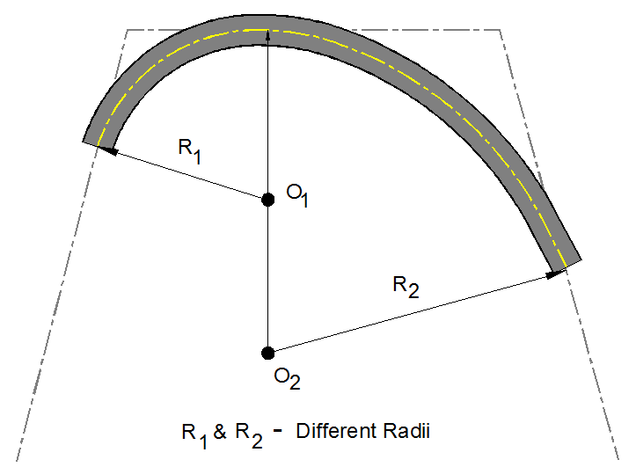
Geometric Design Standards
Compound curves may be used in difficult topography but only when it is impossible to fit in a single circular curve.
To ensure safe and smooth transition from one curve to the other, the radius of the flatter curve should not be disproportional to the radius of the sharper curve.
A ratio of 1.5:1 should be considered the limiting value.

Slide 22
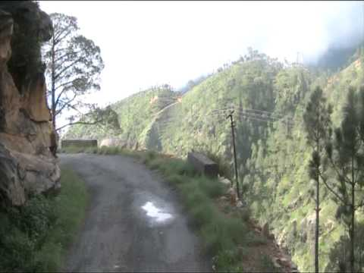
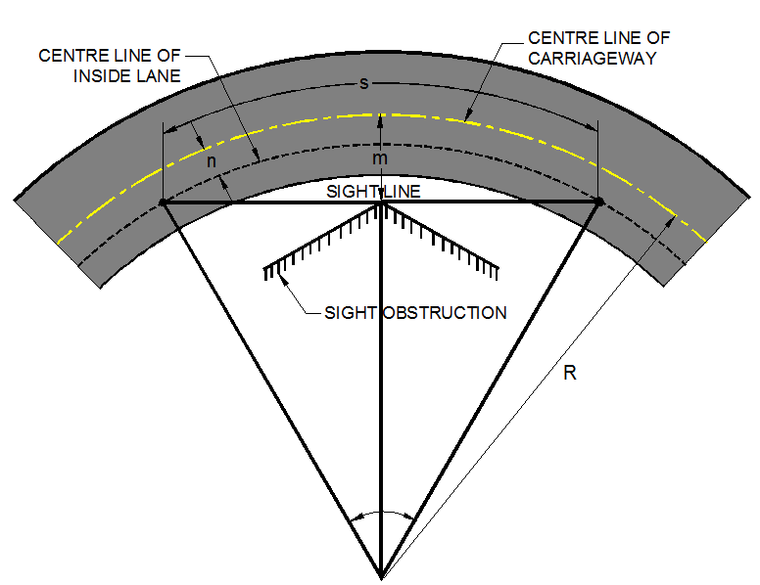
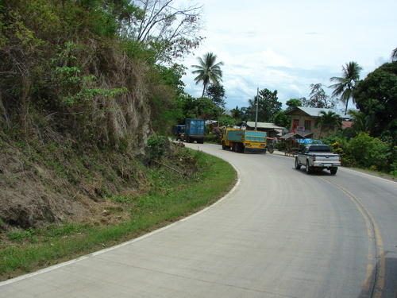
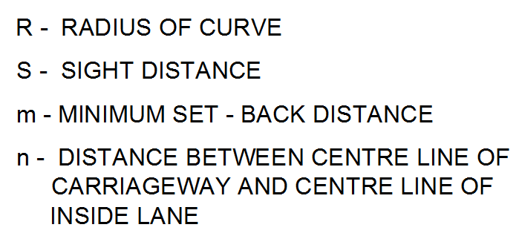
Geometric Design Standards
Set Back Distance
Requisite sight distance should be available to sight the inside of horizontal curves.
Lack of visibility in the lateral direction may arise due to obstruction like walls cut, slopes, wooded areas, high crops etc.

Slide 23
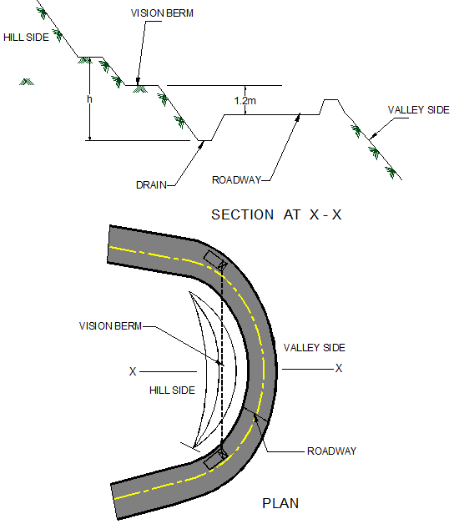
Geometric Design Standards
Vision Berm
Where there is a cut slope on the inside of the horizontal curve, the average height of sight line can be used as an approximation for deciding the extent of clearance.
Cut slope shall be kept lower than this height at the line demarcating the set back distance envelop, either by cutting back the slope or benching suitably, which is also generally known as vision berm.

Slide 24
Geometric Design Standards
Vertical Alignment
The vertical alignment of a hill road need to be adaptive by:
Adopting mild vertical grades for reduced potential for erosion of road bed.
Designing vertical profile compatible with natural topography for optimum and balanced cut-fill quantities hence generate less spoil.
Keeping finished road level and fill slopes higher than the high flood level (HFL).
Avoiding interception with water table line which cause wet pavement layers.
Optimizing the cut height at landslide and rock fall prone areas.
Ensure Easy Access to Properties.
Ensure Safer Junction Design.

Slide 25
Geometric Design Standards
Vertical Alignment
Vertical curves are introduced for smooth transition at grade change.
Both Summit curves and Valley curves should be designed as Square parabola.
The Length of vertical curves is controlled by sight distance requirements.
Curves with greater length are aesthetically better.
Recommended gradients for different terrain conditions, except at hair pin bends, are given below:
 | As per IRC:SP:48-1998 and IRC:52- 2001 |  | As per IRC:SP:73 & IRC:SP:84
Classification of Gradient | Mountainous Terrain and Steep Terrain more than 3000 m above MSL | Steep Terrain up to 3000 m above MSL | Mountainous | Steep
Ruling Gradient | 5% | 6% | 5% | 6%
Limiting Gradient | 6% | 7% | 6% | 7%
Exceptional | 7% | 8% | - | -

Slide 26
Design of Hair-pin Bends
At unavoidable circumstances Hair-pin Bends may be designed as Circular Curve with Transitions or as Compound Circular curves.
Design Criteria for Hair-pin Bends As per IRC:SP:48-1998 and IRC:52- 2001
Description |  | Criteria
Min Design Speed |  | 20 Km/h
Min Roadway width at apex | NH/SH | 11.5m (Double lane) 9.0m (Single lane)
 | MDR/ODR | 7.5m
 | Village Roads | 6.5m
Min radius for the inner curve |  | 14 m
Min Length of transition Curve |  | 15 m
Gradient | Maximum | 1 in 40 (2.5%)
 | Minimum | 1 in 200 (0.5%)
Max Super elevation |  | 1 in 10 (10%)
Minimum Intervening distance between the successive hair pin bends |  | 60m

Slide 27
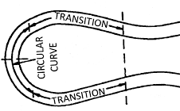
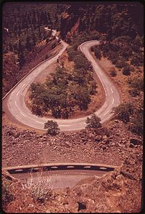
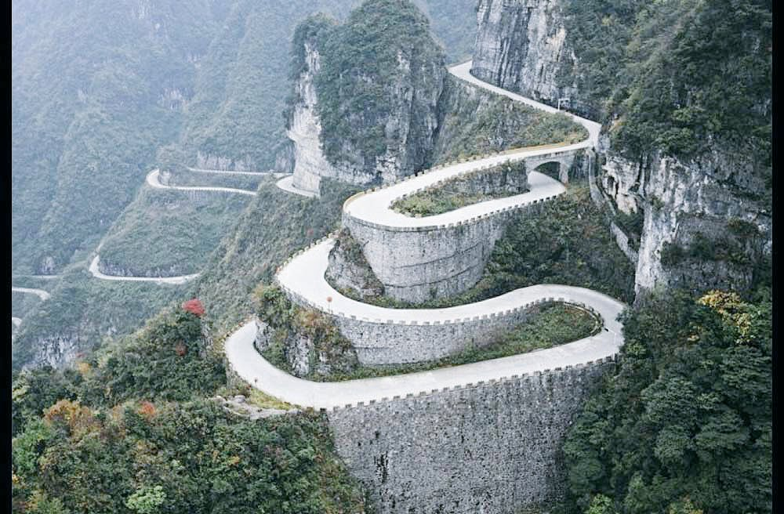
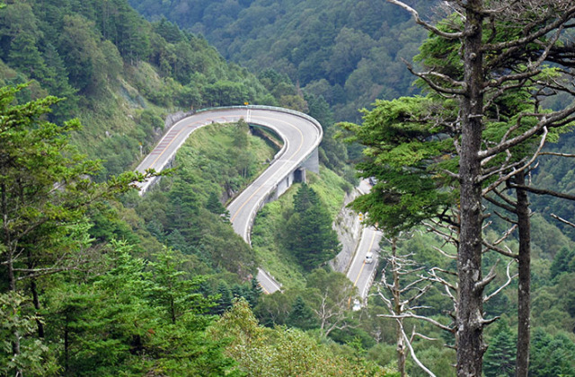
Illustrations of Hair-pin Bends

Slide 28
Climbing Lane
Climbing Lane shall be provided in order to address the necessity of making available separate lane for safe overtaking for vehicle travelling uphill.
IRC:52-2001, IRC:SP:73-2015 and IRC:SP:84-2014 mandates for provision of Climbing lanes but no warrants are provided.
AASHTO provides the guidelines for the provision of Climbing lanes:
Up Grade traffic flow rate in excess of 200 vehicles per hour.
Up Grade truck flow rate in excess of 20 vehicles per hour.
One of the following conditions exists:
A 15 km/h [10 mph] or greater speed reduction is expected for a typical heavy truck.
Level of Service ‘E’ or ‘F’ exists on the grade.
A reduction of two or more levels of service is experienced when moving from the approach segment to grade.
In addition, safety considerations may justify the addition of a climbing lane regardless of grade or traffic volumes.

Slide 29
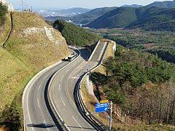
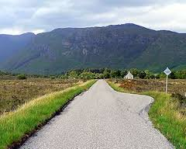
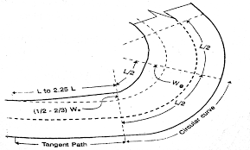
Other Geometric Design Aspects
Escape Lane
Grade Compensation at Curves
Passing Places
Vertical and lateral Clearances
Widening at Curves
Co-ordination of Horizontal and Vertical Alignments
Tunnels
Escape lane
Passing Places
Widening at Curves

Slide 30
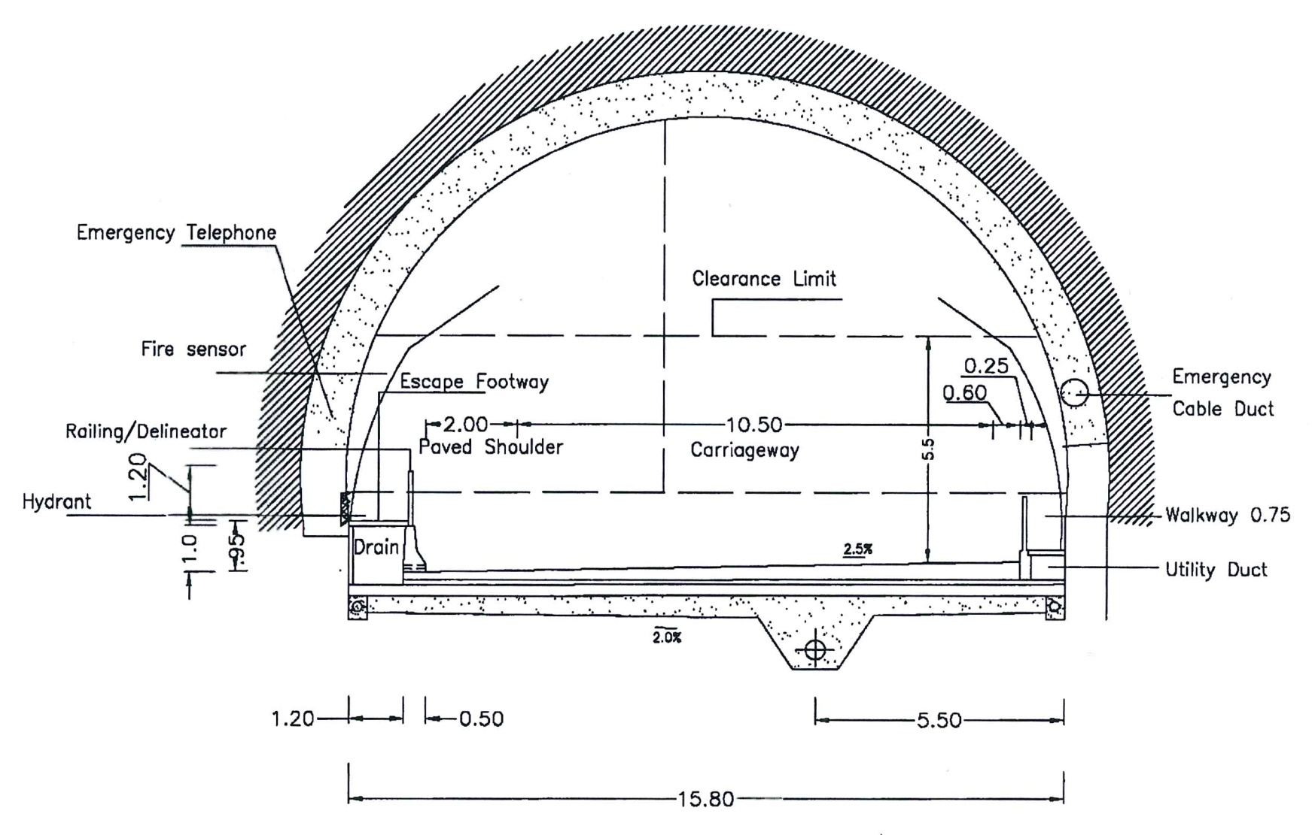
Typical Section for Tunnels
Typical Cross section for 3-lane Tunnel as per IRC SP 91-2010

Slide 31
CASE STUDY OF NH-21
(Kiratpur Nerchowk Alignment)

Slide 32
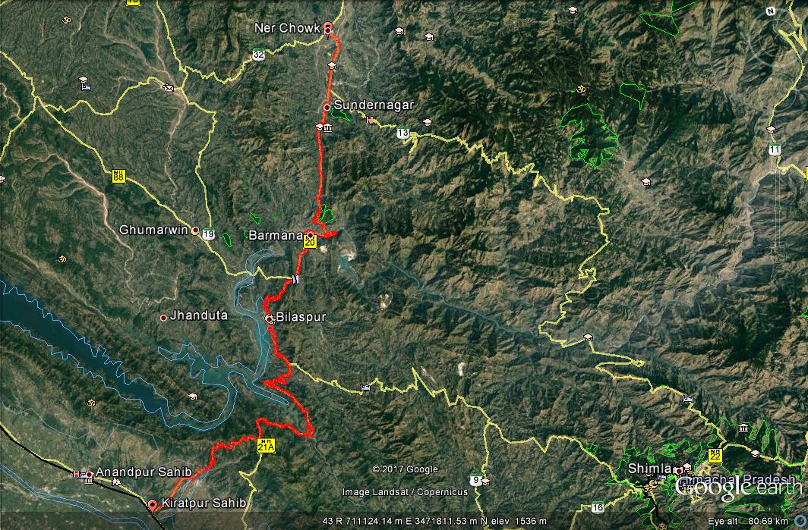
Index Map
End of Project Road
Start of Project Road
Length of Existing Alignment = 116.8 Km

Slide 33
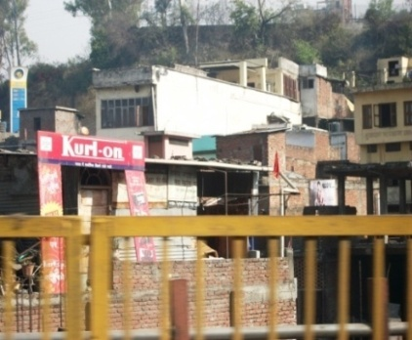
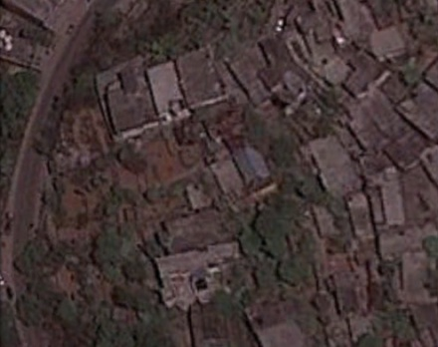
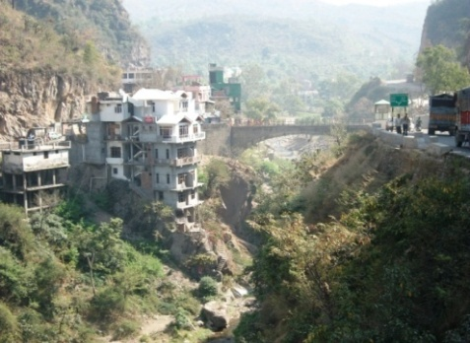
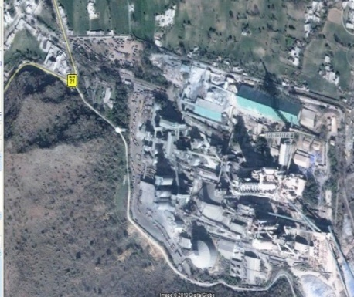
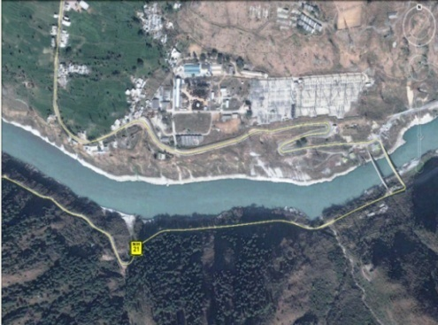
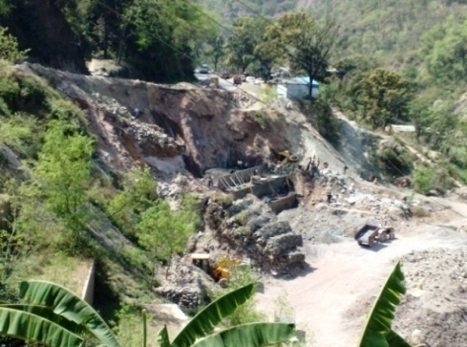
Major Bottlenecks along the Existing Road
Heavy Settlements along the Project Road.
Settlements along Hill Side.
Deep Gorge Section.
Barmana Cement Factory.
Steep Hill and River Satluj Running Parallel to the Existing Road between Km.154+000 to Km.156+000.

Slide 34
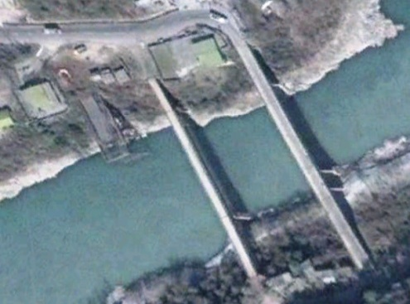
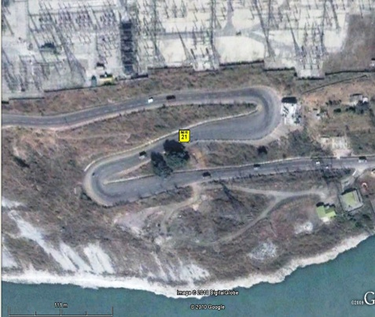
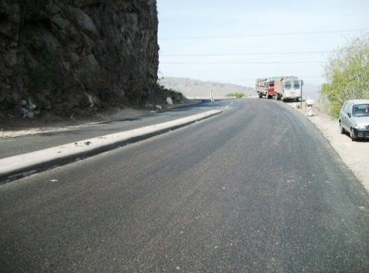
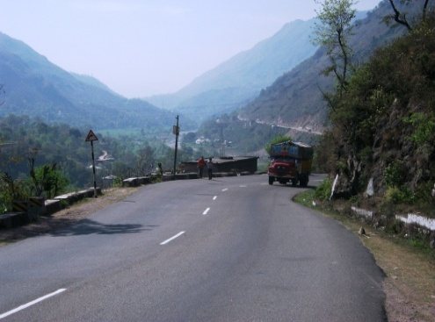
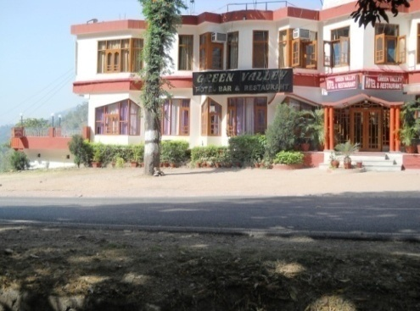
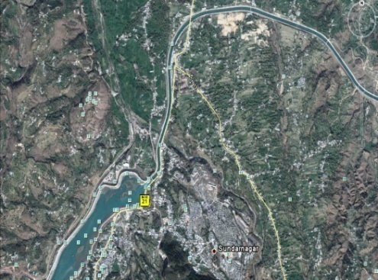
Major Bottlenecks along the Existing Road
Bridge across River Satluj at Km 157+000
Sharp hair pin bends
Steep grade section
Sundar Nagar lake

Slide 35
Capacity Augmentation – Base Year Traffic
Station No. | Chainage (km) | Location of Survey | ADT |  | Peak Hour Flows |  | Peak Hour proportion in daily Vehicle Vol. | Peak Hour proportion in daily PCU Vol.
 |  |  | Veh’s | PCUs | Veh’s | PCUs
MCC-1 | 138+500 | Bamta Village | 5439 | 9841 | 324 | 547 | 5.96 | 5.56
MCC-2 | 167+000 | Zedol Village | 6526 | 9914 | 412 | 542 | 6.31 | 5.47

Slide 36
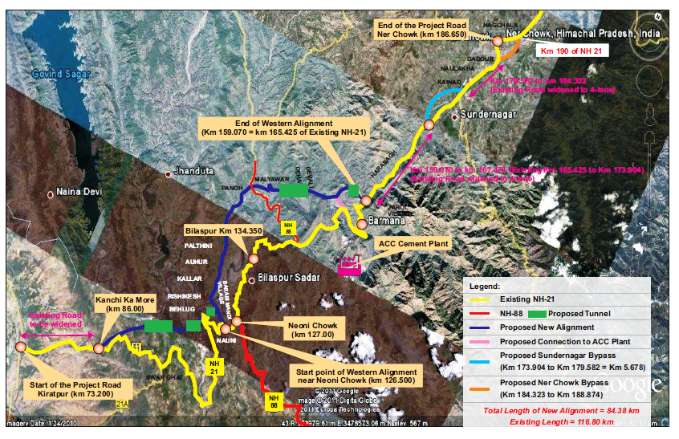
Key Plan
Length of Existing Alignment = 116.80 Km,
Length of Revised Alignment = 84.38 Km,
Saving in Length = 32.42 Km
Tunnel | Length (Km)
T1 | 1.75
T2 | 0.65
T3 | 0.4
T4 | 1.41
T5 | 0.86
Total | 5.07
T4
T5
T3
T1
T2

Slide 37
Salient Features of the Project
Capacity Augmentation/ Development Scope | 4 Laning
Major Bridges | 15 nos., Longest Bridge of 650m over Govind Sagar lake
Proposed Bypasses | 2 (Sunder nagar Bypass – 5.678 Km, Ner Chowk Bypass – 4.551 Km)
Major Realignments | New alignment along Govind Sagar Lake/Satluj Beas River – 32.570 Km
Tunnels | 5 nos. for Total length of 5.07 Km
Toll Plazas | 2 nos.
Total Civil Cost | INR 1818.47 Cr. (Rs. 21.64 Cr/km)

Slide 38
Thank you

