Slide 1
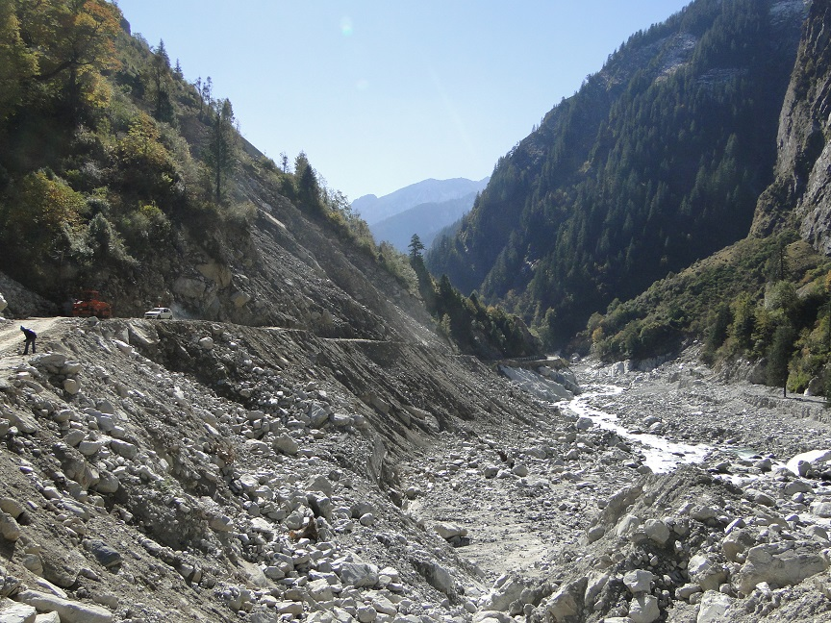
LANDLSIDE MITIGATION MEASURES
Dr. Ratnakar R. Mahajan
Deputy General Manager
Maccaferri Environmental Solutions Pvt. Ltd.

Slide 2
Flow Of Presentation
Landslide Scenario In India
Types of Landslides
Factors Affecting Landslides
Approach towards Landslide Mitigation
Investigations
Conclusion & Discussion
Design & Analysis
Solutions
Case Study- Lambagarh

Slide 3
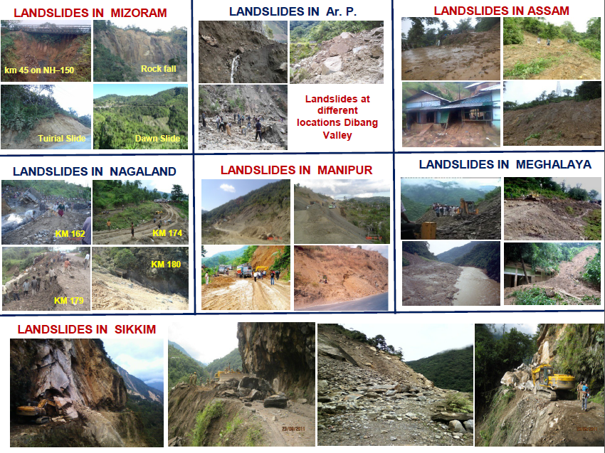
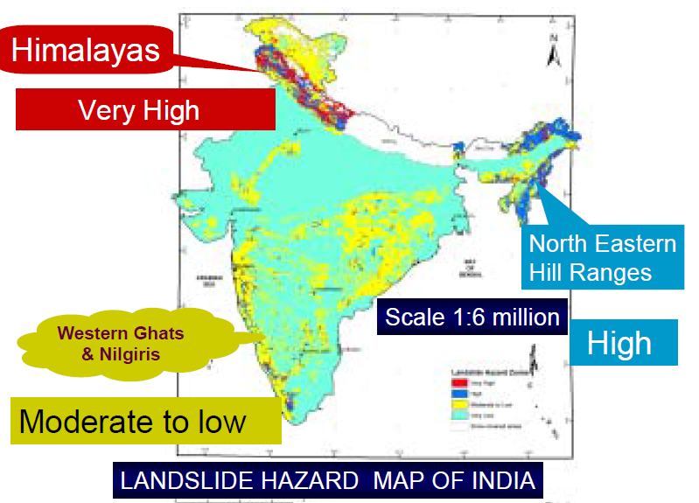
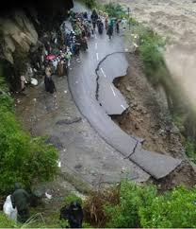
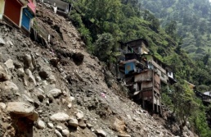
LANDSLIDE SCENARIO IN THE COUNTRY
LANDSLIDES IN HIMALAYAS- A PERENNIAL PROBLEM
22 states and 2 union territory of the country are affected by landslides, although they differ from the scale of severity of disaster.
LANDSLIDE IN UTTARAKHAND
Notes:
According to NDMA India, India has the highest mountain chain on earth, the Himalayas, which are formed due to collision of Indian and Eurasian plate, the northward movement of the Indian plate towards China causes continuous stress on the rocks rendering them friable, weak and prone to landslides and earthquakes. The slow motion of the Indian crust, about 5 cm/year accumulates stress to which natural disasters are attributed. Some landslides make unique, and unparalleled catastrophes. Landslides and avalanches are among the major hydro-geological hazards that affect large parts of India besides the Himalayas, the Northeastern hill ranges, the Western Ghats, the Nilgiris, the Eastern Ghats and the Vindhyans, in that order, covering about 15 % of the landmass. The Himalayas alone count for landslides of every fame, name and description- big and small, quick and creeping, ancient and new. The Northeastern region is badly affected by landslide problems of a bewildering variety. Landslides in the Darjeeling district of West Bengal as also those in Sikkim, Mizoram, Tripura, Meghalaya, Assam, Nagaland and Arunachal Pradesh pose chronic problems, causing recurring economic losses worth billions of rupees. A different variety of landslides, characterized by a lateritic cap, pose constant threat to the Western Ghats in the South, along the steep slopes overlooking the Konkan coast besides Nilgiris, which is highly landslide prone.

Slide 4
TYPES OF LANDSLIDE
“Landslides may be due to soil movement or rock movement”
Classification of landslides based on type of movements
  Fall
  Topple
  Spread
  Flow
  Slides (Rotational/ translational)
  Complex (combination of above)
Notes:
“A landslide can be portrayed as an episode of downward and outward displacement/
movement ranging from very slow to rapid in velocity, of any kind of slope forming materials
(rock, soil or their combination) under the influence of gravity.

Slide 5
INVESTIGATION-FACTORS TRIGERRRING THE LANDSLIDE
Mitigation cannot begin without investigating the various factors that triggers the slope instability
Natural factors
Anthropogenic factors
Inherent factors
External factors
Lithology (Type of rock)
Structure
Slope
Hydro-geological condition
Geotechnical parameters
Seismicity
Precipitation (Rainfall)
Melting of snow
Volcanic eruption
Improper land use
Deforestation

Slide 6
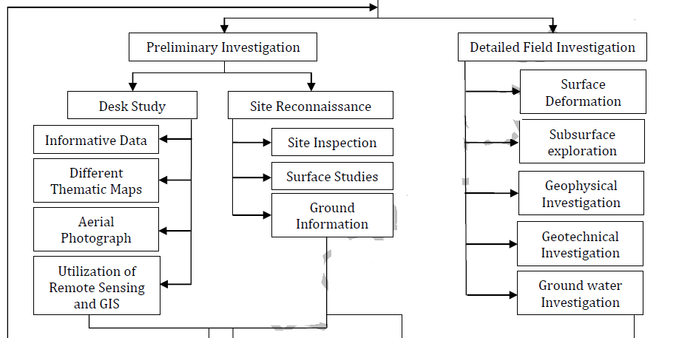
APPROACH TOWARDS INVESTIGATION OF LANDSLIDES
investigation phases

Slide 7
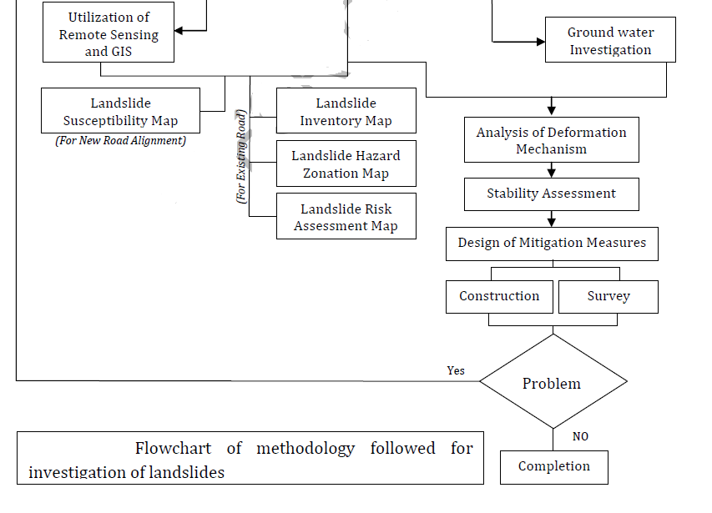
APPROACH TOWARDS INVESTIGATION OF LANDSLIDES

Slide 8
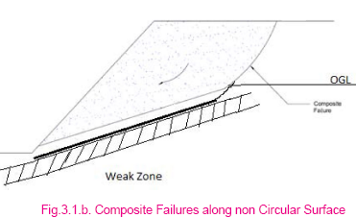
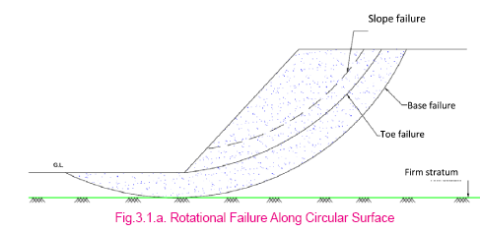
ANALYSIS
Stability analysis of predominantly soil slopes
Various methods of stability analysis for soil strata (Morgenstern-Price or Spencer, Bishop or Janbu etc
IRC 75 can be referred for details
Stability analysis for predominantly rock slopes
Structural geology of a slope plays a major role on its mode of failure and determines how it should be analyzed.
Structural geology refers to the naturally occurring breaks in the rock such as bedding planes, joints and faults, which generally termed as discontinuities.
Notes:
The selection of the failure mode is the first step in stability analyses. Shallow or deep, circular or polygonal are the initial choices. There various methods of stability analysis for soil strata
If one has very good geometry, groundwater and soil strength data, it would be a better to use a rigorous method such as Sarma, Morgenstern-Price or Spencer. They will give very similar and accurate results.
On the other hand, if the data quality is not so good, the engineer may still use a rigorous method, or a simplified one such as Bishop or Janbu.

Slide 9
SYSTEMS FOR LANDLSIDE MITIGATION
Facility relocation
Complete removal of slides
Bridging
Tunneling
1. Avoid or eliminate the problem itself
Buttressing
Retaining structures
Reinforced soil slope and walls
2. Increase the resisting forces
Reinforcement
Nails/ Anchors
Micropiles
Surface slope protection
Excavation
Light weight fill materials
Unloading
3. Reduce the driving forces
Surface drainage
Sub surface drainage
Drainage systems
Drainage measures alone may not sufficient to improve slope stability, so drainage measures are adopted in conjunction with other methods based on the site specific requirement.
Notes:
Drainage helps in landslide mitigation by reducing pore pressures within the soil, thereby increasing effective stress and shear strength; and (2) by reducing the driving forces of water pressures in cracks

Slide 10
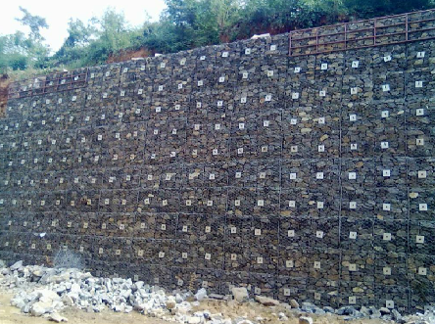
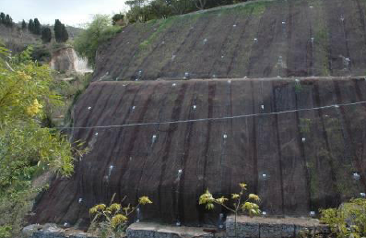
Buttressing
Retaining structures
Increase the resisting forces
Reinforced soil slope and walls
Reinforcement
Surface slope protection
Soil nailing
Micropiles
Anchors
Reinforcement
Soil nailing with Gabion fascia
Soil nailing with Flexible fascia

Slide 11
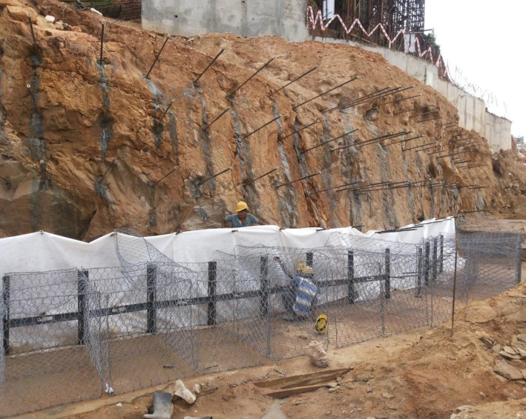
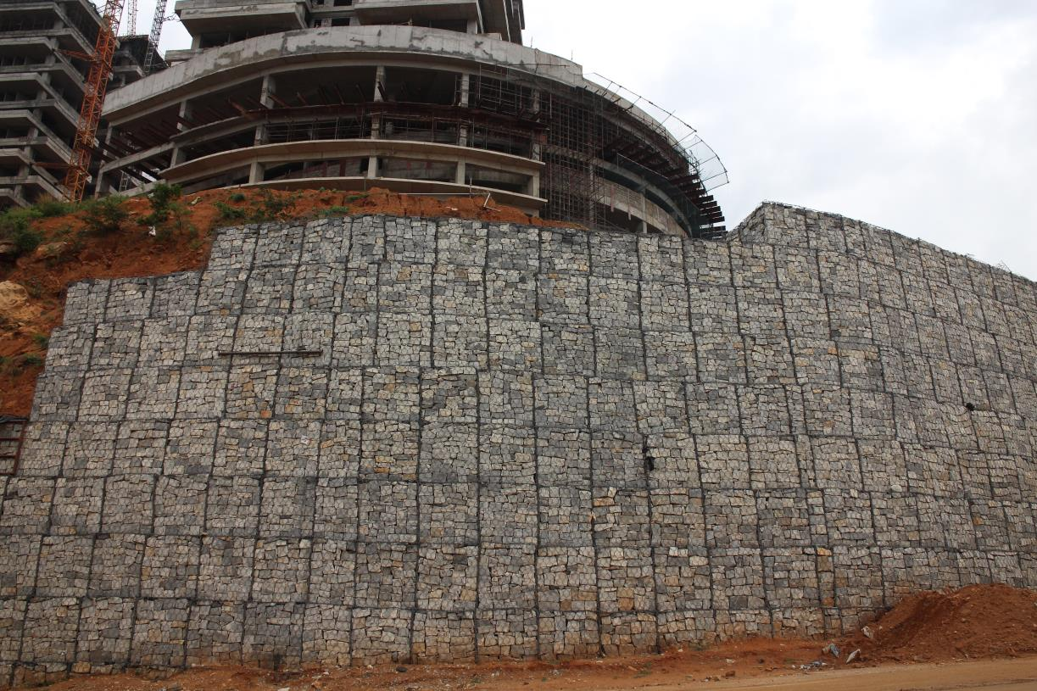
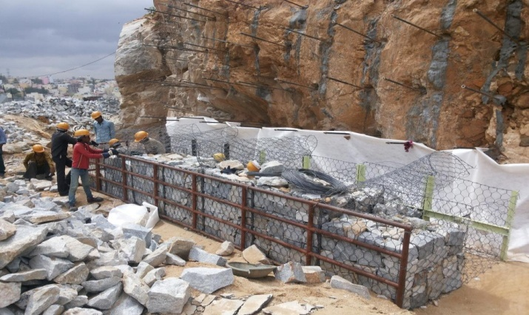
NAILING+GABION FACIA
Slope stabilization – Nailing with Gabion Facia (Tata Housing Bangalore Project)

Slide 12
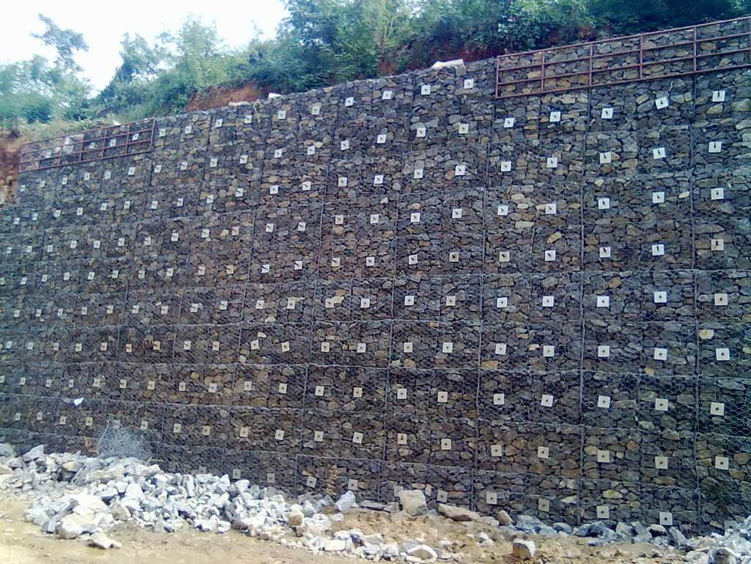
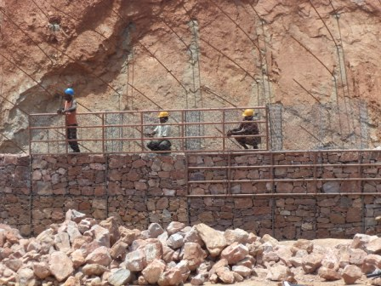
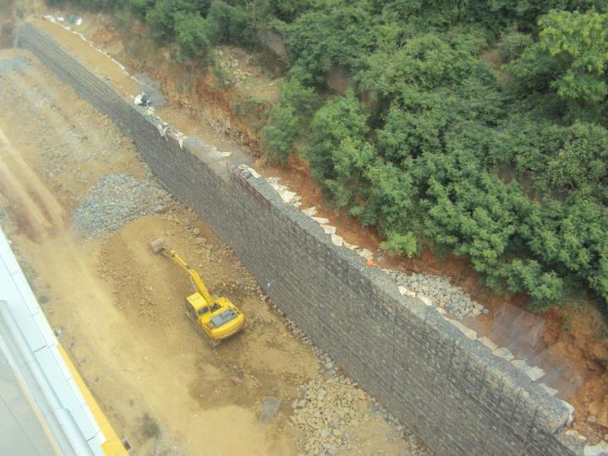
NAILING+GABION FACIA
Slope stabilization – Nailing with Gabion Facia (Shriram Properties – Chennai)

Slide 13
RETENTION SOLUTIONS
Types
RCC Walls
Reinforced soil walls
Gabion gravity walls etc
Selection
Local resources
Local skill
Slope angle
Foundation conditions
Seismicity
Climate/rainfall etc
SOLUTIONS FOR SLOPE RETENTION (VALLEY SIDE)

Slide 14
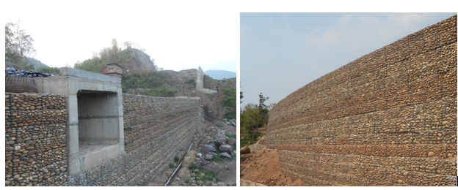
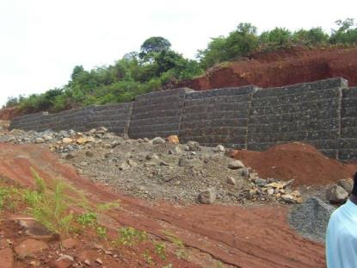
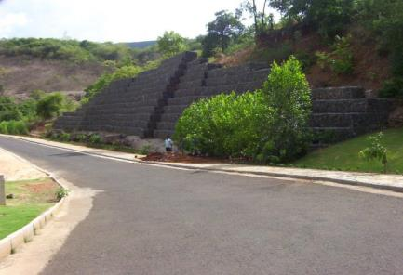
RETENTION SOLUTIONS - GABION
REINFORCED SOIL WALL AT KIRATPUR
Gabion wall at Amby valley Sahara lake city, Pune, Maharashtra
14

Slide 15
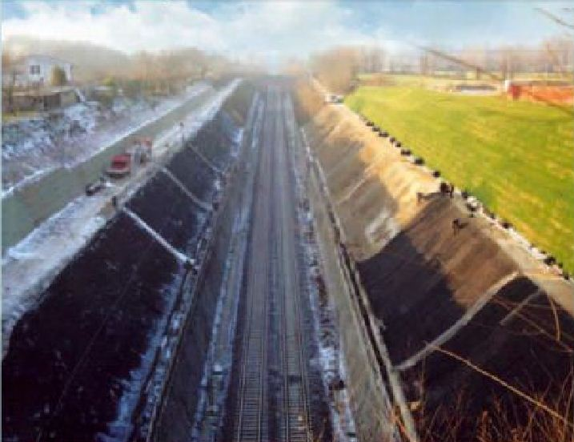
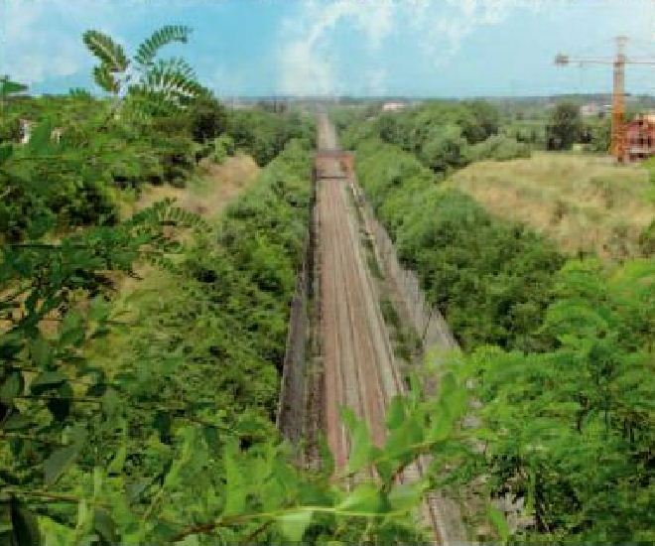
SURFACE SLOPE PROTECTION
a) Shotcrete b) Stone pitching
c) Gabion mattress d) Vegetation /bioengineering measures
Vegetation
Most cost-effective and sustainable
Protect the soil surface from the direct impact of rain, running water, wind, moving ice etc,
Selection of the bioengineering measures based on
Site characteristics such as elevation
Topography
Soil properties
Climate (rainfall information, rainy season, normal growing season, temperature)
Soil fertility shall be evaluated to measure its ability to supply essential elements.
During installation
Few months after installation
Notes:
Slope improvement methods…Grouting,

Slide 16
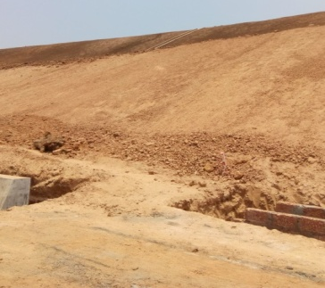
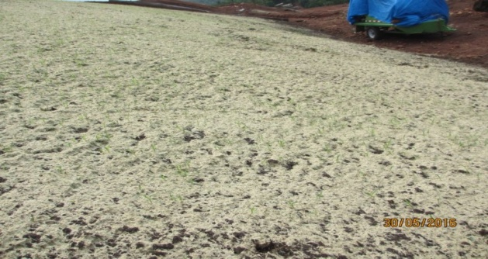
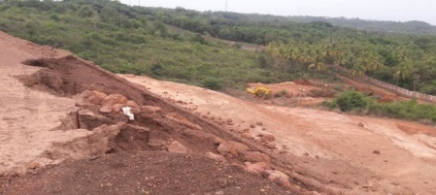
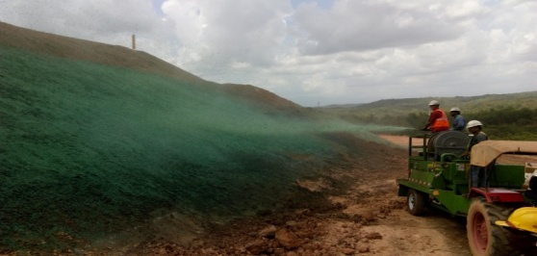
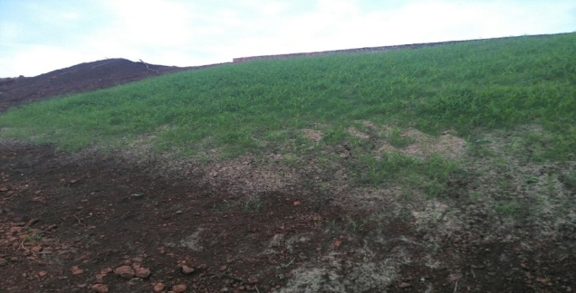
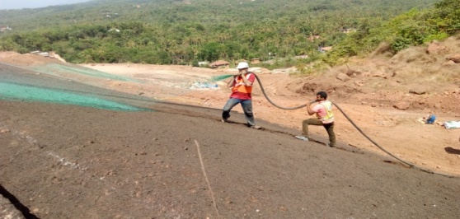
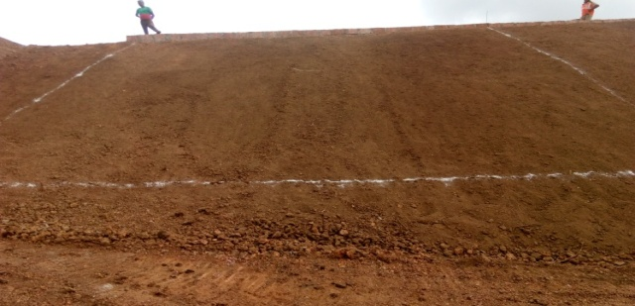
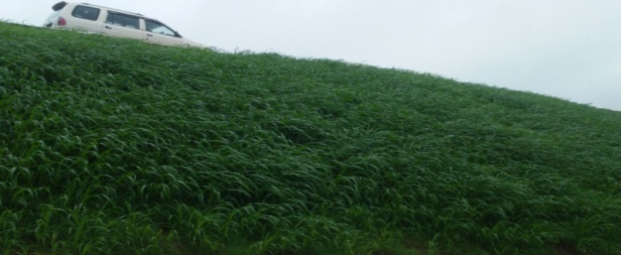
Bioengineering measures using Hydraulically Applied Erosion Control Measures
Site Condition before Trial
Hydraulic Application of
Flexible growth medium
along with Soil Amendments and seeds
Results
Vegetation in 4 Days!
30th
Agronomic Soil Tests were conducted and trial solution was finalised
Site Preparation
6th June 2016
25th
BIOENGINEERING MEASURES FOR SLOPE PROTECTION WORK FOR KANNUR INTERNATIONAL AIRPORT LIMITED Project, KERALA
20th June 2016

Slide 17
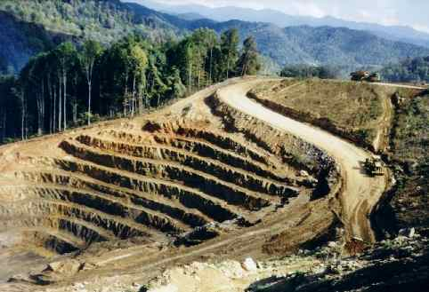
Excavation
Light weight fill materials
Unloading
Reduce the driving forces
Surface drainage
Sub surface drainage
Drainage systems
Light weight fill materials
Benching of slope
Notes:
Excavation
Excavation is a low cost unloading technique which includes the following methods.
Removal of soil from head of a slide or removing the weight from the upper part of the slope
Reduce the height of the slope
Complete removal of all unstable or potentially unstable materials
Grading, i.e., shaping the rock slope by flattening of the slope or reducing the slope.
Benches or series of steps are made to reduce the driving forces. Benches have little or no effect on deep seated failure. Even though bench faces can be steeper than the overall slope angle, vertical bench faces should be avoided. It helps to transform a steep slope into several lower ones (Refer Fig. 1 (a)).
Alteration of the slope geometry can be done by scaling (Hand scaling, mechanical scaling, trim blasting).
Scaling and can be used to remove loose, unstable or overhanging blocks for stabilizing the rock mass.

Slide 18
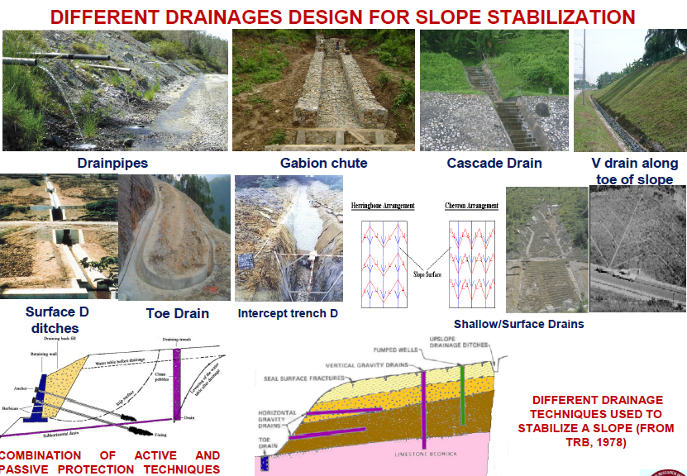
DIFFERENT DRAINAGE MEASURES
Surface drainage measures
Catch water or interceptor drains-drains provided on hill slopes to intercept water flowing from upper reaches (more or less parallel to the road)
Chute/cascade - The water entrapped in the catch water drains is so brought down
Road Side drains

Slide 19
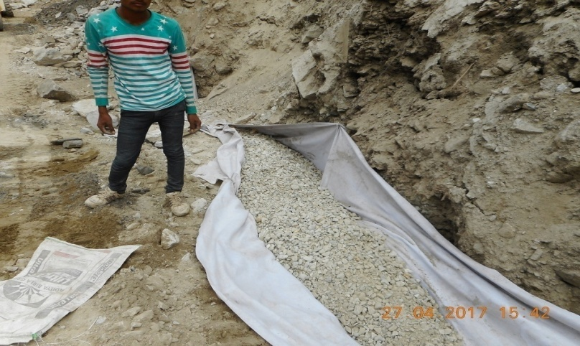
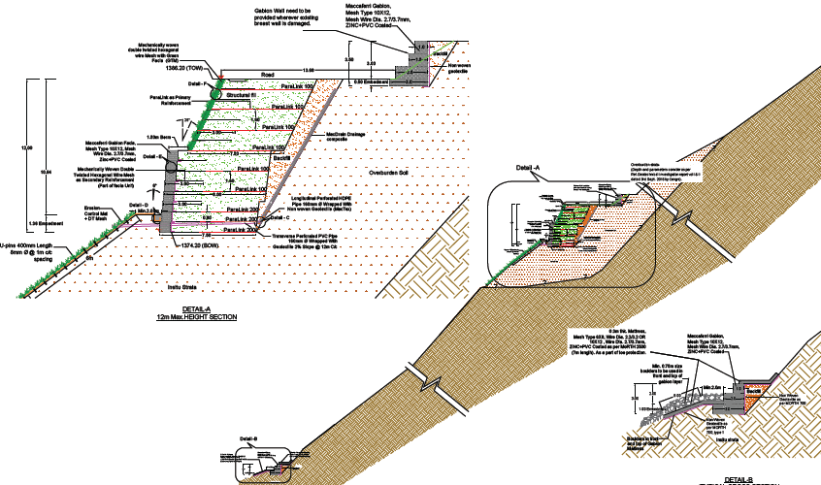
DIFFERENT DRAINAGE MEASURES
Subsurface Drainage measures
Aims at improving slope stability by controlling pore water pressures within the slope
Horizontal drains
Cut-off drains
Drainage trenches
Drain blankets
Relief wells
Internal drains of retaining soil structures
Chimney drain/Drainage geocomposite

Slide 20
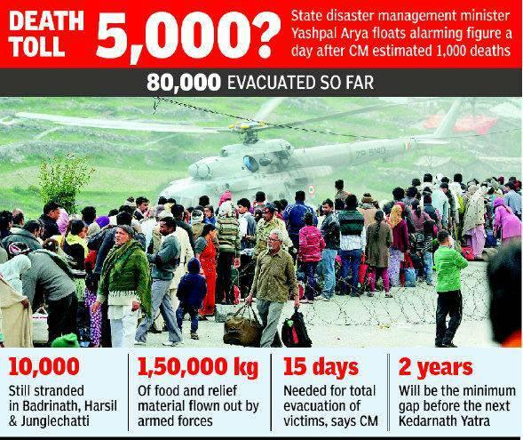
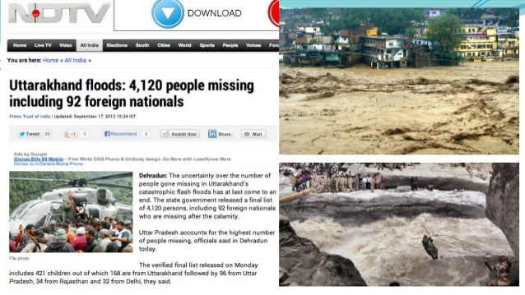
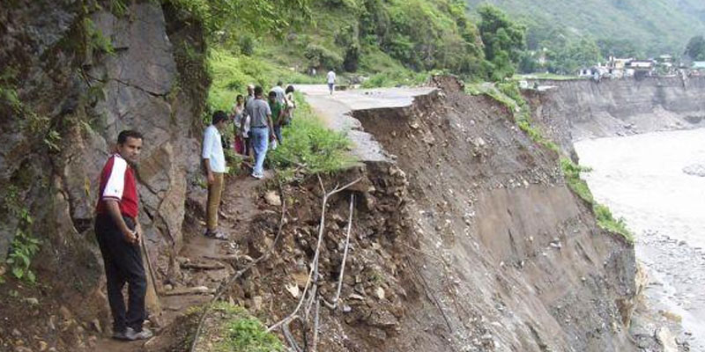
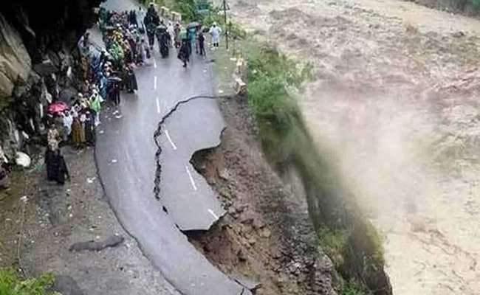

LANDLSIDE - CASE STUDY
In June 2013, a cloud burst hit the state Uttarakhand and damaged its beauty, resulting in
2300 landslides
approximately 5700 fatalities
more than 20000 injuries
1,00,000 people being trapped due to disconnection of communication and transport
31000 km of road getting damaged

Slide 21
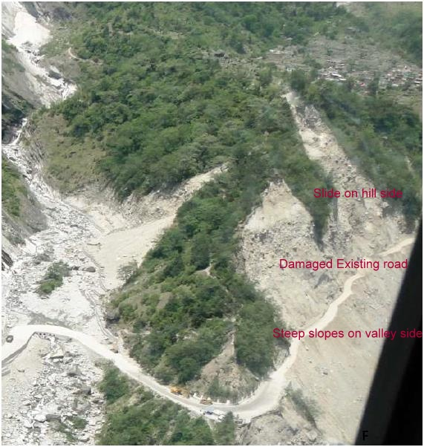
CASE STUDY OF LAMBAGARH LANDSLIDE – HISTORY
Among the 2300 landslides, Lambagarh landslide is one of the biggest and devastating one.
The Lambagarh slide is located on the road to Badrinath, i.e.NH 58.
In 2013, the road gets damaged because of landslide caused by the flash floods.
This Area is under Chronic slip Zone.
Alaknanda river runs along the toe of the slide

Slide 22
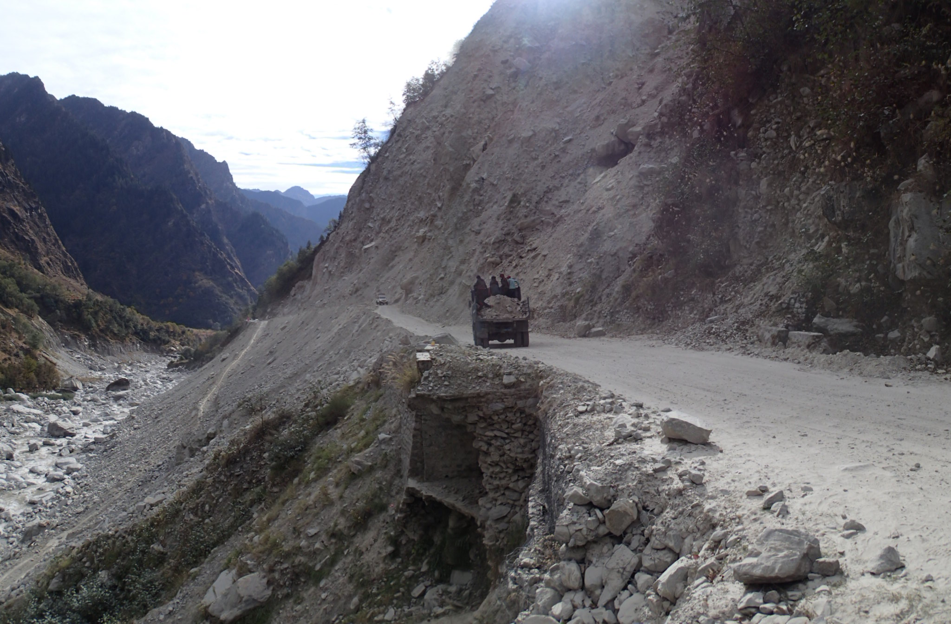

Slide 23
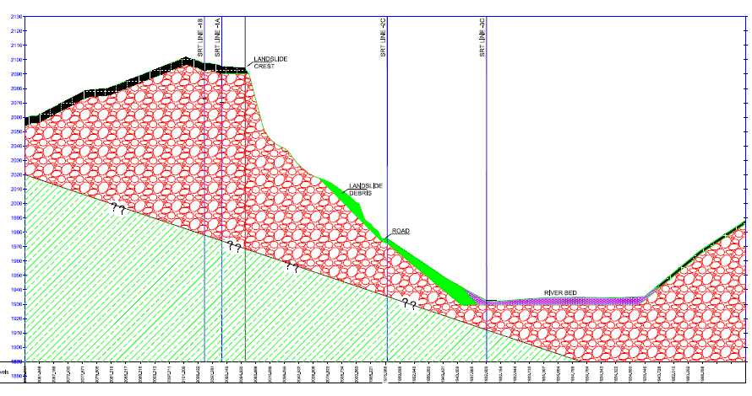
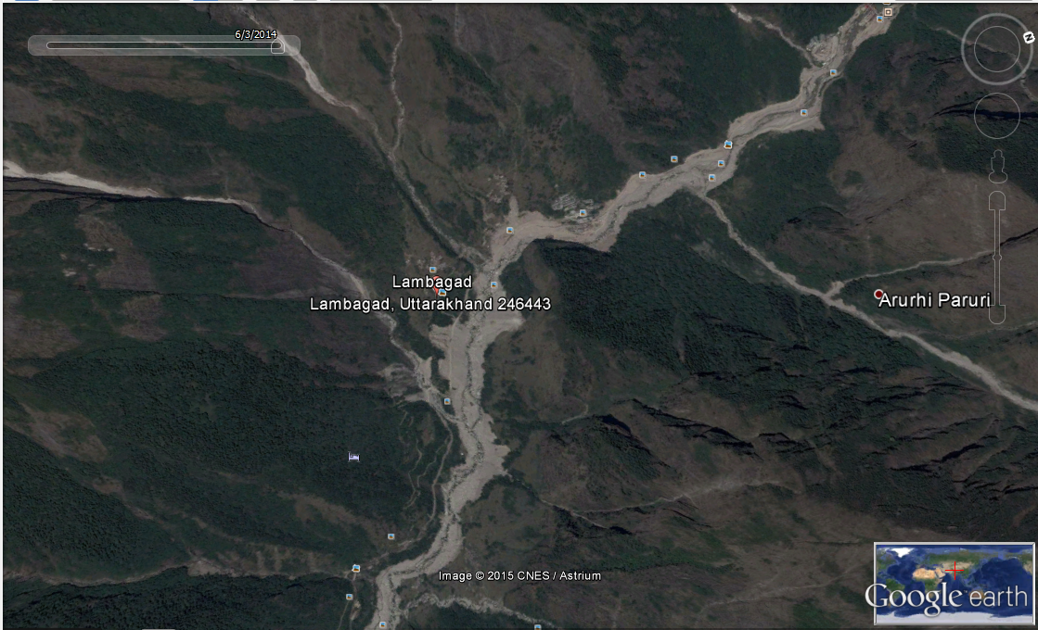
Along the road slide extends to a distance of about 500m.
The crest of the slide is at an elevation of 2094m, wherein it reaches the top of the hillock.
The river bed is at an elevation of 1903 to 1937 m in the extent of the slide.
The gradient of the river is quiet steep i.e., 1 in 10 in the slide portion.
Landslide Crest
Landslide Debris
Jaypee dam
Damaged Road
Alakananda river path
River Alakanandha
Kachra nalla
Land slide location

Slide 24
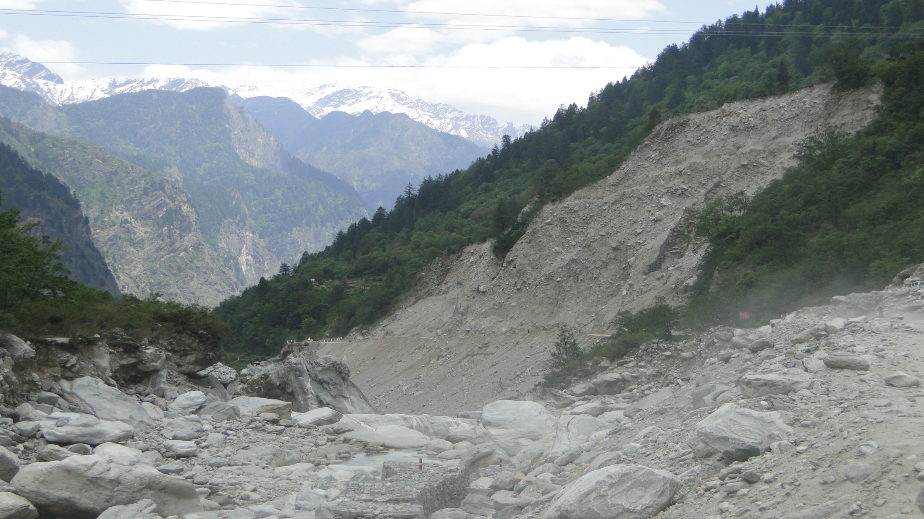
Slided Area
Existing Road

Slide 25
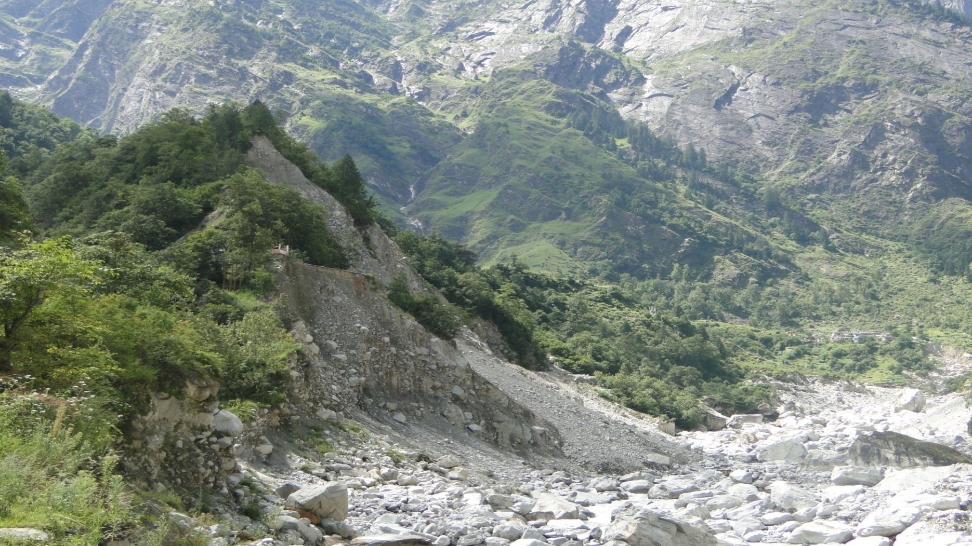
Lambagad landslide
Road towards Badrinath
River Alkananda
Photo graph showing the vulnerability of the Slide

Slide 26

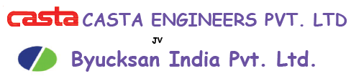


STAKEHOLDERS INVOLVED
NATIONAL HIGHWAYS
CLIENT
CONSULTANT
TECHNOLOGY PARTNER
JV
BHARAT CONSTRUCTION

Slide 27
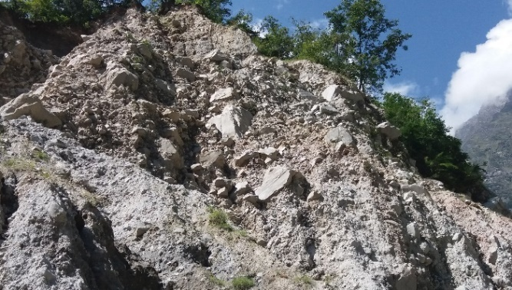
TOPOGRAPHICAL FEATURES
The slide is standing pretty steep with an with an average inclination of about 60º to the horizontal above the road level
Near the crest, the side is near vertical
Below the road level, the slope in general varies between 34º to 38º with respect to horizontal.
There is a nalla flowing on the rear side of the hilllock . Which has a perennial flow
It discharges into Alaknanda river about 180m before the slide.
The nalla caters to glacial melts and drain to large part of the mountain range on the back drop.
Surface erosion due to heavy rains and glacial melting

Slide 28
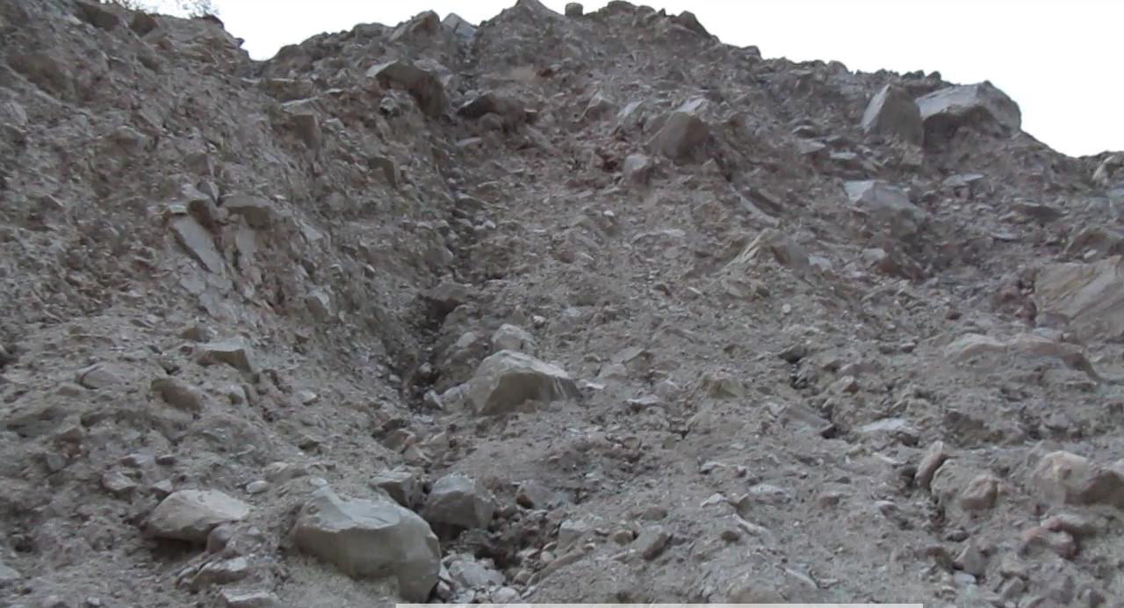
TOPOGRAPHICAL FEATURES
Gullies, overhangs, bolders on the face of the slope
Deep gullies can be seen on the face of the slide due to surface runoff running down the face
  Leading to erosion of fines,
  Loosening of boulders
  Toe cutting
  Formation of over hangs
  Triggering further slides

Slide 29
REGIONAL GEOLOGY
Area under consideration forms the part of the great Himalayas
The tectonic plane - main central thrust (MCT) is very near to the stretch
On the top of hill above slide zone, top layer comprises of unconsolidated loose soil forming the overburden-thickness varying from 2 to 5m along profiles.
Below the top layer a layer of relatively compact strata comprising of glacio-fluvial deposit and boulders is inferred.
Third layer is also comprises of consolidated bouldery strata.

Slide 30
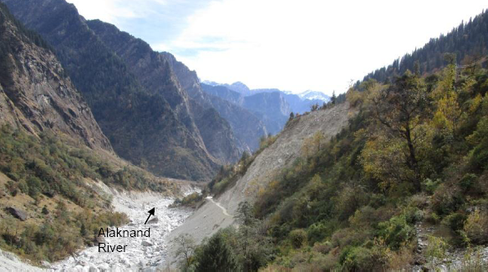
REGIONAL GEOLOGY
The glacio-fluvial deposit may get saturated
experience good amount of seepage at the face of the landslide due perennial flow at the time of monsoon .
River Valley with glacio-fluvial deposit on left and right back of the river
Seismic Refraction Test (SRT) profiling and Electrical Resistivity tests were conducted in and around the slide area as part of Geophysical Investigation.

Slide 31
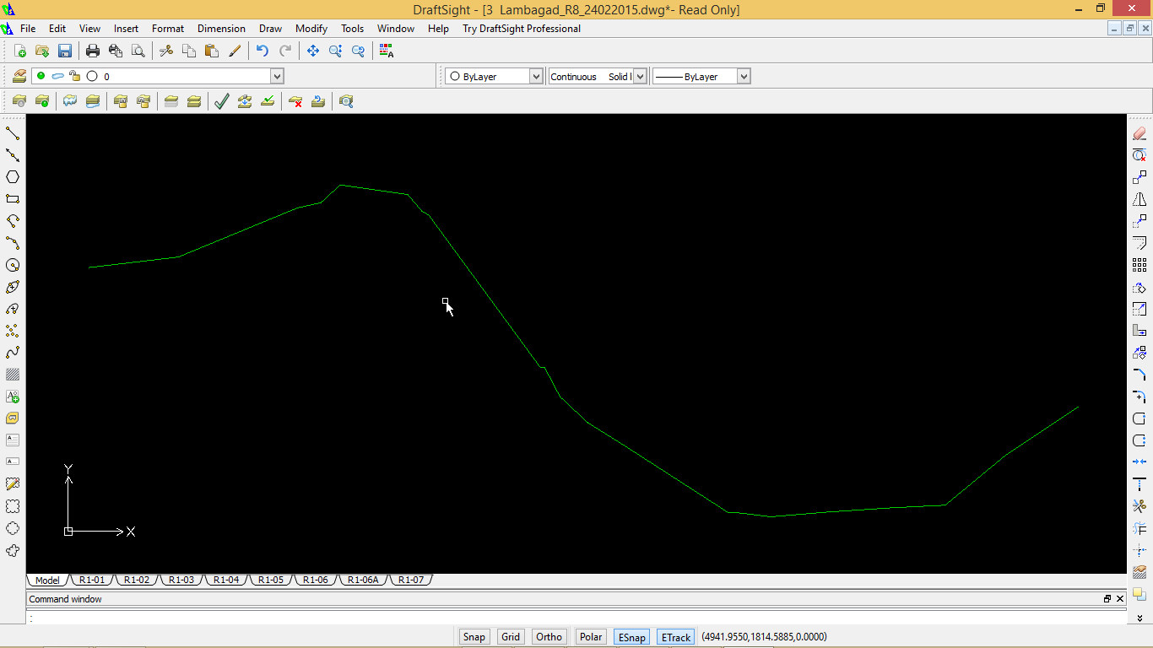
INBRIEF: FORCES OF LANDSLIDE
Toe erosion by river Alakanandha
Water seepage (Glacier melting)
Rainfall (triggers the surface erosion)
Steep slope: Average angle of slope is 60º wrt horizontal
Anthropogenic Activities
Existing Ground Condition
Rolling of the detached Rock Particles
Slip Zone of the slope
The following forces generates the destabilizing effect of the slope
Toe Erosion by River Scouring

Slide 32
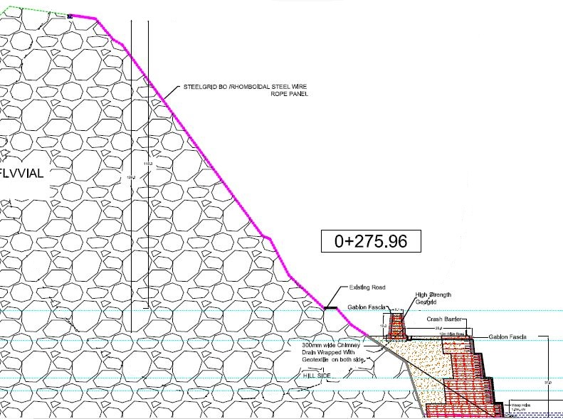

SOLUTION COMPONENTS AND ITS SIGNIFICANCE
  1. A Pinned drapery system with Rhomboidal mesh along with Hexagonal DT mesh-To hold the surface detached particles from the slope, Containing and guiding the surficial instability

Slide 33


SOLUTION COMPONENTS AND ITS SIGNIFICANCE
2. Rockfall Embankment-
Rockfall embankment as passive protection for arresting the rockfall
To collect the falling debris and detached rocks from the slope, Embankment is Proposed

Slide 34

SOLUTION COMPONENTS AND ITS SIGNIFICANCE
3. Reinforced Soil Wall with Flexible Fascia with high strength geogrid
To counteract the huge destabilizing forces due to heavy hill surcharge with seepage forces in the restricted space
44 m height RSS towards the valley side for shifting the road from its current position
4. RCC cutoff wall till the HFL + free board-
To Protect Against Scouring
To protect the fascia from large boulders hit
Glacial fluvial deposit

Slide 35

SOLUTION – FROM TENDER DRAWING
25072 Sqm. Drapery system
10m High Rockfall embankment
37m high Reinforced Soil Structure

Slide 36

ANALYSIS , DESIGN & MATERIAL SPECIFICATIONS (FROM TENDER)
Geometrical Features :
Height of Wall from Foundation 37.00 m (from tender)- Present Height of Wall from Foundation 44.00 m (based on the site condition)
Embedment Depth 2.00 m
Wall Height Above Ground Level 35.00 m
Wall Batter Angle 6.00 deg
Base width (Bottom most Reinforcement/block length) 30.00 m
Reinforced Soil Fill characteristics
Friction angle 32 degrees
Cohesion 0.00 kN/m2
Unit Weight 21.00 kN/m3
Foundation Soil parameters
Friction angle 36 degrees
Cohesion 45.00 kN/m2
Unit Weight 22.00 kN/m3

Slide 37

DESIGN AND ANALYSIS- ROCKFALL EMBANKMENT
Rockfall embankment is designed in various phases
Definition of rockfall trajectory-KE, Velocity, bounce of height of the block, dimension of the block, slope profile, starting point,
Definition of geometry of the embankment
Structural stability checks- internal stability of the embankment
Global stability of the slope
Analysis of the trajectory

Slide 38





ANALYSIS FOR ROCKFALL EMBANKMENT
Check of the rockfall trajectories
Internal stability analysis
Global stability analysis
Geometry of the Rockfall embankment
Height – block should not over pass the embankment
Using the Software CoREAR

Slide 39


Reinforced soil embankment to absorb high energy impacts along the regional road sr 47 aymavilles-cogne, aosta (italy)

Slide 40

CODAL STANDARDS AND REFERENCES
The analysis of Reinforced sioil wall is done by limit equilibrium method, which was based on circular slip surface by Bishop’s Method and for direct sliding along reinforcement layers by Spencer’s Method.
The minimum value of factor of safety required is taken from the guidelines given in Ref-2, BS: 8006, “Code of practice for Strengthened/ reinforced soils and other fills”, for Static load case.
For Seismic load case design, reference is made FHWA-NHI-00-043,“Mechanically stabilized earth walls and reinforced soil slopes design & construction guidelines”.

Slide 41




CODAL STANDARDS AND REFERENCES

Slide 42



MERITS OF THE SYSTEMS PROVIDED
The whole system is designed to make the system sustainable, green and flexible
Self draining nature help to dissipate the pore water pressure
Carbon Foot Print Reduction
Durability

Slide 43


MERITS OF THE SYSTEMS PROVIDED
Each component is engineered in such a way to eliminate localisation of forces and spreading of forces in a uniform manner .
This made the system totally flexible which will be capable of absorbing differential settlements as well as earthquake forces to a good extent .
Damaged portion after Truck hit to gabion wall
After rectification- whole process completed in less than 72 hours after We received the news

Slide 44


INSTALLATION GUIDELINES

Slide 45


Site condition during winter
Snowfall at Site on 08.01.2017

Slide 46


Construction Photographs
Excavation work is in progress

Slide 47


Construction Photographs
Laying of Paralink
Covering paralink with backfill

Slide 48



Construction Photographs
Geotextile behind gabion facia
RCC Cutoff wall

Slide 49

Challenges during execution
Construction of access roads in difficult terrain
Difficulty in excavation due to the Huge boulders present in the site
Variation in the climate. Sudden rains results high water levels in the river at the toe of the structure creating problems
Limited hours of working due to sub-zero temperatures

Slide 50
SUMMARY
Site specific approach for design, analysis and selection of systems for slope stabilization measures
A multidisciplinary approach is required to finalise the best feasible solution- from investigation to the monitoring
Drainage-an inevitable part of landslide mitigation
Main drainage measures which are suitable for Uttarkhand Landslide mitigation are Catchwater drains , Chute drains , longitudinal road drains , chimney drains and culverts.
Drains are to be designed as per types of drains and type of flow
Construction feasibility should be a major consideration , while finalising the dimensions of drain

Slide 51



Rockfall Mitigation Measures

Slide 52
Flow Of Presentation
Why Rockfall mitigation measures?
Types of rockfall mitigation measures
Selection criteria
Testing and codal standards
Conclusion & Discussion
Case study-Rockfall mitigation at Sapthshrugi Ghad temple

Slide 53


WHY ROCKFALL MITIGATION MEASURES ???
Rock slide near Khandala tunnel (Mumbai corridor) (source: NDTV news)
Aftermath of the rockfall happened near Adoshi tunnel (source: Indian Express Newspaper)
Notes:
Increasing development of road networks in the hilly terrains, there is a need to stabilize rock slopes for this increased exposure to rockfall
When rocks dislodge, slide, roll or free-fall on road/rail networks, nearby infrastructure, the impact results in damage, road closures, injuries and mortalities
In mountainous terrains, rockfalls may lead to catastrophic damages

Slide 54









SYSTEMS FOR ROCKFALL MITIGATION MEASURES
Prevention measures
Protection measures
Retention measures
Warning measures
Act to control the detachment of rock/ stabilize rock slope
Controlling the direction, distance of fall and guide the falling rock.
Retains debris from falling down the slope.
Help in detection of rockfall or slope movement
Using predictive warning alarms, remote monitoring systems and danger flashers
Secured Drapery (Mesh+anchors),
Berms
Ditches
Rock sheds
Rock anchors
Fences and warning signals triggered by falling rocks or detached rock masses
Drainage
Simple Drapery
Barrier
Shotcrete
controlled blasting

Slide 55

SELECTION CRITIREA FOR ROCKFALL MITIGATION SYSTEMS
Constructability/ Installation feasibility
Accessibility
Presence of Vegetative cover/overburden
Cost effectiveness
Aesthetics
Is it possible to cut trees before installation of the mesh or rockfall barriers?
Are there access roads?
Is it possible to remove unstable blocks by scaling?
Are there any restrictions regarding possible use or need to use a Helicopter? Presence of electric line

Slide 56

SELECTION CRITIREA FOR ROCKFALL MITIGATION SYSTEMS
Suitability of potential mitigation option to the characteristics of the rockmass
Surface Instability??
Deep seated Instability??
Availability of space between the road/rail network/infrastructure from the toe of the slope
Service life
Level of risk acceptable

Slide 57

CODAL STANDARDS AND RFERENCES
Notes:
To ensure the quality and the products are inaccordance with the codal standards

Slide 58
TESTS ON ROCKFALL MITIGATION MEASURES
Test on Prevention measures
Pullout test on anchor/nail
Tensile and shear strength test on anchor/nail
Test on Retention measures
Preconstruction strength test on Shotcreting
Test on Protection measures
Tensile strength, Punch test, Static unthreading and tearing test on meshes
Impact test (crash test)on flexible barriers
Impact test on embankment

Slide 59


TESTS ON MESHES-TENSILE STRENGTH
Tensile strength and deformation are the 2 important parameters of the meshes
Sample length not less than 1.0 m and minimum area of 1.0 m2.
2 procedures are allowed
  Lateral shrinkage not allowed (all kind of meshes)
  Free lateral shrinkage (wire meshes)
Tensile strength Range (as per IRC HRB 23)
For hexagonal double twist mesh (simple rockfall netting)– 32 kN/m to > 60 kN/m
For reinforced mesh – 40kN/m to 170 kN/m

Slide 60



TESTS ON MESHES-PUNCH STRENGTH
Sample 3.0 x 3.0 m restrained on 4 sides.
The test provides information about the mesh behavior on typical situations and allows the right design approach for the secured drapery calculation.

Slide 61


MESHES FIELD TEST-PUNCH STRENGTH
Pont Bozet (AO – Italy) - mesh field test
Nails
Jack
Realistic conditions:
- Large dimension sample
- Inclined load
- Real tie condition
Punching device

Slide 62



Test for tearing and unthreading resistance of knots
Rhomboidal Cable Wire Rope Mesh
As per IRC HRB 23
Tearing/rupture strength – 20 to 24 kN
Pull apart strength- 10kN-11.5kN
Tensile strength – 80 kN/m to >200 kN/m
Static unthreading test
Static tearing test

Slide 63


TESTS ON NAILS/ANCHORS
TEST ON RAW MATERIALS
Steel rods used as nails
Grout strength
TEST ON INSTALLED NAILS
- Field pull out test

Slide 64



The ETAG 027 Crash Test
IMPACT TEST ON FLEXIBLE BARRIER

Slide 65



RMC 850/A
CRASHTEST ON FLEXIBLE BARRIER
MEL main data
Impact speed = 30.31 m/s
Kinetic energy = 8644 kJ
Nominal height = 6.75 m
Residual height = 3.89 m (58% hn)
Block used for the MEL test
18,815 kg

Slide 66
TESTING ON ROCKFALL EMBANKMENT
Impact tests on Embankments
Embankment Testing (University of Turin*)
8700kg @ 37m/s = 5000kJ impact energy.
1st test indent was 0.8m deep.
Embankment collapsed after 3rd 5000kJ test.
(N.B. Embankment crest is only 1m wide)

Slide 67

News paper article where effectiveness of Rockfall Protection System is getting appreciated during the rockfall event happened in Saptashrungi on June 12th, 2017.
Notes:
Now we are in a more confident status, as our system protected more than 100 people’s lives by performing its intended function. This is one of the greatest testimonials of Maccaferri system’s robustness and “engineered to perform “.
Herewith I am sharing another snapshot of the news paper article where effectiveness of our systems is getting appreciated by the media and people during the rockfall event happened in Saptashrungi on June 12th, 2017.

Slide 68


Rockfall Mitigation Measures Implemented at Saptshrungi Gad Temple, Nashik-A Case Study
  Saptashrungi is a hill range consisting of seven hills (Ghads)
  The Sapthshrungi gad is situated in the East-West range of Shyadri mountains, approximately at a distance of 65 km from Nasik.
  One of the most visited religious place for pilgrims
Saptashrungi Gad
Nashik
Source: Google Maps 2017
Notes:
State of Maharashtra
Area: 307,713 km²
Founded: 1 May 1960
Population: 114.2 million (2012)
Capital: Mumbai
170km from Mumbai

Slide 69


Introduction & problem
Cultural significance:
One of 51 Shakti peethas on Indian subcontinent
Sapta Shrungi Mata “goddess / mother of seven hills” is surrounded by seven peaks
Pilgrimage includes walking the Parikama paths circling the shrine
Community significance:
3000 pilgrims per day
Increasing to 5-600,000 during Chaitrostav and Navratostav festivals
Notes:
Shakti peethas are prominent energy seats of the Hindu Goddess
Sapta Shrungi Mata “goddess / mother of seven hills” (mother of the seven peaks) is surrounded by seven (sapta-in Sanskrit) peaks (shrunga-in Sanskrit). She can see all the surroundings from her lofty peak.

Slide 70


The temple is constructed on moderately weathered and fractured basaltic rock hanging dangerously at many locations.
These overhangs pose a danger to the pilgrims
Notes:
Protected staircase going to temple. Protected against rocks and climate.
Devotees need the stairs.
Elevation is high.
Crowd control. Risky situation.
Nasik – comparatively cooler than Mumbai/New Dehli. Still 35-38’C
Monsoon. Rains – SW and SE monsoon. Months….
Pilgrim flow months? Year round.
Monsoon months?

Slide 71

  Highly weathered, jointed and fractured rockmass - with the action of rainfall, tree roots and sometimes monkey movements caused rockfall

Slide 72


Rockfall History ….
Big Parikrama Path (3.71 km)
Small Parikrama Path (2.73 km)
Temple
Various size of rock block fallen on parikrama path
Table: Record of rockfall event for both Parikrama path ( Ansari et al., 2014)
 | Class |  | Number of Rockfall |  | Number of Rockfall
Small Parikrama Path | A | Rockfall of volume < 1 m³ | 253 | Big Parikrama Path | 189
 | B | Rockfall of volume:1m³ to 10m³ | 67 |  | 77
 | C | Rockfall of volume >10 m³ | 0 |  | 2
Notes:
Rockfall risk assessment for pilgrims along the circumambulatory pathway, Saptashrungi Gad Temple, Vani, Nashik Maharashtra, India-M. K. Ansari , M. Ahmad & T. N. Singh, http://www.tandfonline.com/loi/tgnh20 . Due to these rockfall hazards even the custom of making the pradakshina (encompassing) around the shrine got stopped.

Slide 73


Fatality reported …
Year of Rockfall | No of people died
10th December 2006 | 1
28th September 2008 | 2
01st October 2008 | 1
04th March 2010 | 1
During the period 2006 to 2011, 6 times rockfall has happened and caused death of 7 people
Notes:
The document is Marathi Language (Region language of people in Maharashtra) which was shared by the client (PWD, Nashik)

Slide 74



DAMAGE DUE TO THE ROCKFALL IN 2008
Notes:
A mixed database of rockfall affecting the temple and parikrama path was obtained using different sources although no record of rockfall events were kept prior to the rockfall event in 2008. After the big rockfall on 2008, Indian government starts the mitigation work.

Slide 75



Stake holder involved: Stakeholders, community, project team
Client: Public Works Department Nashik
Consultant: Indian Institute of Technology Bombay
Main contractor: Maccaferri Environmental Solutions p.v.t. Ltd
Notes:
To ensure the best quality installation and expert climbers, maccaferri has appointed INACCES.
We signed the contract. We were main contractor.
IIT Bombay. Design consultant appointed by client. We supported them with the design, software.
IIT take specialist advice when needed. Professor Dr. T. N. Singh is a geology specialist.
LiDAR survey employed by Maccaferri: Igenesys . Item in tender for this work.
Macc have own people. Some India specialist contractors with whom we work before.
We do provide training if needed. Usually subcontract and we have project managers and supervisors.
We engaged Inacces for barrier. Company from Spain. Rockfall barrier main input. Brought in specialist people.
Inacces. Trained locals – subsequently set up local company using local labour – economic benefits

Slide 76
Customized Innovative Design/Solution Requirements
Social
Temple could not be fully closed during works
Religious building of religious and architectural value, and replacement not possible
Quantitative Risk Assessment (QRA)
Technical / implementation
No Indian design codes for rockfall (at time)
Limited preliminary scaling / cleaning – too high risk
Long and difficult access to crest / summit – small pedestrian access only
High average wind speed in mountainous region – limited use of helicopters
Selection of suitable materials ensuring the best performance + light systems which are easy to transport + systems that are compatible with the impossibility of scaling and related risks
Notes:
http://www.tandfonline.com/loi/tgnh20
ALARP: As low as reasonably practicable

Slide 77

Slope height > 200 m
Near vertical
Large overhanging portion
Access to area;
Equipment
Materials
Labour
Notes:
Note shrine is built against the mountain and beneath overhang.

Slide 78

ENGINEERING INVESTIGATIONS
Investigations performed:
Topographical
Geological and Geomorphological Investigation
Geotechnical Investigation
Hydrological Investigation
Light Detection and Ranging (LiDAR) technology used:
Digital Elevation Model
Detailed contour maps
Section drawings
Identification of vulnerable areas
Notes:
Due to the difficulties in doing the conventional surveys, latest technologies such as LiDAR survey was adopted.
Light detection & ranging
Convincing client that these solutions were tried and tested and would really work. Then aesthetics, then installation.
Helicopters proposed for most of the works – scared of risk….
Access to top of hill – path only known truly to one family who raised a flag to the goddess periodically. Kept the information secret – it was their family’s job to keep the flag flying on top of the mountain. Not right to follow them, or demand this knowledge. Sensitivity of local tradition and culture.
Lobbying of this solution – industry. Macc and rockfall competitors. Ultimately quality / service.
Academic Institution. Professor Singh Indian Institute of Technology Bombay.
+ GG. Experts helped to convince the client
Public Works Department ultimately the client – released tender.
V.Accurate mapping needed. Could not do this as strata is near vertical. Each step has to be mapped.
Rapid, safer than traditional systems. One of most accurate. 2013 carried out.
Drone surveys – could be used – not available in India at the time.
The LiDAR surveying/mapping carried out for topographic survey to create contours, DEM, 3D fly-though of AOI, cross-sections/profiles at every 5m (meter) interval and identification of rock type and other ancillary details.
LiDAR generated:
1. Generation of contours at 0.5m and 2.0m vertical intervals with cross-section lines superimposed
2. Generations of cross-sections/profiles at every 5m interval
3. Creation of digital terrain model
4. 3D walkthrough / videos of terrain in the form of colorized point clouds or images
5. LiDAR point cloud as base data for augmenting geological interpretation in terms of geo-referencing and deriving various directional and dimensional components of geological rock types
difficulties in doing the conventional surveys, latest technologies such as LiDAR survey was adopted.

Slide 79

Assessment – geotechnical / geological
Digital Elevation Model

Slide 80

Light Detection and Ranging (LiDAR) Survey
Horizontal layers
Number of joints / fractures
Vertical joints (dotted lines)
Uneven fractures
Rock wedge overhang (280 m²)
Notes:
Lidar data – interpreted by Maccaferri in conjunction with Mumbai institution of technology.
Identified vulnerable areas.
Plotted / cross- referred with personal observations.
Information collected from local people and Local Authority.
Rock wedge – not a mass failure but a progressive failure.
Initial tender involved Ph1 – addressing upper part of slope.
Ph2 – remaining part of slope will happen – including addressing the rock wedge with bolting / meshing etc. Barrier in Ph1 addressed immediate problem.

Slide 81

ENGINEERING INVESTIGATIONS
The seven hills are in Deccan Trap formation:
Hard and amygdaloidal basalts
Bole beds (red bole)
Lateritic soils
Instability of the rock formations:
Fractured and columnar joints in basaltic rocks
Multi-oriented joints
Numerous rock blocks on point of detachment
Notes:
The Deccan Traps is a large igneous province located in west-central India and is one of the largest volcanic features on Earth. The name is derived from the Swedish word for steps which refer to the step like hills forming the landscape of the region.
Bole beds (composed of clays and volcanic ashes) are considered as the weathering products of the older neighboring lava flows and are trapped by younger lava flow. Field occurrences shows common red color for bole beds but occurs in a wide range from brown to green colors.
Reddened clay-rich horizons between basalt flows have historically been identified as “baked zones” or as zones of lateral groundwater movement. The reddening was interpreted as a form of alteration due to thermal or chemical processes. Many of these zones are referred to as “bole beds” in Deccan traps
Deccan Trap – igneous rock. Traps – means steps. Hill formations have certain defined steps.
Red boles – clay based material layer within the basalt.
Lateritic soils – India – more common in coastal regions (s and west). In presence of water – loses cohesion. Seasoned Laterites the cohesion can continue. Unseasoned Laterites in rainy season can lose strength and leach out.
Giorgio Giacchetti – visited site 4/5 times and stayed in Nashik for a lot of the installation – contact GG for this.

Slide 82

Numerous rock blocks on point of detachment

Slide 83
Solution
    Key parameters considered in selection and design of rockfall mitigation measures :
    Height and angle of the slope
    Geological conditions
    Proximity of slope to infrastructure to be protected
    Safety and security
    Maintenance requirement and its frequency
    Access to the site
    Aesthetics
Notes:
Presence of heavy jointed loose rock mass at the top of the cliff, and multiple vertical open joints in rock mass on vertical slope above and around the temple was a major point of concern as even a small portion of rock falling from such a height was a threat to the temple complex as well as Parikrama path and could lead to fatal accidents. Considering the existing problem rockfall mitigation works was proposed as a solution to be carried out above and around Parikrama path and temple location. almost all the rock blocks have potential to hit the Parikrama
Path below after detachment from the slope. Thus, there was a need to provide the dynamic rockfall barrier at appropriate location on the slope to mitigate the risk associated with the rolling down of rock blocks from the steep upslope.
Chain link is the traditional solutions in India. Cheap and cheerful. Often hand-made. Keeping people working. Low or no galvanising. On product. Short term solution normally.

Slide 84


SOLUTION– SYSTEMS CONSIDERED
Rock galleries / sheds
Costly
Construction feasibility-Difficult to construct long slabs for rock sheds
Reinforced shotcrete
Aesthetics
Seepage obstruction
Concrete spalling
Poor quality control
Anchors + chainlink mesh
High deformation of mesh causing the stripping of anchors
Unraveling of the mesh due to the accidental breakage of single wire
  Considering key parameters:
  Secured drapery and dynamic rockfall barriers were proposed
Mesh aesthetics; barely visible from distance
Better quality control
No obstruction of seepage
Double-twist mesh – does not unravel
Notes:
Chain link on revetment is a common solution. Hand-manufacture of mesh keeps people employed. Quality is low however. Trying to get local stakeholders to go to a manufactured solution was therefore difficult as it was perceived as taking manufacturing jobs away. However, performance and reliability along with testing and quality were arguments used.

Slide 85

Solution adopted
  Secured Drapery
    Steelgrid MO
    High Energy Absorption (HEA) panels
    3m long SDA with tensile strength >550MPa
    3m centres - square
  Dynamic Rockfall barrier
  5000kJ MEL capacity
  7m high
  1 x 70m (25m above the temple )
  1 x 80m (30m above the Parikrama path )
Notes:
Dynamic Rockfall barrier – 5000kJ capacity and 7m high in two lines
First line is approx. 25m above the temple (for a stretch length of approx. 70m)
Second line is approx. 30m above the Parikrama path (for a stretch of approx. 80m).
Secured Drapery with
Steelgrid MO + High Energy Absorption (HEA) panels
3m long, 32 mm dia self drilling anchors with tensile strength >550MPa at 3m centre to centre
SGMO 150 (3m x 50m); 237kg / roll
HEA (10m x 5m); 182kg / roll
In ROW often combine meshes into one product on the ground and lift into position. In this case, had to keep separate. Costs a but higher to install, but less to transport / handle.
Balance between roll dimensions, handleability
Clamps and wire ropes used to connect panels.
Battery wrenches and hand wrenches used.
No standards in India at the time of the project. Always want to see proof of performance overseas. Although it is innovative to India, we have greater experience in EU. Crash test in EU witnessed.
Validated confidence.

Slide 86


Solution adopted
HEA Panels
Super-stiff yet flexible steel cable mesh
High strength – low strain
Double knot connection: rip-resistant
Punch resistance: Range 200kN - 400kN
Tensile strength: 140kN/m – 250kN/m
Notes:
Punch test in accordance with UNI 11437
Italian standard – R
Displacement: 260mm - 310mm
ockfall Protective Measures - Tests On Meshes For Slopes

Slide 87




Solution adopted
Steelgrid
Stiff yet flexible rockfall mesh
Punch resistance: Range 70kN - 150kN
Tensile strength: 50kN/m – 177kN/m
Notes:
Displacement: 520mm - 420mm
Punch test in accordance with UNI 11437
Italian standard - Rockfall Protective Measures - Tests On Meshes For Slopes
Tensile strength: the wire used to manufacture the mesh shall have a tensile strength between 350-550 N/ mm2 as per EN10223-3:2013
Minimum breaking load (MBL) of rope: 40.7 kN as defined in EN 12385-4 2008

Slide 88


Solution adopted
Dynamic Rockfall Barrier
Available up to 8600kJ MEL
5000 kJ, 7m high barrier selected
Very low post-impact deflection
Energy absorption by compression brakes
Minimise uphill anchors

Slide 89

Inputs for Analysis – Design Information Sheet

Slide 90


ANALYSIS AND DESIGN
  Secured drapery
The design of secured drapery is not at all easy because of numerous variables, including topography, rock mass properties, joint geometry and properties, mesh type and related restraint conditions.
Design approach
Anchoring for surficial instability
Mesh revetment of surface
Small debris (still deadly) + larger block retention
Notes:
Slope was not so complex in terms of failure mechanisms, planes of failure were clear and mechanisms driving failure were clear. Hence Limit equilibrium had good data input and reliable results.

Slide 91

Slope was not so complex in terms of failure mechanisms, planes of failure were clear and mechanisms driving failure were clear.
Hence Limit equilibrium had good data input and reliable results.
MacRo1 (MacRO Studio Software), is used where a limit equilibrium approach for the design of secured drapery is possible.
  Input Parameters
  Slope inclination: 80deg
  Thickness of surficial instability: 1.5m
  Inclination of most critical joint: 25deg
  Horizontal seismic co-efficient: 0.08
  Maximum Height : 200 m

Slide 92

Analysis – secured drapery
  SDA of diameter 25mm, tensile strength >550 MPa, 3m length, at 3m centre to centre spacing .
  As a secondary mesh system, Steelgrid MO (which is having a smaller mesh opening size) was proposed along with HEA Panel to contain larger detachments.
Notes:
Slope was not so complex in terms of failure mechanisms, planes of failure were clear and mechanisms driving failure were clear. Hence Limit equilibrium had good data input and reliable results.
“Rock slope stability analysis[edit]
Rock slope stability analysis based on limit equilibrium techniques may consider following modes of failures:
Planar failure -> case of rock mass sliding on a single surface (special case of general wedge type of failure); two-dimensional analysis may be used according to the concept of a block resisting on an inclined plane at limit equilibrium^{[26][27]}
Polygonal failure -> sliding of a nature rock usually takes place on polygonally-shaped surfaces; calculation is based on a certain assumptions (e.g. sliding on a polygonal surface which is composed from N parts is kinematically possible only in case of development at least (N - 1) internal shear surfaces; rock mass is divided into blocks by internal shear surfaces; blocks are considered to be rigid; no tensile strength is permitted etc.)^{[27]}
Wedge failure -> three-dimensional analysis enables modelling of the wedge sliding on two planes in a direction along the line of intersection^{[27][28]}
Toppling failure -> long thin rock columns formed by the steeply dipping discontinuities may rotate about a pivot point located at the lowest corner of the block; the sum of the moments causing toppling of a block (i.e. horizontal weight component of the block and the sum of the driving forces from adjacent blocks behind the block under consideration) is compared to the sum of the moments resisting toppling (i.e. vertical weight component of the block and the sum of the resisting forces from adjacent blocks in front of the block under consideration); toppling occur if driving moments exceed resisting moments^{[29][30]}“
Slope was not so complex in terms of failure mechanisms, planes of failure were clear and mechanisms driving failure were clear. Hence Limit equilibrium had good data input and reliable results.
Wikipedia: “limit equilibrium is most commonly used and simple solution method, but it can become inadequate if the slope fails by complex mechanisms (e.g. internal deformation and brittle fracture, progressive creep, liquefaction of weaker soil layers, etc.). In these cases more sophisticated numerical modelling techniques should be utilised. Also, even for very simple slopes, the results obtained with typical limit equilibrium methods currently in use (Bishop, Spencer, etc.) may differ considerably. In addition, the use of the risk assessment concept is increasing today. Risk assessment is concerned with both the consequence of slope failure and the probability of failure (both require an understanding of the failure mechanism).^{[8]}
All limit equilibrium methods assume that the shear strengths of the materials along the potential failure surface are governed by linear (Mohr-Coulomb) or non-linear relationships between shear strength and the normal stress on the failure surface.^{[11]} The most commonly used variation is Terzaghi's theory of shear strength which states that
{\displaystyle \tau =\sigma '\tan \phi '+c'}where {\displaystyle \tau } is the shear strength of the interface, {\displaystyle \sigma '=\sigma -u} is the effective stress ({\displaystyle \sigma } is the total stress normal to the interface and {\displaystyle u} is the pore water pressure on the interface), {\displaystyle \phi '} is the effective friction angle, and {\displaystyle c'} is the effective cohesion.
The methods of slices is the most popular limit equilibrium technique. In this approach, the soil mass is discretized into vertical slices.^{[10][12]} Several versions of the method are in use. These variations can produce different results (factor of safety) because of different assumptions and inter-slice boundary conditions.^{[11][13]}”

Slide 93

Analysis of trajectories and design of dynamic rockfall barrier
The simulation for rockfall from the near vertical face of hill slope has been performed with commercial software ‘Rocfall’ of Rocscience Inc.
  program works →calculating the trajectories of thousands of blocks; on the basis of the probabilistic Montecarlo method.
  The governing parameter defining rock-slope impact in the software is the coefficient of restitution
  Which depends on the and thickness of the surface soils, vegetation cover, speed of fall, size of boulders.
Example-Topographic section with the rock trajectories
Notes:
program works →calculating the trajectories of thousands of blocks; varying within a certain range on the basis of the probabilistic Montecarlo method.
The governing parameter defining rock-slope impact in the software is the coefficient of restitution, which defines the fractional change in velocity of the particle during impact in the direction normal to the slope. ( which depends on the and thickness of the surface soils, vegetation cover, speed of fall, size of boulders.

Slide 94

Analysis – Dynamic rockfall barrier
Probable trajectories
Probable trajectories
7m high, 5000 kJ
barrier
Almost all would hit path!
25m
Parikama path
Parikama path
Notes:
The simulation for rockfall from the near vertical face of hill slope has been performed with commercial software ‘Rocfall’ of Rocscience Inc. It is a 2-dimensional rockfall simulation program for the prediction of rockfall behavior on slopes and the design of rockfall barriers. The program works calculating the trajectories of thousands of blocks; all the parameters that characterize the trajectory vary within a certain range on the basis of the probabilistic Montecarlo method. Each rock is modeled as a particle (lumped mass). The frictional resistance of the air is not taken into account in any of the equations.
The design energy was 4233.61 kJ and Design Barrier Capacity (of 5000 kJ dynamic rockfall barrier) was 4378.33 kJ. Therefore the proposed dynamic rockfall barrier of 5000 kJ is sufficient. The Design Impact Height was 4.89m and Design barrier height was 6.50m (considering 0.5m freeboard on 7.0m total post height).

Slide 95

  Large extend of area to be protected
  Inaccessible terrain
    Huge heights (about 250m from road level)
CHALLENGES
Notes:
Due to the weathering action, the loose rock mass from the top of the hill occasionally fall, bounce, roll and slide down along the hill slope with some rock blocks landing on or passing the temple complex and the Parikrama path causing fatal injuries to the pilgrims. The rockfall problem at Saptshrungi Gad temple location had caused accidents to the devotees who were visiting the temple, and also resulted in damaging the temple and the Parikrama path. Various geological observations were taken and topographical survey was conducted to study and analyse the site conditions. Based on the inputs derived from the investigations/studies carried out, the rockfall mitigation solutions including the secured drapery system and dynamic rockfall barriers were adopted.

Slide 96

CHALLENGES
Low visibility
Bad weather conditions
Notes:
weight of a barrier post for 5000 KJ barrier- approx 350 Kg
50 kg/m

Slide 97

CHALLENGES
    Bigger threats of rockfall during installation

Slide 98

CHALLENGES
Relatively high Wind intensity

Slide 99

Delivery – secured drapery
GLIMPSE OF CHALLENGING CONSTRUCTION ACTIVITIES
Installation of Steelgrid MO
Secured to anchored top-rope
Rolled down the slope

Slide 100

Delivery – secured drapery
Lacing of Steelgrid MO
Cables / clips
Notes:
Lacing adjacent panels of Steelgrid MO

Slide 101

Delivery – HEA panels
Installation of HEA Panels
Connected together at crest
Secured to anchored top-rope
Rolled down slope face

Slide 102


Delivery – HEA panels
Lacing of HEA Panels
Cables / rope grips
Battery / manual tools
102
RF & CSS Projects
zxczcc

Slide 103

Delivery - anchors
Self-drilling anchor installation

Slide 104

Far view of Installed Meshes

Slide 105

GLIMPSE OF CHALLENGING CONSTRUCTION ACTIVITIES
Dynamic Rockfall Barrier- Installation
Manual Installation of posts and bracing cables

Slide 106

GLIMPSE OF CHALLENGING CONSTRUCTION ACTIVITIES
Posts were installed almost horizontally

Slide 107


Slide 108




Delivery – logistics
Compound / Site office / Staging area
Winch area A
Crest
Parikama path
Winch area B
Rock face above temple
Helicopter usage where weather / safety allowed
H
1
A
1
2
3
B
2
3
A
B
H

Slide 109



Shifting of Material to summit
Weight of one roll of SteelGrid MO (3mx50m) - 237 kg
Weight of one roll of HEA Panel (10mx5m) - 182 kg

Slide 110




Weight of 7m post
350 kg
Notes:
weight of a barrier post for 5000 KJ barrier- approx. 350 Kg
50 kg/m

Slide 111




Delivery - logistics

Slide 112

Helicopter transferring the barrier components to the temporary storage location near to the slope
Dynamic Rockfall Barrier- Installation

Slide 113



GLIMPSE OF CHALLENGING CONSTRUCTION ACTIVITIES
For the first time in India underslung operation for installation of barriers
was carried out using helicopter

Slide 114

Local engagement
Recruitment of local work force – building skills
  Local contractors supporting specialist contractor – upskilled
  Local survey teams
  Local suppliers whenever possible
  Material movements
Local religious and temple community – building trust
  Accessibility to the top of sacred hill / local knowledge
  Microclimate information
  Crowd management in temple during the works
  Superstitions and ceremony – works needed full support of religious community
Notes:
Temple operations remained open.
However during risky activities, we requested that it was closed for a few hours to reduce risk.
Intermediate ramps – furnicular railway being built to increase access.

Slide 115




Safety measures adopted …
Temporary barrier with SG MO was provided was provided at a distance of 1.5 m from below the main barrier location with a length that extends around 3 m beyond the end posts of the main barrier
Drapery was installed at the top before the installation of main barriers
Climbing & Abseiling Helmet
Climbing Safety Harness
Eight Hook
There were no accidents during the construction phase
Carabiner
Safety Lock Device
Ascender
Double Stop Descender
There were no accidents reported during the installation
Notes:
Details of temporary barrier

Slide 116

Saptshrungi Project
Pilot Project
Phase 1 stage

Slide 117

Solution – pilot project
Success from the past helped us to get the repeated order …
Pilot project
Construction
Start: June 2011
End: May 2012
Secured drapery with High Energy Absorption Panel and Anchors

Slide 118


To ensure the quality …
Material conformance testing
Benefits
Education of institutes in testing methodologies
International standards exist, but not in use locally
Mentality of quality in these high risk installations
Notes:
To ensure the quality and the products are inaccordance with the codal standards
ISO 17745 – Steel wire ring net panels – Definitions & Specifications
ISO 17746 – Steel wire rope net panels and rolls – Definitions & Specifications

Slide 119



To ensure the quality …
Installation checklists
Benefits
Based on standards and industry experience
Knowledge-share with local stakeholders
India-specific check lists created with stakeholders
Education of installation techniques for local workers
Notes:
To ensure the quality and the products are inaccordance with the codal standards
ISO 17745 – Steel wire ring net panels – Definitions & Specifications
ISO 17746 – Steel wire rope net panels and rolls – Definitions & Specifications
These check lists made specifically for the indian market and for the installation.
Adapted from EU.
Observation sheets based on standards and industry experience.
Any problems encountered?
Bad weather – short time windows.
During monsoon hill is covered in clouds.
Nothing falls onto temple during works – care during works.
Could not empty the temple – had to remain open.
Selected self-drilling to reduce work process and collapse of annulus.
Design life requirement on rockfall mitigation works 20 years normally in India. This project required 40+ years.

Slide 120
CODAL STANDARDS AND RFERENCES
Notes:
To ensure the quality and the products are inaccordance with the codal standards

Slide 121


Consultant witnessed the field crash test of the barrier in Italy

Slide 122
Supply chain
Barriers
ETAG Certified
Secured drapery
INDIA
Labour
SPAIN
Anchors
Atlas Copco
ITALY
Kit of parts
Sea freight
Road freight
INDIA
Road freight
INDIA
Corrosion resistance
ITALY
Tried / Tested
QA/QC supply
Codes / standards
Knowledge transfer
Indian factory
QA/QC supply
Overseas expertise only where needed
Knowledge transfer to local companies
Quality on-site
Safety culture
Common product
QA/QC supply
Value for money

Slide 123

WORK DONE CERTIFICATE

Slide 124


PERFORMANCE CERTIFICATE
Notes:
One of the

Slide 125


Demonstrating performance of the system ..

Slide 126

CONCLUSION
Maccaferri ensured the protection of the temple, temple premises and parikrama path from rock fall hazards by the quality construction of rockfall mitigation measures and
Saved the life of thousands and thousands of people

Slide 127

Thank you
Notes:
Dynamic barrier use
Underslung helicopter use
Subsequent use of systems on other sites in Maharashtra

