Slide 1
Flexible Pavements Solutions
Dr. Ratnakar R. Mahajan
Deputy General Manager
Maccaferri Environmental Solutions Pvt. Ltd.

Slide 2
Content
Flexible Pavement
Flexible Pavement – Failure Mode
Asphalt Reinforcement
Geosynthetic Solution
Drainage
Case Studies

Slide 3
FLEXIBLE
PAVEMENT &
FAILURE MODE

Slide 4




Pavements: Terminology
WEARING COURSE
BINDER
BITUMINOUS BASE
BASE
SUBBASE (optional)
SUBGRADE
Main structural element (durable)
BOUND MATERIAL
Pavement foundation
GRANULAR MATERIALS
Existing soil
BOUND MATERIAL: high stiffness, crack and deformation resistant
GRANULAR MATERIAL OVER SOIL: adequate platform to place layers above
Notes:
2

Slide 5
Flexible Pavement Failure
Surface cracking is the most visible sign of pavement deterioration
Once cracking occurs, surface water can penetrate to the underlying road construction. This in-turn can cause the premature failure of the entire pavement.
The mechanisms of failure may be categorized as
Reflective cracking
Traffic induced
Thermally induced
Surface initiated

Slide 6
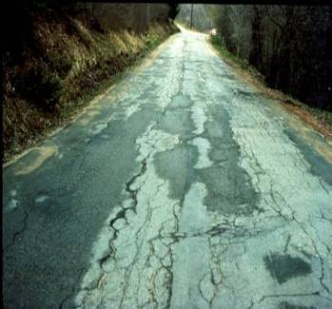

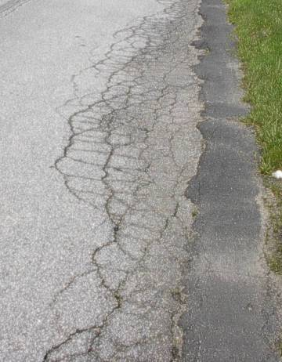
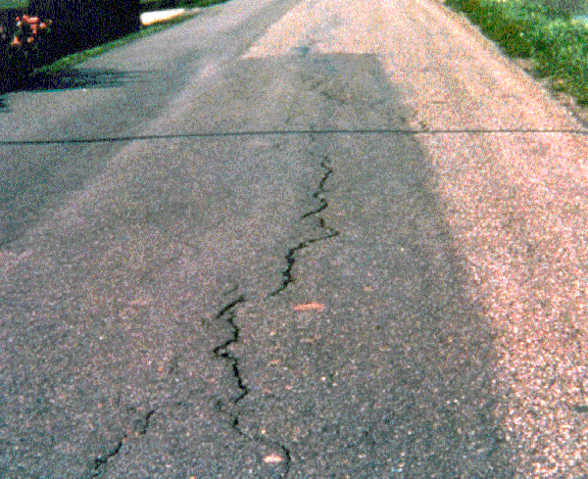
Flexible Pavement Failure
Fatigue cracking
Rutting, Shoving/ structural
Longitudinal / settlement
Edge break/ haunching

Slide 7
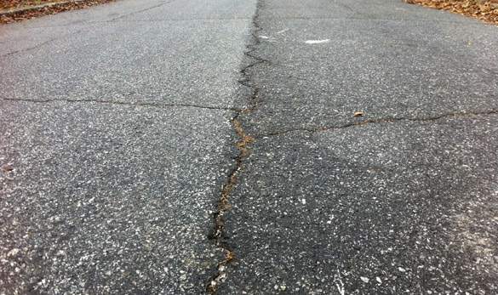
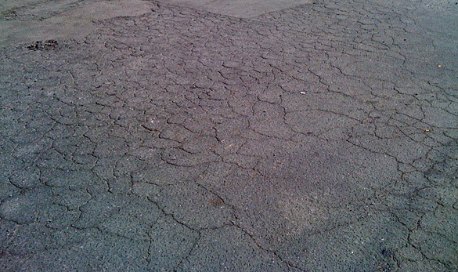
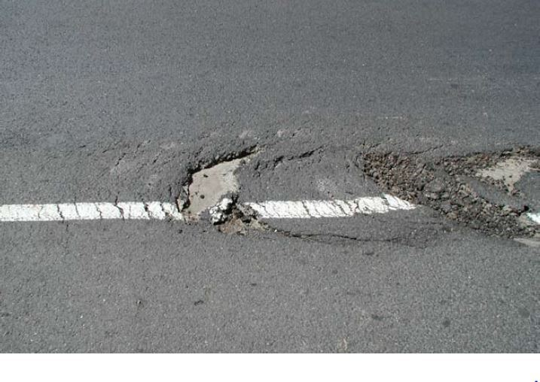
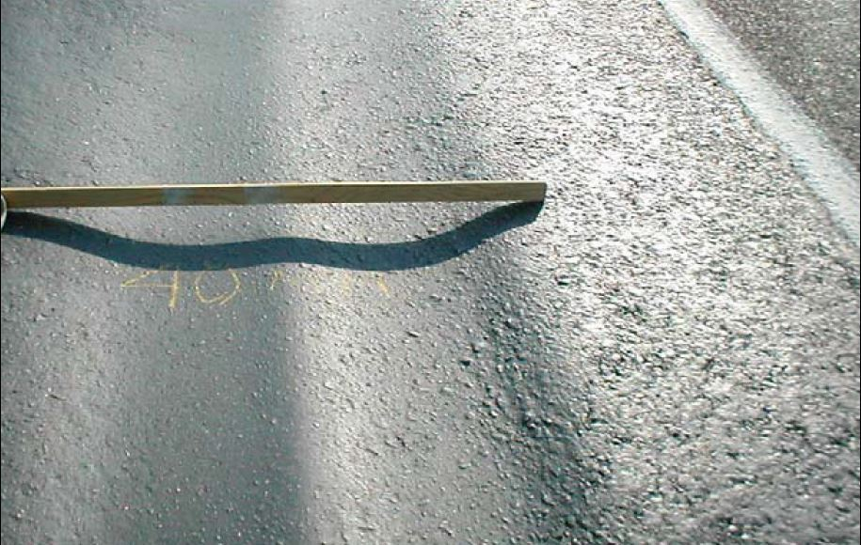
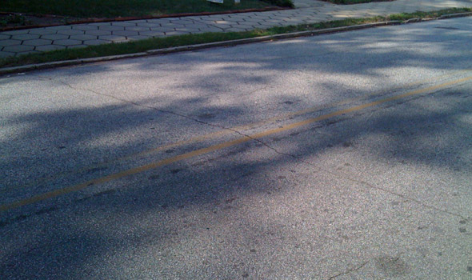
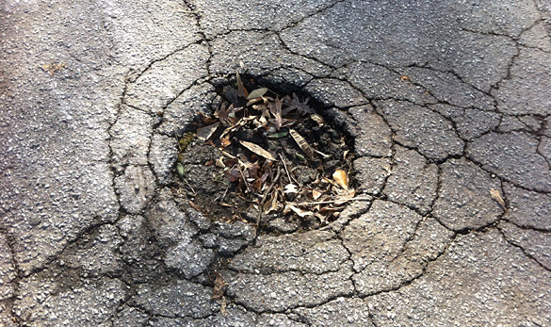
Failures in Flexible Pavements
Different types of failure encountered in flexible pavements are as follow.
Rutting
Fatigue cracking
Pot Holes
Longitudinal cracking
Transverse Cracking
Slippage cracking

Slide 8
GEOSYNTHETIC
SOLUTION

Slide 9
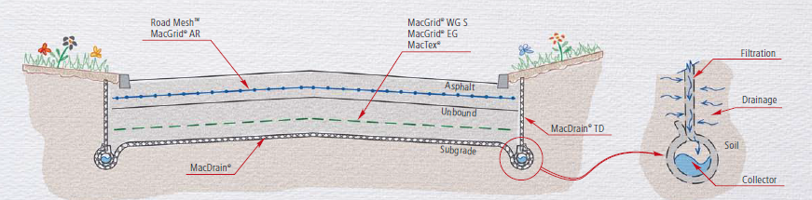
Geosynthetics for pavements

Slide 10
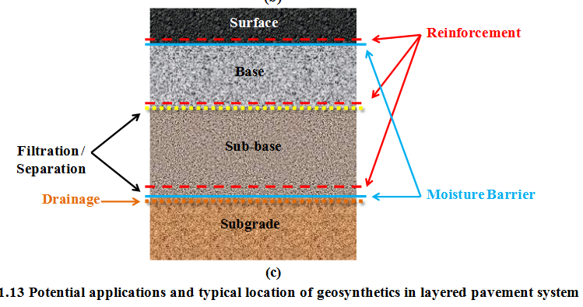
Geosynthetics for pavements
SEPARATION: to prevent the intrusion of fines from the subgrade into the base layer due to traffic loads
FILTERING: to prevent fine particles being washed from the subgrade into the base layer due to water
REINFORCEMENT: to improve the tensile strength of a pavement layer
MOISTURE BARRIER: to abate water infiltration to the underneath pavement layers
STRESS RELIEF: to allow for larger deformations in the interlayer by dissipating the energy
6. Drainage: to enhance the drainage of graded aggregate layers

Slide 11
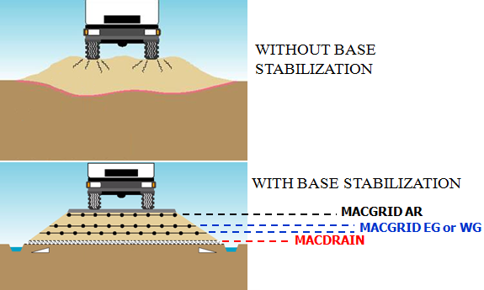
Geosynthetics For Pavements
RoadMesh / Paving Fabric / Glassgrid: Reinforcement of surface course (asphalt layer) / bearing course
Biaxial Extruded geogrid / Woven Geogrid : reinforcement of granular layer (i.e. Base course and Sub-base course)
Drainage Composite : For drainage and / or filter/separator
GLASSGRID/ROADMESH
Extruded /Woven Geogrid
Drainage Composite

Slide 12
Geogrids in Pavement
ASPHALT REINFORCEMENT
When a geosynthetic is placed as a tensile element within the BOUND layer, to increase the service life of the pavement by preventing fatigue and reflective cracks
BASE AND SUBBASE STABILISATION
When a geosynthetic is placed as a tensile element at the bottom or within a flexible UNBOUND base (or sub-base) course to eventually increase resilient modulus of unbound layer & bearing capacity of the subgrade thus having:
(i) improvement of the service life;
(ii) an equivalent performance with a reduced structural section;
BASAL REINFORCEMENT
The reinforcement is used at the embankment-subgrade interface to enhance the resistance of the embankment to avoid failure through excessive deformation or shear in the foundation

Slide 13
ASPHALT REINFORCEMENT
Bound layers
SOIL STABILISATION
Unbound layers
BASAL REINFORCEMENT

Slide 14
BASE and SUBASE
STABILIZATION

Slide 15
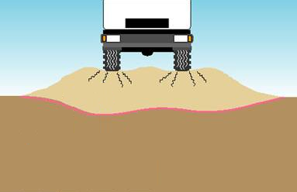
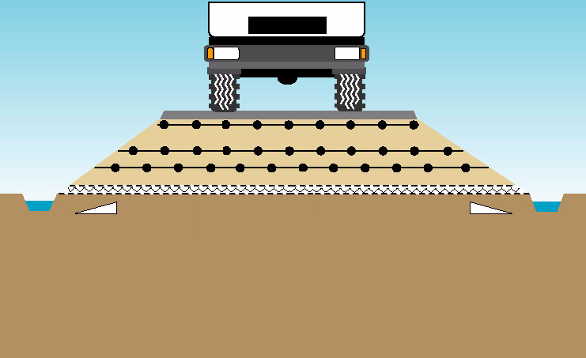
Base and Subbase Stabilization
WITHOUT BASE STABILIZATION
WITH BASE STABILIZATION
Geogrid

Slide 16
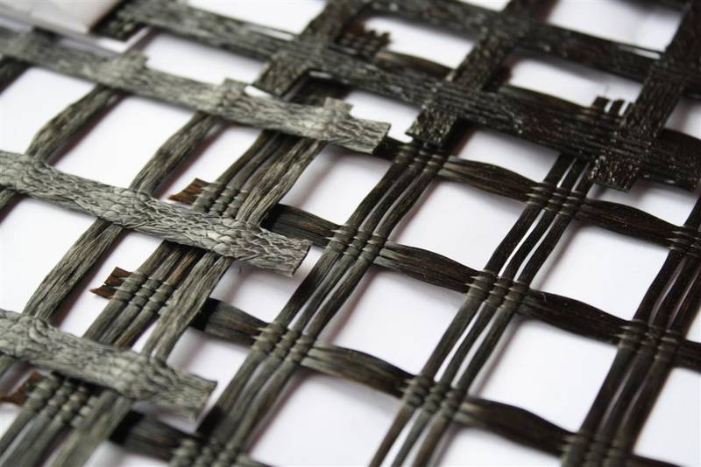
Geogrids in Pavement
Geogrids are widely used in developed countries in pavement structures to improve performance or reduce thickness of pavement.

Slide 17
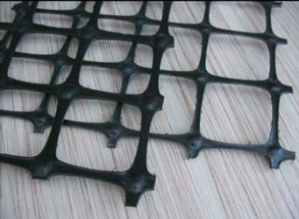
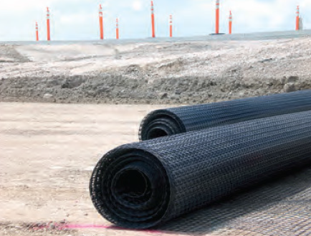
Solution Components
Extruded Geogrid i.e. MacGrid EG
Extruded geogrids are polypropylene geogrids produced by an extrusion process characterized by a tensile resistance both in the longitudinal and cross direction
It exhibits high modulus and high strength at low elongations providing tensile reinforcement to soil and aggregate structures

Slide 18
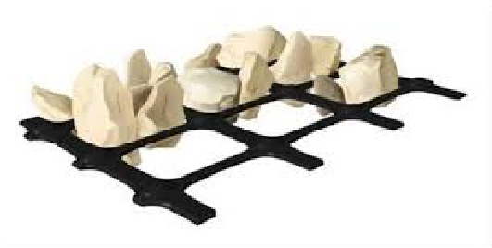
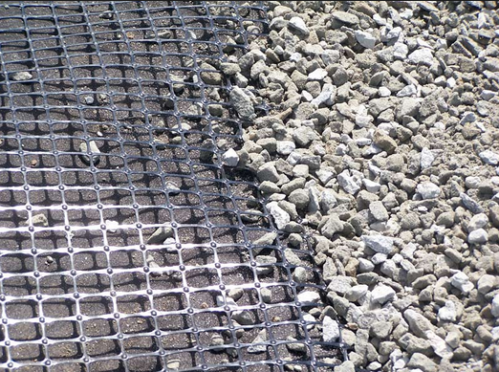
Solution Components
Extruded Geogrid i.e. MacGrid EG
The high tensile strength and junction efficiency of biaxial geogrids
confines and restrains aggregate from lateral movement, ensuring proper
distribution of imposed stresses and ultimately extending the service life

Slide 19
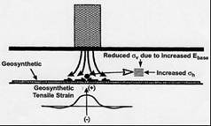
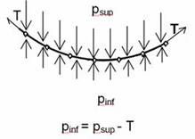
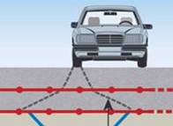
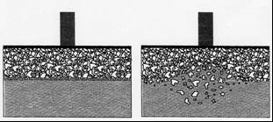
Reinforcing the Base and Subbase With Geogrid
Mechanism
1- lateral confinement;
2- load distribution;
3- tensioned membrane effect;
4- separation effect (GT)

Slide 20
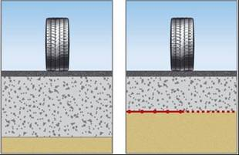
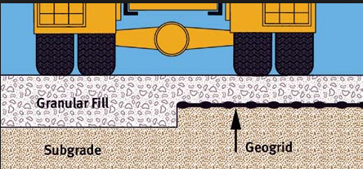
Benefits of Base and Subbase stabilization
Thickness reduction at equal values of c, φ, N;
Base course reduction (BCR)
percent reduction in the reinforced base, or subbase thickness from the unreinforced thickness, with the same material constituents, to reach the same defined failure state

Slide 21
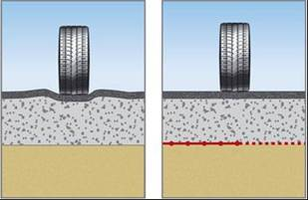
Benefits of base and subbase stabilization
Lifetime increase at equal values of h, c, φ;
Traffic benefit ratio (TBR)
ratio of the number of load cycles on reinforced section to the number of load cycles on an unreinforced section, with same geometry and material constituents, to reach the same defined failure state.
TBR is sometimes termed
traffic improvement factor (TIF)

Slide 22
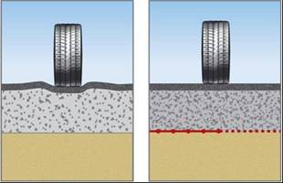
Benefits of base and subbase stabilisation
Reduce the quality of fill at equal values of N, h
Reduces the requirement for good quality
virgin unbound aggregate
Geogrid improves the mechanical properties
i.e modulus and bearing capacity of local low quality/marginal aggregates

Slide 23

Design Methodology of Geogrid Reinforced Pavement
Reinforced Section of Pavement
W.C.
BINDER
BASE
SUBBASE
SUBGRADE
Geogrid
Geogrid

Slide 24
Design Methodology of Geogrid Reinforced Pavement
Despite many successful projects and research it is recognized that the use of geogrid reinforcement in paved roadways is relatively limited compared to other geosynthetics applications.
Major reasons for limited used of geogrids in base reinforcement applications
Geogrids (and geosynthetics in general) are perceived as special materials that are considered only if problem areas need to be fixed (Gabr et al., 2006).
Existing numerical models for pavement design without geosynthetics are complicated and perception is that inclusion of geosynthetics will complicate further.
Ref. Berg et al. (2000), Perkins et al. (2005c), and Gabr et al. (2006)

Slide 25
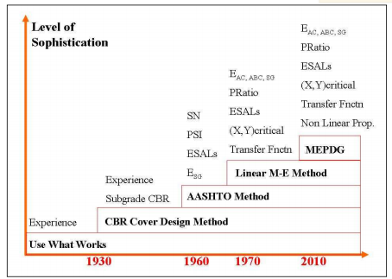
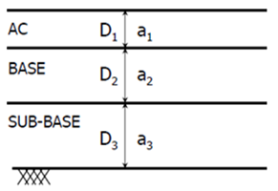
Existing design methods-AASHTO 1993
Empirical
Limiting shear failure
Limiting deflection
Regression methods,
Mechanistic-Empirical
W₁₈ = predicted number of 80 kN (18 kips) ESALs
Z_{R} = standard normal deviate (example: ZR = -1.645 for 95 % reliability)
S_{o} = combined standard error of the traffic prediction and performance
prediction
SN = Structural Number (an index that is indicative of the
total pavement thickness required) [inches]
= a₁D₁ + a₂D₂m₂ + a₃D₃m₃+...
ai = ith layer coefficient
Di = ith layer thickness (inches)
mi = ith layer drainage coefficient
ΔPSI = difference between the initial design serviceability index, P_{o}, and the
design terminal serviceability index, P_{t}
M_{R} = Subgrade resilient modulus (in psi)

Slide 26
Design Methodology of Geogrid Reinforced Pavement
AASHTO method for reinforced roads
The structural contribution of a geogrid can be quantified by the increase in the layer coefficient of the aggregate base and subbase course.
SN Equation now becomes:
SN = a₁d₁ + LCR₁ a₂d₂M₂ + LCR₂ a₃d₃M₃
Where:
LCR = Layer Coefficient Ratio
SN: Structural Number
a1, a2, a3,... – ith layer coefficient
d1, d2, d3.... –ith layer thickness
M2, M3....-ith layer drainage coefficient
26

Slide 27
Geogrid reinforced pavements
How to incorporate Geogrid properties in Pavement
Complexity of layered pavement system and loading conditions- simple design method for incorporating Geogrid reinforcement
Series of performance tests to evaluate contribution of geogrid to derive design parameters & incorporating into a design methodology.
Early design approaches to be modified to reflect the benefit achieved by the addition of geogrid by a pavement reinforcement design term Viz., LCR.
LCR — Layer Coefficient Ratio: A modifier applied to the layer coefficient of the aggregate.
W.C.
BINDER
BASE
SUBBASE
SUBGRADE
Geogrid
Geogrid
27

Slide 28
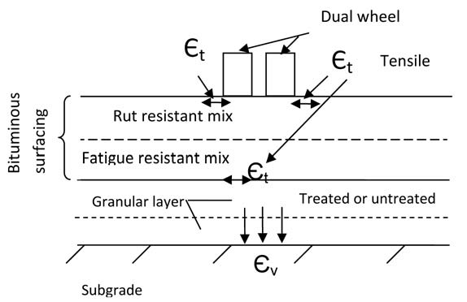
Design method - IRC 37 (2012)
CRITICAL PARAMETERS FOR PAVEMENT DESIGN
Tensile strain, Єt, at the bottom of the bituminous layer and
The vertical subgrade strain, Єv, on the top of the subgrade
to limit cracking and rutting in the bituminous layers and non-bituminous layers respectively.

Slide 29
Design method - IRC 37 (2012)
Fatigue Model (Bottom up cracking)
N_{f} = 2.21 * 10⁻⁰⁴ x [1/ε_{t}]^{3.89} * [1/M_{R}]^{0.854}
(80 per cent reliability)
N_{f} = 0.711 * 10⁻⁰⁴ x [1/ε_{t}]^{3.89} * [1/M_{R}]^{0.854}
(90 per cent reliability)
Where,
N_{f} = fatigue life in number of standard axles,
ε_{t} = Maximum Tensile strain at the bottom of the bituminous layer, and
M_{R} = resilient modulus of the bituminous layer.
Rutting model
N = 4.1656 x 10⁻⁰⁸ [1/ε_{v}] ^{4.5337}
(80 per cent reliability)
N = 1.41x 10⁻⁸x [1/ε_{v}] ^{4.5337}
(90 per cent reliability)
Where,
N = Number of cumulative standard axles, and
ε_{v} = Vertical strain in the subgrade

Slide 30
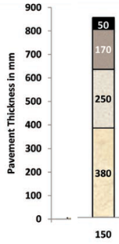
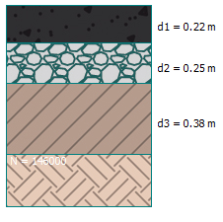
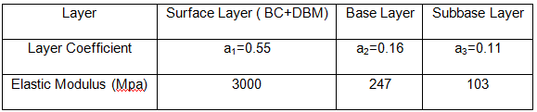
Design example
Unreinforced Section as per IRC 37 & AASHTO 1993
Design Considerations
Design Traffic load – 150msa
Reliability Factor - 90%
Design life – 20 years
Design Subgrade CBR 3%
PSI- 1.7
Drainage Coefficients m₂=m₃=1

Slide 31
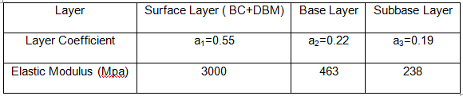
Design example
Considering Maccaferri extruded geogrids MacGrid EG40S in both base and subbase. LCR for base and subbase are 1.40 and 1.73 respectively
Reinforced layer coefficients and Corresponding Elastic modulus

Slide 32
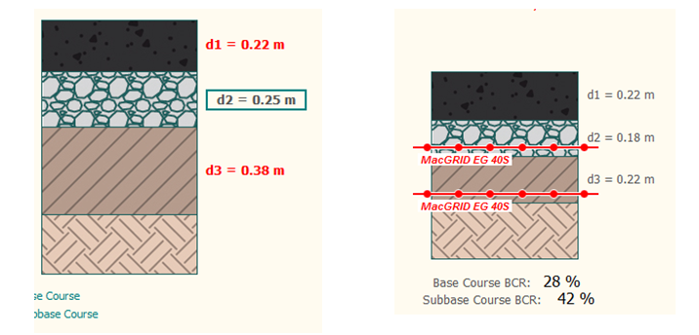
Design example
By using modified layer coefficients in eqn SN we get Reinforced section thickness
By putting the above obtained thickness,In IITPAVE with improved Elastic modulus values,
we get N_{F} and N_{R} to determine the fatigue and rutting resistance of reinforced pavement.
Maximum tensile strain at bottom of surface layer= 86 micro strains
Corresponding N_{F}= 180 MSA >150MSA
Maximum compressive strain at top of subgrade = 291 micro strains
Corresponding N_{R} = 209 MSA >150MSA

Slide 33
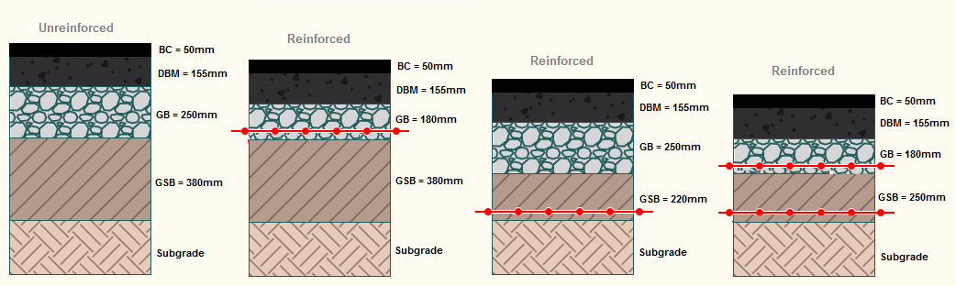
Another Example
Designed pavement section thickness Subgrade CBR is 3% and number of traffic passes during the design life of the pavement is 100 msa. Reinforcement MacGrid EG 40S
Pavement Layer | IRC 37 | Rates | Modified AASTHO
 | Unreinforced | Per cum | Reinforced in Base | Reinforced in Sub-base | Reinforced in both layers
BC (mm) | 50 | 10370 | 50 | 50 | 50
DBM (mm) | 155 | 9950 | 155 | 155 | 155
GB (mm) | 250 | 3500 | 180 | 250 | 180
GSB (mm) | 380 | 3000 | 380 | 220 | 220
Total Thickness (mm) | 835 |  | 765 | 675 | 605
% reduction in thickness |  |  | 8% | 19% | 27.5%
Cost per linear meter | 4075 |  | 3980 | 3745 | 3650
% saving |  |  | 2.3 | 8.1 | 10.4
Saving per km (Lakh) |  |  | 1 | 3.3 | 4.25
Saving for 100 km project |  |  | 1 Cr | 3.3Cr | 4.25 Cr

Slide 34
Indicated numbers are showing direct cost saving.
Indirect saving (Tangible and Non Tangible)
Reduced section require lesser material which means lower transportation cost.
Less material means faster construction compared to conventional pavement.
Less movement of construction equipment means lower maintenance cost which nobody think.
Lower movement of dumper, compactor, mixers and other equipment directly result in lower carbon emission. Environment Friendly solution.

Slide 35
HOW DO I DESIGN
PAVEMENT? DO YOU
HAVE SOFTWARE?

Slide 36
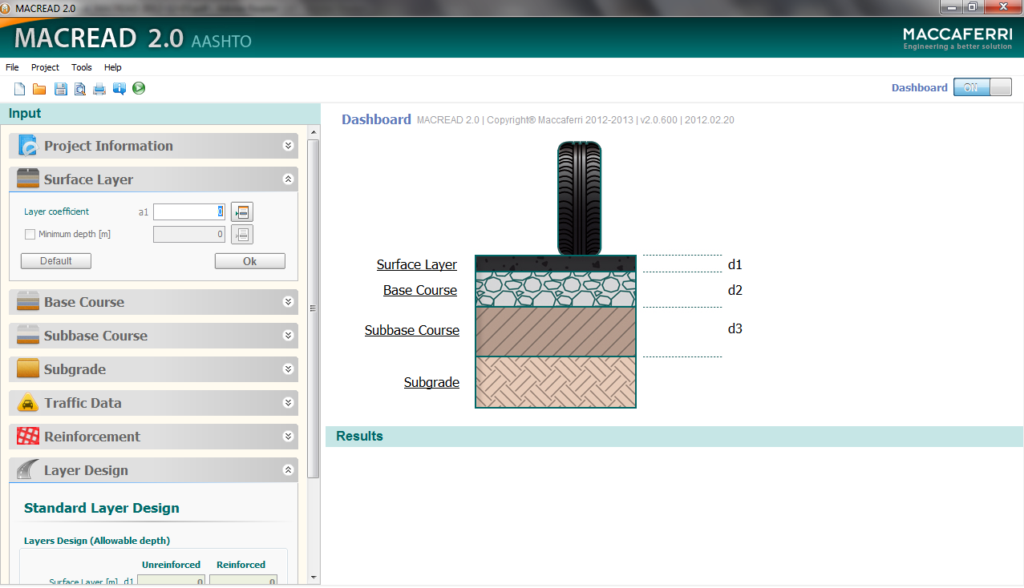

Slide 37
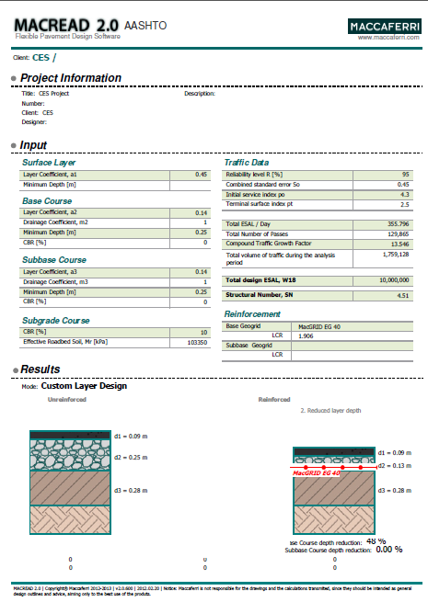
MACREAD 2.0 Software Output

Slide 38

CODAL STANDARDS AND RFERENCES
Notes:
To ensure the quality and the products are inaccordance with the codal standards

Slide 39
?
It is good solution however
My project do not have aggregates or materials as per IRC & MORTH specifications. How can geosynthetic work in this situation?
Locally available material

Slide 40
Geogrid Reinforced Pavement : Field Trial Stretch Testing
For both section i.e. for reinforced and unreinforced section, the testing has been performed
The following field test has been conducted,
Field CBR test
Cyclic plate load test
Plate Load test
Field Density test

Slide 41
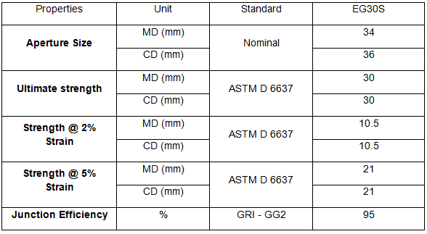
Section Components
Geogrid : Two layers of biaxial geogrid i.e. Macgrid EG one over the subgrade

Slide 42
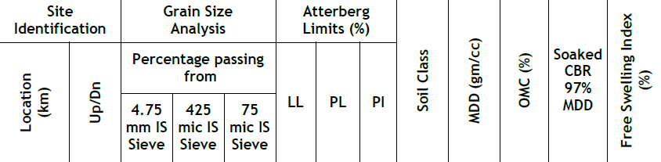
Section Components
Subgrade: Natural subgrade was reasonably uniform across the site and the same has been leveled and compacted for the trial stretch.

Slide 43
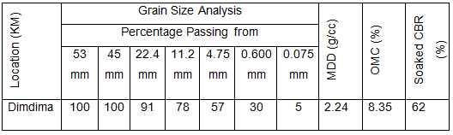
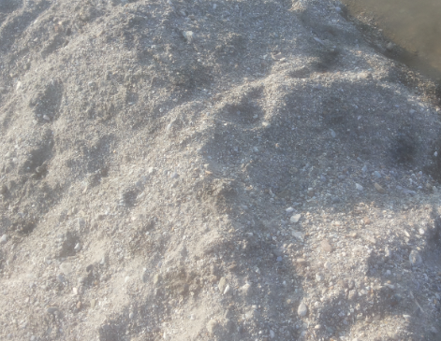
Section Components
Subbase course
Locally available material from the river Dimdima is soil chosen as the subbase course material. The source is approximately 50km from the either ends of the project corridor.
Locally available material is the low cost material available with minimum required properties and in required quantity sufficient for the whole stretch construction.

Slide 44
Subbase Course Soil Gradation

Slide 45
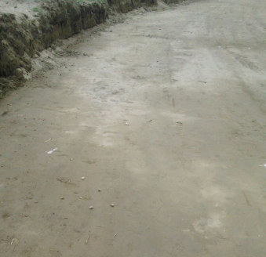
Trial Stretch Construction & Testing
Cleared, grubbed and leveled the shoulder portion
Compacted the subgrade uniformly to minimum 95% MDD at OMC
After Subgrade formation, the CBR, Density and Moisture content test has been performed
Photograph of Compacted Subgrade

Slide 46
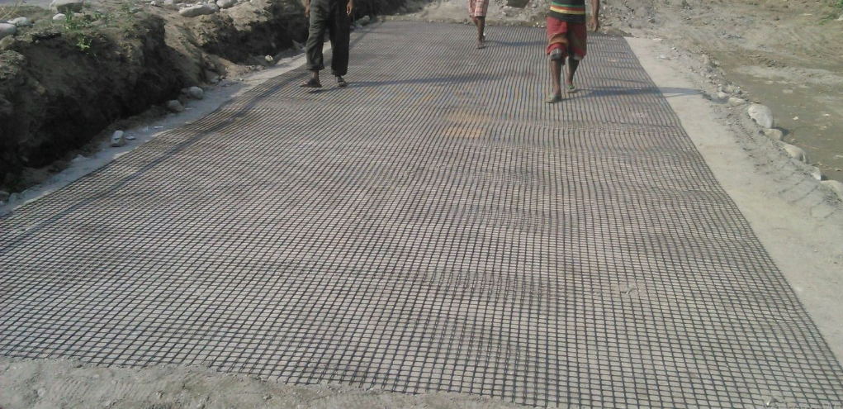
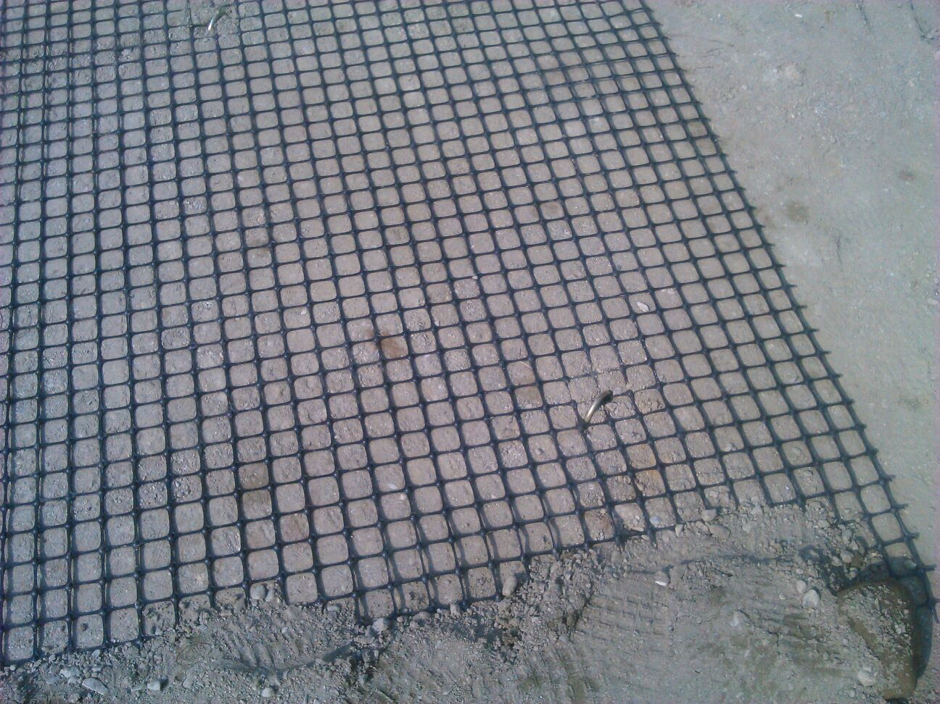
Trial Stretch Construction & Testing
On the prepared subgrade of reinforced section, MacGrid EG 30S of required length has been installed at the required level as per the design sections
As per the Installation guideline MacGrid EG has been laid over the subgrade
Photograph of Securing Geogrid with steel U pins
Photograph during Laying of Geogrid on the prepared subgrade

Slide 47
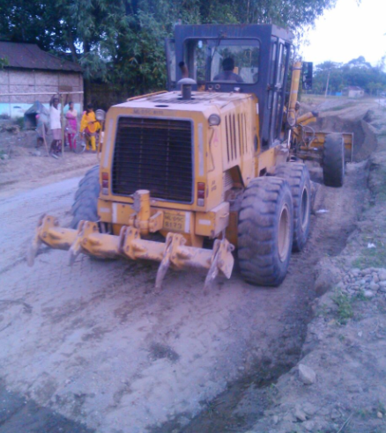
Trial Stretch Construction & Testing
Laid the subbase course soil in uniform layers with grader on prepared surface and compacted each layer not more than of 150 mm thickness with smooth wheel roller.
On prepared subbase layer the CBR, density and moisture content test has been performed
Photograph of Laying, Spreading using grader for preparation of Subbase

Slide 48
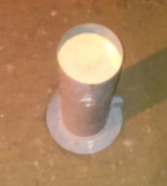
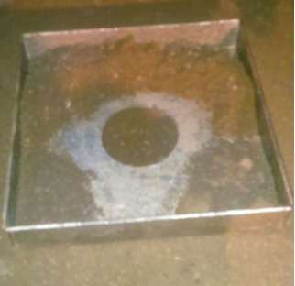
Field Density:
Field density has been performed by using sand replacement method as per the code IS IS 2720-28 (1974): Methods of test for soils, Part 28: Determination of dry density of soils in-place, by the sand replacement method.
Field density has been checked for every compacted layer for ensuring the compaction of minimum 95% MDD
Minimum three tests were performed at different locations on the prepared surface

Slide 49
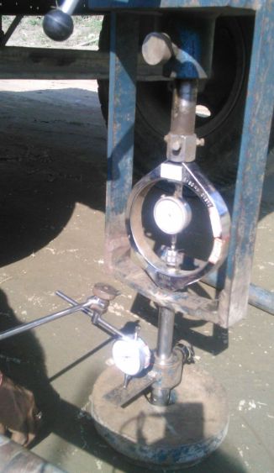
Field CBR Test
Field Tests Performed
Field CBR was performed as per IS 2720 (Part 31): 1990: Methods of tests for soils, part 31, Field determination of California Bearing Ratio.
Field CBR test is performed on the prepared subgrade and subbase for both reinforced and unreinforced Sections
Minimum three CBR tests were conducted on prepared surfaces

Slide 50
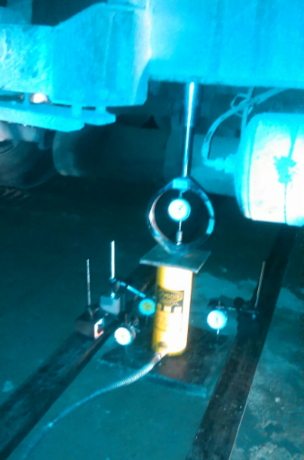
Field Tests Performed
Plate Load test
Plate load test was performed as per IS 9214 (1979): Method of determination of modulus of subgrade reaction (K-Value) of soils in field
Plate load test has been performed on the prepared subgrade and subbase of both reinforced and unreinforced sections
On each layer minimum one plate load test has been performed to understand the modulus of soil reaction of the respective layer.
In this trial test , square plate of 30cm X 30cm size has been used

Slide 51
Field Tests Performed
Cyclic Plate load test:
Cyclic plate load test was performed as per IS 5249 (1992): Determination of dynamic properties of soil - Method of test
Cyclic plate load test was performed on the prepared subgrade and subbase of both reinforced and unreinforced sections.
On each layer minimum one cyclic plate load test was conducted for understanding the settlements corresponding to no. of cycles repeated for reinforced and unreinforced sections.

Slide 52

Summary of Test Results
Field Density Test
Field density and moisture content on each compacted layer has been tested and the average density and moisture content are as shown in the table below.

Slide 53

Summary of Test Results
Field California Bearing Ratio Test Results (CBR Test Results)
Above table clearly indicates that CBR of reinforced section is higher than unreinforced section.
Improvement of 78.7% in CBR is observed for reinforced section which confirms the positive benefit of using extruded biaxial geogrid in the pavement section

Slide 54

Summary of Test Results
CBR and soil modulus E (in MPA) are linked by the relationship used in AASHTO 1993 guidelines:
M_{r} = 17.6 (CBR)^{0.64} (MPa)
Hence we get the following values
Modulus improvement of subbase is 45%
Above table clearly shows Geogrids shall increase the E of base and subbase.

Slide 55

Summary of Test Results
In AASHTO 1993 guidelines the layer coefficient a₃ of subbase are linked to the modulus E_{SB} subbase by the following relationships
a₃ = 0.227 log₁₀ (145 E_{sb}) – 0.839 (Page II-22)
layer coefficients a₃ (for unreinforced conditions) and a₃’ (for reinforced conditions) from above equations are
Hence this very simple field test, even without any traffic applied, confirms that geogrids are able to increase the layer coefficients of base and subbase.

Slide 56

Percentage improvement of Subbase soil reaction modulus K is 11%

Slide 57

Summary of test Results-
Cyclic Plate load test
Cyclic plate load test on Subbase course
Above graph of subbase indicates the lower settlements for unreinforced section for initial 6 repetitions and for further repetitions reinforced section has lower settlements than unreinforced section and this decrement of settlement increases with increase in number of cycles

Slide 58
Locally Available Material can used
With this solution savings can be more e.g. 20% or more
Most important progress of the project is not hampered
Environment Friendly Solution

Slide 59
ASPHALT
REINFORCEMENT

Slide 60



Asphalt Reinforcement
Reinforcement provides a lateral restraint within the asphalt that produces a threefold increase in the service life of pavements by relieving and redistributing stress concentrations

Slide 61


Without Asphalt Reinforcement
TENSION
COMPRESSION
ASPHALT LAYERS
SUBBASE
STRESS DISTRIBUTION
SUBGRADE
Notes:
61
The stress distribution of a (flexible) pavement looks in general like shown in this picture. High tensile stresses at the lower part of the bituminuous surface cause cracks which easily and rapidly grow through the upper part to the surface.

Slide 62
With Asphalt Reinforcement
TENSION
COMPRESSION
ASPHALT LAYERS
Tension taken by reinforcement
SUBBASE
SUBGRADE
STRESS DISTRIBUTION
Notes:
62
Mesh Track inhibits the initiation of cracks at the bottom of the asphalt layer by absorption of the tensile stresses by the Steel Mesh. As a consequence, the bituminuous products are no longer subject to tension and will not crack by bottom-up fatigue.

Slide 63


Asphalt Reinforcement
MacGrid AR G – Glass fibre woven geogrid
Roadmesh – Wire mesh

Slide 64

Asphalt Reinforcement
Glass grid ( Macgrid AR G) is a glass fiber geogrid with coating.
With high tensile strength and high modulus of elasticity at low elongation
designed to control reflective cracking.
Glass grids can be with geotextile backing, impregnated with bitumen to
provide crack prevention with a waterproof membrane and improved bond
between the asphalt layers.

Slide 65


Asphalt Reinforcement
Road Mesh : Unique Properties
Bi Directional Strength
Full Interlock Into Matrix
3D Open Structure
Stands clear of surface - “W” profile
Allows compaction around the wire strands
Robust
Notes:
65
So Product has Bi Directional Strength to resist the BiDirectional Loading which occurs in a pavement.
Unique Geometry allows mesh to Interlock with Aggregate, so if you core, you only see a cross section of a single strand of wire - Acting like a Piece of Agg
The 3D open structure allows the Asphalt to Lie in the Voids and Bond to the Underlying Layer.
The Product is also Able to Withstand Construction Traffic during Installation.

Slide 66
Paved roads: reinforcement of the bound layers
GS in the bound layers
For MacGrid AR and ROAD MESH it is possible to design:
A) reinforced overlays by means of OLCRACK software (Prof. Brown, Nottingham University)
B) pavement rehabilitation (for Road Mesh only) by means of a design equation (Prof. Al-Qadi, USA)
66

Slide 67
Overlay

Slide 68

Applications of Road Mesh
Road Widening Solution
When roads need to be widened, differential settlement cracks occur at the junction between the old and new pavement structures.
Road Mesh is introduced to bridge the junction to absorb the crack stresses caused by the differential settlement.
The effective interlock with the asphalt aggregate matrix ensures the optimum contribution of the Road Mesh.

Slide 69
Paved roads: reinforcement of the bound layers
ROADMESH IN OVERLAYS: Al-Qadi’s Equation
Log W_{t80} = aH_{overlay} + bE_{overlay} + cH_{HMA} + dE_{HMA} + eH_{base} + fE_{base} + gE_{subgrade}
Where:
a, b, c, d, e, f, g = regression constants
W_{t80} = total number of 80-kN single-axle load applications;
H_{overlay} = thickness of HMA overlay (mm);
E_{overlay} = modulus of resilience of HMA overlay (MPa);
H_{HMA} = thickness of existing HMA layer (mm);
E_{HMA} = modulus of resilience of existing HMA layer (MPa);
H_{base} = thickness of base layer (mm);
E_{base} = modulus of resilience of base layer (MPa);
E_{subgrade} = modulus of resilience of subgrade (MPa).
69

Slide 70





Paved roads: reinforcement of the bound layers
Maccaferri’s pavement products have been developed through an extensive program of international research.
Smart Road, Virginia Tech, USA
Full scale instrumented field trials showed Road Mesh produced a 72% decrease in strain and a fatigue life improvement of up to 120%.
Nottingham University, UK
Beam bending tests showed Road Mesh can reduce thermal cracking and extend the service life of asphalt overlays by three times. Wheel track tests showed Road Mesh can half the depth of rutting.
SMES, Italy
Cyclic loading showed Road Mesh can extend the service life of asphalt pavements by three times.
SUMMARY OF RUT RESULTS
Control
20°C
Deformation [mm]
Road Mesh
Control
13°C
Road Mesh
12kN Repetitions

Slide 71
Paved roads: reinforcement of the bound layers
ROADMESH IN OVERLAYS: OLCRACK software
71

Slide 72
Paved roads: reinforcement of the bound layers
ROADMESH IN OVERLAYS:
OLCRACK software
72

Slide 73
Road Mesh is preferred for Reinforcement of surface course as asphalt reinforcement
The Road mesh is preferred for Asphalt Reinforcement due to its unique geometry and 3D structure that allows full compaction to occur around the wire strands resulting in full interlock with the asphalt matrix.
It’s double twist avoids spreading of the damage caused by the accidental breaking of any wire or mesh.
Road Mesh also extends life of pavement
Road mesh is able to withstand construction traffic

Slide 74
Benefits of Asphalt reinforcement
Changes crack behaviour in asphalt
Delayed initiation
Slower growth
Narrower width
Wider spacing
Deviation at grid
Lateral restraint
Reduces rutting and shoving
Little effect on modulus in the short term
Cost benefit up to 35%
Overlays
Extends life x 1.4 – 1.9
Most benefit for thicker overlays (> 75mm)

Slide 75
DRAINAGE

Slide 76



Drainage- Conventional approach
Traditionally, gravel layer is provided as the draining layer
Provision of graded aggregates in the subbase course in order to effectively drain the water from the pavement structure
Provision of french drains (Trench with free drain materials)
Functions of French drains are
Collect surface water run-off
Control ground water flow
Lower the high ground water table

Slide 77
Problems associated with conventional approach
Satisfying the drainage criterion for conventional graded filter design is extremely expensive.- Non availability of required aggregates
Clogging: Ground water flows towards the drain carrying some fine particles from the base soil and consequently, the aggregates become blocked after some period having no adequate water removal capacity.
Internal erosion of the base soil
Requires considerable time for installation as it is to be installed as per gradation
Require Skilled labor
Material quantity and quality tend to differ along the length of the wall due to construction sourcing and human error issues.
Increase in carbon footprints and Pressure on natural resources

Slide 78

Alternatives?
Geosynthetics
Drainage solutions using Geocomposite Drainage

Slide 79

Drainage Geocomposite - MacDrain
Drainage geocomposites are composed of a geotextile filter surrounding either a geonet (blanket drain), a thick preformed core (panel or edge drain), or a thin preformed core (wick drain). Some applications of drainage geocomposite are blanket drains and edge drains.

Slide 80
Drainage geocomposite- MacDrain
Principles of the functions afforded by Drainage geocomposite

Slide 81



Drainage Geocomposite - MacDrain
Road Side Drain Edge Drain: using Drainage Composite
Drainage of Structures

Slide 82

Geocomposite To Replace Subsurface Drainage Layer For Pavements

Slide 83


Solutions with MacDrain
Sub-Surface Drainage
- Sub-Superficial Drainage
- MacDrain Drainage

Slide 84


Conventional Solution
Filter behind retaining wall
GSB – granular layer in pavement

Slide 85

MORTH 700

Slide 86



Drainage Geocomposite - MacDrain
Trench and Edge Drains

Slide 87
CASE STUDIES

Slide 88


Creek kalatalav sanesh road, Bhavnagar, Gujarat
Previous Site Conditions
Poor Soil properties
Low CBR value, soft soil
Critical site conditions i.e possibilities of the Water on both sides of the road
Heavy loading (Salt Industries and Sheep breaking industries nearby)

Slide 89



Creek kalatalav sanesh road, Bhavnagar, Gujarat,,

Slide 90

Creek kalatalav sanesh road, Bhavnagar, Gujarat
Solution:
High Strength Unidirectional Geogrid (ParaLink) having tensile strength 200 kN/m as basal reinforcement to improve the subgrade properties
Geotextile (MacTex) was used as separator
Extruded polypropylene biaxial geogrid (MacGrid EG) of strength 40 kN/m as reinforcing material
Drainage composite (MacDrain) was used in edge drains to drain out the surface runoff
Double twist mesh with longitudinal shooting bars (Road Mesh) was provided which can effectively prevent fatigue cracking, surface rutting etc.

Slide 91








Creek kalatalav sanesh road, Bhavnagar, Gujarat

Slide 92
Inference from this case study
Paved roads can be constructed on soft soil have very low CBR
On soft subgrade pavement with lower thickness can be built.
Road widening problem can be dealt using geosynthetics

Slide 93

Problem:
Pavement Strengthening at Nadia - Kapadwanj - Modasa Road
Nadia-Kapadwanj- Modasa road stretch was subjected to severe problem of series of interconnected cracks.
Due to the increased traffic, the existing pavement section was not able to survive for its initial design life.
Existing pavement had cracks developed on the surface which had deteriorated further into large potholes.
Considering the pavement situations and heavy traffic loading it was required to re-strengthen the pavement by providing an overlay of suitable thickness.

Slide 94
Pavement Strengthening at Nadia - Kapadwanj - Modasa Road
Current pavement was needed to be repaired by placing an asphalt layer to increase the load carrying capacity of the pavement section.
However the ability of asphalt to withstand tensile stress is limited. So there were chances of fatigue and reflective cracking in the surface course.
To avoid this type of cracking, Geosynthetic reinforcement are introduced between new overlay and the existing pavement.
For reinforcing pavement, Geogrid made of fiber glass yarns called as MacGrid AR V5 was suggested to be provided at the interface of the BUSG and BM layer.
For ensuring proper adhesion of the MacGrid to the surface, tack coat is applied over the BUSG layer before laying the MacGrid.
MacGrid AR V is a reinforcing material specially developed for pavements. It consists of glass fibre strands arranged in a grid structure and covered with a polymer coating.

Slide 95




Pavement Strengthening at Nadia - Kapadwanj - Modasa Road

Slide 96

ROADMESH
Road Mesh installation was done in the year 2000, on the
pilot scale, for Pavement Stabilization at Ambala, Punjab.

Slide 97

Construction of Unpaved Road, Haldia, West Bengal,

Slide 98






Construction of Unpaved Road, Haldia, West Bengal,
Present Status of the Project The Project was successfully completed in 2010 and working successfully for intended purpose.
Laying MacGrid WG4S
Laying brickbat and aggregate over geogrid
(MacGrid)
Unrolling Geotextile (MacTex)
Sand Filling
Completed Road
Completed Road after one year

Slide 99


Existing masonry retaining wall
Placing of the MacDrain
Six Laning Of Gurgaon-kotputli-jaipur Section Of Nh-8

Slide 100


Seepage from the weep holes
MacDrain checked after the test

Slide 101

Four laning of Hyderabad –Karimnagar-Ramakundam Road
The backfill material used was fly ash.
As per MORTH requirement, 600 mm thick graded gravel filter is provided behind the panels.
This 600 mm thick gravel graded filter is replaced with MacDrain as shown in the figure.

Slide 102

Installed MacDrain and simultaneous backfilling process

Slide 103


RECAP
RE-CAP…

Slide 104
Recap
ASPHALT REINFORCEMENT
Applicable new roads
Resurfacing of roads
RoadMesh & Glassgrid (Better performance)
BASE AND SUBBASE STABILISATION
Applicable new roads
Repair of road which include base or subbase stabilization
Use of locally available materail
DRAINAGE
Edge Drains
Capillary Cut off

Slide 105
Summary
Use of Geosynthetics in pavements provides following benefits:
Separation/Filtration layer
Reduce vertical and lateral deformation
Increase the bearing capacity of soft soil
Allows the use of Marginal/ Recycled/ locally available materials effectively
Better drainage
Extended Serviceability of the road i.e. Traffic benefit Ratio (TBR)
Reduction in Crust thickness i.e. Base Course Reduction ( BCR)
Less periodical maintenance
Reduce construction and operational costs
Lower Carbon Footprint

Slide 106


THANK YOU
Questions are Welcome
Please contact us on
info@maccaferri-india.com
info@in.maccaferri.com
Dr. Ratnakar R. Mahajan
Deputy General Manager
Maccaferri Environmental Solutions Pvt. Ltd.
Mob:+91-9987050096
ratnwdc@maccaferri-india.com

