Slide 1
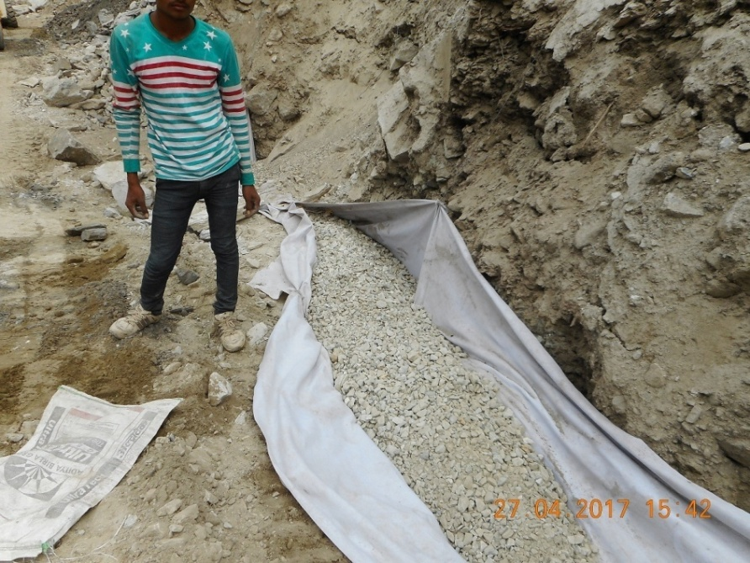
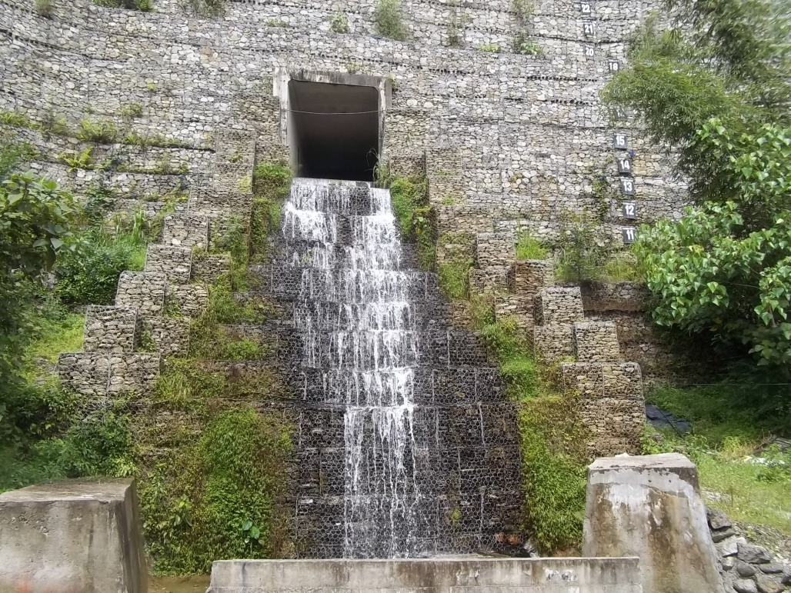
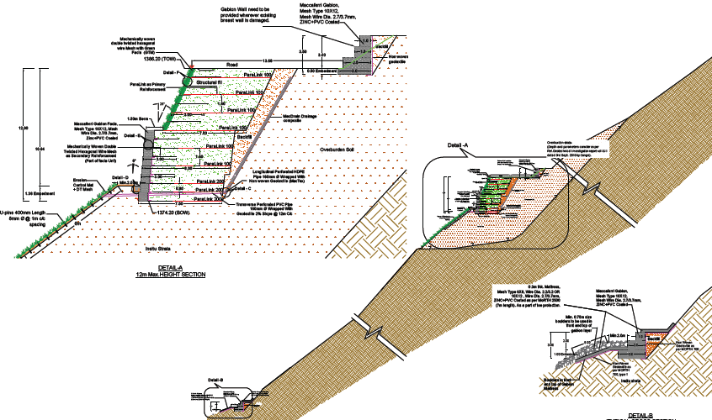
SIGNIFICANCE OF DRAINAGE MEASURES IN LANDSLIDE MITIGATION-CASE STUDIES
Dr. Ratnakar R. Mahajan
Deputy General Manager
Maccaferri Environmental Solutions Pvt. Ltd.

Slide 2
MAJOR CASUES OF LANDLSIDE
Mitigation cannot begin without investigating the various factors that triggers the landslide
Steep gradients
Sudden increase in overburden or other loads
Continuous rainfall (leading to flash floods, toe erosion near river slopes, etc.) and Glacier melting
Deforestation
Increased pore water pressure
Seismic activity
Improper Drainage

Slide 3
SYSTEMS FOR LANDLSIDE MITIGATION
Facility relocation
Complete removal of slides
Bridging
Tunneling
1. Avoid or eliminate the problem itself
Buttressing
Retaining structures
Reinforced soil slope and walls
2. Increase the resisting forces
Soil nailing
Micropiles
Anchors
Reinforcement
Slope improvement
Surface slope protection
Excavation
Light weight fill materials
Unloading
3. Reduce the driving forces
Surface drainage
Sub surface drainage
Drainage systems
Drainage measures alone may not sufficient to improve slope stability, so drainage measures are adopted in conjunction with other methods based on the site specific requirement.
Notes:
Drainage helps in landslide mitigation by reducing pore pressures within the soil, thereby increasing effective stress and shear strength; and (2) by reducing the driving forces of water pressures in cracks

Slide 4
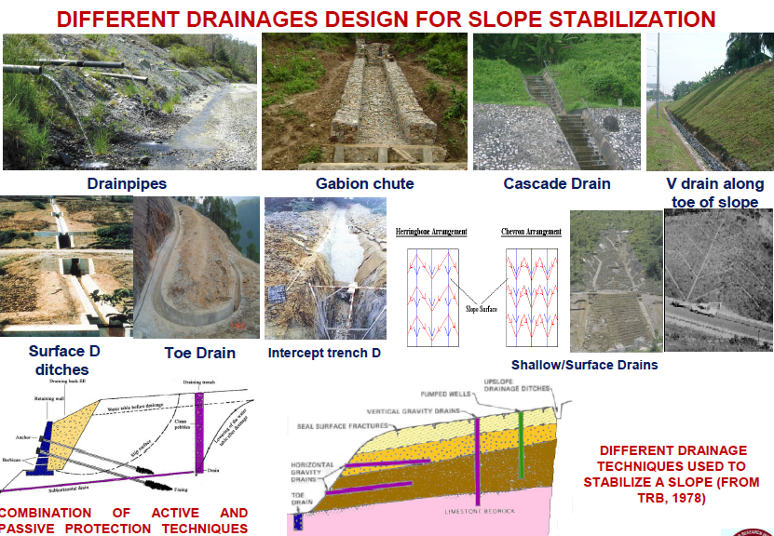
DIFFERENT DRAINAGE MEASURES
Surface drainage measures
Catch water or interceptor drains-drains provided on hill slopes to intercept water flowing from upper reaches (more or less parallel to the road)
Chute/cascade - The water entrapped in the catch water drains is so brought down
Road Side drains

Slide 5

DIFFERENT DRAINAGE MEASURES
Subsurface Drainage measures
Aims at improving slope stability by controlling pore water pressures within the slope
Horizontal drains
Cut-off drains
Drainage trenches
Drain blankets
Relief wells
Internal drains of retaining soil structures
Chimney drain/Drainage geocomposite

Slide 6
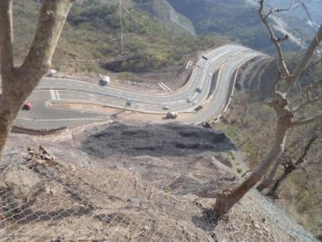
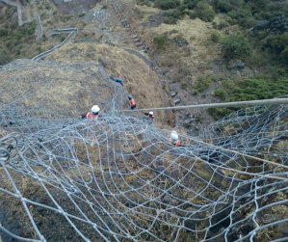
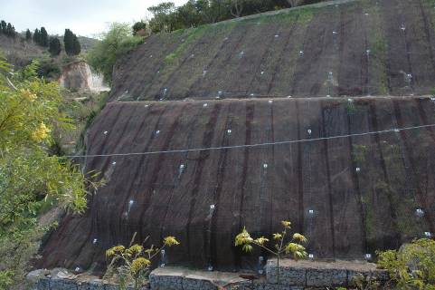
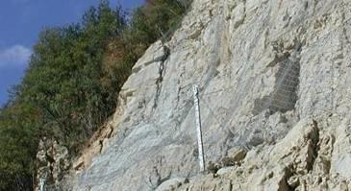

landslide case studies highlighting drainage

Slide 7
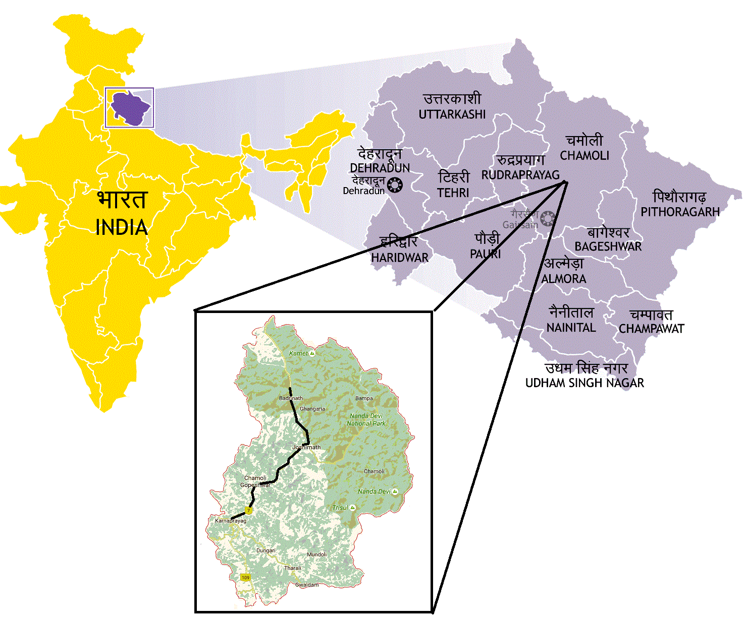
The Ministry of Road Transport & Highways
Rehabilitation/Treatment of landslide locations with slope protection and drainage improvement
Package-I include following locations:-
1.Nandprayag (200m)
2.Maithana (350m)
3.Birahi (100m)
4.Gulabkothi (125m)
Package-II include following locations:-
1.Helang (275m)
2.Govindghat-II (150m)
3.Govindghat-III (150m)

Slide 8








STAKEHOLDERS INVOLVED
CLIENT
PIU, Dehradun
DPR CONSULTANT
AUTHORITY ENGINEER
PROOF CHECKING CONSULTANT
SAFETY CONSULTANT
M/s Khanna Goyal Designers
TECHNOLOGY PARTNER
RG Buildwell Engineers Ltd

Slide 9
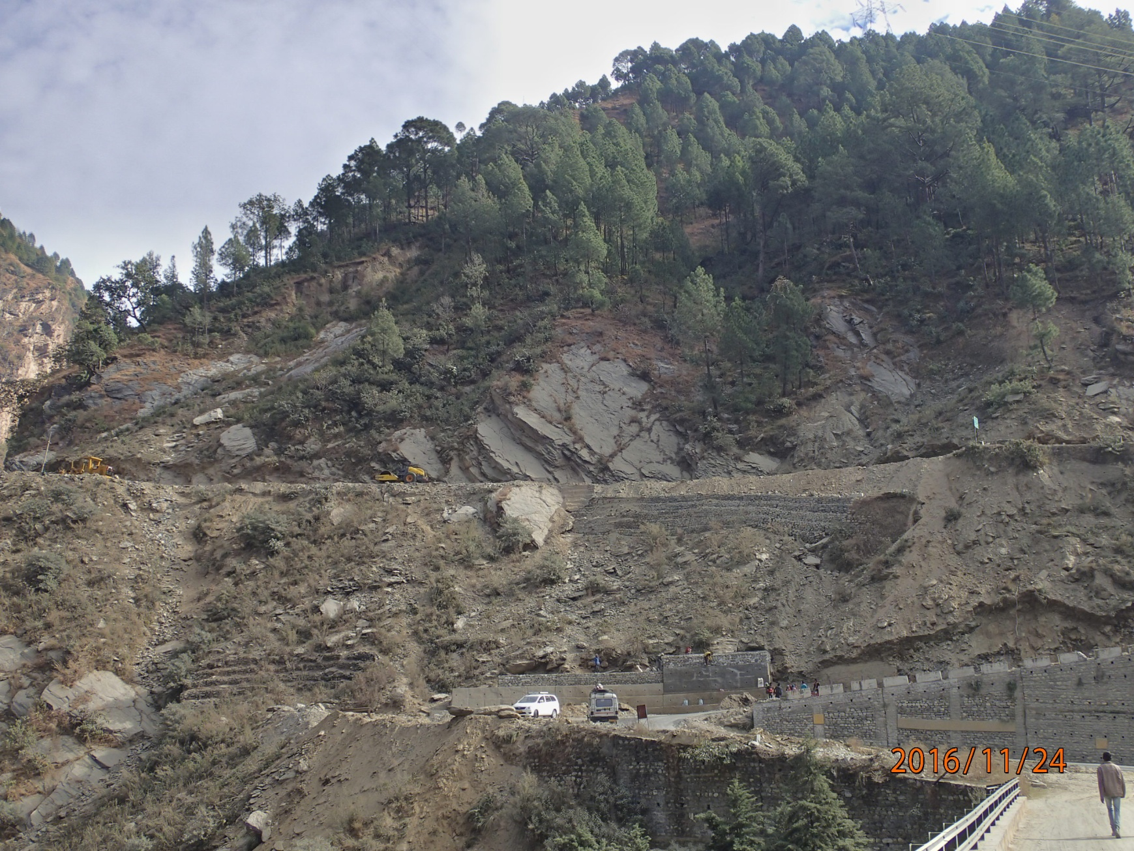
PROBLEM DESCRIPTION & CAUSATIVE FORCES
LOCATION: BIRAHI
Debris material from old slide
Surface Erosion

Slide 10
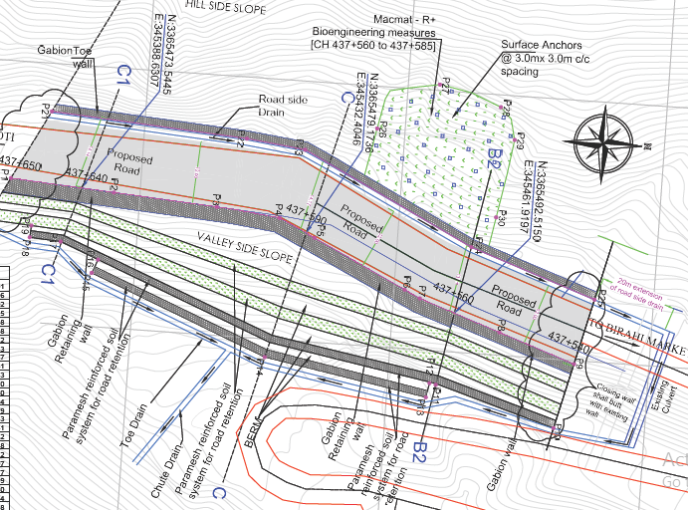
SOLUTION PROVIDED – LOCATION: BIRAHI
Bioengineering measures (Macmat R)
Surface anchors
Road side drain
Gabion wall
Toe drain
Existing culvert
Reinforced soil structure
Chute drain
Notes:
Birahi 2m * 2m

Slide 11
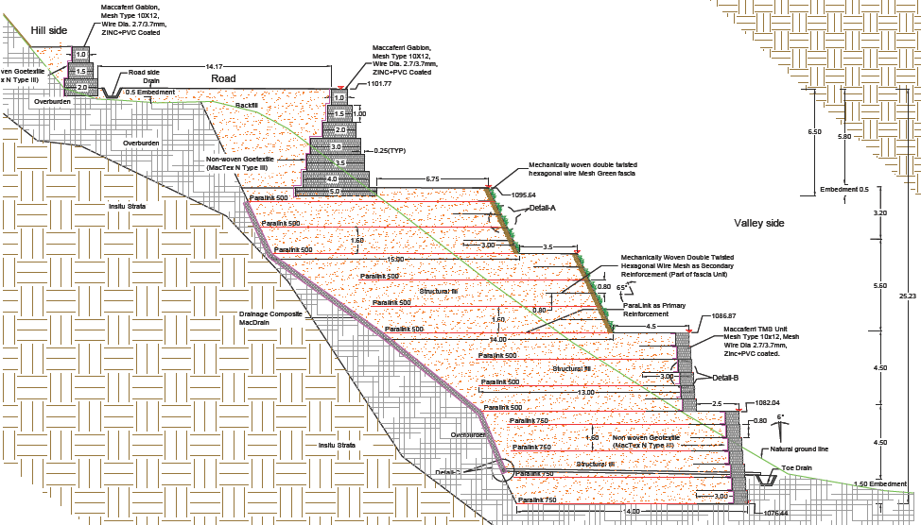
SOLUTION PROVIDED – LOCATION: BIRAHI
Road side drain
Drainage composite
Toe drain

Slide 12
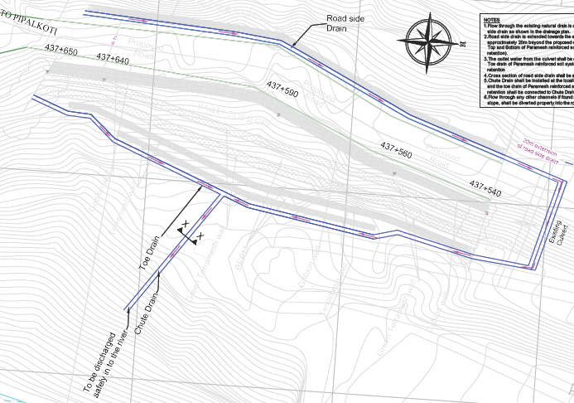
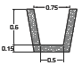

SOLUTION PROVIDED; DRAINAGE SCHEME – LOCATION:BIRAHI
Road side drain
Toe drain
Existing culvert
Chute drain

Slide 13
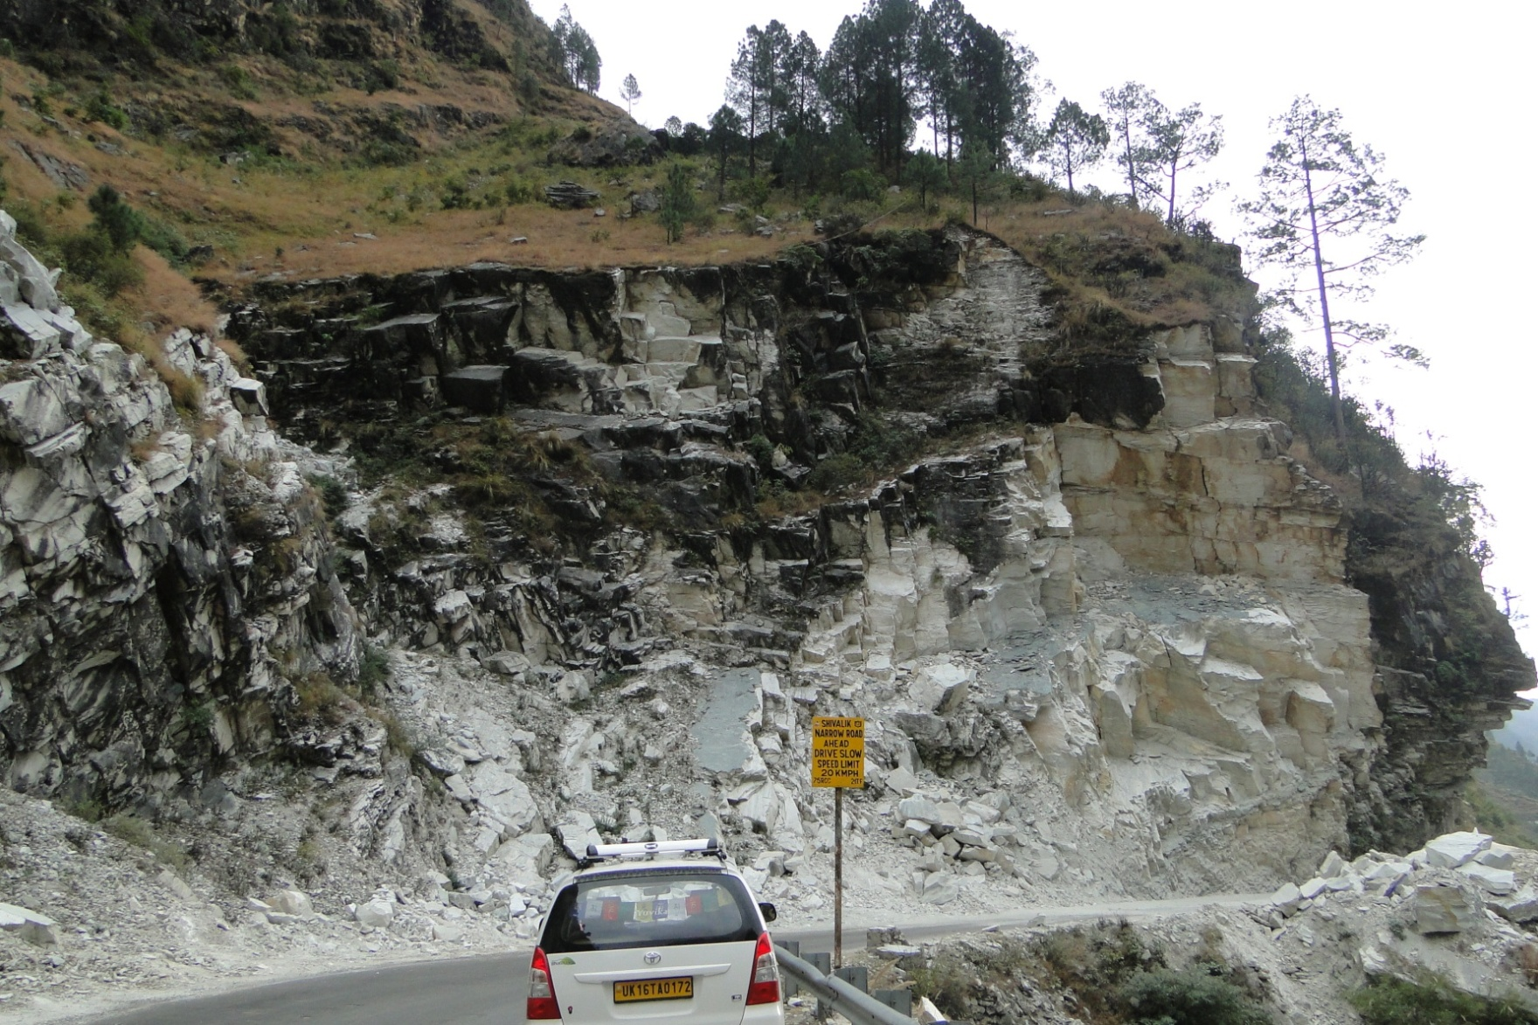
PROBLEM DESCRIPTION & CAUSATIVE FORCES
Heavy jointed rock mass with prominent weakness planes
Increase of pore water pressure in joints
LOCATION: GULABKOTI

Slide 14
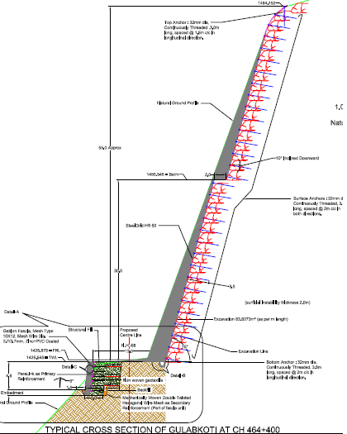
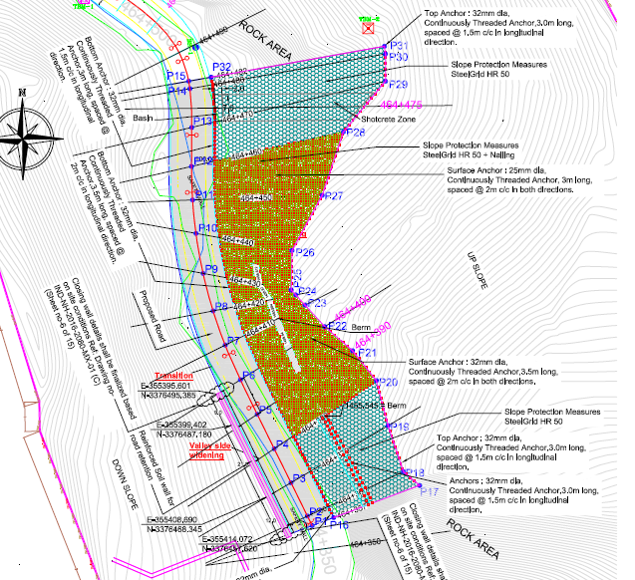
SOLUTION PROVIDED – LOCATION: GULABKOTI
Secured drapery

Slide 15
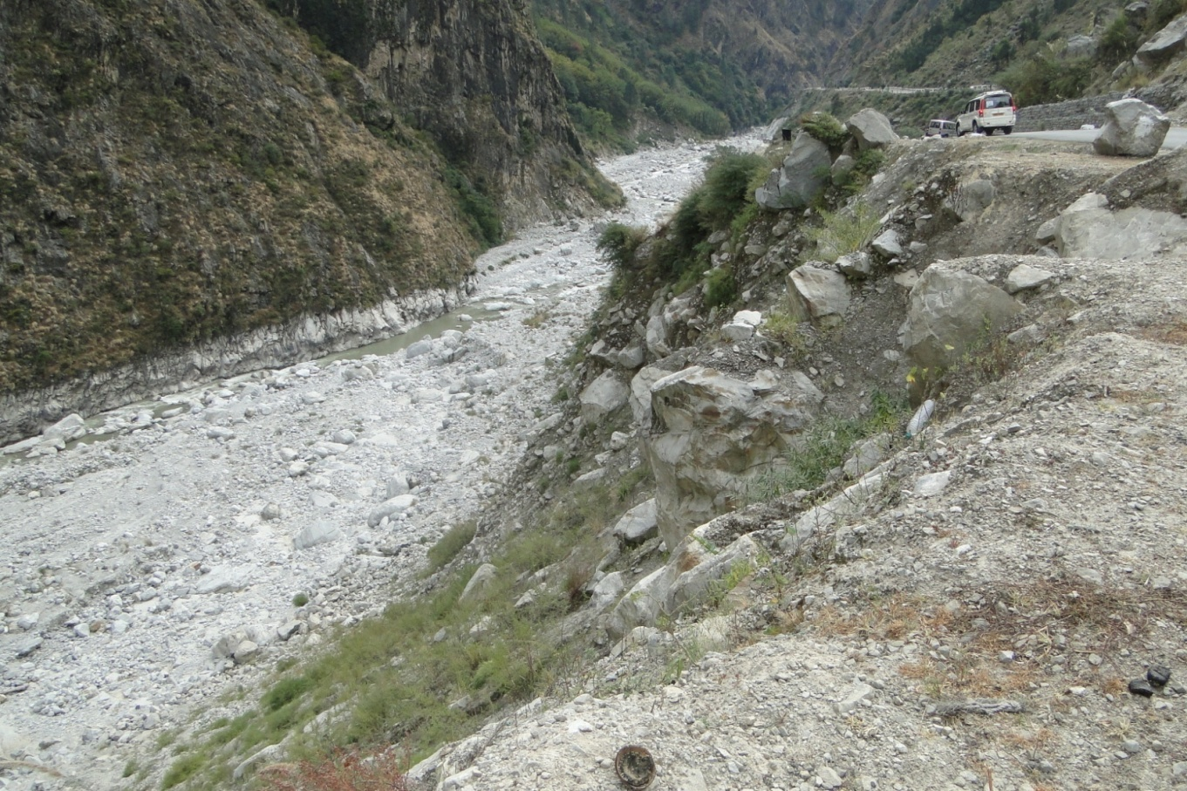
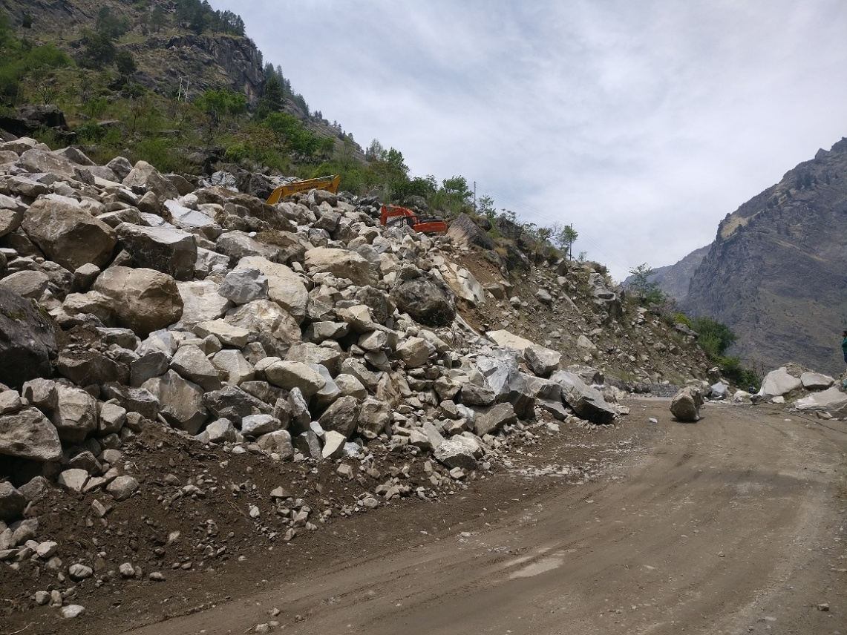
PROBLEM DESCRIPTION & CAUSATIVE FORCES
Toe erosion due to river
Steep slope
LOCATION: GOVINDGHAT II
Valley side
Hill side

Slide 16
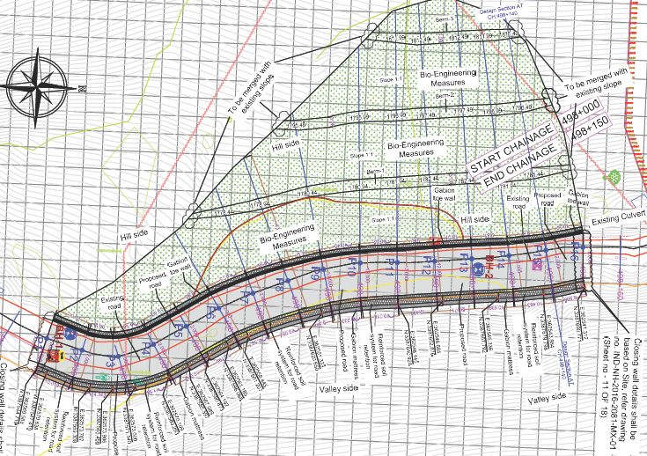
SOLUTION PROVIDED – LOCATION: GOVINDGHAT II
Catch water drain
Bioengineering measures (profile)
Existing culvert
Gabion wall
Gabion mattress
Reinforced soil structure
Road side drain

Slide 17
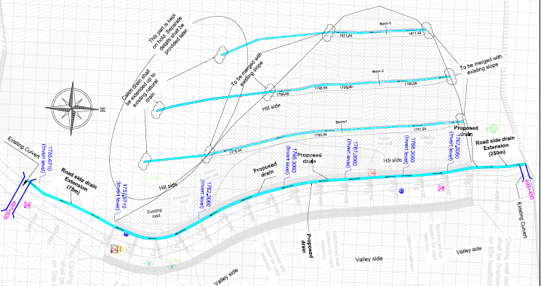
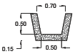

SOLUTION PROVIDED; DRAINAGE SCHEME – LOCATION: GOVINDGHAT II
Catch water drain
Existing culvert
Road side drain

Slide 18
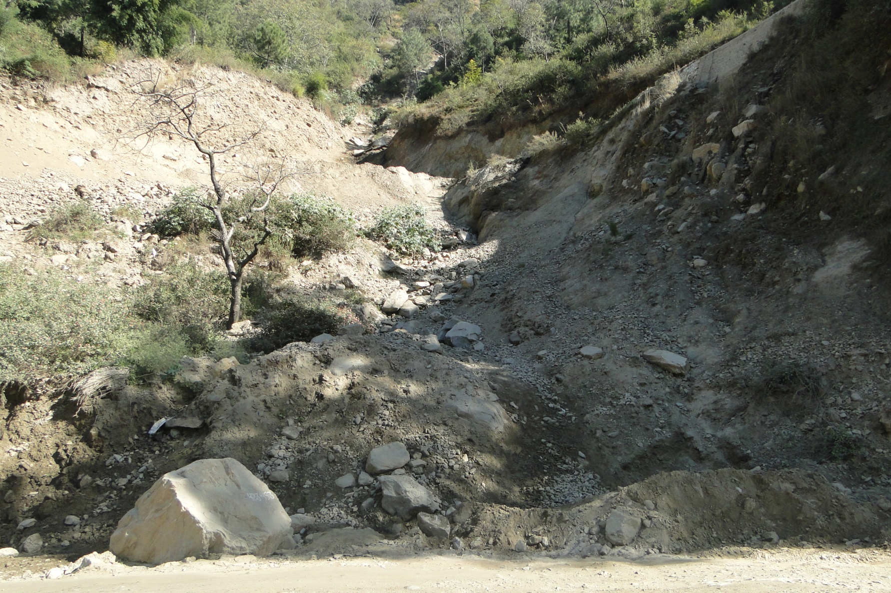
PROBLEM DESCRIPTION & CAUSATIVE FORCES
LOCATION: MAITHANA
Subsurface run off water causes removal of fines
Improper drainage
Formation of nalla
Hill side

Slide 19
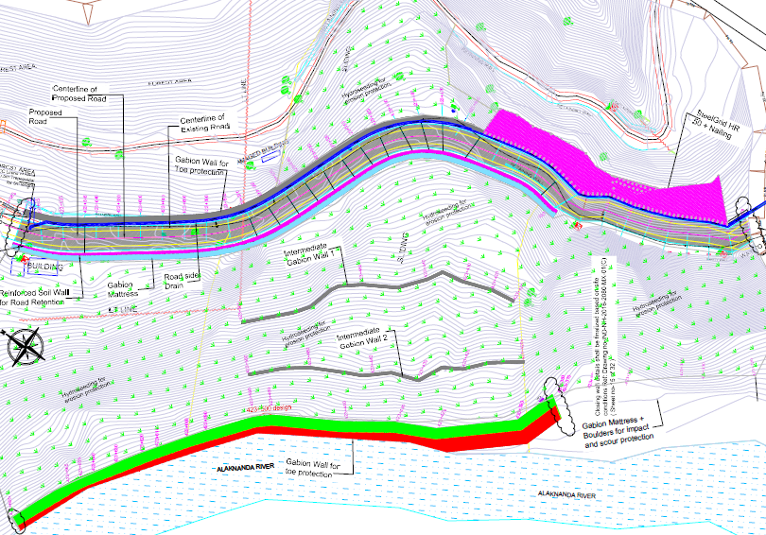
SOLUTION PROVIDED– LOCATION: MAITHANA
Self drilling anchors + Drapery
Hydroseeding
Reinforced soil wall
Gabion mattress
Gabion wall
Gabion toe wall –scour protection

Slide 20
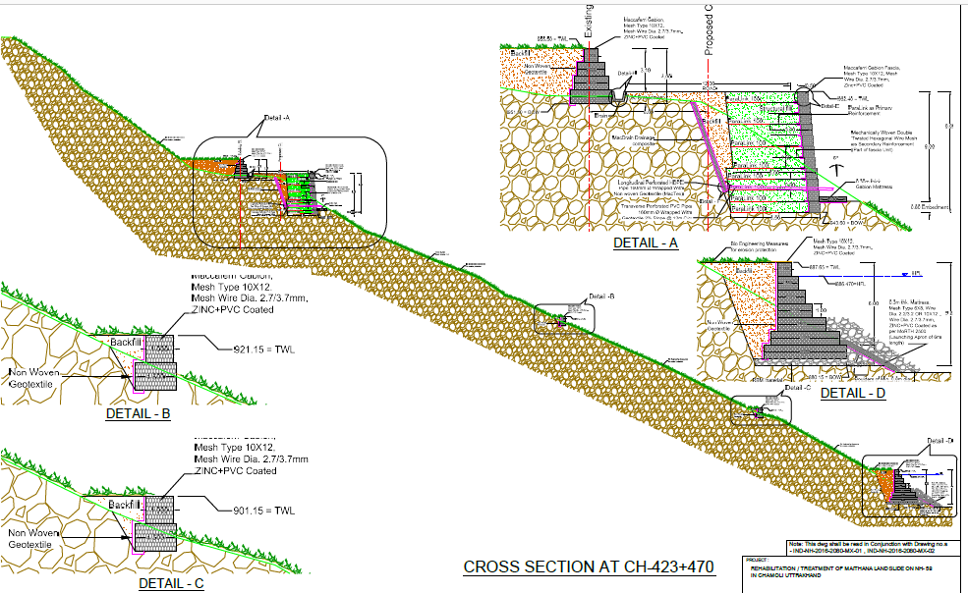
SOLUTION PROVIDED– LOCATION: MAITHANA
Hydroseeding+ SDA
Reinforced soil structure
Gabion wall

Slide 21
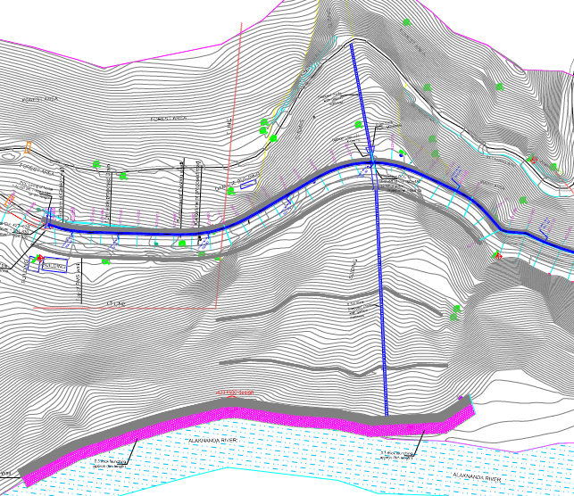
SOLUTION PROVIDED; DRAINAGE SCHEME – LOCATION: MAITHANA
Stepped chute drain
Road side Drain
Gabion Cascade
Stepped chute Drain
RCC box culvert

Slide 22
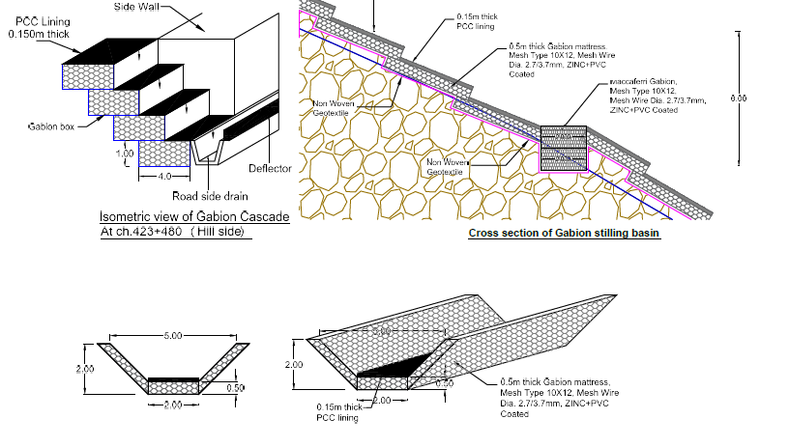
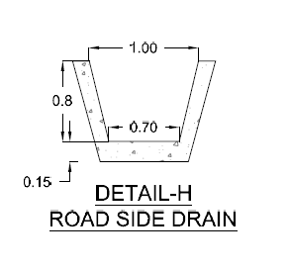

SOLUTION PROVIDED; DRAINAGE SCHEME – LOCATION: MAITHANA
Gabion Cascade
Stepped chute drain

Slide 23
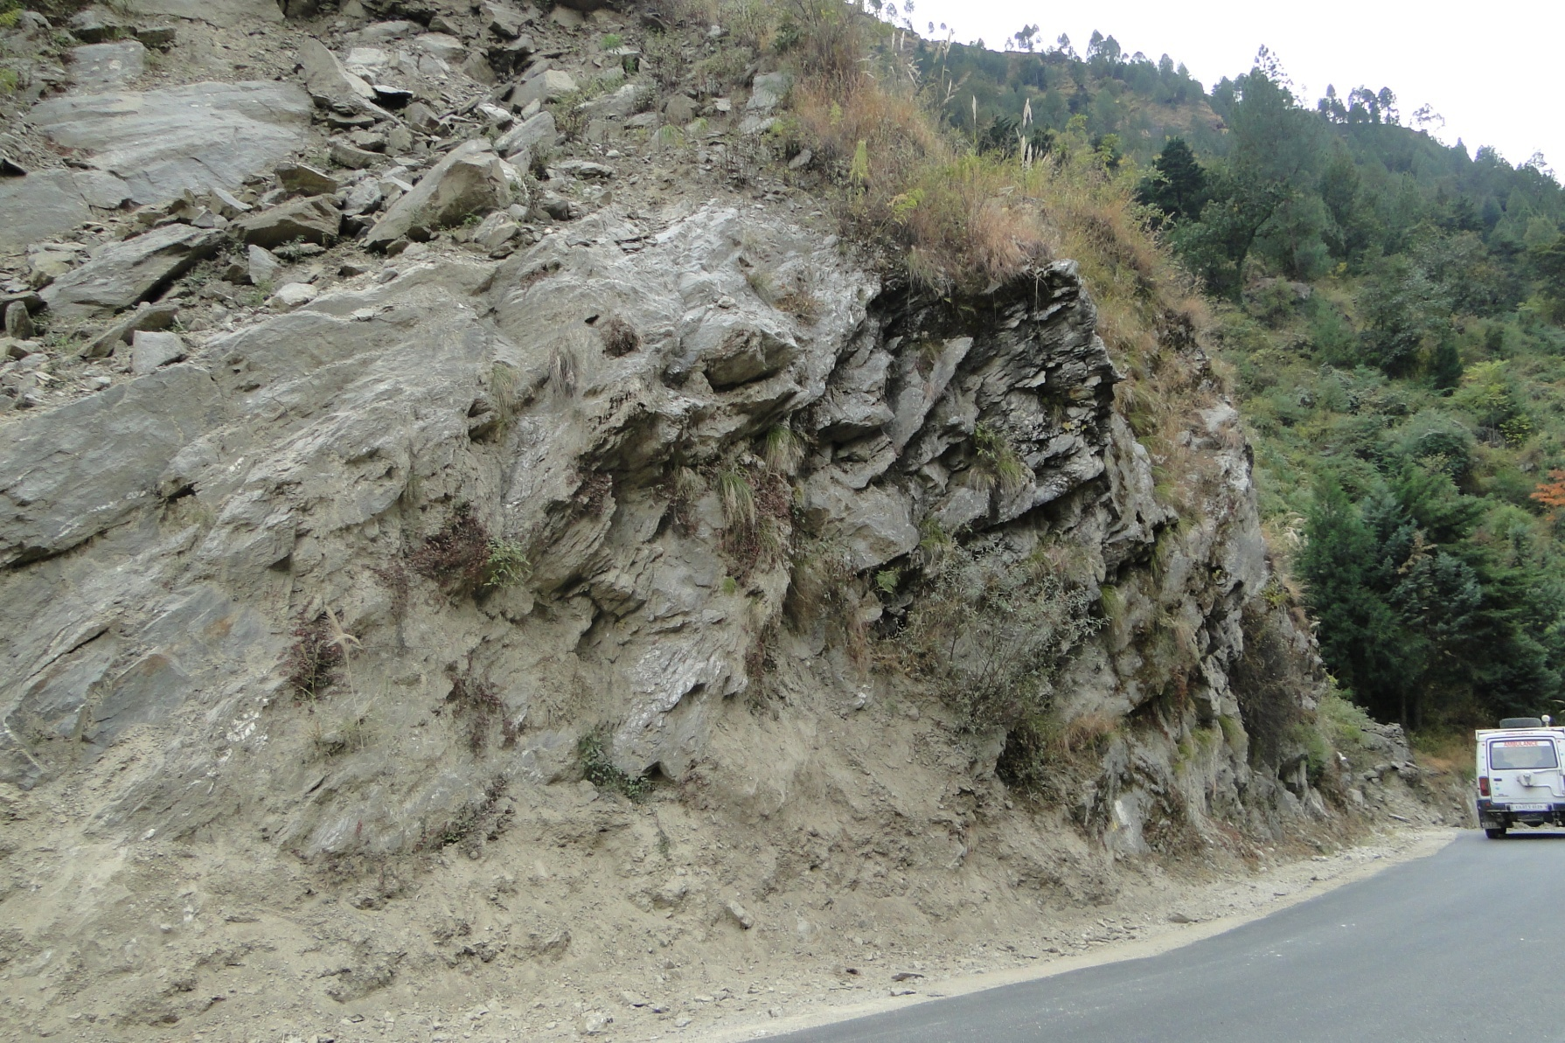
PROBLEM DESCRIPTION & CAUSATIVE FORCES
LOCATION: HELANG
Rock mass failure

Slide 24
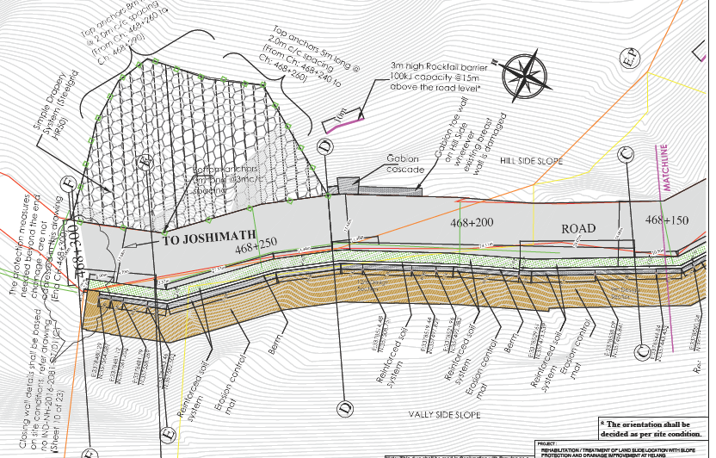
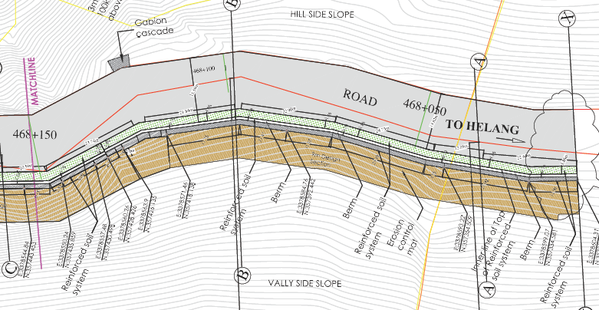
SOLUTION PROVIDED – LOCATION: HELANG
Simple drapery
Gabion cascade
Rockfall Barrier
Reinforced soil structure
Bioengineering solutions
Drainage geocomposite

Slide 25
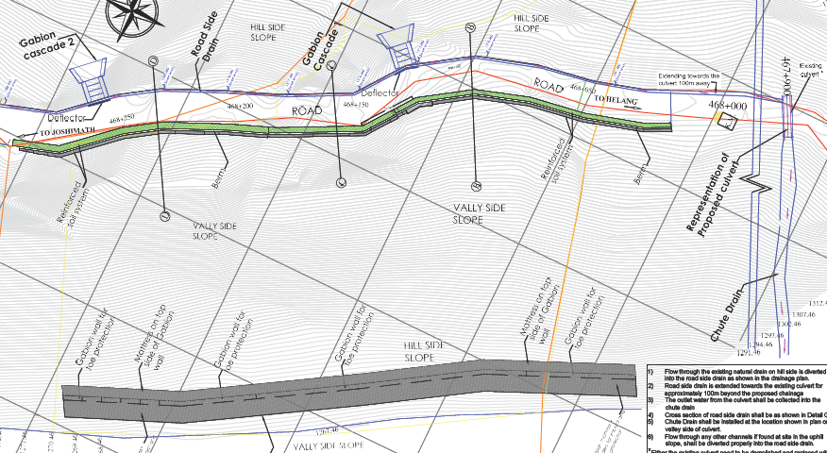

SOLUTION PROVIDED; DRAINAGE SCHEME – LOCATION: HELANG
Gabion cascade
Existing culvert
Road side drain
Chute drain

Slide 26
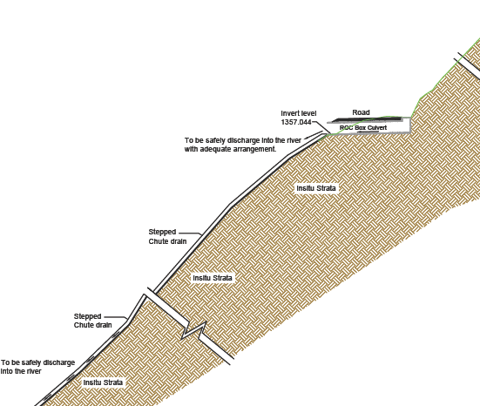
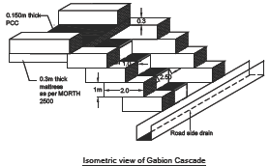

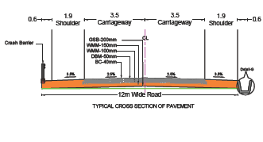
SOLUTION PROVIDED; DRAINAGE SCHEME – LOCATION: HELANG
RCC Box Culvert
Stepped chute drain
Road side drain

Slide 27
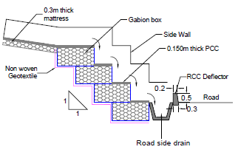
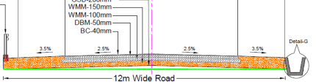
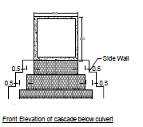
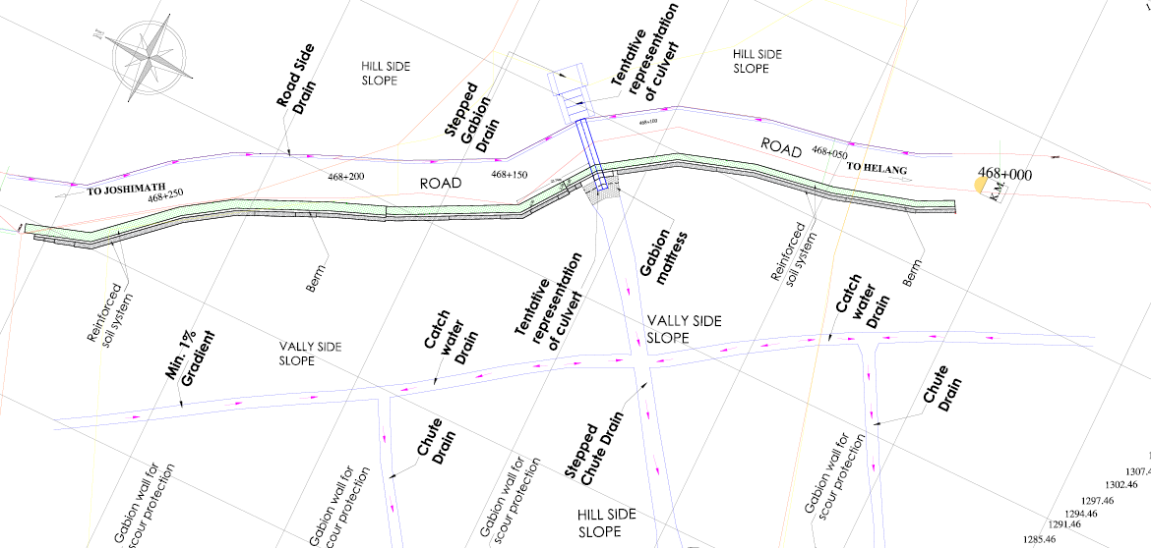
` DRAINAGE DESIGN
Type of Specific Drainage Works Required:
Chute drain
Catch water drains
Road side drain
Box culvert

Slide 28
Parameters required for drainage design
Determination of Rainfall data (IRC-SP-042)
Determination of Catchment Area (IRC-SP-042)
Determination of peak runoff (Hydrological Study)
Hydraulic Design (IRC-SP-042 )
Location of Culverts, Catch drain & Chute drain

Slide 29


Drainage Design
1. Calculation of Rainfall intensity ( IRC SP13, Page 22)
As per Indian Meteorological Department (IMD), Rainfall in the State of Uttarakhand between 15 June and 18 June 2013 was measured at 385.1 mm against normal rainfall of 71.3 mm, which was in excess by 440%. India Disaster Report, Page 22. NIDM- 2013
Frequency of Rainfall= 385.1mm for 3 days
i.e = 128.4 mm for 24 hrs
Uttarakhand Landslide Projects - Glimpses of Drainage Measures

Slide 30
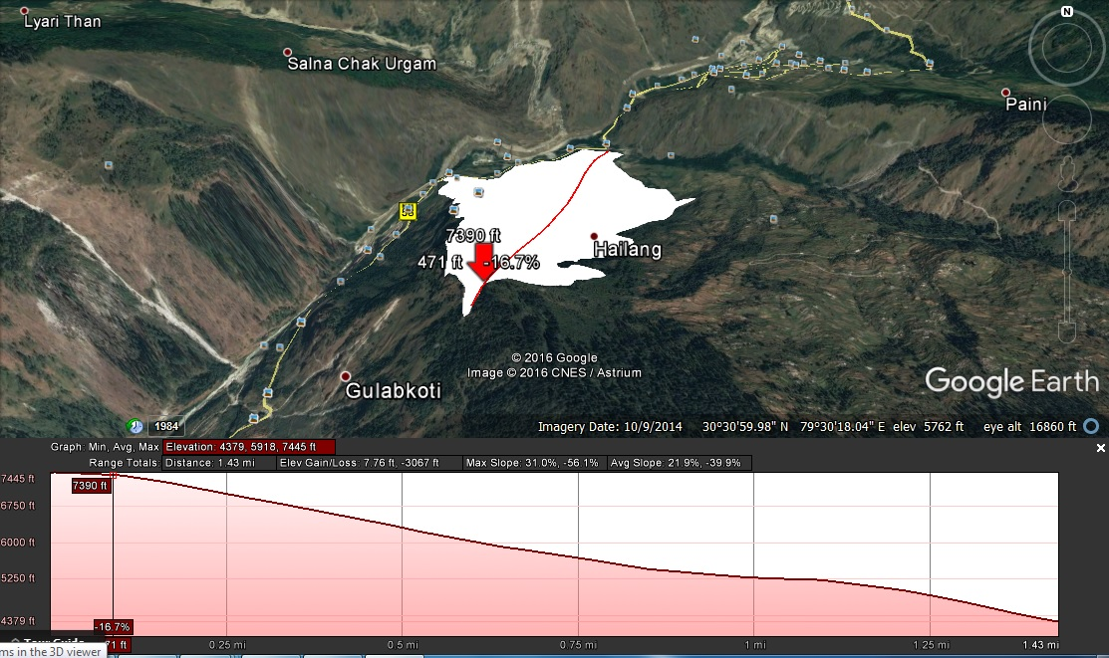
Drainage Design
2. Determination of Catchment Area (Delineation from Satellite imagery and GIS )
Uttarakhand Landslide Projects - Glimpses of Drainage Measures

Slide 31
Drainage Design
3. Determination of Peak Runoff (Hydrological Study- IRC SP42, Page 64)
As per Indian Meteorological Department (IMD), Rainfall in the State of Uttarakhand between 15 June and 18 June 2013 was measured at 385.1 mm against normal rainfall of 71.3 mm, which was in excess by 440%. India Disaster Report, Page 22. NIDM- 2013
Q=0.028 * P* i* A
Q= Discharge in Cumecs (m³/s)
P= Runoff Co-efficient= 0.8
i= rainfall intensity= 6.8 cm/hr
A= 48.30 hectares
Q = 7.2 m³/s
Uttarakhand Landslide Projects - Glimpses of Drainage Measures

Slide 32
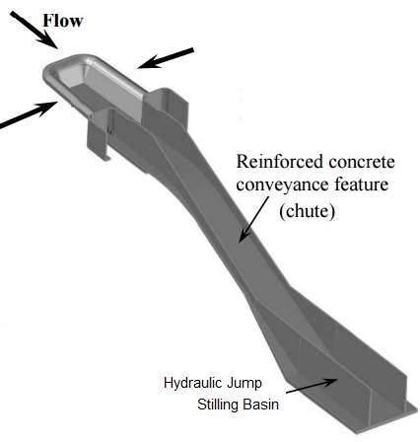
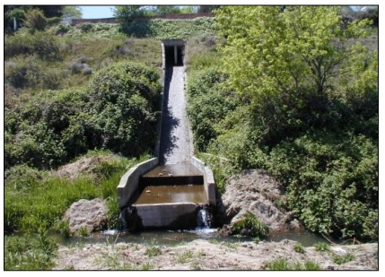
Drainage Design
4. Hydraulic Design (IRC-SP-042 )
We know
Discharge through hill slope
Total height of valley side
We need to know
Width of section
Height of section
Depth of stilling basin
Requirement of Stilling Basin
Slope of channel
Slope of bed
Uttarakhand Landslide Projects - Glimpses of Drainage Measures

Slide 33
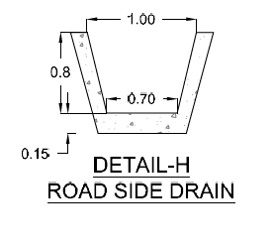

Drainage Design
4. Hydraulic Design (IRC-SP-042 )
Assume,
Base width of Trapezoidal section to be 1.2 m
Manning’s Roughness Co-efficient of 0.013
Bed slope of S=1 (<45⁰)
Channel slope of 1:z = 1:0.36
By Trial and Error Method,
Depth of flow y₁= 0.232m
Velocity
= 15.4 m/s
Uttarakhand Landslide Projects - Glimpses of Drainage Measures

Slide 34



4. Hydraulic Design (IRC-SP-042 )
To know the type of flow we need to calculate Froude’s number (Fr)
Fr is a dimensionless value that describes different flow regimes of open channel flow
Fr = 1 Critical flow,
Fr > 1 Supercritical flow (fast rapid flow)
Fr < 1 Subcritical flow (slow / tranquil flow)
Fr = 8.4
V = Velocity of Flow
D = Hydraulic depth
g = Gravity= 9.81 m/s².
After determining type of flow, Find height of Hydraulic Jump (Y₂) (USBR, Page 7 & IS:4997:1968, Page 6)
Y₂ = 2.6 m
After height of Hydraulic Jump, we need to calculate Length of Hydraulic Jump
L_{B} = 2.5 m

Slide 35
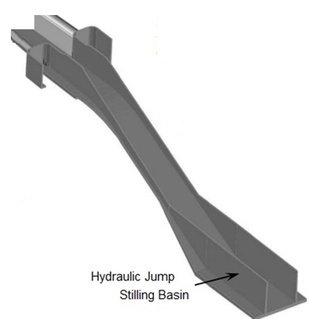
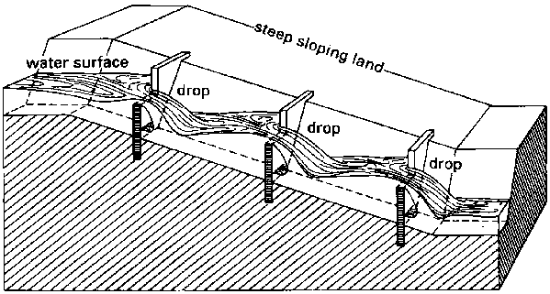
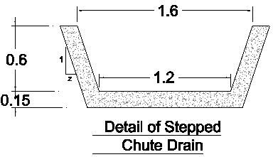
Due to large height of flow of water, stilling basin is required at every 15 m to dissipate energy
Side of Chute drain is kept as 0.6 m based on depth of flow of water
Side walls of Stilling Basin is kept as 2m to accommodate the hydraulic jump
Depth of stilling basin 2.75 m to accommodate the hydraulic jump
Length of Stilling Basin is kept at 2.5m to account for the safe flow of water after the Hydraulic Jump Depth
Uttarakhand Landslide Projects - Glimpses of Drainage Measures

Slide 36
What if chute drain do not performs?
Water flow destroys everything on its way
Scouring, Erosion, Landslide, etc
Construction Feasibility
Site conditions has to be considered before finalizing the design parameters
Base width of Channel, slope of channel, alignment of channel etc has to be considered
Timing of construction-pre monsoon/post monsoon to be dates to be checked
Uttarakhand Landslide Projects - Glimpses of Drainage Measures

Slide 37
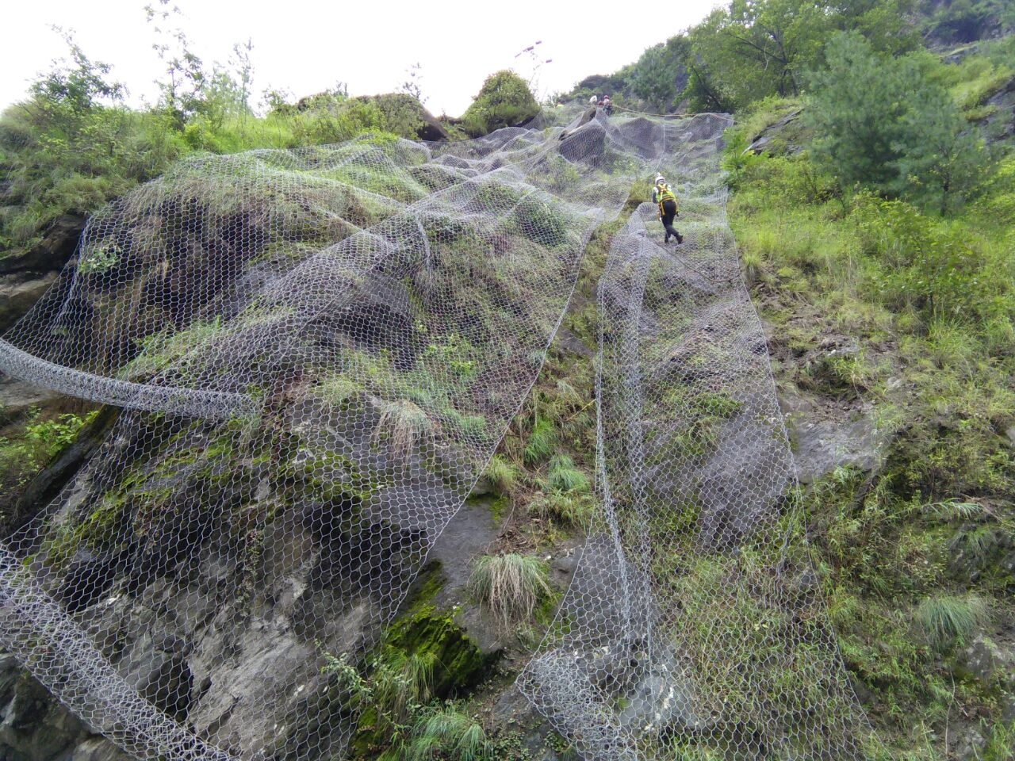
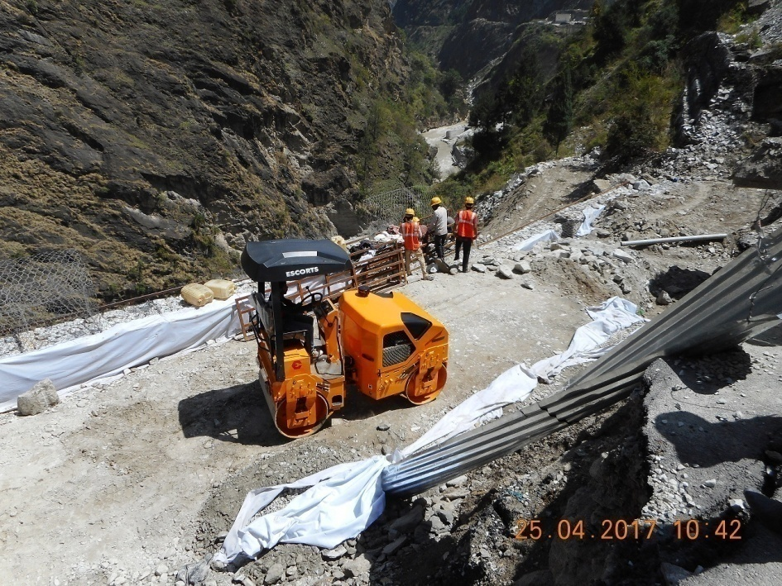
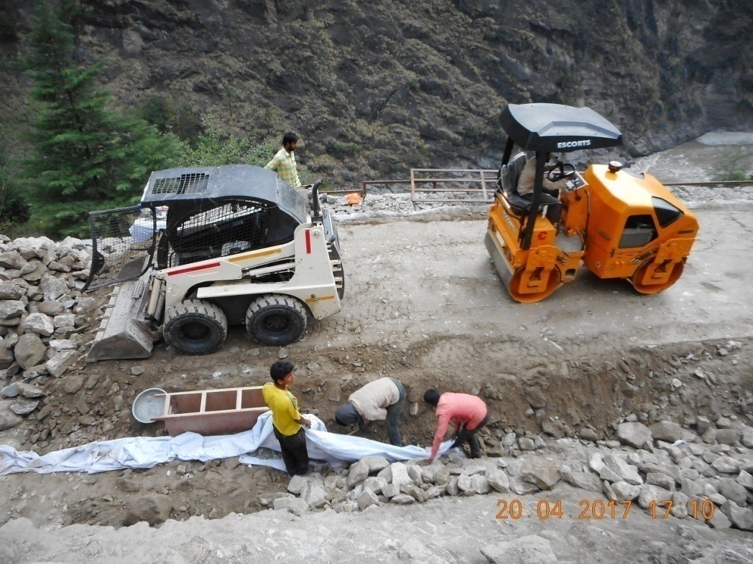
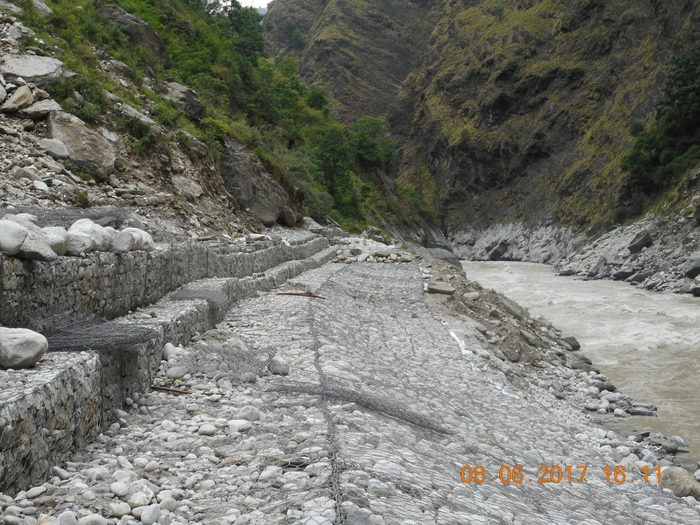

CONSTRUCTION PHOTOGRAPHS- LOCATION: HELANG
Chimney Drain

Slide 38
CONCLUSION
Drainage-an inevitable part of landslide mitigation
Main drainage measures which are suitable for Uttarkhand Landslide mitigation are Catchwater drains , Chute drains , longitudinal road drains , chimney drains and culverts.
Drains are to be designed as per types of drains and type of flow .
Construction feasibility should be a major consideration , while finalising the dimensions of drain .

Slide 39

THANKS FOR YOUR KIND ATTENTION

