Slide 1

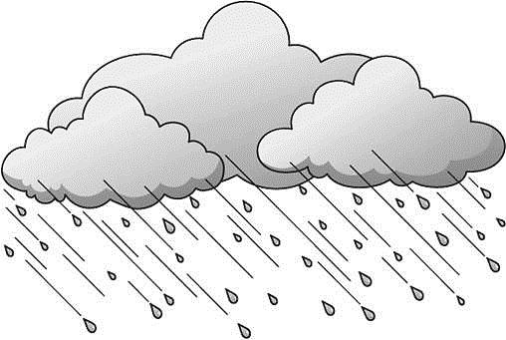


CLIMATE RESISTANT SAFER HILL ROADS
“MY COUNTRY WAS NEVER SO RICH THAT IT COULD AFFORD POOR ROADS”

Slide 2
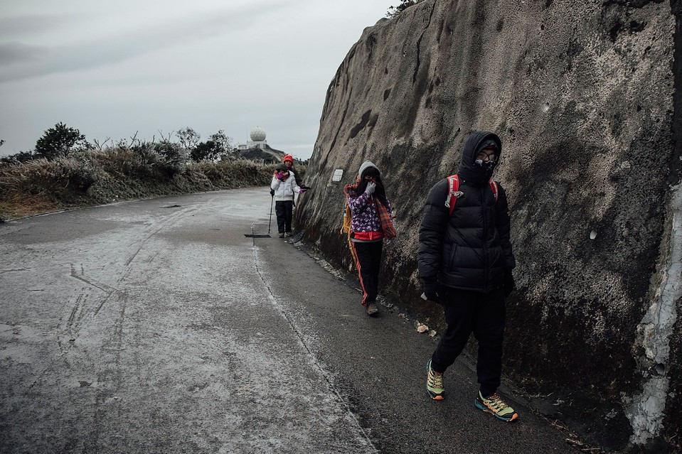
BUILD SUSTAINABLE ASSETS
Notes:
Nano level modification & treatment

Slide 3
HILL ROADS: CRITICAL ISSUES
Expensive to transport materials so it is imperative to use in-situ / local materials
Inconsistent compaction due to cooler temperatures and wind speed
High Shear in Bitumen Layers on curves, extreme slopes and higher loads
Resistance to salt on bituminous layers
Rain cuts on the side slopes

Slide 4
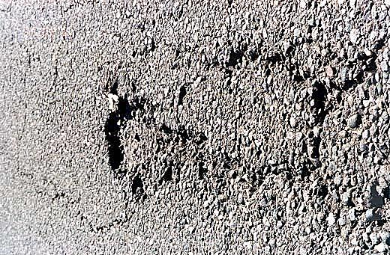
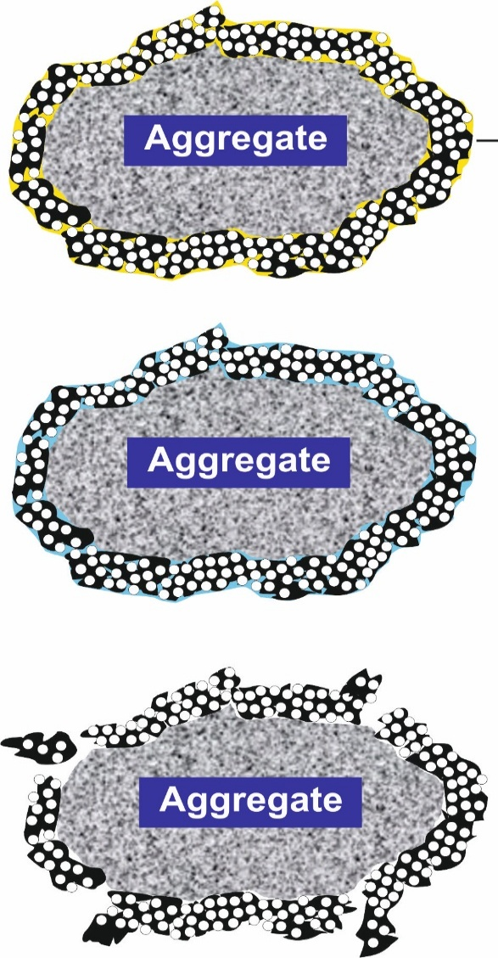
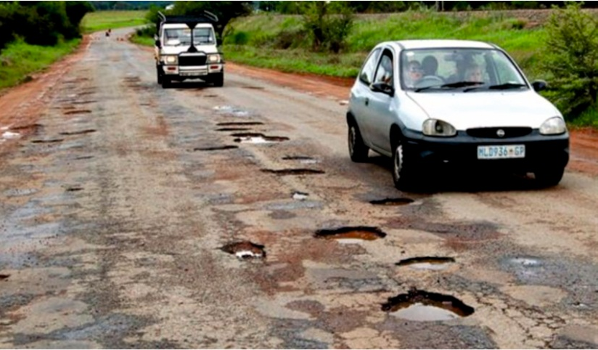
365 DAY HEAVY CONDENSATION IN PAVEMENTS
Stripping
Raveling & Pot Holes
Air Gaps
Water
Gets in
Water
Evaporates
& Expands
Potholes, raveling and undulations can lead to loss of vehicle grip and speed

Slide 5
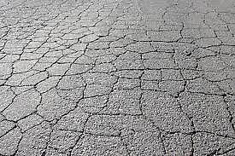

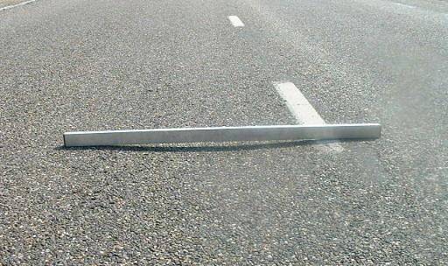
EXPANSION & CONTRACTION CYCLES
Temperature Difference
Fatigue Cracking & Rutting

Slide 6
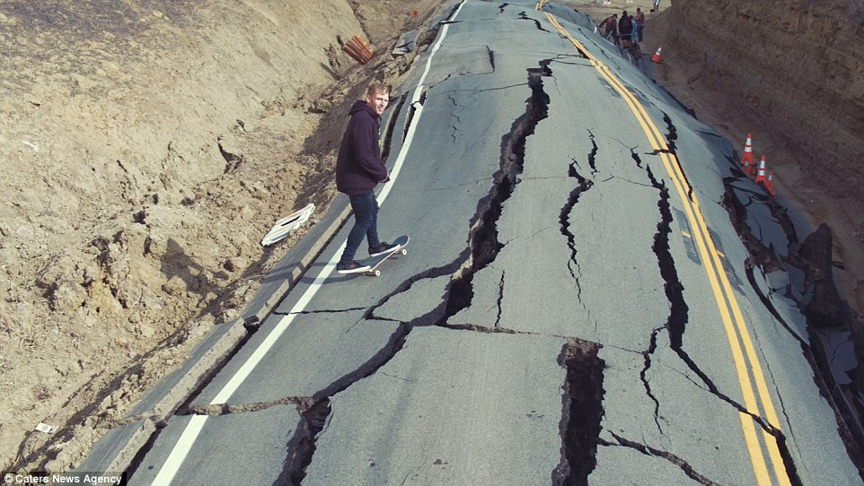
FREEZE-THAW CYCLES
Larger Cracks & Weakening of sub-grade soil
Undulations

Slide 7
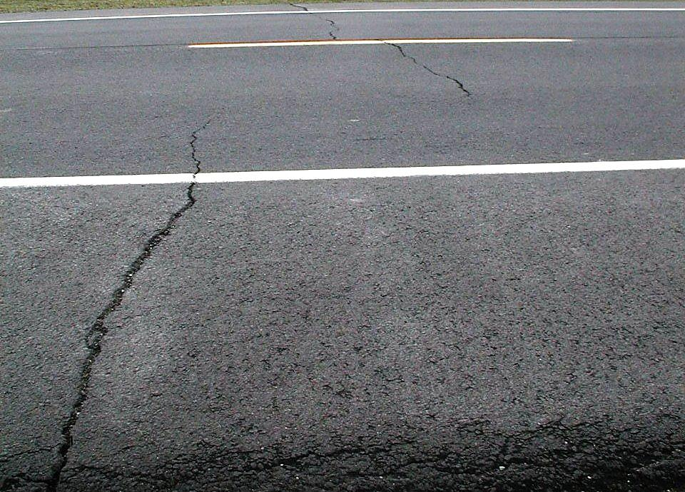
CRACKING DUE TO SUDDEN DROP IN TEMPERATURE

Slide 8
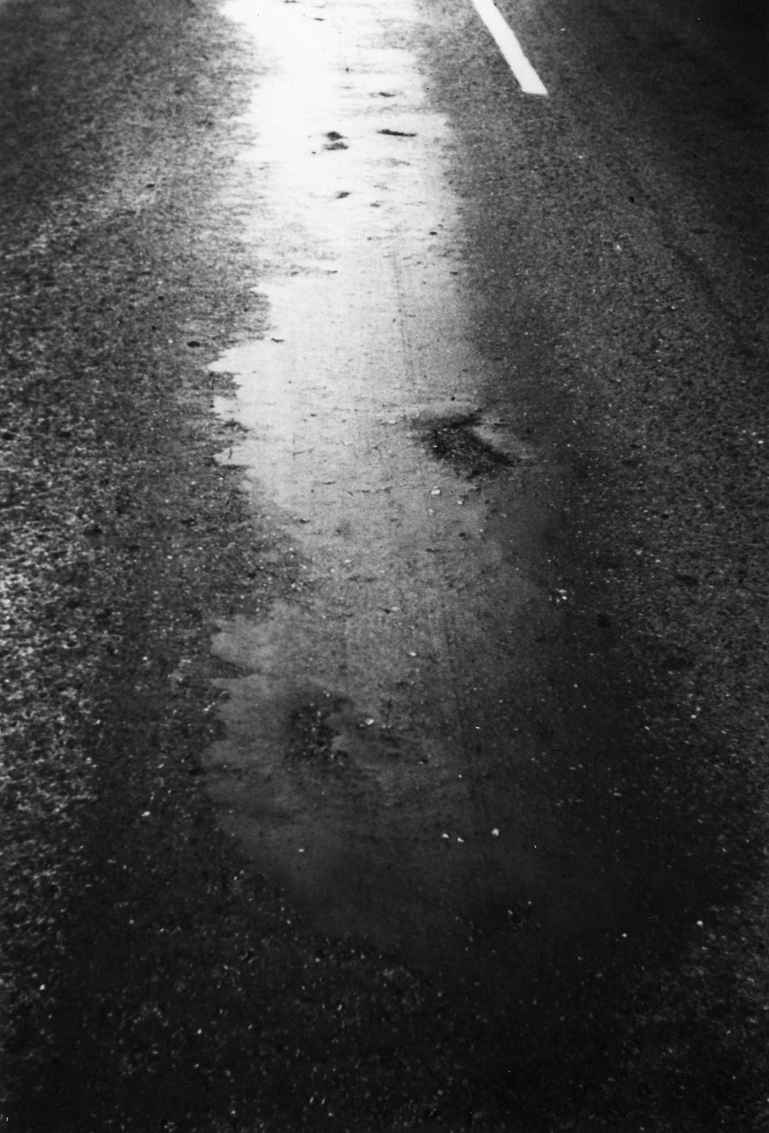
BITUMEN DETERIORATION DUE TO UV RADIATION

Slide 9
SAFETY
Potholes Elimination ?
Salt Effects Elimination ?
Rutting Elimination ?
Cracks Elimination ?

Slide 10
Hill Roads – BETTER ROADS
ASPHALT LAYERS
CRITICAL FACTOR | NANOTECHNOLOGY | BENEFITS
Poor Compaction Bitumen Bonding to Aggregates | Nano modification of aggregates and ability to improve workability at very low temperature is the key | Consistent higher density at lower temperature Resistance to salt water

Slide 11
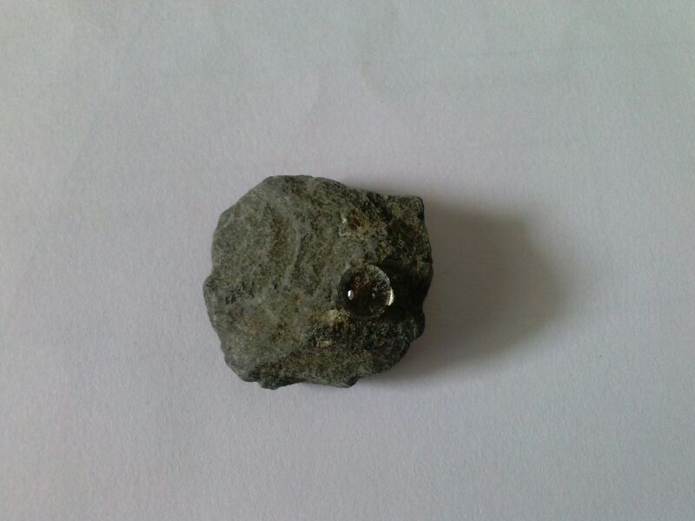
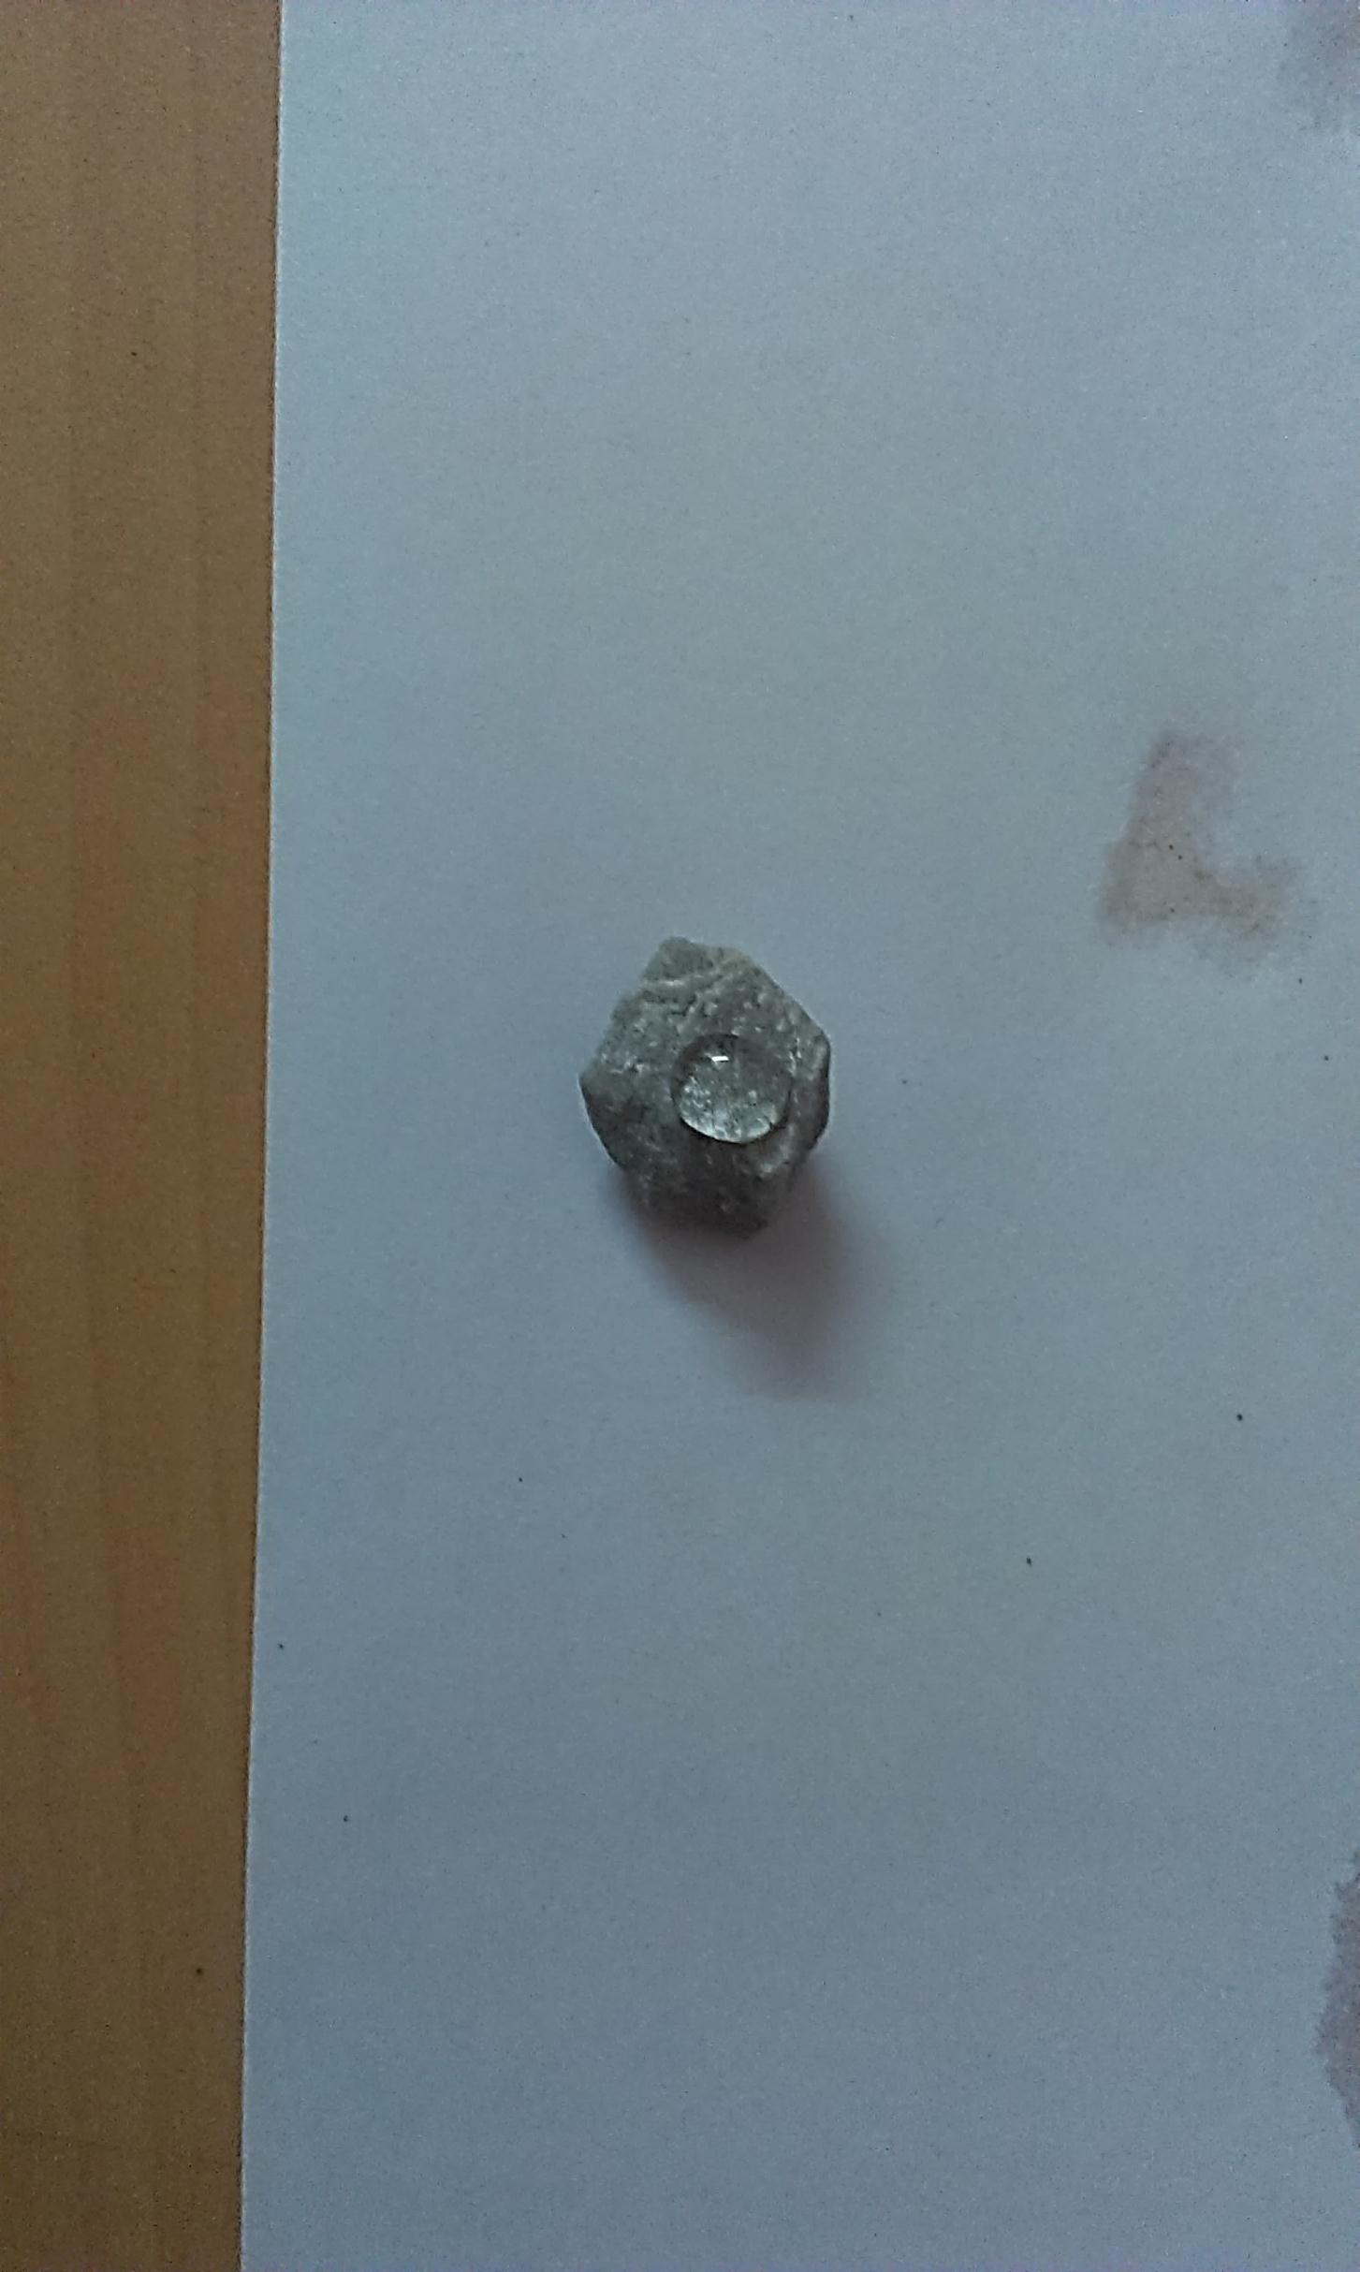
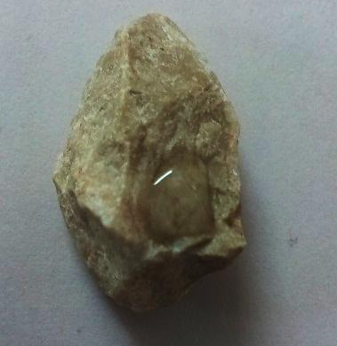
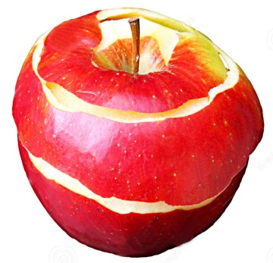
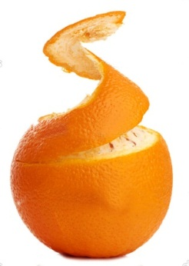
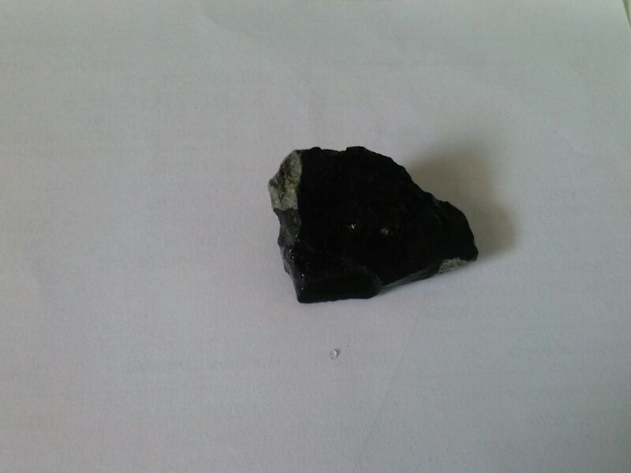
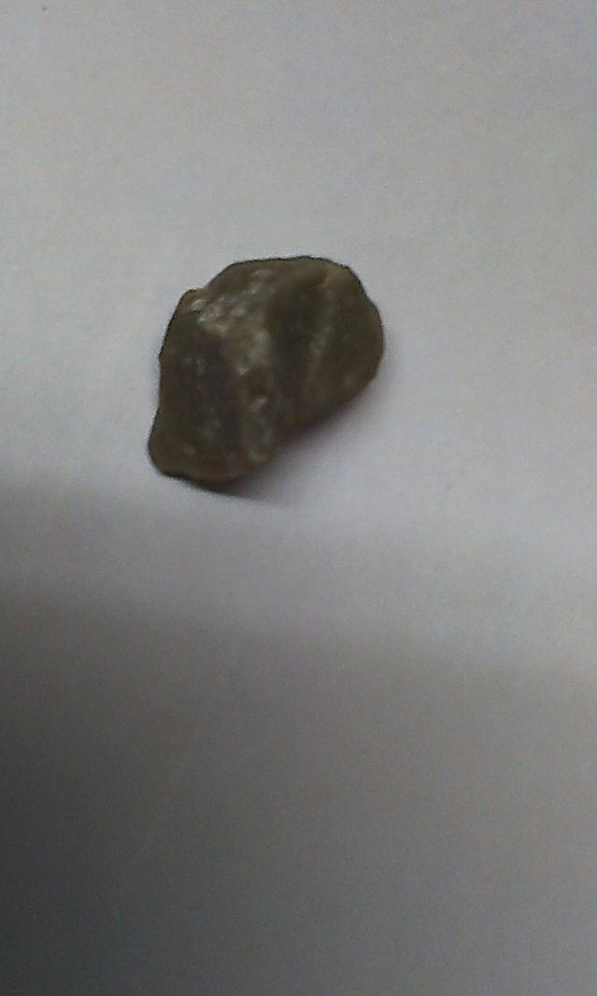
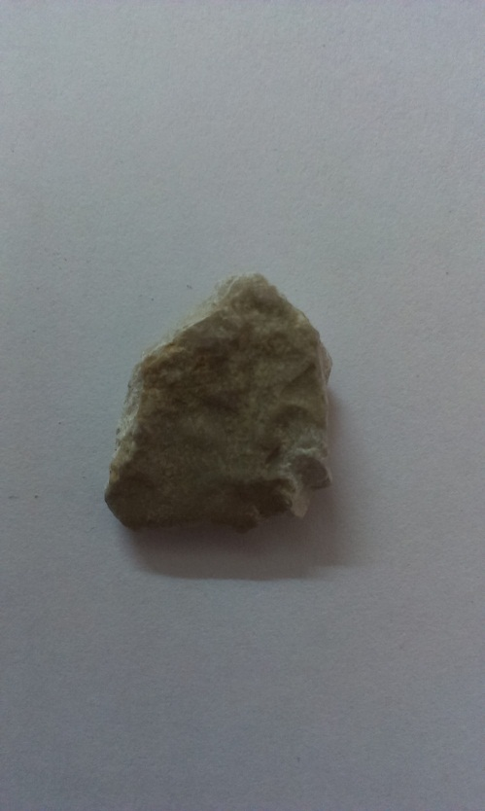
PHYSICAL TO Chemical Bonding
Aggregate Surface with ZycoTherm Nano Layer
Strong Chemical Bonding
Basalt Granite Limestone
Weak Physical Bonding

Slide 12
BOIL SALT TEST ASTM D3625 : EXTEND TO 6 HOURS
PG 64-22 / VG 30 / 60-70 Pen
PG 76-22
Basalt Aggregate (DBM) : 45% 20 mm, 10% 10 mm, 45% less than 6 mm with stone dust
Asphalt Grade: AC-20 (VG-30, 60-70 penetration grade)

Slide 13

WATER PENETRATION DEPTH UNDER PRESSURE : ASTM D 6927 : 2005A
Description | Control |  | ZycoTherm
Sample No. | 9 | 10 | 11 | 12 | 13 | 14 | 15 | 16
ZycoTherm % | 0 | 0 | 0.025 | 0.025 | 0.05 | 0.05 | 0.10 | 0.10
Maximum Penetration (mm) | 5 | 3 | 0 | 2 | 2 | 3 | 0 | 0

Slide 14

COMPACTION RESISTANCE at lower
TEMPERATURE
Mix Type | Binder Type | C / ZT | Compaction Temp ^{O}C | 50 % Coating Sec | Compaction Resistance 21Nm | Void Content Vol %
AC 16 BS | 50/70 | C | 135 | 25 | 41.6 | 7.0
 |  | ZT | 135 | 15 | 43.5 | 7.1
 |  |  | 115 | 19 | 42.8 | 7.2
 |  |  | 95 | 19 | 41.3 | 6.9
AC 11 DS | 25/55-55 A | C | 145 | 37 | 37.3 | 4.3
 |  | ZT | 145 | 22 | 34.2 | 4.6
 |  |  | 125 | 30 | 36.5 | 5.0
 |  |  | 105 | 30 | 36.5 | 5.3
Innovationsgesellschaft Technische Universität Braunschweig mbH

Slide 15
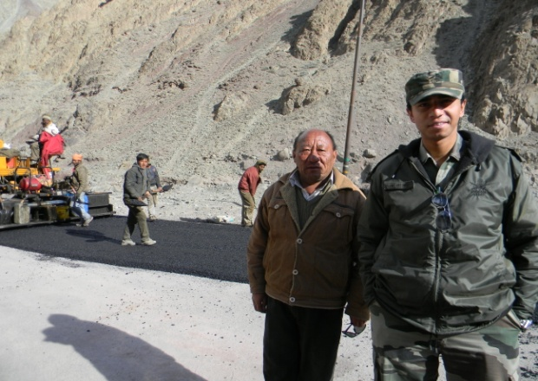
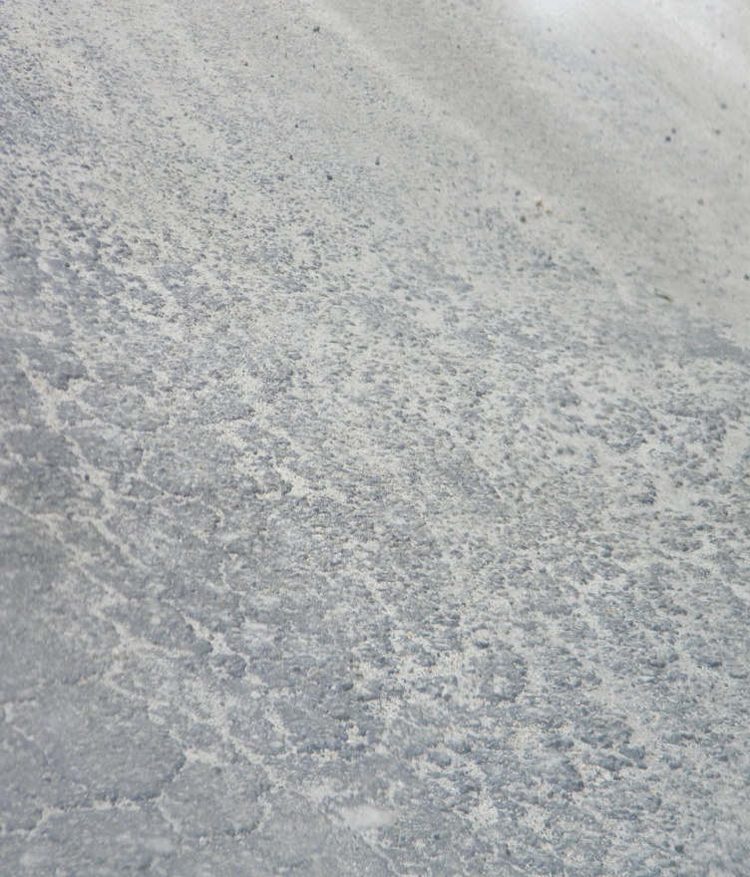
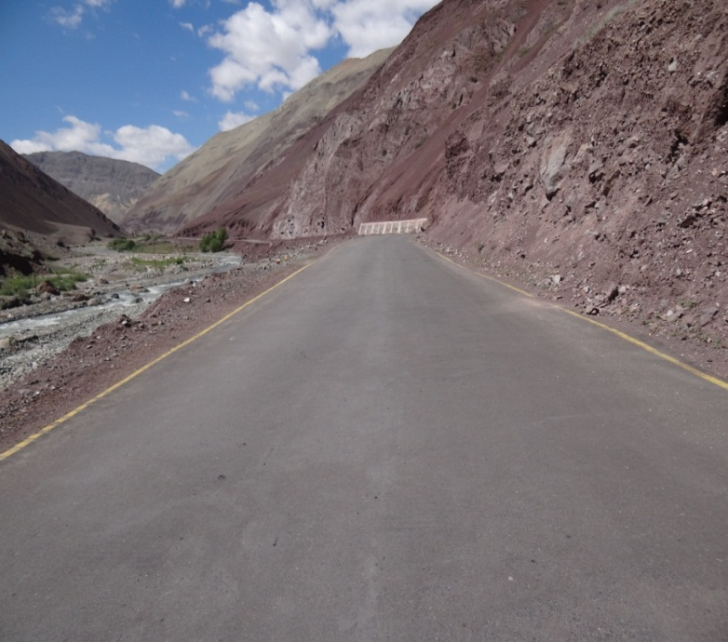
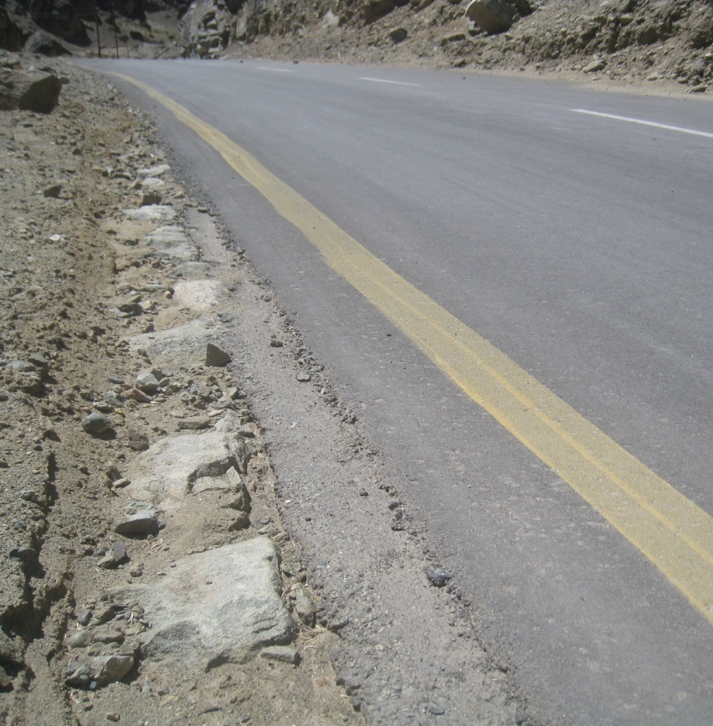
UPSHI SARCHU MOUNTAIN ROAD, LEH 2011
Laying Nano mix 2011
Control 2012
Nano Bonded layer 2015

Slide 16
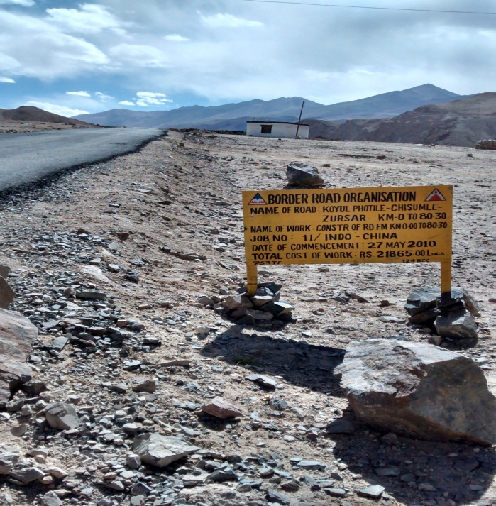
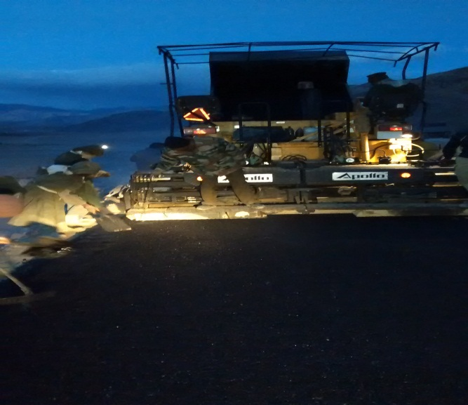
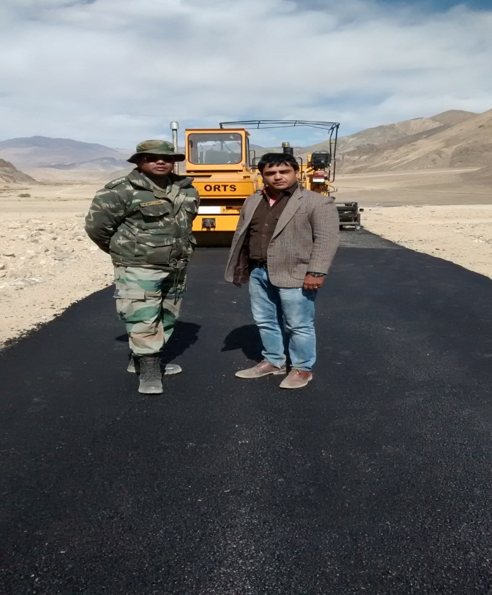
KUYUL PHOTILE CHISUMLE ZURSAR INDO CHINA ROAD @ 14000 FEET LAYING AT -10 C

Slide 17
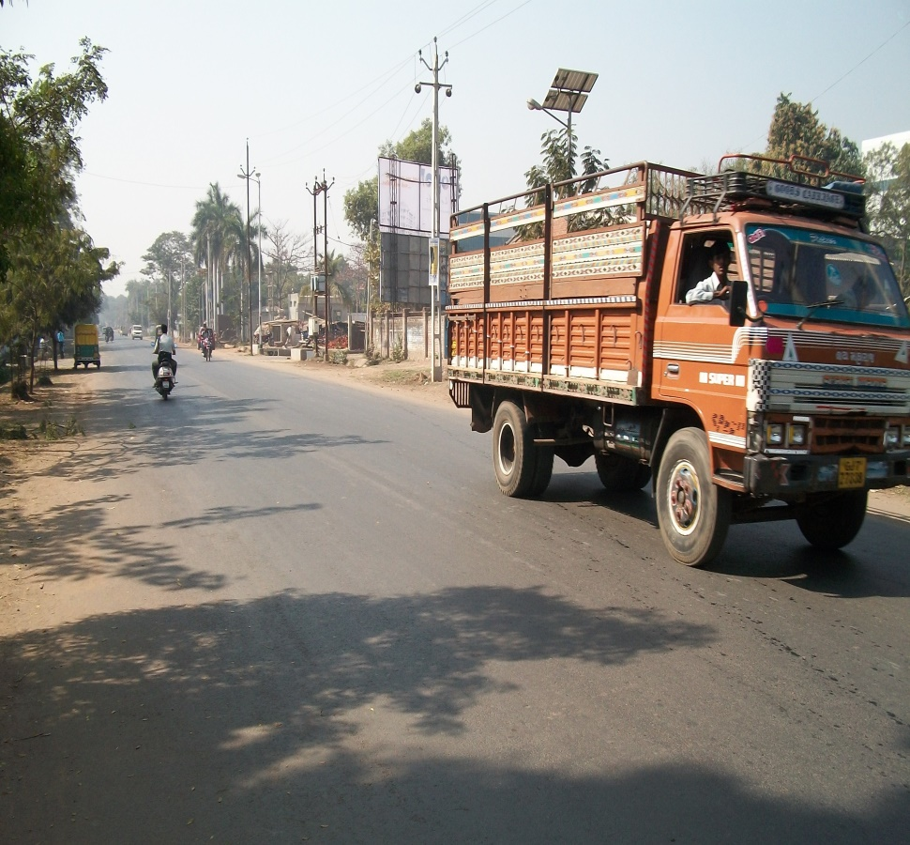
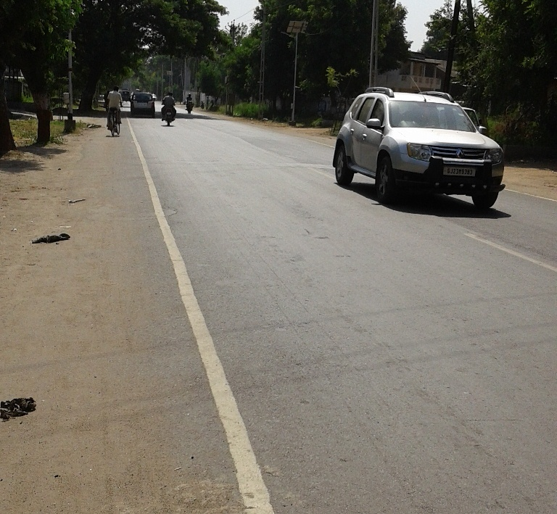
INDUSTRIAL ROAD
April 2009
June 2016
40 mm Wearing Course with VG 30; 3 kms 2 lanes

Slide 18
SAFETY
Cracking due to the shear forces of tires turning on the curves will be eliminated
Chemical bonding and waterproofing will ensure pavement behaves as a monolithic composite giving better grip

Slide 19
Hill Roads – BETTER ROADS
BOND COATS
CRITICAL FACTOR | NANOTECHNOLOGY | BENEFITS
100 % Coverage & Waterproofed surface with reduced tracking | Nano compounds promote bonding and make bond coats penetrative and waterproofed | Layers behave like an integrated waterproofed composite. High Shear on roads curves is taken care due to higher bond strength

Slide 20
TACK COAT BOND STRENGTH
Parameters | Mix # 1 Control Mix |  |  | Mix # 2 Test Mix
Specimen No. | C1 | C2 | C3 | T1 | T2 | T3
Failure Load kN | 3.25 | 3.40 | 3.15 | 4.85 | 5.8 | 5.35
Shear Stress | 0.41 | 0.42 | 0.39 | 0.61 | 0.72 | 0.67
Average Shear Stress N/mm² | 0.41 |  |  | 0.67
Increase in Shear Strength % | 63.4%
CSS1H (60%); Mix 2 emulsion diluted with water and added with Nanotac (Residual bitumen 30%)

Slide 21
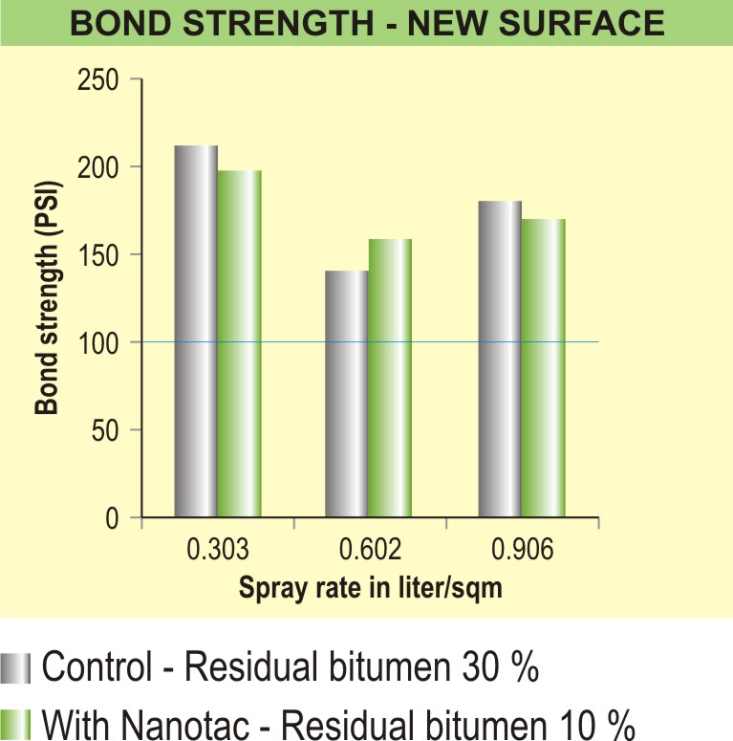

BOND STRENGTH - NCAT
Maintains bond strength with lower residual bitumen content
Bond strength values consistently above 150 PSI
Bond strength
Specs: 100 PSI)

Slide 22
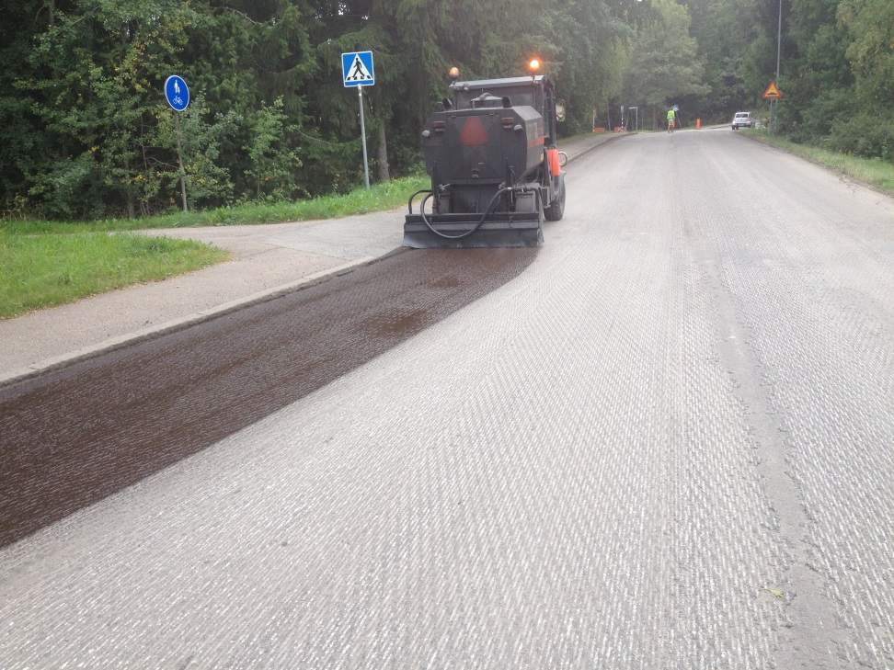
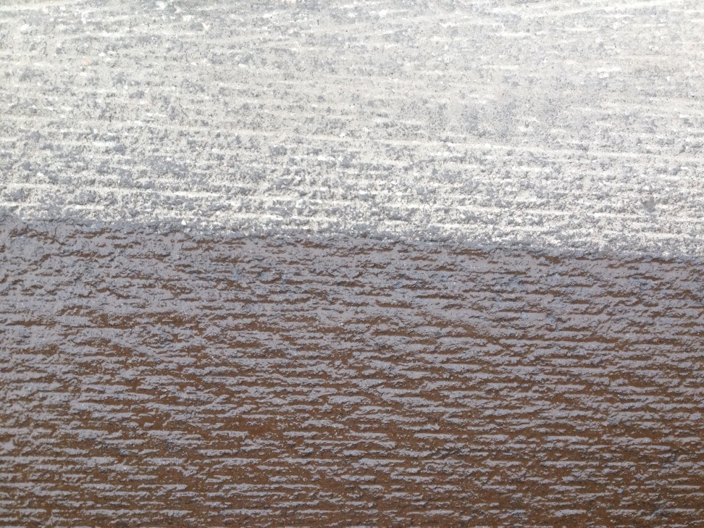
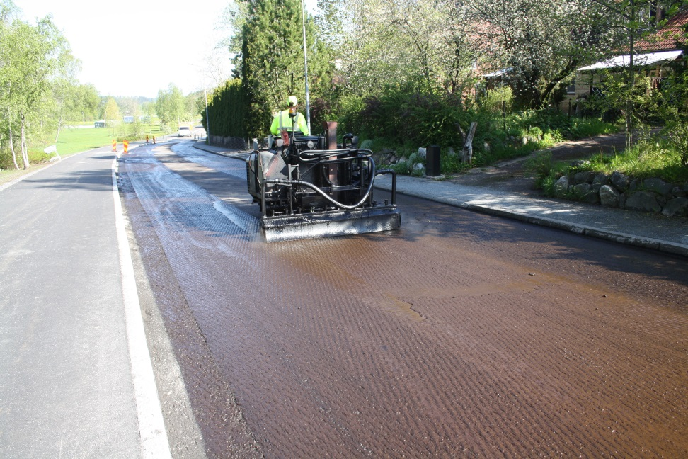
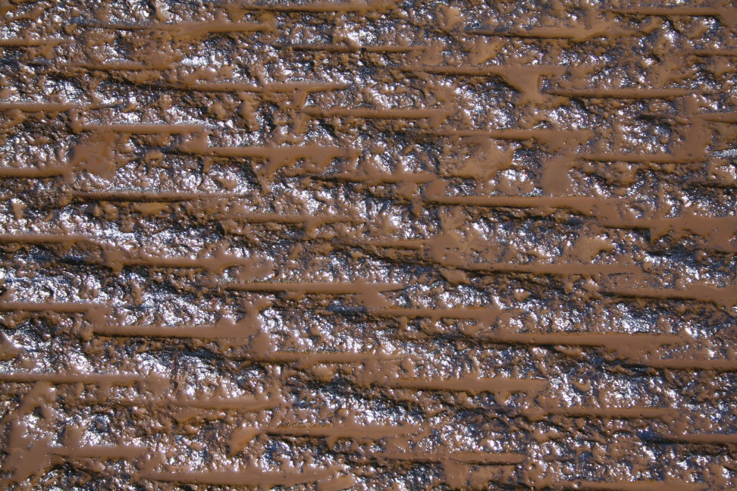
Tack coat – MILLED SURFACE 100 % COATED

Slide 23
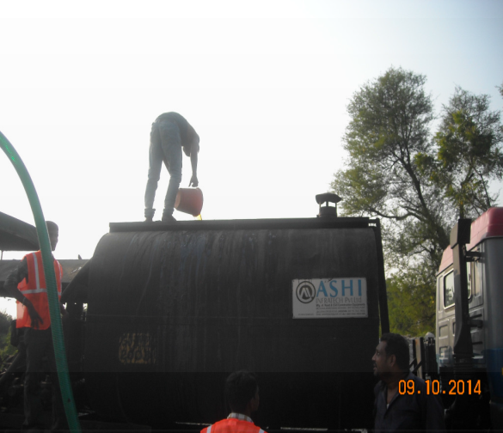
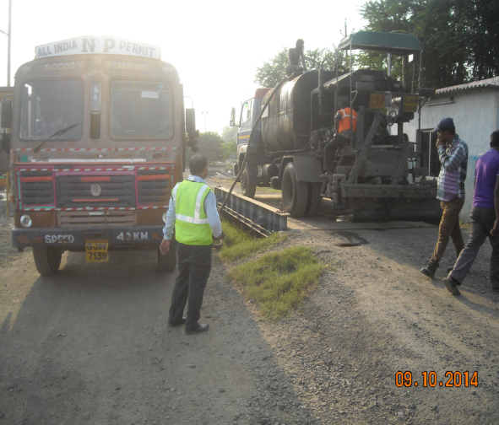
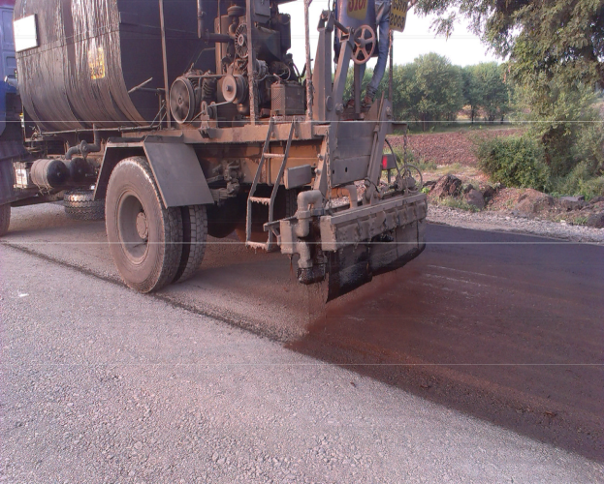
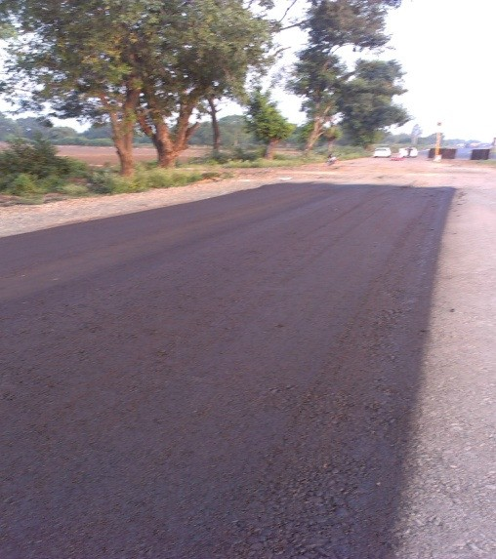
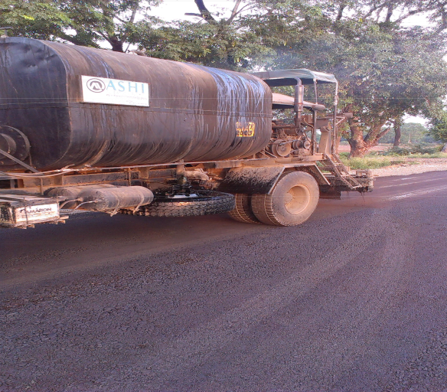
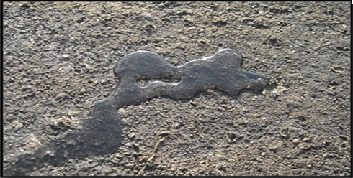
PRIME COAT
Silane Water Solution
CSS1 + Silane Solution
Spraying
Treated Surface
Quick set 1 hour - no tire pickup
Waterproofed Surface

Slide 24
SAFETY
Undulations Elimination ?
Sinking Bases Prevention ?
Bound stabilized layers with swell control and flexible bonding will reduce deflection values substantially
Reduced Fatigue of top layers

Slide 25
Hill Roads – BETTER ROADS
STABILIZATION & WATERPRROFING OF SOILS
CRITICAL FACTOR | NANOTECHNOLOGY | BENEFITS
Waterproofed Base with low swelling & freeze – thaw | Swell reduction, Increase of MDD due to alkyl lubrication effect & nano inter-particle bonding | Waterproofed, stabilized flexible, low water permeability bases will eliminate undulation thereby improving safety

Slide 26

IMPROVED SOIL COMPACTION
Charge shielding and oil (alkyl) lubrication
Enables optimum compaction
Field proctor density of 100 to 105 have been observed

Slide 27
NANO BONDING WITH FLEXIBILITY, DURABILITY & IMPROVED STRENGTH
Cement Soil Stabilization
Silane + Nano Polymer + Cement
Proctor 95
Cementitious bonds degrade with time and lose strength due to wet and dry cycles - Low durability
Proctor 100 to 105
Unaffected by wet and dry cycles due to hydrophobicity - High durability
Cement Particle
ZycoBond Particle

Slide 28
CRRI RESEARCH : EXECUTIVE SUMMARY
ORGANO SILANE TREATED SOIL DISPLAYED THE FOLLOWING,
Soil Swelling Reduced by 85 %
Compaction Density Increased by 4%
Sr | Parameters | Measure | Soil w/o additive | Soil + Cement 3% | Soil + Silane 0.75 kg/m³ + nano polymer 0.75 kg / m³ + Cement 3%
1 | CBR | % | 7 | 67 | 125
 |  | % Improvement | - | 857% | 1685%
2 | UCS | MPa | 0.27 | 1.02 | 2.43
 |  | % Improvement |  | 278% | 800%
3 | Durability (Wet – Dry Cycles) | No. of cycles | 0 | 4 | 12
 |  | IS : 4332 (Part 4) | Fails | Fails | Passes (Simulates 20 years life)

Slide 29
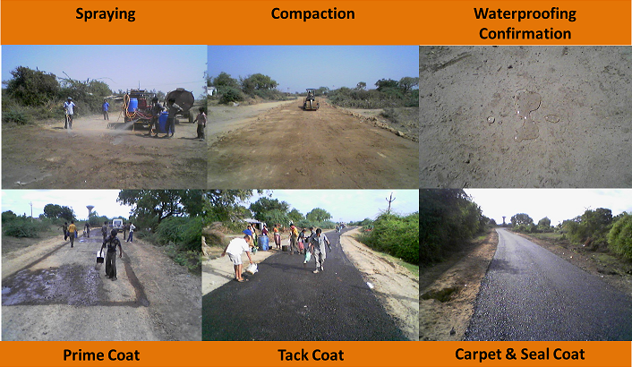
BHARTHALI - BHARTHNA ROAD, TAL. KARJAN, DIST. VADODARA, GUJARAT
Construction in Year 2010
Clayey Soil CBR 1.3 – 2.1, treated with Multi Layer Waterproofed Envelope

Slide 30
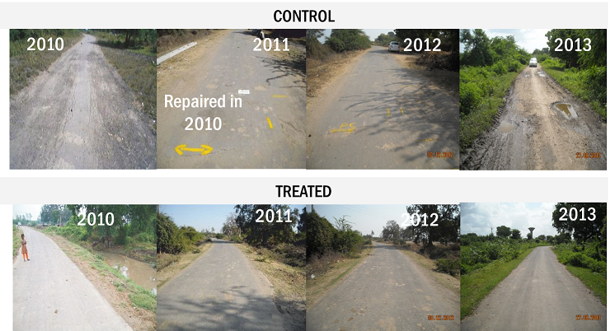
BHARTHALI - BHARTHNA ROAD, TAL. KARJAN, DIST. VADODARA, GUJARAT
Post Monsoon Performance 2010 - 2013

Slide 31
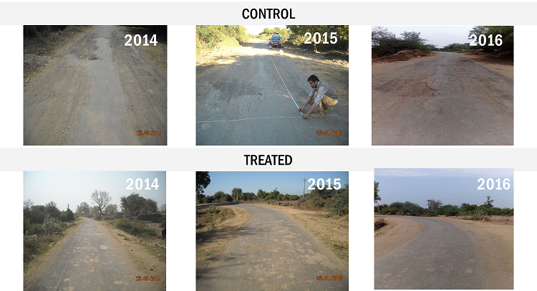
BHARTHALI - BHARTHNA ROAD, TAL. KARJAN, DIST. VADODARA, GUJARAT
Post Monsoon Performance 2014 - 2016

Slide 32
ESAL VALUE GAIN WITH WATER RESISTANCE
Description | IRC Design | IRC Design with Organo-Silane waterproofing (2.5% extra Cost)
Drainage Coefficient | 1 | 1.2 | 1.3 | 1.4 | 1.4 + 10% higher layer coefficient
Structural Number | 4.49 | 5.11 | 5.54 | 5.89 | 6.18
Equivalent MSA | 20 | 62 | 100 | 150 | 220
Times Improvement |  | 3 | 5 | 7.5 | 11

Slide 33
THANK YOU

