Slide 1

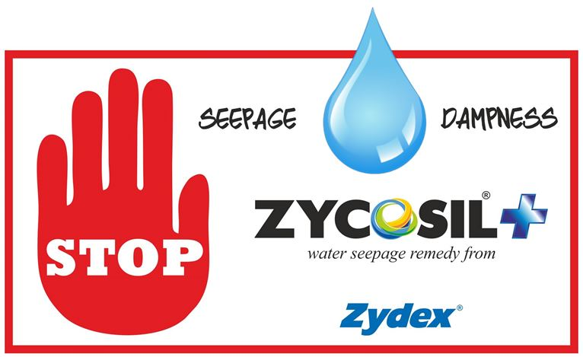
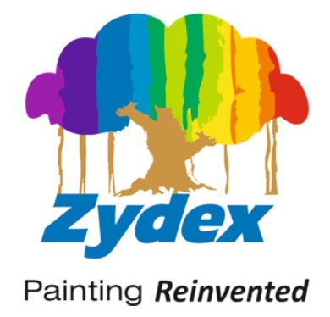
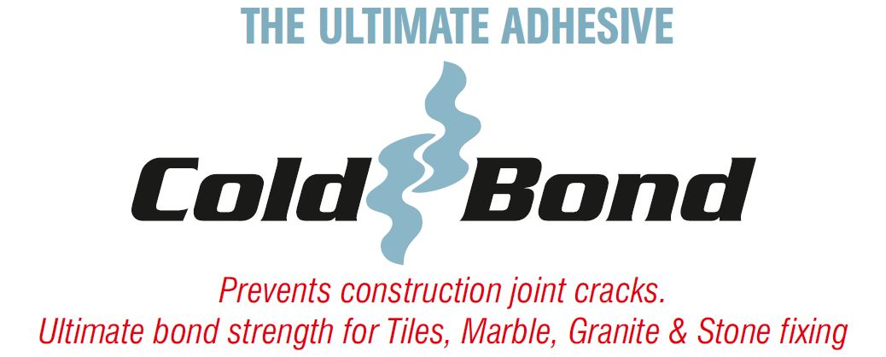
Welcomes You
ZYDEX NANOTECHNOLOGIES FOR BRIDGES REPAIR - AN OVERVIEW
Date : 18th August 2017 (Friday)
Location : CPWD HEADQUARTERS, New Delhi

Slide 2
Zydex Industries Pvt. Ltd.
Conserving Limiting Resources
through Innovation,
for a Sustainable world
Dr. AJAY RANKA

Slide 3
REPAIR OF BRIDGES
Surface preparation
Bonding Technology
Construction Material
Protective Technology
Aesthetic Technology

Slide 4
The Deterioration Process
What are physiochemical processes at a bridge which destroy its physical structure & strength?
1) Wet & Dry Cycle (everyday on a water body or hills)
Water penetrates into the most inaccessible micro cracks and nano capillaries, thus causing degeneration

Slide 5
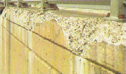
The Deterioration Process
What are physiochemical processes at a bridge which destroys its physical structure & strength?
2) Carbonation
CARBONATION REACTION
H₂O + CO₂ ------------- H₂CO₃ (Carbonic Acid)
Ca(OH)₂ + H₂CO₃ ------CaCO₃ + 2H₂O
Calcium Hydroxide
Calcium Carbonate

Slide 6
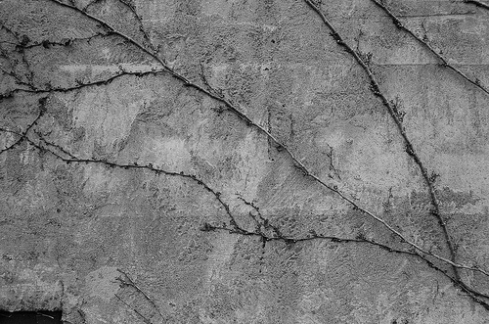
The Deterioration Process
What are physiochemical processes at a bridge which destroys its physical structure & strength?
3) ASR (Alkali Silica Reaction)
ALKALI-SILICA REACTION
[OH-]
=Si-O-Si= + H₂O --------------- =Si-OH…….OH-Si=
Strong Base
Silicate
Silica Gel

Slide 7
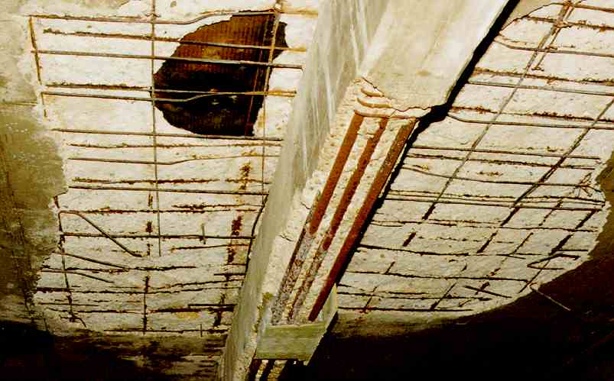
The Deterioration Process
What are physiochemical processes at a bridge which destroys its physical structure & strength?
4) Corrosion
ELECTROCHEMICAL CORROSION REACTIONS
Fe⁺⁺ + 2Cl⁻ → FeCl₂
FeCl₂ + H₂O + OH⁻ → Fe(OH)₂ + H⁺ + 2Cl⁻
2Fe(OH)₂ + ½O₂ → Fe₂O₃ + 2H₂O
½O₂ + H₂O + 2e⁻ → 2 OH⁻
Anode
Cathode

Slide 8
Bridges - Material of Construction
40 – 60 M grade concrete is used
Reduced porosity
Current Problem: Cement Grade 53 – High initial strength & faster curing due to smaller particle size –But high surface area leads to formation of micro cracks

Slide 9
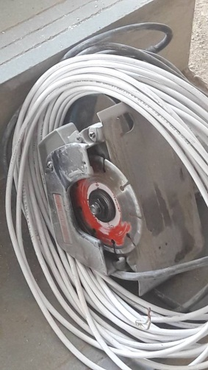
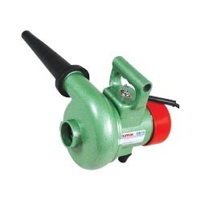
Repair Methodology – Surface Preparation
Mechanical cleaning: Clean the surface by chipping and removing all the loose concrete / mortar debris, dirt or fungal deposits. Remove laitance, if present in the peripheral zone.
Power tools can be used to achieve this.
Clean the dust by pneumatic air pressure with portable blowers.

Slide 10
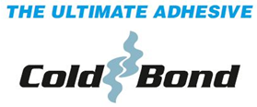
Nanotechnology in Bonding
Repair Methodology – Bonding Technology
Bonding Strength: Very High & Penetrative
A nano particle will have excellent wetting & bonding ability to all ferrous oxide, ferric oxide, metal, cement and sand particles. All micro & nano porosities gets mechanical impregnation. Imparts chemical bonding & flexibility.

Slide 11
Particle size: 70 – 90 nm
Repair Methodology – Bonding Technology
Nanotechnology in Bonding
Nano range can penetrate into
M30 – 40 – 50 concrete also.
Water Resistant
  See boil test
  See nail test
  See drop test

Slide 12
Repair Methodology – Bonding Technology
STRENGTH
  Concrete to Concrete
  Concrete to Plaster
  Plaster to Granite / Stone / Tiles
≈ 34 kN
Test Results / Videos
Heavy Granite with ColdBond
Plaster with ColdBond
ColdBond vs Tile Adhesives

Slide 13
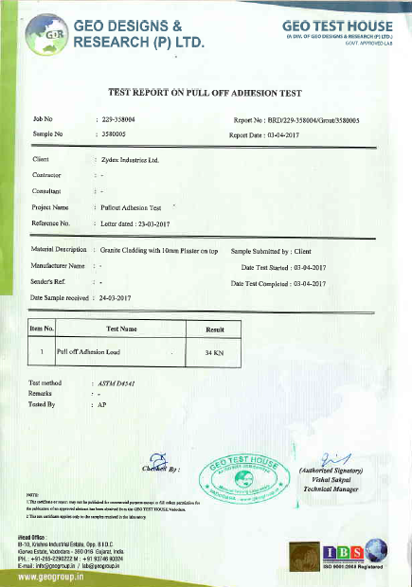
PULL-OFF ADHESION RESULTS
Pull-off adhesion strength registered – 34 kN (3467 kgs.)
That is, 17.32 N/mm²

Slide 14

Repair Methodology – Construction Material
Repair with PMM (Polymer Modified Mortar)
Plaster should be cement + Graded sand / Precipitated silica / Fumed silica + Polymer to impart high flexibility

Slide 15
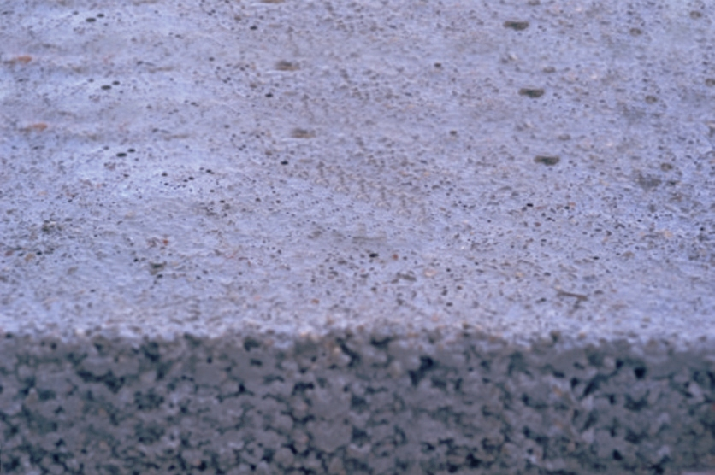
Repair Methodology – Protective Technology
Post 2 weeks of curing, waterproof with penetrative nanotechnology with a bonder in it.
Acts like anti-carbonation barrier.
All fine and micro pores will be sealed and surface is primed for painting.
Does not leach out or wash out due to chemical bonding & penetration
Over 20+ years UV stability (tested as per ASTM G-154)
Organofunctional Long Chain Molecule Group
Zycosil
Zycosil
Nature’s
Strongest
Bond
Si
Si
Si
Si
Si
O
O
O
O
O
Si
O
Si
O
Si
O
Si
O
Si

Slide 16

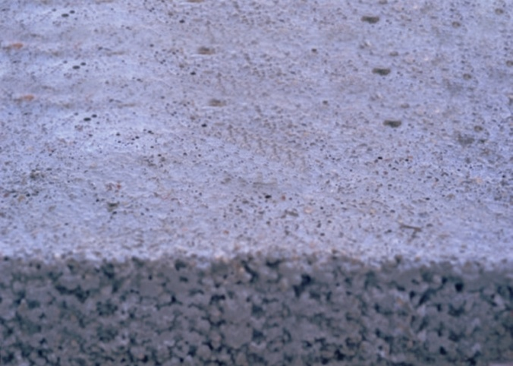
(Penetrative & Reactive)
Makes Surface
Water Resistant
Breathable surface
Allows Vapor
to Escape
UV & Heat Resistant
Concrete

Slide 17
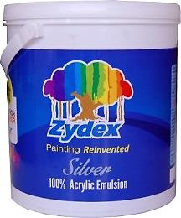
Repair Methodology – Aesthetic Technology
Apply a weather resistant 100% acrylic paint.
The paint should be breathable.
Zydex Silver Paint to be applied in 2 coats without primer.
Zydex Silver Paint conforms to IS:15489-2004
Indian Standard for Plastic Paint Emulsions
Tested for:
Drying Time (surface dry / hard dry)
Finish
Colour
Washability & Cleanability
Temperature Stability
Resistance to Alkali

Slide 18
Indicative cost per m² basis for estimation
Cost | Activity
Rs.70 per m² | Spray Bonding with ColdBond
Up to Rs.200 / m² | Polymer Modified Plaster with Elastobar
Rs.80 / m² | Waterproofing with Zycosil+
Rs.50 / m² | Paint with Zydex Silver
+
Surface preparation cost, as per site conditions
+
Labour, Overheads and profit for Contractor

Slide 19
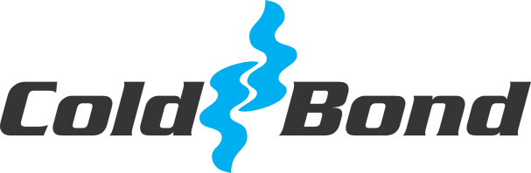
Technologies for New Construction
Construction / Cold Joints Bonding
Protective surface treatment
Weather resistant painting

