Slide 1


Slide 2
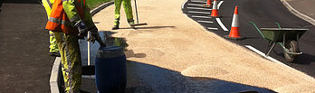
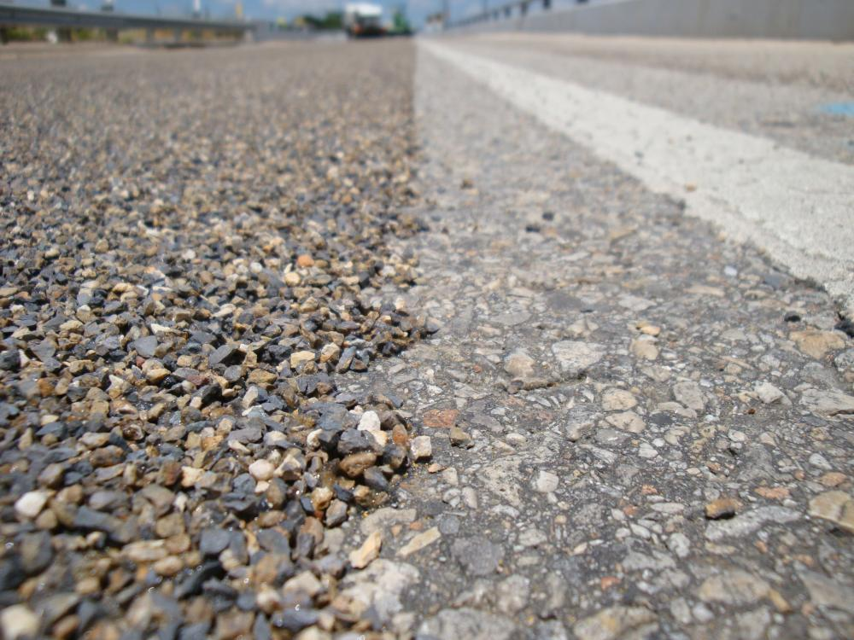
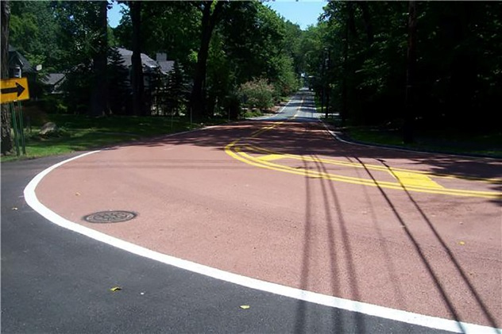

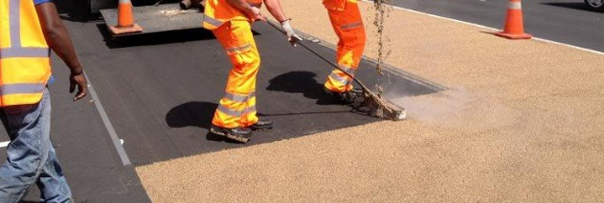
High Friction Surfacing(HFS)
A study in performance
Presentation to CPWD – 18th August 2017
VISHAL SALUJA
Chief Marketing Officer

Slide 3






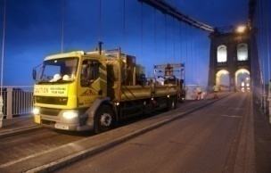
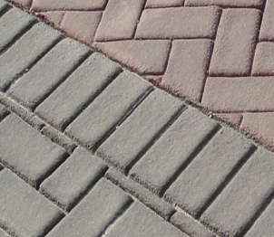
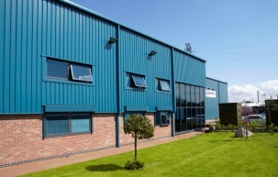
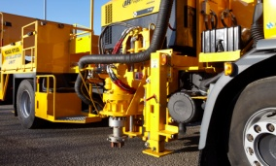
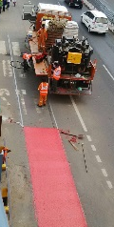
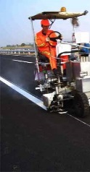
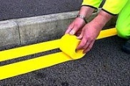
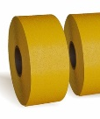
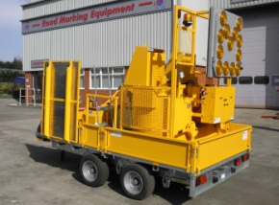
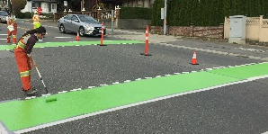
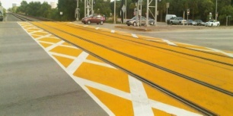
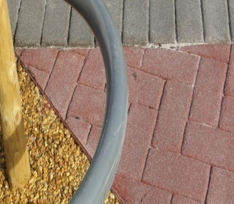
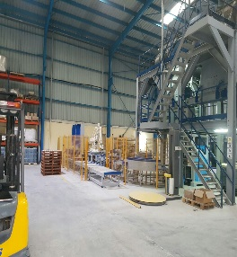
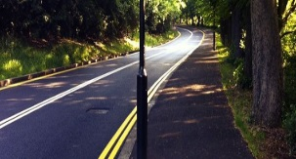
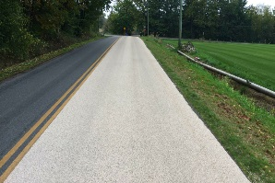
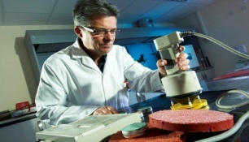
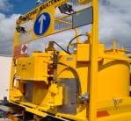
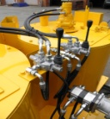

Briefly about each business:
1972
2002
2003
2010
2014
2016
Specialist
Contracting
Decorative Surfacing
Materials
Manufacture
Vehicle and Equipment Supplies
Material Manufacture and Contracting India and South East Asia
Distribution of Hitex Products North and South America
UK
International

Slide 4
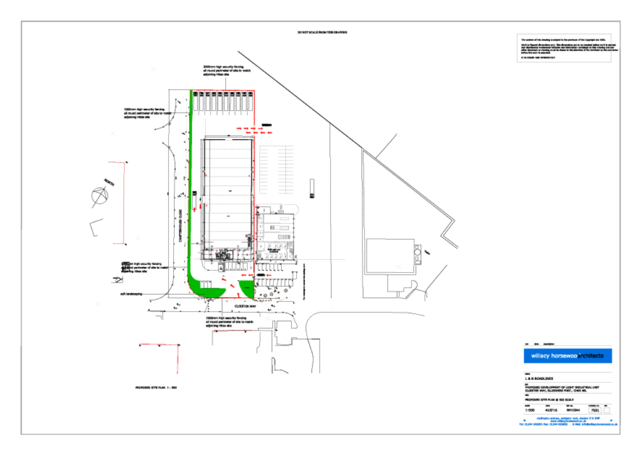
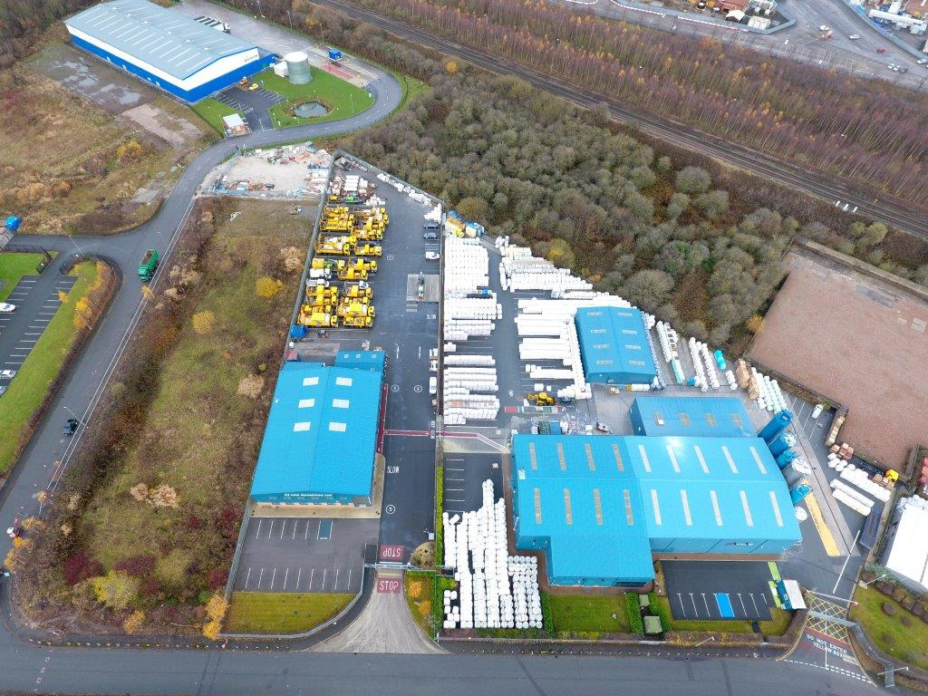


The future:

Slide 5
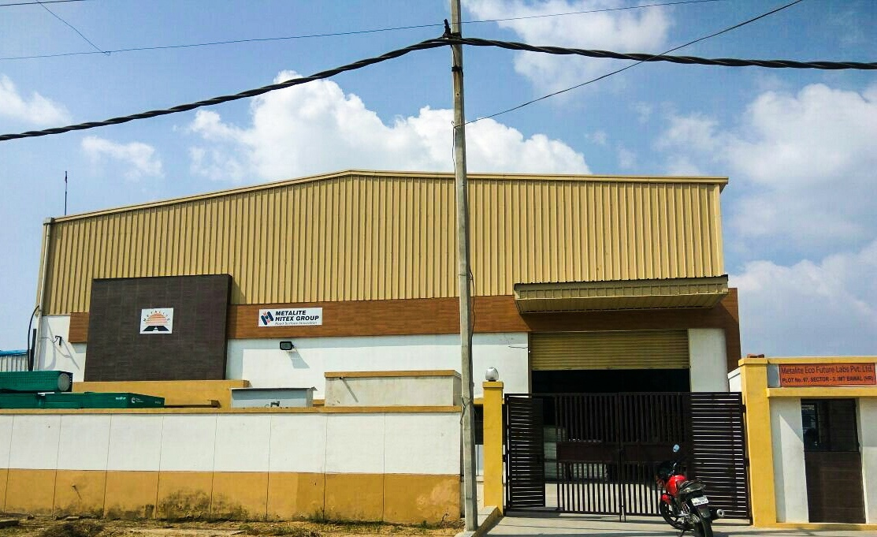
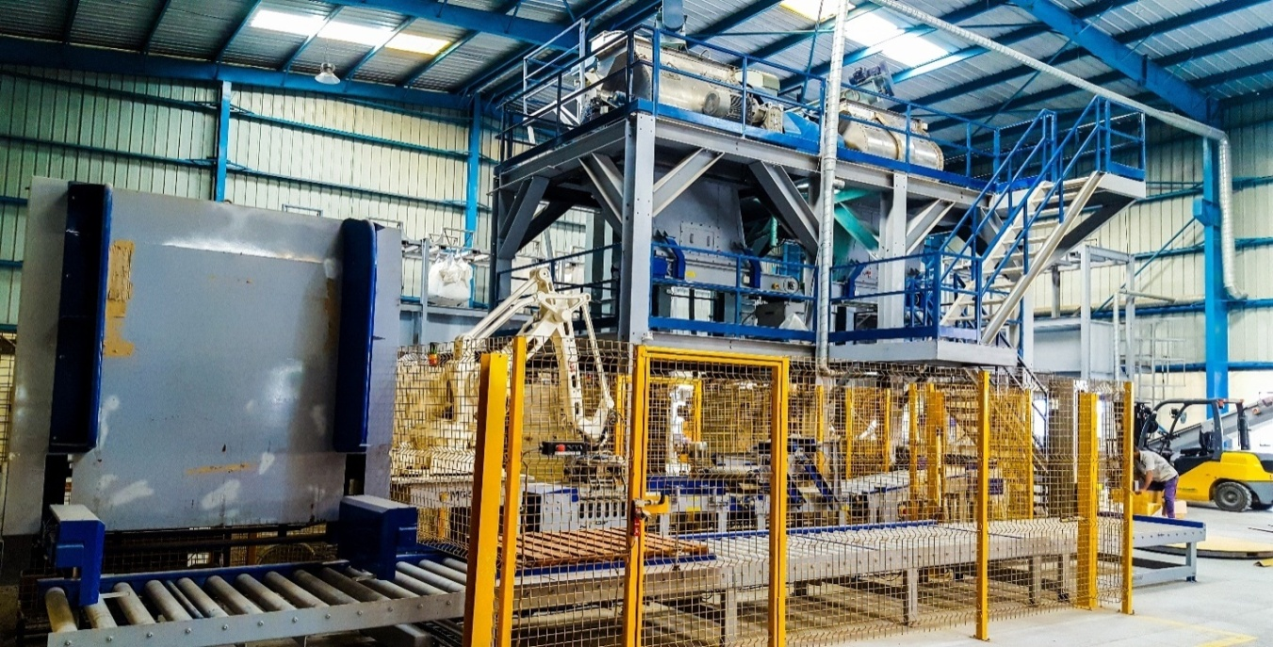
Metalite Hitex Group – Indian facility
Metalite-Hitex Manufacturing Plant
Established : June 2015,
Location: Bawal, India (Delhi Jaipur Highway)
Product Offerings from this plant : Thermoplastic road marking, (HiBrite) High friction anti skid surfacing material (ColourTex), crack sealing material (Texband) and cycle track material (CycleWay)
All our products are manufactured with the same attention to quality and as always, we strive to be the "easiest company to do business with.”

Slide 6
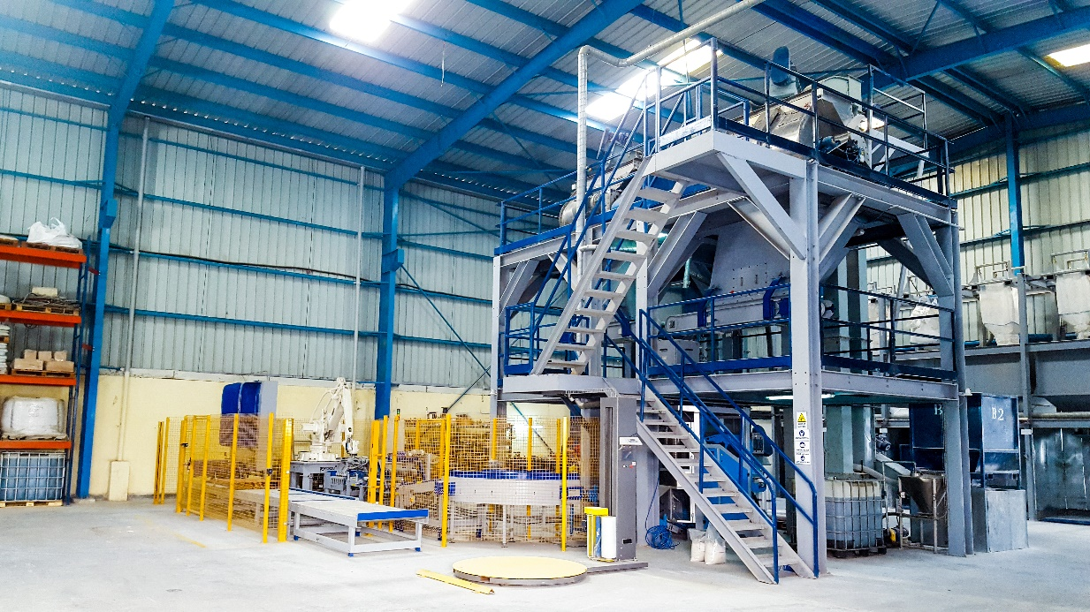
Metalite Hitex Group – Indian facility
The Process
Our manufacturing process consists of fully digital weighing systems for raw materials to ensure the perfect blend every time. After mixing our blend on high spec mixers we use the latest FFS (Form, Fill & Seal) machine to weigh and bag our product confirming to international standards. The finished pallets are weather protected using high quality automated stretch wrap machine.
Quality
To comply with the highest standards of quality we weigh and record every batch details into our system. For us quality starts right from selecting the raw material used in the manufacturing, the equipment & machinery used at the plant, production process, manpower training and knowledge, quality checks and controls and right down to even packaging.
We have a custom built laboratory at our India plant to check the raw material received at the plant & also testing the finished product on various parameters Our Indian plant is both ISO 9000 & ISO 14001 certified.
Hitex products have a proven track record of performance in even the harshest conditions, from the extreme temperatures of the Middle East and Africa, to the frozen roads and studded tyres of Scandinavia and Russia.

Slide 7
What is High Friction Surfacing?
HFS stands for High Friction Surfacing (sometimes also known as anti-skid surfacing)
These are pavement surface treatment systems that are composed of “tough” polish-resistant, abrasion-resistant aggregates bonded to the pavement surface using a resin. Both “hot applied” and “cold applied” with the sole purpose of providing vehicles with better grip on the road surface. High friction surface treatments (HFST) are an effective countermeasure for improving pavement friction to meet friction demand at curves for both asphalt and concrete surfaces.
HFST can increase friction values on bridge decks far above those achieved by new asphalt or concrete, as well as extend its lifespan. Developed to assist road users in important braking zones, such as on the approaches to traffic lights, hazardous bends, junctions, pedestrian crossings and roundabouts, Hitex products improve safety where it’s needed. This also includes improving vehicle steering response and grip in areas such as sharp bends or steep hills, where traction is important.
It is the perfect solution for use on the Urban and Rural networks, providing a safe and durable maintenance – free application. The high friction surfacing enhances road safety by improving braking time through increased surface friction.

Slide 8
Binder Properties in HFS system
Several varieties of resin binders are used in HFS systems, including epoxy-resin, rosin-ester, polyurethane-resin, polyester-resin, and methyl methacrylate binders. A description of the more common binders is provided below:
Epoxy-resin: This type of binder is a two-component system. One part of the system is composed of the resin and an oil to reduce the viscosity of the resin, and the second part is composed of the curing agent, bitumen, oil and accelerators. Both parts are mixed on-site.
Polyurethane-resin: A multi-component binder (two liquid and one powder, respectively) which cures chemically and is generally hand applied. The aggregate is then applied after. These binders help with achieving a quicker curing time during cold weather applications.
Acrylic-resin (MMA): Similar to epoxy-resin, however it has a faster curing time.
Rosin-ester: This type of binder is “premixed”, meaning the resin and the chippings are bagged as a dry powder. Once on-site, the powder is heated and spread.
“COLD”
“HOT”

Slide 9
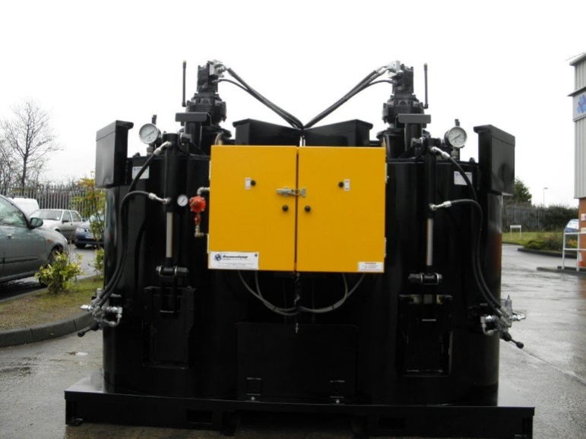
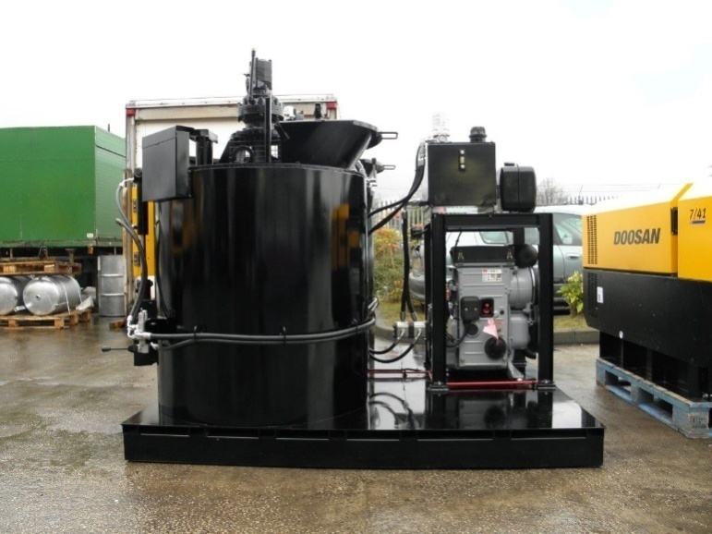
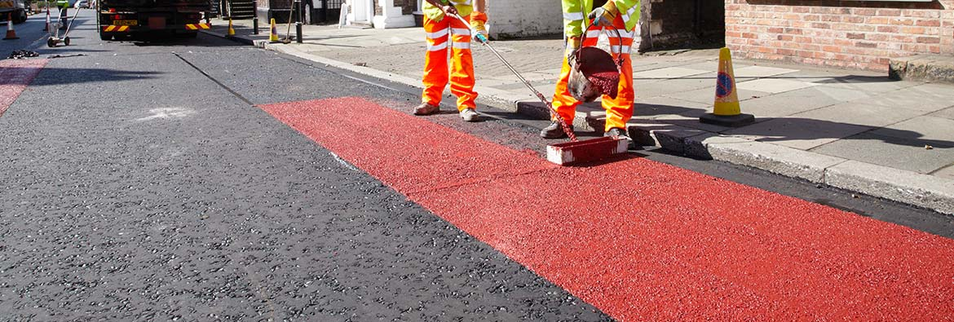
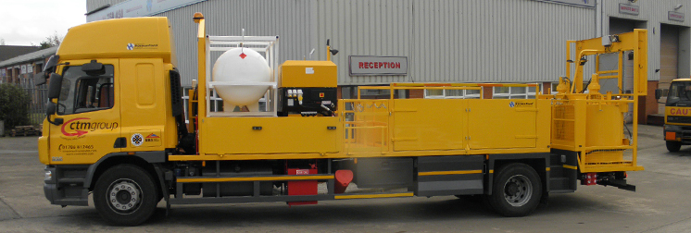

Hot Applied Material

Slide 10

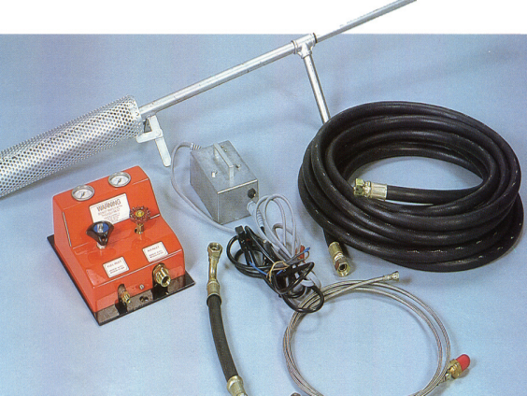
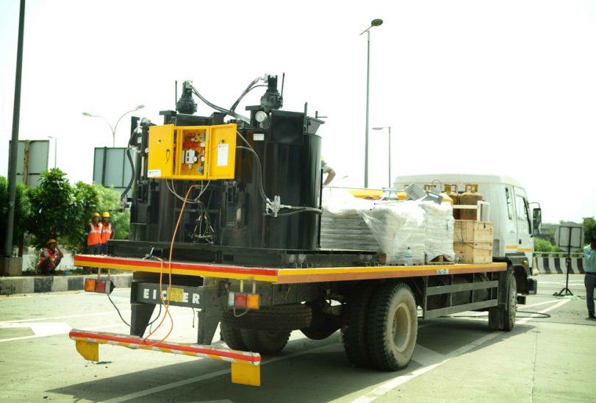
Equipment
Hot Compressed Air Equipment
Hot Compressed Air Equipment uses a mixture of propane gas and compressed air for drying and cleaning of road surface.
Twin Blade Boiler
Twin Blade Boiler constructed with 6mm boiler plate mild steel wall and 15mm base.
Its capacity varies from 0.5 Ton to 2.5 Ton
It is supplied with an integral fuel management system linked with independent thermostatic control
Eco friendly fuel – LPG used.
Most of our Equipment is imported to meet specific needs

Slide 11
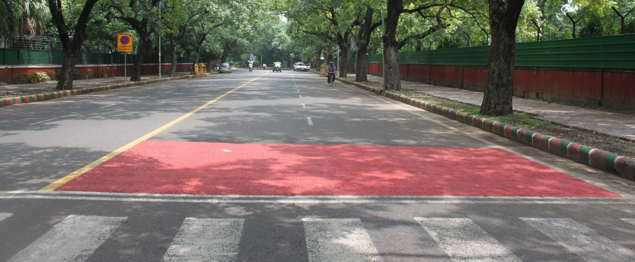
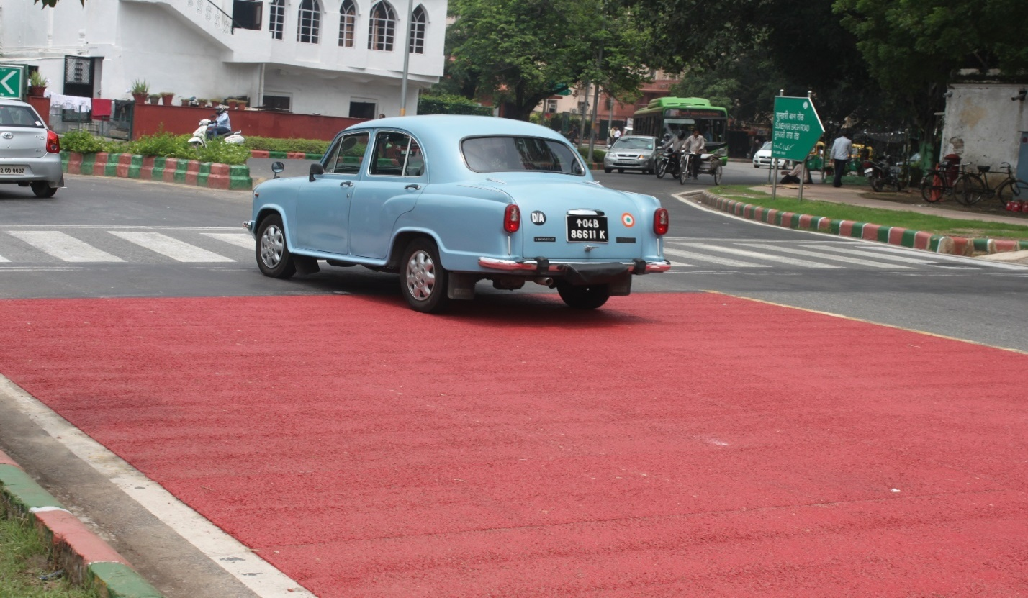
Some recent applications………………
Sunehri Bagh road, NDMC , New Delhi

Slide 12
Matiyala crossing, Dwarka, Delhi

Slide 13
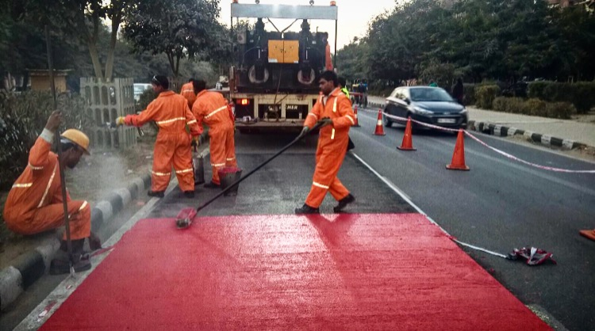
Locations covered so far
Ahmadabad
Pune
Pimpri-Chinchwad
Aurangabad
Nagpur
Delhi NCR
Raipur
Jaipur

Slide 14
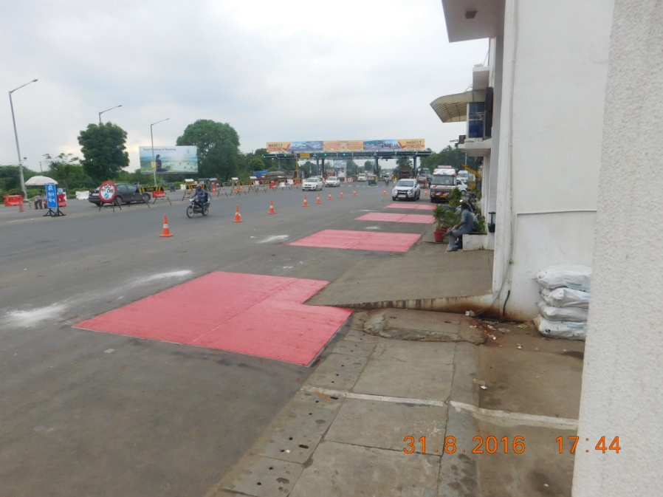
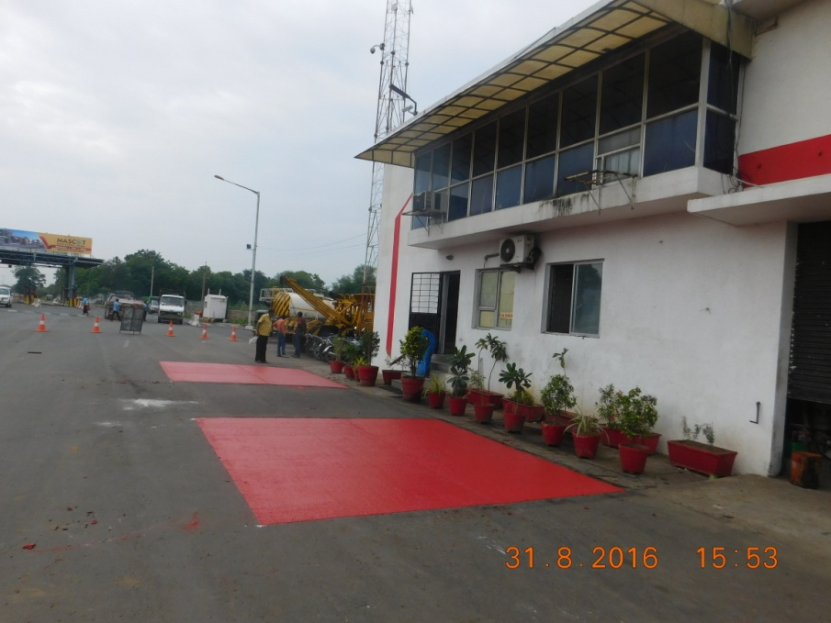
High friction surfacing application at Elsamex project
Applied in front of their toll office

Slide 15
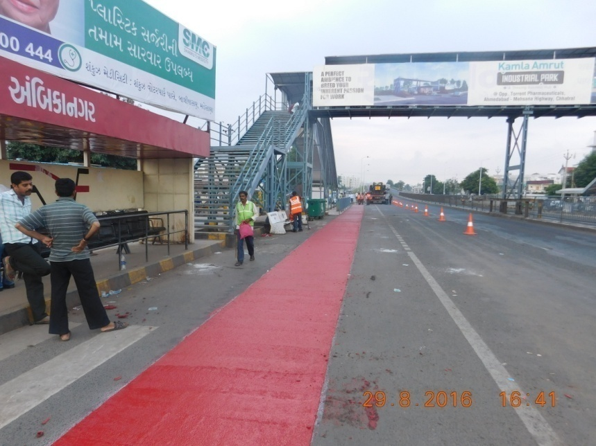
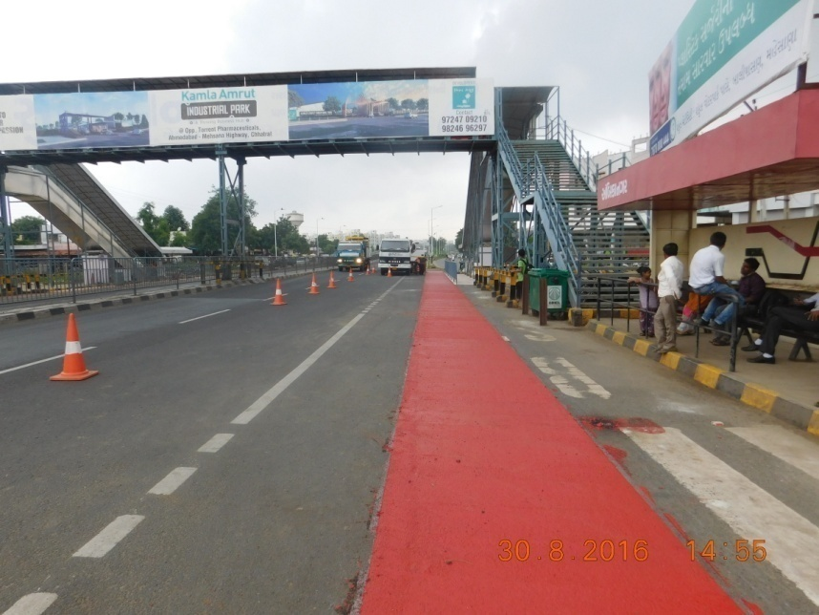
High friction surfacing application at Elsamex NH project
Applied at Ambika Nagar Bus stop Ring Road Ahmadabad

Slide 16
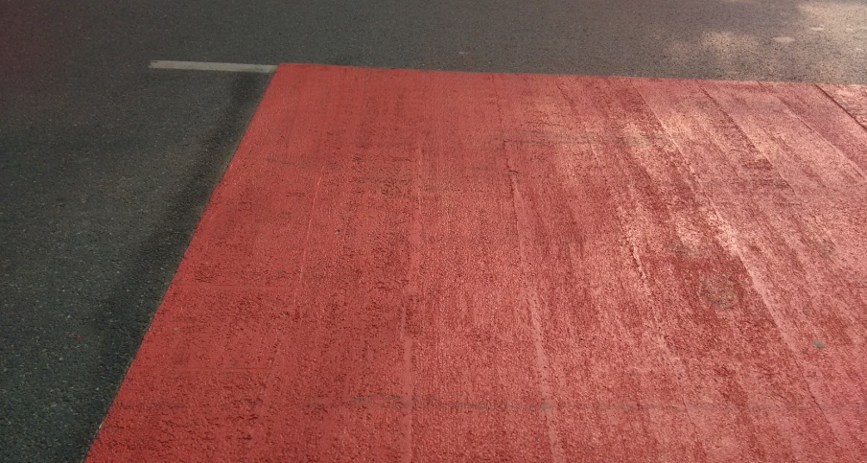
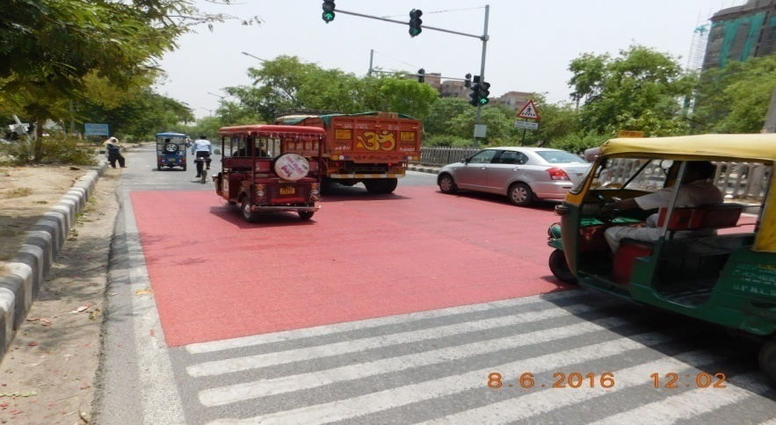
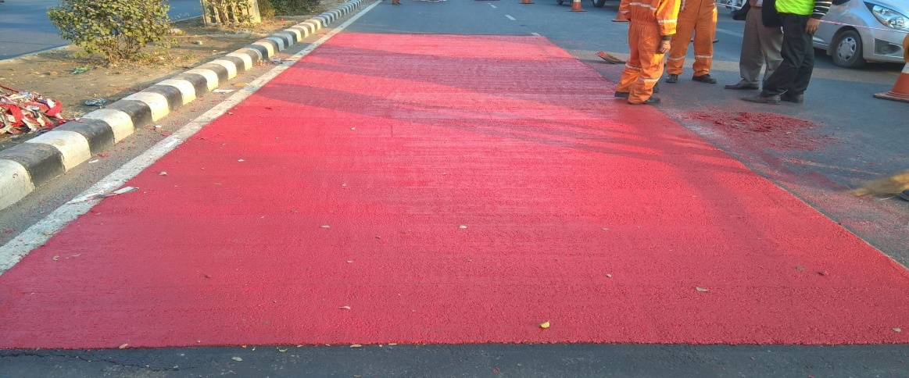
High friction surfacing application at Dwarka Delhi
Applied at Various Location in Dwarka, New Delhi

Slide 17
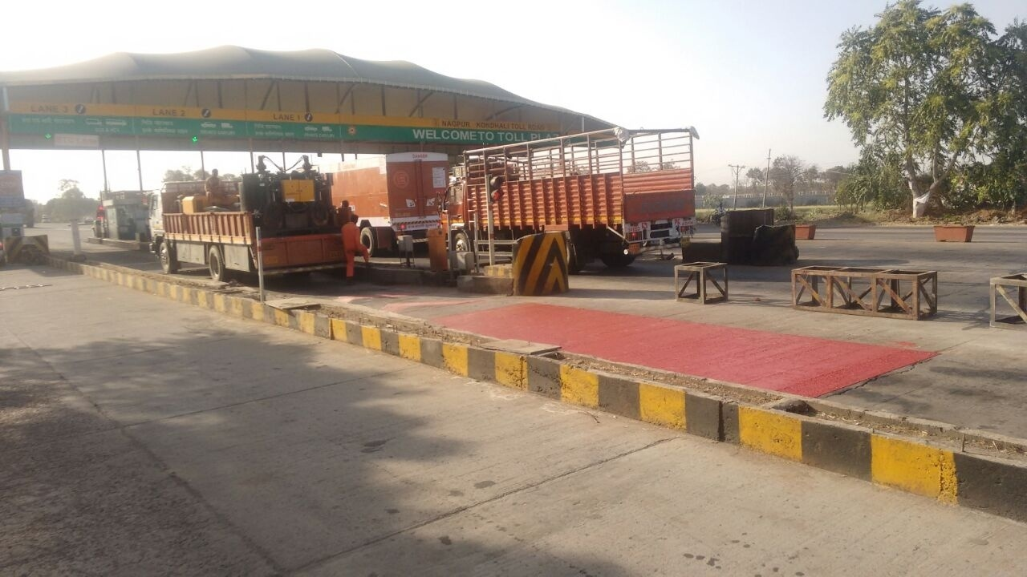
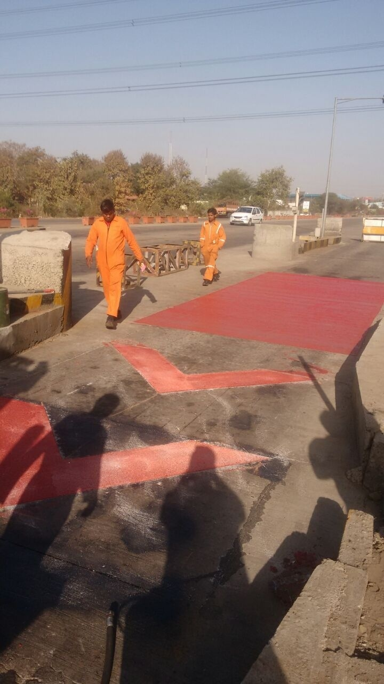
High friction surfacing application at Nagpur Toll-NHAI
Applied on the Toll plaza of Atlanta Infra Projects

Slide 18
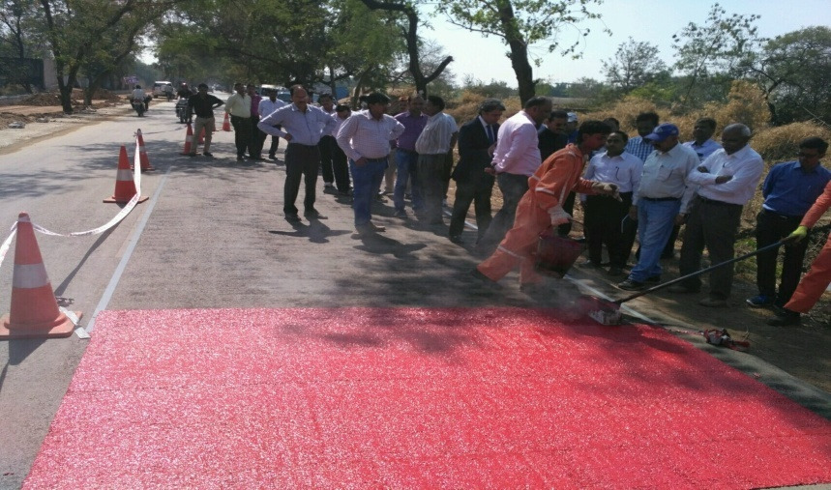
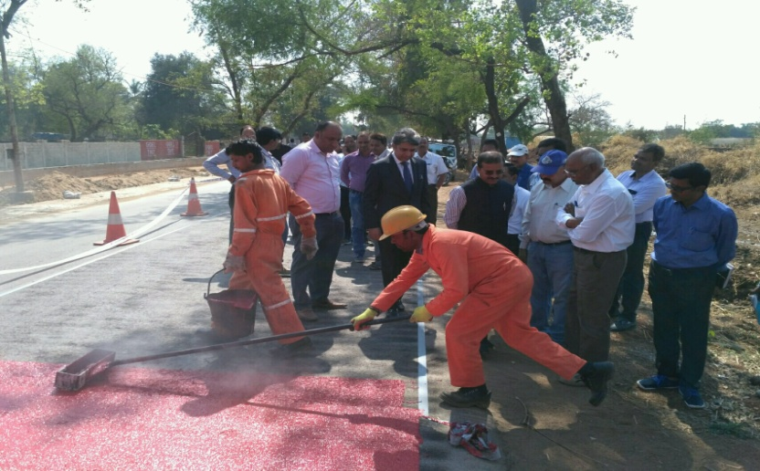
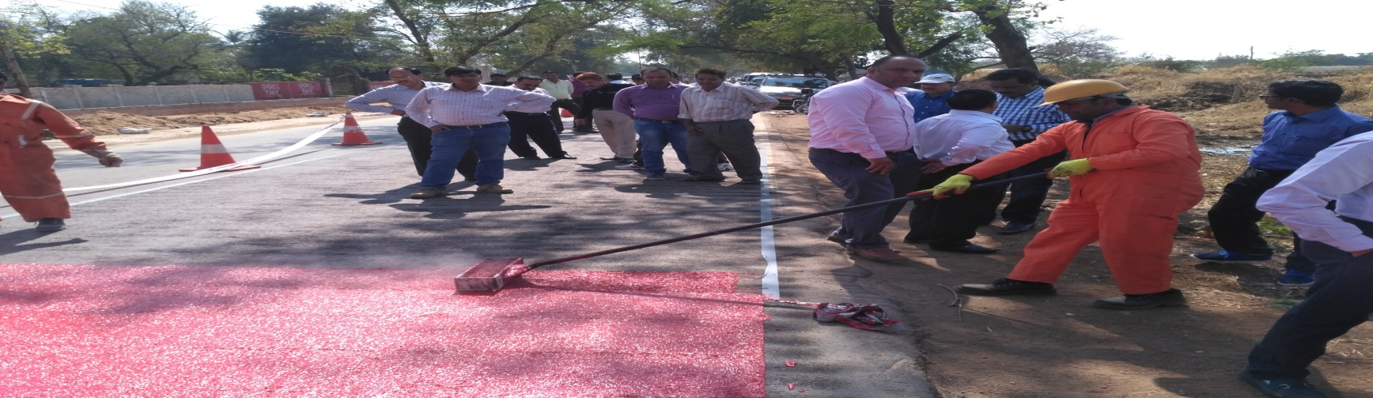
High friction surfacing application for PWD Chattisgarh
Application at Raipur VIP road from airport to city

Slide 19
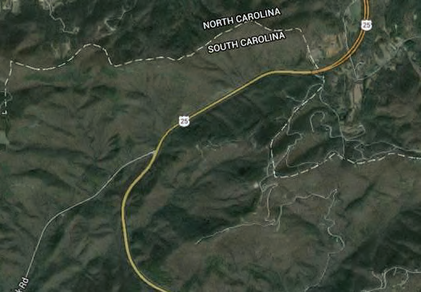
Significant success in US – High friction surfacing
South Carolina Department of Transportation (SCDOT) conducted a before and after study evaluating the HFST project’s success on US 25 revealed significant safety benefits, with a 68 percent reduction in wet crashes and a 56 percent reduction in total crashes. Six years after HFST installation, SCDOT reports the pavement treatment is holding up very well, considering the high exposure to snow plowing.
Iowa Department of Transportation (IDOT) chose to install the HFST application on a bridge over the Cedar River. Immediately after the installation, IDOT measured friction values in the 90s and low 100s and found that they stayed approximately the same several months later. When tested again a year later, values ranged from 80s to low 100s.
Long-lasting high friction values.
Inexpensive
No roadway closure
Quickly applied
Effective countermeasure for combating wet crashes

Slide 20
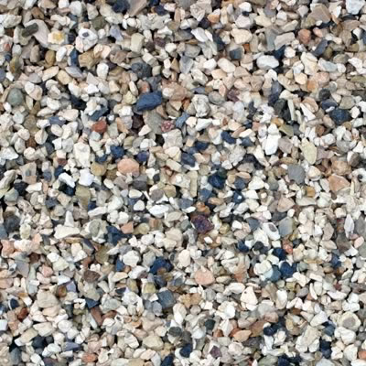



Skid Resistance Value (SRV)
Typical Initial Asphalt SRV level 55 SRV
Intervention Asphalt SRV level 45 SRV
Typical Initial HFS SRV level 78+ SRV
Typical 12 month HFS SRV level 78+ SRV

Slide 21
For the purpose of this scheme a High Friction Surfacing is defined as having a minimum skid resistance vale (SRV) of 65 measured using the portable Skid-Resistance Pendulum Tester as defined in TRL Report 176 : Appendix E
HFS Vs PSV
Asphalt which delivers a SRV above 65 through incorporation of a percentage of high Polished Stone Value aggregates.

Slide 22
UK HFS Application
Broadcast Systems
373,261 sq.m
Broadcast Systems
340,669 sq.m
28.7%
28.6%
71.3%
71.4%
Hot Applied System
927,360 sq.m
Hot Applied System
854,265 sq.m

Slide 23

The site
Main circulatory route
6.4 km long
8 major junctions
8 pedestrian crossings
Resurfaced in sections in 2011 and 2012
Original design specified HFS at all 16 junctions mentioned above. 50% were completed then design changed to High PSV asphalt

Slide 24


The site
Road is predominantly 4 lanes with sections extending to 6 lanes in areas and extending further at major junctions.
At approach to junction we see widening to 7 lanes

Slide 25
Testing
Testing was conducted at all major junctions
Further testing conducted at 4 pedestrian junctions

Slide 26
SCRIM Testing September 2013
SCRIM testing was conducted at 12 locations along the route.
HFS
Average SRV = 77
At this time the High PSV aggregate asphalt was newly laid.
Hot Applied Type 1 Buff had been installed for 14 months
High PSV Aggregates
Average SRV = 68
Difference in SRV
9 units
At each location measurements were taken at:
  Inner Track
  Mid Lane
  Outer Track

Slide 27
Pendulum Testing October 2015
Pendulum testing was conducted at 12 locations along the route.
HFS
Average SRV = 79
At this time the High PSV aggregate asphalt was 2 years old.
Hot Applied Type 1 Buff had been installed for 3 years and 2 months
High PSV Aggregates
Average SRV = 69
Difference in SRV
10 units
At each location measurements were taken at:
  Inner Track
  Mid Lane
  Outer Track

Slide 28


Slide 29


Pendulum Test Results January 2015
Case Study Test Results October 2015
HFS
Average SRV = 82.7
HFS
Average SRV = 79
Asphalt
Average SRV = 77.9
High PSV Aggregates
Average SRV = 69
Difference in SRV
5.7 units
Difference in SRV
10 units

Slide 30


Pendulum Test Results January 2015
Case Study Test Results October 2015
HFS
Average SRV = 82.7
HFS
Average SRV = 79
Asphalt
Average SRV = 77.9
High PSV Aggregates
Average SRV = 69
Difference in SRV
10 units
Difference in SRV
5.7 units

Slide 31
How does this relate to India?
HFS
Average SRV = 82.7
HFS
Average SRV = 82
Typical Indian Initial Asphalt SRV
SRV = 55
Indian Intervention Level SRV
SRV = 45
Difference in SRV
27.7 units
Difference in SRV
37 units
With passing time, every single unit difference in SRV , the distance on ground is even more

Slide 32


Thailands school zones project wins Evonik award
R:15
G:47
B:98
R:63
G:109
B:161
R:123
G:161
B:206
R:235
G:139
B:51
R:237
G:153
B:76
R:242
G:182
B:127
R:26
G:26
B:24
R:91
G:91
B:108
R:127
G:127
B:127
R:192
G:80
B:77

Slide 33



Where should it be used?
All Horizontal Curves, Bends and Ramps
Intersections/Intersection Approaches
Hilly terrain
Steep Grades
Roundabouts
Hard paved shoulders
Toll plaza area
Bus Stop Areas
Pedestrian Walkways
Bridge Decks
Parking bays (optional)

Slide 34


Coloured Lane Delineation

Slide 35
Why Indian roads need high friction surfacing - ColourTex
Indian Road Safety Statistics – Some startling facts
The total number of road accidents increased by 2.5 per cent from 4,89,400 in 2014 to 5,01,423 in 2015. The total number of persons killed increased by 4.6 per cent from 1,39,671 in 2014 to 1,46,133 in 2015.
Road accident injuries have also increased by 1.4 per cent from 4,93,474 in 2014 to 5,00,279 in 2015. Accident severity ( number of persons killed per 100 accidents) has gone up from 28.5 in 2014 to 29.1 in 2015.
The analysis of road accident data 2015 reveals that about 1374 accidents and 400 deaths take place every day on Indian roads. It further reveals that 57 accidents take place and 17 lives are lost every hour on an average in road accidents in our country.
The total number of road accidents per lakh population increased in the country from 39.5 in 2014 to 40.0 in 2015. Similarly number of persons killed and injured per lakh population also increased from 11.3 to 11.7 per cent and 39.8 to 39.9 respectively in 2015.

Slide 36
Some Statistics - Cost involved in road accidents in India
Medical costs account for43% of total costs of care in the management of rod accident victims. These are the direct costs, the indirect costs are related costs, loss of work and wages, loss of property etc.
Nearly 3,80,000 Indians have been displaced by the road accident disasters and it is expected to cost more than 1.2 billion dollars (World Bank).
In 2009 only, 1.27 lakh people died in road accident in India resulting a financial cost of approximately 1,36,000 crore Indian rupees (Mondal et al, 2011).
In 2009, for every 4.14 minute and 1.13 minute one death and one injury took place respectively in India from road accident s. The Planning Commission of India had actually assessed the social cost at 55,000 Crore on account of road accidents in India.
In 2012, the International Road federation (IRF) estimated that traffic collision results in an annual monetary loss of $20 billion in India. This figure includes expenses associated with the accident victim, property damage and all other administration expenses.
The Save Life Foundation, a Delhi-based, independent, non-profit organization working to improve road safety and emergency care across India, has said that the Planning Commission in a 2014 report had estimated that the annual cost of road crashes in India could be around 3% of GDP.

Slide 37

Some Statistics - Cost involved in road accidents in India
According to the data released by the Central Statistical Organization, the GDP for 2014-15 was Rs 126 lakh crore. Thus, the cost of road crashes would have amounted to Rs 3.8 lakh crore. Compared to Budget 2015, the cost of road crashes amounts to one-fifth of the Budget.
The table below compares the cost of road crashes with the monetary allocation of certain important ministries:
Conclusion: The cost involved in road accident far exceeds the budget allocation by respective ministries and continues to increase year after year.

Slide 38

Summary:
HFS provides a solution for restoration of skid resistance on existing pavements or enhancement of skid resistance on new pavements
HFS provides a solution for “spot treatment” of a pavement where friction demand is highest – high braking zones
Low Cost Treatment (when compared to removal and replacement existing pavement)
Can be installed during short (4-6 hour) closures of the pavement and only one lane at a time, also curing time is
Only minimal additional thickness or (3-5mm) thickness for areas where overhead clearance is limited
Can be installed over virtually all pavement types and can be coloured for delineation purposes
To reduce accidents and casualties on Indian roads and highways its high time that the authorities start using high friction surfacing to save precious lives and make roads safer for use

Slide 39
Thank You!

