Slide 1

CPWD PRESENTATION - August 18th, 2017
NUPHALT - AN INFRARED RECYCLING POTHOLE REPAIR TECHNOLOGY
Vishal Saluja - Chief Marketing Officer

Slide 2
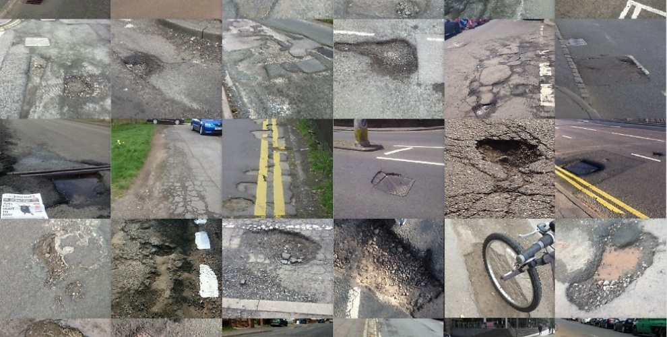
Potholes aren’t just a local problem, It’s a global problem that needs local solution

Slide 3
Over 11,000 people are killed by potholes in India every year.
UP tops the list with around 4800 deaths due to potholes in UP itself
Other leading states are Madhya Pradesh, Bihar, Tamil Nadu, Karnataka & Maharashtra.
Actual figure could be much higher since the data was not properly captured by local police while registering accidents and in many cases these are recorded as any other road crash.
Experts have concluded that poor maintenance by road-owning agencies is the main reason behind potholes contributing to crashes and also lack of uniformity and standard design
Recommendations by Road Safety Committee
Road-owning agencies were held accountable for maintenance and booked for negligence, the menace of potholes won't end. "We have hardly any cases of any action taken against such negligent officials/employees," .
For deaths caused caused by potholes, governments must compensate the families of victims and hold contractors, government officials and ministers criminally liable for sub-standard roads.

Slide 4
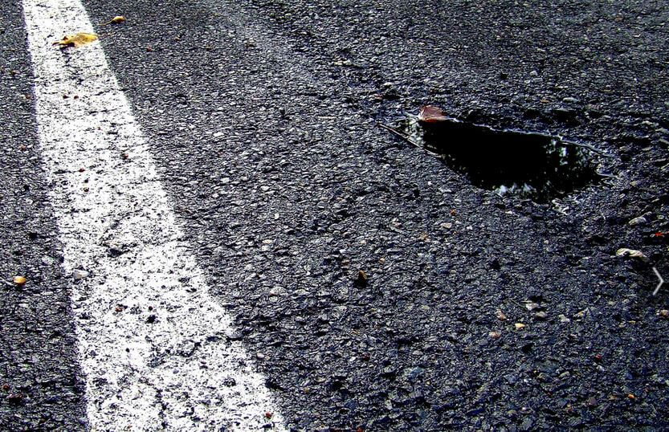
What are potholes?
Potholes are localized distress in an asphalt-surfaced pavement resulting from the breakup of the asphalt surface and possibly the asphalt base course. Pieces of asphalt pavement created by the action of climate and traffic on the weakened pavement are then removed under the action of traffic, leaving a pothole
What is their cause?
Potholes are commonly caused from water seeping into cracks in the roadway during wet and freezing conditions. The water weakens the underlying support of the road surface, and when it freezes, it pushes up on the asphalt layer and down on the underlying material. When traffic passes over the weakened and stressed portion of asphalt, the loads and vibration cause the weak underlying material to sink and the surface layer to crack and break up leading to a pothole.
Best Remedy
Quality pothole patching is achieved through a combination of material selection and repair procedures. Although hot mix asphalt is the best type of patching material, cold mix asphalt is also sometimes used by agencies due to its low cost, however it’s a very temporary repair and does not last beyond few months.

Slide 5
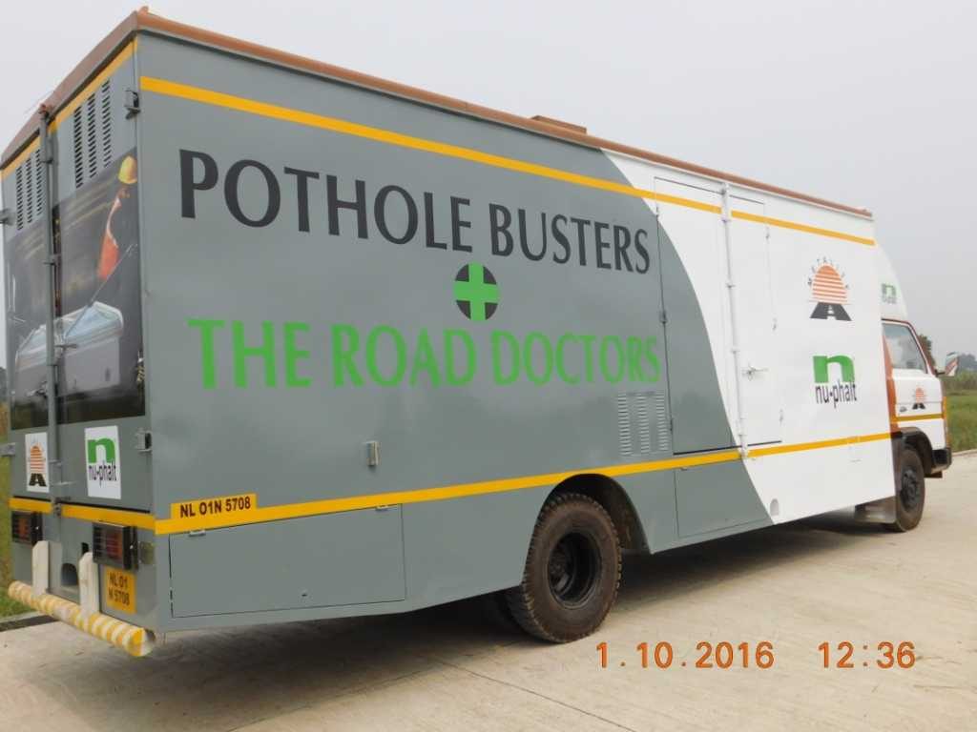
2x1 m Heater Model – For Highway & Heavy Duty Work
1x1 m Heater Model – For Inner City & Smaller Jobwork
FUTURE OF ROAD AND POTHOLE REPAIRS

Slide 6
NuPhalt - A Way to Hassle Free Road Repair System
Road repair work is always a painful aspect, being scattered in small patches at distances and if the defects are not arrested at the right time by the right process, then the requirement for overlays come up sooner than desired or projected. The damaged road surface invites traffic jams and leads to a lot of accidents and fatalities.
Whereas
We offer a solution under a single window, which addresses all the road surface related problems in a systematic and effective manner.
Both the rapid repair systems are useful since both are single vehicle operations and only one lane of the road is barricaded for execution of the work. There is minimal traffic disruption which avoids pollution due to traffic jam during repair. Work can be taken up at night in highly congested area

Slide 7
HOW IT WORKS - THE 6 STAGE PROCESS
1
HEATING
The portable thermal heater is positioned over the defect area. An 8 minute pulsed
heat cycle allows the fully controllable and efficient NIT heater to penetrate the
wearing course to relinquish its strength, creating a workable material without
carbonising or damaging it in the process.
2
SCARIFICATION
To deliver a strong seamless joint, operators scarify an area 50mm in from the repair edge. This ensures integrity of the heated thermal joint between new and existing material. No material is taken from the repair, everything is recycled in-situ, resulting in no waste or landfill.
3
REJUVENATION
High grade enriched emulsion is added to the repair area. This is evenly mixed
through the recycled material to deliver a consistent and even exposure. This recoats the recycled aggregate increasing bitumen content to near ‘new materials’ levels.

Slide 8
HOW IT WORKS - THE 6 STAGE PROCESS
4
NEW MATERIAL
BBA HAPAS approved material is supplied in 25kg bags for ease of use and is fed
to and from the on board hot box’s. New material is heated to 100°C before being
transferred to the repair area. Sufficient levels of material are added to create a level repair following compaction.
5
CHECKING TEMPERATURE
An Infrared Thermometer is used to check the temperature of the repair area,
material temperature should be between 70-100°C to provide the best compaction conditions.
6
COMPACTION
Compaction equipment is specified in line with the repair area’s requirements. All
edges are rolled first to create a mechanic interlock with the surrounding surface. A
skilled operator assesses the repair area’s compaction requirements to complete a
high quality and level repair.

Slide 9
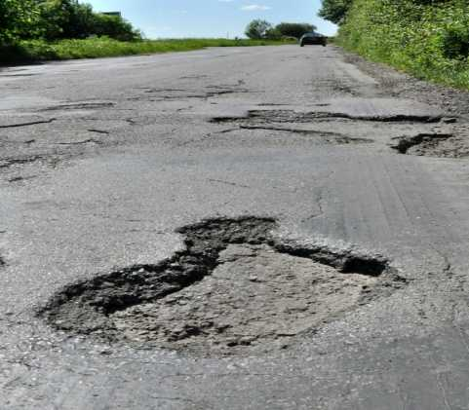
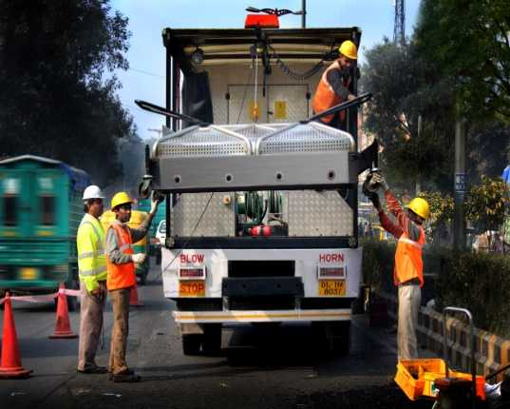
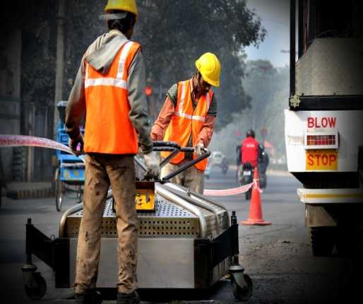
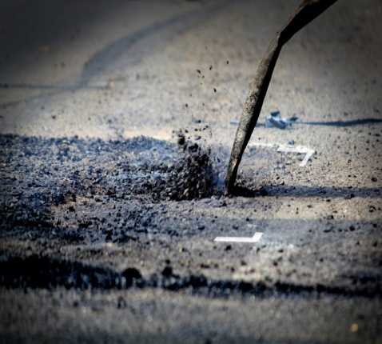
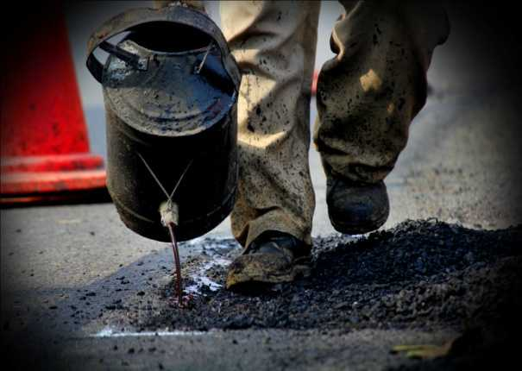
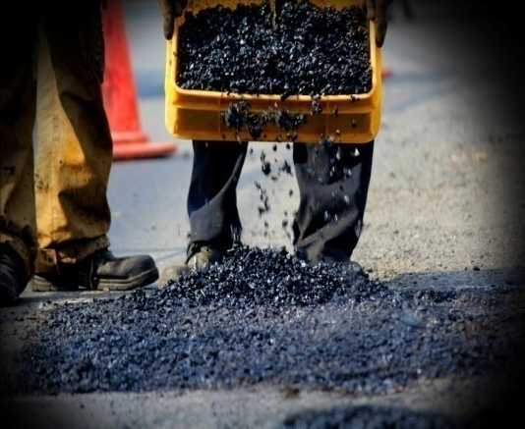
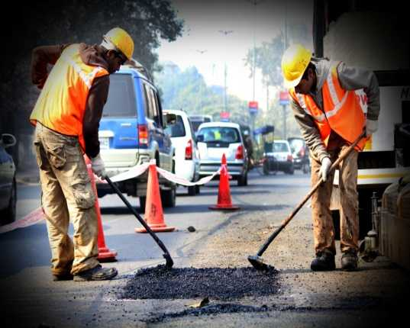
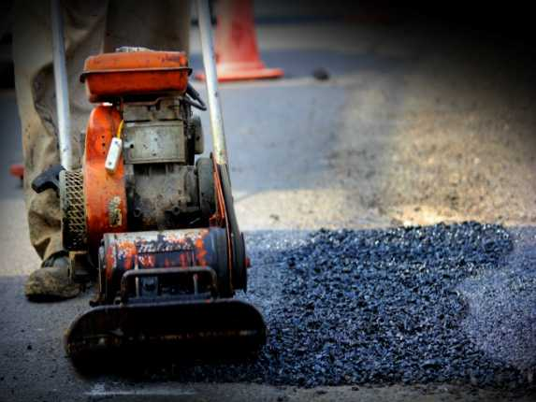
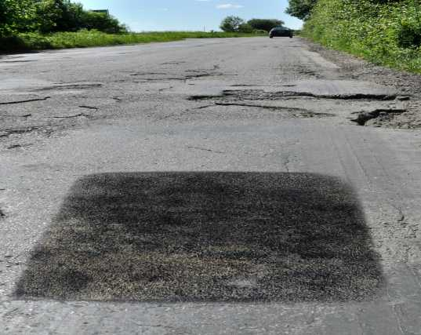
NuPhalt Infrared System Process

Slide 10
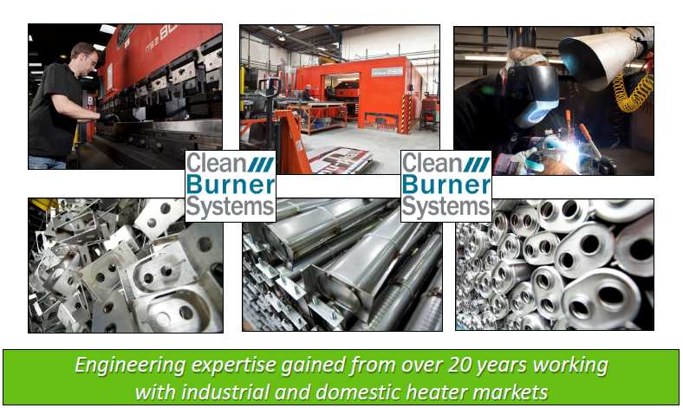
The Engineering behind NuPhalt technology

Slide 11
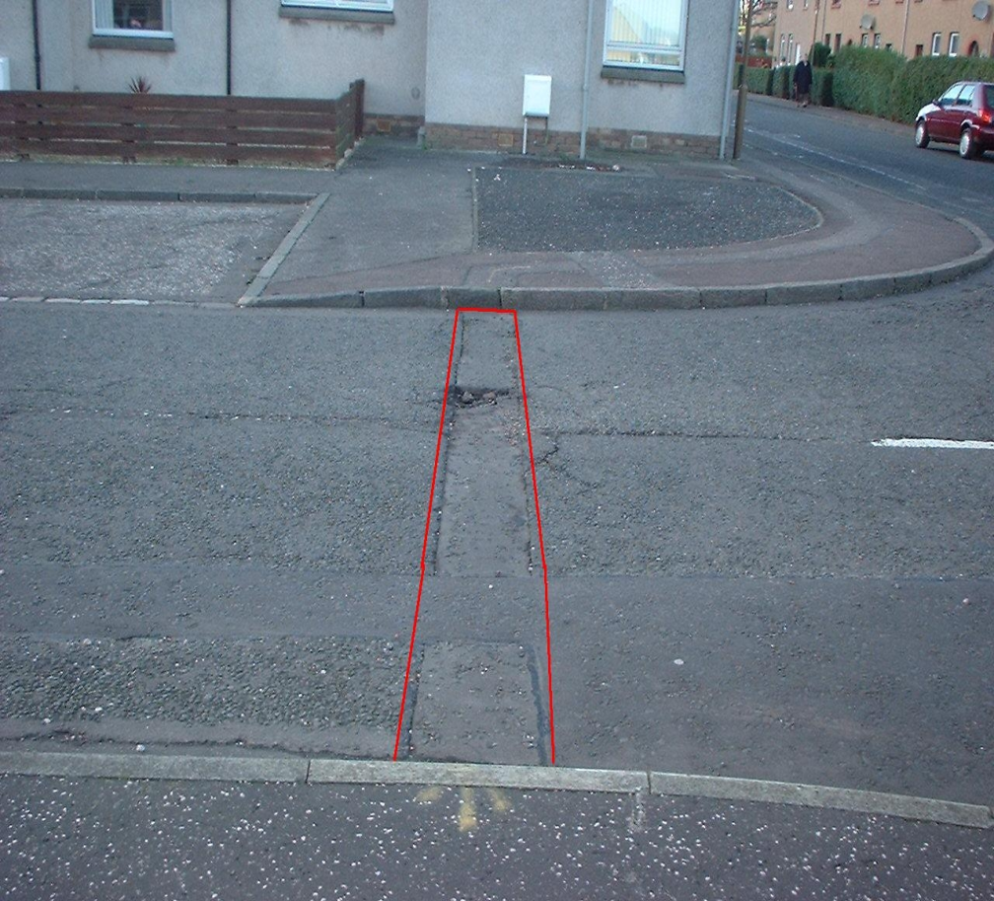
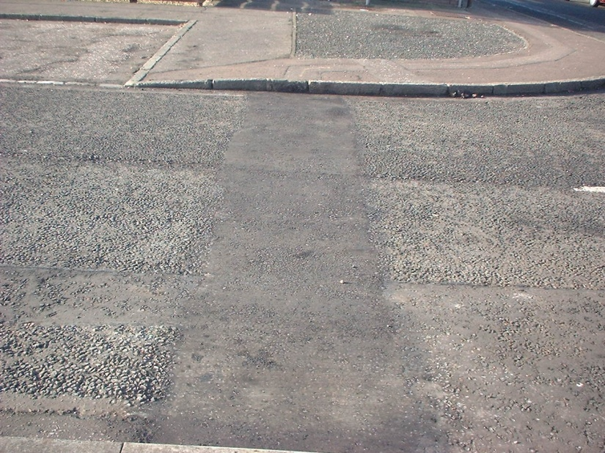
Nu-phalt Infrared Road Crossing Repair
Before
After

Slide 12
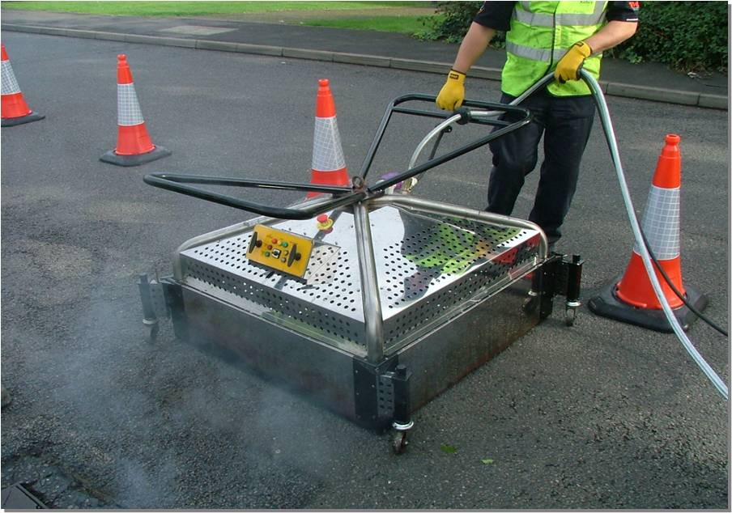
1 x 1 heater – Easy to operate design
Locate IR Heater Over Failed Area

Slide 13
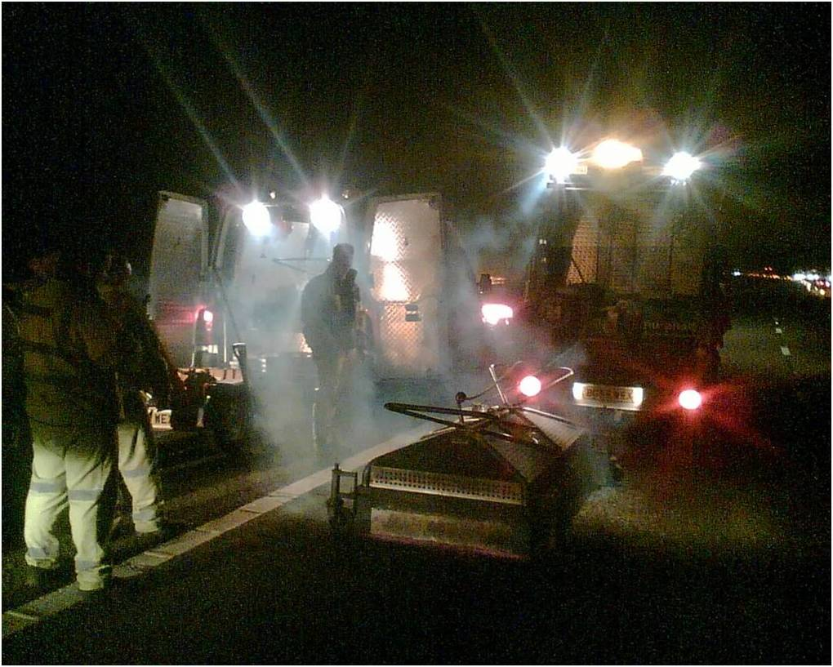
nu-phalt with Highways Agency M1 on HRA

Slide 14
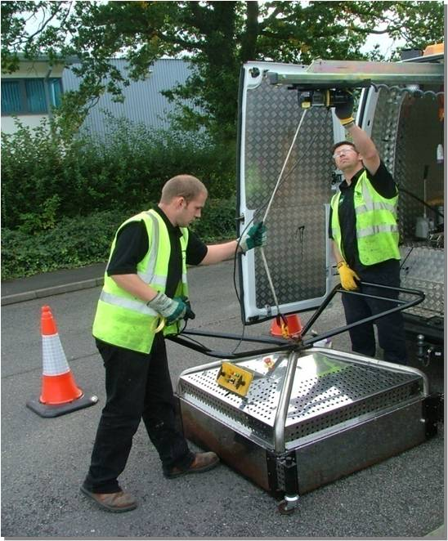
Using Hoist System Off - Load Equipment

Slide 15
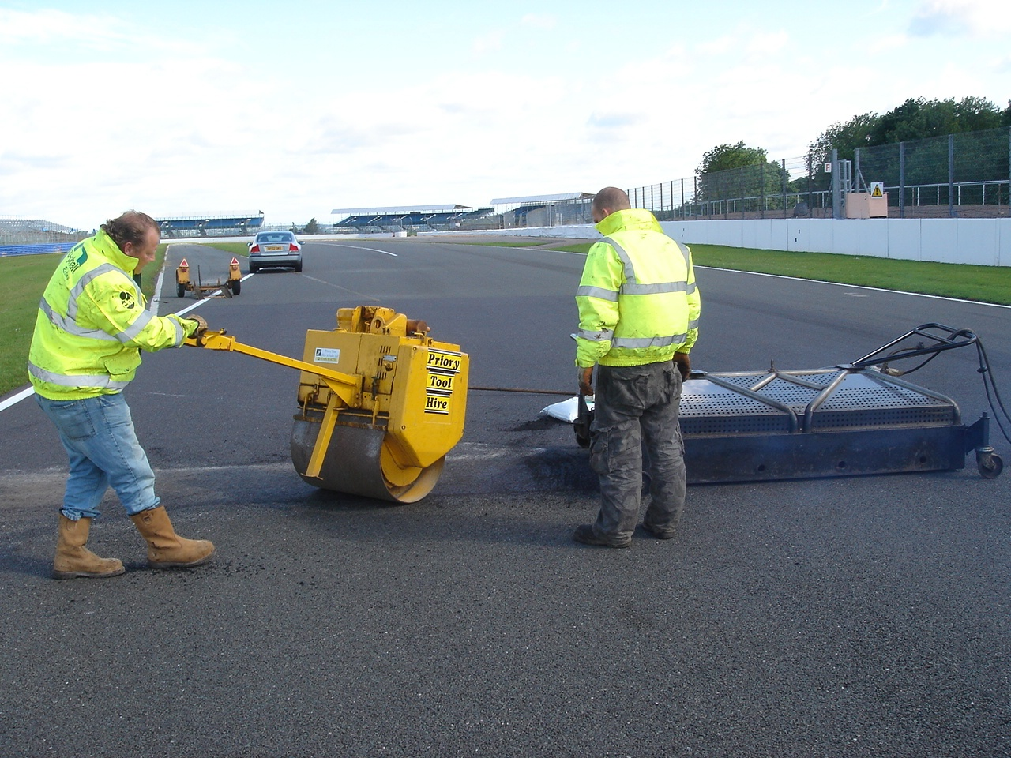
nu-phalt re-level on Silverstone GP Circuit

Slide 16
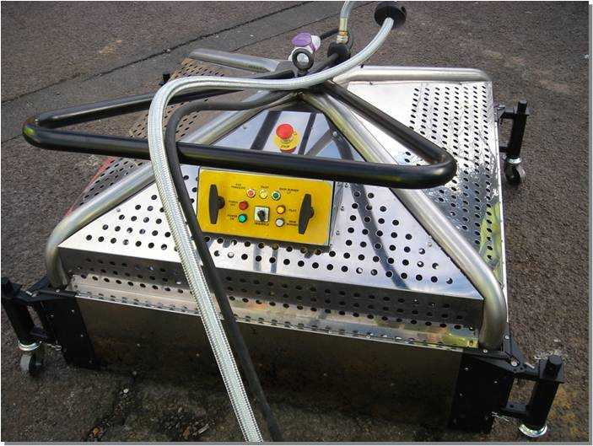
The NuPhalt Infrared Heater
Patented design built in stainless steel 304 grade body with simple to operate unique process logic control system
The heater has simple to operate solid state process logic control (PLC) system
The infrared heater has a maintenance free knitted alloy mesh with no direct visible flame. This knitted material is not only durable it has an advantage because it allows the burner output to be controlled
It is fully controllable through 4 gas burners and via an on-board computer system initially controlling the burner and then measuring ambient temperature, burner deck temperature and surface temperature.
Due to this controllable heat source the amount of gas and air mix through the pre mix fans will reduce once the surface temperature reaches 150°C(Approx.) and will ensure that the surface being heated is not damaged.
The Infrared heater is mounted on metal casters and therefore it can be easily moved into the position on-site.

Slide 17
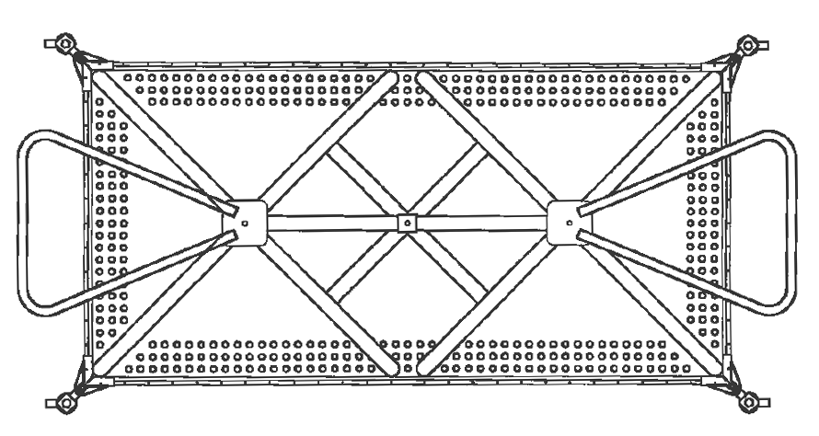
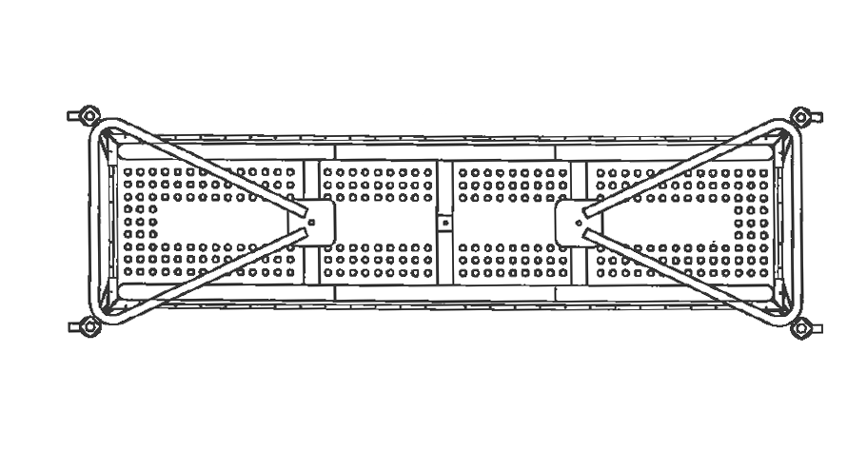
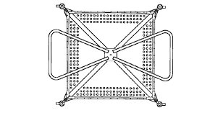
The 5 types of IR Heaters:
1 x 2 Meter – Highways and Urban Road Potholes
0.5 x 2 Meter – Specially for Logitudinal Repairs
1 x 1 Meter – For smaller vehicle & narrow city roads

Slide 18
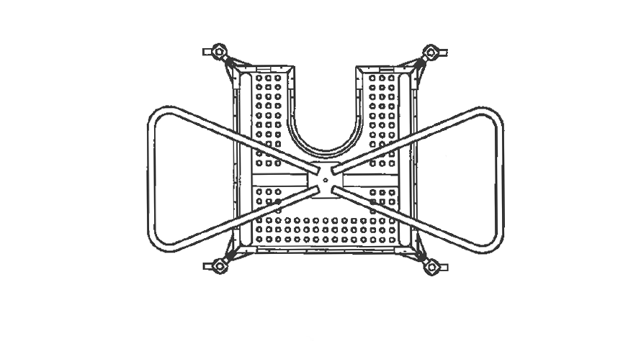
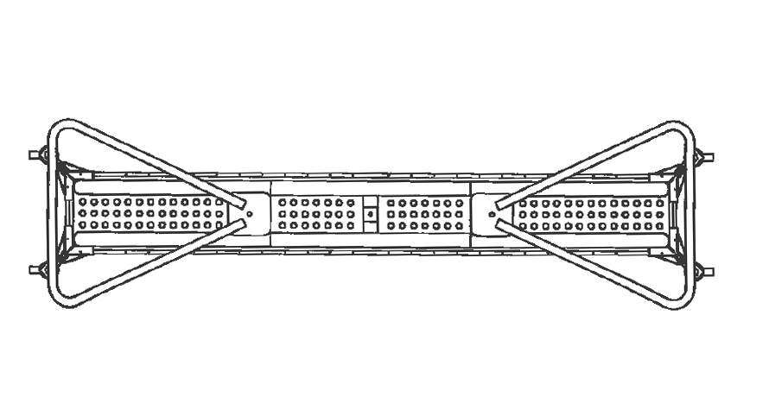
0.8 x 0.8 Meter – Specially for repair work around poles
0.25 x 2 Meter – Specially for Tranche repairs & metal work

Slide 19
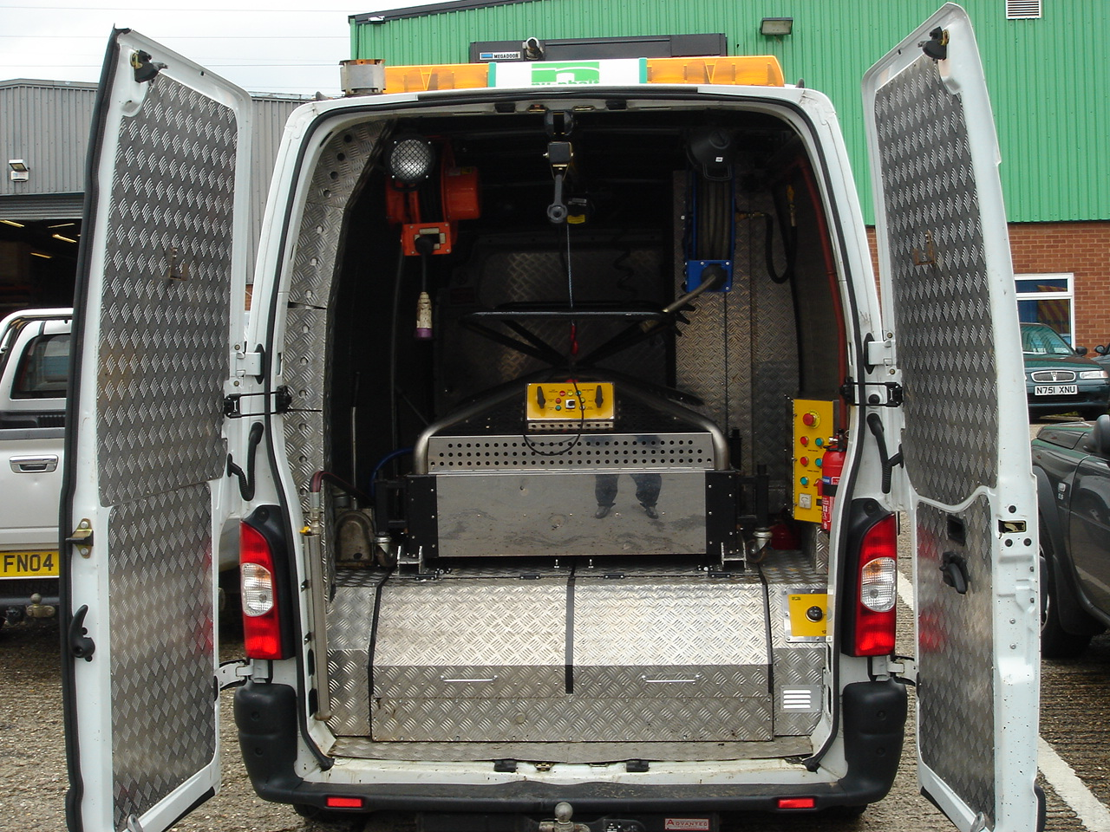
Ready To Drive Away

Slide 20
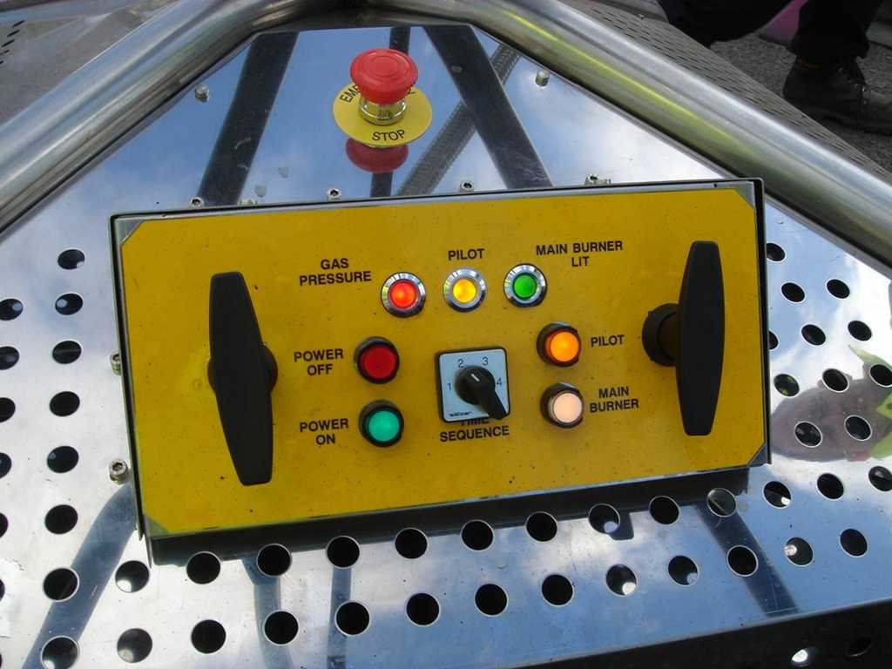
NuPhalt Infrared System Process

Slide 21
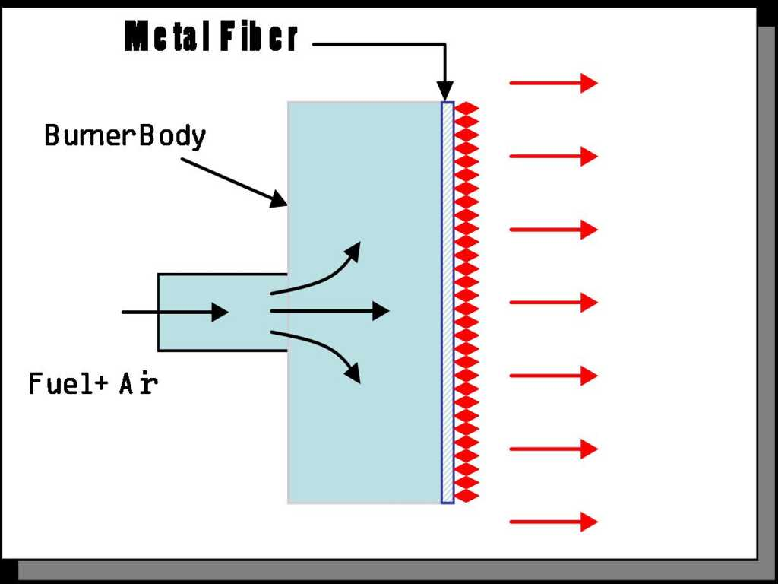
How Does The NuPhalt Infrared System Work?

Slide 22
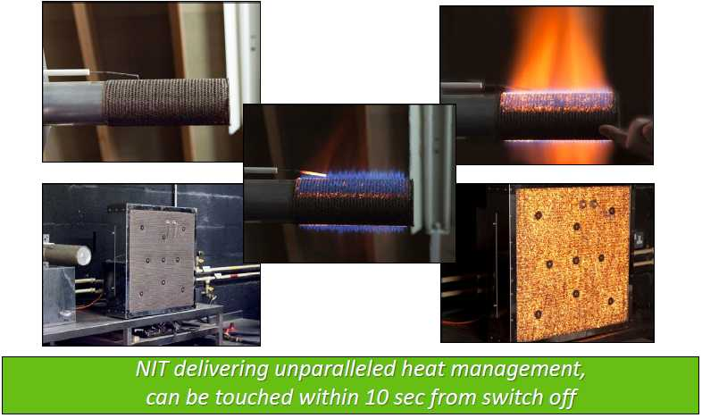
Unique & Innovative NIT Heaters

Slide 23
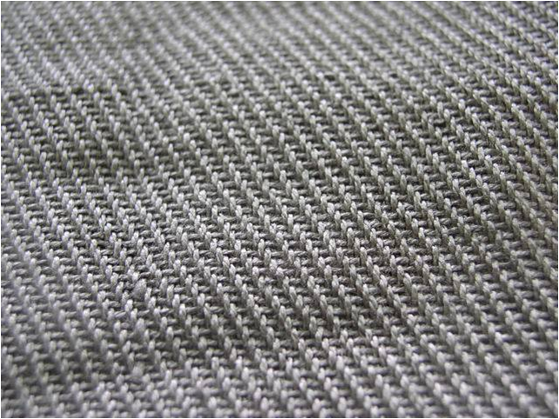
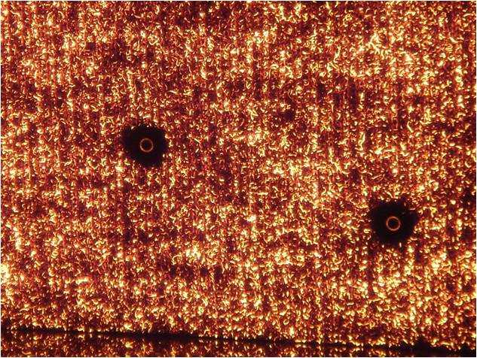
NuPhalt NIT Infrared Heater Panel
NIT at Ambient Temperature
NIT at Operating Temperature

Slide 24

Infrared Method Of Asphalt Repair
pulsed micro wave effect which ensures there is no adverse effect or burning of existing surface.
Infrared Emitter
Short Wave IR
Wearing Course
Medium Wave IR
Long Wave IR
Base or Sub Base Structure

Slide 25
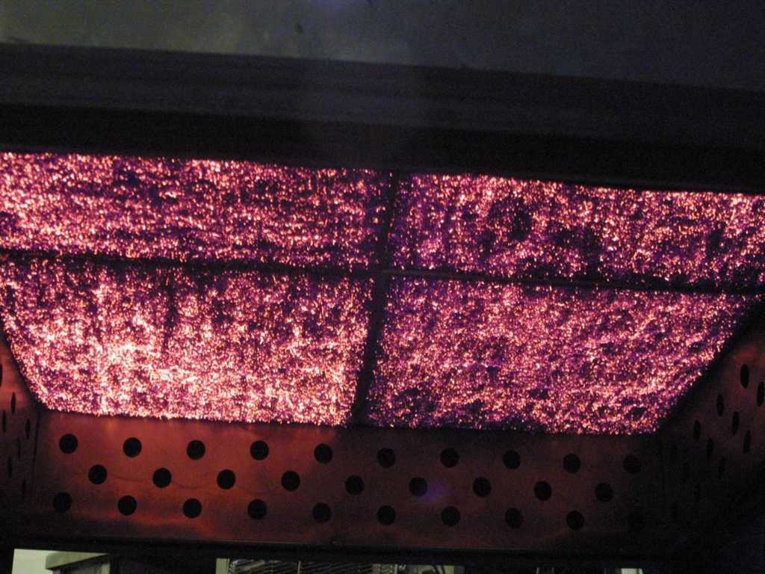
The NIT Panels At Medium Wave Infrared

Slide 26
Growing Importance of Thermal Use
Highway Engineers put under increasing pressure to find ways of maintaining the country’s roads under a burden of reduced budgets, increased traffic flow and environmental considerations
Government’s attempts to reduce the amount of waste material ending up in landfill sites by introducing the Landfill Tax, & this year trying to reduce the amount of new material being extracted from quarries using the Aggregates Tax, has meant that a new method of highway repair was essential;
Cost of traditional patching increasing every year – the cost of disposal is up, purchase of fresh tarmac is up, as well as labour and plant costs also increasing;
The use of modern technology to satisfy these financial pressures and Local Agenda 21 (the international environmental agreement) which has now been introduced into patching repairs on the highway

Slide 27

Sustainability using Thermal Heaters
Scottish Institute for Sustainable Technology @ Heriot Watt Uni Edinburgh
TRADITIONAL METHODS PRODUCE 51.62 KGS OF CO₂ / SQUARE METER REPAIRED
NUPHALT SYSTEM PRODUCES 4.28 KGS CO₂ /SQUARE METER REPAIRED
Traditional 11
Trees required
1 Tree required
To absorb CO₂

Slide 28
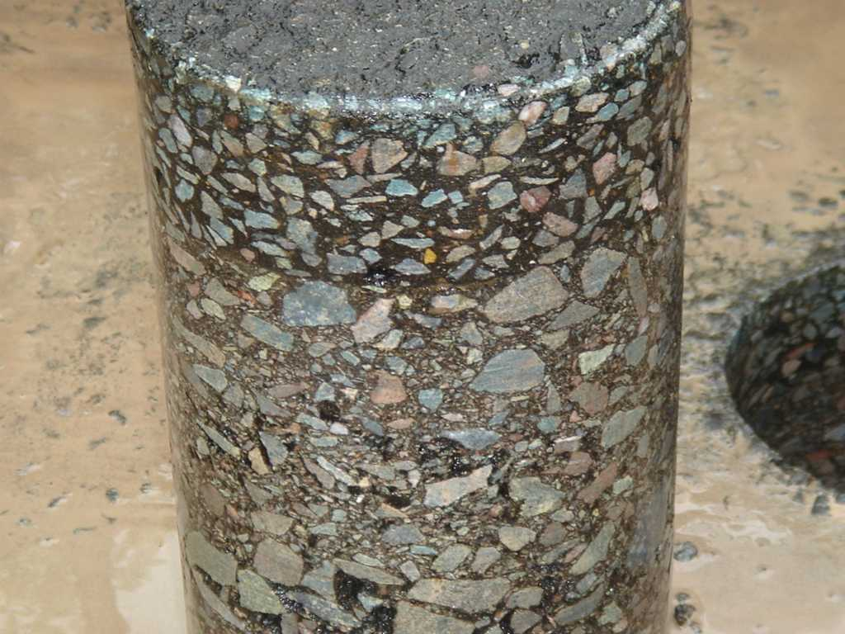
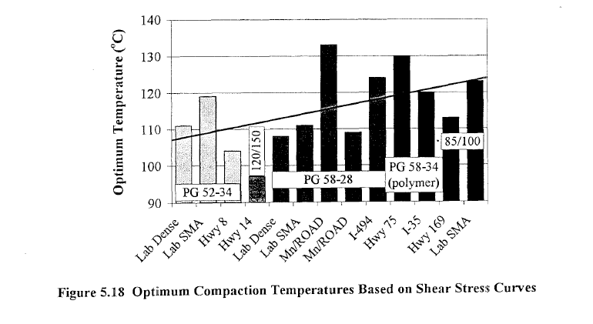
Monolithic Thermal Bond – Right Mix & Right Compaction
Optimum compaction temperature
230-250F (110-120C)
Seamless repair and bonding between old and new asphalt

Slide 29
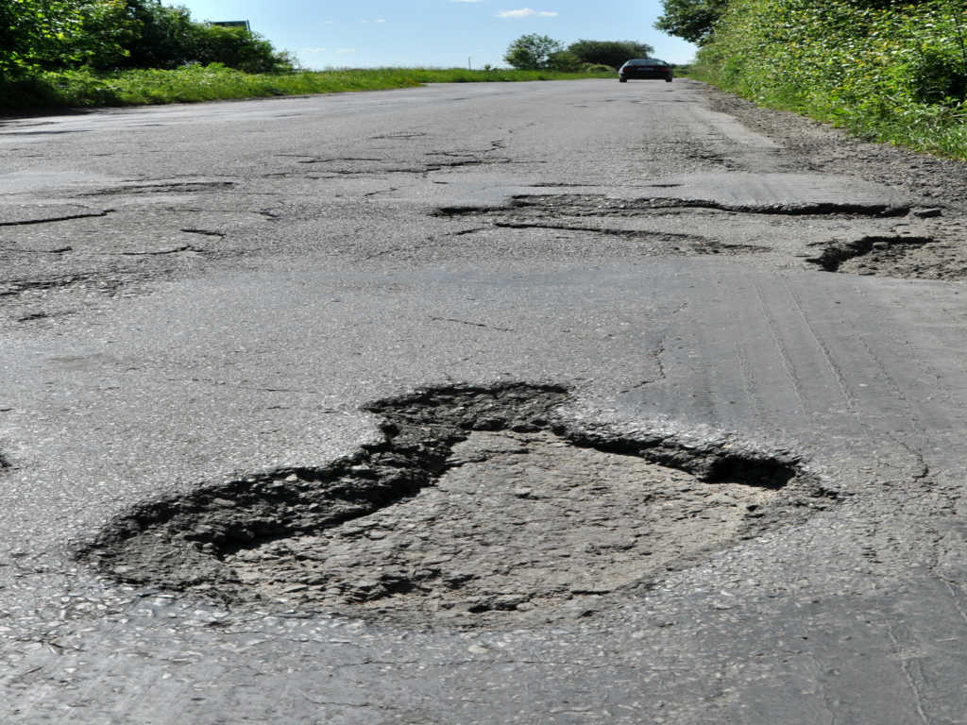
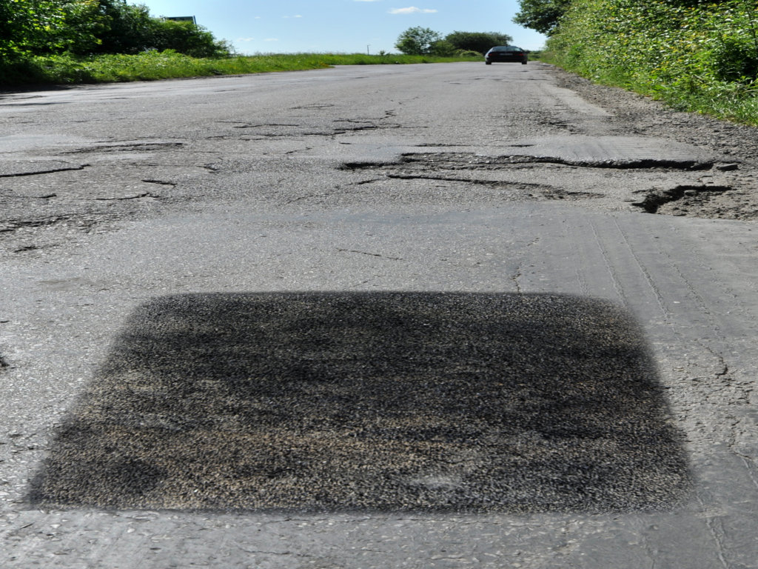
NuPhalt Infrared Patching Sample
Before
After

Slide 30
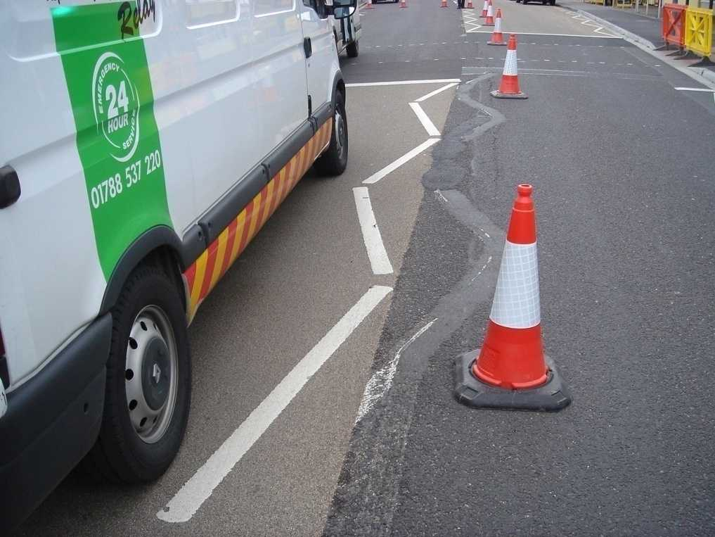
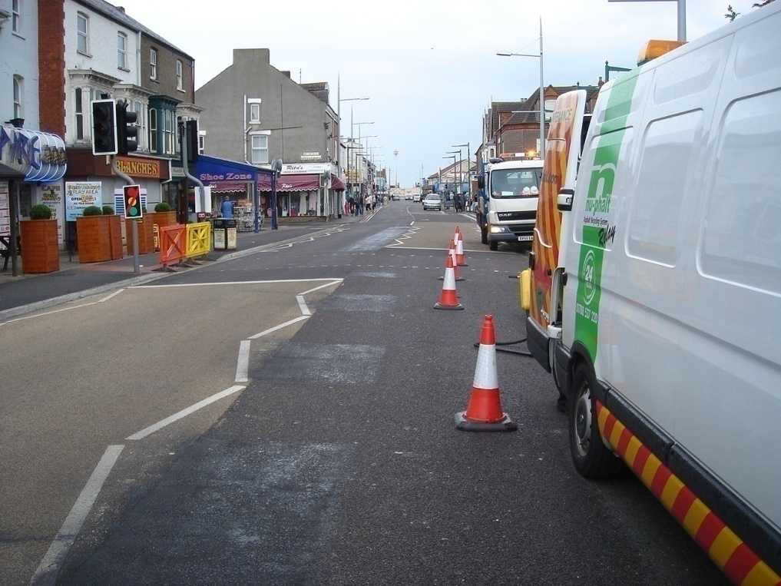
NuPhalt Infrared Surface Recovery
Before
After

Slide 31
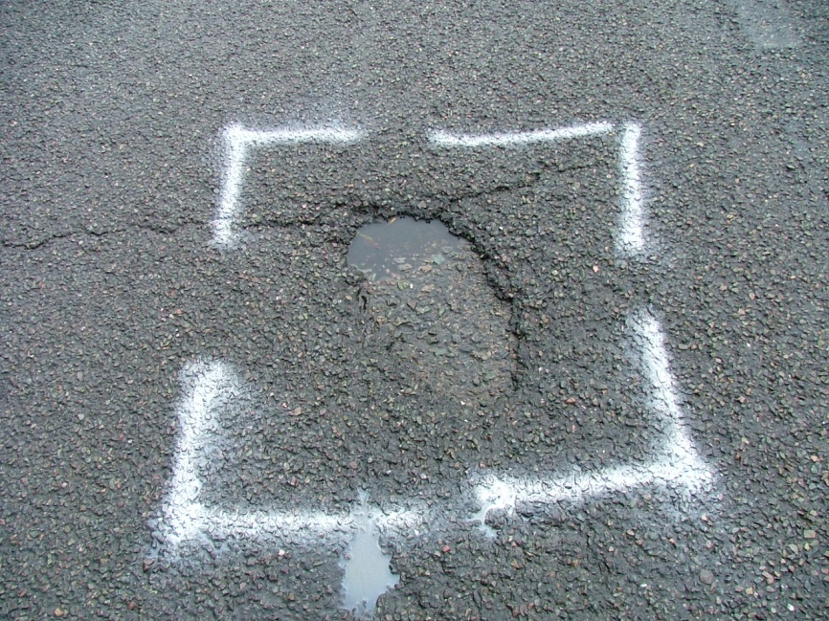
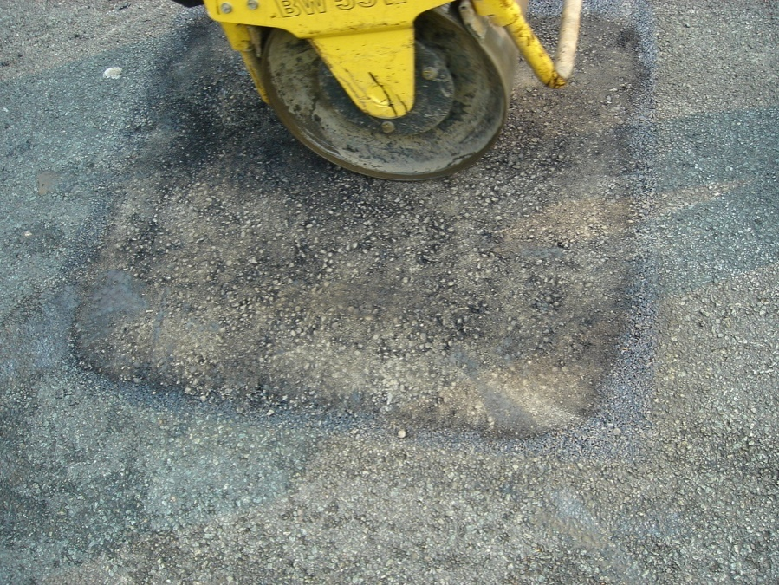
Nu-phalt In-situ Infrared Pot Hole Repair
Before
After

Slide 32
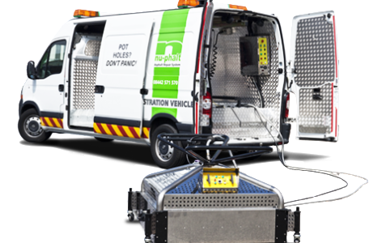
Nuphalt’s Applications
UNDER REACTIVE MAINTENANCE
Planned Defects repair
Potholes
Longitudinal & transverse Joint Failures
Metal Work
Utility Tracks, trenches
Cracks & Crazing
Consequential Damage due to rutting
Crowning/Depression in carriageway

Slide 33
NuPhalt provides a 21stcentury solution for all Asphalt Repairs
SPEED - Complete pothole repair in approximately 20 minutes
REDUCED PLANT COSTS– Only one fully equipped vehicle required
EFFICIENTLABOUR UTILISATION - Onlyfourtofivemen required
NO WASTED COSTS - No additional men, vehicles or materials needed
NO DISPOSAL COSTS - No additional men or vehicles to remove waste ad dump in landfill

Slide 34
ADVANTAGES
QUALITY OF WORK
This process gives a strong monolithic bond between the NEW and the EXISTING surface making it a permanent patching system.
By this process we are able to maintain the existing FRL (Finished Road Level)
Latest technology NIT heaters, water based Anionic emulsion, vibratory compactor
RECYCLING/NO WASTAGE
This technology repairs potholes, mends surface defects by recycling the existing bitumen giving a seamless and permanent surface repair.
No Wastage of asphalt because existing asphalt is recycled by this technology.
No material to dispose of as no debris are left after the work and material is recycled.

Slide 35
ADVANTAGES
EASE OF OPERATION
The Process can be carried out anytime during the DAY/NIGHT
The Vehicle is capable of working in Highly Congested Areas.
Single Vehicle Operation means minimal disruption of traffic
Even larger bigger sized potholes that can pose significant danger can be repaired within 30 Minutes, without causing any inconvenience to the road users.
Simple Maintenance: With very few moving parts and using a design that features spare parts that are readily available the NuPhalt machine/system is quick and easy to maintain.

Slide 36
Major Benefits – for Clients
Seamless repair: No saw cutting-out, ‘hot on hot’ edge creates a thermal bond
Faster: 8-10 minute heater cycle, 4-5 minutes on surface dressing
Permanent: 1st time fix, no need to return to site
Safer: Thermal heater can go from 750°C to 0°C within seconds
Greener: Powered purely from gas and electricity
Minimum Congestion: Everything contained in a single transit system
Easy to use: Max 4 man operation
No landfill: No waste as everything is recycled
Quieter: Heater is silent meaning a lot of work can be carried out at night
BBA / HAPAS approved: For both the process and the material

Slide 37





APPROVALS
OUR TECHNOLOGY HAS BEEN APPROVED BY A NUMBER OF REPUTED NATIONAL AND INTERNATIONAL AGENCIES
IRC (INDIA): Accredited by the reputed INDIAN ROAD CONGRESS.
CRRI (INDIA): The methods and technology have been accredited by CRRI (Central Road Research Institute)
BBA HAPAS (UK): Full BBA HAPAS approval first of its kind (Thermal Permanent Repairs Certificate)
RSTA Certificate (UK): Certificate for membership with the Road Surface Treatment Association
MoRTH(India): Approved by the Ministry of Roads Transport and Highways
NRRDA(India): Approved by the National Rural Roads Development Authority
GASTEC Accreditation: independent respected energy and environmental product testing company and has over 50 year’s experience in appliance testing and certification to satisfy regulatory requirements.
SAFE contractor status – Benchmark of health and safety award &
Environmental Scientifics Group Ltd (ESG UK) – Safe technology

Slide 38
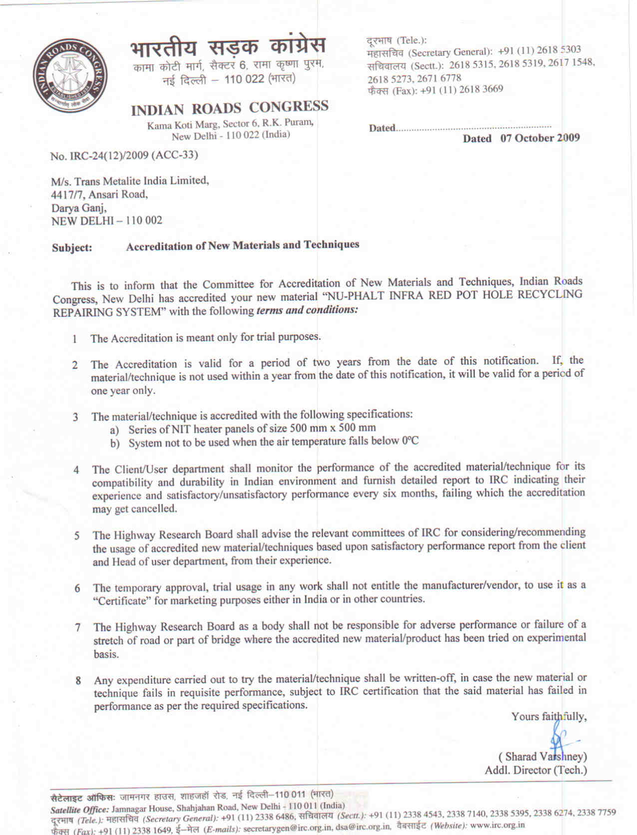

Slide 39
VISION- SUSTAINABLE DEVELOPMENT To Maintain Existing Road Surface for Riding Quality By Timely Repair through Innovative State of the Art Green Technologies / Processes to Keep the Surface Restored For Extended Time

Slide 40
ENVIRONMENTAL CONSIDERATION
Lower Carbon Emissions
We Generate Less than 1/7th of the CO₂ compared to traditional repair methods
No noise pollution, complete soundless working
An average Mature tree absorbs 4.5-5 Kg of CO₂ per year, therefore planting one tree would be sufficient to absorb the CO₂ emitted from one NU-PHALT repair, as compared to 10-11 for a repair using the traditional process.
One Time – Sustainable Repairs : Because the because the Nu-phalt system heats the area surrounding the pothole to be repaired it forms an excellent cohesive bond between old material and new materials introduced to repair the pothole.

Slide 41


Environmental Innovation Awards
Best Environmental Process - Environment Scotland (VIBES) awards
Green Business Award
This repair system releases just one seventh of the CO2 of traditional road repairs, independently verified by the Scottish Institute of Sustainable Technology (SISTech).
The Green Business Award judging panel, which included Prof. John Cheshire, OBE of the Government's Sustainable Energy Policy Advisory Board, praised Nuphalt's system as "a glowing example of eco‐innovation", saying "rarely can environmental improvements claim such all‐round benefits".

Slide 42
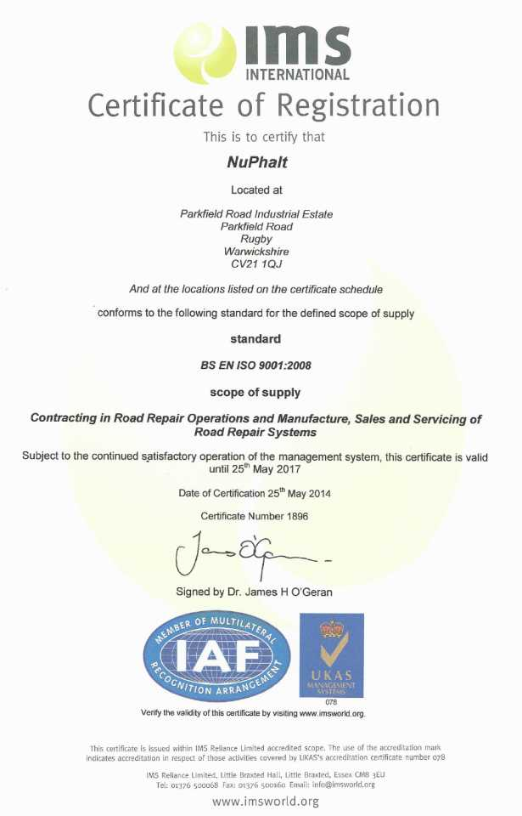
ISO Certificate (Environment)
Quality Management ,Environment Management , OSHAS

Slide 43
ACHIEVEMENTS
Successfully working in Delhi-NCR for the past 6 Years and in Rajasthan for the Past 3 Years
1
2
3
16+ Countries Worldwide 25+ Years Of Innovation 500438+ Number Of Potholes Repaired in India
(Number Of Road Accidents Avoided) (Number Of Carbon Credits earned)
4
5

Slide 44
SCOPE OF NUPHALT TECHNOLOGY
The NuPhalt technology and its application has a tremendous scope and is not limited to only highways.
Just to name a few agencies :
NATIONAL & STATE HIGHWAYS
STATE MUNICIPAL CORPORATIONS
URBAN DEVELOPMENT AUTHORITIES
GROUP HOUSING SOCIETIES
PRIVATE AND GOVERNMENT TOWNSHIPS
RESIDENTIAL WELFARE ASSOCIATIONS (RWA’s)
AIRPORTS AND TAXIWAYS
Any application that requires small quantity of asphalt can be most likely repaired by our NU-PHALT technology

Slide 45
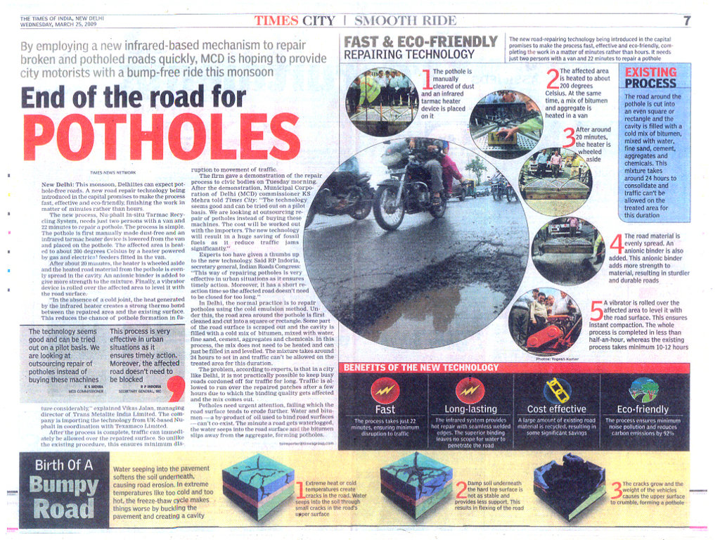

Slide 46
“Operations at a glance” Overview of Technology
Understanding the Vehicle mounted Machine

Slide 47
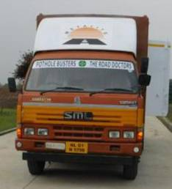
Major Components-
INFRARED HEATER – NUPHALT UK MADE (SIZE 1 X 2 METER).
BASE VEHICLE – SML ISUZU – SAMRAT TRUCK (MODEL ZT 54 SM TCIIIB ELWB (PS)).

Slide 48
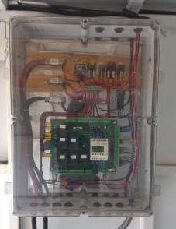
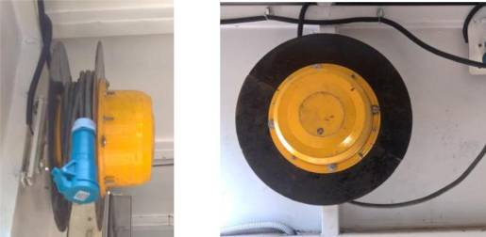
CONTROL PANEL - UK MADE (12 VOLT DC).
ELECTRIC CABLE REEL - INDIGENIZED SPRING LOADED ELECTRIC CABLE REEL FORSUPPLYING 12 VOLT CURRENT TO HEATER.

Slide 49
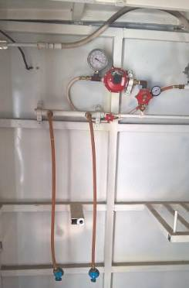
GAS STACK – COMPARTMENT MADE TO INSTALL 4 NOS. STANDARDCOMMERCIAL LPG CYLINDERS (48 KG CAPACITY EACH).
GAS LINE & CONTROLS – INSTALLED AS PER REQUIREMENTS WITH HIGH CLASSCONTROL VALVES.

Slide 50
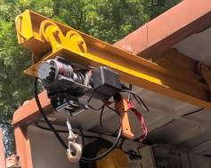
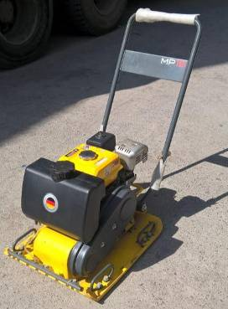
WINCH – 12 VOLT DC OPERATED WINCH FOR LOWERING DOWN AND LIFTING THEHEATER.
COMPACTOR – WACKER NEUSON MAKE PLATE COMPACTOR (MODEL-MP15)1.5 TON, INSTALLED WITH HONDA PETROL ENGINE.

Slide 51




METALITE – BIG PICTURE
INFRARED RECYCLING OF ROADS | SEAMLESS BONDED INSTANT PATCHING | POTHOLES, SPOT UNDULATIONS & CRACKS
MAKE IN INDIA
Making the machine in INDIA – Patented technology from UK
Local Manufacture of special materials – Plant in Production SKILL DEVELOPMENT
1000 machines to begin with
10,000 workers get employed (Five workers + One Driver per vehicle)
ROAD SAFETY
Accidents and ailments being saved by removal of potholes and cracks
Single vehicle operation – completed within 20 minutes. YOUTH ENTREPRENEURSHIP
Youth can become first generation entrepreneurs.
One machine per youth per town or village.
Payback for machine is in less than Two years.
LONGEVITY OF ROADS AND PREVENTIVE MAINTENANCE
Money saving of Exchequer –indirectly saving for INDIA
Lakh of tons of asphalt saved from repeated overlays. GREEN INITIATIVE & REDUCTION IN CARBON FOOTPRINT
No wastage and debris residue at site
Reduces the carbon footprint dramatically

Slide 52

Ready To Drive Away....??

Slide 53
Thank You for your kind attention!

Slide 54



Live tracking Road Maintenance App
3 different User Interfaces
Road Owning Agency
Metalite – Road Maintaining Agency
End User – Any Road User

