Slide 1
Quick Launch Bridges for Optimal Bridge Solutions in the Mountains

Slide 2
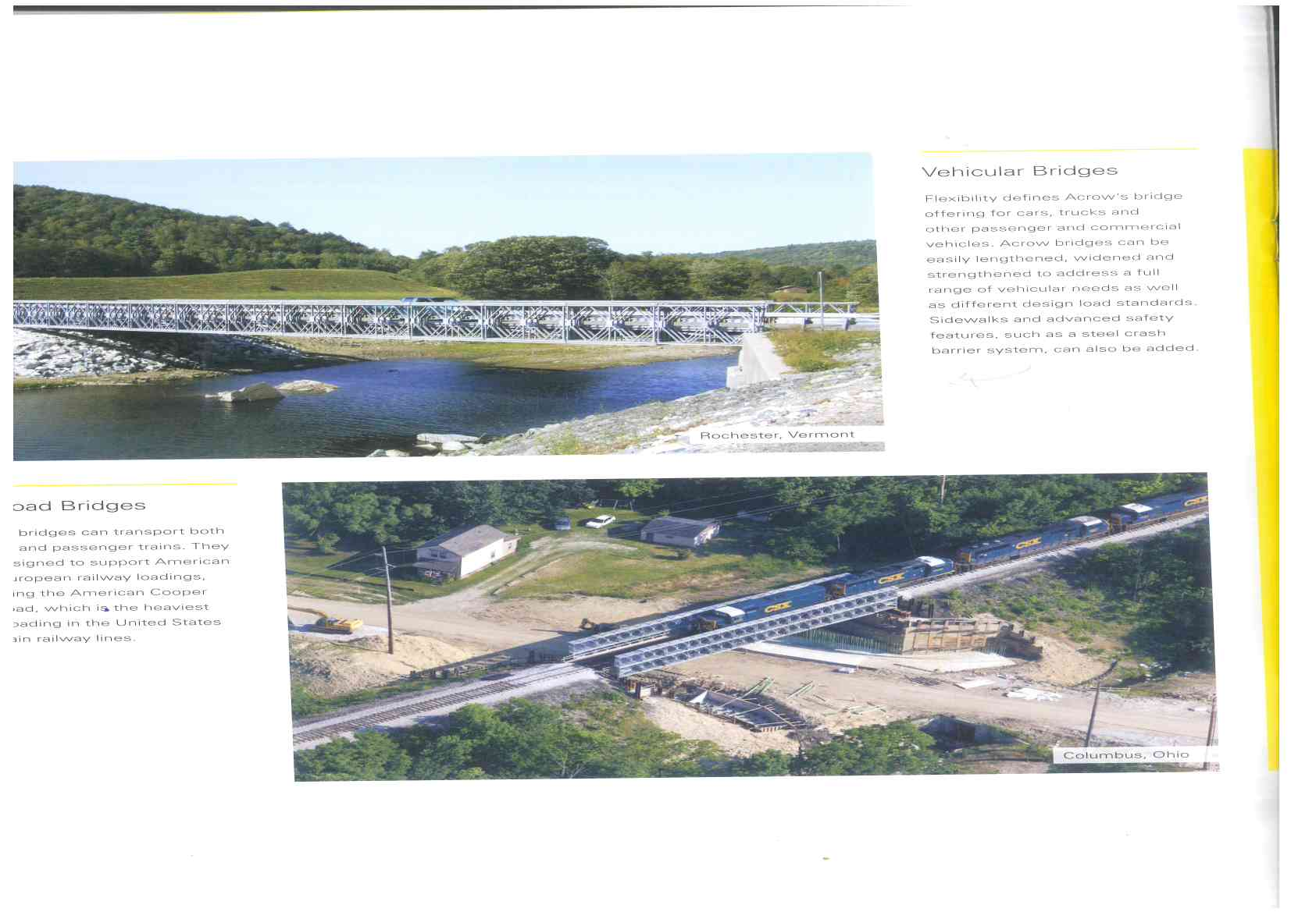
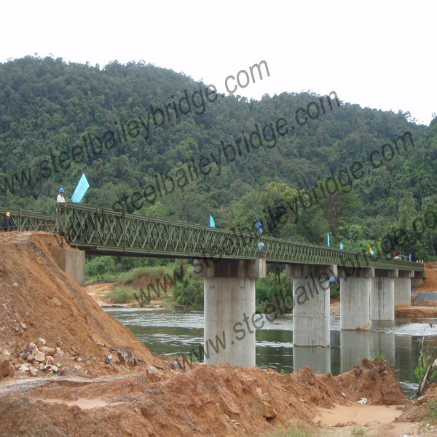
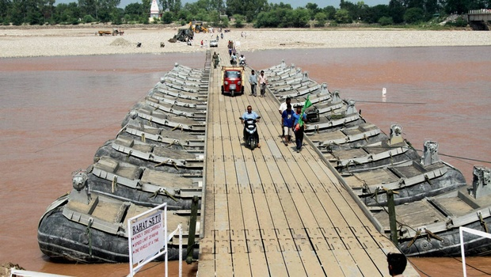
Quick Launch -Emergency Bridges:
Pre-engineered, lorry portable, incrementally launched bridges constructed in quick-time – in hours or a few days, depending on the site conditions.
Uses
  Military.
  Commercial.
  Emergency Situations.
In Disaster Situations they-
  Provide timely and large scale relief.
  Resume commercial activity saving crores every day.
  Restore public morale by speedy results.
Types
  Bailey Bridge (of tried and tested II World War Design)
  Advance Military Bridges– expensive and short life.
  New Generation Emergency Bridges – Not available in India.
2
Notes:
2

Slide 3
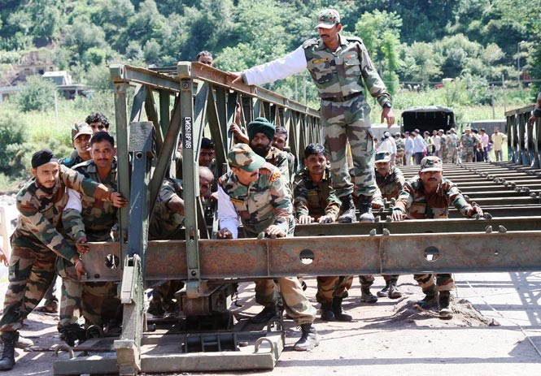
Single Lane, Ld Cl 30 for 50m span
II World War Tech
Will remain bottlenecks in NHDLs
Bailey Bridge Being Launched

Slide 4
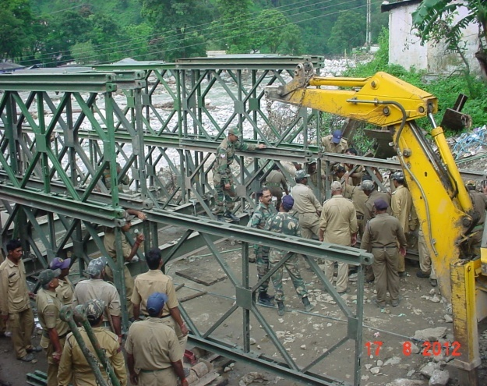
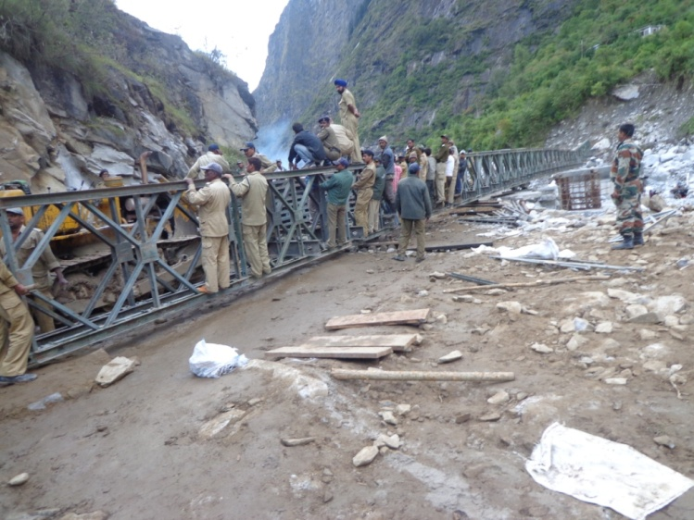
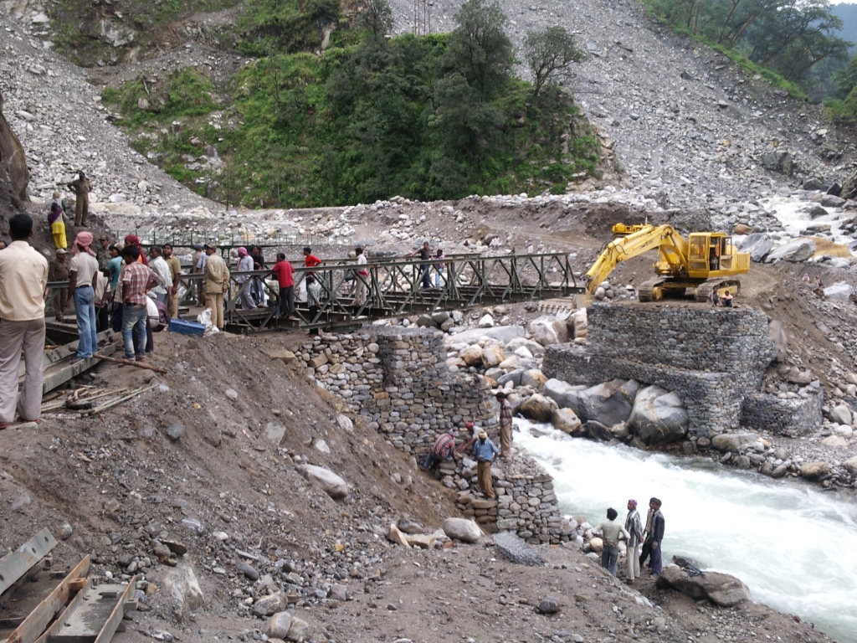
NH 108: Launching of 190 ft Bailey Bridge at Gangorigad on Assiganga R
2011.
DISASTER RESPONSE
Year after year
NH 58: 160 ft Bailey Bridge at Lambagarh on NH to Badrinath
2012
NH 109: 70 ft Bailey Bridge at Songanga now washed away. 2013

Slide 5
PERMANENT BOTTLENECKS ON NHs
Single Lane bridges on Double Lane NH with restricted loading.
  32 such bridges were identified on the Char Dham routes.
  Load class from 16.5 Tons to 10 Tons as against Class 70 R.
Problems
  Slower Traffic and Jams increase travel time by 20-25%.
  Increase in fuel consumption and carbon foot print.
  Concertina effect in traffic flow, makes it more unsafe.
  Load restricted by lowest classification ie 16.5 Tons.
    Reduced size of transport for personnel and stores.
    Higher costs.
    Restricted induction of construction equipment/stores.
  Manpower for traffic control at bridges.
Underutilization of NHs effect development and revenue

Slide 6
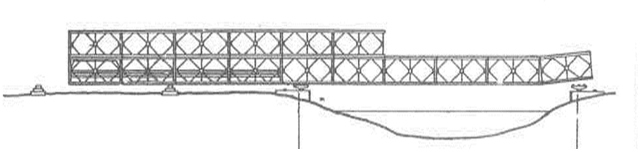
Reason for so Many Single Lane Bridges
Road widened from SL to DL NH. Bridging has not kept pace.
Alternate site not easily available.
Bridges washed away and replaced by, the Bailey Bridge.
No planning of DL bridges for disasters.
Replacement of bridges by conventional bridges is time consuming. Takes 3-4 years and needs alternate site.
Technical problems of de-launching/ re-launching truss bridges in the mountains:-
  Less Backspace.
  Launching new bridge on same site when there is regular traffic.
  Can be facilitated by special techniques as practiced by ACROW.
Main Bridge
Nose
Gap

Slide 7
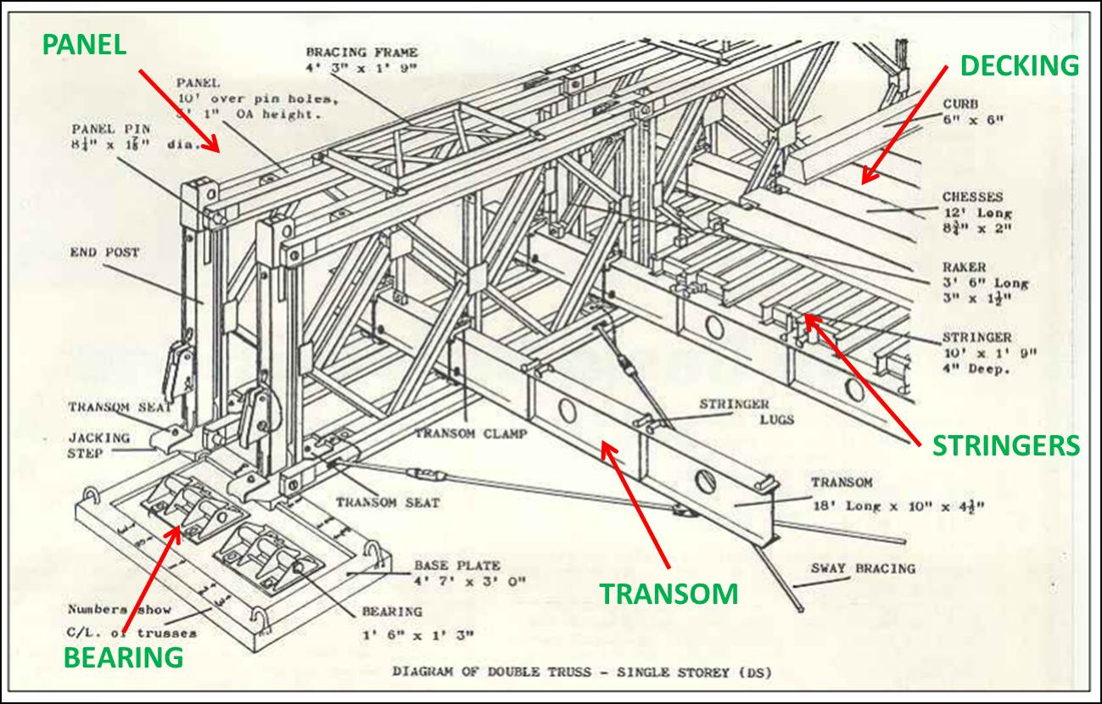
Understanding the Bailey Bridge
The genius of
Sir Donald Bailey

Slide 8
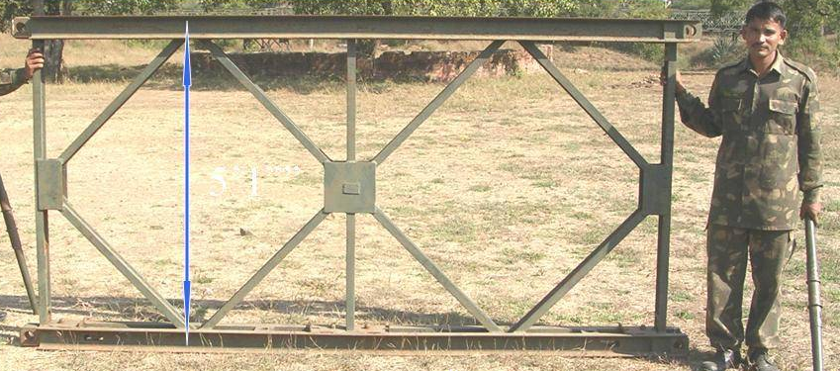
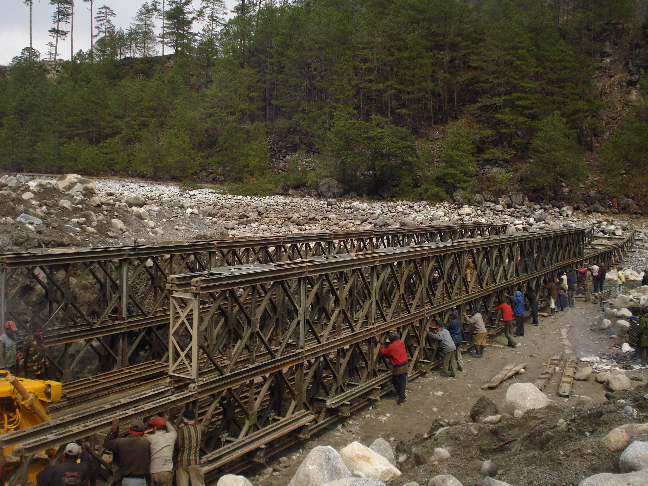
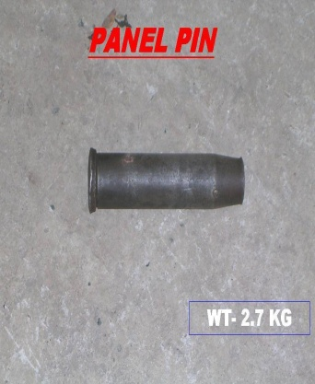
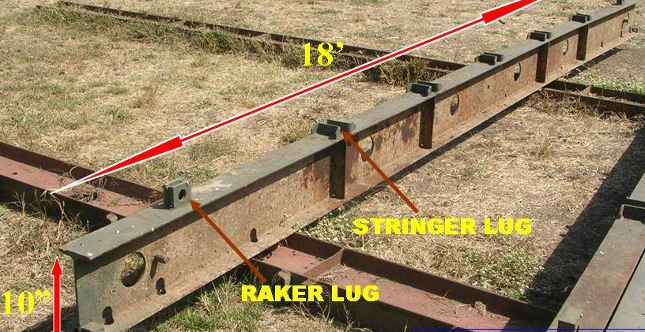
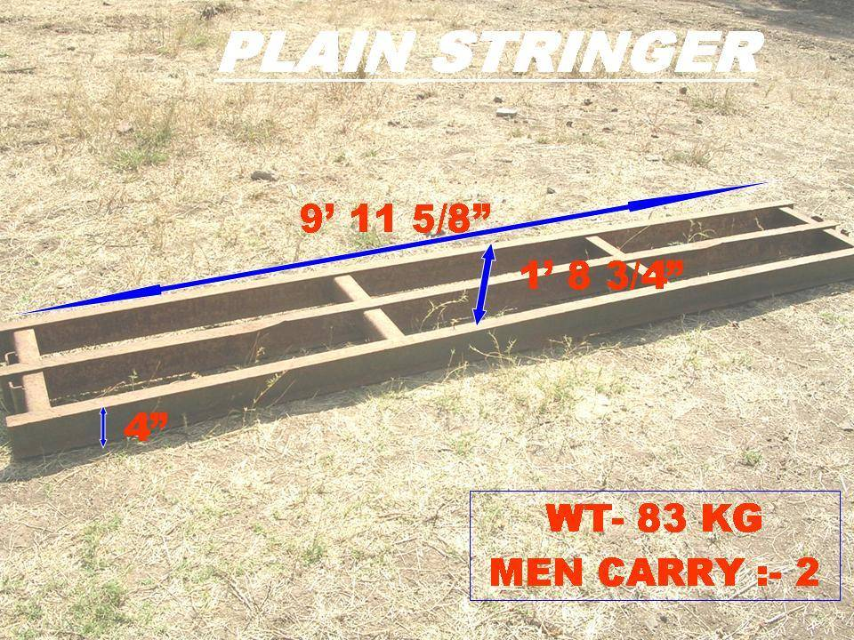
MAIN COMPONENTS
Panels joined with pins
Transoms
Stringers
PANEL
10’ X 5’
250Kg
PANEL PIN
2” Dia – 2.5Kg
TRANSOM
18’ X 10”
200Kg
STRINGER
10’ X 21” X 4”
90Kg0

Slide 9
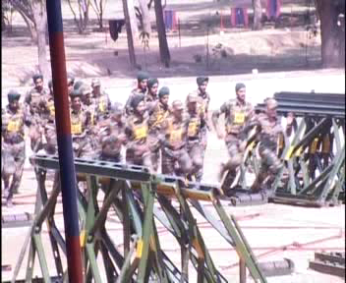
How quick is quick?

Slide 10
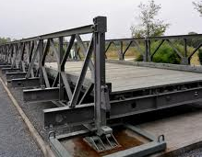
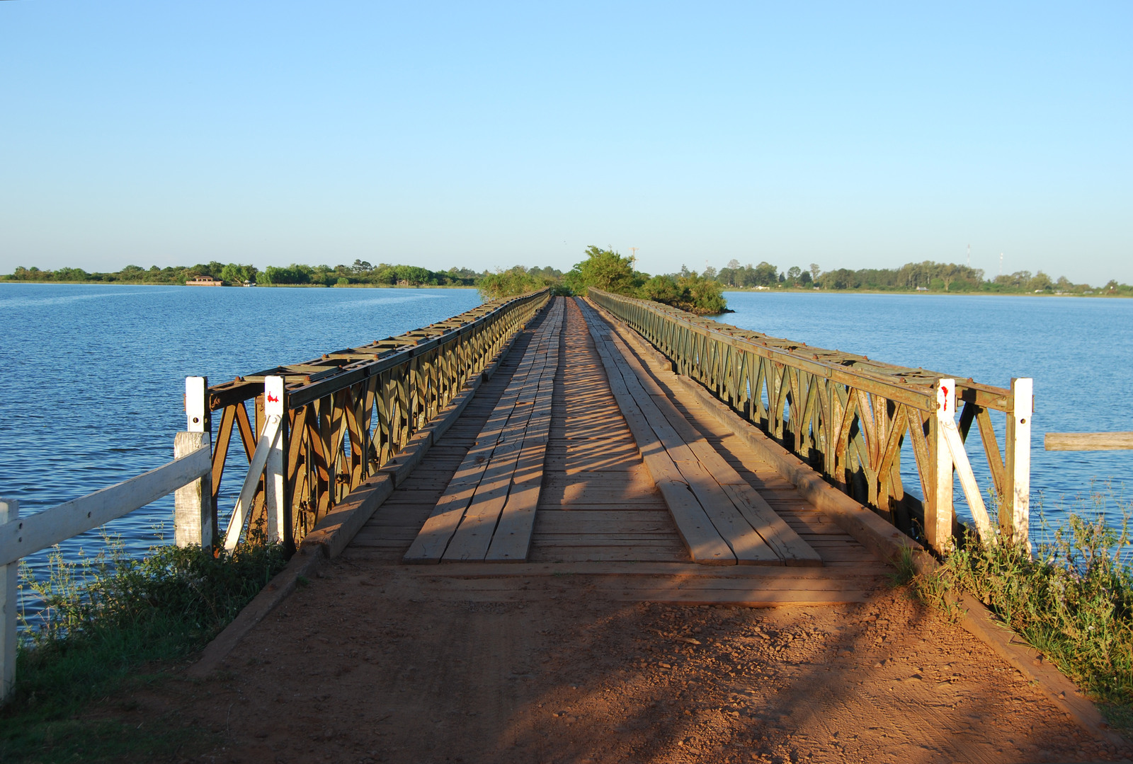
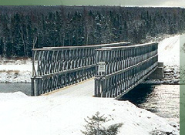
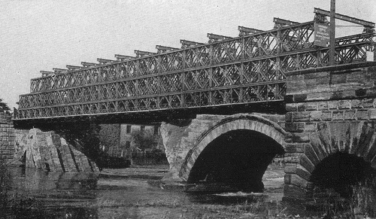
Single-Single
Double-Single
SINGLE PANEL TRUSS -SINGLE STOREY
Double-Double
Triple-Triple

Slide 11
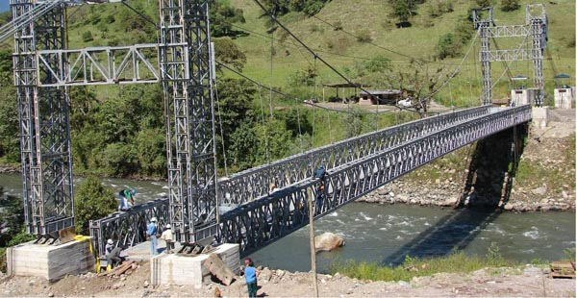
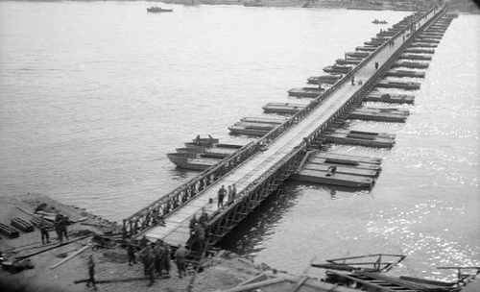

Slide 12
Modern Emergency Bridges
ACROW (US)
MABEY (UK)
MATIERE (F)
Design to NH Specs: Two Way. Ld Cl 70T
Up to Quadriple Truss, 450 Grade Steel.
Better durability, Life span of upto 70 years.
Quick Launch and ability to reuse.
Specialised Uses
Stocked by countries for Disaster and Military uses.

Slide 13
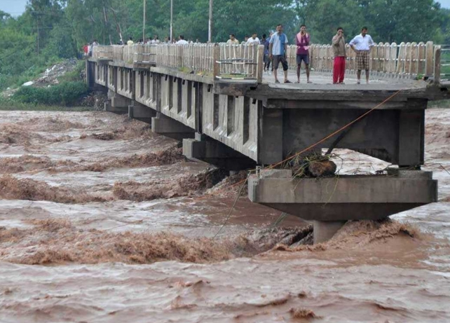
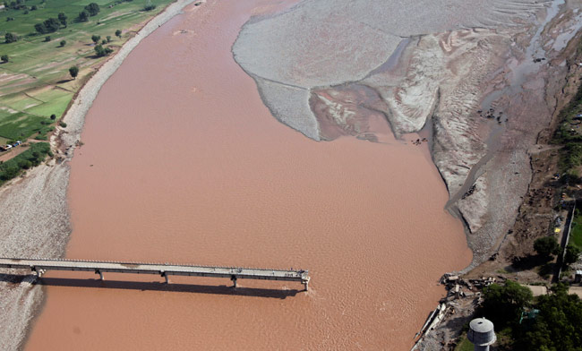
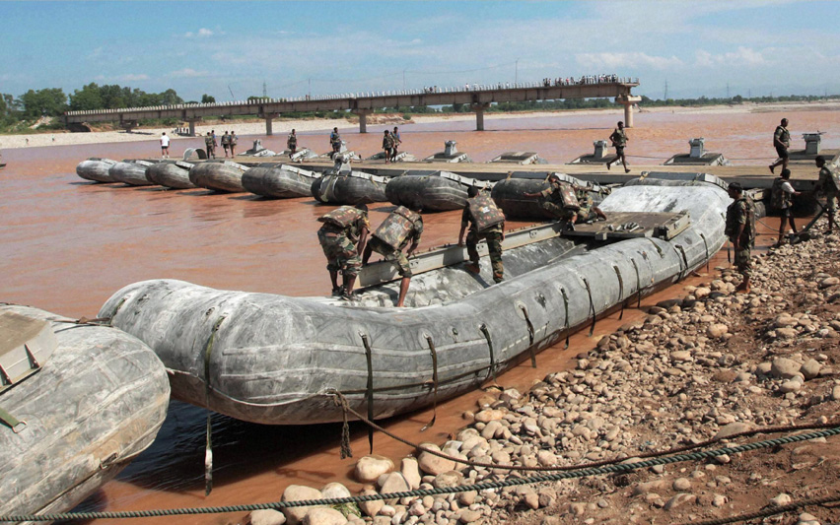
JAMMU TAWI RIVER BRIDGE
ARMY CONSTRUCT FLOATING BRIDGE

Slide 14
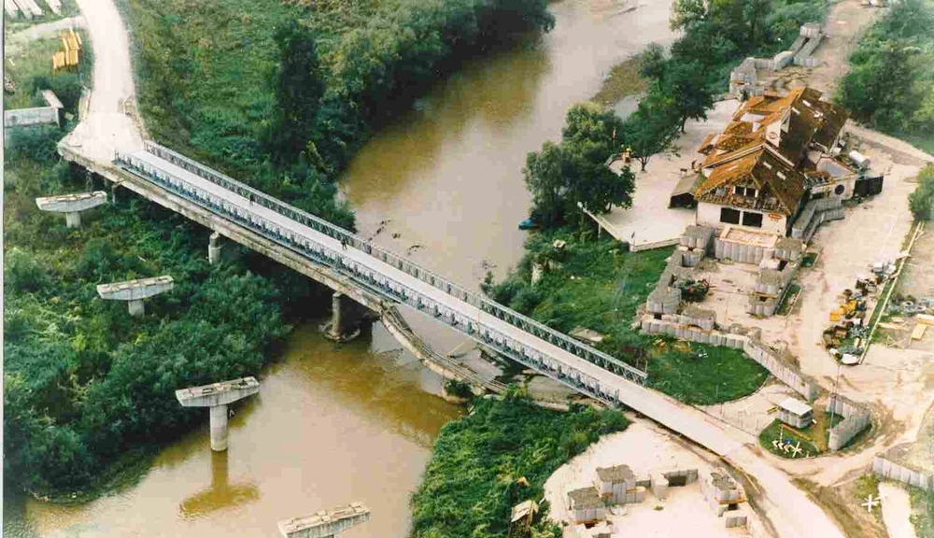
A Solution with new Generation Emergency Bridges
98m Mabey Bridge In Romania Construction time 6 days, Completed on July 6th 1996. Loading MLC60.
http://en.wikipedia.org/wiki/Mabey_Group

Slide 15
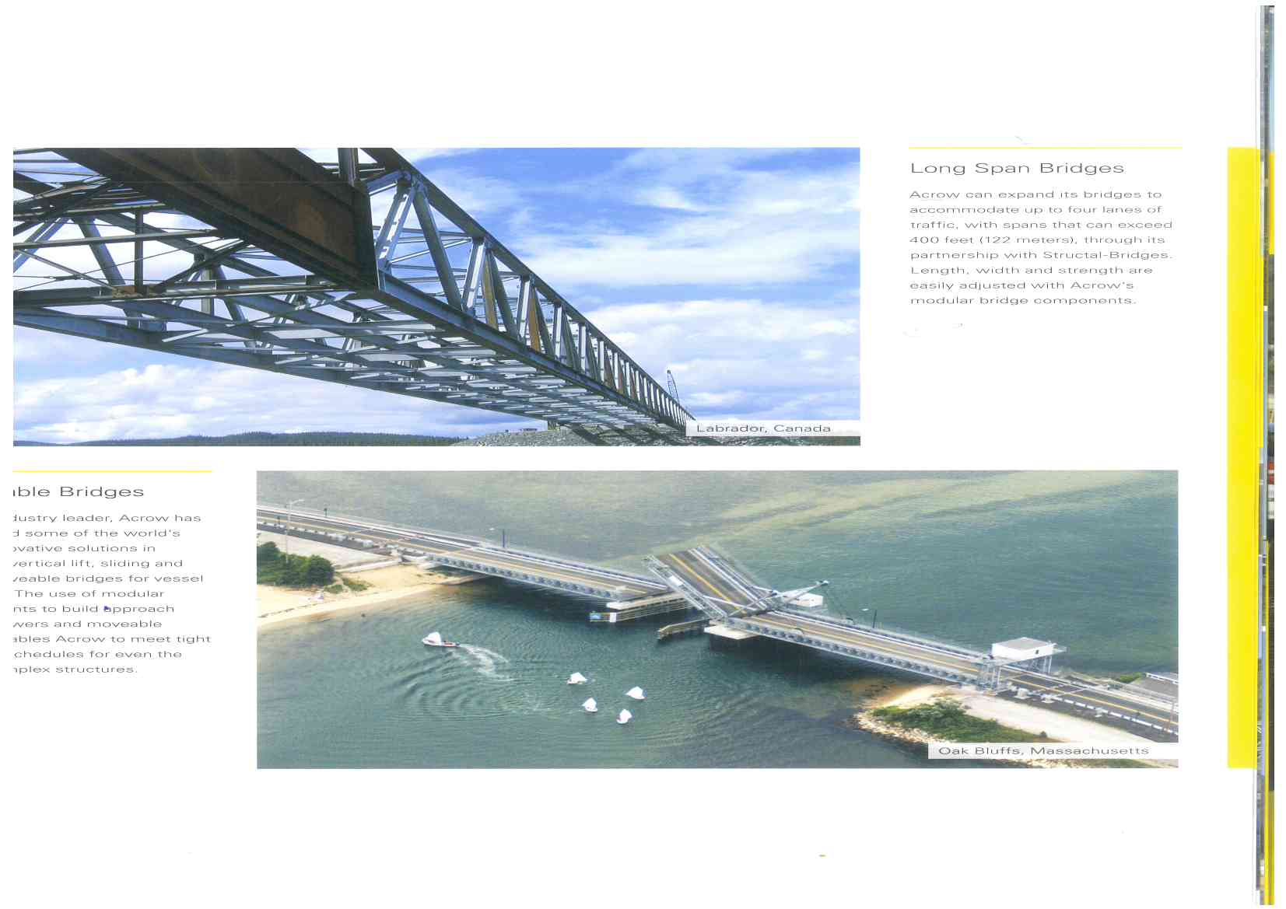
Railway Bridge
Moveable Bridge
for ship passage
Special Uses

Slide 16
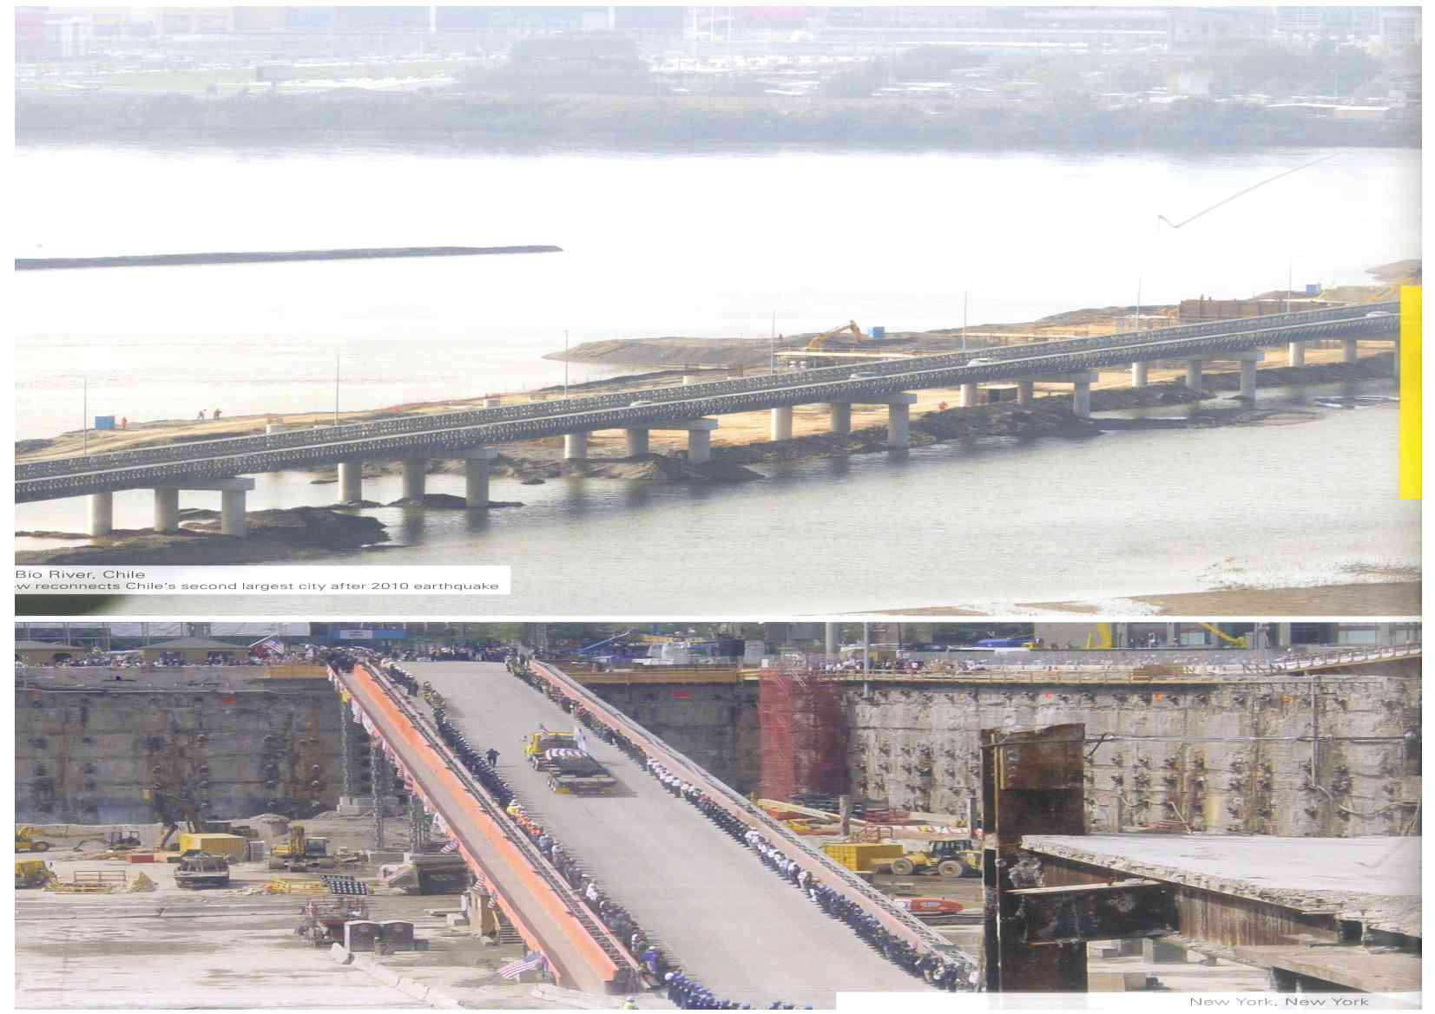
Bio River, Chile
after 2010 earthquake
Disaster Relief
New York
World Trade Center
Recovery operations

Slide 17
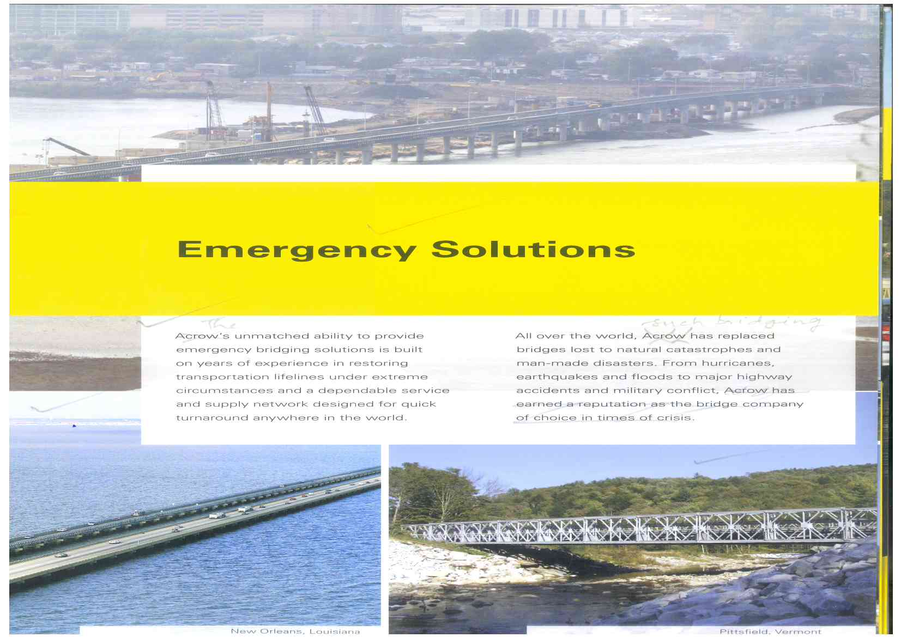
New Orleans, Louisiana
Acrow restores major causeway Hurricane Katrina
Pittsfield, Vermont
Replacement of bridge washed away during Hurricane Irene

Slide 18
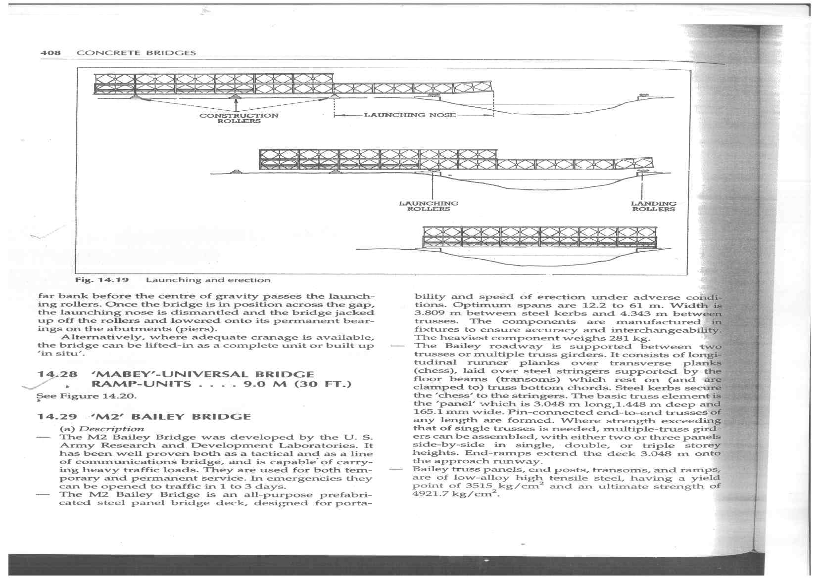
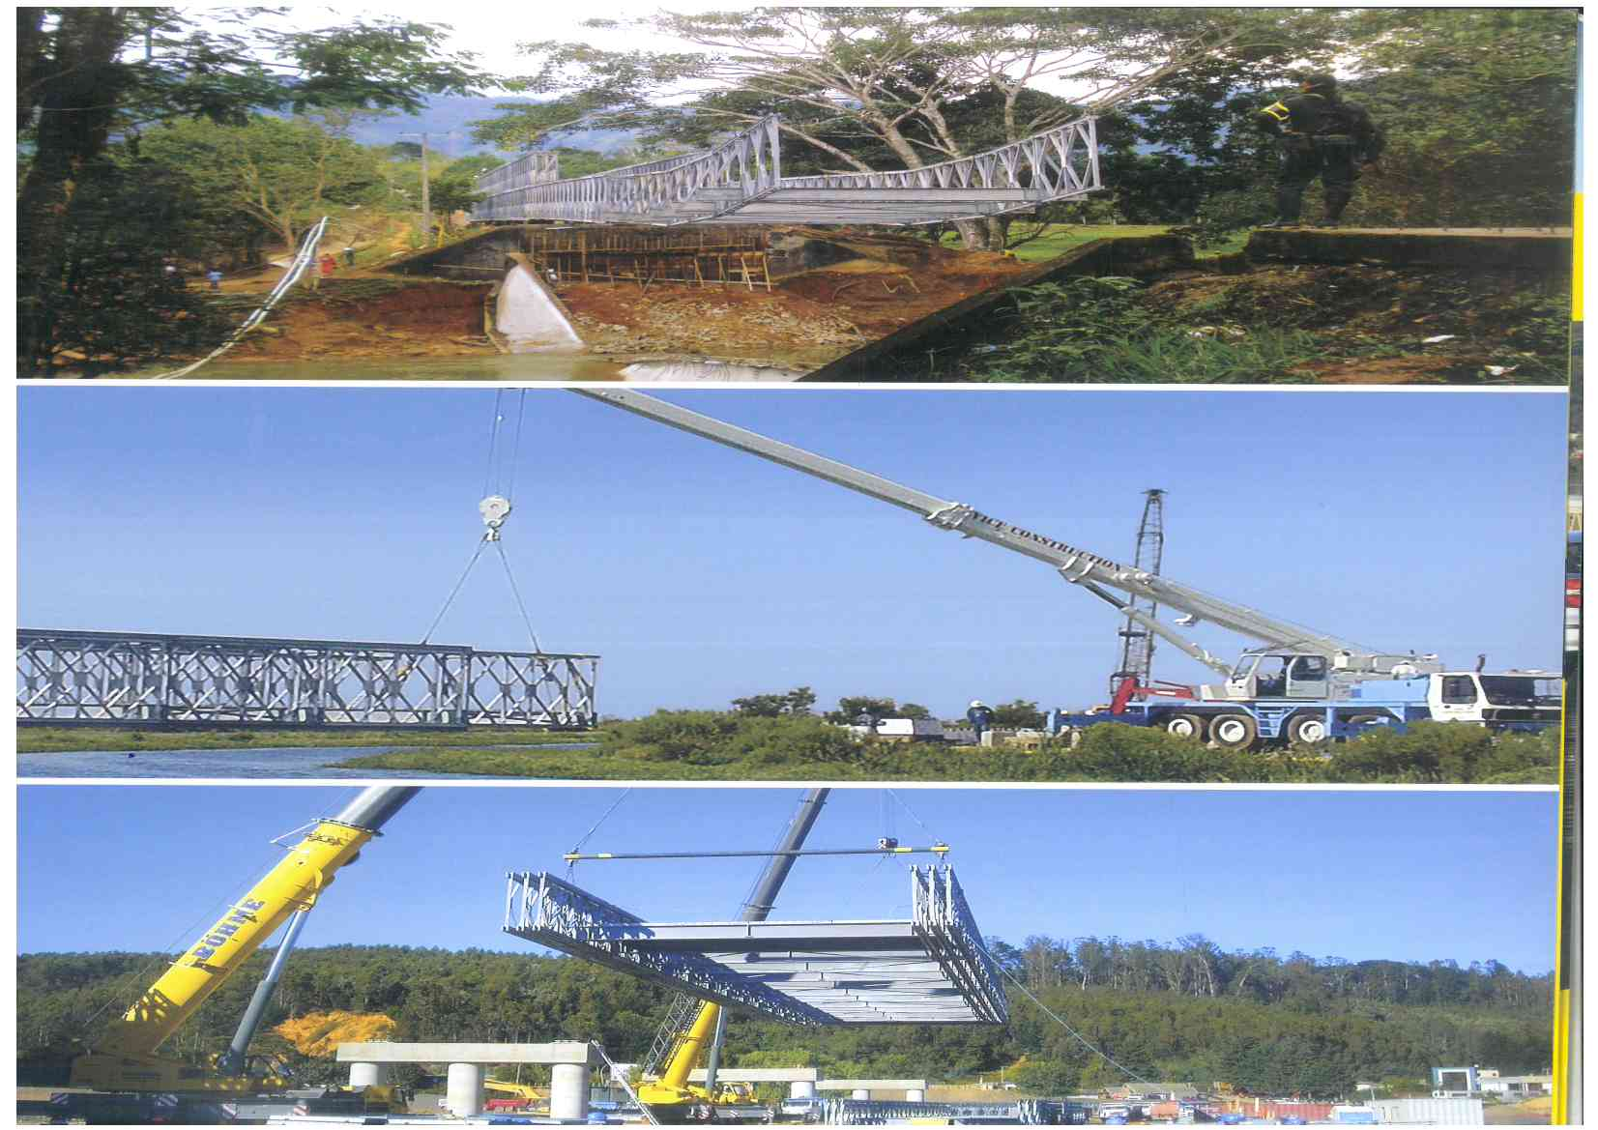
Main Bridge
Nose
Launching of
Emergency Bridges

Slide 19
Modern Emergency Br Systems:
Comparative Cost & Advantage
Superstructure Cost for 50 m span (in Rs)*
  Bailey bridge : 3.7 Lakh/m (Cl 30, one way)
  ACROW/MABEY: 9-10 Lakhs/m (70 T, two way)
  Four fold advantage at about double the cost.
Life of up to 70 years.
Mechanical load handling reduces manpower/time.
Standard designs to save time.
Reusable.
Sets can be stocked for emergencies for quicker response.
*Rough Cost estimated from published literature.

Slide 20
Bailey Vs ACROW
Cost: 1.8 times of Bailey Bridge for a four fold advantage

Slide 21
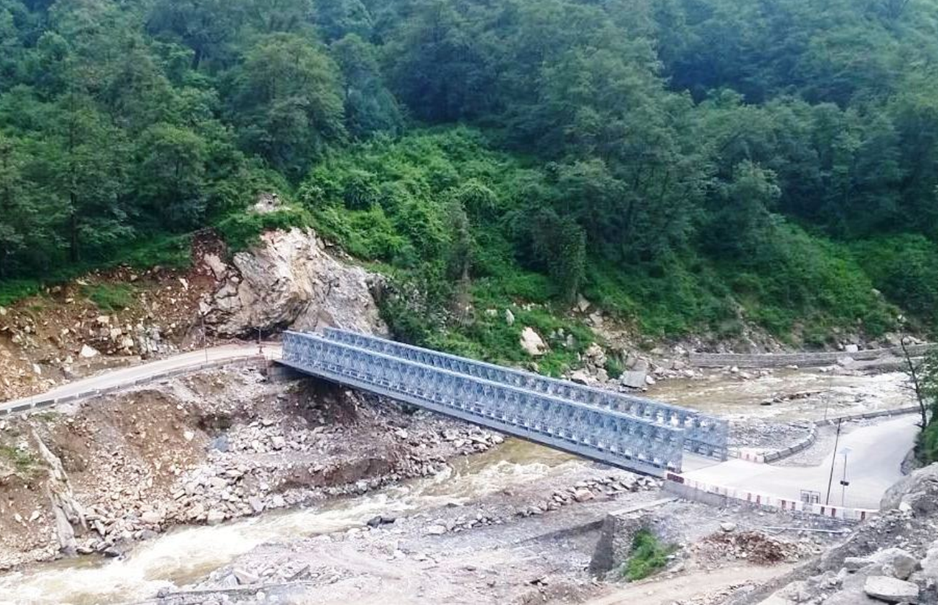
Bridge at Sonprayag Enroute to Kedernath
( superstructure completed in 30 days – 17 Mar 2016)

Slide 22
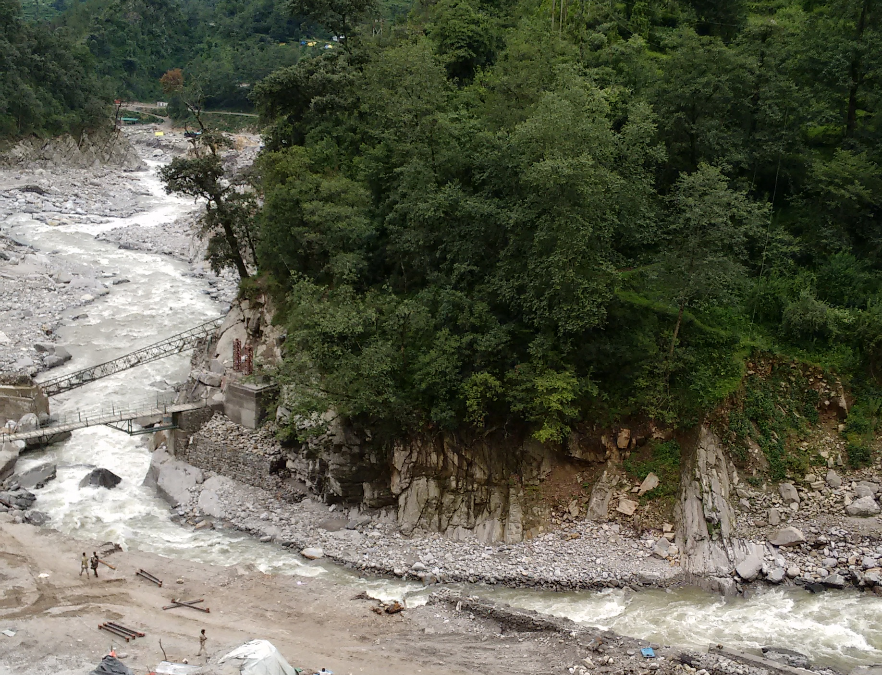
Need:
  Existing Bridge on NH 107 washed away in Jun 2013 floods.
  Temporary replacement washed away in Jun 2015.
  2nd 36m BB inadequate- only one way & limited to 9 T loading.
  Two way, 70 R Bridge on NH 107 must before next Yatra.
NEW LOCATION

Slide 23
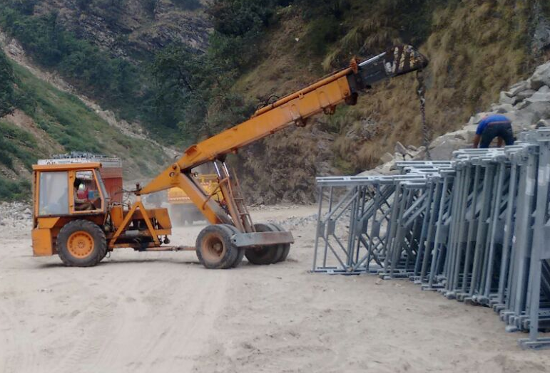
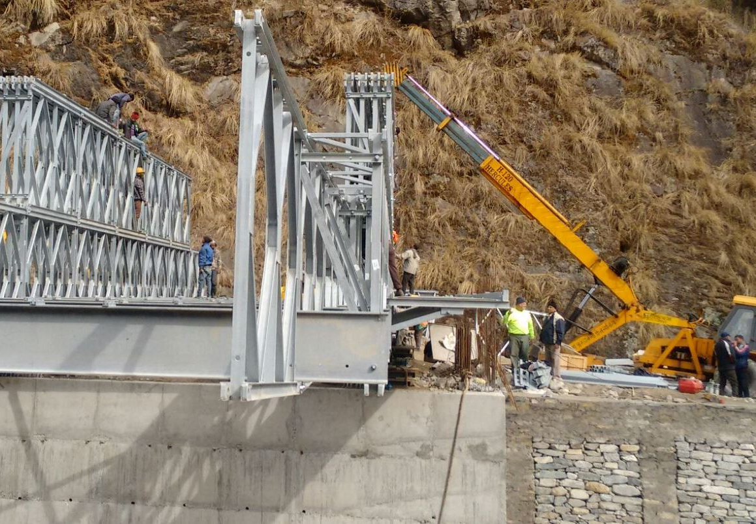
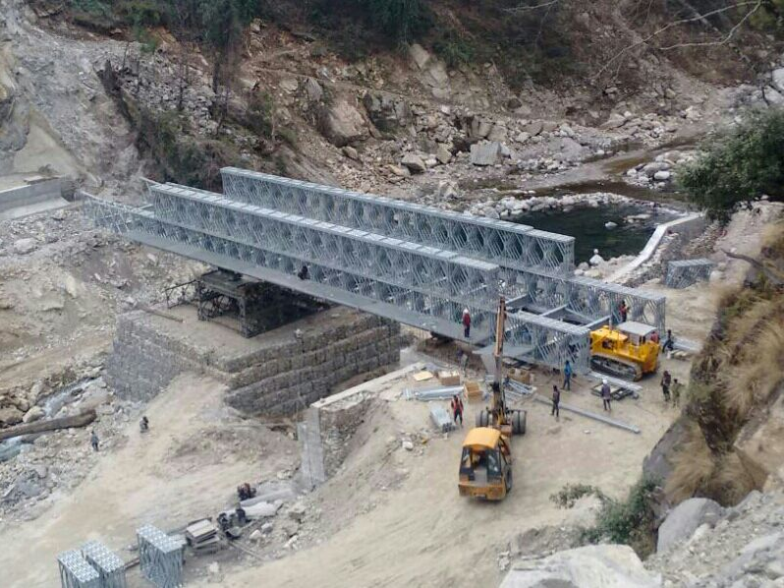
Solution
  ACROW Bridge planned through WB Aid by State Govt.
  Bridge delivered from NJ, USA in two months in Oct 15.
  Approaches, Abutments & Protection works by Feb 16.
  Bridge launched in 30 days.
EQUIPMENT ON SITE
LAUNCH IN PROGRESS

Slide 24
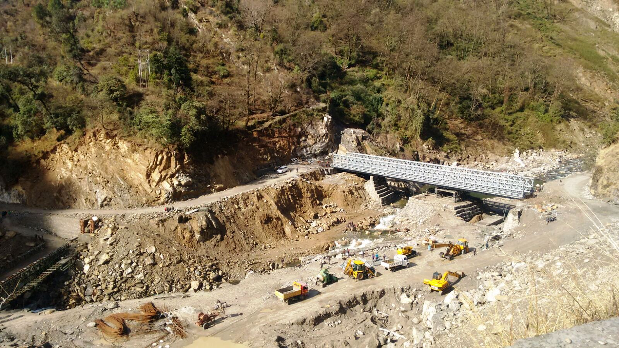
Technical Challenges
  Approaches.
  Limited Backspace for launch.
  Logistics of move of bridge from NJ, USA.
  First launch in India– ACROW Supervisor, with local crew.

Slide 25
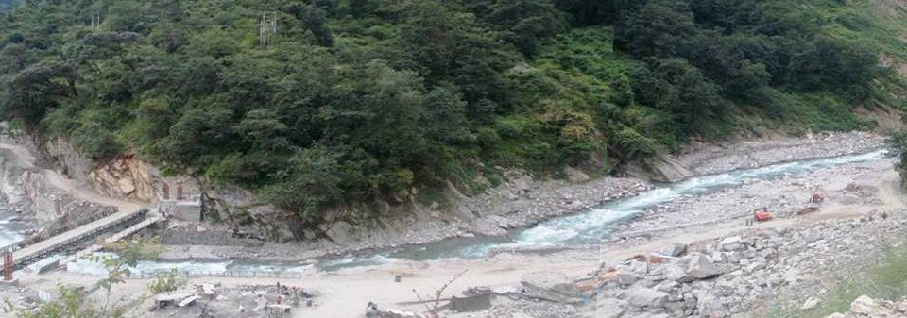
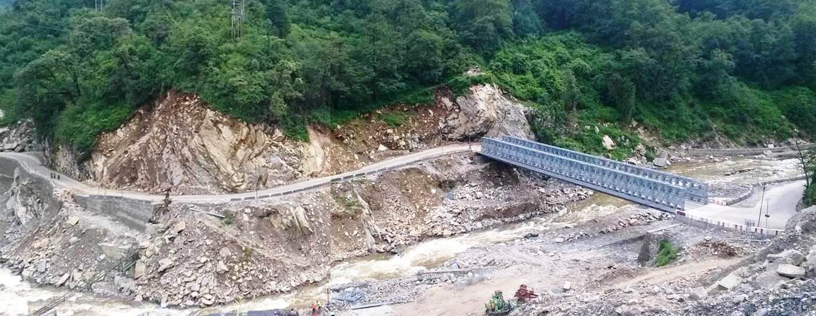
BEFORE
AFTER

Slide 26
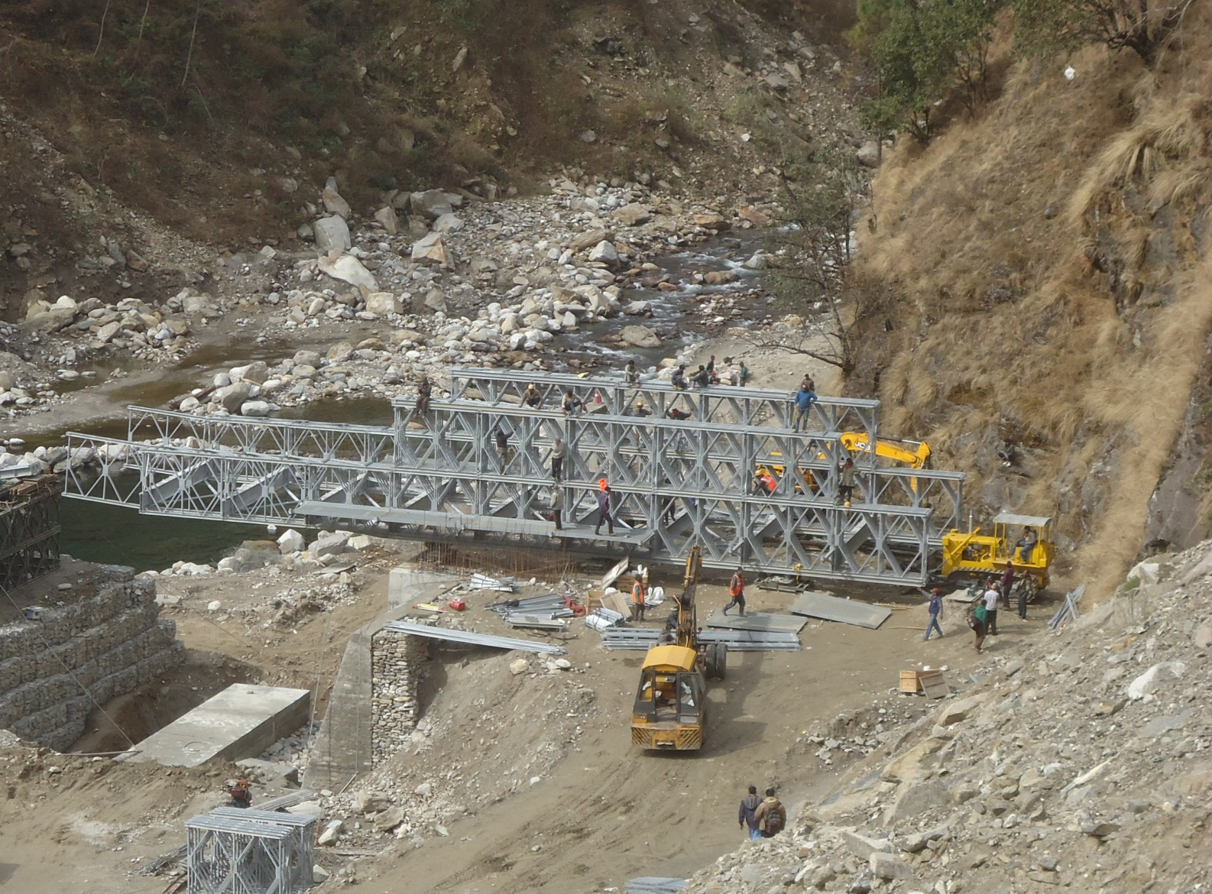

Slide 27
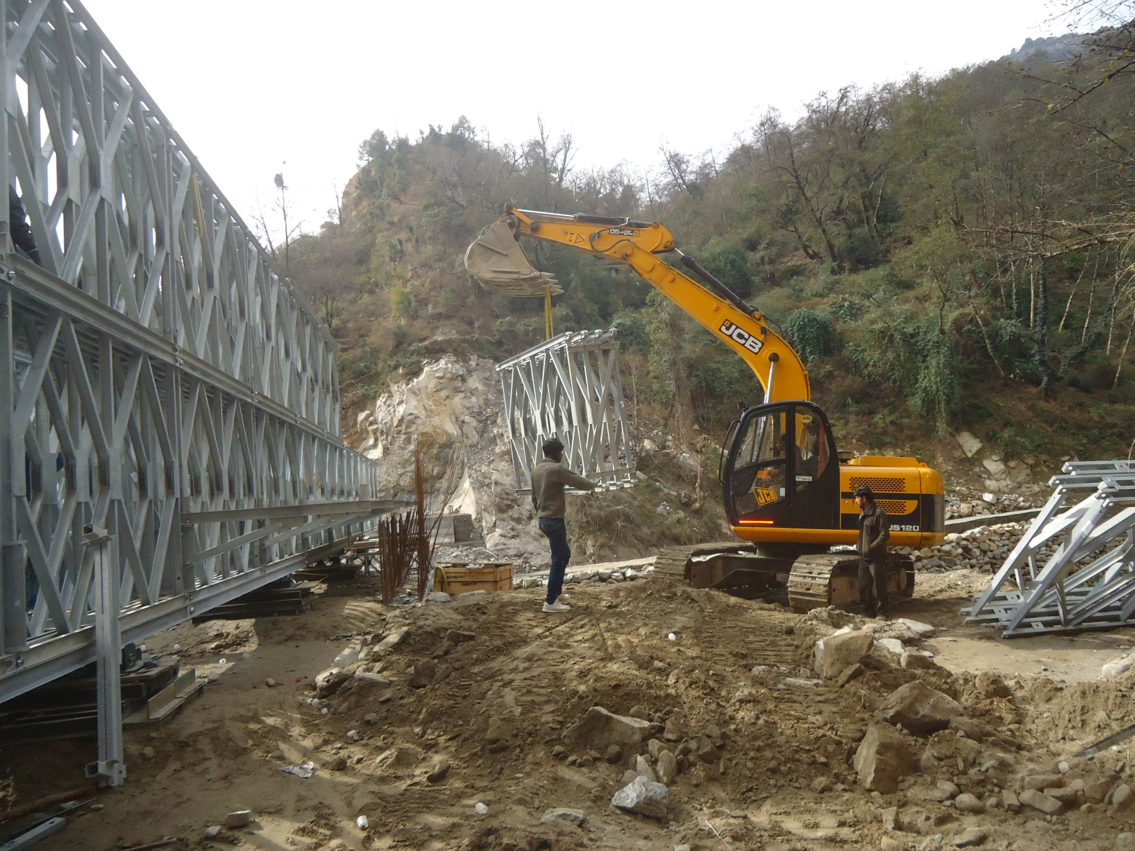

Slide 28
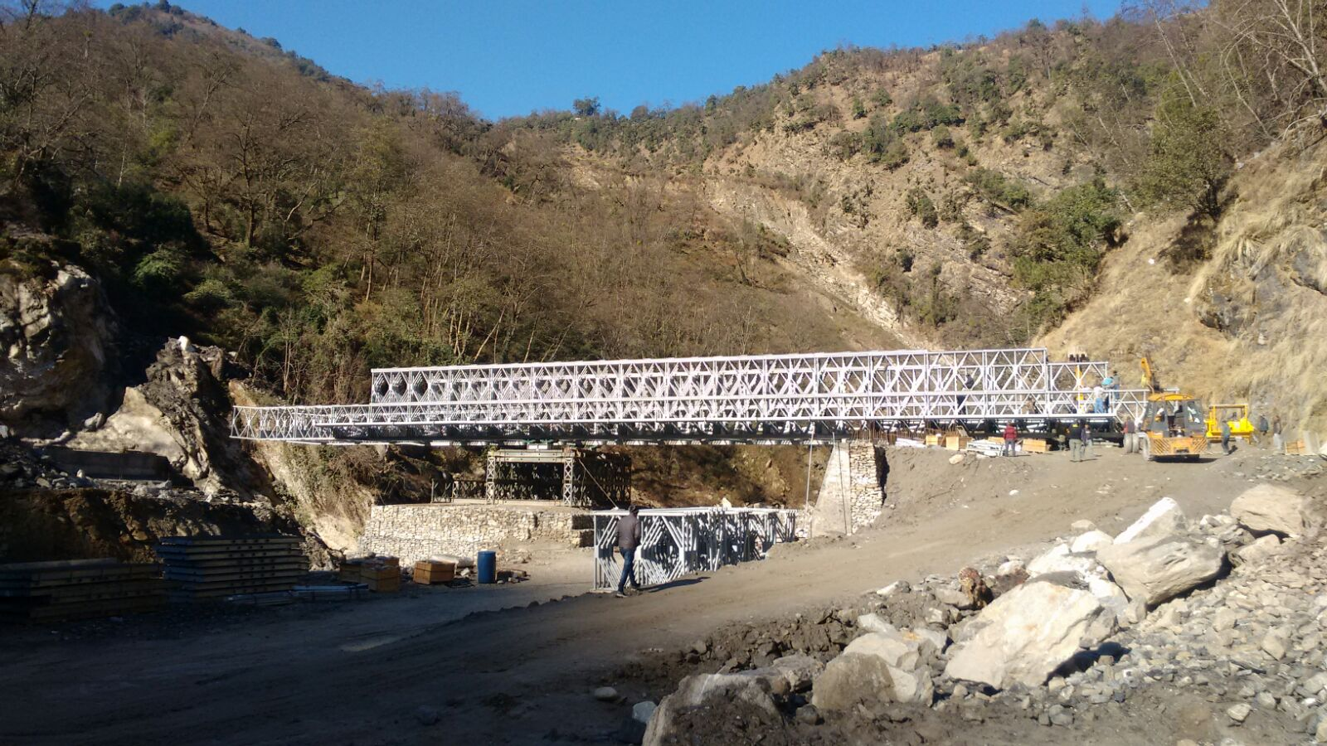

Slide 29
Emergency Bridges: The Way Ahead
Qualitative Requirement:
Ready COTS for two lane (7.35m + pedestrian); 70 R
Equipment delivery 12 weeks.
Erection 5 weeks after abutments ready.
Quicker Sanctions
Tendering action should be for Emergent Use..
Limited Tendering to firms in India and abroad.
Time for processing be restricted to one month.
New Bridge can be constructed in 4 months.
In one month if pre -stocked : Recommended.

Slide 30
THE WAY FORWARD
Identify major bottle necks for immediate address on a war-footing.
Carry out a detailed assessment of replacement with a quick- launch DL 70 R bridge through expert consultancy.
Explore mobilizing resources in shortest time:-
  By limited tendering.
  Use WB project approved rates to ensure reasonable costs, allowing for escalation.
Procure tried and tested quick launch bridges for replacement and also for future use in disasters.
Minimum six numbers of 50m span recommended for emergent purchase per state. Even these could be at WB approved rates for an emergency.

Slide 31
Discussion
.
Thank You

Slide 33
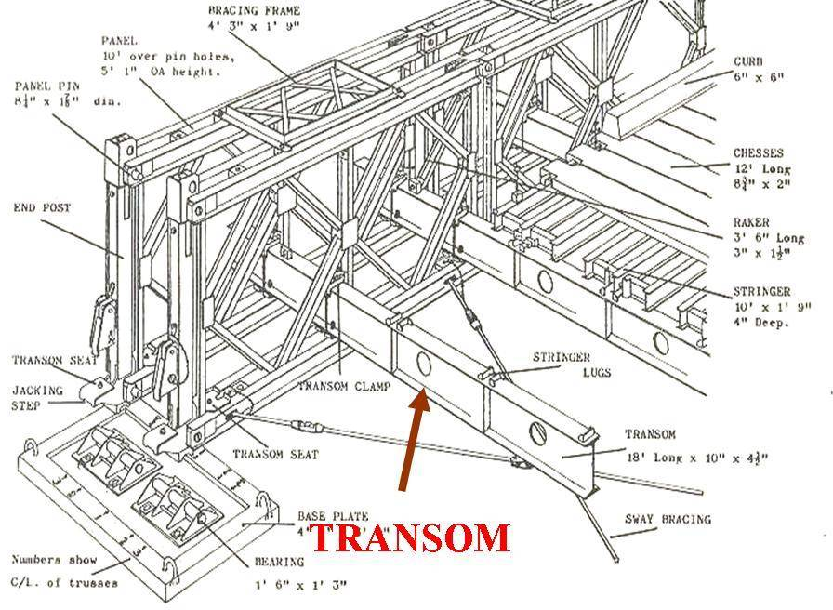
Panel
Decking
The genius of
Sir Donald Bailey
Bearing
Stringer
Transom
Extensively used in Second World War……… still in use.

